Slide 1



Joint Reasoning For Temporal And Causal Relations
Qiang Ning, Zhili Feng, Hao Wu, Dan Roth
07/18/2018
University of Illinois, Urbana-Champaign & University of Pennsylvania
Notes:
18mins talk

Slide 2

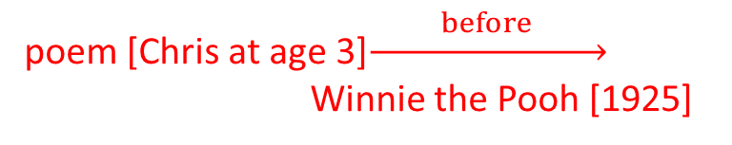
Time is Important
Understanding time is key to understanding events
Timelines (in stories, clinical records), time-slot filling, Q&A, common sense
[June, 1989] Chris Robin lives in England and he is the person that you read about in Winnie the Pooh. As a boy, Chris lived in Cotchfield Farm. When he was three, his father wrote a poem about him. His father later wrote Winnie the Pooh in 1925.
Where did Chris Robin live?
When was Chris Robin born?
Based on text: <=1922
Requires identifying relations between events, and temporal reasoning.
Temporal relation extraction
Events are associated with time intervals: $\left[t_{start}^{1},t_{end}^{1}\right], \left[t_{start}^{2},t_{end}^{2}\right]$
“A” happens BEFORE/AFTER “B”; “Time” is often expressed implicitly
2 explicit time expressions per 100 tokens, but 12 temporal relations
Clearly, time sensitive.
poem [Chris at age 3]$\underset{→}{ before }$ Winnie the Pooh [1925]
(Wikipedia: 1920)
Notes:
“The only thing constant is change.” – Heraclitus
The world is evolving over time: one’s place of work, place of home, a conflict between two countries, the progress of a social event, …
Many applications rely on a good understanding of time.

Slide 3
Example
More than 10 people (e1: died), he said. A car (e2: exploded) Friday in the middle of a group of men playing volleyball.
Temporal question: Which one happens first?
”e1” appears first in text. Is it also earlier in time?
“e2” was on “Friday”, but we don’t know when “e1” happened.
No explicit lexical markers, e.g., “before”, “since”, or “during”.

Slide 4
Example: Temporal determined by causal
More than 10 people (e1: died), he said. A car (e2: exploded) Friday in the middle of a group of men playing volleyball.
Temporal question: Which one happens first?
Obviously, “e2:exploded” is the cause and “e1:died” is the effect.
So, “e2” happens first.
In this example, the temporal relation is determined by the causal relation.
Note also that the lexical information is important here; it’s likely that explode BERORE die, irrespective of the context.
Notes:
how to define an event: 99 events?

Slide 5
This paper
Event relations: an essential step of event understanding, which supports applications such as story understanding/completion, summarization, and timeline construction.
[There has been a lot of work on this; see Ning et al. presented yesterday for a discussion of the literature and the challenges.]
This paper focuses on the joint extraction of temporal and causal relations.
A temporal relation (T-Link) specifies the relation between two events along the temporal dimension.
Label set: before/after/simultaneous/…
A causal relation (C-Link) specifies the [cause – effect] between two events.
Label set: causes/caused_by

Slide 6
Introduction
T-Link Example: John worked out after finishing his work.
C-Link Example: He was released due to lack of evidence.
Temporal and causal relations interact with each other.
For example, there is also a T-Link between released and lack
The decision of one relation is often based on evidence from the other, which suggests that joint reasoning could help.

Slide 7
Example: Causal determined by temporal
People raged and took to the street (after) the government stifled protesters.
Causal question:
Did the government stifle people because people raged?
Or, people raged because the government stifled people?
Both sound correct and we are not sure about the causality here.

Slide 8
Example: Causal determined by temporal
People raged and took to the street (after) the government stifled protesters.
Causal question:
Did the government stifle people because people raged?
Or, people raged because the government stifled people?
Since “stifled” happened earlier, it’s obvious that the cause is “stifled” and the result is “raged”.
In this example, the causal relation is determined by the temporal relation.

Slide 9
Related Work
Obviously, temporal and causal relations are closely related (we’re not the first who discovered this).
NLP researchers have also started paying attention to this direction recently.
CaTeRs: Mostafazadeh et al. (2016) proposed an annotation framework, CaTeRs, which captured both temporal and causal aspects of event relations in common sense stories.
CATENA: Mirza and Tonelli (2016) proposed to extract both temporal and causal relations, but only by “post-editing” temporal relations based on causal predictions.
…

Slide 10
Contributions
Proposed a novel joint inference framework for temporal and causal reasoning
Assume the availability of a temporal extraction system and a causal extraction system
Enforce declarative constraints originating from the physical nature of causality
Constructed a new dataset with both temporal and causal relations.
We augmented the EventCausality dataset (Do et al., 2011), which comes with causal relations, with new temporal annotations.

Slide 11
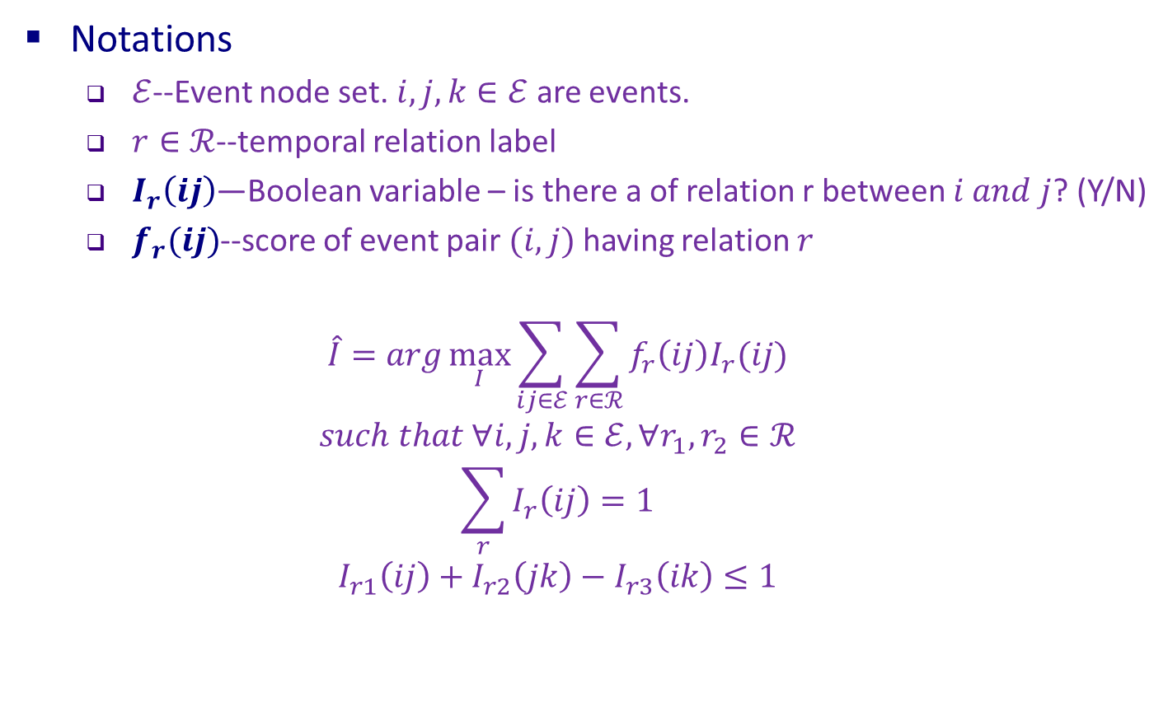

Temporal Relation Extraction: An ILP Approach [Do et al. EMNLP’12]
Notations
$ℰ$--Event node set. $i, j, k∈ℰ$ are events.
$r∈ℛ$--temporal relation label
$I_{r}\left(ij\right)$—Boolean variable – is there a of relation r between $i and j$? (Y/N)
$f_{r}(ij)$--score of event pair $(i, j)$ having relation $r$
$$\hat{I}=arg\max_{I}{\sum_{ij∈ℰ}{\sum_{r∈ℛ}{f_{r}\left(ij\right)I_{r}(ij)}}}$$
$$such that ∀i,j,k∈ℰ, ∀r_{1},r_{2}∈ℛ$$
$$\sum_{r}{I_{r}\left(ij\right)}=1$$
$$I_{r1}\left(ij\right)+I_{r2}\left(jk\right)−I_{r3}\left(ik\right)≤1$$
Global assignment of relations:
The sum of all softmax scores in this document
Uniqueness
Transitivity
$r_{3}$--the relation dictated by $r_{1}$ and $r_{2}$

Slide 12
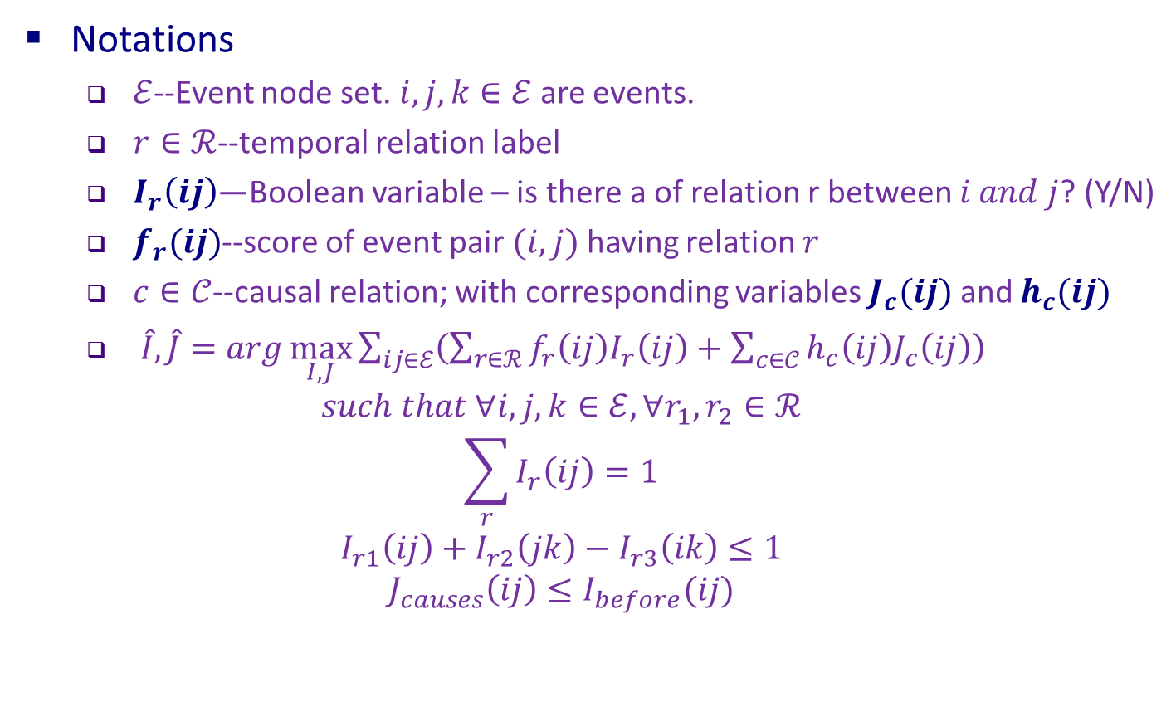
Proposed Joint Approach
Notations
$ℰ$--Event node set. $i, j, k∈ℰ$ are events.
$r∈ℛ$--temporal relation label
$I_{r}\left(ij\right)$—Boolean variable – is there a of relation r between $i and j$? (Y/N)
$f_{r}(ij)$--score of event pair $(i, j)$ having relation $r$
$c∈𝒞$--causal relation; with corresponding variables $J_{c}(ij)$ and $h_{c}(ij)$
$\hat{I},\hat{J}=arg\max_{I,J}{\sum_{ij∈ℰ}{\left(\sum_{r∈ℛ}{f_{r}\left(ij\right)I_{r}\left(ij\right)}+\sum_{c∈𝒞}{h_{c}\left(ij\right)J_{c}\left(ij\right)}\right)}}$
$$such that ∀i,j,k∈ℰ, ∀r_{1},r_{2}∈ℛ$$
$$\sum_{r}{I_{r}\left(ij\right)}=1$$
$$I_{r1}\left(ij\right)+I_{r2}\left(jk\right)−I_{r3}\left(ik\right)≤1$$
$$J_{causes}\left(ij\right)≤I_{before}(ij)$$
Global assignment of T & C relations
The “causal” part
“Cause” must be before “effect”

Slide 13
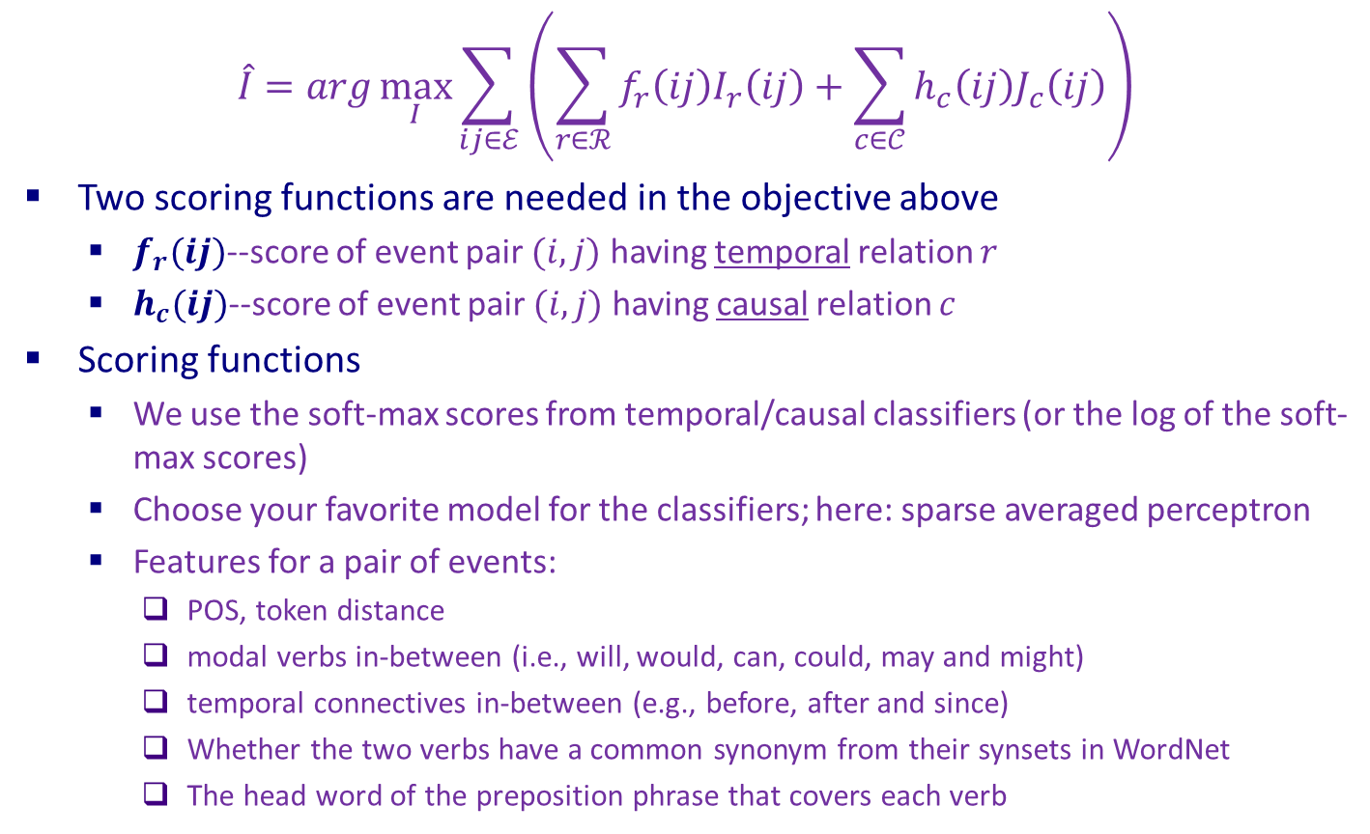
Scoring Functions
$$\hat{I}=arg\max_{I}{\sum_{ij∈ℰ}{\left(\sum_{r∈ℛ}{f_{r}\left(ij\right)I_{r}\left(ij\right)}+\sum_{c∈𝒞}{h_{c}\left(ij\right)J_{c}\left(ij\right)}\right)}}$$
Two scoring functions are needed in the objective above
$f_{r}(ij)$--score of event pair $(i, j)$ having temporal relation $r$
$h_{c}(ij)$--score of event pair $(i, j)$ having causal relation $c$
Scoring functions
We use the soft-max scores from temporal/causal classifiers (or the log of the soft-max scores)
Choose your favorite model for the classifiers; here: sparse averaged perceptron
Features for a pair of events:
POS, token distance
modal verbs in-between (i.e., will, would, can, could, may and might)
temporal connectives in-between (e.g., before, after and since)
Whether the two verbs have a common synonym from their synsets in WordNet
The head word of the preposition phrase that covers each verb
Can we use more than just this “local” information?

Slide 14
Back to the Example: Temporal determined by causal
More than 10 people (e1: died), he said. A car (e2: exploded) Friday in the middle of a group of men playing volleyball.
Temporal question: Which one happens first?
Obviously, “e2:exploded” is the cause and “e1:died” is the effect.
So, “e2” happens first.
In this example, the temporal relation is determined by the causal relation.
Note also that the lexical information is important here; it’s likely that explode BERORE die, irrespective of the context.
Notes:
how to define an event: 99 events?

Slide 15
TemProb: Probabilistic Knowledge Base
Source: New York Times 1987-2007 (#Articles~1M)
Preprocessing: Semantic Role Labeling & Temporal relations model
Result: 51K semantic frames, 80M relations
Then we simply count how many times one frame is before/after another frame, as follows. http://cogcomp.org/page/publication_view/830
Frame 1 | Frame 2 | Before | After
concern | protect | 92% | 8%
conspire | kill | 95% | 5%
fight | overthrow | 92% | 8%
accuse | defend | 92% | 8%
crash | die | 97% | 3%
elect | overthrow | 97% | 3%
…

Slide 16
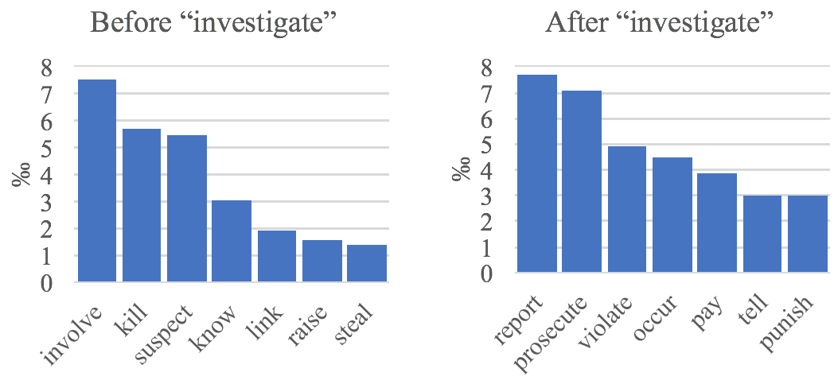
Some Interesting Statistics In TemProb

Slide 17
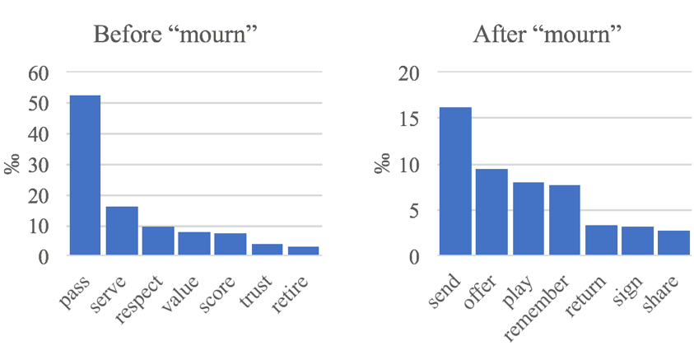
Some Interesting Statistics In TemProb

Slide 18
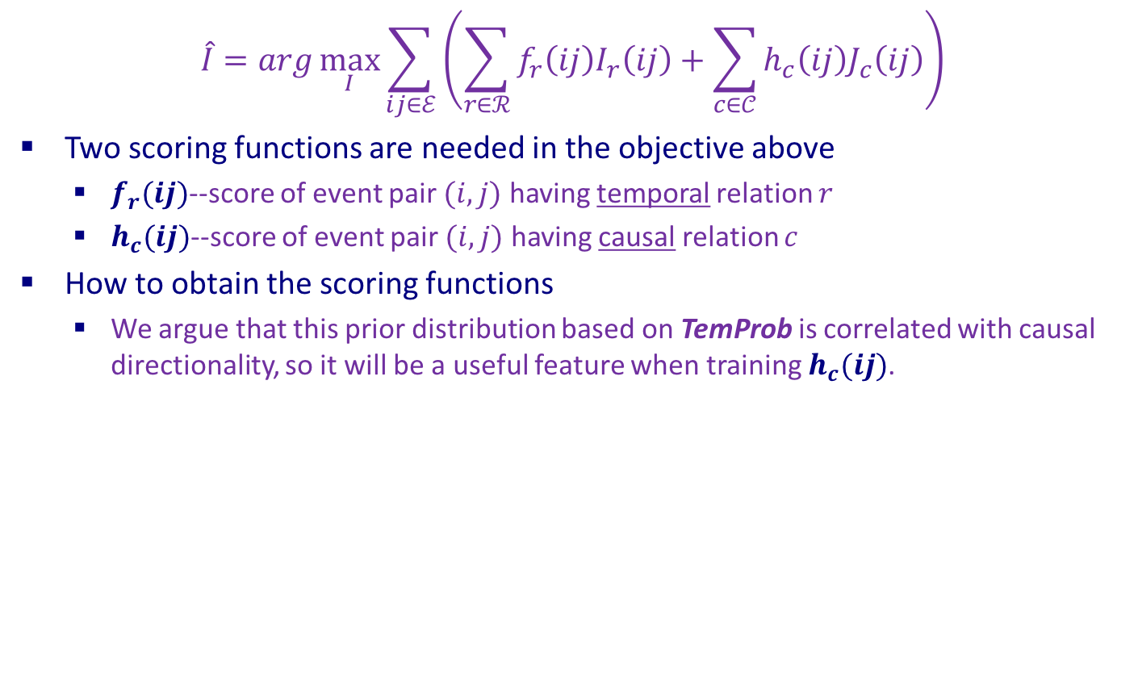
Scoring Functions: Additional Feature For Causality
$$\hat{I}=arg\max_{I}{\sum_{ij∈ℰ}{\left(\sum_{r∈ℛ}{f_{r}\left(ij\right)I_{r}\left(ij\right)}+\sum_{c∈𝒞}{h_{c}\left(ij\right)J_{c}\left(ij\right)}\right)}}$$
Two scoring functions are needed in the objective above
$f_{r}(ij)$--score of event pair $(i, j)$ having temporal relation $r$
$h_{c}(ij)$--score of event pair $(i, j)$ having causal relation $c$
How to obtain the scoring functions
We argue that this prior distribution based on TemProb is correlated with causal directionality, so it will be a useful feature when training $h_{c}(ij)$.
Notes:
Here it was used only for H not for F (but was used also for F in the NAACL paper)

Slide 19
Result on TimeBank-Dense
TimeBank-Dense: A Benchmark Temporal Relation Dataset
The performance of temporal relation extraction:
CAEVO: the temporal system proposed along with TimeBank-Dense
CATENA: the aforementioned work “post-editing” temporal relations based on causal predictions, retrained on TimeBank-Dense.
System | P | R | F1
ClearTK (2013) | 53 | 26 | 35
CAEVO (2014) | 56 | 42 | 48
CATENA (2016) | 63 | 27 | 38
Ning et al. (2017) | 47 | 53 | 50
This work | 46 | 61 | 52
Notes:
~7K relations in train & dev
~3K relations in test
Actually, This work is not the best version; an earlier version;

Slide 20
A New Joint Dataset
TimeBank-Dense has only temporal relation annotations, so in the evaluations above, we only evaluated our temporal performance.
EventCausality dataset has only causal relation annotations.
To get a dataset with both temporal and causal relation annotations, we choose to augment the EventCausality dataset with temporal relations, using the annotation scheme we proposed in our paper [Ning et al., ACL’18. A multi-axis annotation scheme for event temporal relation annotation.]
*due to re-definition of events
 | Doc | Event | T-Link | C-Link
TimeBank-Dense | 36 | 1.6K | 5.7K | -
EventCausality | 25 | 0.8K | - | 0.6K
Our new dataset | 25 | 1.3K | 3.4K | 0.2K*

Slide 21
Result On Our New Joint Dataset
 | Temopral |  |  | Causal
 | P | R | F | Acc.
Temporal Scoring Fn. | 67 | 72 | 69 | -
Causal Scoring Fn. | - | - | - | 71
Joint Inference | 69 | 74 | 71 | 77
Joint+Gold Temporal | 100 | 100 | 100 | 92
Joint+Gold Causal | 69 | 74 | 72 | 100
The temporal performance got strictly better in P, R, and F₁.
The causal performance also got improved by a large margin.
Comparing to when gold temporal relations were used, we can see that there’s still much room for causal improvement.
Comparing to when gold causal relations were used, we can see that the current joint algorithm is very close to its best.

Slide 22
Conclusion
Thank you!
We presented a novel joint inference framework, Temporal and Causal Reasoning (TCR)
Using an Integer Linear Programming (ILP) framework applied to the extraction problem of temporal and causal relations between events.
To show the benefit of TCR, we have developed a new dataset that jointly annotates temporal and causal annotations
Showed that TCR can improve both temporal and causal components

