Slide 1



A Multi-Axis Annotation Scheme for Event Temporal Relations
Qiang Ning, Hao Wu, and Dan Roth
07/17/2018
University of Illinois, Urbana-Champaign & University of Pennsylvania
Notes:
18mins talk

Slide 2



Towards Natural Language Understanding
.
.
.
4.
…..
…..
11. Reasoning about Time

Slide 3
Time is Important
[June, 1989] Chris Robin lives in England and he is the person that you read about in Winnie the Pooh. As a boy, Chris lived in Cotchfield Farm. When he was three, his father wrote a poem about him. His father later wrote Winnie the Pooh in 1925.
Where did Chris Robin live?
Notes:
“The only thing constant is change.” – Heraclitus
The world is evolving over time: one’s place of work, place of home, a conflict between two countries, the progress of a social event, …
Let’s look at an example.

Slide 4
Time is Important
[June, 1989] Chris Robin lives in England and he is the person that you read about in Winnie the Pooh. As a boy, Chris lived in Cotchfield Farm. When he was three, his father wrote a poem about him. His father later wrote Winnie the Pooh in 1925.
Where did Chris Robin live?
This is time sensitive.
When was Chris Robin born?
Notes:
“The only thing constant is change.” – Heraclitus
The world is evolving over time: one’s place of work, place of home, a conflict between two countries, the progress of a social event, …
Many applications rely on a good understanding of time.

Slide 5

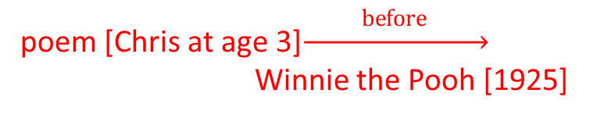
Time is Important
[June, 1989] Chris Robin lives in England and he is the person that you read about in Winnie the Pooh. As a boy, Chris lived in Cotchfield Farm. When he was three, his father wrote a poem about him. His father later wrote Winnie the Pooh in 1925.
Where did Chris Robin live?
This is time sensitive.
When was Chris Robin born?
Based on text: <=1922
Requires identifying relations between events, and temporal reasoning.
Temporal relation extraction
“A” happens BEFORE/AFTER “B”;
Events are associated with time intervals: $\left[t_{start}^{1},t_{end}^{1}\right], \left[t_{start}^{2},t_{end}^{2}\right]$
12 temporal relations in every 100 tokens (in TempEval3 datasets)
poem [Chris at age 3]$\underset{→}{ before }$ Winnie the Pooh [1925]
(Wikipedia: 1920)
“Time” could be expressed implicitly
Notes:
“The only thing constant is change.” – Heraclitus
The world is evolving over time: one’s place of work, place of home, a conflict between two countries, the progress of a social event, …
Many applications rely on a good understanding of time.

Slide 6
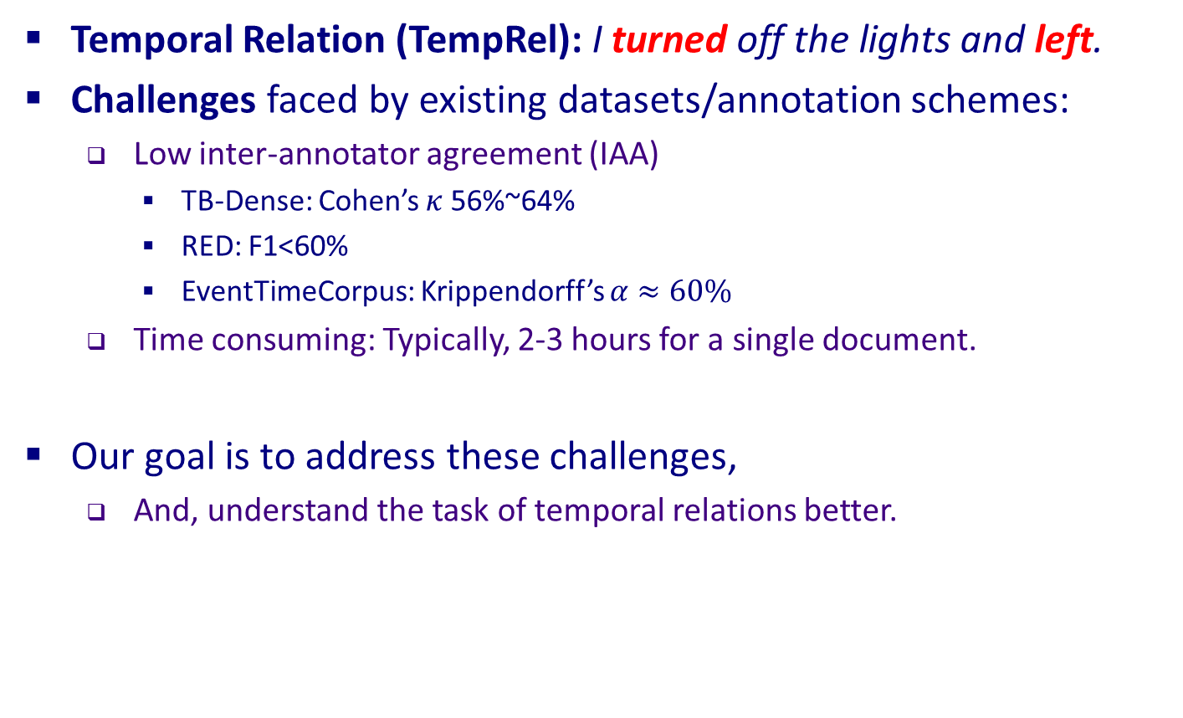
Temporal Relations: A Key Component
Temporal Relation (TempRel): I turned off the lights and left.
Challenges faced by existing datasets/annotation schemes:
Low inter-annotator agreement (IAA)
TB-Dense: Cohen’s $κ$ 56%~64%
RED: F1<60%
EventTimeCorpus: Krippendorff’s $α≈60\%$
Time consuming: Typically, 2-3 hours for a single document.
Our goal is to address these challenges,
And, understand the task of temporal relations better.
Notes:
A temporal relation specifies the comparison between two events according to the dimension of time.
There has been many existing TempRel datasets

Slide 7
Highlights And Outline
What we did:
276 docs: Annotated the 276 documents from TempEval3
1 week: Finished in about one week (using crowdsourcing)
$10: Costs roughly $10/doc
80%: IAA improved from literature’s 60% to 80%
Re-thinking identifying temporal relations between events
Results in re-defining the temporal relations task, and the corresponding annotation scheme, in order to make it feasible
Outline of our approach (3 components)
Multi-axis: types of events and their temporal structure
Start & End points: end-points are a source of confusion/ambiguity
Crowdsourcing: collect data more easily while maintaining a good quality
Notes:
We will introduce these three components in the following.

Slide 8
1. Temporal Structure Modeling: Existing Annotation Schemes
“Police tried to eliminate the pro-independence army and restore order. At least 51 people were killed in clashes between police and citizens in the troubled region.”
Task: to annotate the TempRels between the bold faced events (according to their start-points).
Existing Scheme 1: General graph modeling (e.g., TimeBank, ~2007)
Annotators freely add TempRels between those events.
It’s inevitable that some TempRels will be missed,
Pointed out in many works.
E.g., only one relation between “eliminate” and “restore” is annotated in TimeBank, while other relations such as “tried” is before “eliminate” and “tried” is also before “killed” are missed.
Notes:
By “freely”, the annotators don’t need to follow a particular structure.

Slide 9
1. Temporal Structure Modeling: Existing Annotation Schemes
“Police tried to eliminate the pro-independence army and restore order. At least 51 people were killed in clashes between police and citizens in the troubled region.”
Existing Scheme 2: Chain modeling (e.g., TimeBank-Dense ~2014)
All event pairs are presented, one-by-one, and an annotator must provide a label for each of them.
No missing relations anymore.
Rationale: In the physical world, time is one dimensional, so we should be able to temporally compare any two events.
However, some pairs of events are very confusing, resulting in low agreement.
E.g., what’s the relation between restore and killed?
Notes:
restore vs killed: before, after, includes, and some annotators simply say vague; all these labels are reasonable in some sense.

Slide 10
1. Temporal Structure Modeling: Difficulty
“Police tried to eliminate the pro-independence army and restore order. At least 51 people were killed in clashes between police and citizens in the troubled region.”
Why is restore vs killed confusing?
One possible explanation: the text doesn’t provide evidence that the restore event actually happened, while killed actually happened
So, non-actual events don’t have temporal relations?
We don’t think so:
tried is obviously before restore: actual vs non-actual
eliminate is obviously before restore: non-actual vs non-actual
So relations may exist between non-actual events.

Slide 11
1. Temporal Structure Modeling: Multi-Axis
“Police tried to eliminate the pro-independence army and restore order. At least 51 people were killed in clashes between police and citizens in the troubled region.”
We suggest that while time is 1-dimensional in the physical world, multiple temporal axes may exist in natural language.
to restore order
✓
to eliminate army
✓
police tried
51 people killed
✓

Slide 12
1. Multi-Axis Modeling: NOT Simply Actual Vs Non-Actual
“Police tried to eliminate the pro-independence army and restore order. At least 51 people were killed in clashes between police and citizens in the troubled region.”
Is it a “non-actual” event axis?—We think no.
First, tried, an actual event, is on both axes.
Second, whether restore is non-actual is questionable. It’s very likely that order was indeed restored in the end.
Non-actual axis
?
to restore order
to eliminate army
Real world axis
police tried
51 people killed
Notes:
By introducing an addition axis, we have explained the confusions we met in practice. Then, what’s the meaning of that additional axis?

Slide 13
1. Multi-Axis Modeling
“Police tried to eliminate the pro-independence army and restore order. At least 51 people were killed in clashes between police and citizens in the troubled region.”
Instead, we argue that it’s an Intention Axis
It contains events that are intentions: restore and eliminate
and intersects with the real world axis at the event that invokes these intentions: tried
Intention axis
to restore order
to eliminate army
Real world axis
police tried
51 people killed

Slide 14
Intention Vs Actuality
Identifying “intention” can be done locally, while identifying “actuality” often depends on other events.
Text | Intention? | Actual?
I called the police to report the body. | Yes | Yes
I called the police to report the body, but the line was busy. | Yes | No
Police came to restore order. | Yes | Yes
Police came to restore order, but 51 people were killed. | Yes | No
Notes:
An advantage of using “intention” instead of “non-actual” is…

Slide 15
1. Multi-Axis Modeling
So far, we introduced the intention axis and distinguished it from (non-) actuality axis.
The paper extends these ideas to more axes and discusses their difference form (non-)actuality axes
Sec. 2.2 & Appendix A; Sec. 2.3.3 & Appendix B.
Event Type | Time Axis | %
intention, opinion | orthogonal axis | ~20
hypothesis, generic | parallel axis | ~10
Negation | not on any axis
static, recurrent | not considered now
all others | main axis | ~70

Slide 16
1. Multi-Axis Modeling: A Balance Between Two Schemes
Our proposal: Multi-axis modeling –
balances the extreme schemes.
Allows dense modeling, but only within an axis.
Scheme 2: Chain modeling
E.g., TimeBank-Dense
A strong restriction on modeling
Any pair is comparable
But many are confusing
Scheme 1: General graph modeling
E.g., TimeBank
No restrictions on modeling
Relations are inevitably missed

Slide 17
Overview: Multi-Axis Annotation Scheme
Step 0: Given a document in raw text
Step 1: Annotate all the events
Step 2: Assign axis to each event (intention, hypothesis, …)
Step 3: On each axis, perform a “dense annotation” scheme
In this paper, we use events provided by TempEval3, so we skipped Step 1.
Our second contribution is successfully using crowdsourcing for Step 2 and Step 3, while maintaining a good quality.

Slide 18
Cross-Axis Relations
This work doesn’t annotate cross-axis relations for convenience.
But is it impossible to annotate them?
“I received positive feedback about my idea. Then I worked very hard to submit a paper. Finally, the paper was accepted.”
Type 1: actually covered by our annotation
Type 2: submit has a projection submit onto the real world axis.
Intention axis
Type 1
submit
Type 2
✓
Real world axis
received
worked
submit
accepted

Slide 19
2. Crowdsourcing
Platform: CrowdFlower https://www.crowdflower.com/
Annotation guidelines: Find at http://cogcomp.org/page/publication_view/834
Quality control: A gold set is annotated by experts beforehand.
Qualification: Before working on this task, one has to pass with 70% accuracy on sample gold questions.
Important: with the older task definition, annotators did not pass the qualification test.
Survival: During annotation, gold questions will be given to annotators without notice, and one has to maintain 70% accuracy; otherwise, one will be kicked out and all his/her annotations will be discarded.
Majority vote: At least 5 different annotators are required for every judgement and by default, the majority vote will be the final decision.

Slide 20

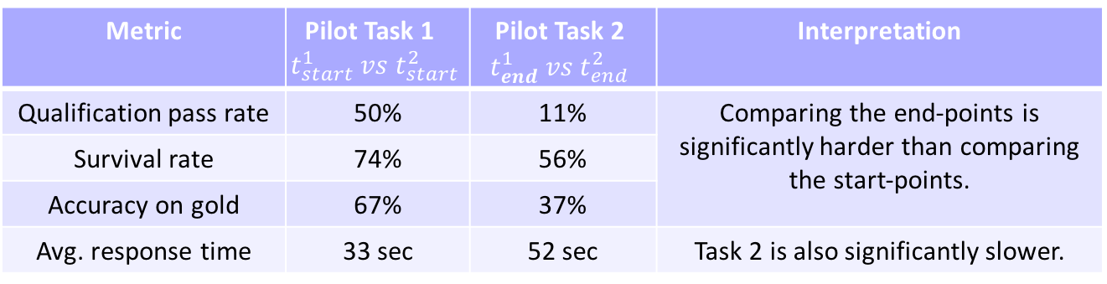
3. An Interesting Observation: Ambiguity In End-Points
Given two time intervals: $\left[t_{start}^{1},t_{end}^{1}\right], \left[t_{start}^{2},t_{end}^{2}\right]$
How durative events are expressed (by authors) and perceived (by readers):
Readers usually take longer to perceive durative events than punctual events, e.g., “restore order” vs. “try to restore order”.
Writers usually assume that readers have a prior knowledge of durations (e.g., college takes 4 years and watching an NBA game takes a few hours)
We only annotate start-points because duration annotation should be a different task and follow special guidelines.
Metric | Pilot Task 1 $$t_{start}^{1} vs t_{start}^{2}$$ | Pilot Task 2 $$t_{end}^{1} vs t_{end}^{2}$$ | Interpretation
Qualification pass rate | 50% | 11% | Comparing the end-points is significantly harder than comparing the start-points.
Survival rate | 74% | 56%
Accuracy on gold | 67% | 37%
Avg. response time | 33 sec | 52 sec | Task 2 is also significantly slower.
Notes:
Writers usually assume readers to have a prior knowledge of durations so that they won’t write the durations explicitly.
50% passed the qualification test of 70%.

Slide 21
Overview: Multi-Axis Annotation Scheme
Step 0: Given a document in raw text
Step 1: Annotate all the events
Step 2: Assign axis to each event (intention, hypothesis, …)
Step 3: On each axis, perform a “dense annotation” scheme according to events’ start-points

Slide 22
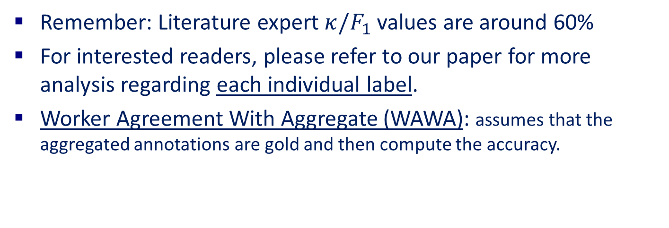
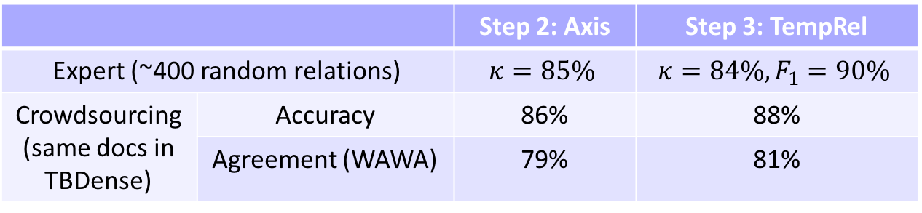
Quality Metrics Of Our New Dataset
 |  | Step 2: Axis | Step 3: TempRel
Expert (~400 random relations) |  | $$κ=85\%$$ | $$κ=84\%, F_{1}=90\%$$
Crowdsourcing (same docs in TBDense) | Accuracy | 86% | 88%
 | Agreement (WAWA) | 79% | 81%
Remember: Literature expert $κ/F_{1}$values are around 60%
For interested readers, please refer to our paper for more analysis regarding each individual label.
Worker Agreement With Aggregate (WAWA): assumes that the aggregated annotations are gold and then compute the accuracy.

Slide 23
Result On Our New Dataset
We implemented a baseline system, using conventional features and the sparse averaged perceptron algorithm
The overall performance on the proposed dataset is much better than those in the literature for TempRel extraction, which used to be in the low 50’s (Chambers et al., 2014; Ning et al., 2017).
We do NOT mean that the proposed baseline is better than other existing algorithms
Rather, the proposed annotation scheme better defines the machine learning task.
Annotation | Training Set | Test Set | Training |  |  | Test
 |  |  | P | R | F | P | R | F
TBDense | Same-axis & Cross-axis | Same-axis | 44 | 67 | 53 | 40 | 60 | 48
Proposed | Same-axis | Same-axis | 73 | 81 | 77 | 66 | 72 | 69
Notes:
Size of training data: 7k (TBDENSE) vs. 2k

Slide 24
Conclusion
Thank you!
We proposed to re-think the important tasks of identifying temporal relations, resulting in a new annotation scheme it.
Three components:
Multi-axis modeling: a balance between general graphs and chains
Identified that “end-point” is a major source of confusion
Showed that the new scheme is well-defined even for non-experts and crowdsourcing can be used.
The proposed scheme significantly improves the inter-annotator agreement level, by ~20%.
The resulting dataset defines an easier machine learning task.
We hope that this work can be a good start for further investigation in this important area.

Slide 25
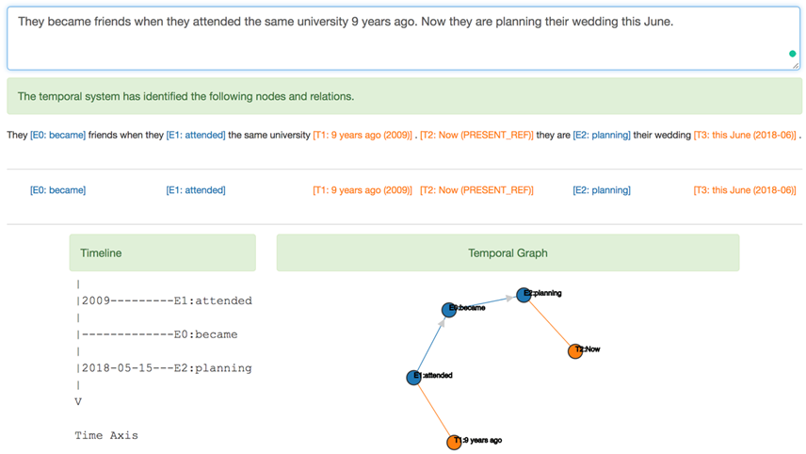
CogCompTime: An Online Temporal Demo Based On This Work

Slide 26
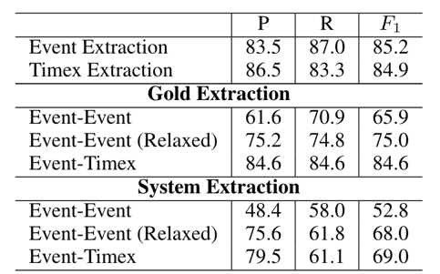
CogCompTime: An Online Temporal Demo Based On This Work
Works on raw text
Extracts events & time expressions
Normalizes the time expressions
Extracts the temporal relations

