Slide 1
Understanding Events In Natural Language: -- Learning, Common Sense, Data Annotation, and What’s Next
Qiang Ning
Electrical and Computer Engineering
University of Illinois at Urbana-Champaign
Notes:
Hello everyone. Many thanks for joining me today. I’m Qiang Ning from the ECE department at the University of Illinois. Today I’ll talk about event understanding in natural language from three aspects: machine learning, common sense knowledge acquisition, and data annotation. I will also discuss my vision about the important topics in this field in the next decade and talk about my research plan to carry it out.
(30 sec)

Slide 2








Why did Homo sapiens suddenly flood the earth?
Natural language!
2.5M ago
70K ago
12K ago
500 ago
Now
Multiple species of humans appeared
Cognitive
revolution
Agricultural revolution
Scientific revolution
Computer
revolution
Other species of humans
disappeared
Notes:
Speaking of natural language, last year I read a brief history of humankind by Prof. Harari. One of his arguments about language is very interesting.
We know, about 2 and a half million years ago, multiple species of humans appeared on earth. A question that many historians wanted to answer was: since 70k yrs ago, why did Homo sapiens suddenly flood the earth and create glorious civilizations, while other species of humans disappeared? Prof. Harari attributes it to natural language! Because of the appearance of language during cognitive revolution, Homo sapiens were able to form complex social structures and collaborate on tasks that used to be difficult for individuals. It’s fair enough to say that natural language played a crucial role in making us different. Now in the modern history, language continues its important role in our life, in the form of various text data.
(1 min)

Slide 3



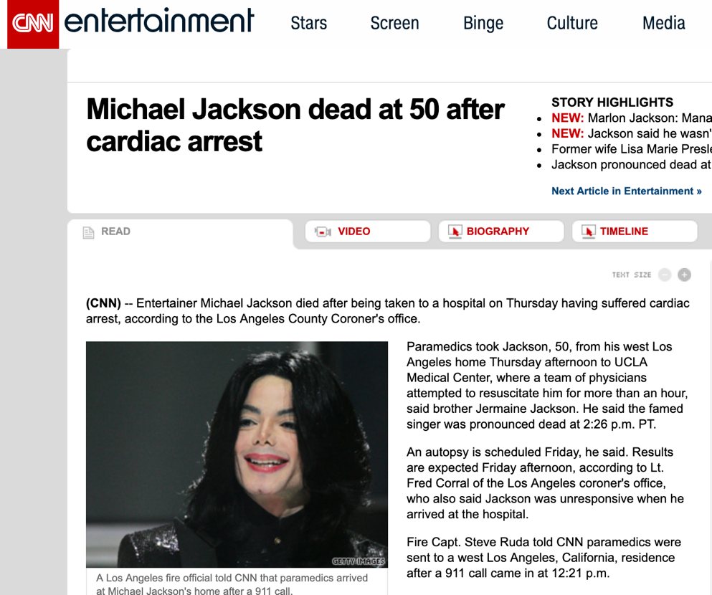

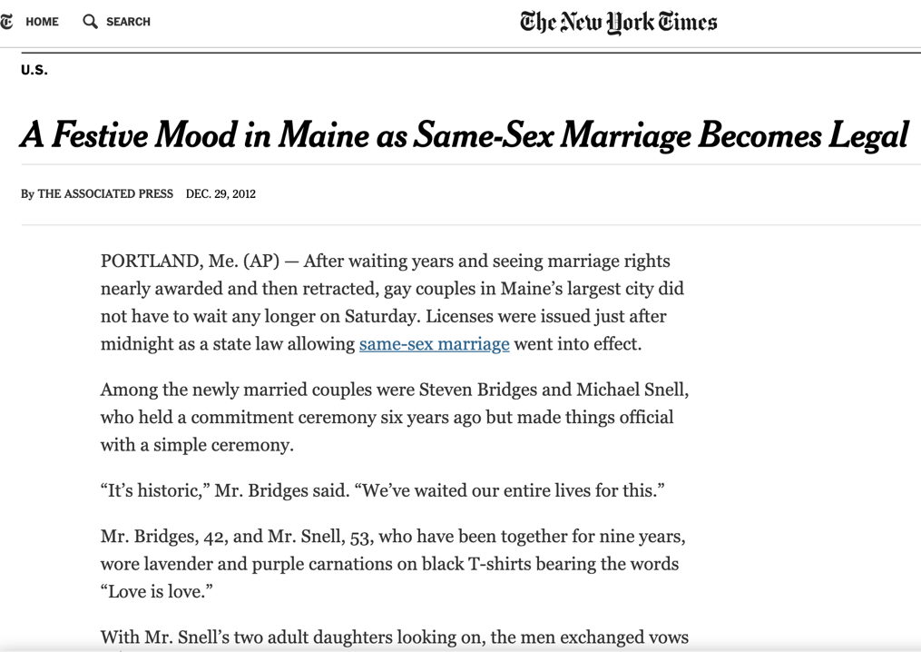
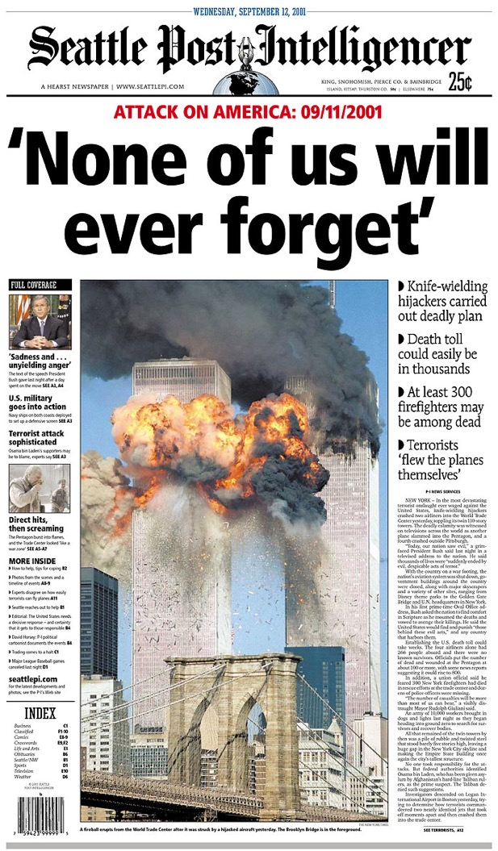




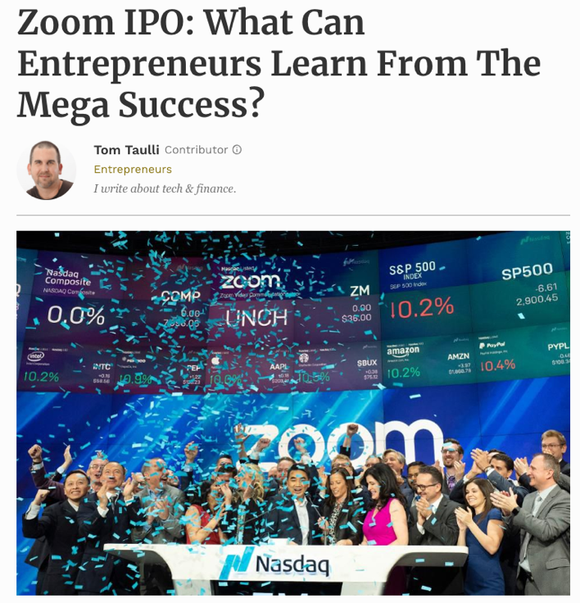


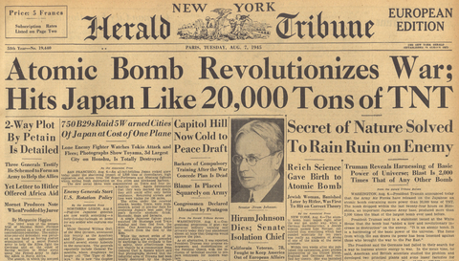
Notes:
In the beginning, was the news. It made it easier to know the world. And the news multiplied, multiplied, and multiplied. We had stepped into an age of information explosion before we realized it.
(15 secs)

Slide 4
Every single day
1200 news stories
4000 papers
2M blog posts
500M tweets
Notes:
Every single day, 1200 news stories are published on Washington Post, 2M blogs on wordpress, and 500M tweets on twitter. But we only have 24 hours a day and a single pair of eyes, and cannot read so big data.
(20 sec)

Slide 5
Every single day
1200 news stories
Big Data
4000 papers
Big Text
2M blog posts
500M tweets
>80% of the world’s data unstructured text
[by breakthrough analysis]
Big text, big opportunities
Notes:
We’ve heard a lot about big data, but a less popular fact is that actually over 80% of it is natural language text. It’s undeniable that big text opens up big opportunities for NLP research.
(15 sec)

Slide 6

Big text, big opportunities
If we manage to
assess the health of a company
study causality in medical records
read and compare multiple sources
perhaps we can
provide better diagnostics
fight against fake news
better predict the market trend
Legalzoom: Fake news, what laws are designed to protect
www.milesweb.com
Engineersjournal: BioInnovate Ireland Fellowship: innovating tomorrow’s medical devices
Notes:
Imagine...
These are not outrageous imaginations in fictions. Instead, hedge funds are already using NLP to get trade signals. The US government also spent 36 billion dollars to digitize medical records and there have been various NLP competitions on analyzing these data. But of course, these promising explorations doesn’t mean the problem is solved.
(1 min)

Slide 7
Natural language is natural for humans
Notes:
The challenge is, although natural language is natural for humans

Slide 8
Natural language is not natural for computers
Notes:
not natural for computers; instead, it’s highly ambiguous.
(15 sec; overall 3.5 min)

Slide 9
Natural language is not natural for computers
Public Radio International (1998/02/13 Friday)
In Los Angeles that lesson was brought home Friday when tons of earth cascaded down a hillside, ripping two houses from their foundations. No one was hurt, but firefighters ordered the evacuation of nearby homes and said they'll monitor the shifting ground until March 23rd.
Who are they? Nearby homes?
Plural form of “home” as in “brought home”?
Same
Will they monitor until 2019/03/23?
Notes:
Let’s take a look at this paragraph from PRI in 1998. (read the paragraph) I guess most of you have got the gist of it. Does any one find this ambiguous? How about these two appearances of “home”? Are they the same? Apparently the first home is an abstract meaning and the second concrete Again, will they monitor until 2019? Obviously not because that’s twenty years ago. Further, who are they? We know it’s the firefighters, but for computers, nearby homes is closer to it. Finally, earth cascaded vs shifting ground. They are totally different words, but have the same meaning.

Slide 10
Natural language is not natural for computers
Public Radio International (1998/02/13 Friday)
In Los Angeles that lesson was brought home Friday when tons of earth cascaded down a hillside, ripping two houses from their foundations. No one was hurt, but firefighters ordered the evacuation of nearby homes and said they'll monitor the shifting ground until March 23rd.
Who are they? Nearby homes?
Plural form of “home” as in “brought home”?
Same
Will they monitor until 2019/03/23?
NLP is to help computers resolve the ambiguity that are seemingly easy for humans
Notes:
All these questions are straightforward for humans and we don’t even realize the ambiguity before someone asks about it. But these questions are tricky for computers. That's why we are doing NLP research to help computers understand this ambiguity that are usually easy for humans.

Slide 11
A brief overview of NLP
…
…
Situation
Events, Q&A, reasoning, …
Sentence
Syntactic parsing, semantic role labeling, language modeling, …
Token
Tokenization, lemmatization, POS tagging, chunking, …
Methodology
machine learning, Linguistics, …
Notes:
The foundation of resolving this ambiguity is machine learning. We then tackle various problems at the token level, such as tokenization, lemmatization, and part-of-speech tagging. And at the sentence level, we have syntactic parsing which is to convert sentences into trees representing the relationship between tokens; semantic role labeling is to label the subjects, predicates, and objects in a sentence. A higher level is situation, where we often need a coherent understanding of several sentences or documents, and some common sense knowledge. Example tasks are events, Q&A, and situation reasoning.
(1min)
My vision is, based on the development achieved at the token and sentence level, it's time to work at a higher level, "situations", where we study events, try to answer questions, and perform reasoning based on the situations.

Slide 12
A brief overview of NLP
Level
Accuracy
George Lowe died Wednesday after a long-term illness
George Lowe died Wednesday after a long-term illness
Notes:
Here’s a more detailed explanation of what I mean by each layer.

Slide 13
A brief overview of NLP
Level
Accuracy
George Lowe died Wednesday after a long-term illness
George Lowe died Wednesday after a long-term illness
Token
(POS)
NNP
NNP
VBD
NNP
IN
JJ
NN
>95%
DT
George Lowe died Wednesday after a long-term illness
Notes:
For this sentence, a typical token level processing is to label the part-of-speech tags for each token. Here “George Lowe” is a noun phrase, “died” is the past tense of “die”, and “after” is a preposition, so on so forth. Current NLP is quite reliable in token level tasks, often in the high 90s.

Slide 14
A brief overview of NLP
Level
Accuracy
NAME
SBJ
ROOT
TMP
George Lowe died Wednesday after a long-term illness
George Lowe died Wednesday after a long-term illness
Sentence
(dependency)
~90%
TMP
NMOD
NMOD
PMOD
George Lowe died Wednesday after a long-term illness
Token
(POS)
NNP
NNP
VBD
NNP
IN
JJ
NN
>95%
DT
George Lowe died Wednesday after a long-term illness
Notes:
Then it comes to the sentence level. Here I’m showing a syntactic parsing tree, where “died” is the root, “Wednesday” is a temporal modifier, “long-term” is modifying “illness”, so on so forth. We are also quite robust in tasks at this level, with performance often in the high 80s or 90s.

Slide 15
A brief overview of NLP
Level
Accuracy
often >10 years
Person
Situation
Lowe: long-term illness --> died on 03-20-2013
Not robust
Wednesday
no activities after death
NAME
SBJ
ROOT
TMP
George Lowe died Wednesday after a long-term illness
Sentence
~90%
(dependency)
TMP
NMOD
NMOD
PMOD
George Lowe died Wednesday after a long-term illness
Token
NNP
NNP
VBD
NNP
IN
JJ
NN
>95%
(POS)
DT
George Lowe died Wednesday after a long-term illness
Notes:
If we want to understand this sentence at the situation level, things become more complex. We need to know that “George Lowe” is not only a name, but also a person. We need to figure out when is this “Wednesday” in this situation. We also need to use our common sense to know that “long-term illness” is often more than 5 or 10 years, and that a person is not involved in further activities after death. There are many ongoing research in NLP working at the situation level, and we can imagine that the accuracies are usually not robust.

Slide 16
Where are we in NLP?
It’s time to study situation and event
what is going on
what is the cause and effect
how things unfold along time
…
Now
Situation
~2010’s
Sentence
Robust
~2000’s
Token
~1990’s
Methodology
Machine learning
Notes:
So where are we in NLP? I think we are very reliable at the token level roughly since 2000, very reliable at the sentence level roughly since 2010, and right now, it’s time to study events at the situation level; that is, what is going on, what is the cause and impact, and how things unfold along time.
(slides 9-here, 2.25 mins; overall ~ 7 min)

Slide 17


Let’s take a look at two events
People were angry
Police used tear gas
Time
People were angry at something (and ended in violent conflicts with the police)…The police finally used tear gas (to restore order).
Notes:
Now let's try to understand two events: people were angry and police used tear gas. If people were angry happened first, the understanding would be people ended in violent conflicts with the police, and the police used tear gas to restore order.

Slide 18
Reversing them
Police used tear gas
People were angry
Time
Police used tear gas…People were angry at the police.
Notes:
If we simply reverse the order of these events, we get a new story, which says that police used tear gas and then people were angry at the police. We can see that time is crucial if we want to understand what’s going on in a situation.

Slide 19
Reversing them
Police used tear gas
People were angry
Time
In natural language, we rarely have timestamps, so we have to figure out the order based on text.
Notes:
But in natural language, we never have timestamps like here telling us which one is earlier and which one is later. That leads to “temporal relations”

Slide 20
Temporal relation (TempRel)
Event: An action or state headed by a verb
BE_INCLUDED
Tons of earth cascaded down a hillside, ripping two houses. Firefighters will monitor the shifting ground.
BEFORE
My talk mainly focuses on TempRel extraction
…assuming those events are given.
Notes:
This leads to the so called temporal relations. Here in this example, we have two events: met and leaving, and a time point Thursday. We have met before leaving, and leaving included in Thursday. My system will first extract those events, and then label the temprels among them, but my talk today will mainly focus on temprel extraction, assuming those events are already extracted.

Slide 21
Multiple events form a situation
“Temporal Graph”
In Los Angeles that lesson was brought home Friday when tons of earth cascaded down a hillside, ripping two houses from their foundations. No one was hurt, but firefighters ordered the evacuation of nearby homes and said they'll monitor the shifting ground until March 23rd.
The task is to label those edges in temporal graphs.
ripping
monitor
This task is difficult:
Temporal relation extraction | Literature F1 (%)
w/ gold events | low 50’s
w/o gold events | low 30’s
hurt
cascaded
ordered
BEFORE
BE_INCLUDED
Notes:
When we have multiple events, they form a situation.(read snippet) If we draw all the temprels in this situation, it would form a graph, which we call a temporal graph. In other words, we want to label those edges in a consistent way. This task is difficult and the literature F1's with or without gold events are both very low, which also reflects the difficulty of understanding a situation.

Slide 22
Challenges
My solutions
Structured learning
Interrelated events
If A<B and B<C, then A<C (time is transitive)
Lack of prior knowledge
Common sense
Humans have the common sense about the typical orders of events, even if a sentence doesn’t say so
Data annotation
Insufficient data
#edges is quadratic in terms of #nodes
Temporal relation extraction | Literature F1 (%)
w/ gold events | low 50’s
w/o gold events | low 30’s
Our F1 (%)
70’s
50’s
Notes:
I think the challenges are three-fold.

Slide 23



Structured learning
EMNLP’17, SEM’18
ACL’18 (a)
NAACL’19
EMNLP’18
NAACL’18
1 in submission
1 in submission
ACL’18 (b)
1 in submission
Common sense
Data annotation
Notes:
With this understanding, I have organized my relevant publications in such a structured way. I hope it makes it easier. I will discuss one from each category and how to put all pieces together.
(phd intro: 4.5 mins; overall 11.5 min)

Slide 24

Understanding time for events
Part I: Structured learning
[EMNLP’17] Q. Ning, Z. Feng, and D. Roth. A Structured Learning Approach to Temporal Relation Extraction
Notes:
The first part is on structured learning, which is our EMNLP'17 paper.

Slide 25
Temporal graphs are structured
Due to transitivity, TempRels are not independent
Existing methods: global inference
ripping
monitor
ripping
monitor
ripping
ripping
monitor
monitor
monitor
cascaded
ordered
?
hurt
hurt
hurt
Time
ripping
ordered
ordered
cascaded
ordered
cascaded
cascaded
cascaded
cascaded
Must be before
BEFORE
INCLUDED
Part I: Structured learning
Notes:
The motivation is that temporal graphs are structured, or in other words, temporal relations are not independent. In the previous graph, assume that we are looking at ripping, cascaded, and ordered. Then because ripping is inside cascaded and cascaded is before ordered, the relation between ripping and ordered must be before. Existing methods are all local learning plus global inference. That is
(40 sec)

Slide 26
Assume a model is already trained
Confidence/softmax
before: 0.4
after: 0.2
cascaded
ordered
model
includes: 0.1
( , )
included: 0.1
equal: 0.0
vague: 0.2
Based on these confidence scores, we need to solve for the final temporal graph.
Part I: Structured learning
Notes:
The resulting model from local learning is: given a pair of events, produce the confidence or softmax score for each label. Based on these confidence scores, we need to solve the final temporal graph.
(15 sec)

Slide 27
Global inference (a toy example)
monitor
0.6
0.7
Local inference:
Mani et al., 2006
Chambers et al., 2007
Bethard et al., 2007
0.4
0.3
cascaded
0.8
ordered
0.2
Time cannot be a loop!
Part I: Structured learning
Notes:
Here's a toy example of how we solve for the final graph. The naive way is to select the best score for each edge. And we get a loop! However, time cannot be a loop. How should we avoid this situation?

Slide 28
Global inference (a toy example)
monitor
0.6
0.7
Local inference:
Mani et al., 2006
Chambers et al., 2007
Bethard et al., 2007
cascaded
0.8
ordered
We should not only select the assignment with the best score, but also avoid loops
Part I: Structured learning
Notes:
The answer is: we should not only...but also...

Slide 29
Global inference (a toy example)
Option 1
Option 2
Option 3
monitor
monitor
monitor
0.6
0.7
0.4
0.7
0.6
0.3
cascaded
ordered
cascaded
ordered
cascaded
ordered
0.2
0.8
0.8
0.6+0.2+0.7=1.5
0.4+0.8+0.7=1.9
0.6+0.3+0.8=1.7
We should not only select the assignment with the best score, but also avoid loops
Part I: Structured learning
Notes:
To do that, we actually have three options, as shown here.

Slide 30
Global inference (a toy example)
Option 2
monitor
monitor
monitor
0.6
0.7
0.4
0.7
0.6
0.3
cascaded
ordered
cascaded
ordered
cascaded
ordered
0.2
0.8
0.8
0.6+0.2+0.7=1.5
0.4+0.8+0.7=1.9
0.6+0.3+0.8=1.7
We should not only select the assignment with the best score, but also avoid loops
Part I: Structured learning
Notes:
We sum up all the scores, and select the best one.

Slide 31
Global inference (a toy example)
Option 2
monitor
monitor
monitor
0.6
0.7
0.4
0.7
0.6
0.3
cascaded
ordered
cascaded
ordered
cascaded
ordered
0.2
0.8
0.8
0.6+0.2+0.7=1.5
0.4+0.8+0.7=1.9
0.6+0.3+0.8=1.7
How should we formulate this procedure?
Global inference via ILP
[Roth & Yih, 2004]
Part I: Structured learning
Notes:
The only problem is how to formulate this procedure. Actually this type of problems have been studied quite early in our group. The answer is global inference via ILP.
(intro to ILP 1 min)

Slide 32
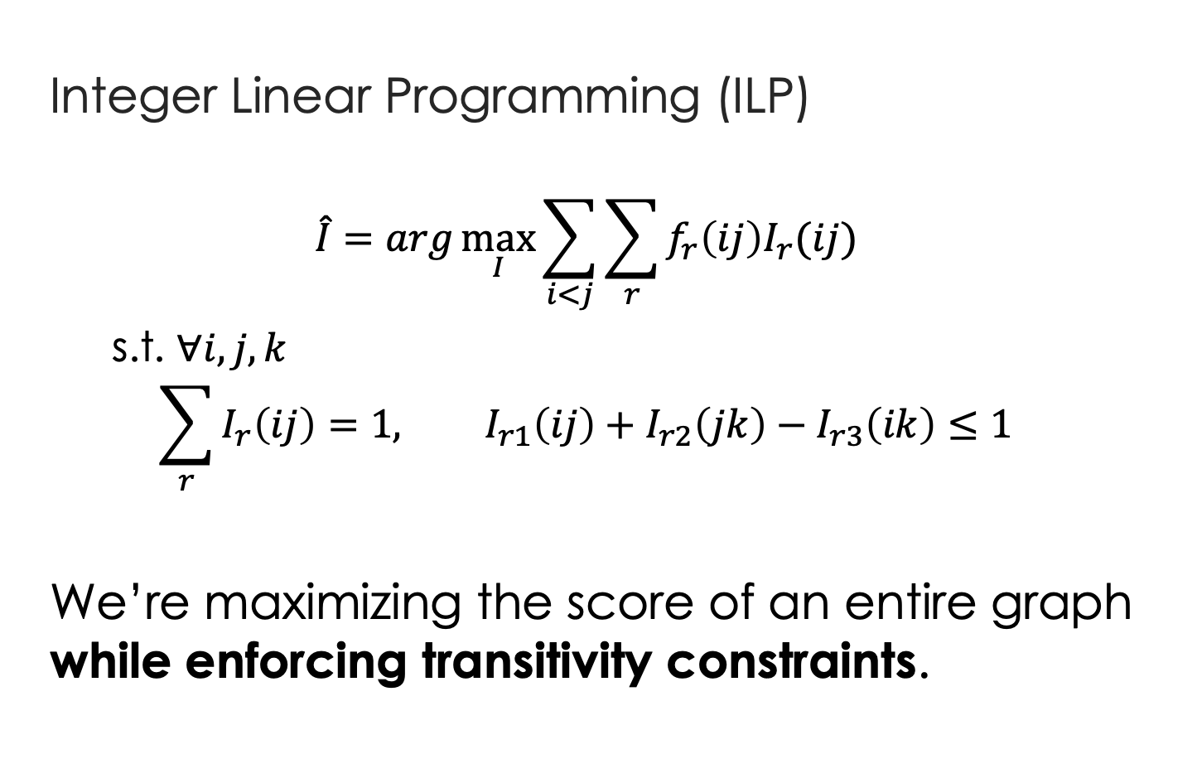




Global inference via ILP
$$I_{→}\left(ij\right)=1$$
$$f_{→}\left(ij\right)=0.6$$
Event i
j
$$f_{←}\left(ij\right)=0.4$$
Integer Linear Programming (ILP)
$$\hat{I}=arg\max_{I}{\sum_{i<j}{\sum_{r}{f_{r}\left(ij\right)I_{r}(ij)}}}$$
s.t. $∀i,j,k$
$$\sum_{r}{I_{r}\left(ij\right)}=1, I_{r1}\left(ij\right)+I_{r2}\left(jk\right)−I_{r3}\left(ik\right)≤1$$
We’re maximizing the score of an entire graph while enforcing transitivity constraints.
$$I_{←}\left(ij\right)=1$$
real variable
boolean variable
Uniqueness
Transitivity (no loops)
Global inference for TempRel extraction: Bramsen et al., 2006. Chambers & Jurafsky, 2008. Denis & Muller, 2011. Do et al., 2012. Chambers et al., 2014. Mirza & Tonelli, 2016.
Notes:
ILP stands for...We have two types of variables. Boolean variable I, indicating the relation between event i and event j. And real variable f, representing the confidence scores for each relation. We sum them up, enforce the no-loop constraint, and that's our mathematical formulation for this problem.
(30 sec)

Slide 33
Benefit of global inference via ILP
5%
Global inference via ILP
Baseline
[UTTime] Laokulrat et al. *SEM’13. UTTime: Temporal relation classiﬁcation using deep syntactic features.
[Perceptron+ILP] Do et al. EMNLP’12. Joint inference for event timeline construction.
Part I: Structured learning
Notes:
In this tempeval13 competition, UTTime was the best system. We implemented a perceptron based system and achieved comparable F1 to it. With the global inference and ILP formulation that we just introduced, we could achieve a significant improvement.
(30 sec; overall ~15 mins)

Slide 34
How was the model trained?
Due to transitivity, TempRels are not independent
Existing methods: global inference
with local learning
ripping
monitor
ripping
monitor
ripping
ripping
monitor
monitor
monitor
cascaded
ordered
?
hurt
hurt
hurt
Time
ripping
ordered
ordered
cascaded
ordered
cascaded
cascaded
cascaded
cascaded
Must be before
BEFORE
INCLUDED
Part I: Structured learning
Notes:
The motivation is that temporal graphs are structured, or in other words, temporal relations are not independent. In the previous graph, assume that we are looking at ripping, cascaded, and ordered. Then because ripping is inside cascaded and cascaded is before ordered, the relation between ripping and ordered must be before. Existing methods are all local learning plus global inference. That is
(40 sec)

Slide 35
Local learning in previous methods
Training Data
ripping
cascaded
ripping
hurt
cascaded
hurt
ordered
monitor
cascaded
ordered
Learning algorithm
ripping
monitor
ripping
ordered
Perceptron
SVM
Neural net
…
cascaded
monitor
hurt
monitor
BEFORE
INCLUDED
Part I: Structured learning
Notes:
Local learning means during learning, we don't care about the structure; we decompose the graph into individual edges, and feed them to the learning algorithm, one by one. The algorithm can be neural nets, but it's still local learning.
(20 sec)

Slide 36
Local learning is not sufficient
tons of earth cascaded down a hillside,
…ripping two houses…firefighters ordered the evacuation of nearby homes…
Q: (ripping, ordered)=? (difficult even for humans)
Annotation says “before”, so let’s update the parameters to fit it.
which leads to overfitting
No overfitting is needed anymore.
cascaded
ordered
Time
ripping
Must be before
Structured learning
Part I: Structured learning
Notes:
But our argument is: local learning is not sufficient. In the previous example, imagine a learning algorithm is looking at this pair: ripping and ordered. Even for humans, when we only look at the local context, we don't know the relation between ripping and ordered. But annotation says the label is "before", so the algorithm will simply update the local model to fit it, which leads to overfitting. If we bring in a third event, "cascaded", and since we know (ripping,cascaded)=included and (cascaded,ordered)=before, we immediately know (ripping,ordered)=before, and we don't rely on the local model itself to overfit this decision. That's why global information is specifically needed in this task. Again, the question is, how should we formulate it?
(1min)

Slide 37

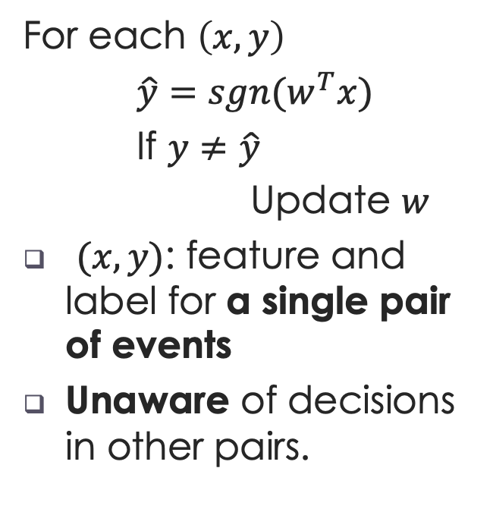
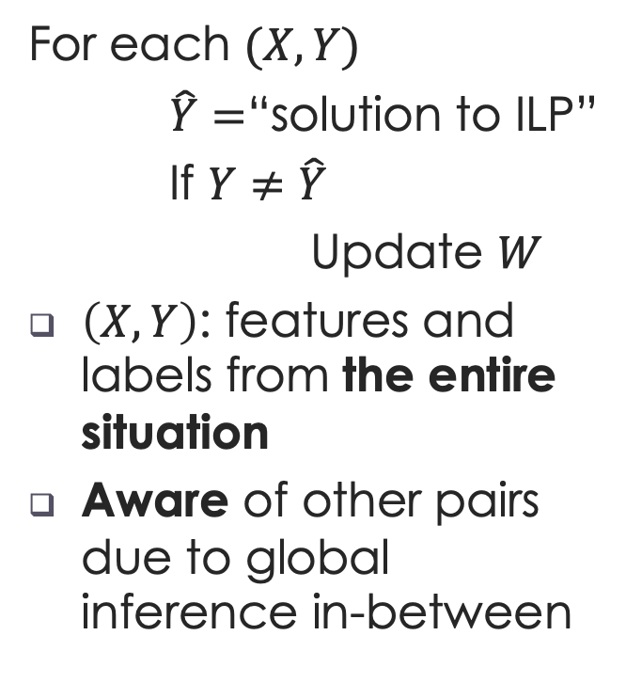
Structured (global) Learning
Local Learning
Structured Learning
[Collins, 2002]
For each $\left(x,y\right)$
$\hat{y}=sgn(w^{T}x)$
If $y≠\hat{y}$
Update $w$
$(x,y)$: feature and label for a single pair of events
Unaware of decisions in other pairs.
For each $(X,Y)$
$\hat{Y}=$“solution to ILP”
If $Y≠\hat{Y}$
Update $W$
$\left(X,Y\right)$: features and labels from the entire situation
Aware of other pairs due to global inference in-between
$$\hat{Y}=\underset{Y∈𝒞}{argmax}{W^{T}X}$$
Part I: Structured learning
Notes:
This is a standard structured learning problem. If you're not familiar with it, let's use perceptron as an example to do a side-by-side comparison. Left is the standard perceptron and right is structured perceptron. In local learning, an instance is a single pair of events, while in global learning, an instance is the entire situation, usually a paragraph, a document, or even multiple documents. Local learning is unaware of decisions in other pairs; global learning is using a global inference in-between so it's aware of the entire situation.
(40 secs)

Slide 38
Results
5%
Global inference
Local learning
[UTTime] Laokulrat et al. *SEM’13. UTTime: Temporal relation classiﬁcation using deep syntactic features.
Part I: Structured learning
Notes:
Results also supported our intuition above. When we used structured perceptron, we achieved even more improvements on top of local learning+global inference.

Slide 39
Results
We know which event pairs are related
5%
Structured learning
5%
Global inference (ILP)
Local learning
[UTTime] Laokulrat et al. *SEM’13. UTTime: Temporal relation classiﬁcation using deep syntactic features.
Part I: Structured learning
Notes:
I need to mention that in this setup, we know which event pairs have relations and we only need to classify it, as shown on the top right.

Slide 40
Results
We don’t know which event pairs are related
?
Local learning
&
Global inference
Structure learning
+2%
[CAEVO] Chambers et al. TACL2014. Dense event ordering with a multi-pass architecture.
Part II: Common sense
Notes:
A more realistic and more difficult setup is: What if we don‘t know this? That means, we need to extract pairs that we think are related, and then classify them. In that setup, the best system was CAEVO. It’s conceptually local learning+global inference. When we use structured learning, we also get improvement on top of CAEVO, although the benefit is diluted due to this more difficult setting. But don’t worry, we will achieve more, in a few minutes.

Slide 41
Understanding time for events
Part I: Structured learning
[EMNLP’17] Q. Ning, Z. Feng, and D. Roth. A Structured Learning Approach to Temporal Relation Extraction
Notes:
Now we have seen the benefit of structured learning for understanding time in a global situation, and that concludes our first part.
(conclude part I 1 min; part I total 6 min; overall ~18 mins)

Slide 42
Understanding time for events
Part I: Structured learning
Part II: Common sense
[EMNLP’17] Q. Ning, Z. Feng, and D. Roth. A Structured Learning Approach to Temporal Relation Extraction
[NAACL’18] Q. Ning, H. Wu, H. Peng, and D. Roth. Improving Temporal Relation Extraction with a Globally Acquired Statistical Resource
Notes:
The second part is common sense knowledge acquisition. This is our NAACL'18 paper.

Slide 43
More than 10 people have (event1: died), police said. A car (event2: exploded) on Friday in a group of men in north Pakistan.
Notes:
It's based on such an intuition. In this example, I deleted the words describing the events themselves. (read it). I believe most people don't understand what's going on, let alone figuring out the temporal relation between these two events.

Slide 44
More than 10 people have (event1: died), police said. A car (event2: exploded) on Friday in a group of men in north Pakistan.
Notes:
But if I told you, event1 is died, and event2 is exploded, most people would immediately say the explosion happened first.

Slide 45
When events are …
… missing
More than 10 people have (event1: died), police said. A car (event2: exploded) on Friday in a group of men.
This turns out to be difficult.
Part II: Common sense acquisition
Notes:
This means, when the event content is missing, the problem is very difficult even for humans.

Slide 46
When events are …
… present
More than 10 people have (event1: died), police said. A car (event2: exploded) on Friday in a group of men.
This turns out to be easy because humans have the common sense of which event “usually” happens before another.
We would like to acquire this common sense.
Part II: Common sense acquisition
Notes:
But when the event content is present, it's very easy because we can use common sense to support the decision. Motivated by such observations in practice, we would like to obtain this common sense knowledge first.
(intro to part II: 1min)

Slide 47
TemProb [NAACL’18]: Temporal Relation Probabilistic Knowledge Base
To mimic human’s reading experience
New York Times 1987-2007, #Articles~1M
Ran our system on top of it (via AWS)
80M temporal relations
Simply by counting, we get
Example pairs |  | Time Before (%) | Time After (%)
Text Before | Text After
Ask | Help | 86 | 9
Attend | Schedule | 1 | 82
Accept | Propose | 10 | 77
Die | Explode | 14 | 83
Part II: Common sense acquisition
Notes:
In NAACL'18, we proposed TemProb, short for ... The intuition is that humans get common sense through lots of life experience. We want to mimic this, so we collected over 1 million articles from new york times. We ran our system on top of it to imitate human's reading experience. To accelerate it, we used 100 AWS instances in parallel and finished it within one day. We find that simply by counting, we could get many interesting statistics. For example, we find ask before help, attend after schedule, accept after propose, and die after explode.
(1min)

Slide 48
Event distributions from TemProb
Part II: Common sense acquisition
Notes:
We also plotted the distribution of events that usually precede or follow specific events, of course, in terms of time. Although we only have the verbs here, we can still get some intuitive answers.

Slide 49
Event distributions from TemProb
Part II: Common sense acquisition
Notes:
For example, before bomb, there is fire; after bomb, there are kill, destroy, and people get wound.

Slide 50
Event distributions from TemProb
Part II: Common sense acquisition

Slide 51
Event distributions from TemProb
Part II: Common sense acquisition
Notes:
This is what I like the most. I have a long list of such examples, and of course, there can be errors in it. But the good thing is, we mined these automatically and no more human annotations were used, so it's pretty nice. Imagine that if we could incorporate the common sense knowledge in TemProb into the temporal relation extraction task, then we can further improve the performance. The only question is how to apply TemProb in our task.
(1 min 20 sec)

Slide 52
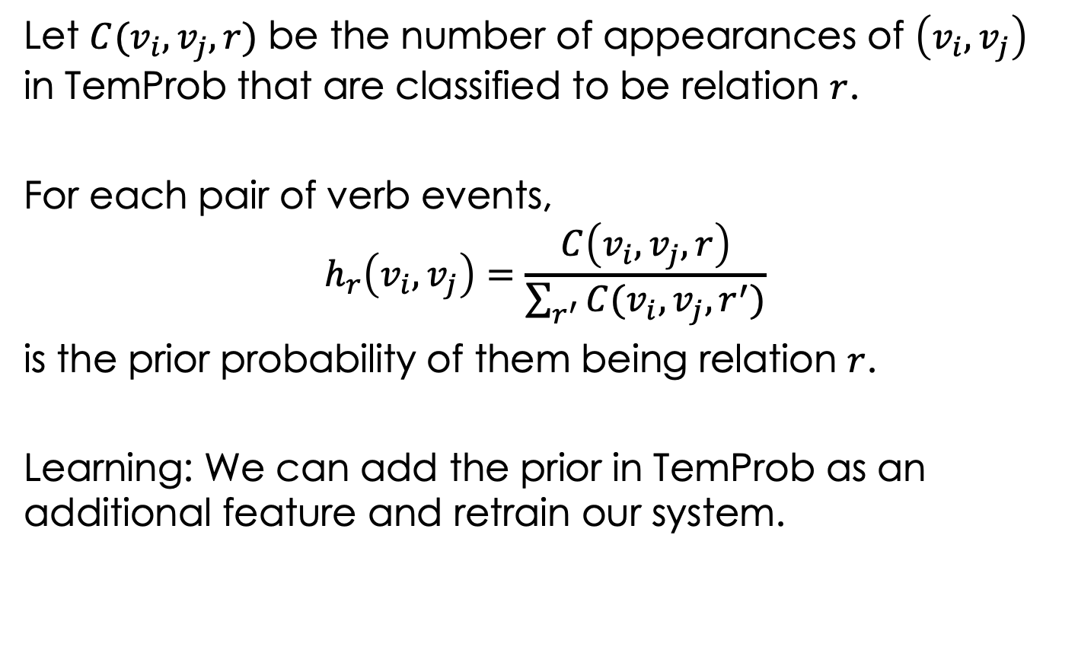
Apply TemProb in learning
Let $C(v_{i},v_{j},r)$ be the number of appearances of $\left(v_{i},v_{j}\right)$ in TemProb that are classified to be relation $r$.
For each pair of verb events,
$$h_{r}\left(v_{i},v_{j}\right)=\frac{C\left(v_{i},v_{j},r\right)}{\sum_{r^{′}}{C(v_{i},v_{j},r^{′})}}$$
is the prior probability of them being relation $r$.
Learning: We can add the prior in TemProb as an additional feature and retrain our system.

Slide 53
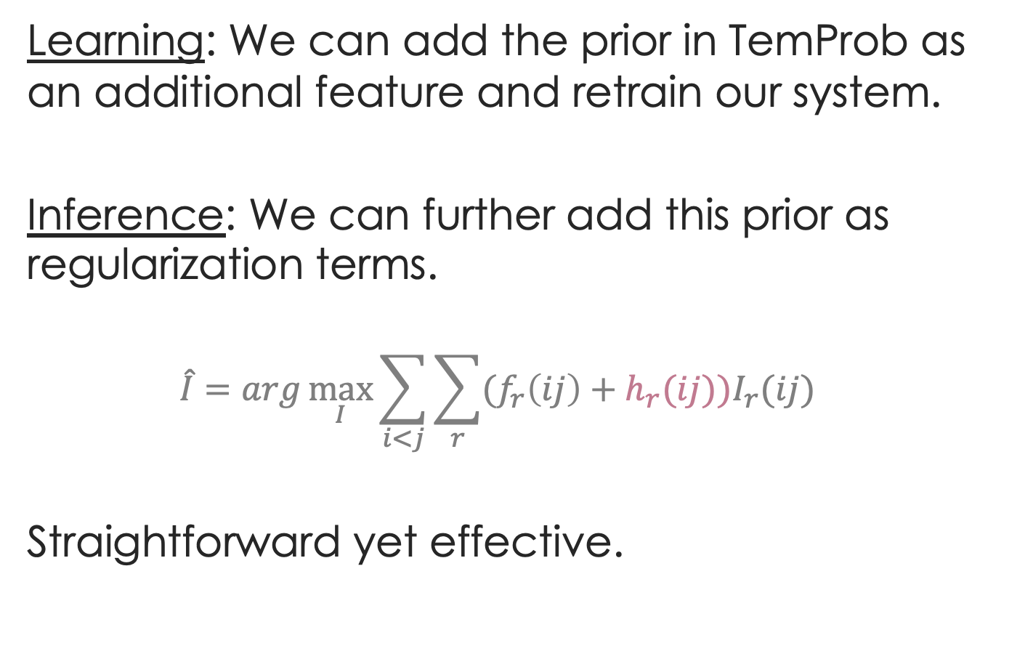
Apply TemProb in our task
Learning: We can add the prior in TemProb as an additional feature and retrain our system.
Inference: We can further add this prior as regularization terms.
$$\hat{I}=arg\max_{I}{\sum_{i<j}{\sum_{r}{(f_{r}\left(ij\right)+h_{r}(ij))I_{r}(ij)}}}$$
Straightforward yet effective.
Part II: Common sense acquisition
Notes:
Again, I tried to use TemProb in both learning and inference. During learning, we can add the prior obtained in TemProb as an addition feature, so that we should simply retrain the system.
During inference, we can further add the prior as regularization terms, to drive the prediction to favor our common sense. Here the grey part was the ILP formulation we used earlier, and the red part is the newly added common sense regularizations.
These are pretty convenient modifications to our old system. My research philosophy is, if one is doing it right, the solution should not be complicated in most cases.
(40 sec)

Slide 54
Further improvement by TemProb
TemProb
+4%
Structure learning
+2%
Local learning
&
Global inference
[CAEVO] Chambers et al. TACL2014. Dense event ordering with a multi-pass architecture.
Part II: Common sense acquisition
Notes:
Results do support our claim. When we add TemProb on top of our EMNLP’17 system, we get additional 3-4 points gain in precision, recall, and F1.
(15 sec)

Slide 55
Results
TemProb: +4%
Structure learning: +2%
[CAEVO] Chambers et al. TACL2014. Dense event ordering with a multi-pass architecture.
Part II: Common sense acquisition
Notes:
Results also supported that common sense is an important component for the task. When we add TemProb on top of our EMNLP’17 system, we get additional 3-4 points gain in precision, recall, and F1.

Slide 56
Understanding time for events
Part I: Structured learning
Part II: Common sense
[EMNLP’17] Q. Ning, Z. Feng, and D. Roth. A Structured Learning Approach to Temporal Relation Extraction
[NAACL’18] Q. Ning, H. Wu, H. Peng, and D. Roth. Improving Temporal Relation Extraction with a Globally Acquired Statistical Resource
Notes:
And that concludes the second part: common sense knowledge acquisition.
(part 2: 4.25 min; overall 22 mins)

Slide 57
Understanding time for events
Part I: Structured learning
Part II: Common sense
Part III: Data annotation
[EMNLP’17] Q. Ning, Z. Feng, and D. Roth. A Structured Learning Approach to Temporal Relation Extraction
[NAACL’18] Q. Ning, H. Wu, H. Peng, and D. Roth. Improving Temporal Relation Extraction with a Globally Acquired Statistical Resource
[ACL’18] Q. Ning, H. Wu, and D. Roth. A Multi-Axis Annotation Scheme for Event Temporal Relations.

Slide 58
“Houston, we’ve had a problem here”
The performance of temporal relation systems has come to a bottleneck. Even if we address this problem from structured learning and common sense, it’s still very low.
Bottleneck: size and quality of datasets
Not scalable: requirement for expertise on this task (honestly, only the authors of those papers know how)
Low inter-annotator agreement (IAA): low chance of agreement when people work on it without discussion
TB-Dense: Cohen’s Kappa 56%~64%
RED: F1<60%
EventTimeCorpus: Krippendorff’s Alpha~60%
The annotation task was difficult even for the researchers who designed the annotation guidelines.
No more than 60%
Part III: Data annotation
Notes:
The motivation is that we are not satisfied with our performance. Even if we have addressed it from structured learning and common sense, it’s still very low. As I showed earlier, with gold events, we have managed to come to high 50s. What I didn’t show is that without gold events, we are still in the 30s range, which means downstream systems cannot get reliable signals at all. I think this problem is due to the small size and low quality of existing datasets. Previous datasets are not scalable because they require the annotators to be NLP experts on this task. Honestly, those datasets were only annotated by the authors of those papers. In addition, we find that they all have very low inter-annotator agreements, or IAA, which conceptually measures the chance of agreement if different human annotators work on the task without discussion. I listed a few previous datasets and you can see the IAAs were not more than 60%, which also partly explains why it had been so difficult to further improve our system. To summarize, the annotation task was difficult even for the researchers who designed the annotation guidelines. Something must be wrong.
(1.5 min)

Slide 59
Existing annotation schemes
Police tried to eliminate the pro-independence army and restore order. At least 51 people were killed in clashes between police and citizens in the troubled region.
Annotation task: to label the TempRels between the bold faced events
Existing Scheme 1: TimeBank [Pustejovsky et al., 2003]
Annotators freely add TempRels between those events.
It’s inevitable that some TempRels will be missed.
E.g., only one relation between “eliminate” and “restore” is annotated in TimeBank, while other relations such as “tried” is before “eliminate” and “tried” is also before “killed” are missed.
Notes:
before we introduce our annotation scheme, let's use this example to see those previous ones.

Slide 60
Existing annotation schemes
Police tried to eliminate the pro-independence army and restore order. At least 51 people were killed in clashes between police and citizens in the troubled region.
Existing Scheme 2: TimeBank-Dense [Cassidy et al., 2014]
“All” – all event pairs are presented, one-by-one, and an annotator must provide a response for each of them.
“1” – In the physical world, time is one dimensional.
“0” – missing relations anymore.
“?” – However, some pairs of events are very confusing, resulting in disagreement.

Slide 61
Existing annotation schemes
Police tried to eliminate the pro-independence army and restore order. At least 51 people were killed in clashes between police and citizens in the troubled region.
E.g., what’s the relation between restore and killed?
restore BEFORE killed?
restore INCLUDES killed?
restore AFTER killed?
Part III: Data annotation

Slide 62
Proposed solution: multi-axis
Police tried to eliminate the pro-independence army and restore order. At least 51 people were killed in clashes between police and citizens in the troubled region.
We suggest that multiple time axes may exist in natural language.
Intention axis
restore order
✓
to eliminate army
✓
police tried
51 people killed
Main axis
✓
Part III: Data annotation
Notes:
In this particular example, we used intention axis. We also define other axes, such as opinion and hypothesis.

Slide 63
Proposed solution: multi-axis
We complete a set of definitions for axes
Event Type | Axis Type | %
intention, opinion | orthogonal axis | ~20
hypothesis, generic | parallel axis | ~10
negation | not on any axis
static, recurrent | not considered now
main | main axis | ~70
Part III: Data annotation
Notes:
In this particular example, we used intention axis. We also define other axes, such as opinion and hypothesis.

Slide 64
What we achieved
20k: Annotated the 20k relations
1 week: Finished in about one week using crowdsourcing (actual time much shorter)
80%: IAA improved from literature’s 60% to 80%, although those crowdsourcers are laymen in NLP
Part III: Data annotation
Notes:
In contrast, what we achieved is: we annotated 20 thousand temporal relations within one week, with the help of crowdsourcers. At the same time, we improved the IAA from literature’s 60% to more than 80%. The reason that we were able to do this was we started to re-think the task and annotation scheme. And as we show later, if the task is defined well, then it’s easy even for laymen crowdsourcers. After all, that’s the way it should be.
(30 sec)

Slide 65
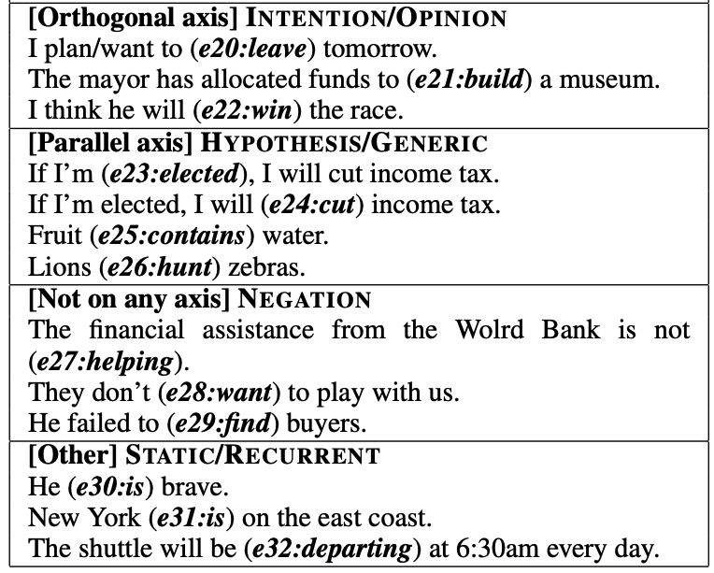
Proposed scheme: multi-axis
Part III: Data annotation

Slide 66
With a better IAA (>80%)
The performance of a baseline system on our new dataset is much better than one on the old dataset
+22%
+21%
[Old dataset] Cassidy et al. ACL’14. An annotation framework for dense event ordering.
Notes:
With a better quality, we can achieve even higher improvements.

Slide 67
Discussion
With a better IAA, the overall performance on our new dataset is much better than those in the literature
The learning task is defined in a better way by the new annotation scheme
It represents a deeper understanding of how time is expressed in language
“Language distinguishes us from other species”
Wait…Animals also have language
Well, more precisely, we’re the only species that can express our imaginations via language
Banks get our money by promising us more in the future, but we cannot get a banana by promising a monkey two bananas in ten minutes
Intention, Opinion, Hypothesis, Negation, etc.
Part III: Data annotation
Notes:
My understanding is that these axes are various forms of imaginations.

Slide 68
Understanding time for events
Part I: Structured learning
Part II: Common sense
Part III: Data annotation
[EMNLP’17] Q. Ning, Z. Feng, and D. Roth. A Structured Learning Approach to Temporal Relation Extraction
[NAACL’18] Q. Ning, H. Wu, H. Peng, and D. Roth. Improving Temporal Relation Extraction with a Globally Acquired Statistical Resource
[ACL’18] Q. Ning, H. Wu, and D. Roth. A Multi-Axis Annotation Scheme for Event Temporal Relations.
Notes:
(proposed scheme 5 mins; part III 7 mins; over all 29 mins)

Slide 69
Understanding time for events
Put all pieces together
[EMNLP’17] Q. Ning, Z. Feng, and D. Roth. A Structured Learning Approach to Temporal Relation Extraction
[NAACL’18] Q. Ning, H. Wu, H. Peng, and D. Roth. Improving Temporal Relation Extraction with a Globally Acquired Statistical Resource
[ACL’18] Q. Ning, H. Wu, and D. Roth. A Multi-Axis Annotation Scheme for Event Temporal Relations.
[In submission] Q. Ning, S. Subramanian, and D. Roth. An improved neural approach for temporal relation extraction
Notes:
Now we have confirmed the improvement brought by structured learning, common sense acquisition, and multi-axis annotation. A natural question is how about putting all pieces together? I’m going to mainly discuss our neural approach in submission.

Slide 70
Put all pieces together
: CogCompTime [EMNLP’18]
New Dataset
+11.1%*
Common sense
+4%
Structure learning
+2%
*Not a fair comparison because test set is re-labeled
Put all pieces together
Notes:
But before the neural approach, we have an EMNLP’18 paper, CogCompTime, that is also putting all together, but not neural-net based. We can see CogCompTime achieved 11% gain on top of our previous system using TemProb. Note that this is not a fair comparison since the test set is re-labeled now. However, this still shows that we can get more reliable temporal signals with all these efforts. Now, based on CogCompTime, how can we use neural nets to make it even better?

Slide 71
: a neural approach
Put all pieces together
LSTM
+
Feed-Forward NN
+
Siamese
Siamese network
Common sense
Long short-term memory network
Structured learning
Feedforward network
Trained on new data
Put all pieces together
Notes:
Our proposal is to use long short-term memory network (LSTM) to represent structured learning, a feedforward neural net to get supervision from our new dataset, and a Siamese network to represent common sense. Let me quickly go through the high-level ideas behind it.

Slide 72
Put all pieces together
: a neural approach
LSTM takes word embeddings as input
Hidden vectors represent events
FFNN predicts the labels of temporal relations (followed by ILP inference)
Siamese network is a generalized TemProb
Siamese network
(Common sense)
LSTM
Feedforward network
(Trained on new data)
word embeddings
t₀ t₁ t₂ t_{n}
LSTM w/ concatenations of two hidden states
Put all pieces together
Notes:
Specifically, LSTM takes a sequence of word embeddings as input

Slide 73
Put all pieces together
: a neural approach
LSTM takes word embeddings as input
Hidden vectors represent events
FFNN predicts the labels of temporal relations (followed by ILP inference)
Siamese network is a generalized TemProb
Siamese network
(Common sense)
h_{e1}
LSTM
128
word embeddings
h_{e2}
128
t₀ t₁ t₂ t_{n}
LSTM w/ concatenations of two hidden states
Put all pieces together
Notes:
And generates hidden vectors to represent those events

Slide 74
Put all pieces together
: a neural approach
LSTM takes word embeddings as input
Hidden vectors represent events
FFNN predicts the labels of temporal relations (followed by ILP inference)
Siamese network is a generalized TemProb
Siamese network
(Common sense)
h_{e1}
LSTM
128
output
before
after
equal
vague
word embeddings
h_{e2}
64
128
t₀ t₁ t₂ t_{n}
LSTM w/ concatenations of two hidden states
Output confidence scores
Put all pieces together
Notes:
The event representations are stacked as input to the feedforward neural net, which generates the final temporal relation label

Slide 75
Put all pieces together
: a neural approach
LSTM takes word embeddings as input
Hidden vectors represent events
FFNN predicts the labels of temporal relations (followed by ILP inference)
Siamese network is a generalized TemProb
Siamese network trained on TemProb
v₁
v₂
500
500
150
dropout 0.3
45
dropout 0.3
h_{e1}
LSTM
128
output
before
after
equal
vague
word embeddings
h_{e2}
64
128
t₀ t₁ t₂ t_{n}
LSTM w/ concatenations of two hidden states
Output confidence scores
Put all pieces together
Notes:
In addition, a separate Siamese network fits the statistics in TemProb

Slide 76
Put all pieces together
: a neural approach
LSTM takes word embeddings as input
Hidden vectors represent events
FFNN predicts the labels of temporal relations (followed by ILP inference)
Siamese network is a generalized TemProb
Siamese network trained on TemProb
v₁
v₂
500
500
150
dropout 0.3
45
dropout 0.3
h_{e1}
LSTM
128
output
before
after
equal
vague
word embeddings
h_{e2}
64
128
t₀ t₁ t₂ t_{n}
LSTM w/ concatenations of two hidden states
Output confidence scores
Put all pieces together
Notes:
And provides additional embeddings that can be used in the feedforward neural net.

Slide 77
Put all pieces together
: a neural approach
Siamese
BERT
+3%
New dataset
Neural
+4%
Common sense
+3%
Structured learning
+11%*
Previous SOTA
+4%
+2%
*Test set is re-labeled
Put all pieces together
Notes:
This is a final summary for our progress on this task. CAEVO is the previous SOTA, structured learning 2%, common sense 4%, new dataset 11%, LSTM with standard word embeddings 3%, LSTM with BERT embeddings 4% (BERT is the most recent word embedding), and Siamese another 3%.

Slide 78
Put all pieces together
: a neural approach
Move fast!
Siamese
BERT
+3%
New dataset
Neural
+4%
Common sense
+3%
Structured learning
+11%*
Previous SOTA
+4%
+2%
*Test set is re-labeled
Put all pieces together
Notes:
As you can see, if we gain a deep understanding of the challenges of a task, we can move in the correct direction and improvement just comes naturally. I think the process of finding the correct direction is very fun.
(neural 2.5 min)

Slide 79
Put all pieces together
: a neural approach
Move slow to move fast!
Siamese
BERT
+3%
New dataset
Neural
+4%
Common sense
+3%
Structured learning
+11%*
Previous SOTA
+4%
+2%
*Test set is re-labeled
Put all pieces together
Notes:
As you can see, if we gain a deep understanding of the challenges of a task, we can move in the correct direction and improvement just comes naturally. I think the process of finding the correct direction is very fun.
(neural 2.5 min)

Slide 80
Put all pieces together
: a neural approach
+10%
+10%
+6%
Our own baseline
[EMNLP’18]
Put all pieces together

Slide 81
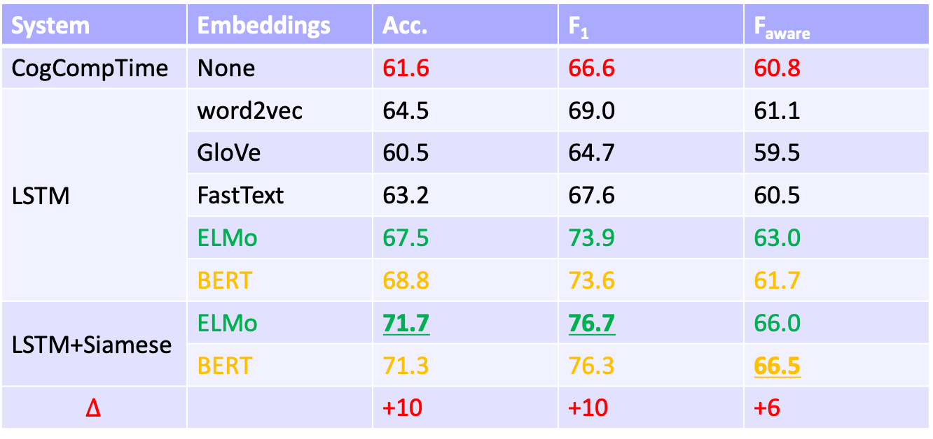
Further Investigation: Neural Method
System | Embeddings | Acc. | F₁ | F_{aware}
CogCompTime | None | 61.6 | 66.6 | 60.8
LSTM | word2vec | 64.5 | 69.0 | 61.1
 | GloVe | 60.5 | 64.7 | 59.5
 | FastText | 63.2 | 67.6 | 60.5
 | ELMo | 67.5 | 73.9 | 63.0
 | BERT | 68.8 | 73.6 | 61.7
LSTM+Siamese | ELMo | 71.7 | 76.7 | 66.0
 | BERT | 71.3 | 76.3 | 66.5
$$∆$$ |  | +10 | +10 | +6

Slide 82
Recap
Structured learning
EMNLP’17
Annotating structures
NAACL’19
1 in submission
NAACL’18
ACL’18
Common sense
Data annotation
Notes:
A quick recap: we have discussed … In structured learning, we discussed that the structure information should be taken into consideration during the inference phase and during the learning phase. A natural question is: can we push it deeper, to an even earlier stage, that is, the data annotation stage? As you will see in the next few slides, this problem is a natural extension of what I talked about today, but is also a very general machine learning topic.

Slide 83
Annotating structures
is important
Most NLP tasks are structured: Syntactic parsing (tree), semantic role labeling (assignment), temporal relation extraction (no loops)
A common perception is: “partial” data are of low quality and should be avoided
How should we quantify the quality of “partial”?
How should we quantify the quality of “partial”?
ripping
monitor
hurt
quality = 2 / 10?
cascaded
ordered
BEFORE
BE_INCLUDED

Slide 84
How should we quantify the quality of “partial”?
ripping
monitor
quality = 2 / 10?
hurt
quality > 2 / 10!
cascaded
ordered
BEFORE
BE_INCLUDED
BE_INCLUDED
AFTER
BEFORE
INCLUDES
EQUAL
ripping
monitor
monitor
cascaded
Time
The existing two links has partly explained the red link.
Partial or complete? [NAACL’19]

Slide 85
Silver lining of “partial”
ripping
monitor
hurt
quality > 2 / 10?
cascaded
ordered
BEFORE
BE_INCLUDED
BE_INCLUDED
AFTER
BEFORE
INCLUDES
EQUAL
ripping
monitor
monitor
cascaded
Time
So, is ”partial” even better than “complete”?
Partial or complete? [NAACL’19]

Slide 86
Partial or complete, that’s the question [NAACL’19]
Training Phase
(a) Complete
(b) Partial
same budget
same budget
$$𝒯_{test}$$
Testing Phase

Slide 87
Partial or complete, that’s the question [NAACL’19]
Training Phase
(a) Complete
(b) Partial
same budget
same budget
partial
complete
+: p<5%
++: p<1%
$$𝒯_{test}$$
++
++
++
++
++
++
++
++
+
Testing Phase
When we have a fixed budget, partial structures indeed lead to better performance.
How should we quantify the quality of “partial”?

Slide 88


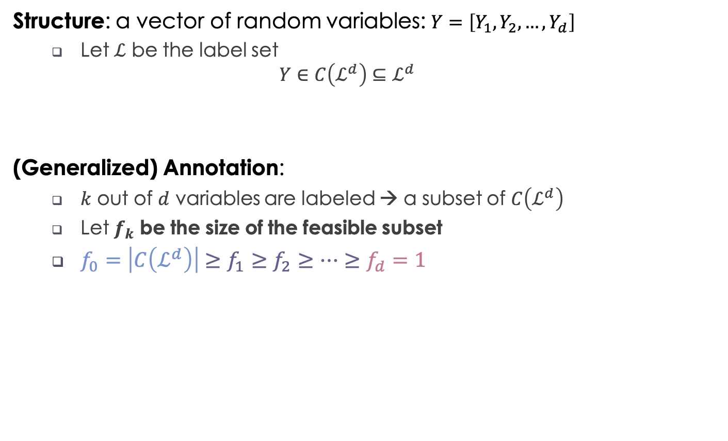
The quality of partially annotated structures
Structure: a vector of random variables: $Y=\left[Y_{1},Y_{2},…,Y_{d}\right]$
Let $ℒ$ be the label set
$$Y∈C\left(ℒ^{d}\right)⊆ℒ^{d}$$
(Generalized) Annotation:
$k$ out of $d$ variables are labeled → a subset of $C\left(ℒ^{d}\right)$
Let $f_{k}$ be the size of the feasible subset
$f_{0}=\left|C\left(ℒ^{d}\right)\right|≥f_{1}≥f_{2}≥⋯≥f_{d}=1$
Not all assignments are valid (e.g., no loops in time)
$f_{k}$ be the size of the feasible subset
No annotation
Complete annotation
1
1→2→3→4
Or
1→3→2→4
2
3
$$f_{k}=2$$
Partial order
4
Partial or complete? [NAACL’19]
Notes:
First, structure. It’s a vector of random variables. L is the label set that each variable can choose from. Usually the structure Y lies in a constrained space of L^d since not all assignments are valid; just like in a temporal graph, there cannot be loops. The complete annotation for a structure means all variables are labeled and thus a unique point in C is determined. Partial annotation means only some of the variables are labeled. Then a subset of C is determined and that contains the true structure. Let f_k be the size of the subset if k variables are labeled. We know f_0 means no variables are labeled yet, so f_0 is the cardinality of C. Then f_k decreases as more variables are labeled, and at the end, f_d means all variables are labeled and only one point is left. We define quantity I_k as the difference between the original feasible set and the feasible set at step k, and it measures how much of C has been disqualified by k labels. In other words, that is the benefit of k labels. And furthermore, Delta_k is the benefit of the k-th label
(1 min)

Slide 89


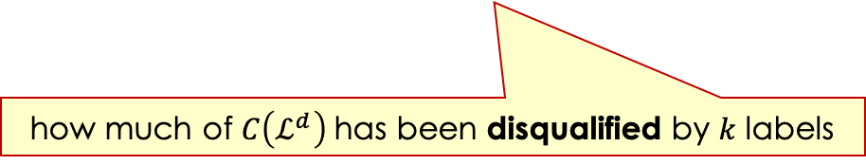
The quality of partially annotated structures
Structure: a vector of random variables: $Y=\left[Y_{1},Y_{2},…,Y_{d}\right]$
Let $ℒ$ be the label set
$$Y∈C\left(ℒ^{d}\right)⊆ℒ^{d}$$
(Generalized) Annotation:
$k$ out of $d$ variables are labeled → a subset of $C\left(ℒ^{d}\right)$
Let $f_{k}$ be the size of the feasible subset
$f_{0}=\left|C\left(ℒ^{d}\right)\right|≥f_{1}≥f_{2}≥⋯≥f_{d}=1$
Define the benefit of k labels: $I_{k}≜\log{|C(𝓛^{d})|}−E[\log{f_{k}}]$
Not all assignments are valid (e.g., no loops in time)
$f_{k}$ be the size of the feasible subset
No annotation
Complete annotation
$$I_{k}≜\log{|C(𝓛^{d})|}−E[\log{f_{k}}]$$
how much of $C\left(ℒ^{d}\right)$ has been disqualified by 𝑘 labels
Partial or complete? [NAACL’19]
Notes:
First, structure. It’s a vector of random variables. L is the label set that each variable can choose from. Usually the structure Y lies in a constrained space of L^d since not all assignments are valid; just like in a temporal graph, there cannot be loops. The complete annotation for a structure means all variables are labeled and thus a unique point in C is determined. Partial annotation means only some of the variables are labeled. Then a subset of C is determined and that contains the true structure. Let f_k be the size of the subset if k variables are labeled. We know f_0 means no variables are labeled yet, so f_0 is the cardinality of C. Then f_k decreases as more variables are labeled, and at the end, f_d means all variables are labeled and only one point is left. We define quantity I_k as the difference between the original feasible set and the feasible set at step k, and it measures how much of C has been disqualified by k labels. In other words, that is the benefit of k labels. And furthermore, Delta_k is the benefit of the k-th label
(1 min)

Slide 90
Diminishing return of new labels
$$I_{k}:\text{The} \text{benefit} \text{of} \text{k} \text{label}\text{s} \text{is} \text{concave}$$
$$Δ_{k}=I_{k}−I_{k−1} \text{: }\text{The} \text{benefit} \text{of} \text{a} \text{new} \text{label} \text{is} \text{diminishing}$$
Partial or complete? [NAACL’19]

Slide 91
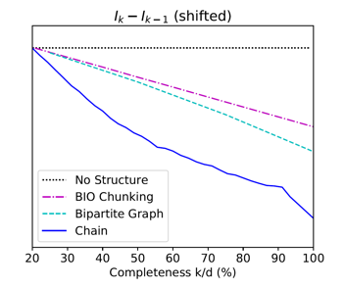
The more concave $I_{k}$ is, more benefit partial brings!
$$Δ_{k}=I_{k}−I_{k−1} \text{: }\text{The} \text{benefit} \text{of} \text{a} \text{new} \text{label}$$
Seq Tagging
(chunking)
partial
complete
Seq Tagging
complete
partial
more concave
Bipartite Graph
(semantic role classification)
Chain
(temporal relation extraction)
partial
partial
complete
complete
complete
complete
partial
partial
Notes:
Based on this figure, we know from seq tagging, to bipartite, to chain, I_k is more concave. We selected three tasks: shallow parsing, semantic role classification, and our temporal relation extraction. They represent the seq tagging structure, the bipartite structure, and the chain structure. We can see the benefit of partial is indeed larger as I_k is more concave. Now we have seen the power of using I_k to analyze the benefit of partial data. Can we say more about I_k?
(30 sec)

Slide 92
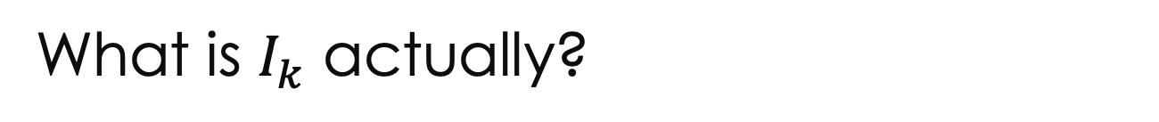
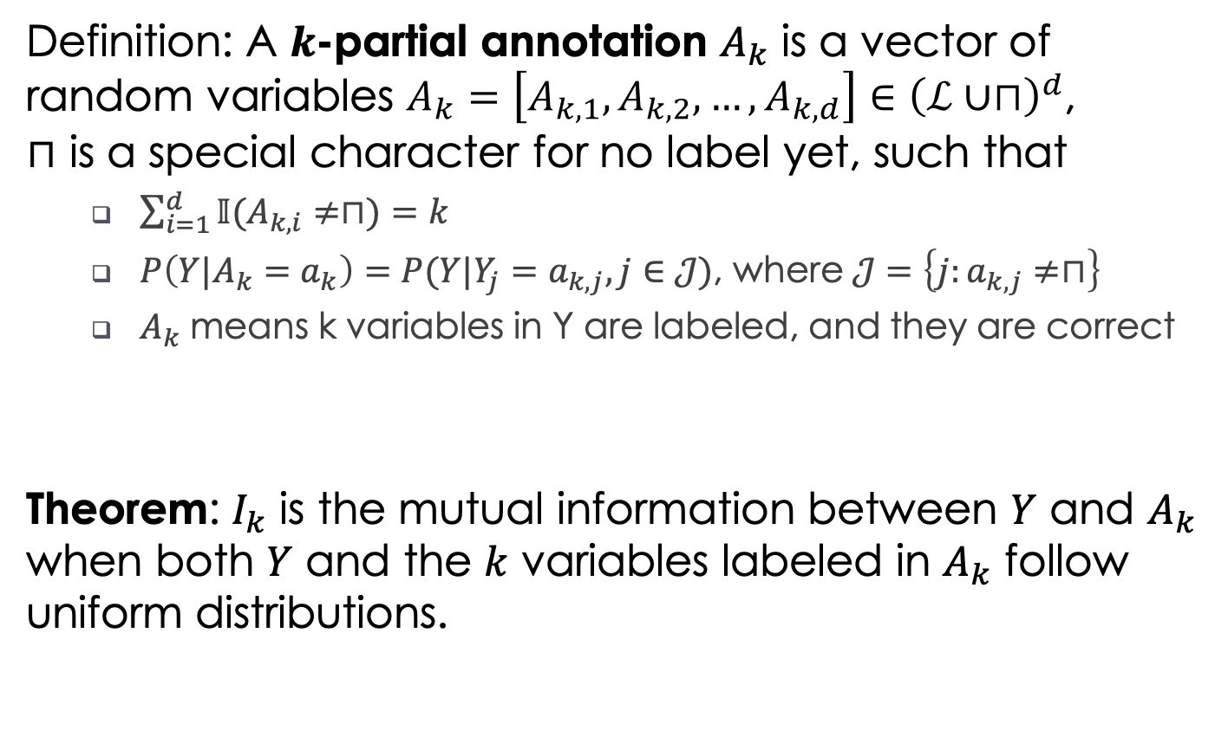
What is $I_{k}$ actually?
Definition: A $k$-partial annotation $A_{k}$ is a vector of random variables $A_{k}=\left[A_{k,1},A_{k,2},…,A_{k,d}\right]∈{\left(ℒ∪⊓\right)}^{d}$, where $⊓$ is a special character for no label yet, such that
$\sum_{i=1}^{d}{𝕀(A_{k,i}≠⊓)}=k$
$P\left(Y|A_{k}=a_{k}\right)=P(Y|Y_{j}=a_{k,j},j∈𝒥)$, where $𝒥=\left\{j:a_{k,j}≠⊓\right\}$
$A_{k}$ means k variables in Y are labeled, and they are correct
Theorem: $I_{k}$ is the mutual information between $Y$ and $A_{k}$ when both $Y$ and the $k$ variables labeled in $A_{k}$ follow uniform distributions.
Partial or complete? [NAACL’19]
Notes:
If we define k-partial annotation as a vector of random variables A_k. You don’t need to read the formulations below. The translation is: A_k means k variables are labeled in Y. Then actually we can prove, that I_k is the mutual information between structure Y and the k-partial annotation A_k, when they follow certain uniform distributions. This is a very interesting finding.
(30 sec)

Slide 93
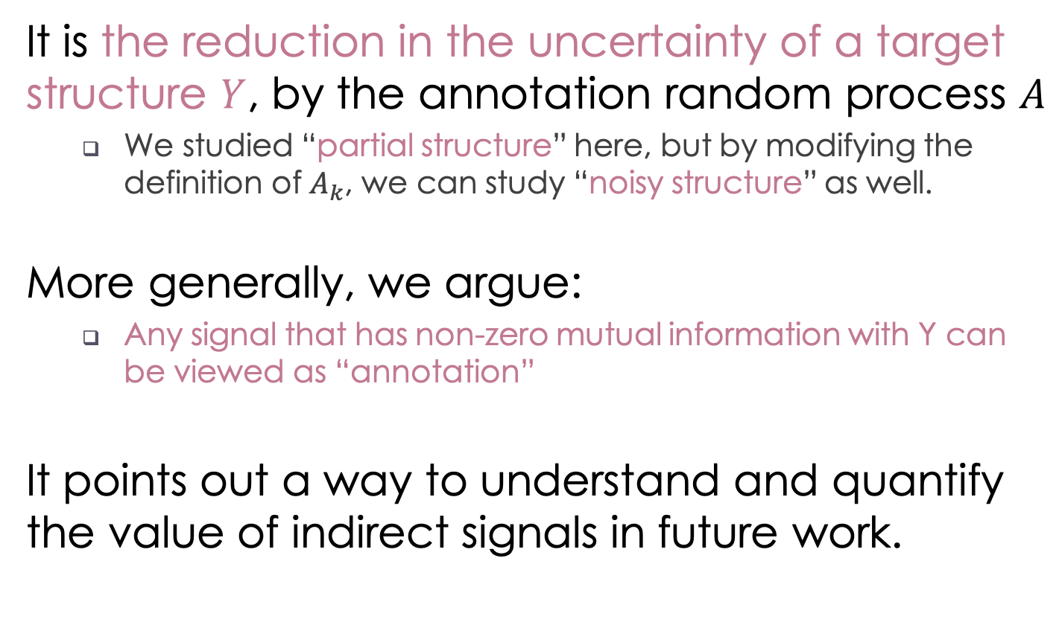
Unique view of structured annotation
It is the reduction in the uncertainty of a target structure $Y$, by the annotation random process $A$
We studied “partial structure” here, but by modifying the definition of $A_{k}$, we can study “noisy structure” as well.
More generally, we argue:
Any signal that has non-zero mutual information with Y can be viewed as “annotation”
It points out a way to understand and quantify the value of indirect signals in future work.
Incidental supervision
Partial or complete? [NAACL’19]
Notes:
(partial 5 min)

Slide 94
Achilles heel of standard paradigms
Task
Data
Learn
Task
Data
Learn
Not scalable
Task
Data
Learn
Task
Data
Learn
Task
Data
Learn
Task
Data
Learn
Task
Data
Learn
Task
Data
Learn
Task
Data
Learn
Task
Data
Learn
Task
Data
Learn
Task
Data
Learn
Incidental supervision is the idea of learning from indirect signals, which may be noisy, partial, or only correlated.
My vision is that situation-level tasks will require gigantic training data, and at that time, incidental supervision will be crucial for them.

Slide 95
What’s next
Structured learning
Incidental supervision
Common sense
Data annotation
Notes:
A quick recap: we have discussed … In structured learning, we discussed that the structure information should be taken into consideration during the inference phase and during the learning phase. A natural question is: can we push it deeper, to an even earlier stage, that is, the data annotation stage?

Slide 96



What’s next
Time
Joint extraction of events & relations
Multi-task & structured learning
Structured learning
Temporal common sense
Duration, frequency, …
Common sense
Data annotation
Multi-axis temporal parser
Important for information trustworthiness
Notes:
Specifically, I have already started doing joint extraction of events and relations in multi-task learning. I will make my multi-axis temporal parser more robust, which I think will be important for trustworthiness. And also, temporal common sense.

Slide 97
Temporal common sense
[in submission]
TemProb [NAACL’18] is only about temporal ordering
In addition, we proposed other types of temporal common sense:
Duration: how long something takes
Frequency: how often something happens
Stationary vs transient: “being allergic” vs “being a student”
Absolute time point: “go to work” vs “go to bed”
We are the first to study this, have collected 10K Q&A pairs, and achieved ~70% on it in a baseline system
“My movie starts in 30 mins. Can I have dinner before it?”
What’s next: preliminary results
Notes:
The common sense studied in this talk is about ordering, but there are actually more aspects about temporal common sense. For example, duration, stationary vs transient, absolute time point, and frequency. We are the first to systematically study all types of temporal common sense, we collected 10 thousand Q&A pairs on it, and have already achieved roughly 70% accuracy on it. This paper is currently in submission. But of course this is an initial step and there’re many interesting research we can do here. “I cooked for an hour vs I have been cooking for years.”

Slide 98
What’s next
Predict how things unfold [in submission]
Summarization [ISIT’19]
Event
Extension: Medical records, financial reports, etc.
Information theory for text summarization
Joint extraction of events & relations
Time
Temporal common sense
Multi-axis temporal parser
Event hierarchies, coreference, causality, etc.
Notes:
At the event level, I would also like to investigate summarization, what happens next, and event hierarchies. We have one paper in ISIT this year, and another paper in submission, but these is still a long way to go.

Slide 99
What’s next
Robotics
Event
Biomedicine
Information theory
Time
Optimization
Deep learning
Statistics
Short-term: build a more robust temporal parser
Mid-term: study event understanding problems, e.g., text summarization, timeline construction, event hierarchies, and common sense.
Long-term: understand the social, political, medical, and financial events expressed in text; provide a semantic engine for reasoning about situations.
Incidental supervision
Notes:
So, in the short term, we want to build a more robust temporal parser and try to make that a standard parser when people want to study events...mid term...long term...Those are on the NLP side.
(practice at Julia’s group: 40 mins up to now)

Slide 100
Summary
Big text, big opportunities
We are standing at the situation-level of NLP
Temporal relation is a crucial component
Structured learning [EMNLP’17]
Common sense knowledge acquisition [NAACL’18]
New definition of the task [ACL’18]
Combined them by neural nets [in submission]
Besides future work on time and event, incidental supervision is also necessary for situation understanding.
Supervision from partial structures [NAACL’19]
3rd wave of AI
Notes:
Alright. That’s all I’m talking today. It’s been a long talk and I hope you don’t get sleepy. To summarize it, in the age of big text, we have big opportunities for NLP. Regarding where we are, I think we are standing at the situation-level, and that’s the next important thing to do in the field. To that end, temporal relation extraction is a crucial component, and we have addressed it from structured learning, common sense knowledge acquisition, new task definition which leads to an improved dataset, and how to combine them using neural nets. Finally, besides future work on time and event, I think incidental supervision
(1 min)

Slide 101
References
Harari, 2016. Sapiens: A Brief History of Humankind
Mani et al., 2006. Machine learning of temporal relations
Chambers et al., 2007. Classifying temporal relations between events
Bethard et al., 2007. Timelines from text: Identification of syntactic temporal relations
Roth & Yih, 2004. A linear programming formulation for global inference in natural language tasks
Bramsen et al., 2006. Inducing temporal graphs
Chambers & Jurafsky, 2008. Jointly combining implicit constraints improves temporal ordering
Denis & Muller, 2011. Predicting globally-coherent temporal structures from texts via endpoint inference and graph decomposition
Chambers et al., 2014. Dense event ordering with a multi-pass architecture
Mirza & Tonelli, 2016. CATENA: CAusal and TEmporal relation extraction from NAtural language texts
Do et al., 2012. Joint inference for event timeline construction
Laokulrat et al., 2013. UTTime: Temporal relation classiﬁcation using deep syntactic features
Collins, 2002. Discriminative training methods for hidden Markov models: Theory and experiments with perceptron algorithms
Pustejovsky et al., 2003. The TIMEBANK corpus
Cassidy et al., 2014. An annotation framework for dense event ordering

Slide 102



Many thanks to my collaborators.
UPenn
CU Boulder
UIUC
UIUC
UIUC
UIUC
USC
BBN
ARL
Particle Media
UPenn
UPenn
UPenn
UIUC
Wisconsin
Notes:
Many thanks to my advisor and collaborators.

Slide 103
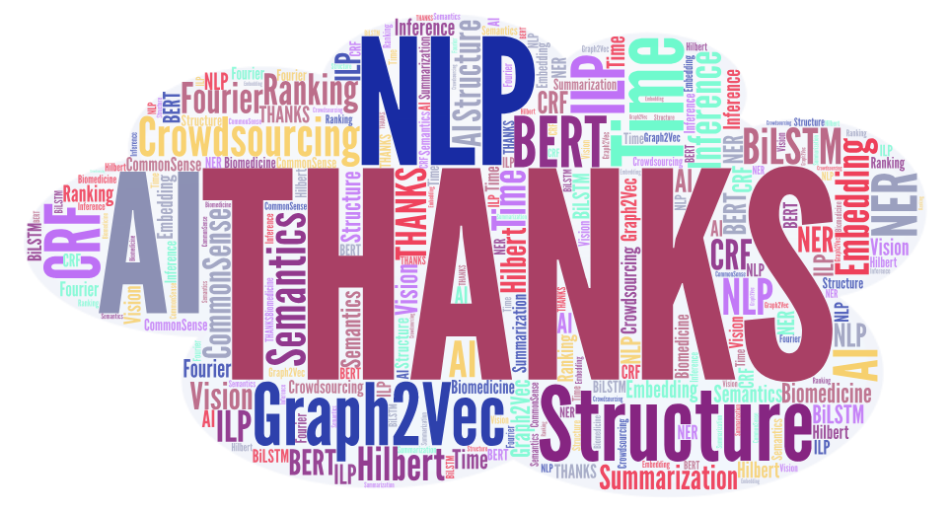

Slide 104
Courses that I can teach
Computing & algorithms
COMP 100 - INTRO COMPUTING & INFO SYS
COMP 110 - COMPUTATION IN SCI & ENGI
COMP 130 - ELEMENTS OF ALGORITHMS & COMP
COMP 140 - COMPUTATIONAL THINKING
COMP 180 - PRINCIPLES OF COMPUTING
COMP 182 - ALGORITHMIC THINKING
COMP 200 - ELEMENTS OF COMPUTER SCIENCE
COMP 310 - ADV OBJECT-ORIENTED PROG
COMP 326 - DIGITAL LOGIC DESIGN
COMP 330 - TOOLS & MODELS - DATA SCIENCE
Bioinformatics & medical imaging
COMP 370 - EVOLUTIONARY BIOINFORMATICS
COMP 485/486 - FUNDAMENTALS OF MEDICAL IMAGING
COMP 571 - BIOINFORMATICS: SEQUENCE
COMP 572 - BIOINFORMATICS: NETWORKS
Machine learning & AI
COMP 440/557 - ARTIFICIAL INTELLIGENCE
COMP 441/542 - LARGE-SCALE MACHINE LEARNING
COMP 502 - NEURAL MACHINE LEARNING I
COMP 540 - STATISTICAL MACHINE LEARNING
COMP 576 - INTRODUCTION TO DEEP LEARNING
COMP 602 - NEURAL MACHINE LEARNING II
Notes:
https://courses.rice.edu/courses/!SWKSCAT.cat?p_action=CATALIST&p_acyr_code=2018&p_subj=COMP

Slide 105
Recap
Structured learning
EMNLP’17, SEM’18
ACL’18 (a)
NAACL’19
EMNLP’18
NAACL’18
1 in submission
1 in submission
ACL’18 (b)
1 in submission
Common sense
Data annotation
Notes:
I hope that you have enjoyed the progress we have made so far, just as much as I do. We have tackled the problem of temporal relation extraction for events in a situation based on structured learning, common sense acquisition, and data collection. We have published 7 papers on this, and of course, we need to move forward.

Slide 106
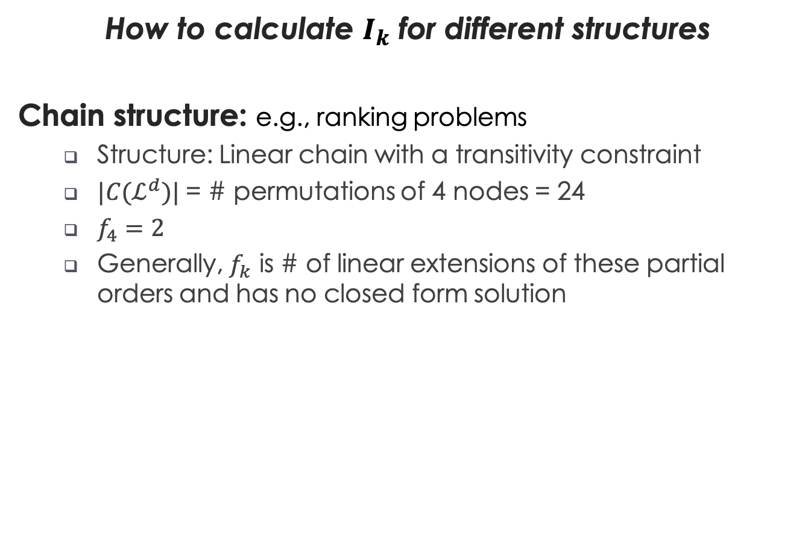


$$I_{k}≜\log{|C(𝓛^{d})|}−E[\log{f_{k}}]$$
$f_{k}$ be the size of the feasible subset
How to calculate $I_{k}$ for different structures
Chain structure: e.g., ranking problems
Structure: Linear chain with a transitivity constraint
$|C(ℒ^{d})|$ = # permutations of 4 nodes = 24
$f_{4}=2$
Generally, $f_{k}$ is # of linear extensions of these partial orders and has no closed form solution
1
1→2→3→4
Or
1→3→2→4
2
3
Partial order
4
Supervision from partial structures [NAACL’19]
Notes:
We can apply the same analysis to 3 general cases: chain structure in ranking problems, bipartite graph in assignment problems, and sequence tagging problems. These three types of problems are very general in machine learning and NLP, and we can either derive or simulate the I_k for all of them.
(20 sec)

Slide 107

$$I_{k}≜\log{|C(𝓛^{d})|}−E[\log{f_{k}}]$$
$f_{k}$ be the size of the feasible subset
How to calculate $I_{k}$ for different structures
Bipartite structure: e.g., assignment problems
Structure: Each agent handles exactly one task, and each task can only be handled by at most one agent
Generally, $I_{k}$ has closed form solutions
a
b
c
Agents
1
2
3
4
5
Tasks
Supervision from partial structures [NAACL’19]
Notes:
We can apply the same analysis to 3 general cases: chain structure in ranking problems, bipartite graph in assignment problems, and sequence tagging problems. These three types of problems are very general in machine learning and NLP, and we can either derive or simulate the I_k for all of them.
(20 sec)

Slide 108

$$I_{k}≜\log{|C(𝓛^{d})|}−E[\log{f_{k}}]$$
$f_{k}$ be the size of the feasible subset
How to calculate $I_{k}$ for different structures
BIO structure: e.g., sequence tagging problems
Structure: O cannot be immediately followed by I
Generally, $I_{k}$ has no closed-form solution
This is an example showing the BIO structure .
O O B I O B I I O
Begin
Inside
Supervision from partial structures [NAACL’19]
Notes:
We can apply the same analysis to 3 general cases: chain structure in ranking problems, bipartite graph in assignment problems, and sequence tagging problems. These three types of problems are very general in machine learning and NLP, and we can either derive or simulate the I_k for all of them.
(20 sec)

Slide 109
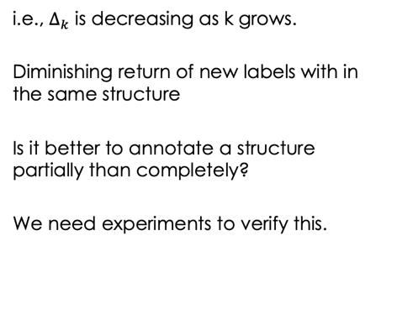
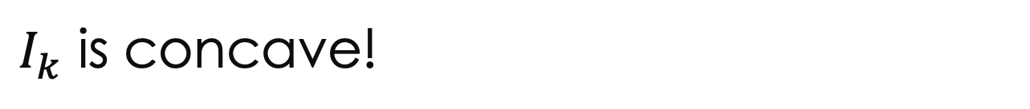

$I_{k}$ is concave!
$$Δ_{k}=I_{k}−I_{k−1} \text{: }\text{The} \text{benefit} \text{of} \text{a} \text{new} \text{label}$$
i.e., $Δ_{k}$ is decreasing as k grows.
Diminishing return of new labels with in the same structure
Is it better to annotate a structure partially than completely?
We need experiments to verify this.
Seq Tagging
Complete
Partial
Supervision from partial structures [NAACL’19]
Notes:
We proved that for these three cases, I_k is concave, or Delta_k is decreasing as k grows. Then we have diminishing return of new labels within the same structure. Because of that, it’s better to annotate a structure partially than completely. At last, the more concave I_k, the strong a structure, and the more benefit partial can bring.
(30 sec)

Slide 110
What’s next
Event
Time
Learning:
standard paradigm
Standard learning (including deep learning) paradigms:
Task
Data
Learn
Task
Data
Learn
Not scalable
Task
Data
Learn
Task
Data
Learn
Task
Data
Learn
Task
Data
Learn
Task
Data
Learn
Task
Data
Learn
Task
Data
Learn
Task
Data
Learn
Task
Data
Learn
Task
Data
Learn
Notes:
Another thread is machine learning. We know the standard learning paradigm, including deep learning, is, given a task, collect data, and learn from the data. Nowadays, we are still in the stage where for each new task, we need a new dataset. And that is simply not scalable. We cannot solve all the tasks in this way.

Slide 111
What’s next
Event
Learning:
incidental supervision
[Roth, AAAI’17]
Time
Incidental supervision is the idea of learning from indirect signals, which may be noisy, partial, or only correlated.
My vision is that situation-level tasks will require gigantic training data, and at that time, incidental supervision will be crucial for them.
Partial
Notes:
Incidental supervision is the general idea of learning from indirect signals, which may be noisy, partial, or only correlated. And my vision is that, many situation-level tasks are highly abstract and require gigantic data for training. At that time, incidental supervision will be crucial. To demonstrate the idea of incidental supervision, next I’m going to talk about a recent paper of mine discussing how to get supervision from partial data.
(future work at each level 2.25 min; future work in total 3.75 min)

