Slide 1




TORQUE: A Reading Comprehension Dataset of Temporal ORdering QUEstions
Qiang Ning, Hao Wu, Rujun Han
Nanyun Peng, Matt Gardner, Dan Roth
Notes:
Hello everyone. My name is Qiang. I’m going to present our new English reading comprehension dataset, TORQUE, focusing on temporal ordering type of questions. This work was done when I was at the Allen Institute for AI, in collaboration with Hooray Data, Plus Lab at UCLA, and Cognitive Computation Group at University of Pennsylvania.
(22’’)

Slide 2
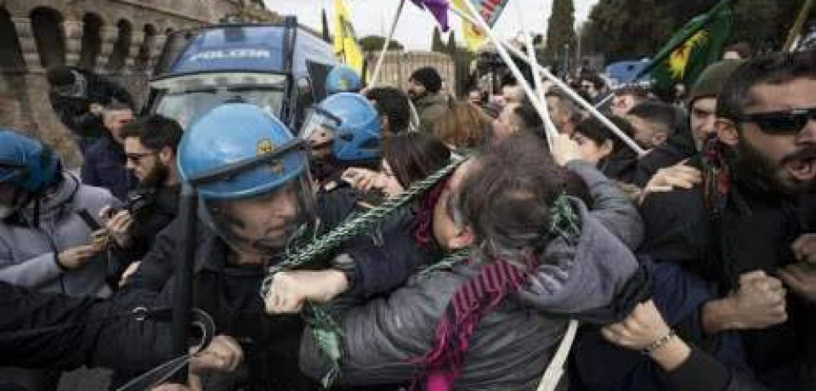
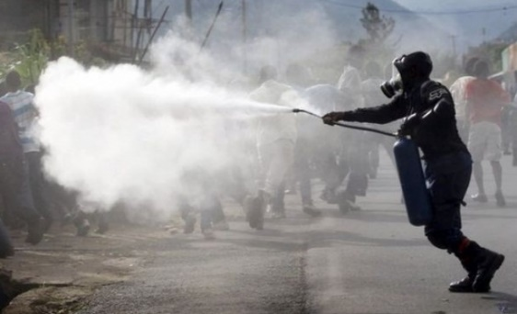
Time is important for story understanding
People were angry
Police used tear gas
Time
People were angry first, and then the police used tear gas.
Notes:
Time is important for story understanding. For instance, let's look at two events: people were angry and police used tear gas. If this is the temporal ordering, people got angry first and followed by tear gas. It leaves us with the impression that people may have turned anger into violence. And that's why tear gas was used.
(22'')

Slide 3
Same events, different temporal ordering
Police used tear gas
People were angry
Time
Police used tear gas first, and then people were angry.
Notes:
However, if we reverse the temporal ordering, then we get a different story, where people were angry at the police because they had used tear gas inappropriately.
(12'')

Slide 4
Same events, different temporal ordering
Police used tear gas
People were angry
Time
This paper studies temporal relationship as a machine reading comprehension (MRC) problem.
Notes:
This paper aims to study this important problem in a machine reading comprehension, MRC, setting, where we present a passage, pose questions about temporal ordering, and then test if a system can answer them. The first question we ask is: Do state-of-the-art machine reading comprehension systems already know time?
(25'')

Slide 5
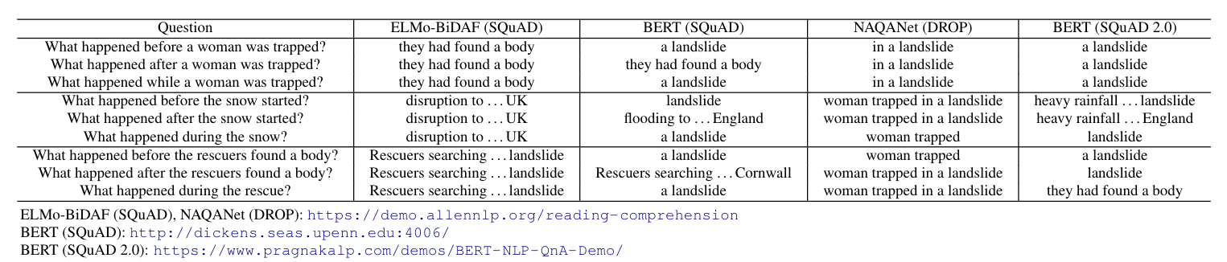
Text: Heavy snow is causing disruption to transport across the UK, with heavy rainfall bringing flooding to the south-west of England. Rescuers searching for a woman trapped in a landslide at her home said they had found a body.
SNOW
LANDSLIDE
TRAPPED
FOUND
SAID
TIME
PRESENT
Existing systems don’t really use “time” to answer these questions.
Notes:
This is an example. (read). This is the timeline for those highlighted events. When we ask questions about temporal orderings to existing MRC systems, we realize that they don't do well. One key problem is that they seem to ignore those key words that define temporal orderings, and thus generating almost the same answers no matter what. In other words, they don't really use "time" to answer these time questions.

Slide 6
Text: Heavy snow is causing disruption to transport across the UK, with heavy rainfall bringing flooding to the south-west of England. Rescuers searching for a woman trapped in a landslide at her home said they had found a body.
SNOW
LANDSLIDE
TRAPPED
FOUND
SAID
TIME
PRESENT
Existing systems don’t really use “time” to answer these questions.
We aim to fix this problem using “TORQUE”
Notes:
This phenomena is quite consistent across multiple systems trained on different datasets. The first step to fix this problem is to collect a dataset dedicated for time, which is the TORQUE dataset we're talking about today.

Slide 7
Challenges
1. Requires event understanding
Text: “Rescuers searching for a woman trapped in a landslide at her home said they had found a body.”
Q1: What was a woman trapped in? A typical SQuAD question that only requires predicate-argument understanding.
Q2: What started before a woman was trapped? This requires event understanding: e.g., “landslide” is an event while “body” is not.

Slide 8
Challenges
2. There are many events in a single passage, and they form a complex temporal structure, such that
One question can have multiple events as answers
Or, it can also have no answers at all
What happened after the landslide? – multiple answers
What happened before the snow started? – no answer
SNOW
LANDSLIDE
TRAPPED
FOUND
SAID
TIME
PRESENT

Slide 9
Challenges
3. Temporal relation questions are often sensitive to a few key words such as “before,” “after,” and “start.”
What happened before the rescuers said something?
What happened after the rescuers said something?
What event started before the rescuers said something?
…
Models that don’t really understand time will perform poorly on these questions

Slide 10
TORQUE: Data collection process
Given a passage, an annotator needs to
Label all the events
Repeat the following steps
Ask a question querying temporal relations
Select all the correct answers from the event list
Slightly perturb the question and answer it
For challenge1
For challenge2
For challenge3
Notes:
The data collection process for TORQUE was as follows. (read). As you can see, these steps were designed to handle the aforementioned challenges correspondingly.

Slide 11
TORQUE
Heavy snow is causing disruption to transport across the UK, with heavy rainfall bringing flooding to the south-west of England. Rescuers searching for a woman trapped in a landslide at her home said they had found a body.
The loan may be extended by the McAlpine group for an additional year with an increase in the conversion price to $2.50 a share. The sale of shares to the McAlpine family along with the recent sale of 750,000 shares of Meridian stock to Haden MacLellan Holding PLC of Surrey, England and a recent public offering have increased Meridian's net worth to $8.5 million, said William Feniger, chief executive officer of Toledo, Ohio-based Meridian.
This time, however, some analysts think he could face a real battle. "Without some unexpected coup de theatre, I don't see what will block the Paribas bid," said Philippe de Cholet, analyst at the brokerage Cholet-Dupont amp Cie. Mr. de Cholet said Mr. Fournier's biggest hope was to somehow persuade regulatory authorities to block the bid.
Notes:
We took passages from English news articles. We recruited crowd workers from Amazon Mechanical Turk, and had them ask questions about temporal relations, and had them answer these questions as well.

Slide 12
TORQUE
3.2k passages from the 2.8k articles in TempEval3
Heavy snow is causing disruption to transport across the UK, with heavy rainfall bringing flooding to the south-west of England. Rescuers searching for a woman trapped in a landslide at her home said they had found a body.
The loan may be extended by the McAlpine group for an additional year with an increase in the conversion price to $2.50 a share. The sale of shares to the McAlpine family along with the recent sale of 750,000 shares of Meridian stock to Haden MacLellan Holding PLC of Surrey, England and a recent public offering have increased Meridian's net worth to $8.5 million, said William Feniger, chief executive officer of Toledo, Ohio-based Meridian.
This time, however, some analysts think he could face a real battle. "Without some unexpected coup de theatre, I don't see what will block the Paribas bid," said Philippe de Cholet, analyst at the brokerage Cholet-Dupont amp Cie. Mr. de Cholet said Mr. Fournier's biggest hope was to somehow persuade regulatory authorities to block the bid.
Notes:
Specifically,

Slide 13
TORQUE
3.2k passages from the 2.8k articles in TempEval3
Two sentences per passage
50 tokens per passage
Heavy snow is causing disruption to transport across the UK, with heavy rainfall bringing flooding to the south-west of England. Rescuers searching for a woman trapped in a landslide at her home said they had found a body.
The loan may be extended by the McAlpine group for an additional year with an increase in the conversion price to $2.50 a share. The sale of shares to the McAlpine family along with the recent sale of 750,000 shares of Meridian stock to Haden MacLellan Holding PLC of Surrey, England and a recent public offering have increased Meridian's net worth to $8.5 million, said William Feniger, chief executive officer of Toledo, Ohio-based Meridian.
This time, however, some analysts think he could face a real battle. "Without some unexpected coup de theatre, I don't see what will block the Paribas bid," said Philippe de Cholet, analyst at the brokerage Cholet-Dupont amp Cie. Mr. de Cholet said Mr. Fournier's biggest hope was to somehow persuade regulatory authorities to block the bid.

Slide 14
TORQUE
3.2k passages from the 2.8k articles in TempEval3
Two sentences per passage
50 tokens per passage
24.9k events
Heavy snow is causing disruption to transport across the UK, with heavy rainfall bringing flooding to the south-west of England. Rescuers searching for a woman trapped in a landslide at her home said they had found a body.
The loan may be extended by the McAlpine group for an additional year with an increase in the conversion price to $2.50 a share. The sale of shares to the McAlpine family along with the recent sale of 750,000 shares of Meridian stock to Haden MacLellan Holding PLC of Surrey, England and a recent public offering have increased Meridian's net worth to $8.5 million, said William Feniger, chief executive officer of Toledo, Ohio-based Meridian.
This time, however, some analysts think he could face a real battle. "Without some unexpected coup de theatre, I don't see what will block the Paribas bid," said Philippe de Cholet, analyst at the brokerage Cholet-Dupont amp Cie. Mr. de Cholet said Mr. Fournier's biggest hope was to somehow persuade regulatory authorities to block the bid.

Slide 15
TORQUE
3.2k passages from the 2.8k articles in TempEval3
Two sentences per passage
50 tokens per passage
24.9k events
Heavy snow is causing disruption to transport across the UK, with heavy rainfall bringing flooding to the south-west of England. Rescuers searching for a woman trapped in a landslide at her home said they had found a body.
Q1: What event has already finished?
Q2: What event has begun but has not finished?
Q3: What will happen in the future?
For each passage, we have
- 3 hard-coded questions
Hard-coded questions
Q4: What happened before a woman was trapped?
Q5: What had started before a woman was trapped?
Q6: What happened while a woman was trapped?
Q7: What happened after a woman was trapped?
- on average, 7 user-generated questions
Q8: What happened at about the same time as the snow?
Q9: What happened after the snow started?
Q10: What happened before the snow started?
User-provided

Slide 16
TORQUE
3.2k passages from the 2.8k articles in TempEval3
Two sentences per passage
50 tokens per passage
24.9k events
Heavy snow is causing disruption to transport across the UK, with heavy rainfall bringing flooding to the south-west of England. Rescuers searching for a woman trapped in a landslide at her home said they had found a body.
Q1: What event has already finished?
Q2: What event has begun but has not finished?
Q3: What will happen in the future?
For each passage, we have
- 3 hard-coded questions
Hard-coded questions
Q4: What happened before a woman was trapped?
Q5: What had started before a woman was trapped?
Q6: What happened while a woman was trapped?
Q7: What happened after a woman was trapped?
- on average, 7 user-generated questions
Group of contrast questions
- Grouped as contrast sets
Q8: What happened at about the same time as the snow?
Q9: What happened after the snow started?
Q10: What happened before the snow started?
Group of contrast questions

Slide 17
TORQUE
3.2k passages from the 2.8k articles in TempEval3
Two sentences per passage
50 tokens per passage
24.9k events
Heavy snow is causing disruption to transport across the UK, with heavy rainfall bringing flooding to the south-west of England. Rescuers searching for a woman trapped in a landslide at her home said they had found a body.
Q1: What event has already finished?
A: searching trapped landslide said found
Q2: What event has begun but has not finished?
A: snow causing disruption rainfall bringing flooding
Q3: What will happen in the future?
A: No answers.
For each passage, we have
- 3 hard-coded questions
Hard-coded questions
Q4: What happened before a woman was trapped?
A: landslide
Q5: What had started before a woman was trapped?
A: snow rainfall landslide
Q6: What happened while a woman was trapped?
A: searching
Q7: What happened after a woman was trapped?
A: searching said found
- on average, 7 user-generated questions
Group of contrast questions
- Grouped as contrast sets
Q8: What happened at about the same time as the snow?
A: rainfall
Q9: What happened after the snow started?
A: causing disruption bringing flooding searching trapped landslide said found
Q10: What happened before the snow started?
A: No answers.
- $15k on MTurk ($0.7 per QA pair)
Group of contrast questions
Notes:
6'30''

Slide 18
TORQUE: Data collection process
Given a passage, an annotator needs to
Label all the events
Repeat the following steps
Ask a question querying temporal relations
Select all the correct answers from the event list
Slightly perturb the question and answer it
Notes:
This was the data collection steps we just saw.

Slide 19
TORQUE: Data collection process
Given a passage, an annotator needs to
Label all the events
Repeat the following steps
Ask a question querying temporal relations
Select all the correct answers from the event list
Slightly perturb the question and answer it
Largely followed prior works, e.g., TempEval, RED, & MATRES (see paper for details)
Notes:
There’re several key concepts: what is an event, what’s a valid question in TORQUE, how to answer these questions, and how to perturb questions to create contrast sets. As for events, we have largely followed prior works: an event is a single token of a verb or a noun that triggers an action or state. Please see our paper for more explanations on that. Next, we’ll describe the other 3 concepts.

Slide 20
Questions querying temporal relations
A temporal relation can be represented as a triplet: (Event A, Relation r, Event B)
A valid question is: (?, r, B)
What happened after B?
Perturbation: (?, r’, B)
What happened before/while …?
What had begun before B?
What happened before B finished?
…
Notes:
There’re two important concepts for TORQUE. First, what do we mean by a temporal relation question. A temporal relationship is a triplet of event A, relation r, and event B. There are many ways to ask temporal relation questions, and we choose those questions that are querying one of the events in TORQUE. By perturbation, we mean, keep the event in the original question, but slightly change the relation type. For instance, …

Slide 21
How to Answer These Questions
Must choose from the list of events
Must choose all the correct answers
Answer from the time point when the passage was written.
Notes:
The second important concept for understanding TORQUE is how to answer those questions. We have three guidelines here.

Slide 22
TORQUE: Data collection process
Given a passage, an annotator needs to
Label all the events
Repeat the following steps
Ask a question querying temporal relations
Select all the correct answers from the event list
Slightly perturb the question and answer it
Please check the paper & the actual annotation guidelines at https://qatmr-qualification.github.io/
Annotation interface: https://qatmr.github.io/

Slide 23
Advantages of QA as a format
1. Handle fuzzy relations
Fuzzy relations
Heavy snow is causing disruption to transport across the UK, with heavy rainfall bringing flooding to the south-west of England.
Q: What happens at about the same time as the disruption?
A: flooding
Notes:
One advantage of using QA to label temporal relations is that it handles fuzzy relations more easily. For instance, in this text, (read), the relation between disruption and flooding is vague, but we can say it’s about the same time.
(38'')

Slide 24
Advantages of QA as a format
2. Handle events in different modalities
Events in different modes
The lion had a large meal and slept for 24 hours.
[Negated] The lion didn’t sleep after having a large meal.
[Uncertain] The lion may have had a large meal before sleeping.
[Hypothetical] If the lion has a large meal, it will sleep for 24 hours.
[Repetitive] The lion used to sleep for 24 hours after having large meals.
[Generic] After having a large meal, lions may sleep longer.
Notes:
the 2nd benefit is that we can easily handle different modalities. Here's a sentence, read, we have converted it into different modes. For instance, didn't is negation, may is uncertainty, etc.

Slide 25
Advantages of QA as a format
2. Handle events in different modalities
Questions that query events in different modes
[Negated] What didn’t the lion do after a large meal?
[Uncertain] What might the lion do before sleeping?
[Hypothetical] What will the lion do if it has a large meal?
[Repetitive] What did the lion use to do after large meals?
[Generic] What do lions do after a large meal?
Notes:
These phenomena can be captured by natural language questions easily. For instance, what didn't, what might, etc. This is not surprising because after all, these phenomena were described in natural language in the first place.
1'

Slide 26
Advantages of QA as a format
3. Prior formalisms had a major issue with defining when two events should have a relation.
e.g., TimeBank, TimeBank-dense, VerbClause, RED, and MATRES
In TORQUE, the format of QA naturally bypasses this issue – we don’t need to teach annotators these linguistic formalisms.
Notes:
40''

Slide 27
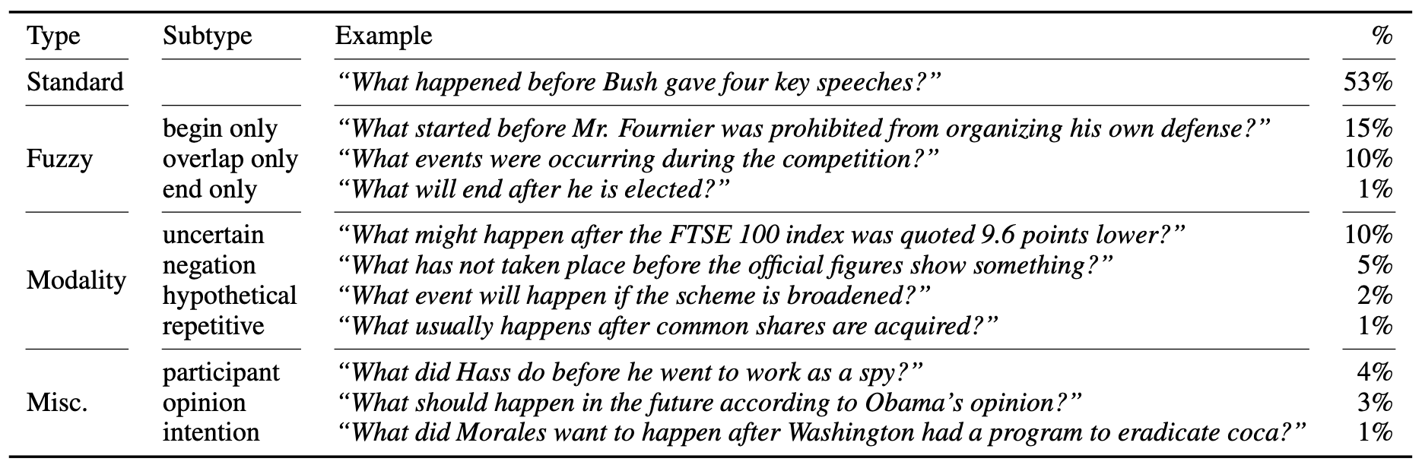
Temporal phenomena in TORQUE
By manually checking a sample of 200 questions, we have the following categorization on their temporal phenomena (some questions can have multiple types):

Slide 28
Experiment
Setup:
Given a passage and a question,
model looks at every token in the passage
makes a binary classification of whether this token is an answer to the question or not
Model:
One-layered perceptron on top of RoBERTa
Split:
Train 80%, dev 5%, test 15%
Dev & test are provided by 5/3 different annotators on their events/answers
Notes:
We did some baseline experiments on TORQUE. The setup was as follows.
40''

Slide 29
Experiment
Human F1
Human EM
Human C
F1 & EM: standard metrics when there’re multiple reference answers
C (consistency) is the percentage of contrast groups for which a model’s predictions have F1>=80% for all questions in a group
Notes:
This is the system performance as compared to human performance. First, we can see as we increased the training set from 50% to 100%, system performance didn’t improve much, which means the key problem is not lack of data anymore and we should study better modeling techniques now. We used three metrics, F1, EM, and consistency. F1 and EM are … Consistency is …. Since the three metrics are getting more and more strict, we can see both human performance and system performance are also lower and lower as we change metrics, but human performance is much more robust and only dropped a few points when switching from EM to consistency. Overall, RoBERTa is behind human performance by a large margin.
(1'11'')

Slide 30
Summary
Time is important in stories
but existing machine reading comprehension datasets don’t cover these phenomena.
TORQUE is a new crowdsourced dataset
on 3k English news snippets
with 10k hard-coded questions and 21k human-generated questions
TORQUE is challenging and RoBERTa is behind human performance by a large margin
Please visit https://allennlp.org/torque.html for dataset, leaderboard, and our annotation tools.
Notes:
37''

