Slide 1
A Brief Intro To BERT
Qiang Ning
Presented at the C3SR weekly meeting
03/05/2019

Slide 2

Roadmap Of Language Modeling
$$P\left(w_{1},w_{2},w_{3},…,w_{t}\right)=?$$
LM
Curse of dimensionality
N-gram
Distributional vectors
SVD
(LSA: Boulder, 97)
(LDA: Berkeley, 03)
Feed-forward neural net
(Bengio, 03)
RNN/LSTM
(Mikolov, 10)
Transformers
(OpenAI, 18)
Contextualization
Computationally slow
ELMo
(AI2&UW, 18)
Word2vec
(Google,13)
True bidirectional?
Computationally fast
CBOW
Skip gram
BERT
(Google, 18)
Global skip-gram
subword
GloVe
(Stanford, 14)
FastText
(FB, 16)
…

Slide 3
Roadmap Of Language Modeling
$$P\left(w_{1},w_{2},w_{3},…,w_{t}\right)=?$$
LM
Curse of dimensionality
N-gram
Distributional vectors
$$P\left(w_{1},w_{2},w_{3}\right)=P\left(w_{1}\right)P\left(w_{2} | w_{1}\right)P(w_{3}|w_{2})$$
SVD
(LSA: Boulder, 97)
(LDA: Berkeley, 03)
Feed-forward neural net
(Bengio, 03)
RNN/LSTM
(Mikolov, 10)
Transformers
(OpenAI, 18)
Contextualization
Computationally slow
ELMo
(AI2&UW, 18)
Word2vec
(Google,13)
True bidirectional?
Computationally fast
CBOW
Skip gram
BERT
(Google, 18)
Global skip-gram
subword
GloVe
(Stanford, 14)
FastText
(FB, 16)
…

Slide 4
Roadmap Of Language Modeling
$$P\left(w_{1},w_{2},w_{3},…,w_{t}\right)=?$$
LM
Curse of dimensionality
Can generalize to unseen sequences
“A cat is walking in the room.”
“A dog is walking in the room.”
“A dog is running in the kitchen.”
…
N-gram
Distributional vectors
SVD
(LSA: Boulder, 97)
(LDA: Berkeley, 03)
Feed-forward neural net
(Bengio, 03)
RNN/LSTM
(Mikolov, 10)
Transformers
(OpenAI, 18)
Contextualization
Computationally slow
ELMo
(AI2&UW, 18)
Word2vec
(Google,13)
True bidirectional?
Computationally fast
CBOW
Skip gram
BERT
(Google, 18)
Global skip-gram
subword
GloVe
(Stanford, 14)
FastText
(FB, 16)
…

Slide 5
Roadmap Of Language Modeling
$$P\left(w_{1},w_{2},w_{3},…,w_{t}\right)=?$$
LM
Curse of dimensionality
N-gram
Distributional vectors
SVD
(LSA: Boulder, 97)
(LDA: Berkeley, 03)
Feed-forward neural net
(Bengio, 03)
RNN/LSTM
(Mikolov, 10)
Transformers
(OpenAI, 18)
Contextualization
[A_{ij}]: word i appearing in doc j
Computationally slow
ELMo
(AI2&UW, 18)
Word2vec
(Google,13)
True bidirectional?
Computationally fast
CBOW
Skip gram
BERT
(Google, 18)
Global skip-gram
subword
GloVe
(Stanford, 14)
FastText
(FB, 16)
…

Slide 6
Roadmap Of Language Modeling
$$P\left(w_{1},w_{2},w_{3},…,w_{t}\right)=?$$
LM
Curse of dimensionality
N-gram
Distributional vectors
SVD
(LSA: Boulder, 97)
(LDA: Berkeley, 03)
Feed-forward neural net
(Bengio, 03)
RNN/LSTM
(Mikolov, 10)
Transformers
(OpenAI, 18)
Contextualization
Computationally slow
ELMo
(AI2&UW, 18)
Word2vec
(Google,13)
True bidirectional?
Computationally fast
CBOW
Skip gram
BERT
(Google, 18)
Global skip-gram
subword
GloVe
(Stanford, 14)
FastText
(FB, 16)
…

Slide 7
Roadmap Of Language Modeling
$$P\left(w_{1},w_{2},w_{3},…,w_{t}\right)=?$$
LM
Curse of dimensionality
N-gram
Distributional vectors
SVD
(LSA: Boulder, 97)
(LDA: Berkeley, 03)
Feed-forward neural net
(Bengio, 03)
RNN/LSTM
(Mikolov, 10)
Transformers
(OpenAI, 18)
Contextualization
Computationally slow
ELMo
(AI2&UW, 18)
Word2vec
(Google,13)
True bidirectional?
Computationally fast
CBOW
Skip gram
BERT
(Google, 18)
Global skip-gram
subword
GloVe
(Stanford, 14)
FastText
(FB, 16)
…

Slide 8
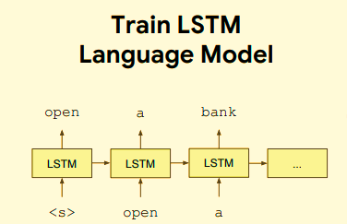
Roadmap Of Language Modeling
$$P\left(w_{1},w_{2},w_{3},…,w_{t}\right)=?$$
LM
Curse of dimensionality
N-gram
Distributional vectors
SVD
(LSA: Boulder, 97)
(LDA: Berkeley, 03)
Feed-forward neural net
(Bengio, 03)
RNN/LSTM
(Mikolov, 10)
Transformers
(OpenAI, 18)
Contextualization
Computationally slow
ELMo
(AI2&UW, 18)
Word2vec
(Google,13)
True bidirectional?
Computationally fast
CBOW
Skip gram
BERT
(Google, 18)
Global skip-gram
subword
GloVe
(Stanford, 14)
FastText
(FB, 16)
…

Slide 9
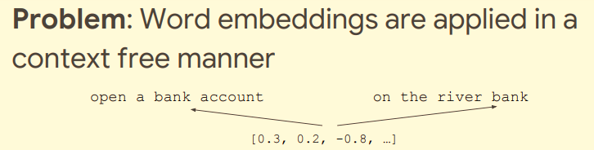
Roadmap Of Language Modeling
$$P\left(w_{1},w_{2},w_{3},…,w_{t}\right)=?$$
LM
Curse of dimensionality
N-gram
Distributional vectors
SVD
(LSA: Boulder, 97)
(LDA: Berkeley, 03)
Feed-forward neural net
(Bengio, 03)
RNN/LSTM
(Mikolov, 10)
Transformers
(OpenAI, 18)
Contextualization
Computationally slow
ELMo
(AI2&UW, 18)
Word2vec
(Google,13)
True bidirectional?
Computationally fast
CBOW
Skip gram
BERT
(Google, 18)
Global skip-gram
subword
GloVe
(Stanford, 14)
FastText
(FB, 16)
…

Slide 10
Roadmap Of Language Modeling
$$P\left(w_{1},w_{2},w_{3},…,w_{t}\right)=?$$
LM
Curse of dimensionality
N-gram
Distributional vectors
SVD
(LSA: Boulder, 97)
(LDA: Berkeley, 03)
Feed-forward neural net
(Bengio, 03)
RNN/LSTM
(Mikolov, 10)
Transformers
(OpenAI, 18)
Contextualization
Computationally slow
ELMo
(AI2&UW, 18)
Word2vec
(Google,13)
True bidirectional?
Computationally fast
CBOW
Skip gram
BERT
(Google, 18)
Global skip-gram
subword
GloVe
(Stanford, 14)
FastText
(FB, 16)
…

Slide 11
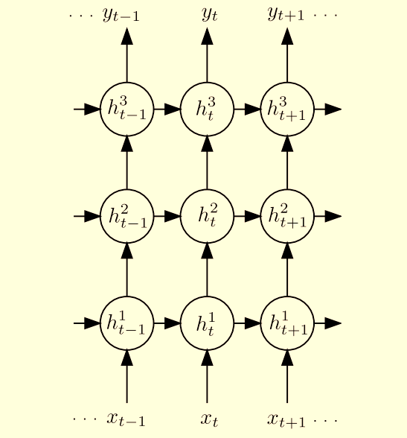
Roadmap Of Language Modeling
$$P\left(w_{1},w_{2},w_{3},…,w_{t}\right)=?$$
LM
Curse of dimensionality
N-gram
Distributional vectors
SVD
(LSA: Boulder, 97)
(LDA: Berkeley, 03)
Feed-forward neural net
(Bengio, 03)
RNN/LSTM
(Mikolov, 10)
Transformers
(OpenAI, 18)
Contextualization
Computationally slow
ELMo
(AI2&UW, 18)
Word2vec
(Google,13)
True bidirectional?
Computationally fast
CBOW
Skip gram
BERT
(Google, 18)
Global skip-gram
subword
We have been using this layer.
GloVe
(Stanford, 14)
FastText
(FB, 16)
…

Slide 12
Roadmap Of Language Modeling
$$P\left(w_{1},w_{2},w_{3},…,w_{t}\right)=?$$
LM
Curse of dimensionality
N-gram
Distributional vectors
SVD
(LSA: Boulder, 97)
(LDA: Berkeley, 03)
Feed-forward neural net
(Bengio, 03)
RNN/LSTM
(Mikolov, 10)
Transformers
(OpenAI, 18)
Contextualization
Computationally slow
Higher levers are contextualized!
ELMo
(AI2&UW, 18)
Word2vec
(Google,13)
True bidirectional?
Computationally fast
CBOW
Skip gram
BERT
(Google, 18)
Global skip-gram
subword
GloVe
(Stanford, 14)
FastText
(FB, 16)
…

Slide 13
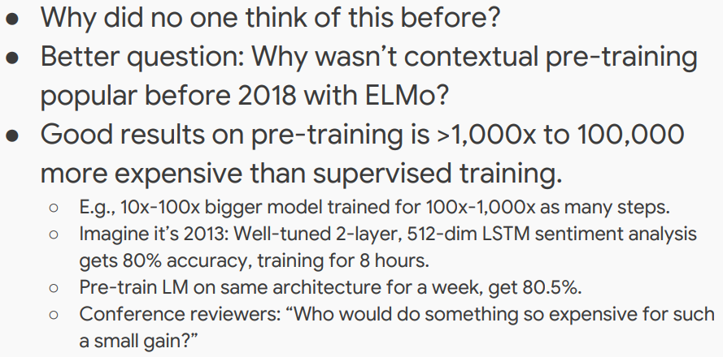
It Looks Naïve?

Slide 14
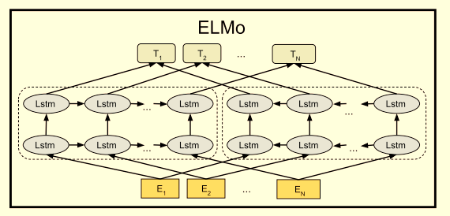
Roadmap Of Language Modeling
$$P\left(w_{1},w_{2},w_{3},…,w_{t}\right)=?$$
LM
Curse of dimensionality
N-gram
Distributional vectors
SVD
(LSA: Boulder, 97)
(LDA: Berkeley, 03)
Feed-forward neural net
(Bengio, 03)
RNN/LSTM
(Mikolov, 10)
Transformers
(OpenAI, 18)
Contextualization
Computationally slow
ELMo
(AI2&UW, 18)
Word2vec
(Google,13)
True bidirectional?
Computationally fast
CBOW
Skip gram
BERT
(Google, 18)
Global skip-gram
subword
Is it really bidirectional? Think of multiple layers.
GloVe
(Stanford, 14)
FastText
(FB, 16)
…

Slide 15
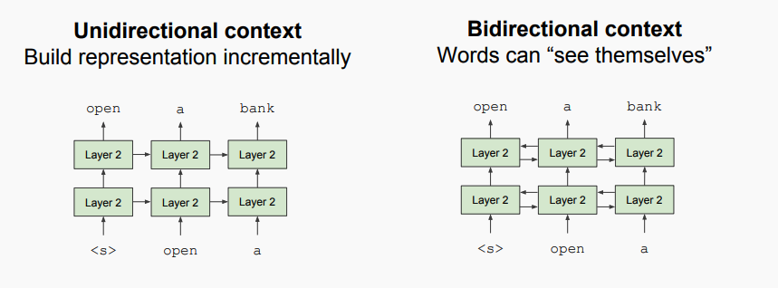
Why Can We Not Do True Bidirectional (Using LSTM)?

Slide 16
Why Can We Not Do True Bidirectional (Using LSTM)?
Assume we want to predict “a” when we see “open” [left to right]
But the layer above “open” has information about “a” from [right to left]

Slide 17
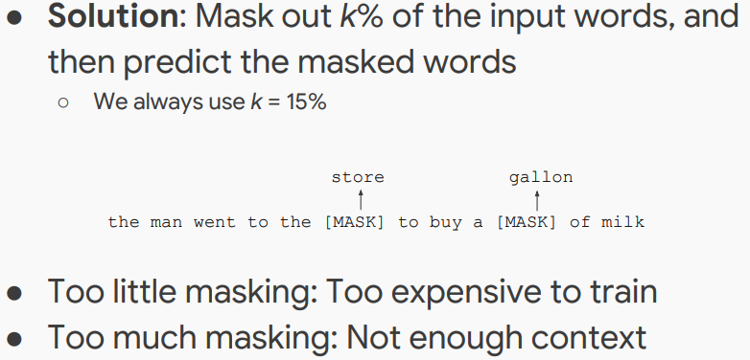
Solution

Slide 18
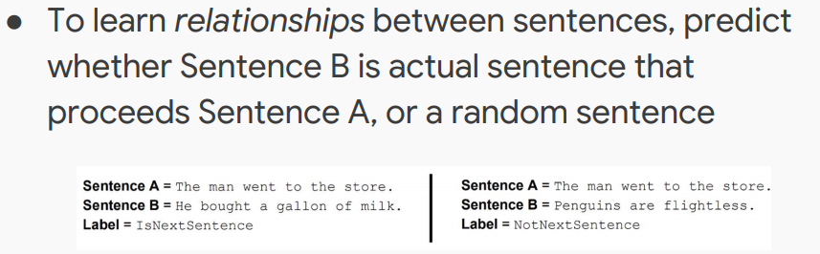
In Addition To Mask LM: Next Sentence Prediction
To summarize what we have seen so far, BERT improves over previous methods by introducing “real” bidirectionality via mask LM, and on top of that, BERT further uses a multi-task learning setup to predict the relation between two adjacent sentences.
How is it implemented?--Transformers

Slide 19
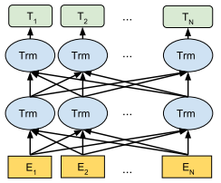
In Addition To Mask LM: Next Sentence Prediction
To summarize what we have seen so far, BERT improves over previous methods by introducing “real” bidirectionality via mask LM, and on top of that, BERT further uses a multi-task learning setup to predict the relation between two adjacent sentences.
How is it implemented?--Transformers

Slide 20
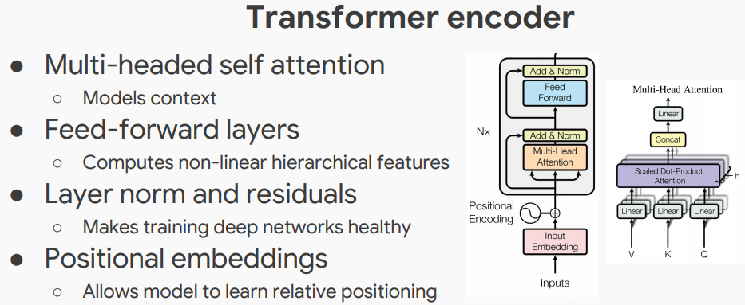
Transformers

Slide 21
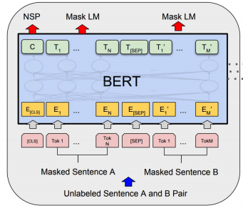
Overview
NSP: Next sentence prediction

Slide 22
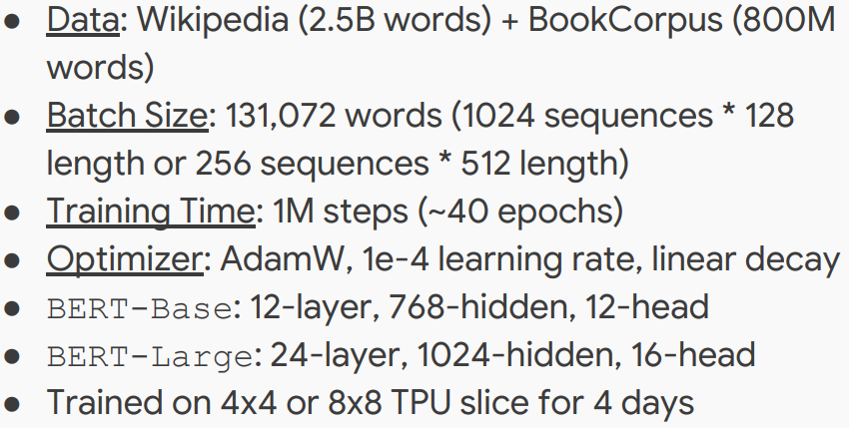
Training Details

Slide 23
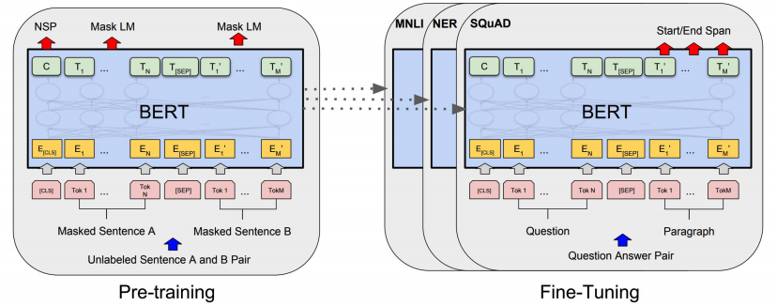
Fine-Tuning

Slide 24
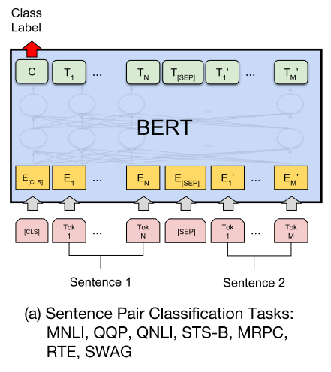

Slide 25
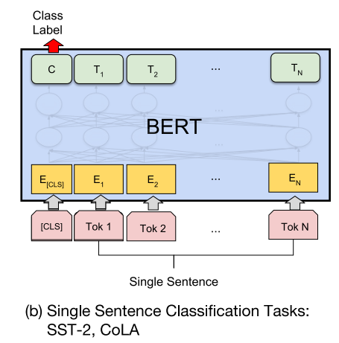
sentiment
Linguistically acceptable

Slide 26
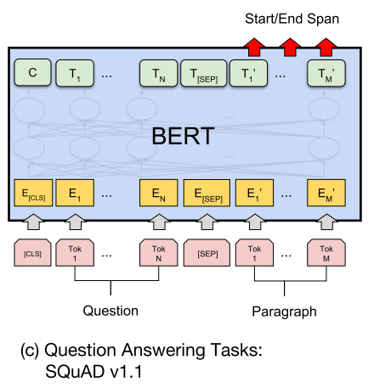
Learning a start and end vector from T_{i}

Slide 27
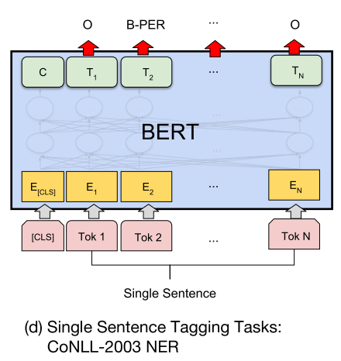

Slide 28
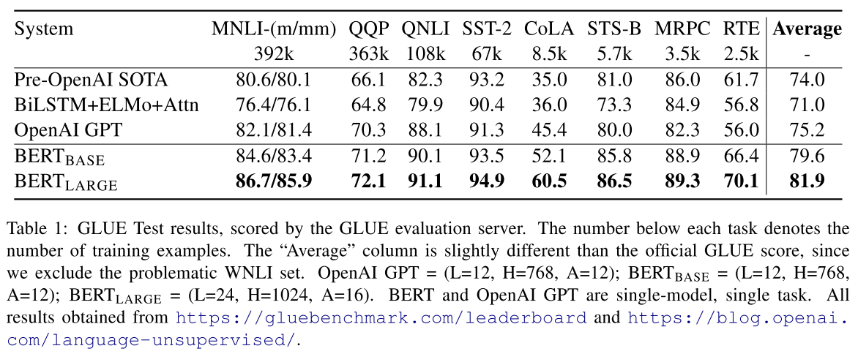
Tasks That Are Significantly Improved By BERT

Slide 29
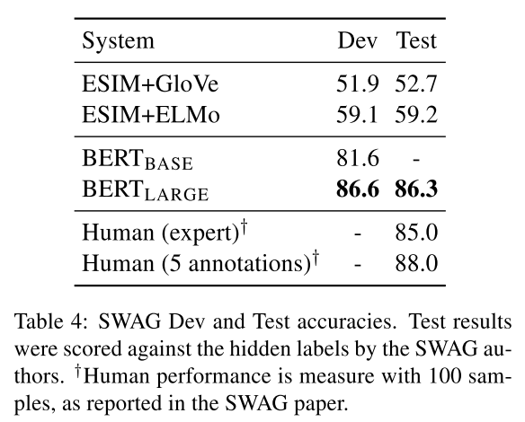
Tasks That Are Significantly Improved By BERT

Slide 30
Resources
BERT [paper]: https://arxiv.org/abs/1810.04805
BERT [presentation]: https://nlp.stanford.edu/seminar/details/jdevlin.pdf
Transformers [blog]: http://jalammar.github.io/illustrated-transformer/
Mask LM Demo By CogComp: http://orwell.seas.upenn.edu:4001/

