Slide 1
Course introduction
EY Random Demonstration
00 of 00
Notes:
Scripts with audio: EY/Random is a number generating software program used to select sampling units to test where the sample size has been determined using a random, discovery or judgmental sampling technique. We can use EY/Random to select our sampling units to test if the population is available as a list of items or in electronic format. This video demonstrates how to select samples with EY Random.
When executing your substantive testing procedures, you have determined your sample size and now need to pick your sample. You can use EY Random to pick your sample. EY Random can also be used in test of controls to select a random population throughout the year to test.
JP – That is set up pretty strongly right before so I did not include it. But I will add it so it can stand on its own.

Slide 2

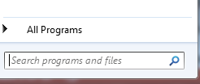
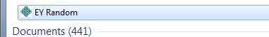
Course introduction
00 of 00
Notes:
Scripts with audio:
EY Random is already included on your PC. Simply go to Start > Search programs & files > and type EY Random. Then click on EY Random.
Note to GSS:

Slide 3
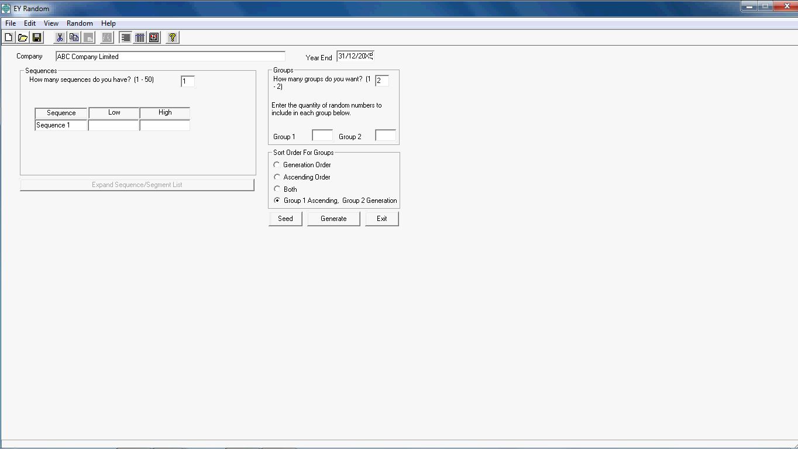
Course introduction
00 of 00
Notes:
Scripts with audio: EY Random will open to the home screen, which displays a form you must fill out in order to for the tool to select your sample. Let’s review the inputs together.
First, input the entity name and audit period end. For our example, the name of our company is ABC Company and the year end is the 31st of December, 2015.

Slide 4
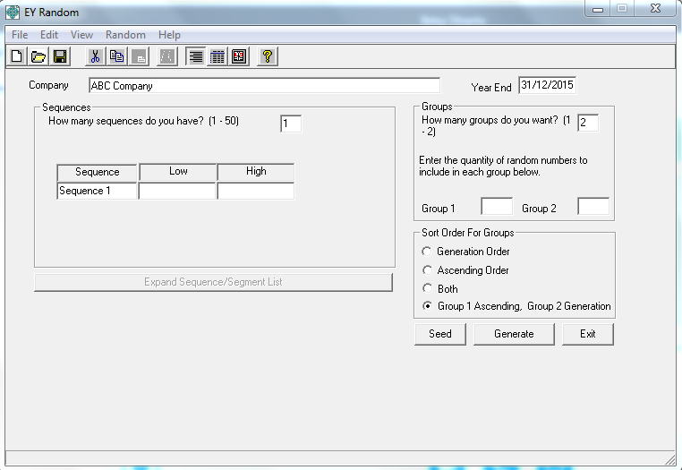
Course introduction
00 of 00
Notes:
Scripts with audio: Based on the results of our EY/MicroSTART, we will use EY Random to pick a representative sample of 25 items from the total population of 1,345 items. Note that EY Random is not only used to pick samples from EY MicroSTART, it can also be used to select unbiased sample for selections from the income statement tables, judgmental samples, or test of controls samples.
Since we have one population listing, we only have one sequence. Thus, will input one sequence in this box. At the end, we will look at an example where we input multiple sequences.

Slide 5
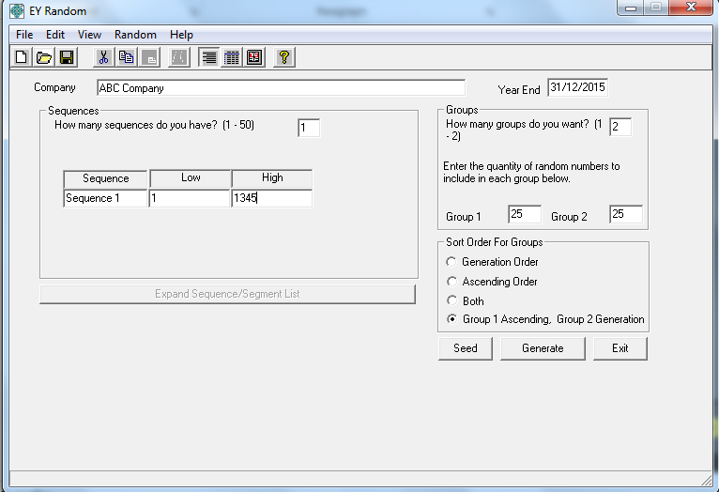
Course introduction
00 of 00
Notes:
Scripts with audio:
Since the population is included in listing, we enter in the number of items on that listing, which starts at 1 and ends on line 1345.

Slide 6
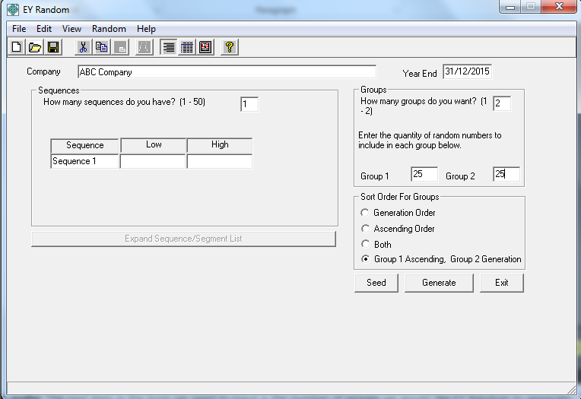
Course introduction
00 of 00
Notes:
Scripts with audio: The next item in the form we need to input is the number of groups we would like EY Random to generate. Often times, we would generate 2 groups when running a Random. We do this because sometimes, the samples in group 1 are not representative of the population. For example, if we neglected to remove credit balances from an accounts receivable listing and Random picked that item to confirm. In that situation, we would likely want to replace that selection with an actual debit balance which we can confirm. If we have two groups, we will not have to re-run the random in order to make additional selections as we already have another group to choose from.
So for our example, we tell Random we want 25 random numbers in both Group 1 and Group 2.

Slide 7
Course introduction
00 of 00
Notes:
Scripts with audio: The last step after you input the information for your groupings is to select the sort order for your groups. The default selection is “Group 1 Ascending, Group 2 Generation”. This means that your selections for group 1 will be in ascending order, and the selections for group 2 will be in generation order. Selecting Group 1 to be in ascending order is chosen most often as it is efficient to locate our sample items when numbers are listed sequentially from lowest to highest.
For our example, we’ll keep this select for our sort order.

Slide 8
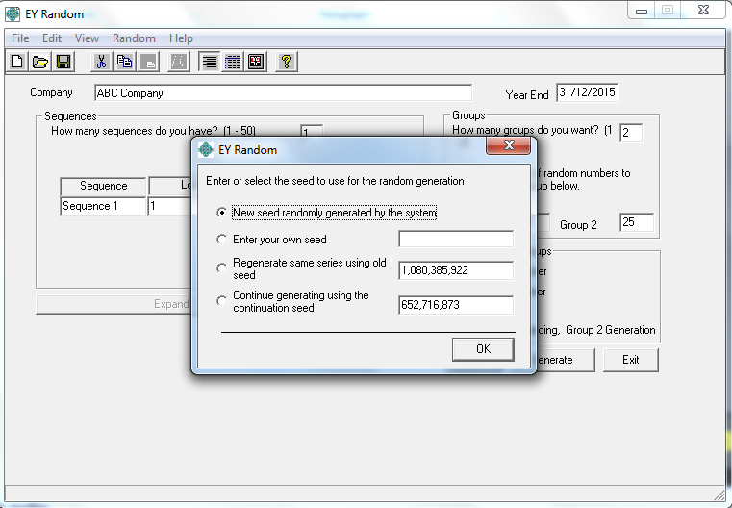
Course introduction
00 of 00
Notes:
Scripts with audio:
One additional option is the seed value. This value is a number assigned to the specific random you are generating. You need this seed value to continue a random number generate from a previous series. For example, if you only selected 5 numbers to be randomly generated on Group 2 but need to replace 7 selections, you can use the seed number to generate the same random sample but increase the number of items in Group 2 from 5 to 7. Random would generate the exact same results for the first 5 items and would get you 2 additional random numbers in Group 2.
Since this is the first time we’re generating our random selections, we will keep the default selection “New seed randomly generated by the system” and click “OK”.

Slide 9
Course introduction
00 of 00
Notes:
Scripts with audio: Now its time to generate your random selections. Click “Generate”.

Slide 10
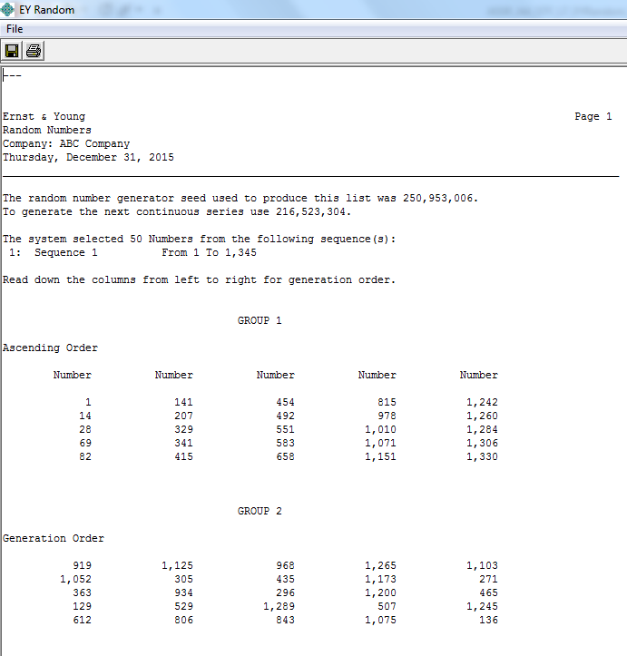
Course introduction
00 of 00
Notes:
Scripts with audio: This is the report with our results based on our inputs. We can see Group 1 is presented in ascending order and Group 2 is presented in generation order. And each group has a total of 25 numbers for our sample.
We can also find the seed of this sample set is “250,953,006” which we can use to regenerate the same result if needed.
So we would now go to our population listing and select the 1st item, then the 14th and so on. But before we leave Random to start making selections, we need to save our results.

Slide 11
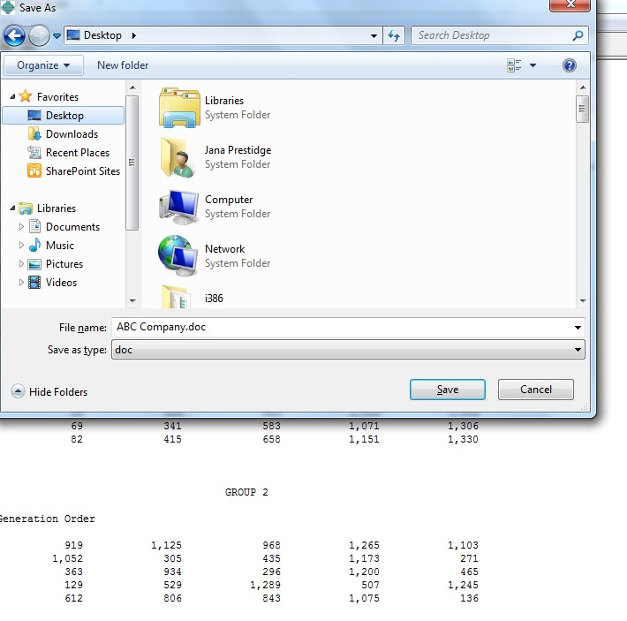
Course introduction
00 of 00
Notes:
Scripts with audio: To save the results, click on the tab with symbol of “Save”

Slide 12
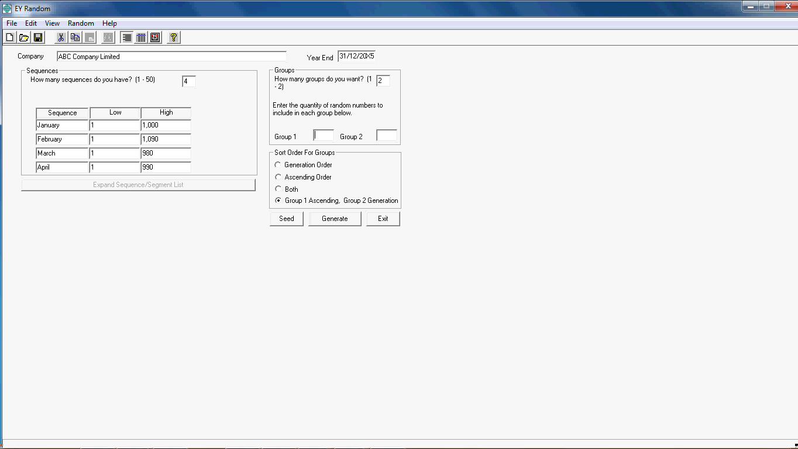
Course introduction
00 of 00
Notes:
Scripts with audio: Let’s change the scenario a bit and go through another example. Instead of having one population listing like in the previous example, we need to select 25 samples from a population of transactions that occurred from January through April that are documented in 4 different monthly spreadsheets. So we will have 4 sequences of items from which to select.
So, we enter 4 for the number of sequences. Then, for each sequence, we enter the number of transactions or line items included in each listing; 1000 for January, 1,090 for February, 980 for March, and 990 for April.

Slide 13

Course introduction
00 of 00
Notes:
Scripts with audio: Again, we will have EY Random generate 2 groups with 25 selections each.
Then input numbers of samples for “Group 1” and “Group 2”.

Slide 14
Course introduction
00 of 00
Notes:
Scripts with audio: We will use the default selection of “Group 1 Ascending, Group 2 Generation”.

Slide 15
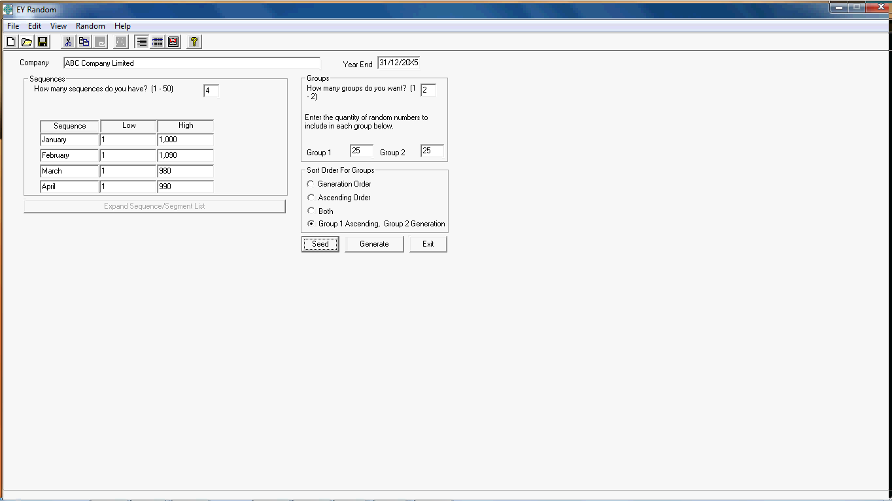
Course introduction
00 of 00
Notes:
Scripts with audio: Click on “Generate” and then we will have the samples.

Slide 16
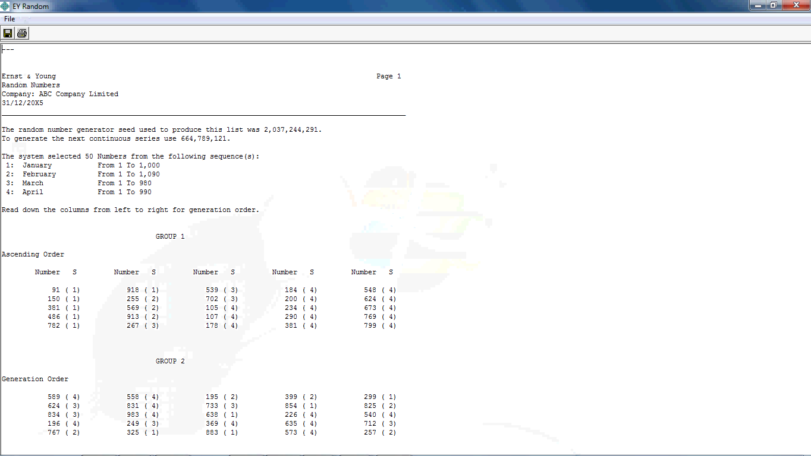
Course introduction
00 of 00
Notes:
Scripts with audio: We can see that Group 1 is presented in ascending order and Group 2 is presented in generation order.
If you look closer, the random numbers are allocated to each sequence or listing based on the number in the parenthesis. For example, the first item to select is number 91 on the first sequence. In the far right hand column, you should also be picking the 548’th item in the fourth sequence.
If necessary, you can also find the seed value of this sample set, “2,037,244,291” which we can use to regenerate the same results if needed.

Slide 17
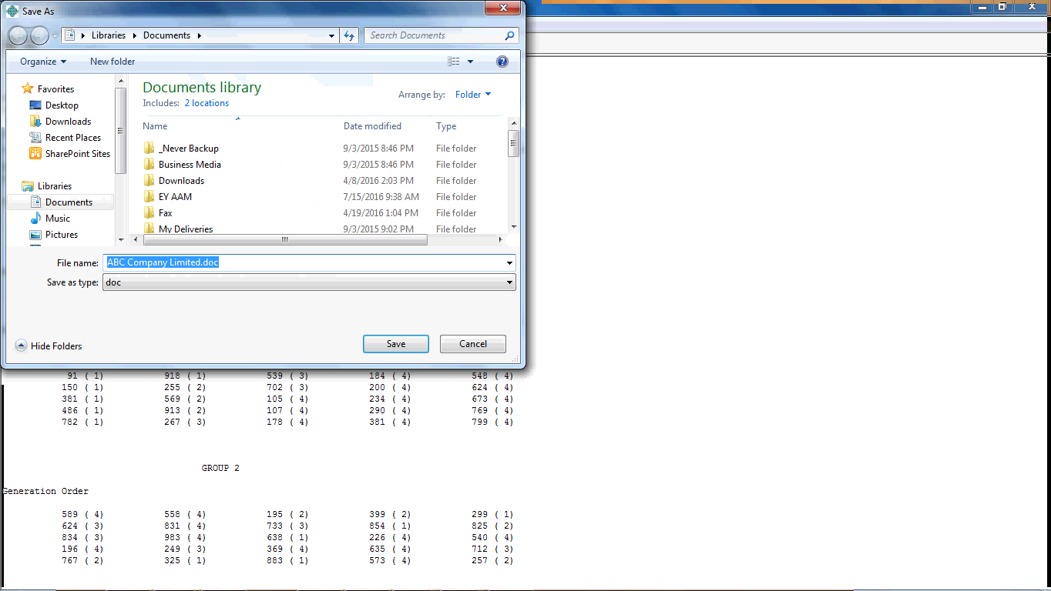
Course introduction
00 of 00
Notes:
Scripts with audio: Again, you need to save your results. Click on the tab with symbol of “Save” and save the results which can later be uploaded into EY Canvas.

Slide 18
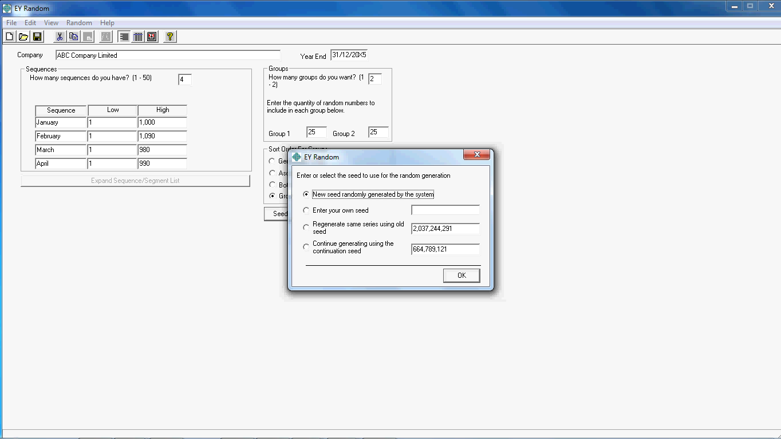
Course introduction
00 of 00
Notes:
Scripts with audio: If we had an error with the results or need to adjust the inputs, click on the tab “Seed” button and we can choose to regenerate the result using the seed value noted on the report we saved. Enter the number in the “Regenerate same series using old seed” box and click “OK”

Slide 19
Course introduction
00 of 00
Notes:
Scripts with audio: You will get the same results as the previous result we generated.

Slide 20
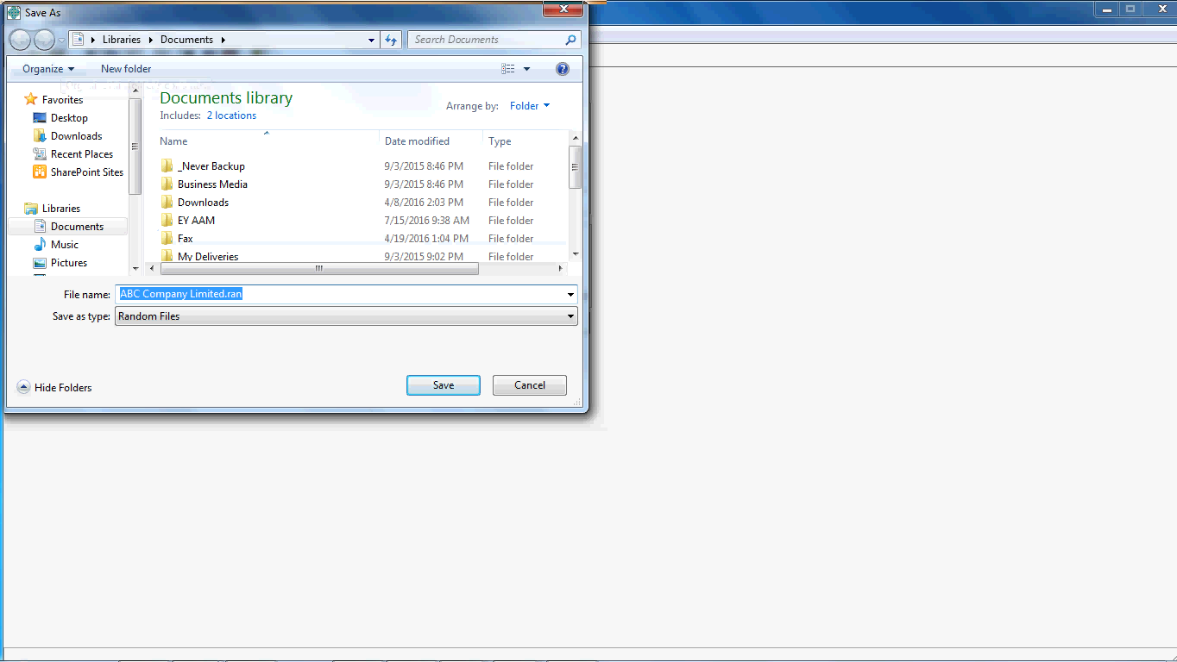
Course introduction
00 of 00
Notes:
Scripts with audio: Click on the tab with the symbol of “Save” and save the client file information for the random.

Slide 21
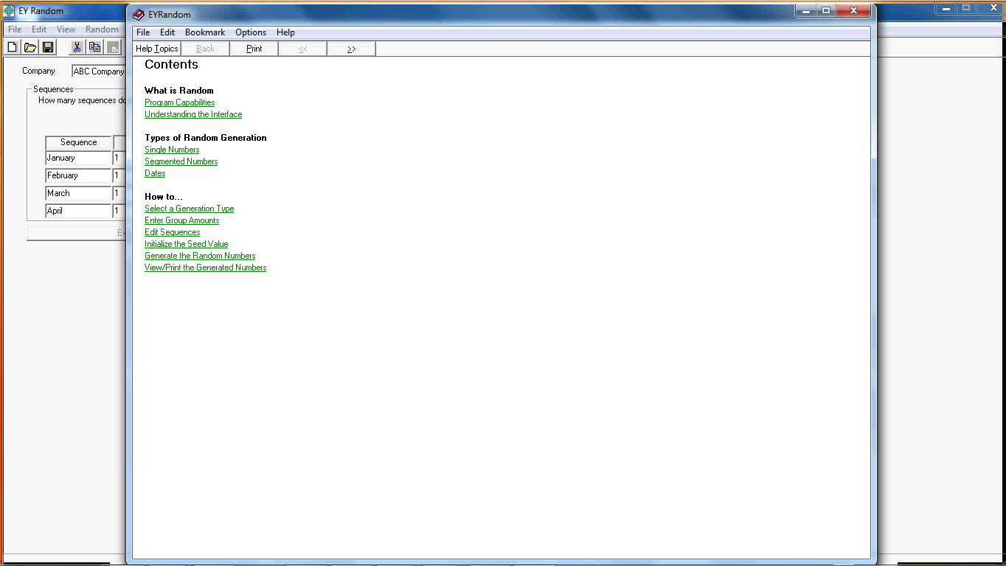
Course introduction
00 of 00
Notes:
Scripts with audio: If at anytime you need assistance, you can always click on the tab “Help” to find out more details about how to use this tool.

