Slide 1
Course introduction
EY MicroSTART Demonstration
00 of 00
Notes:
Scripts with audio:
EY MicroSTART is an audit sampling tool that helps us determine a sample size and evaluate results when performing tests of details using the audit risk tables in EY GAM. The use of this tool is recommended when performing substantive procedures and is not appropriate when performing tests of controls.
EY MicroSTART also has an evaluation function that can help in evaluating the sample results by calculating the known representative misstatement, the projected representative misstatement, the misstatement in key items, and the total amount to the SAD.

Slide 2
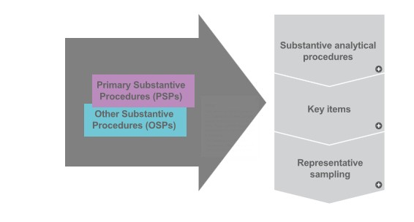
Course introduction
?
Substantive Analytical Procedures
TOC
00 of 00
Notes:
Scripts with audio:
To use EY/Microstart in the execution of your substantive procedures, you should again remember the use of this tool is to assist audit teams in determining a sufficient amount of audit evidence needed to address your combined risk assessment for a specific assertion.
If you have taken a controls reliance approach, the evidence obtained from your tests of controls provided you some audit evidence. When performing only substantive procedures, the use of substantive analytical procedures would also provide you with additional audit evidence. If those procedures did not fill your bucket of evidence, you’d need to proceed to tests of details which would start with selecting key items for testing.
Using professional judgement, you would then need to determine if testing your key items provided you with sufficient audit evidence to fill your bucket or if you need to test an additional sample to fill it all the way. This is where EY/Microstart can come into play. You can use EY/Microstart to help in that assessment.

Slide 3

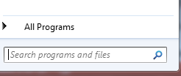

Course introduction
00 of 00
Notes:
Scripts with audio:
MicroSTART is already included on your PC. Simply go to Start > Search programs & files > and type Microstart. Then click on EY Microstart.

Slide 4
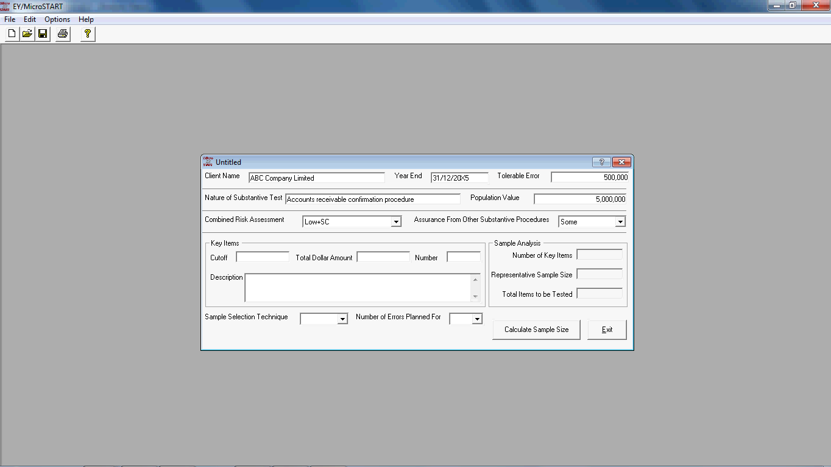
Course introduction
Little
Some
Corroborative
Persuasive
00 of 00
Notes:
Scripts with audio:
MicroSTART will open to the home screen, which displays a form you must fill out in order for the tool to calculate your sample size. Let’s review the inputs together.
First, input the entity name and audit period end. In our example, the name of the entity is ABC Company and their year end date is the 31st of December, 20X5.
Next, you enter the Tolerable Error determined for the audit. MicroSTART will consider the tolerable error when determining the sample size based on statistical tables.
Let’s assume the tolerable error for this entity audit is “500,000”.
Next, you will enter the nature of the substantive test. We will be making sample selections for Accounts Receivable Confirmation Procedures. So we will type this into the form.
In order for the tool to determine the sample size, MicroSTART will also consider the total amount of the balance you are testing. In our case, the total amount of accounts receivable balance is “5,000,000”, which we input in the box population value.
Next, MicroSTART considers the Combined Risk Assessment for the account assertion the procedure is responding to, as well as evidence obtained from other substantive procedures, such as substantive analytical procedures. In our example, let’s assume the combined risk assessment relating to the existence assertion of accounts receivable is “Low”.
Next, you will input the assurance obtained from other substantive procedures your team is performing. This is a required field to fill out. There are four options to select: Little, Some, Corroborative, and Persuasive.
If our assurance from other procedures is persuasive, we have performed procedures that are highly precise with a variance threshold of no more than TE and the recorded amount is within our variance threshold.
If our assurance from other procedures is corroborative, we have performed a combination of substantive analytical procedures and other relevant substantive procedures, where our substantive analytical procedures are moderately to highly precise, and further evidence is obtained from other relevant substantive procedures.
If our assurance from other procedures is some, the extent by which the variance threshold for our substantive analytical procedures exceeds TE is such that we can only conclude that nothing comes to our attention to suggest a material misstatement has occurred.
If our procedures do not meet the requirements for “some” level of assurance, then we input Little.

Slide 5
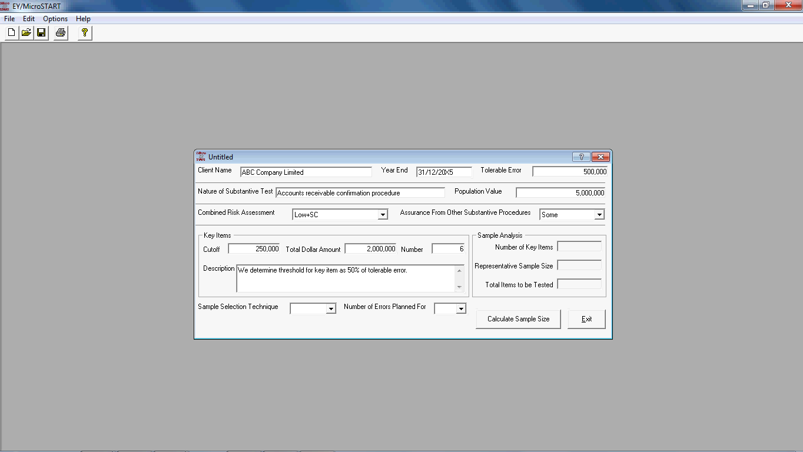
Course introduction
Key item cut off | 250,000
Total key items | 6
Total value of key items | 2,000,000
00 of 00
Notes:
Scripts with audio:
As previously mentioned, you will likely have selected key items for testing which provided you with some amount of audit evidence. As the team is using MicroSTART, that means they have already concluded the evidence from key items and other substantive procedures does not provide sufficient evidence to conclude on the population/account.
In our example, considering tolerable error is “500,000” and combined risk assessment is “Low”, the audit team set the testing threshold or the cutoff amount for key items at “250,000” based on EY GAM minimum testing thresholds. This resulted in a total number of 6 key items which had a total aggregate dollar amount of “2,000,000”. We add this information into the form. Then we drop down the description here.
Note to GSS: Circle the tabs of “Key Items”-”Cutoff”, “Key Items-Total Dollar Amount”, “Key Items-Number”, “Key Items-Description”, one by one during data input.

Slide 6
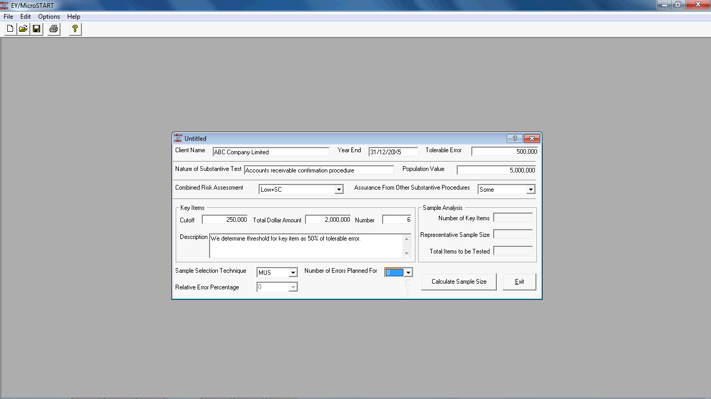
Course introduction
00 of 00
Notes:
Scripts with audio:
There are typically two sample selection techniques that you will likely use to select a sample for substantive testing.
The first is Monetary Unit Sampling, or MUS
MUS is a sampling technique that considers the size or dollar amount of the items within the population to select a sample. MUS expresses a conclusion on the population as a monetary value.
MUS is appropriate when you:
· Have obtained evidence that the population is complete
· Are able to obtain a listing of population items on which we want to conclude
· Have the hypothesis that larger items contain larger monetary errors
· Expect few, if any, errors
Secondly, you could utilize Random Sampling
Random sampling is typically used to determine sample sizes when MUS cannot be applied efficiently (e.g., the data is not in a computer file or a list that includes page or cumulative totals are not available).
For the “Sample Selection Technique” here, we choose “MUS”, as we are expressing a conclusion on the monetary value of Accounts Receivable, and we believe higher value items could contain higher errors.
We assume the expected number of errors is “0” and the relative error percentage is automatically set as “0”.

Slide 7
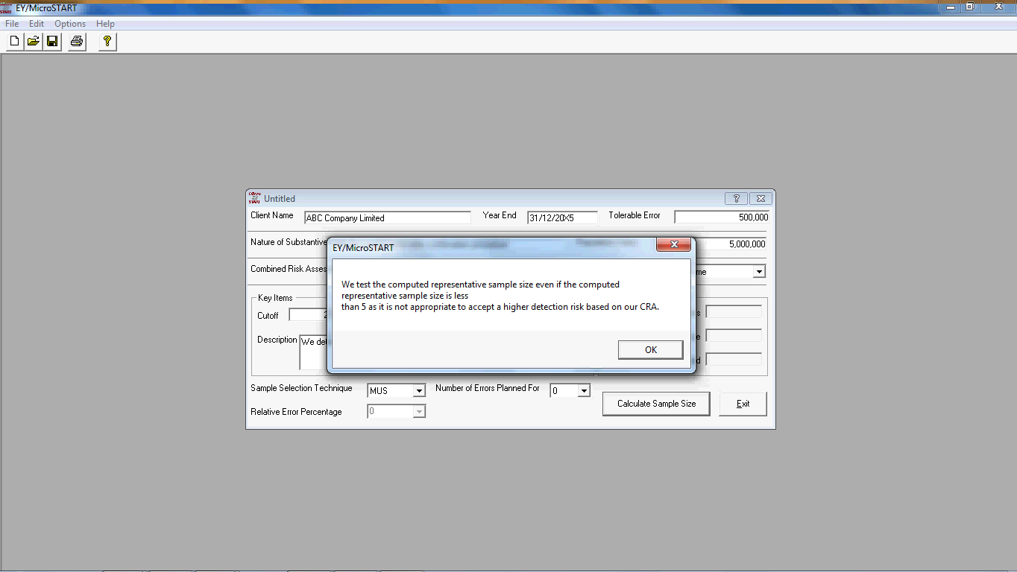
Course introduction
00 of 00
Notes:
Scripts with audio:
The tool is only as accurate as its inputs. BE sure to confirm the inputs with your senior before making your selections.
To calculate your representative sample size, click on the tab “Calculate Sample Size”. Then,
Click “OK”.
In this case, the representative sample size is less than 5 items. SAMPLE 2.3.3 in GAM states “If our CRA is other than minimal or low (i.e., low+SC and above) we test the computed representative sample size even if the computed representative sample size is less than 5 as it is not appropriate to accept a higher detection risk when we are already at a higher CRA.”

Slide 8
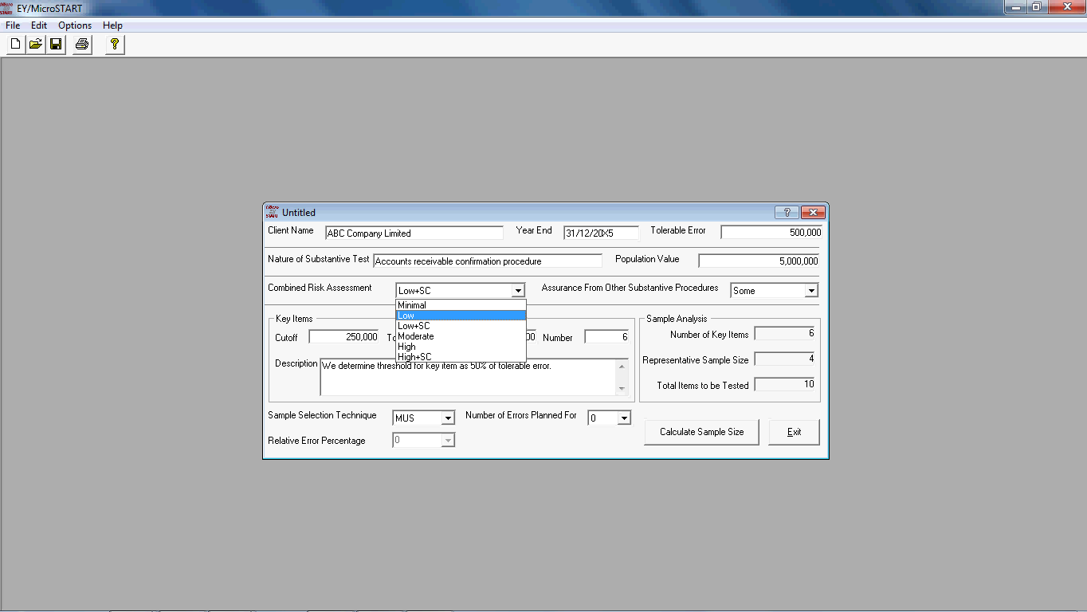
Course introduction
00 of 00
Notes:
Scripts with audio:
Now let’s change the combined risk assessment to “Moderate” and re-calculate the sample size.

Slide 9
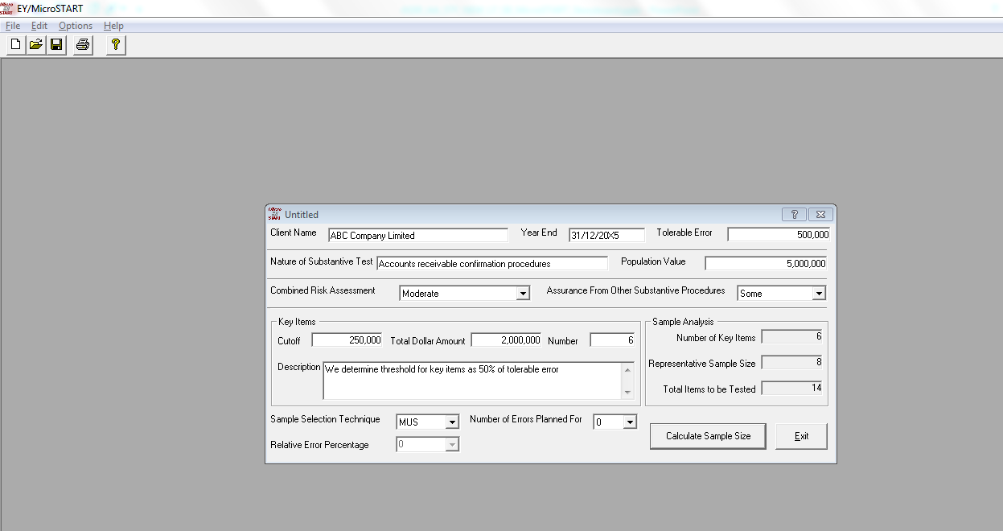
Course introduction
00 of 00
Notes:
Scripts with audio:
Click on the tab “Calculate Sample Size”. In this case, the representative sample size increases to 8.

Slide 10
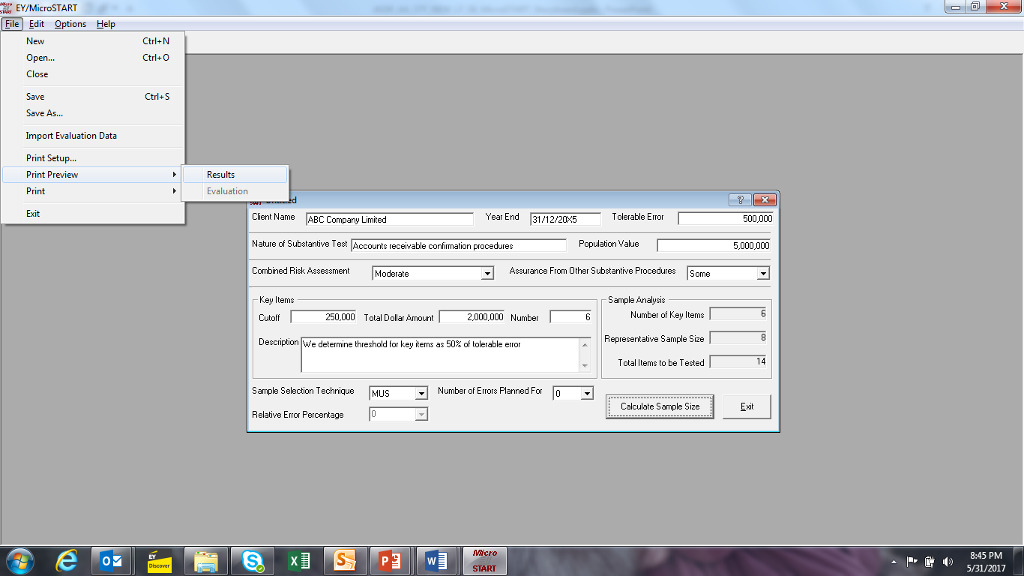
Course introduction
00 of 00
Notes:
Scripts with audio:
Once you have determine the representative sample needed to sufficiently reduce your audit risk, you need to document your considerations for determining the representative sample. In order to save the output of the tool, you Click on “File”-”Print Preview”-”Results”.

Slide 11
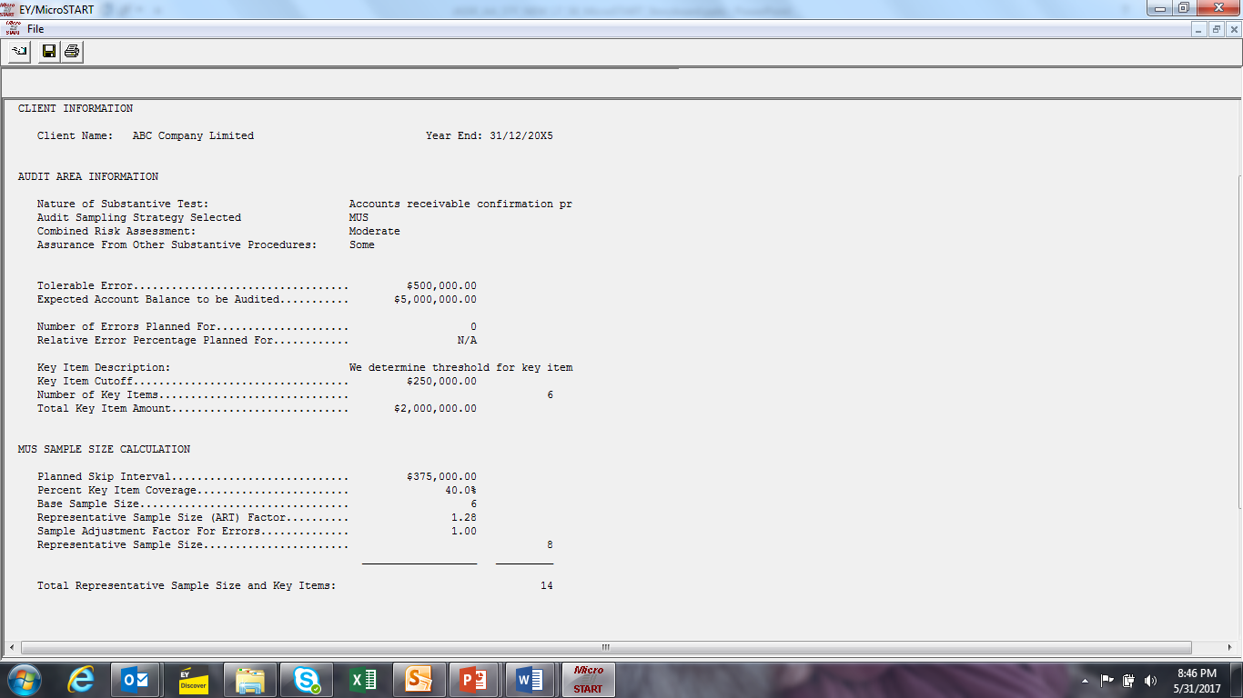
Course introduction
00 of 00
Notes:
Scripts with audio:
This is what your output will look like. This worksheet shows a summary of the calculation result. This report should be saved as a workpaper and attached to the appropriate task in Canvas.

Slide 12
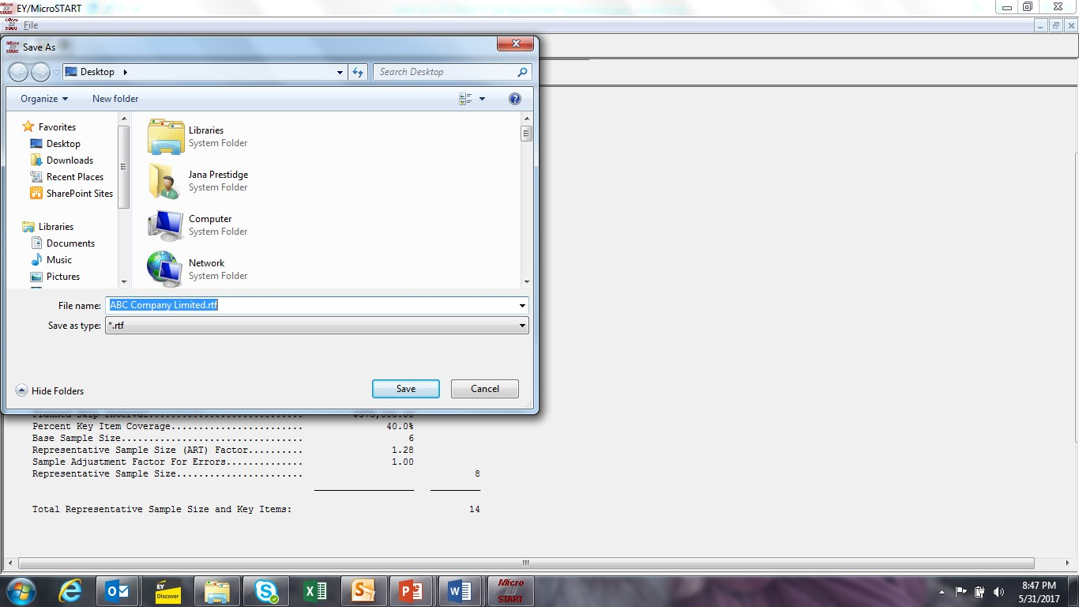
Course introduction
00 of 00
Notes:
Scripts with audio:
Click on the tab with symbol of Save and save the result.

Slide 13
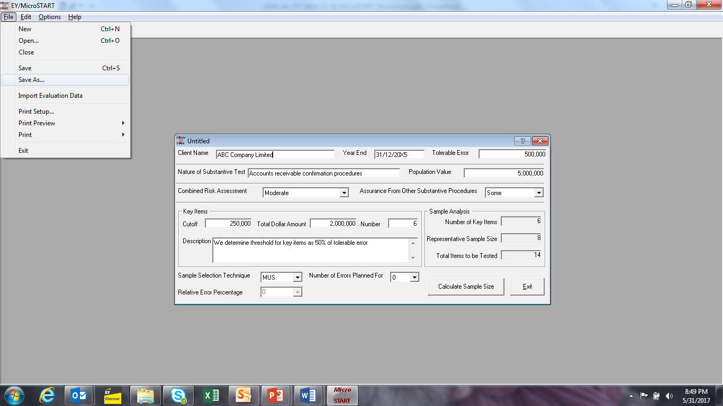
Course introduction
00 of 00
Notes:
Scripts with audio:
You can also save the MicroSTART input page of the client file, which you can quickly access at a later time and adjust, if necessary. From the Print Preview page, click the “Close” button in the upper left hand corner. Then click on the tab “File” and then “Save” to save this MicroSTART document if needed. MicroSTART will also prompt you to save the client file when attempting to exit the program.

Slide 14
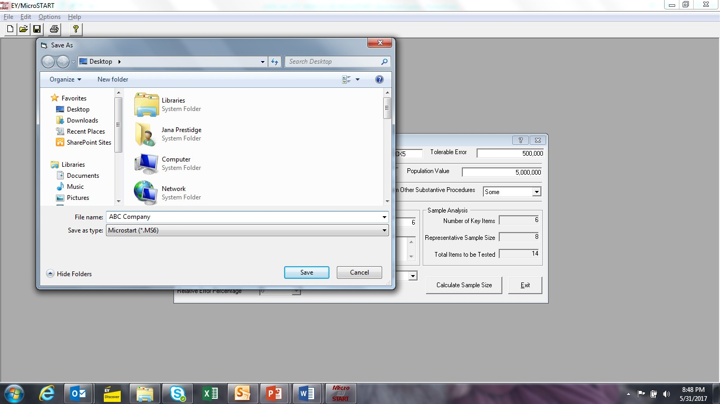
Course introduction
00 of 00
Notes:
Scripts with audio:
If you ever have questions about the tool, you can simply Click on the tab “Help” and then “Tool Help”.

Slide 15
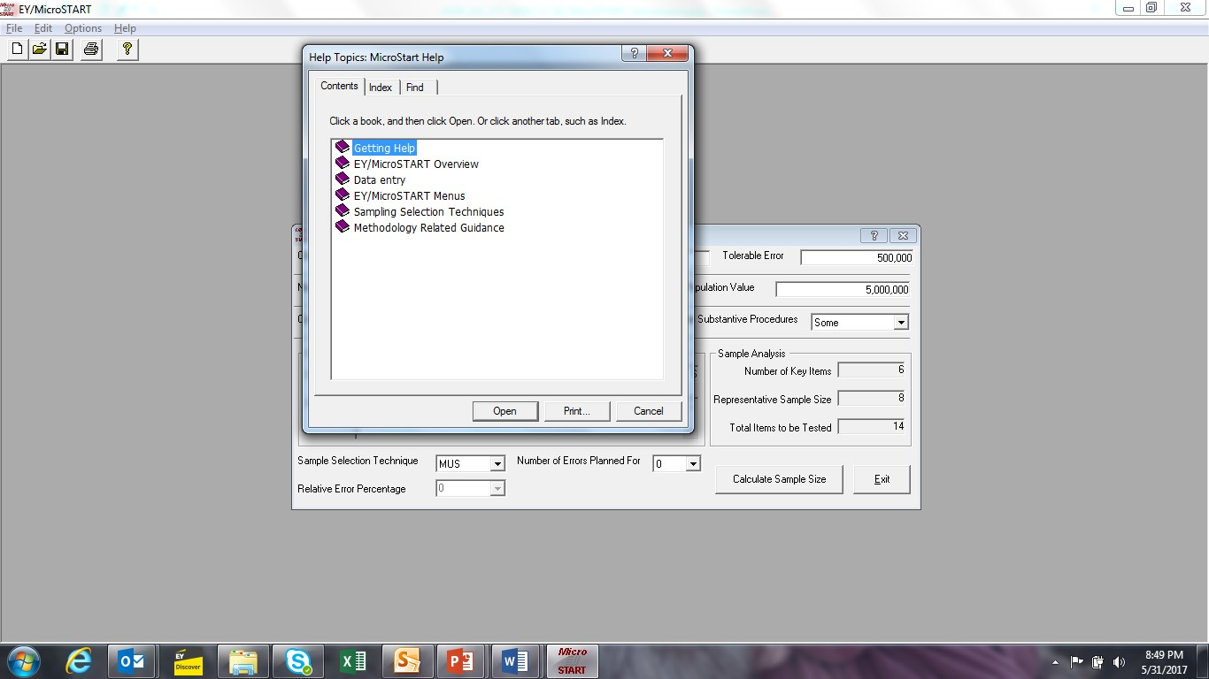
Course introduction
00 of 00
Notes:
Scripts with audio:
Here we can find out more details about how to use this tool.

