Slide 1
Database Normalization

Slide 2
Housekeeping
Assignment 1 marked
Assignment 1 & 2 solutions will be posted this morning
Quiz 1 – pick up at end of class
Quiz 2 – will mark before Friday’s class (return on Fri)
Mid-term: Monday, February 18th
  If can’t make it, or need accommodations, email me NOW
  Coverage: Database design: ER diagrams, conversion to tables, normalization, relational algebra
  Closed book

Slide 3
Chapter 7
Logical Database Design
Fundamentals of Database Management Systems
by
Mark L. Gillenson, Ph.D.
University of Memphis
John Wiley & Sons, Inc.

Slide 4
Chapter Objectives
7-<number>
Describe the data normalization process
Perform the data normalization process.
Test tables for irregularities using the data normalization process.

Slide 5
Logical Database Design
7-<number>
The process of deciding how to arrange the attributes of the entities in the business environment into database structures, such as the tables of a relational database.
The goal is to create well structured tables that properly reflect the company’s business environment.

Slide 6
Logical Design of Relational Database Systems
7-<number>
(1) The conversion of E-R diagrams into relational tables.
(2) The data normalization technique.
(3) The use of the data normalization technique to test the tables resulting from the E-R diagram conversions.

Slide 7
The Data Normalization Process
7-<number>
A methodology for organizing attributes into tables so that redundancy among the nonkey attributes is eliminated.
The output of the data normalization process is a properly structured relational database.

Slide 8
The Data Normalization Technique
7-<number>
Input:
  all the attributes that must be incorporated into the database
  a list of all the defining associations between the attributes (i.e., the functional dependencies).
    a means of expressing that the value of one particular attribute is associated with a single, specific value of another attribute.
    If we know that one of these attributes has a particular value, then the other attribute must have some other value.

Slide 9
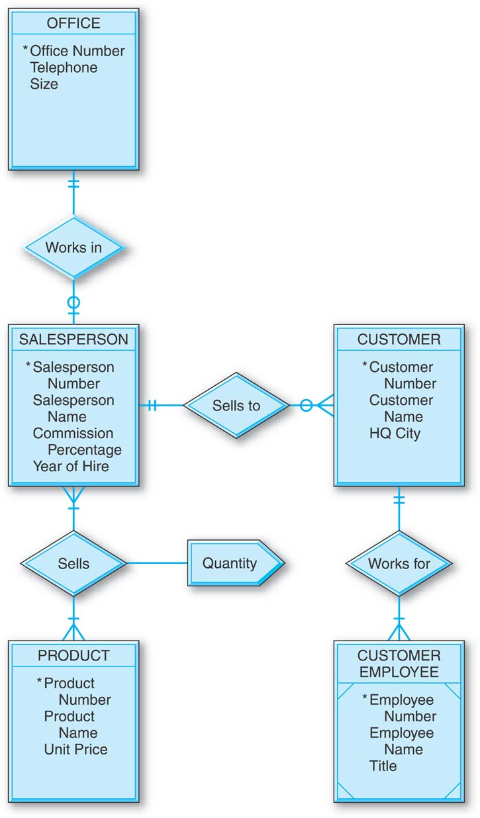






General Hardware Company Database
7-<number>

Slide 10

Functional Dependence
7-<number>
Salesperson Number
Salesperson Name
Salesperson Number is the determinant.
The value of Salesperson Number determines the value of Salesperson Name.
Salesperson Name is functionally dependent on Salesperson Number.

Slide 11
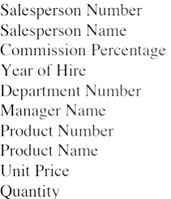
General Hardware Environment: SALESPERSON and PRODUCT
7-<number>
What are the functional dependencies?

Slide 12
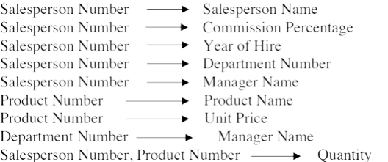
General Hardware Environment: SALESPERSON and PRODUCT
7-<number>

Slide 13
Full Functional dependency:
If A and B are attributes(columns)of a table, B is fully functionally dependent on A if B is functionally dependent on A, but not on any proper subset of A.
SalesPerson#--→SalesPersonName
Partial Functional Dependency:
If A and B are attributes of a table, B is partially dependent on A if there is some attribute that can be removed from A and yet the dependency still holds.
SP#, SPName -------> Comm%
Comm% is functionally dependent on a subset of A (SP#, SPName), namely SP#.
Transitive Functional Dependency:
A , B and C are attributes of a table. If A is functionally dependent on B, and B is functionally dependent on C, then C is Transitively dependent on A via B.
        SP#---->SPName, Comm%, YearOfHire, Office#
        Office#---→Telephone#
        SP# attribute functionally determines Telephone# via Office# attribute.

Slide 14
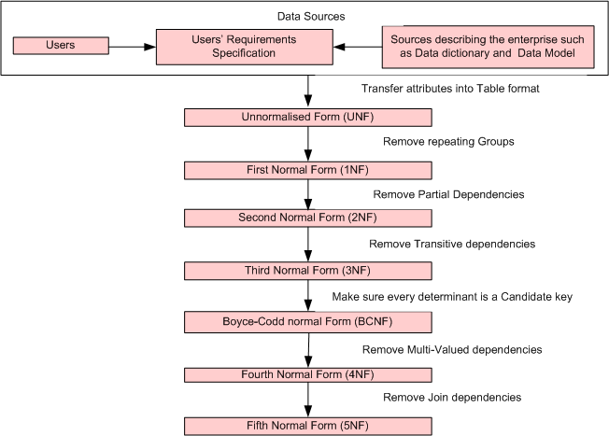
Steps in the Data Normalization Process
7-<number>

Slide 15
The Data Normalization Process
7-<number>
Once the attributes are arranged in third normal form, the group of tables that they comprise is a well-structured relational database with no data redundancy.
  Subsequently R.Boyce and E.F.Codd introduced a stronger definition of 3NF called Boyce-Codd Normal Form(BCNF).
  With the exception of 1NF, all these normal forms are based on Functional dependencies among the attributes of a table. Higher normal forms that go beyond BCNF were introduced later such as Fourth Normal Form (4NF) and Fifth Normal Form (5NF). However these later normal forms deal with situations that are very rare.
A group of tables is said to be in a particular normal form if every table in the group is in that normal form.
The data normalization process is progressive.
  For example, if a group of tables is in second normal form, it is also in first normal form.

Slide 16
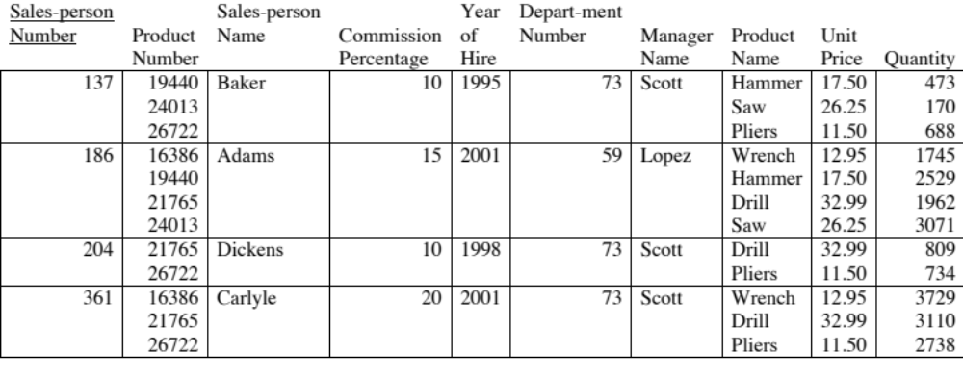
General Hardware Company: Unnormalized Data
7-<number>
Records contain multivalued attributes.

Slide 17
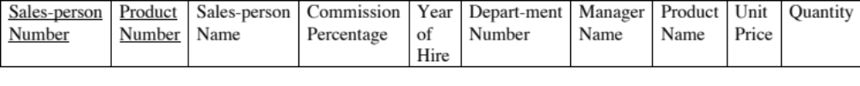
General Hardware Company: First Normal Form
The only thing that is required for a table to be in 1NF is to contain only atomic values (intersection of each row and column should contain one and only one value). This is sometimes referred to as: Eliminate Repeating groups.
The attributes under consideration have been listed in one table, and a primary key has been established.
The number of records has been increased so that every attribute of every record has just one value.
The multivalued attributes have been eliminated.
7-<number>

Slide 18
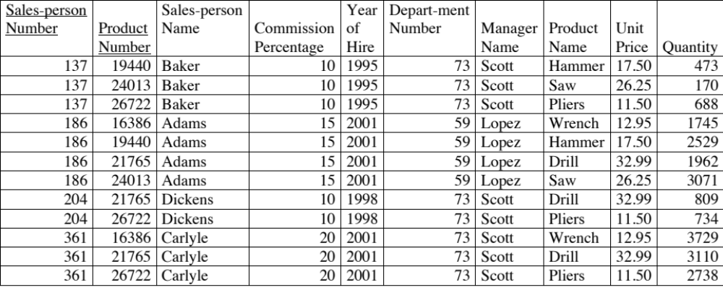
General Hardware Company: First Normal Form
7-<number>

Slide 19
General Hardware Company: First Normal Form
7-<number>
First normal form is merely a starting point in the normalization process.
First normal form contains a great deal of data redundancy.
  Three records involve salesperson 137, so there are three places in which his name is listed as Baker, his commission percentage is listed as 10, and so on.
  Two records involve product 19440 and this product’s name is listed twice as Hammer and its unit price is listed twice as 17.50.

Slide 20
Second Normal Form
7-<number>
A Table is said to be in 2NF if it is in 1NF and there are no partial dependencies
No Partial Functional Dependencies
  Every non primary key attribute of the table must be fully functionally dependent on the entire primary key of that table.
  A non-key attribute cannot depend on only part of the key.

Slide 21
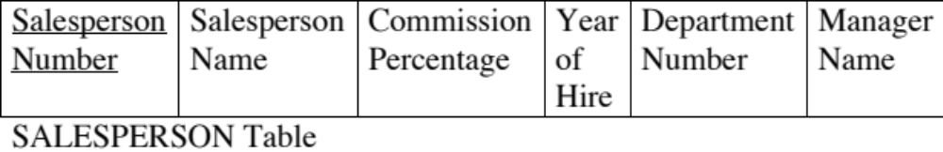


General Hardware Company: Second Normal Form
In SALESPERSON, Salesperson Number is the sole primary key attribute. Every nonkey attribute of the table is fully defined just by Salesperson Number.
Similar logic for PRODUCT and QUANTITY tables.
7-<number>

Slide 22
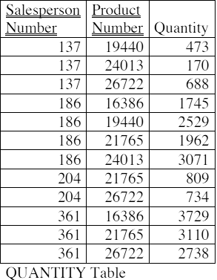
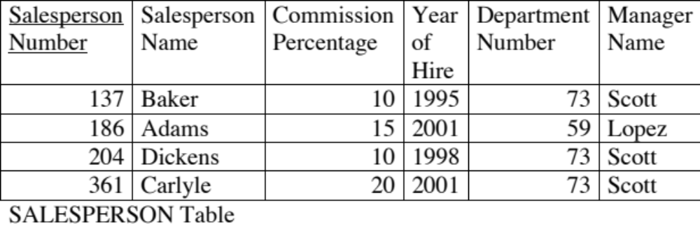
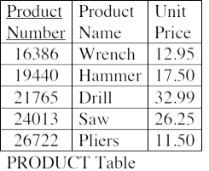
General Hardware Company: Second Normal Form
7-<number>

Slide 23
Third Normal Form
7-<number>
A Table that is in 1NF and 2NF and in which no non primary key attribute is transitively dependent on the primary key.
Does not allow transitive dependencies in which one nonkey attribute is functionally dependent on another.
Nonkey attributes are not allowed to define other nonkey attributes.
"Each attribute must be a fact about the key, the whole key, and nothing but the key."

Slide 24




General Hardware Company: Third Normal Form
7-<number>
Notes:
Manager name is transitively dependent on Salesperson Number via Department number

Slide 25
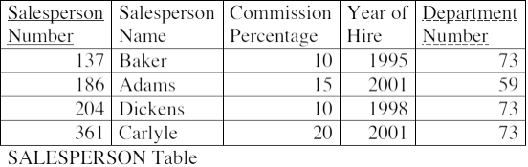
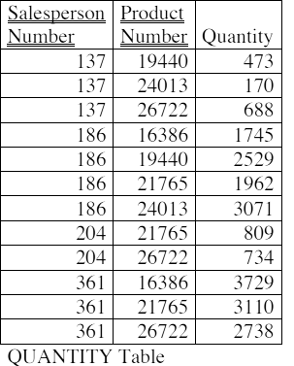
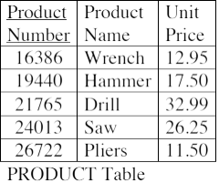
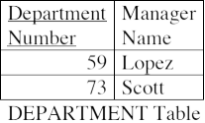
General Hardware Company: Third Normal Form
7-<number>

Slide 26
General Hardware Company: Third Normal Form
7-<number>
Important points about the third normal form structure are:
  It is completely free of data redundancy.
  All foreign keys appear where needed to logically tie together related tables.
  It is the same structure that would have been derived from a properly drawn entity-relationship diagram of the same business environment.

Slide 27
Recap + clarification
0NF:
  Unstructured data, can have multi-valued attributes
1NF:
  Atomic values (one per column of the record)
  No duplicate rows (implies there is a key)
As we move forward need to consider functional dependencies and determine candidate keys
    Note: earlier slides simplified this slightly by saying choose a primary key, but normalization is actually about candidate keys
    For the higher forms of normalization, we need to consider the case where there is not a single option for the primary key

Slide 28
Definitions
Superkey: a combination of attributes that can be used to uniquely identify a row in a database. The trivial superkey is all attributes.
Candidate key: a minimal superkey – all attributes are necessary to uniquely identify the record
Primary key: one candidate key, arbitrarily chosen
Prime attribute: an attribute that occurs in some candidate key
Non prime attribute: an attribute that does not occur in any candidate key

Slide 29
2NF (revisited)
A Table is said to be in 2NF if it is in 1NF and there are no partial dependencies
No Partial Functional Dependencies
  Every non primary key attribute of the table must be fully functionally dependent on the entire primary key of that table.
  A non-key attribute cannot depend on only part of the key.
No Partial Functional Dependences
  Every non prime key attribute of the table must be fully functionally dependent on the entire key of one of the candidate keys in the table.
  An non-prime attribute cannot depend on only part of one of the candidate keys.

Slide 30
3NF revisited
A Table that is in 1NF and 2NF and in which no non primary key attribute is transitively dependent on the primary key.
Old:
  Does not allow transitive dependencies in which one non-key attribute is functionally dependent on another.
  Nonkey attributes are not allowed to define other nonkey attributes.
New:
  Every non-prime attribute is non-transitively dependent on every candidate key in the table.
  The attributes that do not directly contribute to the description of the candidate keys are removed from the table. In other words, no transitive dependency is allowed.

Slide 31
"Each non-key attribute must provide a fact about the key, the whole key, and nothing but the key.”
The key: 1NF – we have a table of related items, with each row unique, with atomic values
The whole key: 2NF – no partial dependences on the candidate keys
Nothing but the key: 3NF – no transitive dependencies

Slide 32
Boyce-codd Normal Form (BCNF)
7-<number>
A Table is in BCNF if and only if every determinant (i.e., the attribute or a group of attributes on which some other attribute is fully functionally dependent) is a candidate key. BCNF is a stronger form of 3NF.
The difference between 3NF and BCNF is that for a Functional dependency A--->B, 3NF allows this dependency in a table if attribute B is a primary key attribute and attribute A is not a candidate key, where as BCNF insists that for this dependency to remain in a table, attribute A must be a candidate key.
Only in rare cases does a 3NF table not meet the requirements of BCNF. A 3NF table which does not have multiple overlapping candidate keys is guaranteed to be in BCNF. Depending on what its functional dependencies are, a 3NF table with two or more overlapping candidate keys may or may not be in BCNF

Slide 33
Example of 3NF table not in BCNF
Today's Court
Bookings
Each row in the table represents a court booking at a tennis club that has one hard court (Court 1) and one grass court (Court 2). A booking is defined by its Court and the period for which the Court is reserved Additionally, each booking has a Rate Type associated with it. There are four distinct rate types:
  SAVER, for Court 1 bookings made by members
  STANDARD, for Court 1 bookings made by non-members
  PREMIUM-A, for Court 2 bookings made by members
  PREMIUM-B, for Court 2 bookings made by non-members
http://en.wikipedia.org/wiki/Boyce%E2%80%93Codd_normal_form
Court | StartTime | EndTime | RateType
1 | 09:30 | 10:30 | SAVER
1 | 11:00 | 12:00 | SAVER
1 | 14:00 | 15:30 | STANDARD
2 | 10:00 | 11:30 | PREMIUM-B
2 | 11:30 | 13:30 | PREMIUM-B
2 | 15:00 | 16:30 | PREMIUM-A

Slide 34
What is the problem?
Identify the functional dependencies
Identify the table’s super keys
Determine the candidate keys
Why isn’t the table in BCNF?
  A Table is in BCNF if and only if every determinant is a candidate key.
  For all functional dependencies A -> B, is A a candidate key?

Slide 35
Fourth Normal Form (4NF)
4NF is a stronger normal form than 3NF/BCNF as it prevents Tables from containing nontrivial Multi-Valued Dependencies (MVDs) and hence data redundancy.
The Normalization of BCNF Tables to 4NF involves the removal of MVDs from the Table by placing the attribute(s) in a new Table along with the copy of the determinant(s).
http://en.wikipedia.org/wiki/Fourth_normal_form

Slide 36
Pizza Delivery Example – not in 4NF
Restaurant Pizza Variety Delivery Area
A1 Pizza Thick Crust Springfield
A1 Pizza Thick Crust Shelbyville
A1 Pizza Thick Crust Capital City
A1 Pizza Stuffed Crust Springfield
A1 Pizza Stuffed Crust Shelbyville
A1 Pizza Stuffed Crust Capital City
Elite Pizza Thin Crust Capital City
Elite Pizza Stuffed Crust Capital City
Vincenzo's Pizza Thick Crust Springfield
Vincenzo's Pizza Thick Crust Shelbyville
Vincenzo's Pizza Thin Crust Springfield
Vincenzo's Pizza Thin Crust Shelbyville

Slide 37
Fifth Normal Form (5NF)
Also known as project-join normal form (PJ/NF)
Designed to reduce redundancy in relational databases recording multi-valued facts by isolating semantically related multiple relationships.
A table is said to be in the 5NF if and only if every join dependency in it is implied by the candidate keys.
http://en.wikipedia.org/wiki/Fifth_normal_form

Slide 38
Traveling Salesman Product Availability By Brand
Traveling Salesman Brand Product Type
Jack Schneider Acme Vacuum Cleaner
Jack Schneider Acme Breadbox
Willy Loman Robusto Pruning Shears
Willy Loman Robusto Vacuum Cleaner
Willy Loman Robusto Breadbox
Willy Loman Robusto Umbrella Stand
Louis Ferguson Robusto Vacuum Cleaner
Louis Ferguson Robusto Telescope
Louis Ferguson Acme Vacuum Cleaner
Louis Ferguson Acme Lava Lamp
Louis Ferguson Nimbus Tie Rack
Not in 5NF if the Salesman must offer only products of Type P made by Brand B if that product type and brand is in his repetoire

Slide 39
Steps in the Data Normalization Process
7-<number>

Slide 40
Other good resources:
http://www.informationqualitysolutions.com/FreeStuff/rettigNormalizationPoster.pdf
Today’s handout includes the explanations of each normalization step for the example highlighted in the poster

Slide 41
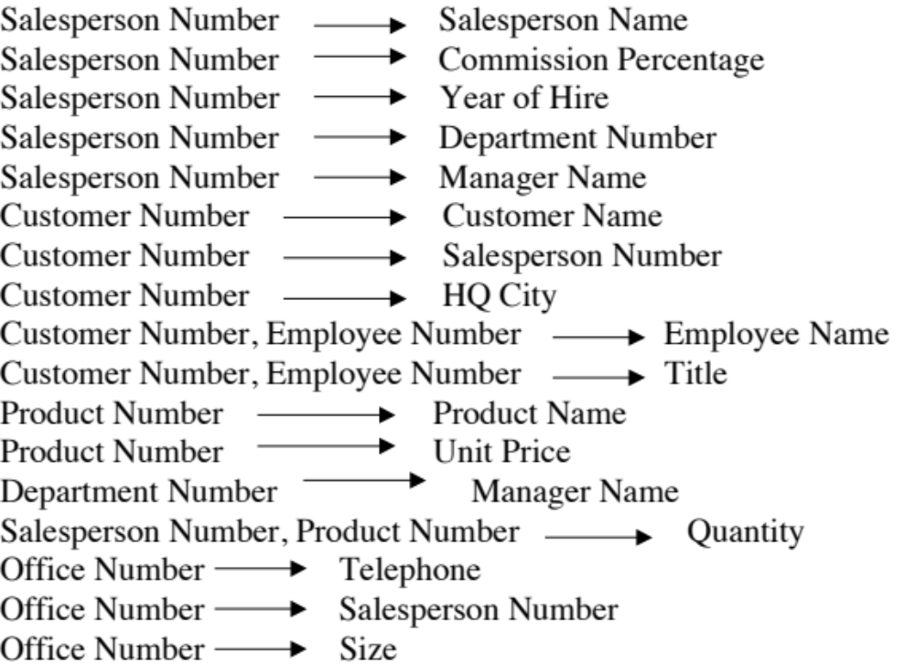
General Hardware Company: Functional Dependencies
7-<number>

Slide 42
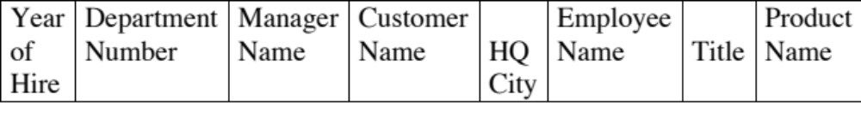

General Hardware Company: First Normal Form
7-<number>

Slide 43
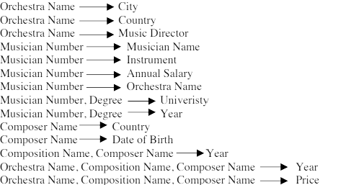
World Music Association: Functional Dependencies
7-<number>

Slide 44
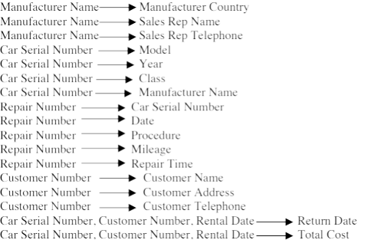
Lucky Rent-A-Car:
Functional Dependencies
7-<number>

