Slide 1
Algorithmic Analysis
Measuring “Work”
Linear and Binary Search

Slide 2
Algorithms and Running Time
Some programs are fast
Other programs are slow
Even if they’re doing the “same thing”
Even if they’re on the same computer
Even if they’re written in the same language
It’s a question of how much work they’re doing

Slide 3
Print the Numbers From 1 to N
Stupid method
Print the number 1
Repeat
  Count how many numbers we already printed
  If it’s N, stop (* we’re done *)
  Add 1 to the number from step a.
  Find the end of the list
  Print the number you got in step c.

Slide 4
How Much Work to Print to 3?
Print number 1
Count number 1
Test if 1 = 3
Add 1 to 1 → 2
Skip over number 1
Print number 2
Count number 1
Count number 2
Test if 2 = 3
Add 1 to 2 → 3
Skip over number 1
Skip over number 2
Print number 3
Count number 1
Count number 2
Count number 3
Test if 3 = 3

Slide 5
Print the Numbers From 1 to N
Better method
Set k to 1
While k ≤ N
  Print k
  Add 1 to k

Slide 6
How Much Work to Print to 3?
Set k to 1 (k = 1)
Test k ≤ 3
Print k
Add 1 to k (k = 2)
Test k ≤ 3
Print k
Add 1 to k (k = 3)
Test k ≤ 3
Print k
Add 1 to k (k = 4)
Test k ≤ 3
6 less steps than Stupid

Slide 7
Faster and Slower
Second way clearly better
  Six less steps for N = 3
For N = 1000
  Better alg^{thm} takes 999,997 less steps
  If Better took 1 second to print to 1000…
  …Stupid would take over 5 minutes
How do I know?

Slide 8
Three Ways to Find Faster
Stupid way
  Write out all the steps required & count them
Better way
  Write a program to calculate & count steps
Best way?

Slide 9
Counting in the Program
Create a variable to count the operations
  make it static OR have method return it
Make a loop to call the method with different numbers to count to
  count to 0, count to 1, count to 2, …
  record the amount of work
  look at the numbers
  figure out the pattern

Slide 10
Counting Operations
Using a local variable
  public static int doThis() {
  in opCount = 0; // initialize
  …
  ++opCount; // update (as necessary)
  …
  return opCount; // return
  }

Slide 11
Getting All the Comparisons
Counting before each operation of interest
  comparison
  ++opCount;
  if (v[i] == item)
  return i;
  assignment
  ++opCount;
  v[i] = v[j];

Slide 12
Counting for Loops
Count one comparison going into the loop
  ++opCount;
  while (item != sentinel)
  {
  …
  ++opCount;
  }
And another at the bottom of the loop
  why?
    another comparison is coming up!

Slide 13
fillStupidly with opCount
  public static int fillStupidly(int n, int v[]) {
  opCount = 0;
  int a;
  int c = 1;
  ++opCount; v[0] = 1; //step 1 (asgn)
  while (true) {
  for (a = 0; v[a] != 0; ++a) {++opCount;} // step 2a (comp)
  ++opCount; if (v[a]==n) // step 2b (comp)
  return opCount;
  ++opCount; c = a + 1; // step 2c (asgn)
  for (a = 0; v[a] != 0; ++a) {+opCount;} // step 2d (comp)
  ++opCount; v[a] = c; // step 2e (asgn)
  }
  return opCount;
  }

Slide 14
fillIntelligently with opCount
  private static int fillIntelligently(int n, int[] v) {
  opCount = 0;
  ++opCount; int k = 1; // step 1 (asgn)
  while (true) {
  ++opCount; if (k > n) // step 2 (comp)
  return opCount;
  ++opCount; v[k-1] = k; // step 2a (asgn)
  ++opCount; ++k; // step 2b (asgn)
  }
  }

Slide 15
Head-to-Head
Number of Steps taken (program count):
  N Stupid Better
  1 3 5
  2 9 8
  3 17 11
  4 27 14
  5 39 17
  10 129 32
  100 10,299 302
The bigger N gets, the worse Stupid looks

Slide 16
Growth Pattern
Number of Steps taken (program count):
  N Stupid (change) Better (change)
  1 3 5
  2 9 +6 8 +3
  3 17 +8 11 +3
  4 27 +10 14 +3
  5 39 +12 17 +3
  10 129 32
  100 10,299 302
Stupid grows faster and faster
Better grows at a steady rate

Slide 17
Three Ways to Find Faster
Stupid way
  Write out all the steps required & count them
Better way
  Write a program to calculate & count steps
Best way
  Figure out how to do algorithmic analysis
  Apply it to this problem

Slide 18
Algorithmic Analysis
Figuring out how much work it will do
  how many steps it will take to finish
In terms of how “big” the problem is
  size of problem is called “N”
  in our example, N is the number to print to
At its best – a “closed-form” solution
  exact number of steps it’ll take
In any case, an “order of magnitude”

Slide 19
The Better Printing Algorithm
Set k to 1
While k ≤ N
  Print k
  Add 1 to k
One step to set k
For each number to print, 3 steps
  Test k
  Print k
  Add 1 to k
Also need to test N+1
Number of steps:
1 + 3N + 1
= 3N + 2

Slide 20
Reality Check
Set k to 1
Test k ≤ N
Print k
Add 1 to k
Test k ≤ N
Print k
Add 1 to k
Test k ≤ N
Print k
Add 1 to k
Test k ≤ N
For N = 1
  Stops at step 5
  5 = 3(1) + 2
For N = 2
  Stops at step 8
  8 = 3(2) + 2
For N = 3
  Stops at step 11
  11 = 3(3) + 2
f(N) = 3N + 2 is good
N = 1
N = 2
N = 3

Slide 21
The Stupid Printing Algorithm
Print number 1
Count number 1
Test if 1 = N
Add 1 to 1 → 2
Skip over number 1
Print number 2
Count number 1
Count number 2
Test if 2 = N
Stops at “Test if” step
Steps just to print k?
  Add 1 to k–1 → k
  Skip over k–1 numbers
  Print k
  Count k numbers
  Test k
1 + (k–1) + 1 + k + 1
= 2k + 2
k = 2

Slide 22
Spot Check
Add 1 to 2 → 3
Skip over number 1
Skip over number 2
Print number 3
Count number 1
Count number 2
Count number 3
Test if 3 = N
Works for k = 3
  8 = 2(3) + 2
Off-by-one for k = 1
  Only takes 3 steps
  Special case
Check for k = 7
  …

Slide 23
Exercise
Stupid takes 3 steps to print the 1, 6 steps to print the 2, 8 steps to print the 3, …
  how many steps to print from 1 to 3?
  how many steps to print the 4?
  how many steps to print 1 to 4?
  how many steps to print the 5?
  how many steps to print 1 to 5?

Slide 24
Work in the Stupid Alg^{thm}
For printing 1 to N
Let W be the # of steps to print 1 to N
  W = 3 + 6 + 8 + 10 + 12 + … + (2N + 2)
Do we know what this sum is?
What sum do we know that it’s like?
  how can we use that sum?

Slide 25
Sum From 1 to N
Sum from 1 to N is a common series
  S = 1 + 2 + 3 + 4 + 5 + … + N
  S = _{i=1}Σ^{N} i
  S = N (N + 1) / 2
Also variations
  S = 1 + 2 + 3 + … + (N+1) + (N+2) = ?
  S = 2 + 4 + 6 + 8 + 10 + … + 2N = ?
  S = 3 + 4 + 5 + 6 + 7 + … + N = ?

Slide 26
Work in the Stupid Alg^{thm}
W = 3 + 6 + 8 + 10 + 12 + … + (2N + 2)
W + 1 = 4 + 6 + 8 + 10 + 12 + … + (2N + 2)
(W+1)/2 = 2 + 3 + 4 + 5 + 6 + … + (N + 1)
1 + (W+1)/2 = 1 + 2 + 3 + 4 + … + (N + 1)
= (N+1)(N+2)/2
= (N² + 3N + 2)/2
2 + (W+1) = N² + 3N + 2
W = N² + 3N – 1

Slide 27
Reality Check
For N = 1
  N² + 3N – 1 = (1)² + 3(1) – 1 = 3 correct
For N = 2
  N² + 3N – 1 = (2)² + 3(2) – 1 = 9 correct
For N = 3
  N² + 3N – 1 = (3)² + 3(3) – 1 = 17 correct
Prediction for N=4: 27 steps check it

Slide 28
Theory and Practice
Number of steps taken (program count):
  N Stupid Better
  5 39 17
  10 129 32
  100 10,299 302
Number of steps taken (alg. anal.):
  N N² + 3N – 1 3N + 2

Slide 29
Comparing the Algorithms
Work for Better = 3N + 2
Work for Stupid = N² + 3N – 1
For N = 1000
  Better: 3(1000) + 2 = 3,002 steps
  Stupid: (1000)² + 3(1000) – 1 = 1,002,999 steps
For N = 1, Stupid actually takes less steps…
For N > 1, Better takes less steps

Slide 30
Exercise
Calculate the formula for the amount of work in the following algorithm:
  Sum numbers from 1 to N
  set i to 1
  set sum to 0
  while i ≤ N
    add i to sum
    add 1 to i

Slide 31
But, But, But….
The above was rather informal
Lots of valid complaints
  You ignored variables in Stupid, not in Better
  Some steps will take longer than others
  And just how did you decide what the “steps” were, anyway?
Mostly, we ignore these problems
  It has been shown that things work out, anyway

Slide 32
Desiderata
We want to get an idea of how fast the algorithm is
  Want to ignore different speed machines
  Want to ignore differences in machine language
  Want to ignore compiler issues
  Want to ignore O/S issues
Running time on an “ideal” computer

Slide 33
Fudges
Can’t deal with fine timing issues
  Multiplication takes longer than addition
  Pretend they take the same time
Can’t deal with memory limits
  Assume we have infinite memory
  No paging in/out
Note: those issues may need to be considered sometimes

Slide 34
Calculating Work
Want a function that tells us how many “steps” an algorithm takes for a problem of a given size
Any simple instruction takes one “step”
  complex instructions must be counted as multiple steps (e.g. counting numbers printed)
Bigger problems naturally take longer

Slide 35
Time and Space
Above is time complexity
  How long it takes to do something
Also interested in space complexity
  How much memory is required
  Also expressed in terms of problem size
More interested in time than space, tho’

Slide 36
Orders of Magnitude
Work for Better = 3N + 2
Work for Stupid = N² + 3N – 1
For N = 1000
  Better: 3(1000) + 2 = 3,002 steps
  Stupid: (1000)² + 3(1000) – 1 = 1,002,999 steps
Work_{Better}(1000) ≈ 3,000 = 3N
Work_{Stupid}(1000) ≈ 1,000,000 = N²

Slide 37
Lower Order Terms
The extra two steps for Better don’t matter much when N is “big”
  the 3N term dominates the formula
The extra 3N – 1 steps for Stupid don’t matter much, either
  the N² term dominates its formula
We’re mostly interested in the dominant term of the formula

Slide 38
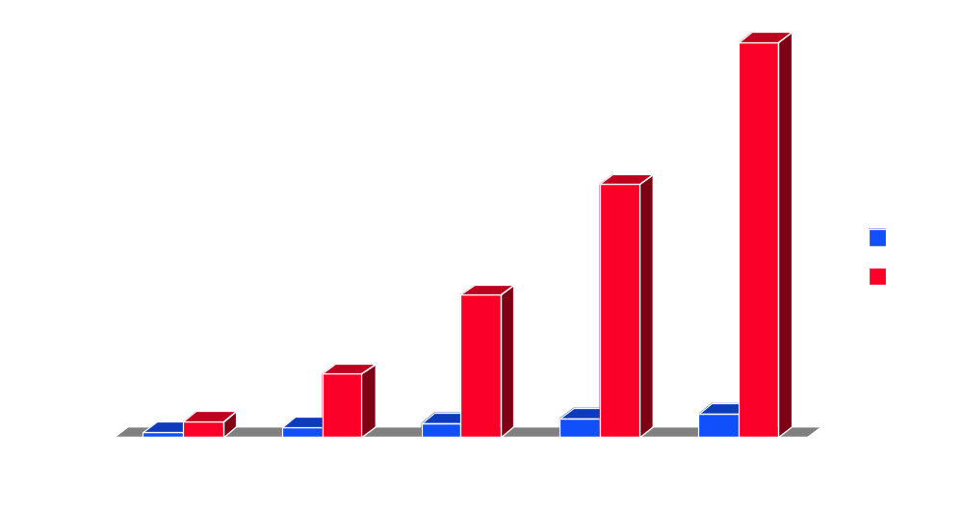
Graph of 3N vs. N²

Slide 39
Leading Constants
Leading constants (3N vs. N) are more important, but still secondary
If you double the size of the problem…
…N and 3N both double the work
  while N² takes four times as much work
“How fast does it grow?”

Slide 40
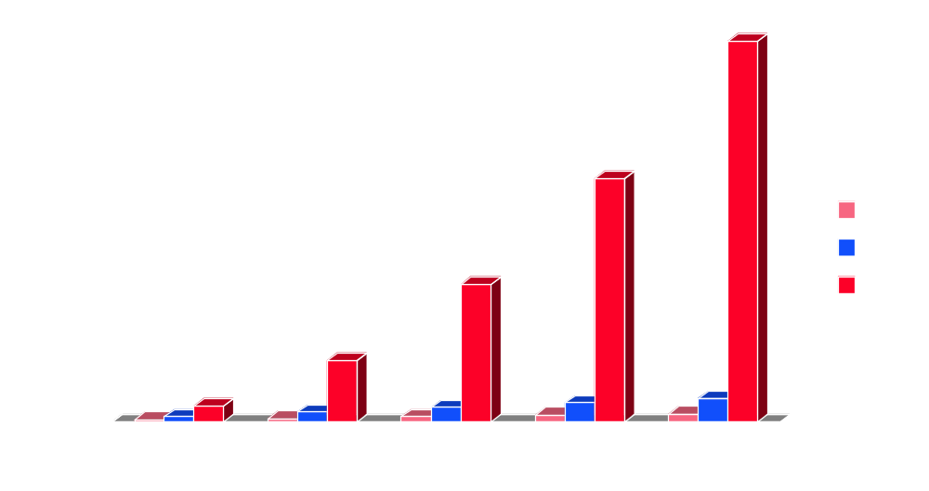
Graph of N vs. 3N vs. N²

Slide 41
Big Oh Notation
We often just state the “order of magnitude” of an algorithm
  the dominant term of the formula…
  …without any constants added
Written with capital O
  N + 75 = O(N) order N
  3N + 2 = O(N) order N
  N² + 3N – 1 = O(N²) order N squared

Slide 42
Exercises
What are the orders of magnitude of the following formulas?
  21N + 54.6
  121N² + 5N + 2000
  33N + 22²
  2700N + 3N² + 54
  12N^{3/2} + N³ + 9
  53N + 2 log N + 5

Slide 43
Standard Orders of Magnitude
O(1) constant time
O(log N) logarithmic time
O(N) linear time
O(N log N) order N log N
O(N²) quadratic time
O(N^{k}) polynomial time
O(2^{N}) exponential time

Slide 44
Comparison of Orders
1 log N N N² 2^{N}
1 0 1 1 2
1 1 2 4 4
1 2 4 16 16
1 3 8 64 256
1 4 16 256 65,536
1 5 32 1024 4,294,967,296
1 6 64 4096 ≈ 2*10¹⁹

Slide 45
Searching an Unsorted List
Finding out whether an item is in a list
  contains method
Linear search:
  loop thru list looking at each item
    stop when item found or no more list to look at
to linearSearch(arr, item):
for i = 0..arr.len-1:
if arr[i]=item:
return true
return false

Slide 46
Linear Search
Worst case? It’s not there!
  total of N comparisons → O(N)
But if it is there?
  best case: it’s first (1 comparison): O(1)
  worst case: it’s last (N comparisons): O(N)
  average case: any position equally likely!
    1 comparison, 2 comparisons, 3, 4, …, N
    average = (1 + 2 + 3 + … + N) / N
    = (N(N+1)/2) / N = (N+1)/2: O(N)

Slide 47
Best, Worst, Average
Number of operations often variable
  depends on specific values being used
  no single formula that states amount of work!
Formulas for best, worst may be easy to get
Formula for average usually a bit harder
Most interested in worst and average
  best is nice, but we don’t expect/worry about it
  expect average, prepare for worst

Slide 48
Searching a Sorted List
Improved linear search:
  stop when we pass where it should have been
should have been before 17
so it must not be there
Saves very little time, actually
  average case the same: half the places seen
  worst case: half the places seen (.: still O(N))
5
7
9
12
13
17
22
25
27
28
42
15

Slide 49
Cutting in Half
Binary search better:
  look at middle item
  if it is bigger than what we’re looking for, then we only need to look in the lower half
  if it’s smaller than what we’re looking for, then we only need to look in the upper half
  if it’s what we’re looking for – return the index
But the list needs to be sorted!

Slide 50
Binary Search
Find midpoint, compare it to the item
  too big → search lower part of array
  too small → search upper part of array
  otherwise → just right!
5
7
9
12
13
17
22
25
27
28
42
9

Slide 51
Binary Search
Repeat until found…
  too big → search lower part of array
  too small → search upper part of array
  otherwise → just right!
5
7
9
12
13
17
22
25
27
28
42
9

Slide 52
Binary Search
Find midpoint, compare it to the item
  too big → search lower part of array
  too small → search upper part of array
  otherwise → just right!
5
7
9
12
13
17
22
25
27
28
42
4

Slide 53
Binary Search
Repeat until found…
  too big → search lower part of array
  too small → search upper part of array
  otherwise → just right!
5
7
9
12
13
17
22
25
27
28
42
4

Slide 54
Binary Search
Repeat until found…
  or until nowhere left to look
  (return fail)
5
7
9
12
13
17
22
25
27
28
42
4

Slide 55
Binary Search
int binaryFind(T item, T v[], int lo, int hi)
if (lo > hi)
return –1; // not found
int mid = lo + (hi – lo)/2;
if (item<v[mid])
return binaryFind(item, v, lo, mid–1);
if (v[mid]<item)
return binaryFind(item, v, mid+1, hi);
return mid; // found

Slide 56
Binary Search in Java
So massively useful there’s a method for it:
  int posn = Arrays.binarySearch(arr, item);
  returns position of item in (sorted) arr
    returns –(insertionPoint + 1) if not found
    4 would be inserted at position 0, so return -1
    14 would be inserted at position 5, so return -6
    47 would be inserted at position 11, so return -12
4
(-1)
9
(2)
14
(-6)
47
(-12)
5
7
9
12
13
17
22
25
27
28
42
0 1 2 3 4 5 6 7 8 9 10

Slide 57
Complexity of Binary Search
Worst case, we get half the list every time!
  assume N is a power of 2: N == 2^{k}
    1 comparison reduces list from 2^{k} to 2^{k-1}
    1 more comparison reduces from 2^{k-1} to 2^{k-2}
    …
    1 more comparison reduces from 2¹ to 2⁰ (i.e. 1)
    1 more comparison reduces from 2⁰ to 0
      #comparisons = k+1 = 1 + log N = O(log N)
  shorter lists: 1 + ceiling(log N) = O(log N)

Slide 58
Sorted Lists
Sorting a list gives big performance benefit
  O(N) vs. O(log N) for N = 1,000,000?
    1,000,000 vs. 20
Sorting lists is a very high priority
  lots of different sorting methods
  simplest methods not usually very good
    bubble sort, anybody?
  fastest methods usually hard to explain

Slide 59
Next Time
Sorting Arrays
  methods
  algorithmic analysis

