Slide 1
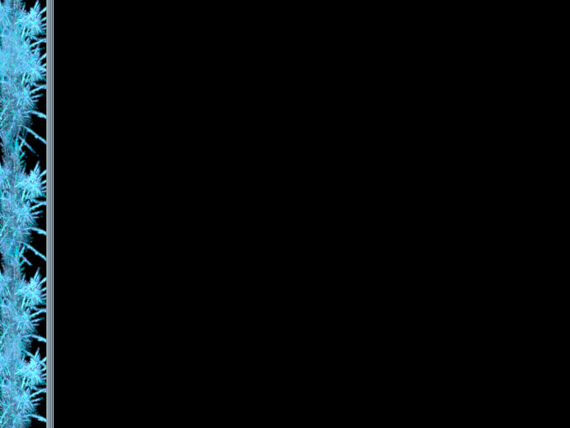
Programming
with Java

Slide 2
Chapter 1
Focuses on:
  components of a computer
  how those components interact
  how computers store and manipulate information
  computer networks
  the Internet and the World-Wide Web
  programming and programming languages
Read Sections 1.1-1.3 for background.
We will focus on 1.4-1.5.

Slide 3
Hardware and Software
Hardware
  the physical, tangible parts of a computer
  keyboard, monitor, wires, chips, data
Software
  programs and data
  a program is a series of instructions
A computer requires both hardware and software
Each is essentially useless without the other

Slide 4
Computer Architecture
Monitor
Central
Processing
Unit
Keyboard
Hard Disk
Main
Memory
Floppy Disk

Slide 5
Software Categories
Operating System
  controls all machine activities
  provides the interface to the computer
  manages resources such as the CPU and memory
  Windows 98, Windows NT, Unix, Linux, Mac OS
Application program
  generic term for any other kind of software
  word processors, missile control systems, games

Slide 6
Digital Information
Computers store all information digitally:
  numbers
  text
  graphics and images
  audio
  video
  program instructions
In some way, all information is digitized - broken down into pieces and represented as numbers

Slide 7
Representing Text Digitally
For example, every character is stored as a number, including spaces, digits, and punctuation
Corresponding upper and lower case letters are separate characters
H i , H e a t h e r .
72 105 44 32 72 101 97 116 104 101 114 46

Slide 8
Binary Numbers
Once information is digitized, it is represented and stored in memory using the binary number system
A single binary digit (0 or 1) is called a bit
A single bit can represent two possible states, like a light bulb that is either on (1) or off (0)
Combinations of bits are used to store values

Slide 9
Bit Combinations
1 bit
2 bits
3 bits
4 bits
0
1
00
01
10
11
000
001
010
011
100
101
110
111
0000
0001
0010
0011
0100
0101
0110
0111
1000
1001
1010
1011
1100
1101
1110
1111
Each additional bit doubles the number of possible combinations
There are 2^{N} combinations of N bits. so N bits are needed to represent 2^{N} unique items

Slide 10
Memory
9278
9279
9280
9281
9282
9283
9284
9285
9286
Main memory is divided into many memory locations (or cells)
Each memory cell has a numeric address, which uniquely identifies it

Slide 11
Storing Information
Each memory cell stores a set number of bits (usually 8 bits, or one byte)
9278
9279
9280
9281
9282
9283
9284
9285
9286
10011010
Large values are
stored in consecutive
memory locations

Slide 12
The Central Processing Unit
A CPU is also called a microprocessor
It continuously follows the fetch-decode-execute cycle:
Retrieve an instruction from main memory
fetch
execute
decode
Carry out the
instruction
Determine what the
instruction is

Slide 13
Problem Solving
The purpose of writing a program is to solve a problem
The general steps in problem solving are:
  Understand the problem
  Dissect the problem into manageable pieces
  Design a solution
  Consider alternatives to the solution and refine it
  Implement the solution
  Test the solution and fix any problems that exist

