Slide 1

Programming in Java
Friday, January 11, 2002

Slide 2
Today’s Agenda
Recap last class (section 1.4)
  Java Program Structure
  Comments
  White space
  Identifiers and reserved words
Learn about:
  How Java translates and executes our code (section 1.5)
  Using predefined objects (section 2.1)

Slide 3
Java Program Structure
// comments about the class
public class MyProgram
{
}
// comments about the method
public static void main (String[] args)
{
}
method header
method body

Slide 4
Comments
Comments in a program are also called inline documentation
They should be included to explain the purpose of the program and describe processing steps
They do not affect how a program works
Java comments can take two forms:
// this comment runs to the end of the line
/* this comment runs to the terminating
symbol, even across line breaks */

Slide 5
Identifiers
Identifiers are the words a programmer uses in a program
An identifier can be made up of letters, digits (0-9), the underscore character _, and the dollar sign $
They cannot begin with a digit (0-9)
Java is case sensitive, therefore Total and total are different identifiers

Slide 6
White Space
Spaces, blank lines, and tabs are collectively called white space
White space is used to separate words and symbols in a program
Extra white space is ignored
A valid Java program can be formatted many different ways
Programs should be formatted to enhance readability, using consistent indentation

Slide 7
Programming Language Levels
There are four programming language levels:
  machine language (01110110)
  assembly language (LDA 10)
  high-level language (c = a + b)
  fourth-generation language (end user programming)
Each type of CPU has its own specific machine language
The other levels were created to make it easier for a human being to write programs

Slide 8
Programming Languages
A program must be translated into machine language before it can be executed on a particular type of CPU
This can be accomplished in several ways
A compiler is a software tool which translates source code into a specific target language.
Often, that target language is the machine language for a particular CPU type
The Java approach is somewhat different

Slide 9
Java Translation and Execution
The Java compiler translates Java source code into a special representation called bytecode
Java bytecode is not the machine language for any traditional CPU
Another software tool, called an interpreter, (Java Virtual Machine – JVM) translates bytecode into machine language and executes it
Therefore the Java compiler is not tied to any particular machine

Slide 10
Java Translation and Execution
Hello.java
Java source
code
Java
bytecode
Hello.class
Java
compiler
Java
interpreter
Bytecode
compiler
javac Hello.java
java Hello
Machine
code

Slide 11
Syntax and Semantics
The syntax rules of a language define how we can put symbols, reserved words, and identifiers together to make a valid program
The semantics of a program statement define what that statement means (its purpose or role in a program)
A program that is syntactically correct is not necessarily logically (semantically) correct
A program will always do what we tell it to do, not what we meant to tell it to do

Slide 12
Examples of syntax and semantics
The cat is in the hat.
in Cat the Is hat the
The hat ate the cat.

Slide 13
Errors
A program can have three types of errors
The compiler will find problems with syntax and other basic issues (compile-time errors)
  If compile-time errors exist, an executable version of the program is not created
A problem can occur during program execution, such as trying to divide by zero, which causes a program to terminate abnormally (run-time errors)
A program may run, but produce incorrect results (logical errors)

Slide 14
What type of error?
Misspelled reserved words
Mismatching of data types
  Variable is an integer, assign a String to it
  Program expects integer, user enters String
Incorrect output values
Missing punctuation
Output in wrong format
Division by zero

Slide 15
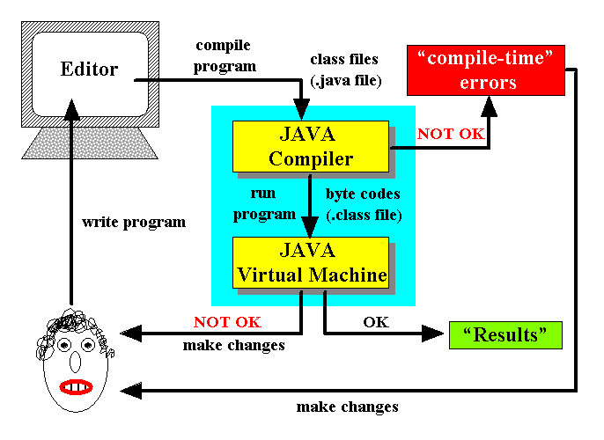
Programming and debugging
From http://www.scs.carleton.ca/~courses/105/Notes/105Notes1.htm#Java

Slide 16
Bugging
The deliberate introduction of errors into a program with correct syntax to see the types of errors the compiler generates.
Tips:
  At first, introduce only 1 error at a time so that you can clearly see the effect.
  Later, try errors in combination.

Slide 17
Anti-bugging
Defensive programming - designing, coding, testing and documenting so as to prevent as many errors as possible from occurring.
Making a program robust (guarding against incorrect user input).
Tips:
  Design on paper before entering code.
  Write small test programs to investigate points that you are unclear about.

Slide 18
Debugging
Discovering, locating and removing from a program the errors it contains.
Tips:
  Try to fix the earliest errors in the program first - this sometimes causes other errors to disappear.
  If errors are persistent, get a hard copy of the program and the errors.
  Ask for help! The staff at the Learning Center are quick to recognize common errors.

Slide 19
Objects and Primitive Data
We can now explore some more fundamental programming concepts
From Chapter 2, we will focus on:
  predefined objects
  primitive data
  the declaration and use of variables
  expressions and operator precedence
  class libraries

Slide 20
Data types
Primitive data (section 2.4)
  Common fundamental values
  Numbers, characters
Objects
  Usually more complex than primitive data types
  Sets of values and the operations that can be performed on the values

Slide 21
Introduction to Objects
Initially, we can think of an object as a collection of services that we can tell it to perform for us
The services are defined by methods in a class that defines the object

Slide 22
Println Method
We have invoked the println method of the System.out object:
System.out.println (“Hello world, I can print something!");
object
method
Information provided to the method
(parameters)
Object’s name is out – stored in the System
class
System.out represents an output device or file
(default is the monitor)
println method is an operation that we perform
on the System.out object

Slide 23
The println and print Methods
The System.out object provides another service as well
The print method is similar to the println method, except that it does not advance to the next line
Therefore anything printed after a print statement will appear on the same line
See Countdown.java (page 53)

Slide 24
Special character: \n
Can also embed new line characters in the string being printed:
System.out.print(“One line of text.\n”);
  is equivalent to
  System.out.println(“One line of text”);
See Countdown2.java
See Countdown3.java

