Slide 1
Graphical User Interfaces (GUIs)
Chapter 13
(available on the Web)

Slide 2
Overview
What is a GUI?
Creating GUIs in Java
GUI components & layout managers
GUI (sub)classes
Event control
(getting the GUI to do something)
NetBeans’ GUI design tool

Slide 3
What is a GUI?
Graphical User Interface
a graphical way to use the program
windows, icons, menus, pointing (WIMP)
Lots less typing for the user
Lots less things for them to remember
see options by looking
_
X
This is a GUI
File Edit Help
File Edit Help
Open
Save
——
Exit
Mrph
Blah
Yuck
Eeew
Gross
Dpbl
Xvgl

Slide 4
Getting Started
Java program that creates and shows a GUI
JFrame object with JLabels & more inside it
Program class has a main method
compile & run program as usual
GUI window will appear
we’ll need to do something special to make sure our program ends when it’s supposed to!

Slide 5
Java GUI
Java has two different GUI libraries
java.awt.* Frame, Label, …
javax.swing.* JFrame, JLabel, …
we need stuff from both of them
The Swing Tutorial
look up components in the following site: http://java.sun.com/books/tutorial/uiswing

Slide 6
The GUI Window
GUI starts with a window object
give a title for the window
JFrame win = new JFrame(“My Win”);
Nothing happened!
actually an invisible window was created
win.setVisible(true);
It’s tiny!
but you can resize it
See GUIStuff.java

Slide 7
The GUI Window
JFrame win = new JFrame(“My Win”);
win is a variable – will be the window object
JFrame is the class we’re creating an instance of (class of windows)
title of window (in title bar): “My Win”
win.setVisible(true);
win is the window object
setVisible is the command
true is the argument → true = visible

Slide 8
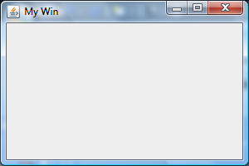
Making it Bigger at the Start
Don’t want to have to re-size every window
win.setSize(300, 200);
300 pixels wide
200 pixels tall
exactly how big that is depends on your screen resolution (number of pixels per inch)
NOTE: dimensions are of outer edges
200
300

Slide 9
Our Window So Far
Title bar
cup of java icon
title of window
min., max. & close buttons
otherwise empty
Note:
looks like other windows on your computer
will look like Mac window on Mac computer

Slide 10
Things to Add to Your Window
All in javax.swing:
JLabel – text for user to read
JTextField – box for user to type in
JButton – button for user to push
JCheckBox – box for user to check/uncheck
JRadioButton – one radio button
ButtonGroup – for grouping radio buttons
…many more…

Slide 11
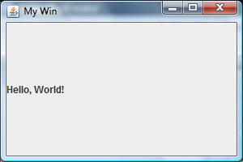
Labels
Label needs to know its text
need to tell the window to repaint itself
JLabel lbl1 = new JLabel(“Hello, World!”);
win.add(lbl1);
win.setVisible(true);
Didn’t say where to put the label, so it filled the pane
add method can be told where to put the object

Slide 12
Component Placement
Default “layout” gives you five places to put components:
PAGE_START (NORTH)
PAGE_END (SOUTH)
LINE_START (WEST)
LINE_END (EAST)
CENTER
Need to import java.awt.*;
use like: BorderLayout.NORTH
PAGE_START
LINE_START
CENTER
LINE_END
PAGE_END

Slide 13
Text Fields
Labels don’t do anything
For text you can edit, use JTextField
JTextField tf = new JTextField(“Initial Text”);
win.add(tf, BorderLayout.PAGE_END);
win.setVisible(true);
small amount of plain text
JTextPane for more text

Slide 14
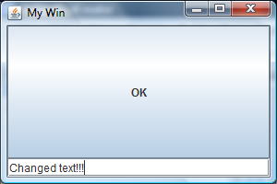
Buttons
Buttons can be clicked
lets the user select an action to carry out
JButton b1 = new JButton(“OK”);
win.add(b1);
win.setVisible(true);
computer put it CENTER, right over the label, because we didn’t say where it went

Slide 15
Window Layout Managers
It’s possible to tell the window exactly where you want each piece you add to it
how many pixels across, down
looks real good if you do it right
generally gets messed up if user resizes window
Easier and more portable to use manager
default manager: BorderLayout
others available: we’ll look at two more

Slide 16
Window Layout Managers
Window layout managers in java.awt
BorderLayout
CardLayout
FlowLayout
GridBagLayout
GridLayout
Each has its own way of determining what goes where…
We’ll look at
BorderLayout
FlowLayout
GridLayout
See GUIStuff.java

Slide 17
BorderLayout
Five locations to place objects
objects in the same location are placed one on top of the other
objects are stretched or squashed in order to fill the space allotted
empty locations are not used (other objects expand)
PAGE_START
LINE_START
CENTER
LINE_END
PAGE_END

Slide 18
FlowLayout
FlowLayout just puts the objects into the window one after the other
if there’s not enough room across, it goes down to the next “line”
objects centred on each line
objects move around when window gets resized
FIRST
SECOND
THIRD
FOURTH
FIFTH

Slide 19
GridLayout
Creates a small table
each object goes in the next cell of the table
Need to say how many rows and/or columns
new GridLayout(5, 3) →
don’t put more than 15 things in the grid!
(0, 3) means 3 columns and as many rows as you need
1st
2nd
3rd
Fourth
Fifth

Slide 20
Choosing a Layout Manager
Create a new layout object and tell the content pane to use it (setLayout method)
flow layout
win.setLayout(new FlowLayout());
border layout
win.setLayout(new BorderLayout());
grid layout (2 rows, 3 columns)
win.setLayout(new GridLayout(2, 3));

Slide 21
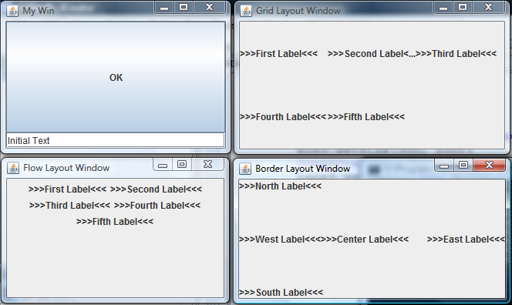
Some Windows

Slide 22
Putting it Together
We have created a lot of objects
window (JFrame), label (JLabel), text fields (JTextField), buttons (JButton)
Want them all to work together
but we’ve done it all in a very procedural way
should do object oriented way
Create a class for this kind of window
create window objects as required
(use main to test: create an object and show it)

Slide 23
GUI Window Class
Create a window class that inherits from the Java window class (javax.swing.JFrame)
public class MyWinClass extends JFrame {
constructor sets the title using super
public MyWinClass(String title) {
super(title);
…
then constructor adds stuff to this window

Slide 24
GUI Window Class
The object created will be a window object (in the class JFrame)
use this — there is no variable named win here
this.add(new JLabel(“Hello!”));
or use super – to get rid of NetBeans’ complaint
super.add(new JButton(“OK”));
Don’t make it visible in the constructor
let client decide when to make it visible

Slide 25
Adder Dialog Mock-Up
Adding Numbers
Enter two numbers to add together:
First number:
10
Second number:
25
Result:
35
Calculate
Done

Slide 26
Adder Dialog Grid Mock-Up
Adding Numbers
Enter two numbers to add…
note this empty cell…
First number:
10
Second number:
25
Result:
35
Calculate
Done

Slide 27
Adder Dialog (version 1)
public class AdderDialog1 extends JFrame {
public AdderDialog1() {
super(“Adding Numbers”);
this.setSize(450, 250); // or super.setSize(450, 250);
this.setLayout( new GridLayout(0, 2, 10, 5) );
… // add labels/fields/buttons to this window
}
}
? rows, 2 columns
10 pixels between columns
5 pixels between rows

Slide 28
Adder Dialog (version 1) main
public class AdderDialog1 extends JFrame {
…
public static void main(String[] args) {
AdderDialog1 ad1 = new AdderDialog1();
ad1.setVisible(true);
}
}
Create the window
Make it visible

Slide 29
Now Do Something!
Our windows do nothing
(other than resize)
Want actions to go with the buttons
read values from text boxes, maybe
add results & put back into another box
Need event controllers
methods that are called when something happens (e.g. button pushed)

Slide 30
Getting the Program to End
First we want the program to end when the adder dialog box is closed
JFrames have an easy way to do that
setDefaultCloseOperation(JFrame.EXIT_ON_CLOSE);
add that line to the constructor, and then closing the adder window ends the application
For other events, we need an ActionListener

Slide 31
The ActionListener Interface
One method needs to be implemented:
public void actionPerformed(ActionEvent ae) {…}
this called whenever anything happens in a component of the window
not when the minimize/resize/close buttons clicked
methods needs to see what event happened…
button clicked, text changed, …
…and deal with it
You don’t call this method!
It gets called when it’s needed: “event control”

Slide 32
Implementing ActionListener
You could make a separate class…
and create an object of that class
…but we will use the window class instead
we already have an object of that class: this
public class MyWindowClass extends JFrame implements ActionListener { … }
need to import more classes
import java.awt.event.*;

Slide 33
The actionPerformed Method
Has one parameter
an ActionEvent – an object representing the event that just occurred
knows which component the event happened to
ae.getSource()
check which button it is
if (ae.getSource() == done) { … }
else if (ae.getSource() == calculate) { … }

Slide 34
Our actionPerformed Method
If it’s the Done button:
exit the program
If it’s the Calculate button
get and add the numbers
we’ll have a separate method to do that
if (ae.getSource() == done) {
System.exit(0);
} else if (ae.getSource() == calculate) {
addTheNumbers();
}

Slide 35
Two More Things…
Our buttons need to be instance variables
so actionPerformed can talk to/about them
private JButton done = new JButton(“Done”);
private JButton calculate = new JButton(“Calculate”);
We need to say this window is listening
it’s the ActionListener for that button
done.addActionListener(this);
calculate.addActionListener(this);

Slide 36
Listening?
User clicks a button
button sends a message to every object listening
those objects do what they need to do
exit program
add up the numbers
Our window has the number fields in it
it’s the one that can do the adding…
…so it should be listening to calculate
(and since it’s listening anyway, why not done)

Slide 37
Our Adder Dialog So Far
Clicking the close box or Done button closes the window and ends the application
Clicking on the Calculate button
calls our addTheNumbers method
currently a stub!
Need to say how to add the numbers
need to get the two numbers from the text fields
add them up & put result in result field

Slide 38
Getting & Setting Text Fields
Getter & setter for JTextFields
gets/sets the text in the text field
field1.setText(“Hello?”);
String f1Text = field1.getText();
use getText to get the numbers the user typed in
use setText to show the result
Now we just need the text fields…
they need to be instance variables, too!

Slide 39
Keeping Track of Your Fields
Window needs to remember its fields
instance variables
private JTextField numField1 = new JTextField();
private JTextField numField2 = new JTextField();
private JTextField resultField = new JTextField();
constructor adds them to the window
super.add(numField1);
super.add(numField2);
super.add(resultField);

Slide 40
addTheNumbers
Get the text and parse it as an integer
int n1 = Integer.parseInt(numField1.getText());
getText gets the text from the box
parseInt tries to change it to an integer
may throw a NumberFormatException
Add them up
int result = n1 + n2;
Drop it back into resultField as text
resultField.setText(Integer.toString(result));

Slide 41
addTheNumbers
Catch the exception
set the result field to an error message
public void addTheNumbers() {
try {
int n1 = Integer.parseInt(numField1.getText());
int n2 = Integer.parseInt(numField2.getText());
int result = n1 + n2;
resultField.setText(Integer.toString(result));
}
catch (NumberFormatException e) {
resultField.setText(“One of those is not a number!”);
}
}

Slide 42
Formatting the Text Fields
Number fields should align to the right
numField1.setHorizontalAlignment(JTextField.RIGHT);
Result field shouldn’t be editable
resultField.setEditable(false);
Make some space around the box edges
Insets object gives number of pixels to be blank
top, left, bottom, right
Insets margin = new Insets(5, 5, 5, 5);
numField1.setMargin(margin);

Slide 43
Adding Sub-Panes
You can create a JPanel and put objects inside it…
using its own layout manager
JPanel top = new JPanel();
top.setLayout(new FlowLayout());
top.add(new JLabel(“Enter two numbers to add…”));
…then put the JPanel into the window
using the window’s layout manager
super.add(top, BorderLayout.NORTH);

Slide 44
Exercise: Adding Sub-Panes
BorderLayout for full window
NORTH, CENTER, SOUTH
FlowLayout for top pane
already done!
GridLayout for middle
3 rows, 2 columns
FlowLayout for bottom
Enter two numbers to add…
First number:
Second number:
Result:
Calculate
Done

Slide 45
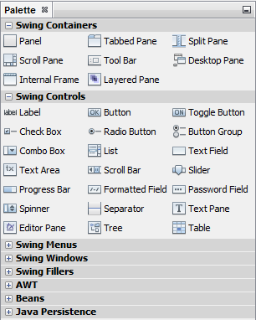
NetBeans GUI Designer
NetBeans provides a design tool
Add a new “JFrame Form…” to project
opens in “Design” view (instead of “Source”)
shows a “Palette” with containers & controls
and more, but collapsed
Sometimes NetBeans will switch to “Source” view.
Just click on the “Design” button to get back.

Slide 46
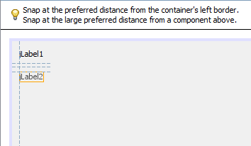
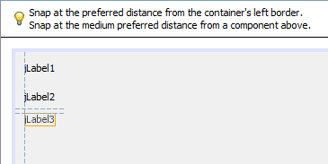
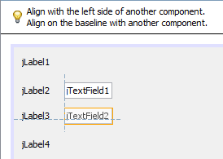
Adding Items to the Window
Drag and drop
watch guidelines for placement
wide space
medium space
align above and beside

Slide 47
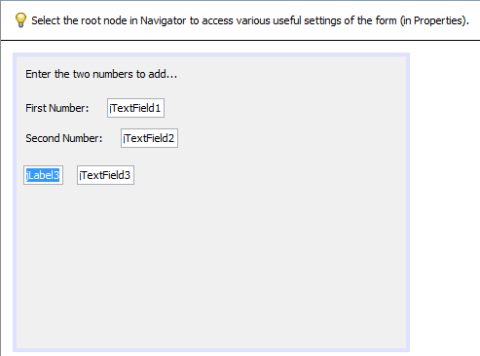
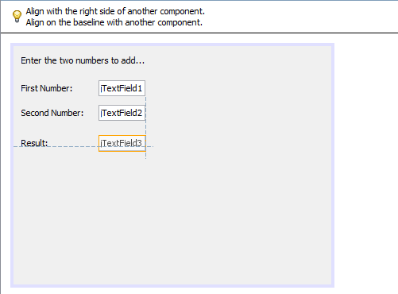
Setting Labels
Slow double-click label to set its text
other items may move relative to new label contents
fix them by dragging to line up with other text boxes

Slide 48
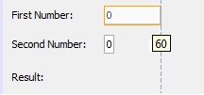
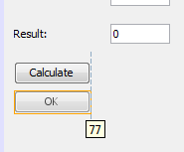
Sizing Text Boxes
Slow double click text fields to change text inside the box
box may resize
Select box and drag corner/edge to resize it
Similarly for buttons
I put it below “Calculate” so I could make them the same width
then I moved it to its final location

Slide 49
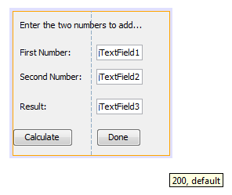
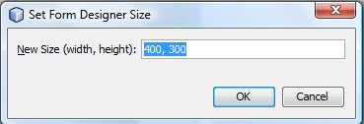
Resizing Window
Drag from bottom-right corner until you get the size you want
or double-click border and type in the dimensions you want

Slide 50
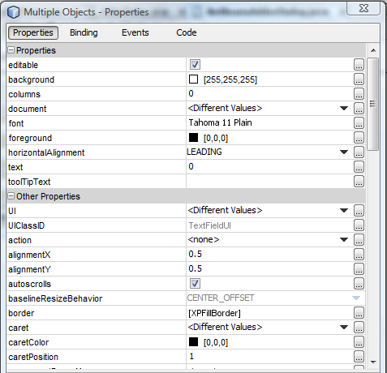
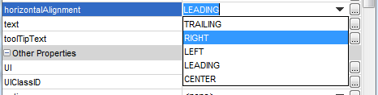
Changing Properties
Select the items to change
(e.g. all the text boxes)
Right-click to get properties
change as desired

Slide 51
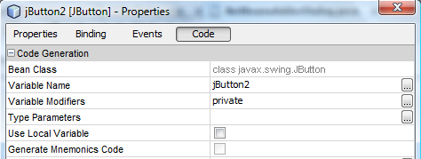
Changing Name
NetBeans gives blah names:
jTextField1, jTextField2, jButton1, jButton2
Should change to better names
variable name property in “Code” properties

Slide 52

Adding Actions
Double-click button to add an action
switches to “Source” mode…
...in the method that handles click of that button
Add code to do what you want

Slide 53

Differences
Code generated by NetBeans will look very different from what I told you before
code to lay out the fields is very different
code to add a listener to button is “anonymous”
creates unnamed object that just listens to the button
no need for window to listen
no need to check which button was pushed!

Slide 54
Exercise
Use NetBeans to make another adder form
use NetBeans’ layout tool
make the buttons work!

Slide 55
Questions?

