Slide 1
Computer Programming
Chapter 1

Slide 2
Computers
Personal computers
  desktop, laptop, and notebook machines
  web-surf, chat, write letters/papers, ...
Embedded systems
  games consoles, cell phones, cars, ...
    might not even notice you’re using a computer!
Servers
  web servers, file servers, cloud computing, ...

Slide 3
What is a Computer?
A machine that stores information and instructions for its own operation
Hardware = the machine part
Software = the stored stuff
Computer program = a set of instructions
  programmable = can set/change what it does

Slide 4
Computer Hardware...
Input devices (data into the computer)
  mouse, keyboard, microphone, touch screen, ...
Output devices (data out of the computer)
  monitor, speakers, printer, ...
Exercise:
  name some input and output devices/modes for
    iPod
    video game systems

Slide 5
...Computer Hardware...
CPU (Central Processing Unit)
  process the data (add, multiply, move, ...)
  understands the instructions
  may have extra CPUs (GPU, for example)
Main Memory
  remember what the computer’s working on
  volatile = lost when power goes out
  small(ish) capacity (megabytes/gigabytes)

Slide 6
...Computer Hardware
Secondary storage
  hold files when the power’s off
    use the open and save commands in a program
  large capacity (gigabytes/terabytes/...)
  Internal:
    hard disk, flash card
  External:
    USB drive, CD, DVD, ...
    punch cards, tape, floppy disk, ...

Slide 7
Computer Networks
Computers send messages to each other
  phone to web server: Can I have this page?
  web server to phone: Here it is.
“File Servers” remember files
  DropBox has computers that hold your files
    need to be on internet to get them
  J-drive on lab computers is a link to other computers here at SMU
    need to be on SMU file network to get them

Slide 8
Speed of Memory
The longer the trip, the longer it takes
  data in main memory is accessed FAST
    data in your cache is even faster!
  data on secondary storage is slow
  data on J-drive is even slower
    takes time to open/save files
  data on internet is slower still
Solid state memory faster than disk
  but also more expensive

Slide 9
What is “Memory”
Where information is stored
  your user data (photos, papers, messages, ...)
  your programs (browsers, word processors, ...)
Parts of memory
  bits: each either a 0 or a 1 (“binary digit”)
  bytes: 8 bits
    each byte has an address (is addressable)
  everything is represented with bits and bytes

Slide 10
Software
Data & instructions
  programs (instructions) manipulate data
  all represented with bits/bytes
Data hierarchy
  8 bits → byte
  1 or more bytes → data value (field)
  1 or more data values/objects → object (record)
  data may be stored on secondary memory (file)

Slide 11
Representing Data Values
Usually requires multiple bytes
  the letter ‘A’
  this colour
  the number 65
  the number 65.0
  the String “65.0”
Same byte values != same data
  similar data != same data
00000000
01000001
00000000
00000000
01000001
00000000
00000000
00000000
01000001
01000000
01010000
01000000
00000000
00000000
00000000
00000000
00000000
00000000
00000000
00000000
00000100
00110110
00110101
00101110
00110000

Slide 12
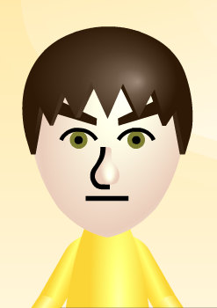
Representing Objects
Complex objects require lots of data
  some of which may be other objects (parts)
MiiAvatar:
Name: (String)
CreatorName: (String)
FavoriteColour: (byte)
MonthBorn: (byte)
DayBorn: (byte)
Height: (byte)
Weight: (byte)
FaceShape: (byte)
...

Slide 13
Users and Programmers
We are computer program users
  use a program already on the computer
  download a program and use it
The program was created by a programmer
  sometimes by a team of programmers
  you’re going to learn to be a programmer
    then you can use programs you made by yourself!

Slide 14
Programs
Instructions the computer can follow
Machine language executables
  Computers understand this – humans, not
High-level languages source code
  Humans can use these
  Need to be translated to machine language
LOTS of different languages
  lots of different kinds of languages

Slide 15
Programming Languages
Programmers create programs
Programs are instructions to the computer
  compare: recipes are instructions to cooks
Generally we write instructions
  but computers don’t understand English
    or any other natural language
  many special languages for programming
    programming languages

Slide 16
Example Languages
FORTRAN
LISP
ALGOL
COBOL
SNOBOL
PL/I
BASIC
APL
Pascal
Smalltalk
c
Prolog
Scheme
Modula
SQL
Ada
C++
Prograph
Perl
Python
Java
Javascript
C#
Ruby
and lots, lots more!

Slide 17
5. Rem calculate an average
10. sum = 0
20. count = 0
30. print(“Enter a number: ”)
40. input(n)
50. if n<0 goto 90
60. sum = sum + n
70. count = count + 1;
80. goto 30
90. ave = sum/count
100. print(“Average = ”, ave)
BASIC
an old beginners’ language

Slide 18
Program Average(Input, Output);
var sum, count, n: integer;
begin
sum := 0;
count := 0;
repeat
write(“Enter a number: ”);
read(n);
if n >= 0 then
begin
sum := sum+n;
count := count+1;
end
until n < 0;
writeln(“Average = ”, sum/count)
end.
Pascal
a “structured” language

Slide 19
#include <iostream> using namespace std;
void main() {
int sum = 0;
int count = 0;
int n;
cout << “Enter a number: ”;
cin >> n;
while (n > 0) {
sum += n; count++;
cout << “Enter a number: ”;
cin >> n;
}
cout << “Average = ” << sum/count;
}
C++
we used this language in 1226 until a few years ago

Slide 20
average(List, Average) :-
sumList(List, Sum),
length(List, Length),
Average is Sum / Length.
sumList([], 0).
sumList([Num | MoreNums], Total) :-
sumList(MoreNums, SubTotal),
Total is Num + SubTotal.
Prolog
a logic-programming language

Slide 21
average
^(self
inject: 0
into: [:element :tempsum |
tempsum + element])
/
self size.
Smalltalk
an object-oriented language

Slide 22
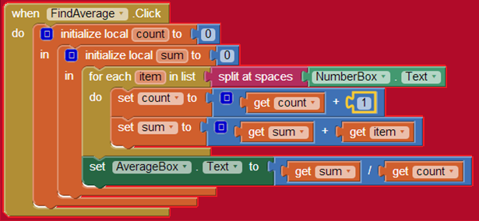
AppInventor
a graphical programming tool

Slide 23
#!/usr/bin/ruby
sum = 0
count = 0
puts "Enter a number“
number = gets.to_i
while number > 0 do
sum += number
count += 1
puts "Enter another number or 0 to quit"
number = gets.to_i
end
average = sum / count
puts "The average is #{average}."
Ruby
The language behind “Ruby on Rails” web design tool

Slide 24
Kinds of Languages
Imperative (*)
  tell it what to do
Functional
  specify processes
Logical
  specify meanings
  say what you want
Object Oriented (*)
  data & process abstraction
Parallel
  process control
Graphical
  use pictures

Slide 25
Translation
Human-usable languages = source code
  Computer doesn’t understand them
  Need to be translated to machine language
  (on Wintel machines: .exe files)
  Translator is called a compiler
#include <iostream>
using namespace std;
void main() {
cout << “Hi!”;
}
$^%#§&*^#½&Þ%^)J=®\|:”<± ₪ (*^&$%^ *(&T·¤Hi!•&^%$()&^&^^&^T^&”?+_)(“*(
C++ compiler
HiProg.cpp
HiProg.exe

Slide 26
Java
Java is an imperative language
  Tell computer what to do
Java is object-oriented
  Source code arranged like objects
  Objects know how to do things that need doing
Java is ideal for internet applications
  Compile once, run anywhere

Slide 27
Two Sides of Language
Syntax
  Grammar
  Valid structures
  How parts go together
Semantics
  Meaning
  Useful structures
  Specification of the process
Colourless green ideas sleep furiously.
Grammar OK
No meaning
Him falled down gotted owie.
Meaning clear
Not good English

Slide 28
Syntax & Compilation
Compiler will reject programs with invalid syntax
  this happens a lot
If the program’s syntax is OK, compiler gives object code = semantics of program
  means something
  not necessarily what you wanted it to mean!

Slide 29
Compiler Messages
Error message = you wrote it down wrong
  you need to fix it
Warning message = computer thinks what you wrote looks funny
  you should check to make sure you wrote it down right
No error messages or warnings
  program correct?

Slide 30
Logic & Run-Time Errors
Computer will do exactly what you said
  even if it’s not the right thing to do
  logic error
  example: add when you should multiply
Something may go wrong when the program is running
  run-time error
  tries to divide by zero, for example

Slide 31
Testing and Debugging
Bug = error
Don’t assume it works properly
Don’t just test normal cases
  program should behave “gracefully” even when stuff goes wrong (bad/no input data, e.g.)
  try to make run-time errors – then fix them!
The program isn’t done till it’s debugged

Slide 32
Exercise
Find the errors:
To find the area of a circle
1. get it’s diameter
2. raduis = diameter / pi
3. area = pi * radius * squared

Slide 33
Pseudocode / Algorithms
Program is instructions for computer
  recipe is instructions for cook
Can be in any programming language
  recipe can be in English, French, Korean, ...
Generally start in a mixture of English and some generic programming language
  called pseudocode (“almost code”)
  make an algorithm (steps to solve the problem)

Slide 34
to Find the Average of a List
create the count and sum variables
set count and sum to zero
for each number in the list
  add it to the sum
  add one to the count
set average to sum divided by count
report/return average
Typically when we write an algorithm, we number the steps in the order they’re to be done

Slide 35
Variables
Algorithm may need to remember things
  numbers, names, etc.
Values are stored in variables
  variable = may change its value
Each variable remembers a particular value
  count: how many numbers we added up so far
  sum: what the total is so far
  average: the number we’re looking for!

Slide 36
Exercise
Write an algorithm to calculate the area of a rectangle
  what more information do you need?
    where will you get it?
  write pseudo-code

Slide 37
Programming Programs
We use programs to write programs
  need to write the code (can use Notepad)
  need to compile (translate) the code (javac)
  need to run the code (java)
IDE: Integrated Development Environment
  use to write, compile and run
  JCreator, NetBeans, ...

Slide 38
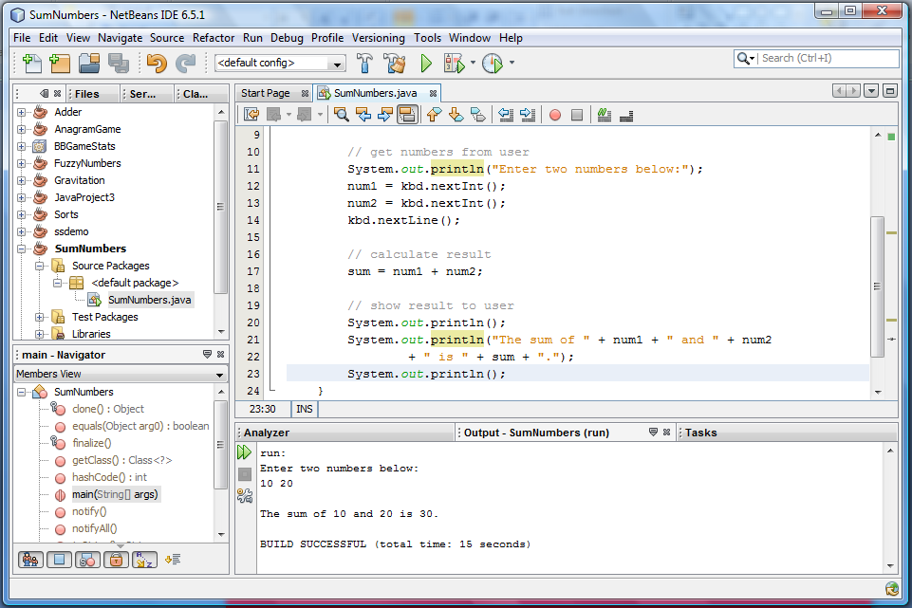
Our IDE (NetBeans)
List
of
projects
Program code
Program
parts
Program output

Slide 39
For This Course
Prefer you use NetBeans
  version 8.1, on desktop
    say “Yes” if it asks you about the default jdk thingy
Accessing files on J-drive can be slow
  may want to use a USB drive
    may want to transfer files to J-drive at end of labs
Can get NetBeans at home

Slide 40
Questions?

