Slide 1
Today’s Agenda
Any questions about the assignment (due Mon)?
Quiz
Quiz review
Homework for Friday:
  Watch the two videos on the Coursera db website that deal with relational algebra
  And/or read up on it from your favorite resource
Formalize concepts of database anomalies
If time, finish off our Transit Tables
4-1

Slide 2
Today’s slides from:
Chapter 4
The Database Management System Concept
Fundamentals of Database Management Systems
by
Mark L. Gillenson, Ph.D.
University of Memphis
John Wiley & Sons, Inc.

Slide 3
Objectives
List the three problems created by data redundancy.
Describe the nature of data redundancy among many files.
Explain the relationship between data integration and data redundancy in one file.
4-<number>

Slide 4
The Database Concept
Data Integration and Data Redundancy - The ability to achieve data integration while at the same time storing data in a nonredundant fashion. This, alone, is the central, defining feature of the database approach.
Multiple Relationships - The ability to store data representing entities involved in multiple relationships without introducing data redundancy or other structural problems.
4-<number>

Slide 5
Data Integration and Data Redundancy
Data integration - the ability to tie together pieces of related data within an information system.
Data redundancy - the same fact about the business environment is stored more than once within an information system.
4-<number>

Slide 6
Data Redundancy - Problems
Redundant data takes up a great deal of extra disk space.
If the redundant data has to be updated, it takes additional time to do so. This can be a major performance issue.
There is the potential for data integrity problems.
4-<number>

Slide 7
Data Integrity
Refers to the accuracy of the data.
Inaccurate data leaves the whole information system of limited value.
4-<number>

Slide 8
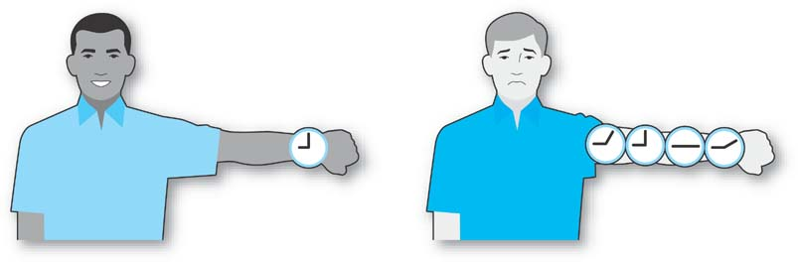
Data Redundancy,
Data Integrity
When all copies of redundant data are not updated consistently, a data integrity problem exists.
4-<number>

Slide 9
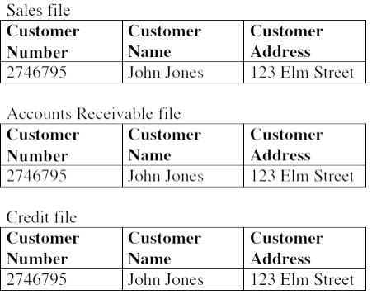
Three Files with Redundant Data
4-<number>

Slide 10
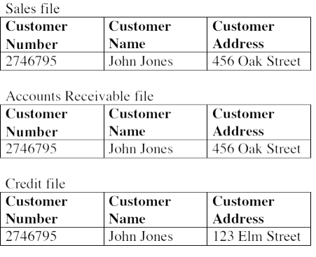
Three Files with a Data Integrity Problem
4-<number>

Slide 11
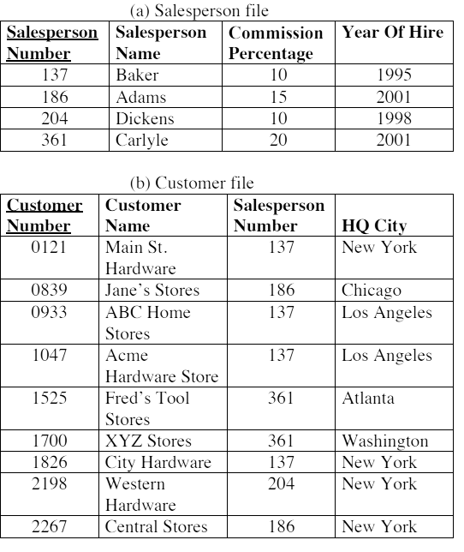
General Hardware Company Files
4-<number>

Slide 12
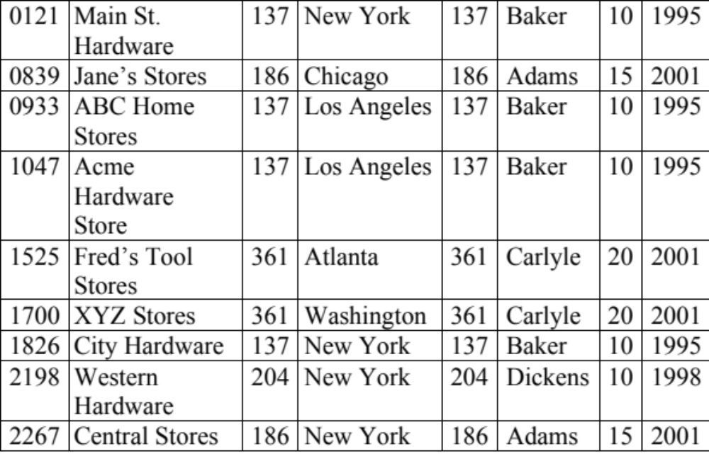
General Hardware Company Combined File
4-<number>

Slide 13
Anomalies
Typically occur in poorly structured files.
Problems arise when two different kinds of data, like salesperson and customer data are merged into one file.
4-<number>

Slide 14
Anomalies
Deletion Anomaly - e.g, if you delete a customer and that record was the only one for a salesperson, the salesperson’s data is gone.
Insertion Anomaly - e.g., General Hardware cannot add data about a new salesperson the company just hired until she is assigned at least one customer.
Update Anomaly - redundant data in the database file must be updated each place it exists when it changes
4-<number>

Slide 15
Database Management System
A software utility for storing and retrieving data that gives the end-user the impression that the data is well integrated even though the data can be stored with no redundancy at all.
4-<number>

Slide 16
How would you represent Sales and Customers?
What is the cardinality/modality of the relationship
How should we handle it?
4-<number>

Slide 17
In order to avoid anomalies, we normalize our tables
But first… we will start a side trip into Relational Algebra first
  Need to know the basic rules for how relational data is updated/deleted/combined/selected/projected in order to fully understand the implications of normalization
Do your homework for Friday – dive into relational algebra
4-<number>

Slide 18
“Copyright 2004 John Wiley & Sons, Inc. All rights reserved. Reproduction or translation of this work beyond that permitted in Section 117 of the 1976 United States Copyright Act without express permission of the copyright owner is unlawful. Request for further information should be addressed to the Permissions Department, John Wiley & Sons, Inc. The purchaser may make back-up copies for his/her own use only and not for distribution or resale. The Publisher assumes no responsibility for errors, omissions, or damages caused by the use of these programs or from the use of the information contained herein.”
4-<number>

