Slide 1
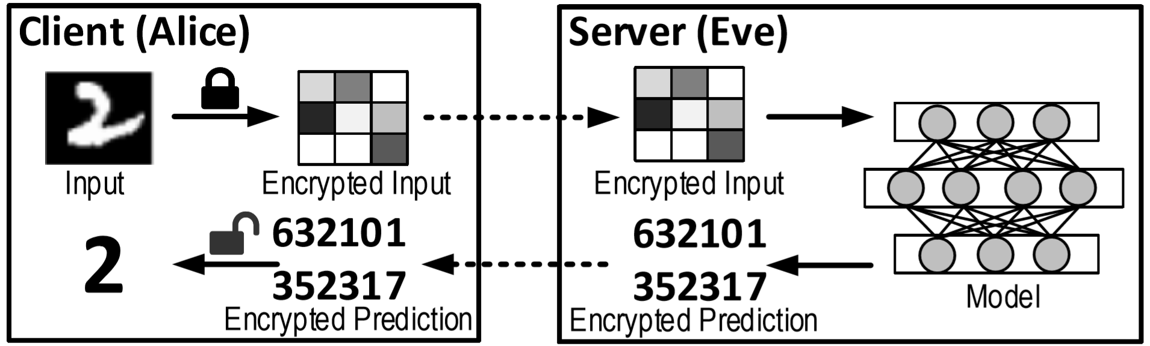
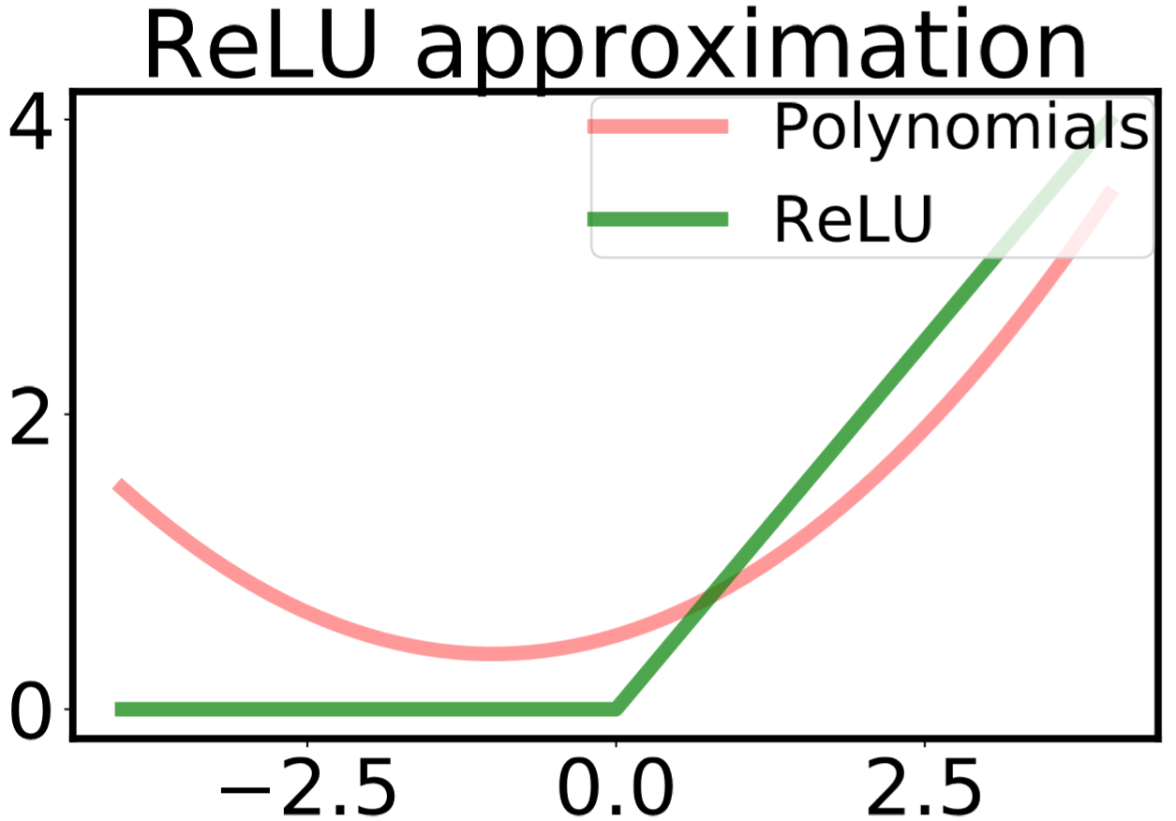
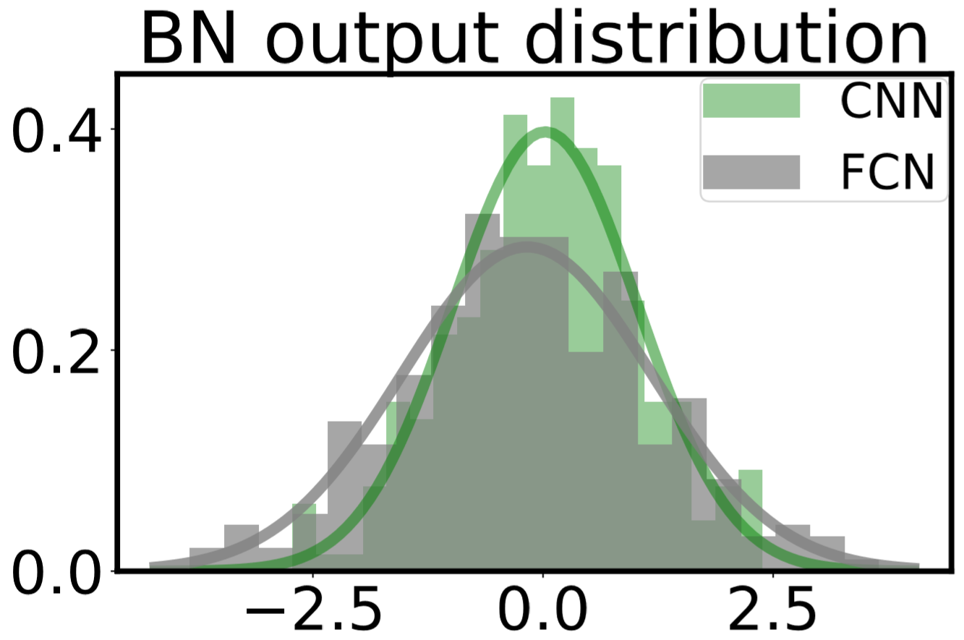
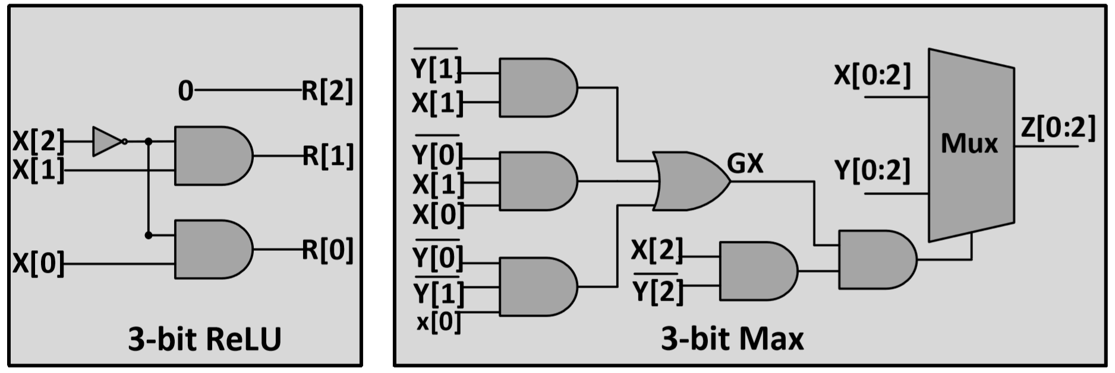
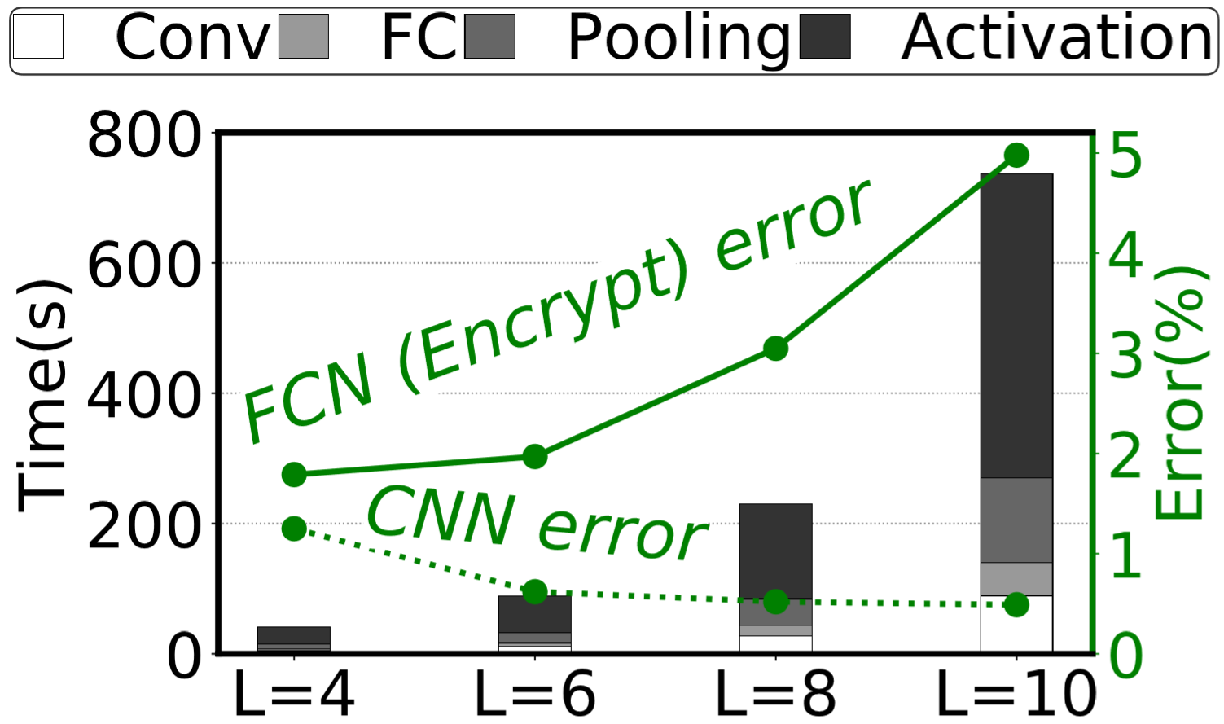
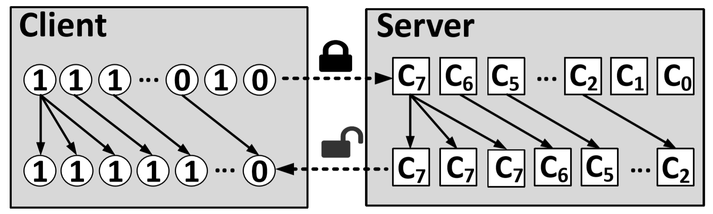
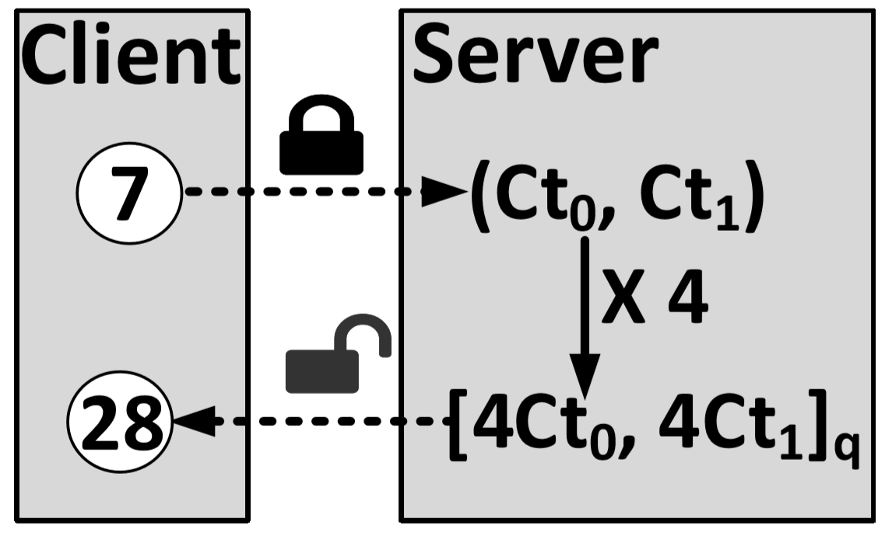
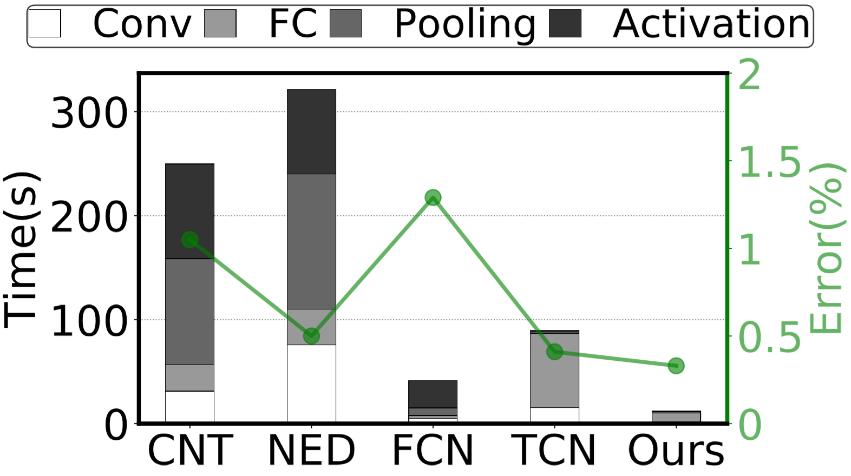

SHE: A Fast and Accurate Deep Neural Network
for Encrypted Data
Qian Lou, Lei Jiang
Indiana University Bloomington, USA
  Chou, E., Beal, J., Levy, D., Yeung, S., Haque, A., and FeiFei, L. Faster cryptonets: Leveraging sparsity for realworld encrypted inference. CoRR, abs/1811.09953, 2018. URL http://arxiv.org/abs/1811.09953.
Executive Summary
Introduction
Need: Fast and accurate deep Learning over encrypted data
Opportunities to improve privacy-preserving deep learning by the co-design of Homomorphic Encryption scheme and neural network optimization:
    Binary bits-operations-friendly TFHE encryption scheme
    Shift-Accumulation based quantization for neural network
Problem: Previous works stacked multiple & inaccurate ReLU activation and max pooling layers (Polynomials approximation):
Accuracy ↓ & overhead ↑ & shallow networks topology
Key Idea: Directly implementing ReLU and max using TFHE [1]; Using cheap Shift-Accumulation to support deeper neural networks other than acceleration.
SHE: Accuracy-lossless CNN, performance ↑76.12%, the first to support modern deep learning like AlexNet on ImageNet.
Thread Model
  Untrusted servers may lead to data leakage where the data from client-side users;
  Results sent to clients from servers are illegally utilized by adversarial.
Private Neural Networks by Homomorphic Encryption
  Untrusted servers learn encrypted data and output encrypted prediction
  Only clients with private key can decrypt the encrypted prediction
Problems
SHE Overview
Traditional Homomorphic Encryption schemes (B/FVs and HEAAN) uses polynomials like y=0.125x^2+0.25X+0.5 to approximate ReLU with large errors. Stacked multiple such inaccurate layers bring distribution distortion of latent variables.
SHE
    Support accuracy-lossless ReLU and Max → Accurate
    Logarithmic Quantization: Convolution to Shift-Accumulation → Fast
    TFHE scheme (Binary bits-operations and shift-operations friendly) → fast & deeper neural networks.
Inaccurate ReLU approximation
Distribution distortion
  Using TFHE scheme to implement ReLU and Max
  Left figures show 3-bit ReLU and Max
Name | Total Depth | Accuracy (%)
FCN[3] | 21K | 98.71
DiNN[5] | 0.8K | 93.34
SHE | 2.0K | 99.54
DSHE | 6.2K | 99.77
Accuracy-lossless 3-bit ReLU and Max
More errors with deeper neural network
Prior works require bigger circuits depth
Because of the distribution distortion of latent variables, even deeper neural network leads to more errors. Also, previous works like CNT [2], FCN [4] and NED [3] requires bigger circuits depth than SHE.
A TFHE shift
A shift in other schemes
Result
References
Name | Support ReLU | Support Max Pooling | No Convs | Deep Neural networks
CNT[2] | ✘ | ✘ | ✘ | ✘
NED[3] | ✘ | ✘ | ✘ | ✘
FCN[4] | ✘ | ✘ | ✘ | ✘
DiNN[5] | ✘ | ✘ | ✔ | ✘
SHE | ✔ | ✔ | ✔ | ✔
[1] Chillotti, et al. Tfhe: Fast fully homomorphic
Encryption over the torus. IACR Cryptology ePrint
Archive, 2018
[2] Dowlin, et al. Cryptonets: Applying neural
networks to encrypted data with high throughput
and accuracy. In ICML 2016
[3] Chou et al. Faster cryptonets: Leveraging
sparsity for realworld encrypted inference.
arXiv 2019.
[4] Hesamifard, et al. Deep neural networks
classification over encrypted data. In ACM
CDASP 2019.
The comparison between previous works and our work
The performance and accuracy comparisons
[5] Bourse,et al. Fast homomorphic evaluation of
deep discretized neural networks. In CRYPTO
2018.
IU Intelligent Systems Engineering
Qian Lou
Email: louqian@iu.edu, Phone:+18125586704

