Slide 1


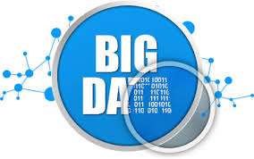

Parallel Processing with MapReduce in Big Data System
Presented by Qian Mai
CSCI 5551
Parallel and Distributed Systems

Slide 2

Outline
Motivation and general introduction
Big Data
Hadoop
Implementation
Notes:
The definition of Big Data
Big data structures
Big data sources
Samples of Big data
Growing trend of Big Data
Big Data Research Fields
Benefits of Big Data
Definition of Big Data
Two Key Components of Hadoop
Hadoop Distributed File System (HDFS) Architecture
Hadoop Distributed File System (HDFS) Data Flow
Hadoop Mapreduce
Advantage of Hadoop
The impact of Hadoop

Slide 3

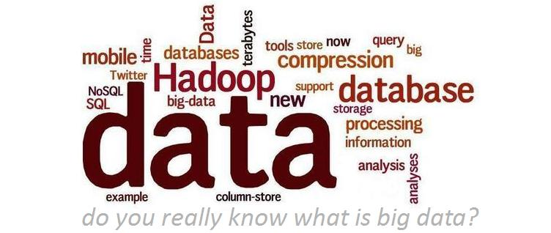
1. Motivation & General Introduction
Big Data is popular and maybe as important to business and society in many aspects.
MapReduce is a prominent parallel data processing tool and it is gaining significant momentum from both industry and academia
MapReduce performance is highly related to Big Data system environment
Notes:
Big Data is popular and maybe as important to business and society in many aspects- as the Internet has become an indispensable part of our daily life. MapReduce is known for a prominent parallel data processing tool and is gaining significant momentum from both industry and academia as the volume of data to analyze grows rapidly. As is known to all, MapReduce performance is highly related to Big Data system environment, for example, the number of nodes in Hadoop, some configuration such as Shuffle, Combiner class.

Slide 4

1. Motivation & General Introduction
Division of team work
Big data (Me)
Hadoop (Me)
MapRdeuce (Bogki)
Our Project…(Bogki)

Slide 5

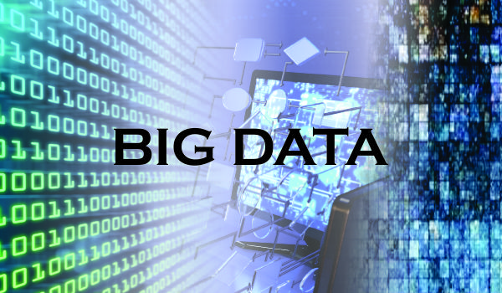
2. Big Data
What is Big Data?
Big data is an all-encompassing term for any collection of data sets so large and complex that it becomes difficult to process using traditional data processing applications.

Slide 6

2. Big Data
File Size Conversion table
Name | Symbol | Binary Measurement | Decimal Measurement | Number of Bytes | Equal to
Kilobyte | KB | 2¹⁰ | 10³ | 1,024 | (1,024) B
Megabyte | MB | 2²⁰ | 10⁶ | 1,048,576 | (1,024) KB
Gigabyte | GB | 2³⁰ | 10⁹ | 1,073,741,824 | (1,024) MB
Terabyte | TB | 2⁴⁰ | 10¹² | 1,099,511,627,776 | (1,024) GB
Petabyte | PB | 2⁵⁰ | 10¹⁵ | 1,125,899,906,842,624 | (1,024) TB
Exabyte | EB | 2⁶⁰ | 10¹⁸ | 1,152,921,504,606,846,976 | (1,024) PB
Zettabyte | ZB | 2⁷⁰ | 10²¹ | 1,180,591,620,717,411,303,424 | (1,024) EB
Yottabyte | YB | 2⁸⁰ | 10²⁴ | 1,208,925,801,182,629,174,706,176 | (1,024) ZB
Notes:
Transactional data—these include data from invoices, payment orders, storage records, and delivery records.
Machine data—this can be data gathered from industrial equipment (for example, the latest generation of aircraft produce several terabytes of data on a single transatlantic flight), real-time data from sensors (including sensors on your smartphone or your heart rate monitor, not to mention the4m CCTV cameras around the UK), and web logs that track user behaviours online.
Social data—this could be data coming from social media services, such as Facebook Likes, Tweets and YouTube views.

Slide 7
2. Big Data
Volume
3Vs of Big Data
Terabytes
Records
Transactions
Tables; files
Big Data
Batch
Near time
Real time
Streams
Structured
Unstructured
Semistructured
All the above
Velocity
Variety
Notes:
Big data is composed of three parts: Volume (terabytes, petabytes), Variety (social networks, blog posts, logs, sensors, etc.) and Velocity (real-time or near-real-time).

Slide 8
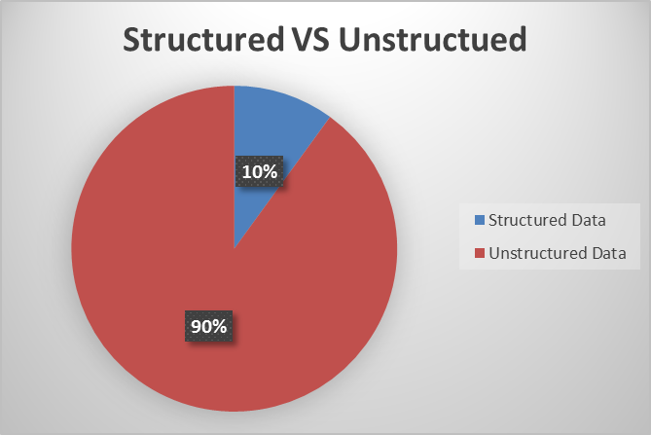
2. Big Data
The structured and unstructured of Data
Structured Data is Data that resides in a fixed field within a record or file is called structured data.
Unstructured Data is the data doesn't reside in a traditional row-column database
Notes:
Structured Data is store in enterprise application such as ERP.
Unstructured Data is not captured or not analyzed.
mostly wasted but it is challenge and opportunity that we are focusing and try to analyze and make it meaningful.

Slide 9



2. Big Data
Where does big data come from?
Transactional data
Machine data
Social data
Notes:
Transactional data—these include data from invoices, payment orders, storage records, and delivery records.
Machine data—this can be data gathered from industrial equipment (for example, the latest generation of aircraft produce several terabytes of data on a single transatlantic flight), real-time data from sensors (including sensors on your smartphone or your heart rate monitor, not to mention the4m CCTV cameras around the UK), and web logs that track user behaviours online.
Social data—this could be data coming from social media services, such as Facebook Likes, Tweets and YouTube views.

Slide 10
2. Big Data
Sample Data Types
Videos
Photos
Text Message
Books
Audios
Logs
Emails
Transactions
Images
Click Trails
Documents
Public Records
Notes:
They are from Users, Applications, Systems and Sensors.

Slide 11

2. Big Data
Sample Events Generating Data
Air bus generates 10 TB every 30 minutes which means about 640 TB is generated in one flight
300 billion Email are sent every day
Facebook generates 25 TB of data daily
Twitter generates 12 TB of data daily
2.9 billion video hours are watched on youtube per month

Slide 12

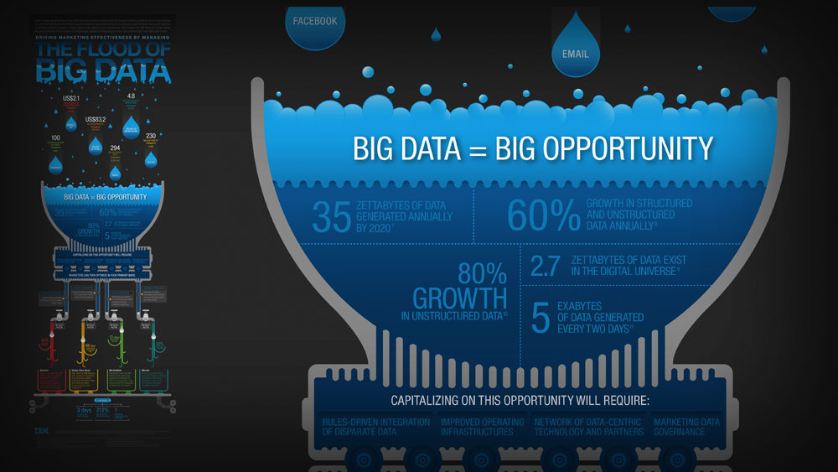
2. Big Data
How much data is there?
A Digital Universe study by Framingham, Mass.-based IDC.
In 2010, 1.2 million PB digital data is created per year
By 2020, 35 ZB digital data will be created per year

Slide 13
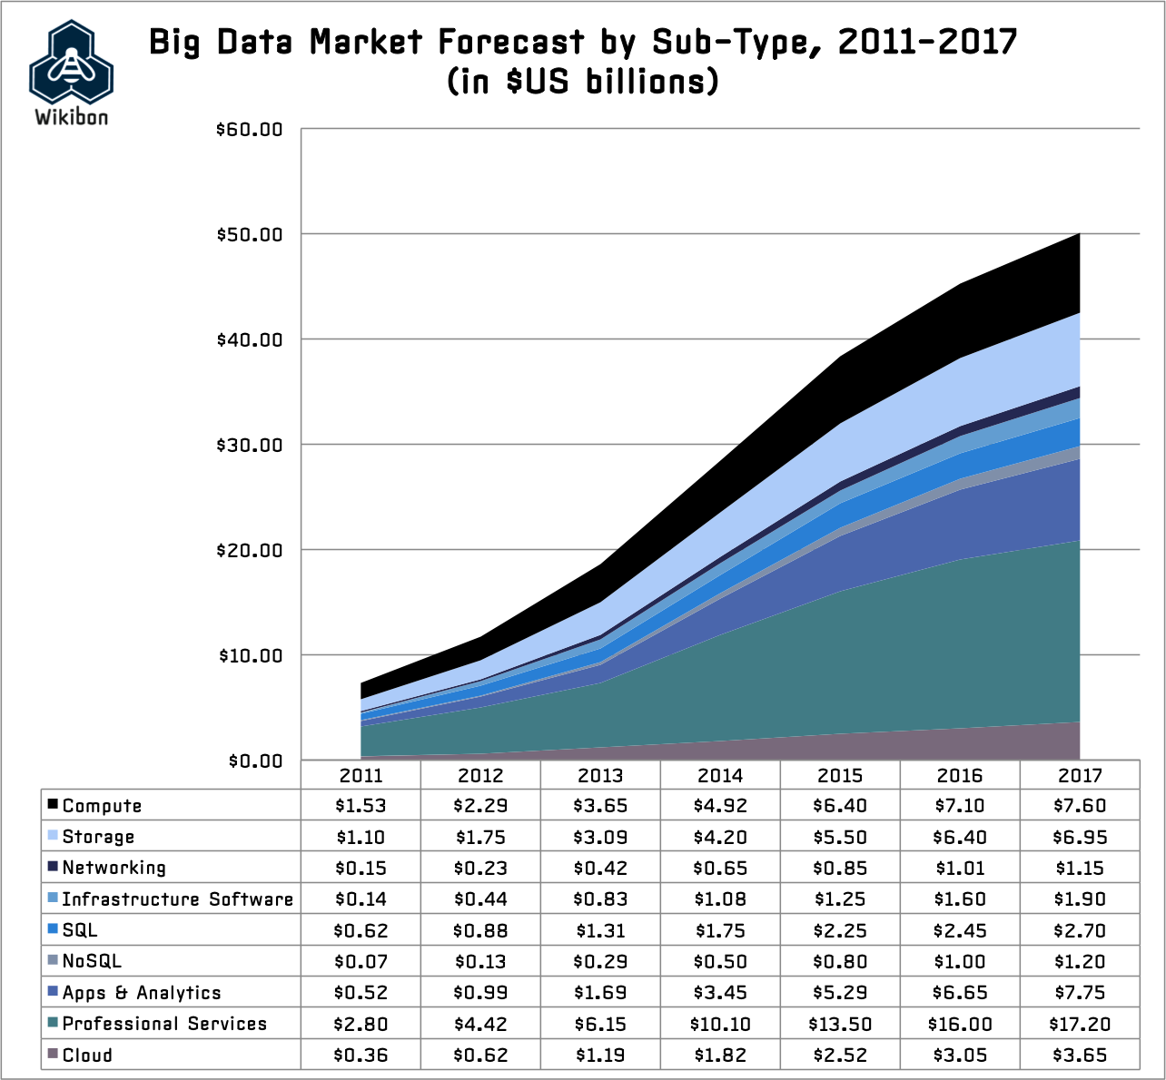
2. Big Data
How much data is there?
In 2013,
Services spends $7393 millions (40%)
Hardware spends $7149 millions (38%)
Software spends $4117 millions (22%)

Slide 14
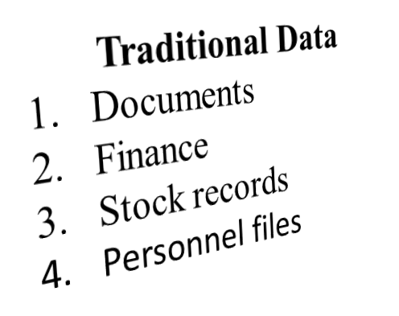
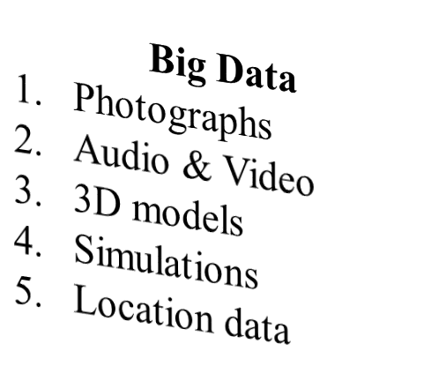

2. Big Data
Traditional Data vs Big Data

Slide 15
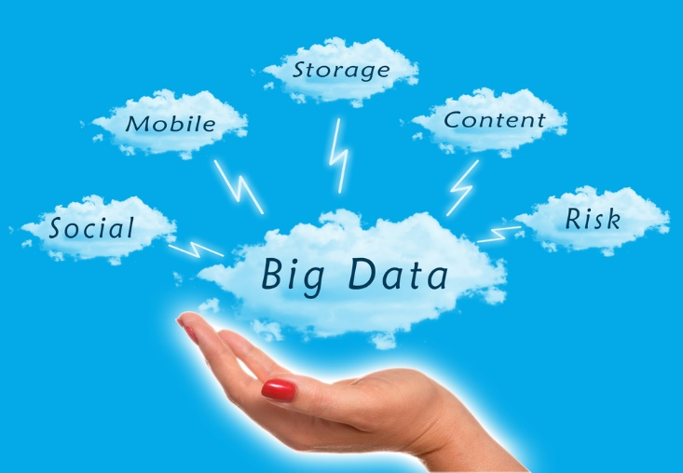
2. Big Data
Big Data Research Fields
Analysis
Capture
Curation
Search
Sharing
Storage
Transfer
Visualization
Privacy Violations
Notes:
The challenges include analysis, capture, curation, search, sharing, storage, transfer, visualization, and privacy violations. The trend to larger data sets is due to the additional information derivable from analysis of a single large set of related data, as compared to separate smaller sets with the same total amount of data, allowing correlations to be found to "spot business trends, prevent diseases, combat crime and so on.

Slide 16
2. Big Data
Benefits of Big Data
Understanding and Targeting Customers
Understanding and Optimizing Business Processes
Personal Quantification and Performance Optimization
Improving Healthcare and Public Health
Improving Sports Performance
Improving Science and Research
Optimizing Machine and Device Performance
Improving Security and Law Enforcement
Improving and Optimizing Cities and Countries
Financial Trading
Notes:
1. Understanding and Targeting Customers
This is one of the biggest and most publicized areas of big data use today. Here, big data is used to better understand customers and their behaviors and preferences. Companies are keen to expand their traditional data sets with social media data, browser logs as well as text analytics and sensor data to get a more complete picture of their customers. The big objective, in many cases, is to create predictive models. You might remember the example of U.S. retailer Target, who is now able to very accurately predict when one of their customers will expect a baby. Using big data, Telecom companies can now better predict customer churn; Wal-Mart can predict what products will sell, and car insurance companies understand how well their customers actually drive. Even government election campaigns can be optimized using big data analytics. Some believe, Obama’s win after the 2012 presidential election campaign was due to his team’s superior ability to use big data analytics.
2. Understanding and Optimizing Business Processes
Big data is also increasingly used to optimize business processes. Retailers are able to optimize their stock based on predictions generated from social media data, web search trends and weather forecasts. One particular business process that is seeing a lot of big data analytics is supply chain or delivery route optimization. Here, geographic positioning and radio frequency identification sensors are used to track goods or delivery vehicles and optimize routes by integrating live traffic data, etc. HR business processes are also being improved using big data analytics. This includes the optimization of talent acquisition – Moneyball style, as well as the measurement of company culture and staff engagement using big data tools.
3. Personal Quantification and Performance Optimization
Big data is not just for companies and governments but also for all of us individually. We can now benefit from the data generated from wearable devices such as smart watches or smart bracelets. Take the Up band from Jawbone as an example: the armband collects data on our calorie consumption, activity levels, and our sleep patterns. While it gives individuals rich insights, the real value is in analyzing the collective data. In Jawbone’s case, the company now collects 60 years worth of sleep data every night. Analyzing such volumes of data will bring entirely new insights that it can feed back to individual users. The other area where we benefit from big data analytics is finding love - online this is. Most online dating sites apply big data tools and algorithms to find us the most appropriate matches.
4. Improving Healthcare and Public Health
The computing power of big data analytics enables us to decode entire DNA strings in minutes and will allow us to find new cures and better understand and predict disease patterns. Just think of what happens when all the individual data from smart watches and wearable devices can be used to apply it to millions of people and their various diseases. The clinical trials of the future won’t be limited by small sample sizes but could potentially include everyone! Big data techniques are already being used to monitor babies in a specialist premature and sick baby unit. By recording and analyzing every heart beat and breathing pattern of every baby, the unit was able to develop algorithms that can now predict infections 24 hours before any physical symptoms appear. That way, the team can intervene early and save fragile babies in an environment where every hour counts. What’s more, big data analytics allow us to monitor and predict the developments of epidemics and disease outbreaks. Integrating data from medical records with social media analytics enables us to monitor flu outbreaks in real-time, simply by listening to what people are saying, i.e. “Feeling rubbish today - in bed with a cold”.
5. Improving Sports Performance
Most elite sports have now embraced big data analytics. We have the IBM SlamTracker tool for tennis tournaments; we use video analytics that track the performance of every player in a football or baseball game, and sensor technology in sports equipment such as basket balls or golf clubs allows us to get feedback (via smart phones and cloud servers) on our game and how to improve it. Many elite sports teams also track athletes outside of the sporting environment – using smart technology to track nutrition and sleep, as well as social media conversations to monitor emotional wellbeing.
6. Improving Science and Research
Science and research is currently being transformed by the new possibilities big data brings. Take, for example, CERN, the Swiss nuclear physics lab with its Large Hadron Collider, the world’s largest and most powerful particle accelerator. Experiments to unlock the secrets of our universe – how it started and works - generate huge amounts of data. The CERN data center has 65,000 processors to analyze its 30 petabytes of data. However, it uses the computing powers of thousands of computers distributed across 150 data centers worldwide to analyze the data. Such computing powers can be leveraged to transform so many other areas of science and research.
7. Optimizing Machine and Device Performance
Big data analytics help machines and devices become smarter and more autonomous. For example, big data tools are used to operate Google’s self-driving car. The Toyota Prius is fitted with cameras, GPS as well as powerful computers and sensors to safely drive on the road without the intervention of human beings. Big data tools are also used to optimize energy grids using data from smart meters. We can even use big data tools to optimize the performance of computers and data warehouses.
8. Improving Security and Law Enforcement.
Big data is applied heavily in improving security and enabling law enforcement. I am sure you are aware of the revelations that the National Security Agency (NSA) in the U.S. uses big data analytics to foil terrorist plots (and maybe spy on us). Others use big data techniques to detect and prevent cyber attacks. Police forces use big data tools to catch criminals and even predict criminal activity and credit card companies use big data use it to detect fraudulent transactions.
9. Improving and Optimizing Cities and Countries
Big data is used to improve many aspects of our cities and countries. For example, it allows cities to optimize traffic flows based on real time traffic information as well as social media and weather data. A number of cities are currently piloting big data analytics with the aim of turning themselves into Smart Cities, where the transport infrastructure and utility processes are all joined up. Where a bus would wait for a delayed train and where traffic signals predict traffic volumes and operate to minimize jams.
10. Financial Trading
My final category of big data application comes from financial trading. High-Frequency Trading (HFT) is an area where big data finds a lot of use today. Here, big data algorithms are used to make trading decisions. Today, the majority of equity trading now takes place via data algorithms that increasingly take into account signals from social media networks and news websites to make, buy and sell decisions in split seconds.

Slide 17
2. Big Data
How to analyze Big Data?
Notes:
Big data is most useful if you can do something with it, but how do you analyze it?

Slide 18

3. Hadoop
What is Hadoop?
Apache™ Hadoop® is an open source software project that enables the distributed processing of large data sets across clusters of commodity servers. It is designed to scale up from a single server to thousands of machines, with a very high degree of fault tolerance.
Notes:
The current big data leading technology is hadoop

Slide 19
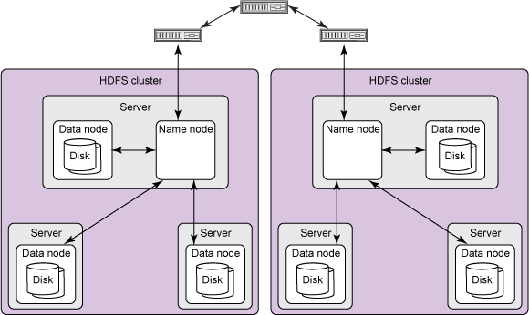
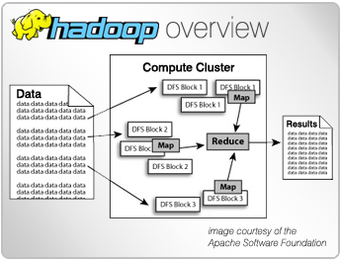
3. Hadoop
Two Key Components of Hadoop
1. Distributed File System
Distributed File System provides high boundary storage
2. MapReduce Engine
MapReduce is data processing frame work
Notes:
the file system, which is a distributed file system that splits up large files onto multiple computers, the other file system are also supported
and the MapReduce framework, which peform calculations and process large data stored on the file system.

Slide 20
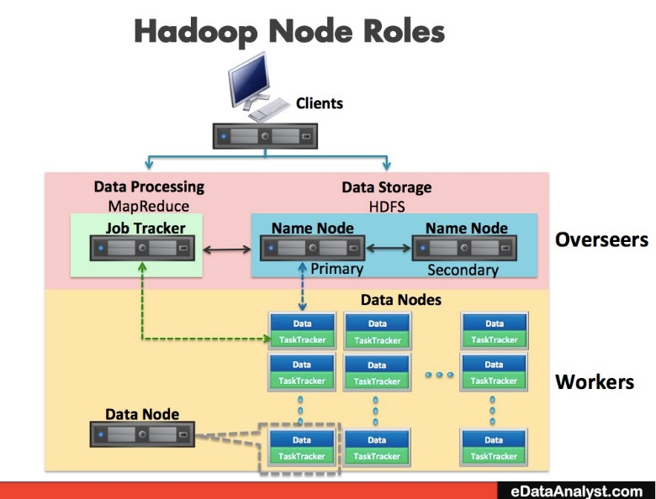
3. Hadoop
Hadoop Distributed File System (HDFS) Architecture
Notes:
Hadoop file system that runs on the top of existing file system
Designed to handle very large files with streaming or sequential data access patterns rather than random access. Sequential data access means fewer seats only sensitive at the beginning of each block
Uses blocks to store a file or parts of a file

Slide 21
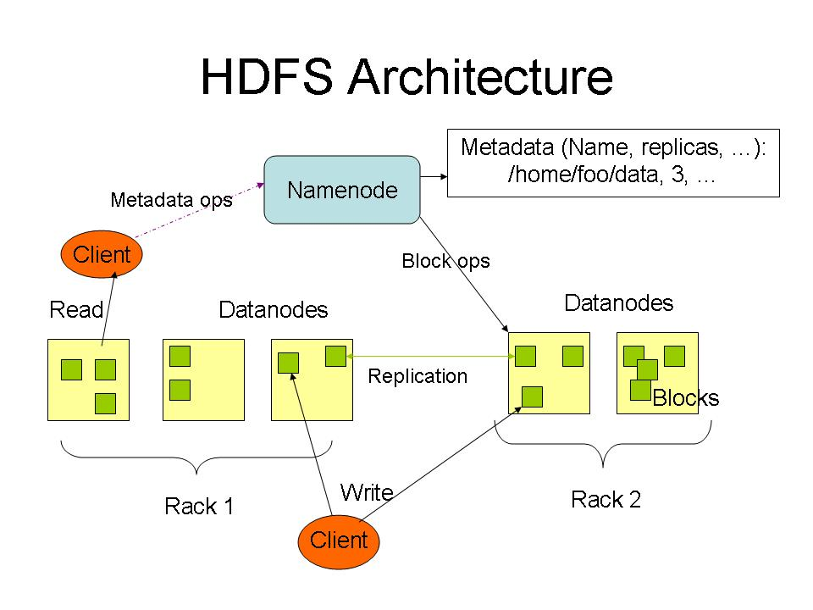
3. Hadoop
Hadoop Distributed File System (HDFS) Architecture cont'd

Slide 22
3. Hadoop
Hadoop Distributed File System Architecture Characteristics
Hadoop file system that runs on the top of existing file system
Designed to handle very large files with streaming or sequential data access patterns rather than random access.
Uses blocks to store a file or parts of a file
Notes:
Hadoop file system that runs on the top of existing file system
Designed to handle very large files with streaming or sequential data access patterns rather than random access. Sequential data access means fewer seats only sensitive at the beginning of each block
Uses blocks to store a file or parts of a file

Slide 23


3. Hadoop
File Blocks of Hadoop Distributed File System
Advantages of blocks:
Fixed size- easy to calculate how many fit on a disk
A file can be larger than any single disk in the network
Only needed space is used if a file is smaller than block size
Eg: 420MB file

Slide 24



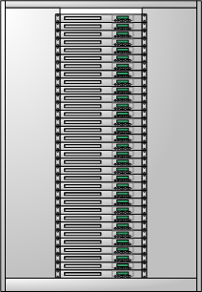


3. Hadoop
Hadoop Distributed File System (HDFS) Data Flow
Web Servers
Scribe Servers
Network Storage
Oracle RAC
Hadoop Cluster
MySQL
Notes:
Mapreduce is data processing frame work → Bogki

Slide 25
3. Hadoop
HDFS is Scalable, Reliable and Manageable
Highly scalable file system (6K nodes and 120PB)
Supports parallel reading and processing of the data
Fault Tolerant & Easy management
Notes:
Mapreduce is data processing frame work → Bogki

Slide 26
3. Hadoop
Hadoop Mapreduce
Notes:
Mapreduce is data processing frame work → Bogki

Slide 27
3. Hadoop
Hadoop Specification
Developer(s) | Apache Software Foundation
Stable release | 2.5.1 / September 12, 2014
Development status | Active
Written in | Java
Operating system | Cross-platform
Type | Distributed file system
License | Apache License 2.0
Website | hadoop.apache.org

Slide 28
3. Hadoop
Why Hadoop?
With its distributed processing, Hadoop can handle large volumes of structured and unstructured data more efficiently than the traditional enterprise data warehouse.
Hadoop is open source and can run on commodity hardware, the initial cost savings are dramatic and continue to grow as your organizational data grows.
Hadoop has a robust Apache community behind it that continues to contribute to its advancement.
Notes:
The complexity of modern analytics needs is outstripping the available computing power of legacy systems.

Slide 29
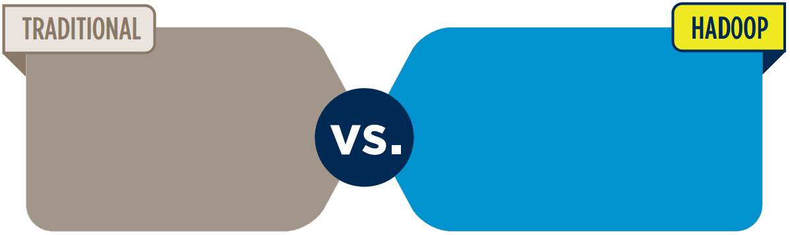
3. Hadoop
Hadoop vs. Traditional Database
Hadoop overcomes the
traditional limitations
of storage and compute.
Specialized hardware
Specialized software
Rigid data models
Structured databases
Commodity hardware
Open Source software
No data models required
Any data types
Leverage inexpensive,
commodity hardware
as the platform.
Expensive
Difficult
Complex
Cheap
Simple
Easy
Notes:
Mapreduce is data processing frame work → Bogki

Slide 30
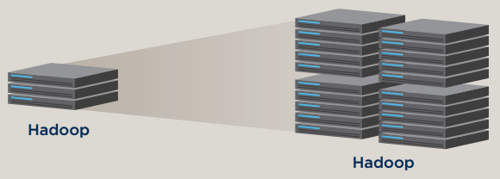
3. Hadoop
Hadoop vs. Traditional Database cont'd
Hadoop provides linear scalability 3 from 1 to 4000 servers.
Proprietary OS
Database
Storage Area Network
Low cost,
open source
software.
Hadoop

Slide 31
3. Hadoop
The impact of Hadoop
Scalable
Cost Effective
Flexible
Fault Tolerant
Notes:
Hadoop is scalable. New nodes can be added as needed without needing to change: data formats or how data is loaded or how jobs are written or the applications on top.
Hadoop brings massively parallel computing to large clusters of regular servers. The result is a sizeable decrease in the cost per terabyte of storage, which in turn makes analyzing all of your data affordable.
Hadoop is flexible. Because it is shcema-less, and can absorb any type of data, structured or not, from any number of sources. Data from multiple sources can be joined and aggregated in arbitrary ways, enabling deeper analyses than other system can provide.
If you lose a node, the system redirects work to another location in the cluster and continues processing without missing a beat. Programmers don’t have to write special code or be aware of the mechanics of the parallel processing infrastructure.
With the help of Hadoop, we can take data management and analytics to a whole new level.

Slide 32
3. Hadoop
Who uses Hadoop?
Amazon/A9
Facebook
Google
IBM
Joost
Last.fm
New York Times
PowerSet
Veoh
Yahoo!
Notes:
Mapreduce is data processing frame work → Bogki

Slide 33
4. Implementation
Install Big Data System (Hadoop) on Hydra
Collecting Source Data (100GB) at Amazon S3
Making MapReduce programming for analyzing the Big Data
Execute the MapReduce Program on different nodes (single, 2, 4, 8, 16)
Notes:
To realize above goal, we will set a Big Data system on Hydra and experiment MapReduce program with 100GB data at a various nodes, single, 2, 4, 8, and 16. To implement it and evaluate the results, we will follow as:

Slide 34
References
[1] Kyong-Ha Lee, Yoon-Joon Lee, Hyunsik Choi, Yon Dohn Chung, Bongki Moon, “Parallel Data Processing with MapReduce: A Survey”, In SIGMOD Record, December 2011 (Vol. 40, No. 4)
[2] Konstantin Shvachko, Hairong Kuang, Sanjay Radia, Robert Chansler, “The Hadoop Distributed File System”, In Proc, IEEE 2010,
[3] MapReduce Wikipedia, http://en.wikipedia.org/wiki/MapReduce
[4] J. Dean, S. Ghemawat, “MapReduce: Simplified Data Processing on Large Clusters,” In Proc. of the 6th Symposium on Operating Systems Design and Implementation, San Francisco CA, Dec. 2004.
[5] Amazon Public data sets, common crawl corpus, http://aws.amazon.com/datasets/41740
[6] Apache Hadoop, http://hadoop.apapche.org
[7] The Hadoop Distributed File System: Architecture and Design,
https://hadoop.apache.org/docs/r0.18.0/hdfs_design.pdf
[8] S. Huang, J. Huang, J. Dai, T. Xie, B. Huang, “The HiBench Benchmark suite: Characterization of the Mapreduce-Based Data Analysis”, In Proc. of IEEE 26th International Conference on Data Engineering Workshops, 2010

Slide 35



Slide 36


