Slide 1
Datapalooza 2019
Team: ACCFS
Team Member: Qianmei Wu – Department of Statistics
Jianxin Sun, Cong Wu – Department of Computer Science and Engineering
Jianwei Li – Department of Accountancy
Nam Le – Department of Finance

Slide 2
Methodology
Problem Formulation:
Predicting fitting scores of buying whole life insurance for a given US zip code
Solution Pipeline:
Feature Construction
Modeling
Validation
Clean Data
Scale Data
Assign Weight
Final Score
Model Validation
Identify Features
Collect Data
Feature Cluster

Slide 3









Features Construction
Modeling
Buy Whole Life Insurance
Economy
Median Household Income
Unemployment Rate
Family Type
Grandparent responsible for grandchildren
– parents not present
Health Status
Disability Percentage
Married couple families with children
– only one working
Single family with children
Size
Total Number of Households
Special Need
Special Needs Organizations Revenue
$$W_{0}$$
$$W_{1}$$
$$W_{2}$$
$$W_{3}$$
…
…
$$⨁=Score$$
$$W_{p−3}$$
$$W_{p−2}$$
$$W_{p−1}$$
$$W_{p}$$

Slide 4
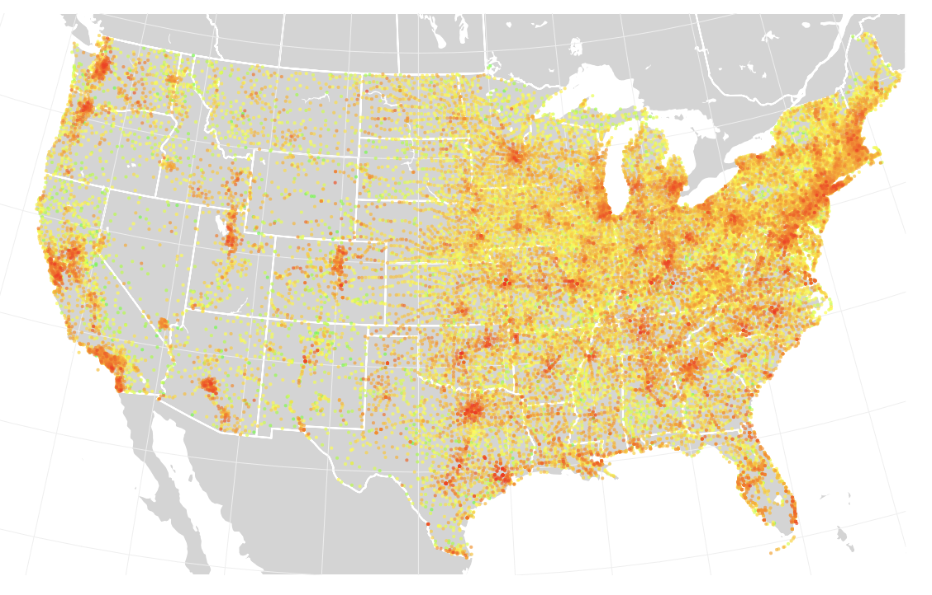
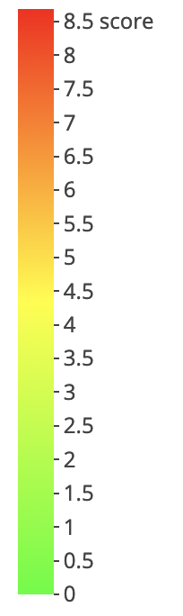
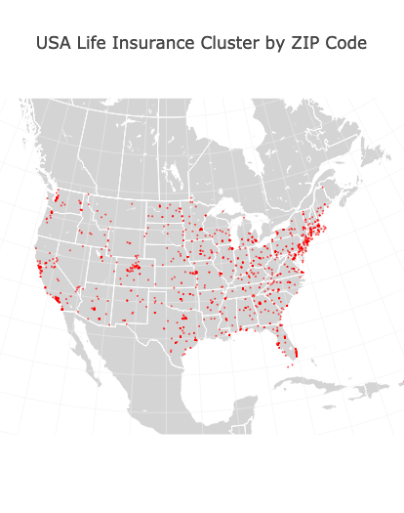
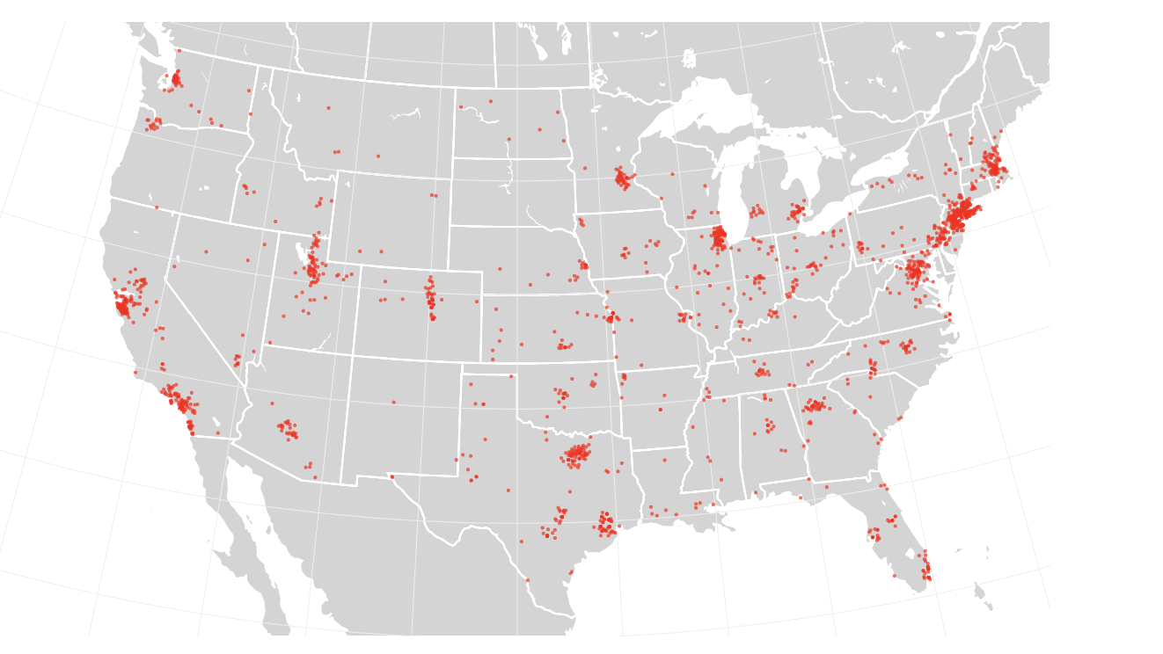
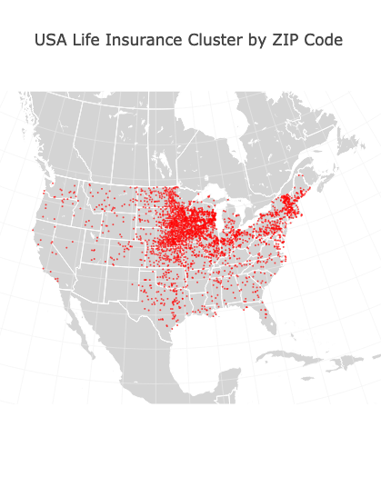
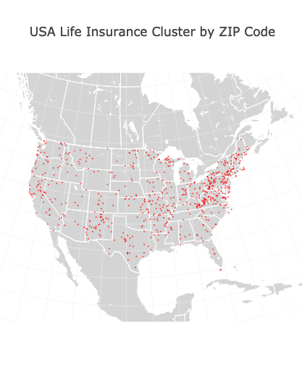
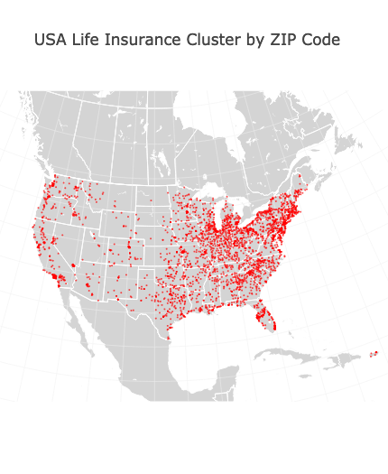
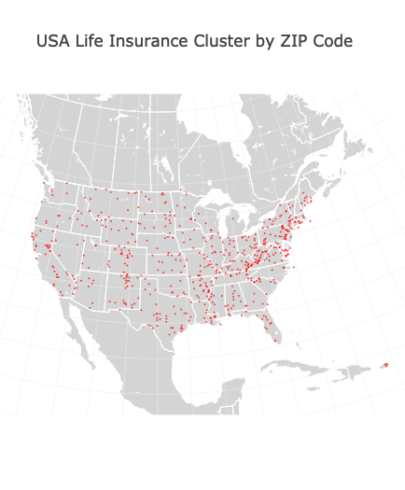
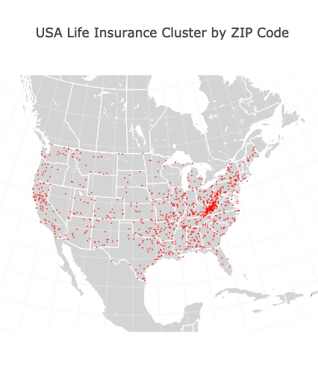
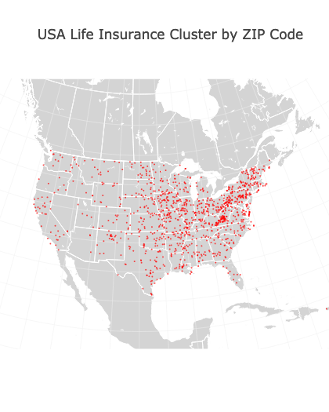
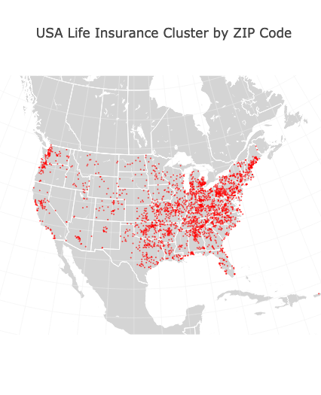
Result: All US Zip Code Scores
Best Matched Cluster: Cluster Number 9

Slide 5
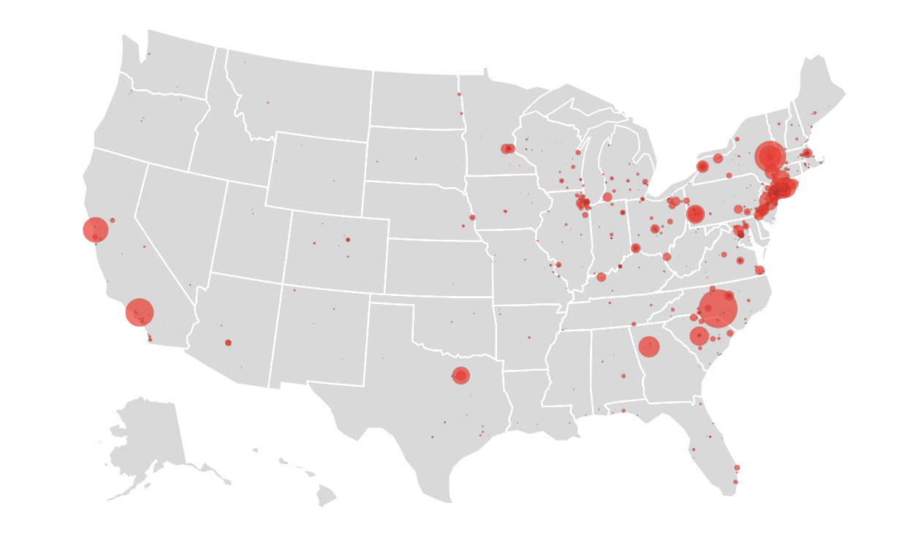
Extra Insights
Family of children with special needs (55percent)
Four types: Autism, Down Syndrome, Spinal Bifida, and Trisomy
Special Need Organization Distribution

