Slide 1

EXECUTIVE DEMO
AI-Powered Production Scheduling
CP-SAT Optimizer v2 · Multi-Week Planning
CONFIDENTIAL · INTERNAL USE ONLY
PRESENTER
DATE
FOCUS
Data Science Team
March 2026
Operations Research

Slide 2




THE PROBLEM
Manual Scheduling Costs Time & Money
Time Intensive
Planners spend 4–8 hours per week manually slotting orders, often reworking the plan multiple times.
8 Hrs
Planning Time
per week / planner
Constraint Violations
Complex rules like "Space out Rear Loader 2512" are easily missed by human planners.
~85%
Rule Compliance
manual error rate
Sub-Optimal Balance
Manual plans often overload specific days or lines, leading to overtime and bottlenecks.
Local
Optimization
vs Global Optimum
Current State Analysis

Slide 3




THE SOLUTION
Optimal Schedule in Seconds
Google OR-Tools CP-SAT Solver delivers mathematically proven optimal plans instantly.
Speed
Precision
Flexibility
Generates a full week's schedule in under 10 seconds, replacing hours of manual work.
Guarantees 100% compliance with complex rules like spacing and day preferences.
Instantly adapts to new constraints, model mixes, or volume changes via parameters.
AI-Powered Optimization

Slide 4





INPUT DATA
Real Production Data
153 Orders · 14 Model Types · 3 Production Lines
153
3
14
3
TOTAL UNITS
WEEKS (14-16)
MODEL TYPES
PROD. LINES
Week 14
Apr 2026
Week 15
Apr 2026
Week 16
Apr 2026
Volume
50 Units
Volume
50 Units
Volume
53 Units
Mix
13 Models
Mix
13 Models
Mix
11 Models
CHARACTERISTICS
CONSTRAINTS
CHALLENGE
Standard production mix. Baseline for testing balance logic.
Includes DC Refuse Stock (Friday priority) and Rear Loader spacing.
High Volume (+6%). Requires tighter packing and precise spacing.
Data Source: daily_tactical_scheduler_v2_2_2026.csv

Slide 5






HOW IT WORKS
Three Steps from Data to Optimal Schedule
1
2
3
Input Demand
Apply Constraints
Solve & Visualize
Upload production orders (CSV) with model, line, and constraint flags. System auto-groups by Exit Factory Year & Week.
Solver enforces 4 special rules (spacing, day preferences) plus balance objectives (Alpha, Beta) via CP-SAT.
CP-SAT engine finds the optimal schedule in <10 seconds. Interactive dashboard displays results with heatmaps and compliance reports.
Optimizer Workflow

Slide 6





BUSINESS LOGIC
Advanced Constraint Engine
Rear Loader 2512
Rear Loader (PKRRLSB)
Constraint: Max 1 unit per day. Logic: Evenly spaced across the week (e.g., Mon, Wed, Fri) to prevent assembly line congestion.
Constraint: Specific day preference. Logic: Prioritize scheduling on Tuesday & Thursday to align with batch processing cycles.
HARD CONSTRAINT
SOFT PREFERENCE
Manual Side Loader (PKRML)
DC Refuse Stock
Constraint: Specific day preference. Logic: Prioritize scheduling on Tuesday & Thursday to match specialized labor availability.
Constraint: End-of-week priority. Logic: Prioritize scheduling on Friday to ensure immediate shipping to the Distribution Center.
SOFT PREFERENCE
SOFT PREFERENCE
Rules the Solver Respects

Slide 7

PERFORMANCE OVERVIEW
Week 16 Results
OPTIMAL Solution Found
120
All constraints satisfied. Global minimum imbalance.
OBJECTIVE SCORE
53
11
3
Total Units
Model Types
Active Lines
Highest volume week
Complex product mix
Lines 1, 2, and 3
Solver Output Summary

Slide 8
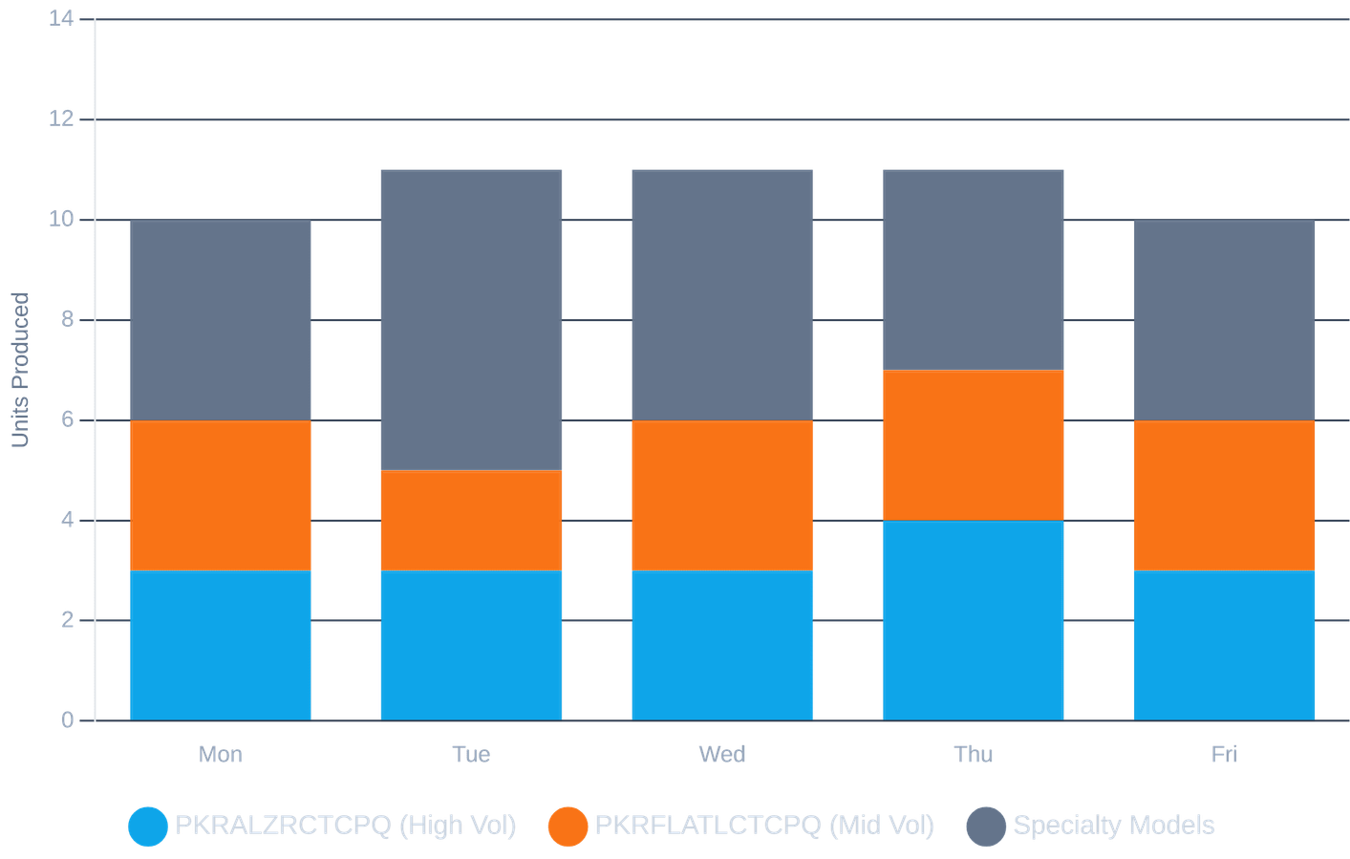
OPERATIONAL STABILITY
Leveled Daily Production Eliminates Bottlenecks
10.6
0%
AVG UNITS / DAY
OVERTIME RISK
No single day exceeds the 12-unit capacity threshold.
Perfectly balanced workload across the week (Range: 10–11 units).
±1
MAX VARIANCE
Stable rhythm ensures predictable material flow.
Week 16 Analysis

Slide 9
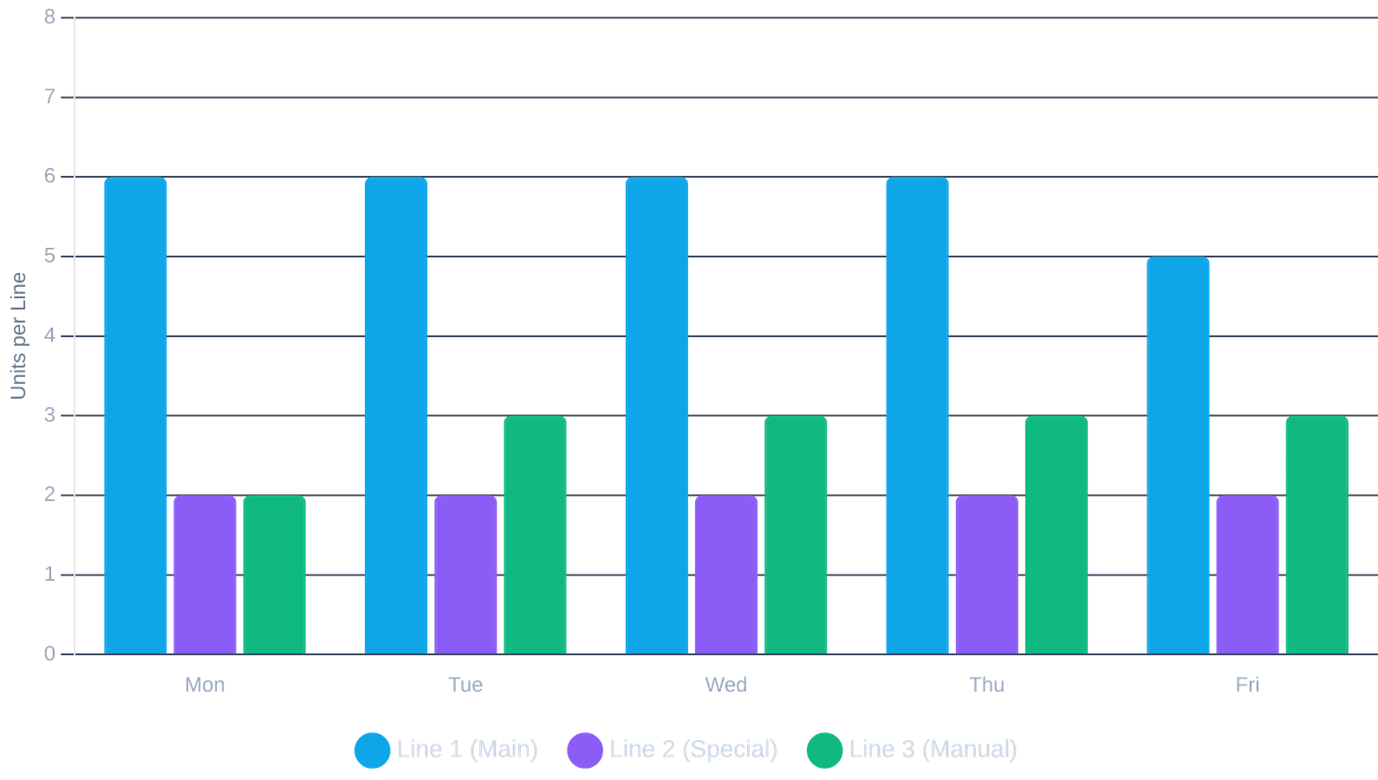
RESOURCE ALLOCATION
Balanced Line Utilization
Line 1
HIGH VOLUME
Steady flow of ~6 units/day. Handles 60% of total volume.
Line 2
SPECIALTY
Consistent ~2 units/day. Dedicated to complex builds.
Line 3
MANUAL OPS
Leveled at ~3 units/day. Prevents labor bottlenecks.
Week 16 Line Load

Slide 10




VALIDATION REPORT
100% Constraint Compliance Achieved
Rear Loader 2512 Spacing
REQUIREMENT
ACTUAL SCHEDULE
Max 1/Day · Evenly Spaced
Wed
Thu
Fri
Rear Loader (PKRRLSB) Preference
REQUIREMENT
ACTUAL SCHEDULE
Preferred: Tue / Thu
Tue
Manual Side Loader (PKRML) Preference
REQUIREMENT
ACTUAL SCHEDULE
Preferred: Tue / Thu
Thu
Week 16 Validation

Slide 11

VISUAL VERIFICATION
Schedule Heatmap: Every Model, Every Day
MODEL TYPE
MON
TUE
WED
THU
FRI
TOTAL
PKRALZRCTCPQ
3
3
3
4
3
16
PKRFLATLCTCPQ
3
2
3
3
3
14
PKRFL78CTCPQ
1
—
1
1
1
4
PKRRL3.5HDCTCPQ
1
1
1
—
1
4
PKRRLHDCTCPQ
1
—
1
1
1
4
PKRRLTAGCTCPQ
—
1
1
1
—
3
PKRRLXCCTCPQ
—
1
—
1
1
3
PKREVALZR
1
1
—
—
—
2
Daily Total
10
11
11
11
10
53
Production Intensity:
1 Unit
2 Units
3 Units
4+ Units
Week 16 Schedule Detail

Slide 12
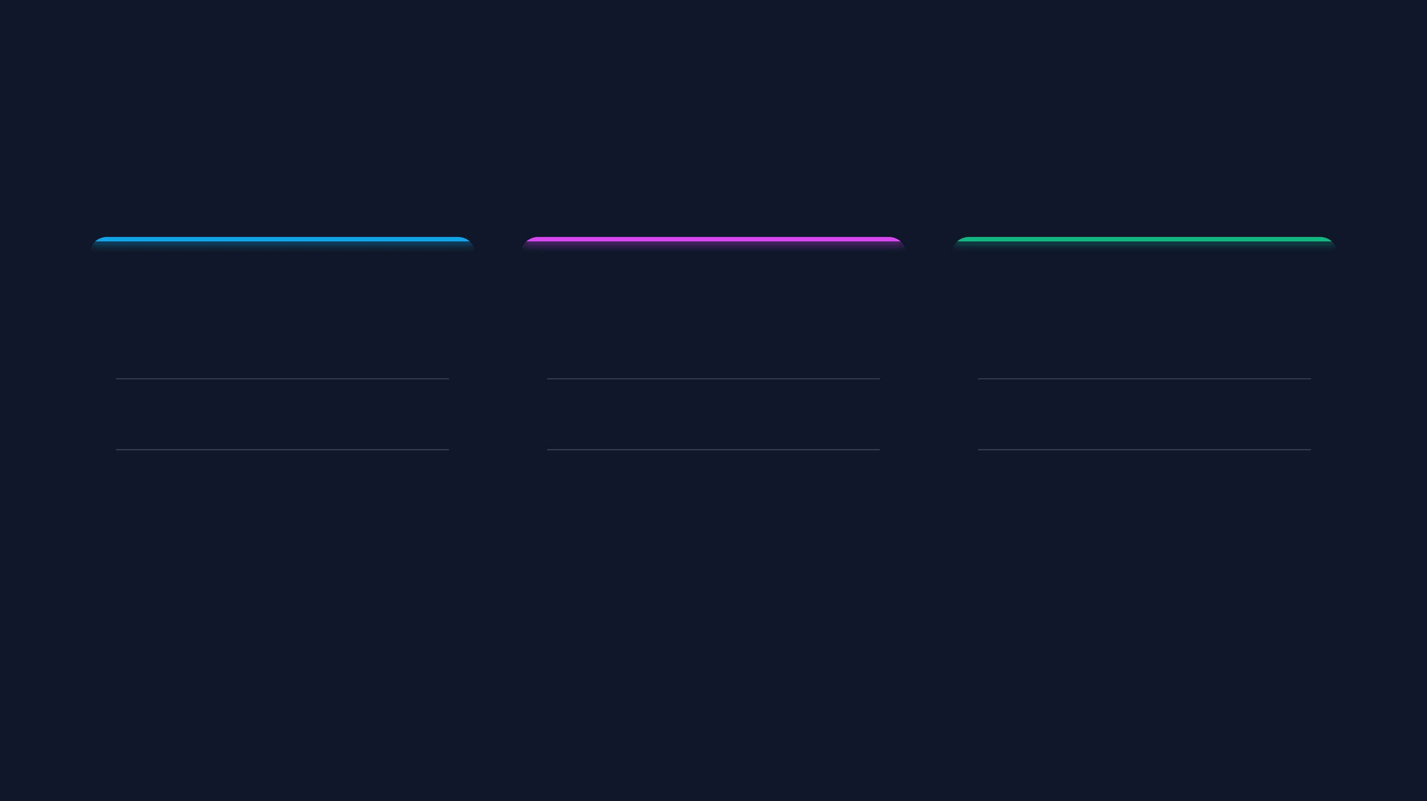

SCALABILITY
Multi-Week Planning
Week 14
Baseline
Week 15
Complex
Week 16
High Vol
50
50
53
VOLUME
VOLUME
VOLUME
13 Types
13 Types
11 Types
MIX
MIX
MIX
FOCUS
FOCUS
FOCUS
Standard Mix
Line Balance
DC Refuse (Fri)
Rear Loader Spacing
Max Capacity
Tight Spacing
Unified Batch Processing
The solver automatically detects the unique constraints of each week (e.g., Week 15's DC Refuse rule) and adapts optimization logic instantly.
Batch Optimization Architecture

Slide 13





RESILIENCE TESTING
Live "What-If" Scenario
Disruption Event
Solver Response
Urgent Order Injection
Parameter Adjustment
Sales adds 15 units of Model-A on Wednesday morning.
Increase Beta (Line Balance) weight to force redistribution away from Line 2.
Line Constraint
Line 2 goes down for maintenance on Thursday.
Instant Re-Optimization
Solver generates a new valid plan in 5 seconds, shifting volume to Mon/Tue/Fri.
Agility Demonstration

Slide 14




ROI ANALYSIS
Why Automate Scheduling?
95%
100%
+15%
Faster Planning
Rule Compliance
Efficiency
Reduce weekly scheduling time from 8 hours to minutes, freeing planners for strategic tasks.
Eliminate human error. Every constraint (spacing, day preference) is mathematically guaranteed.
Optimized line balancing reduces overtime costs and smooths material flow.
Business Impact

Slide 15


IMPLEMENTATION PLAN
Roadmap & Next Steps
1
2
3
4
TODAY
WEEK 1
MONTH 1
Q2 2026
PoC Demo
Pilot Run
Integration
Full Rollout
Validate core logic, constraints, and multi-week batch processing capability.
Run parallel with manual planning for Week 17 to benchmark accuracy.
Connect directly to ERP (SAP/Oracle) for automated data ingestion.
Deploy to all 3 production lines and enable user-managed constraints.
Q&A Session
Open floor for discussion on constraints, scalability, and integration.
NEXT: PILOT KICKOFF
Strategic Roadmap

