Slide 1
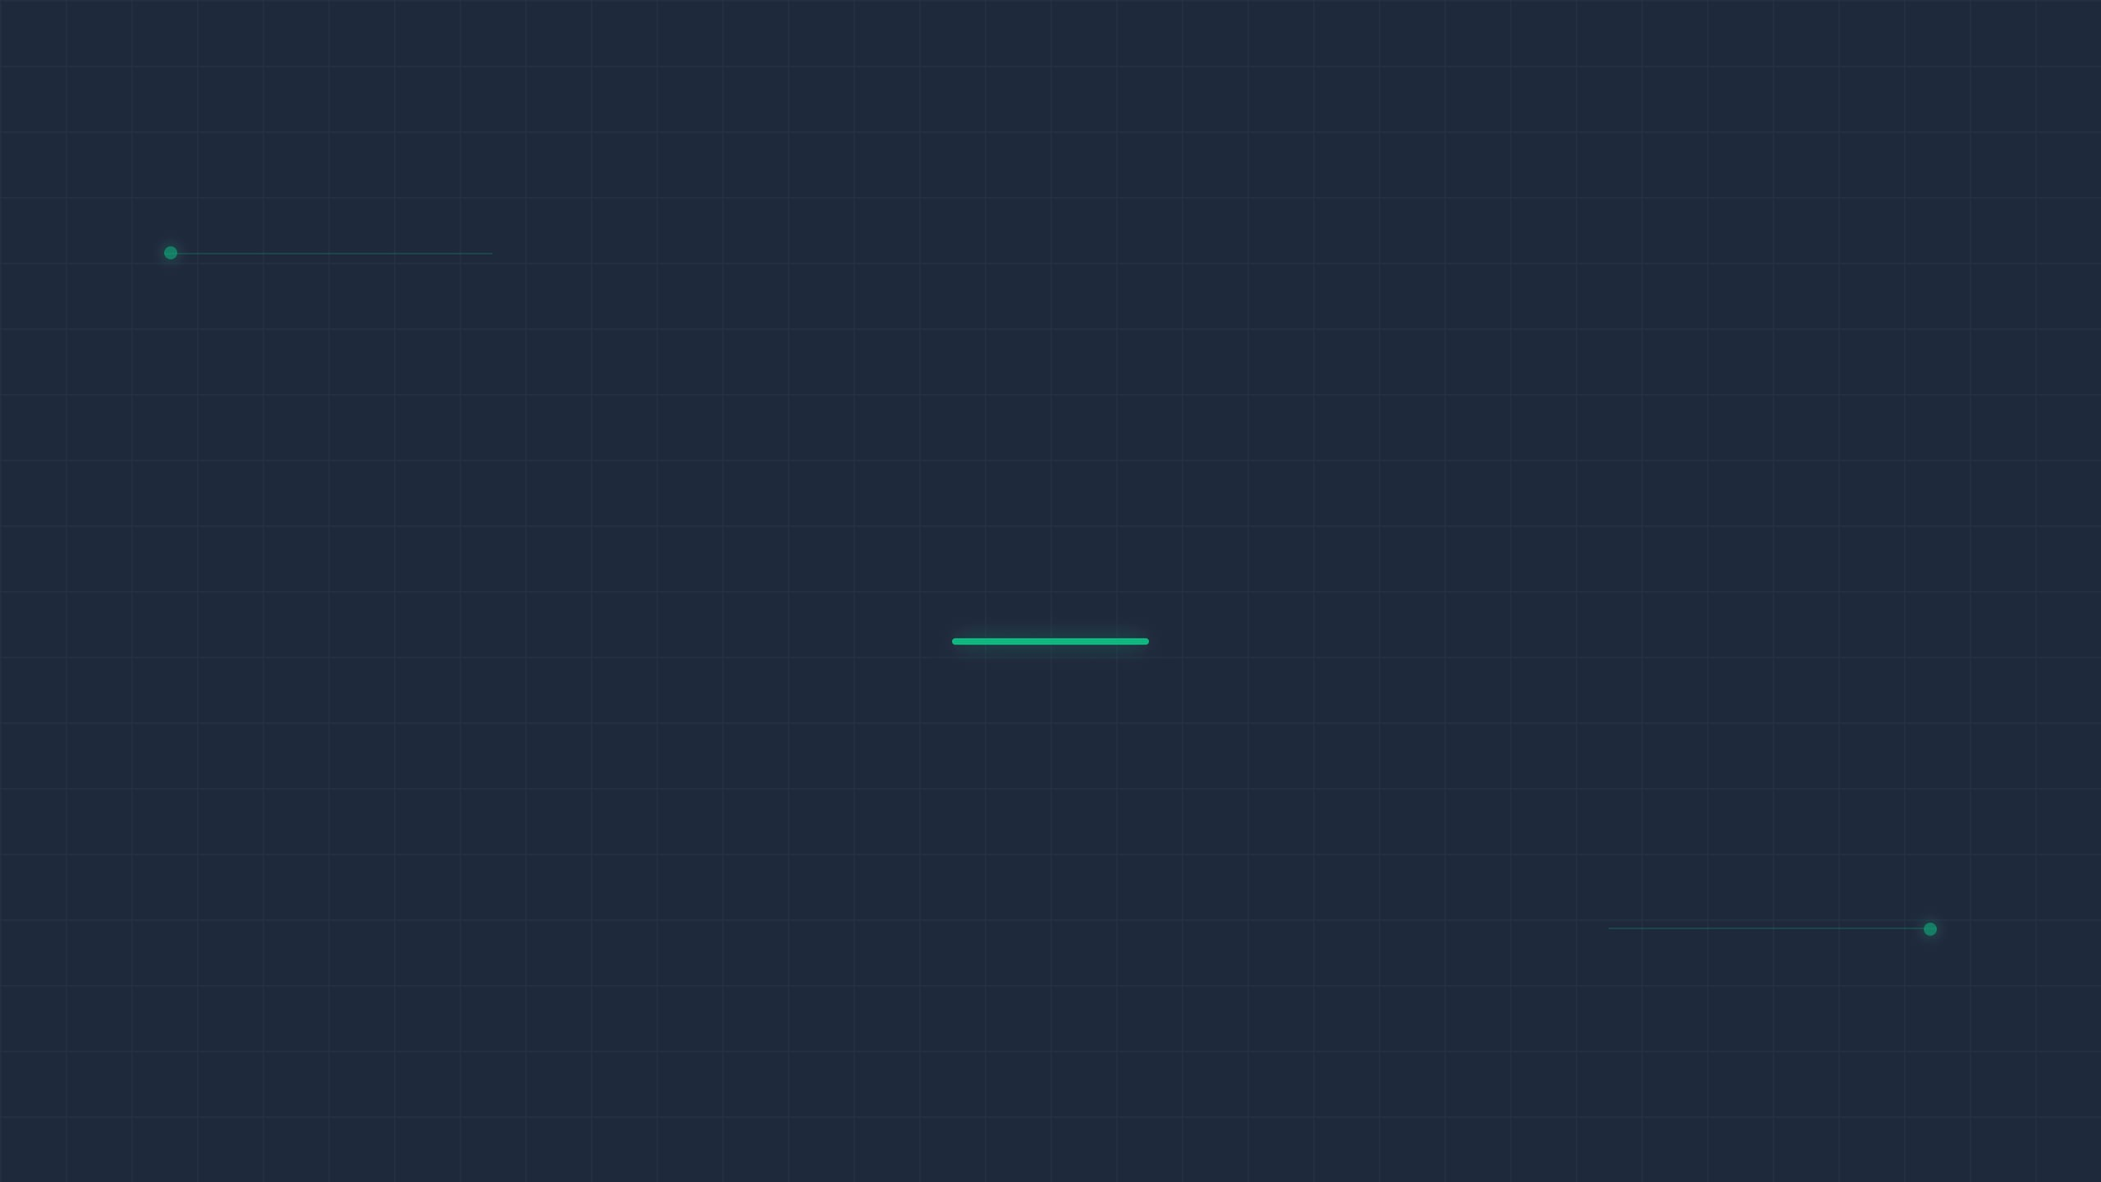
COMPANY LOGO
AI-Powered Production Scheduling
From Manual Spreadsheets to Mathematically Optimal Plans A Proof of Concept
CONFIDENTIAL
INTERNAL DEMO
2026

Slide 2



The Problem We Are Solving
Hours of Manual Effort
A single weekly schedule takes 2–4 hours to build and validate by hand.
Every week, production planners spend hours manually distributing orders across models, lines, and days — relying on experience and intuition rather than data. The result is a schedule that is good enough, but never optimal.
No Resilience to Change
Any mid-week disruption (new order, line downtime) requires rebuilding the entire plan from scratch.
Inconsistent Output
Different planners produce different schedules from the same data; quality depends on who is working that day.
CONFIDENTIAL | INTERNAL DEMO | 2026

Slide 3

What If the Optimal Schedule Could Be Generated in Under 5 Seconds?
The Production Scheduler is an AI-powered optimization engine that automatically distributes work across Monday through Friday in the most balanced, efficient way mathematically possible. No spreadsheets. No guesswork. No rebuilding when plans change.
BUILT ON GOOGLE OR-TOOLS CP-SAT
CONFIDENTIAL | INTERNAL DEMO | 2026

Slide 4



Three Steps from Demand to Optimal Schedule
1
2
3
Input Weekly Demand
Set Business Rules
Run the Optimizer
Input product models, production lines, and quantities. Add or remove rows in seconds. Connects to ERP/MES in production deployment.
Four plain-language sliders control model balance priority, line balance priority, spread rules for low-volume items, and solver time budget.
The AI engine solves the scheduling problem and returns a mathematically optimal weekly plan — typically in under 5 seconds.
CONFIDENTIAL | INTERNAL DEMO | 2026

Slide 5

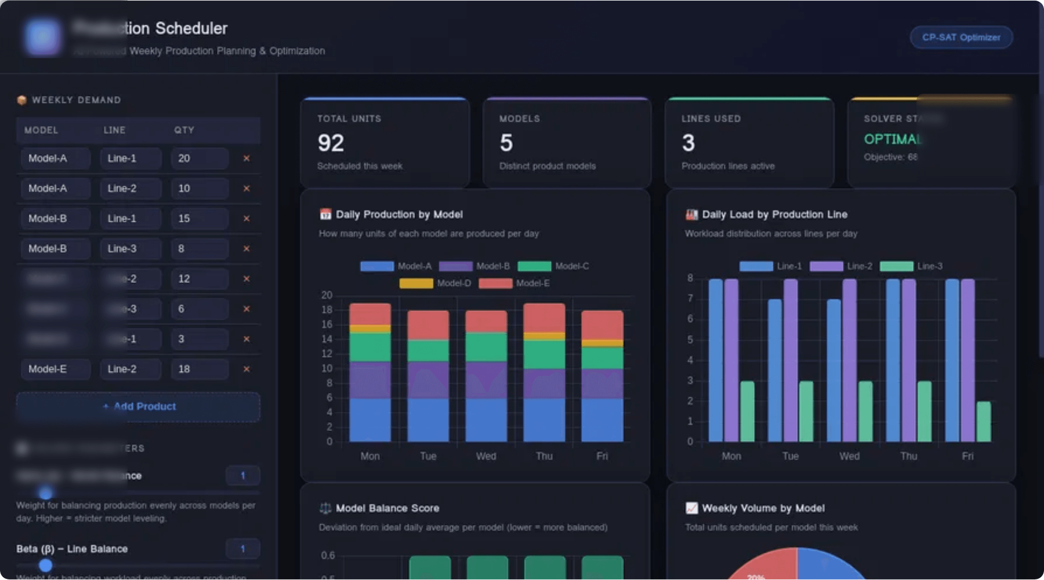
A Planner-Friendly Interface — No Technical Expertise Required
1
Weekly Demand Table
Editable grid: model, line, quantity. Add/remove rows instantly.
1
4
Results Dashboard
KPI cards, charts, heatmap, and detail table animate in upon completion.
4
2
Solver Parameters
Four sliders with live value display and plain-English descriptions.
2
3
Run Optimizer
Single button triggers the AI engine. Status updates in real time.
3
CONFIDENTIAL | INTERNAL DEMO | 2026
The entire interface is operated through a standard web browser. No installation, no training required beyond a 10-minute onboarding session.

Slide 6
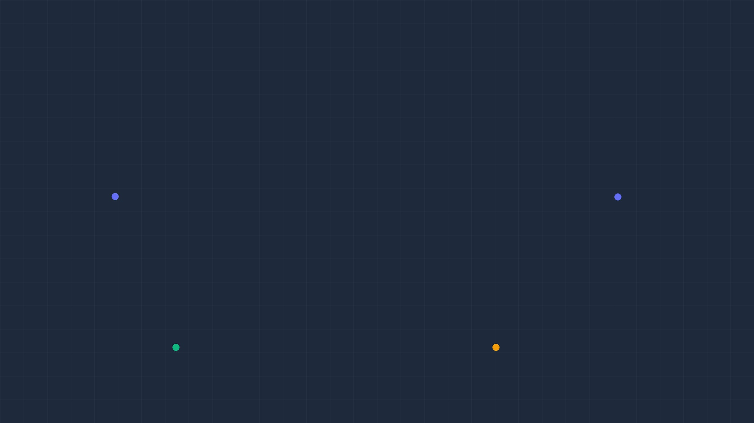

Business Policy, Not Code
Four Levers That Encode Your Operations Strategy
α
Alpha: Model Balance
β
Beta: Line Balance
Controls how strictly production is leveled per model across the week. Higher values enforce near-perfect daily consistency for each product.
Controls how evenly workload is distributed across production lines each day. Critical for labor planning and preventing line bottlenecks.
Example: α=1 (flexible) → α=10 (strict daily leveling)
Example: β=7 prioritizes line balance over model balance
Spread Threshold
Time Limit
Low-volume models below this quantity are forced to produce every day rather than being batched. Eliminates end-of-week rushes.
Maximum solver runtime in seconds. Longer search = potentially better solution.
Example: Threshold=5 means any model < 5 units must appear daily
Example: 10s for typical weekly volumes; 30s for complex scenarios
CONFIDENTIAL | INTERNAL DEMO | 2026

Slide 7

"OPTIMAL" Is a Mathematical Guarantee
CERTIFIED OPTIMAL
When the solver returns the status OPTIMAL, it has mathematically proven that no better schedule exists — given the demand data and business rules provided.
APPROACH
QUALITY
SPEED
CONSISTENCY
Manual (Spreadsheet)
Variable
2–4 hours
Planner-dependent
This is not an approximation or a heuristic. The CP-SAT engine exhaustively explores the solution space and certifies the result.
Rule-based Heuristic
Good
Minutes
Consistent
CP-SAT Optimizer
Mathematically Optimal
< 5 seconds
100% Consistent
For very large problems, it may return FEASIBLE — meaning it found an excellent solution within the time limit but cannot yet prove absolute optimality.
CONFIDENTIAL | INTERNAL DEMO | 2026

Slide 8
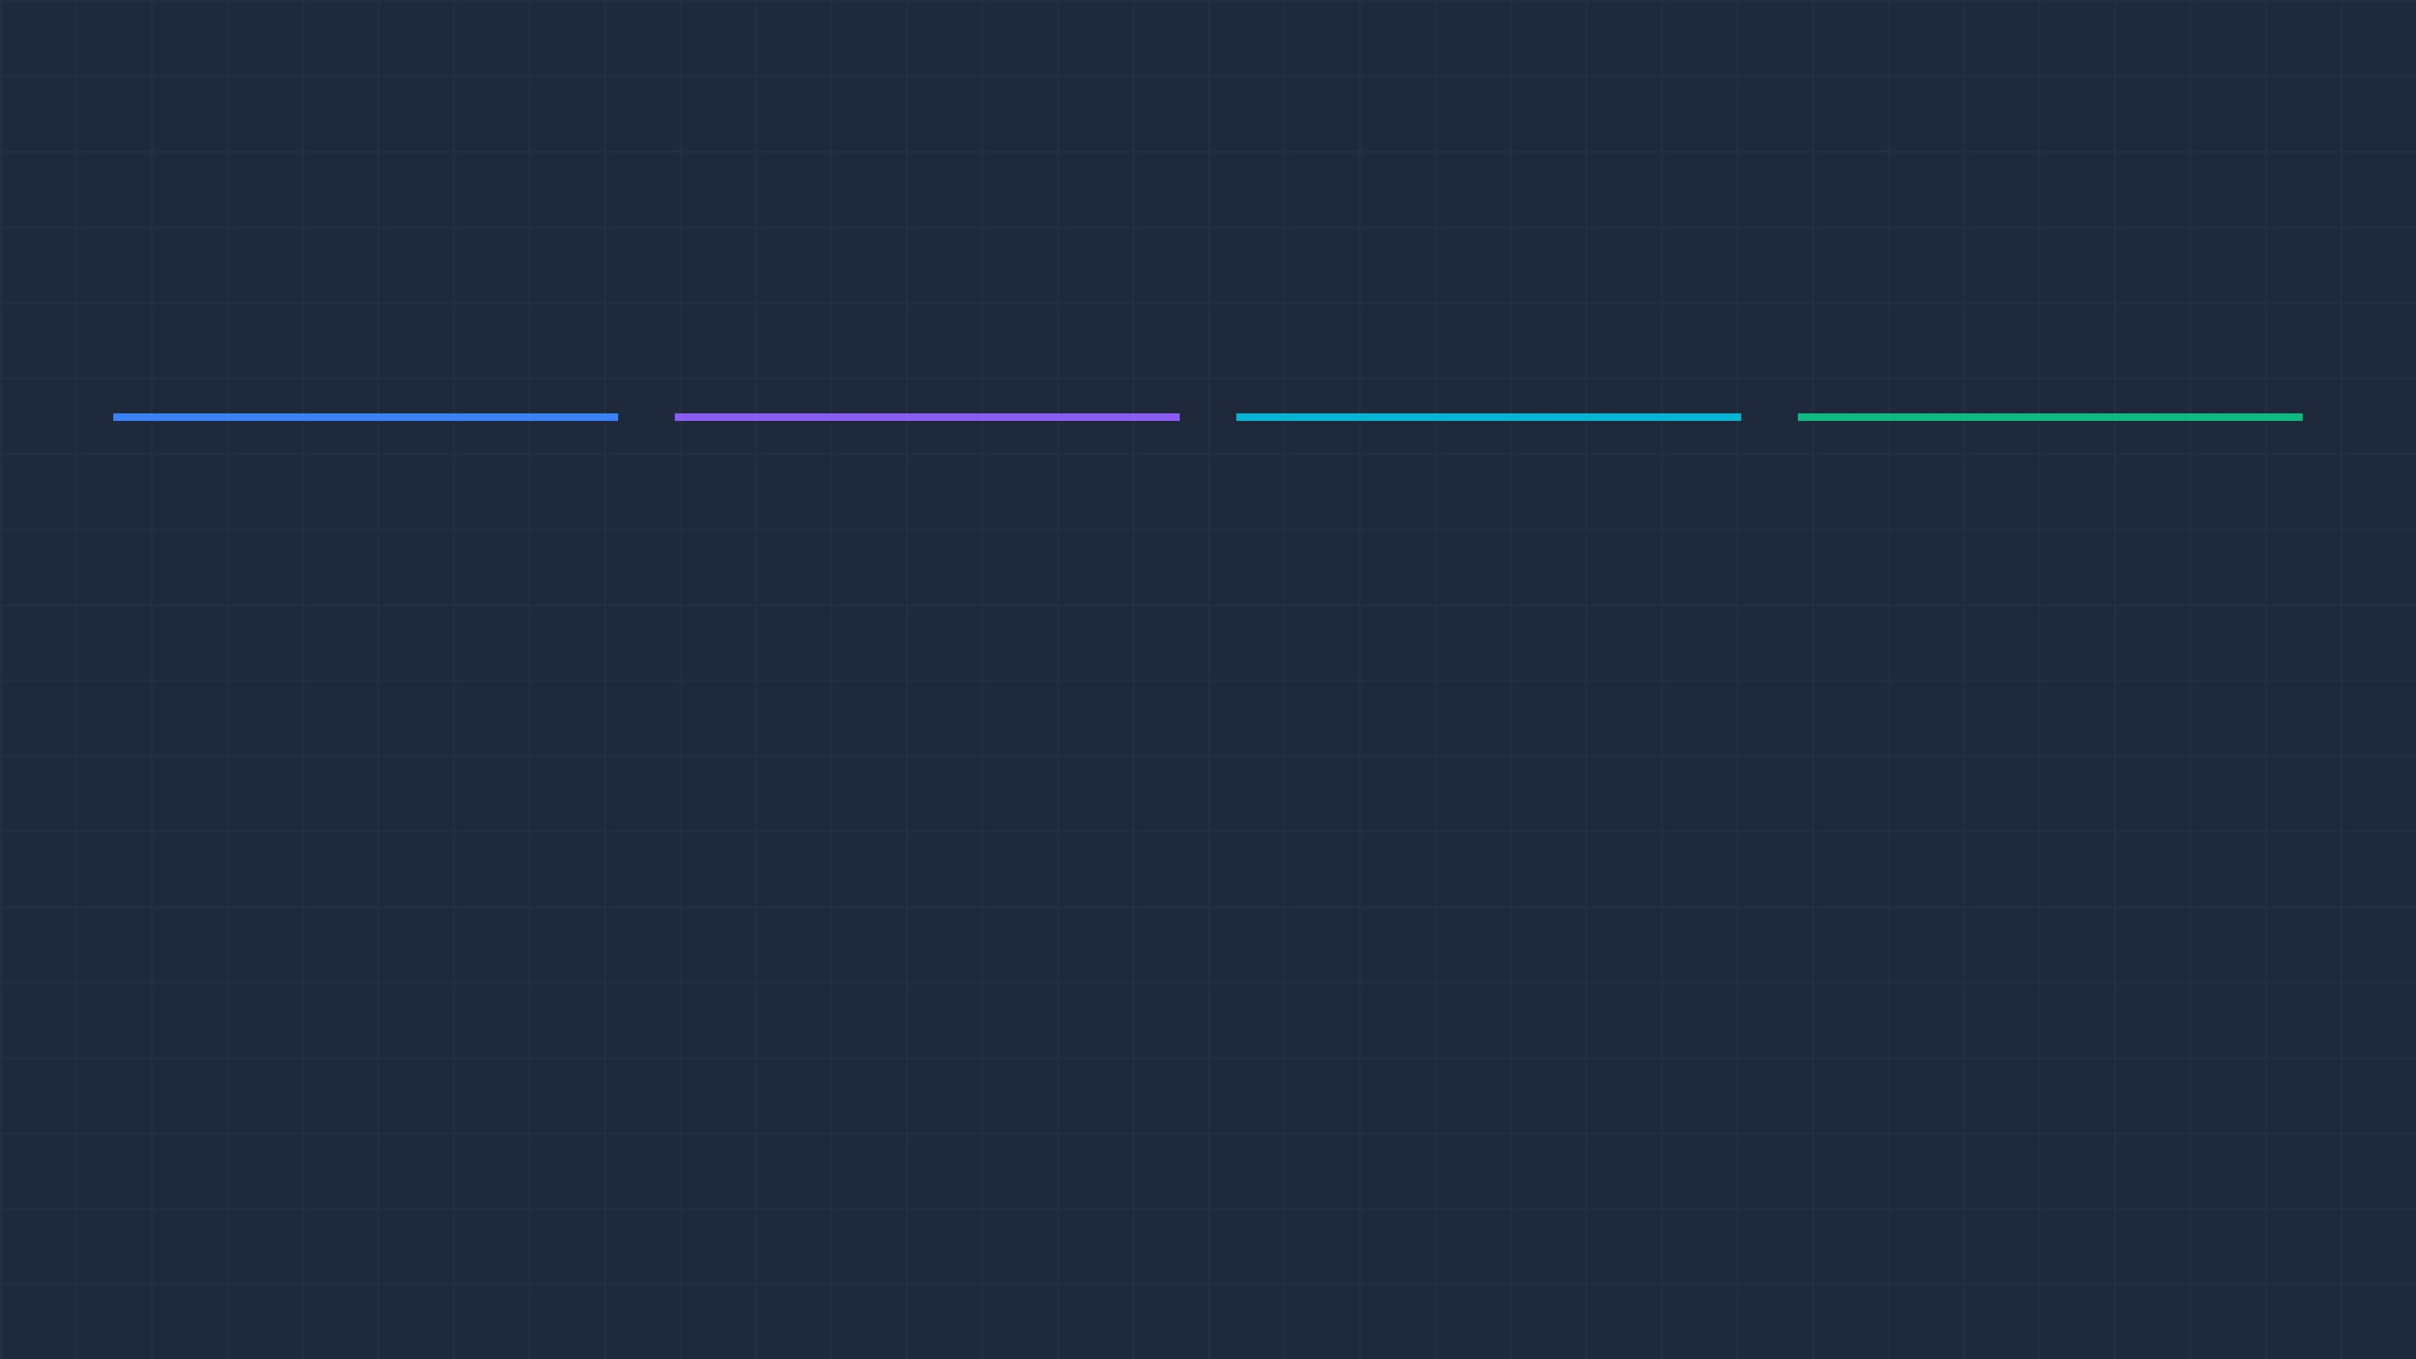
Results at a Glance: KPI Dashboard
Instant Executive Visibility — Four Numbers That Tell the Whole Story
TOTAL UNITS
MODELS
LINES USED
SOLVER STATUS
92
5
3
OPTIMAL
Objective Score: 68 Certified Best Solution
Scheduled This Week All demand fulfilled
Distinct Product Models A, B, C, D, E
Production Lines Active Line-1, Line-2, Line-3
These four metrics are the first thing leadership sees after every solve. They confirm that demand is fully covered, all lines are engaged, and the schedule quality has been certified by the optimizer.
CONFIDENTIAL | INTERNAL DEMO | 2026

Slide 9
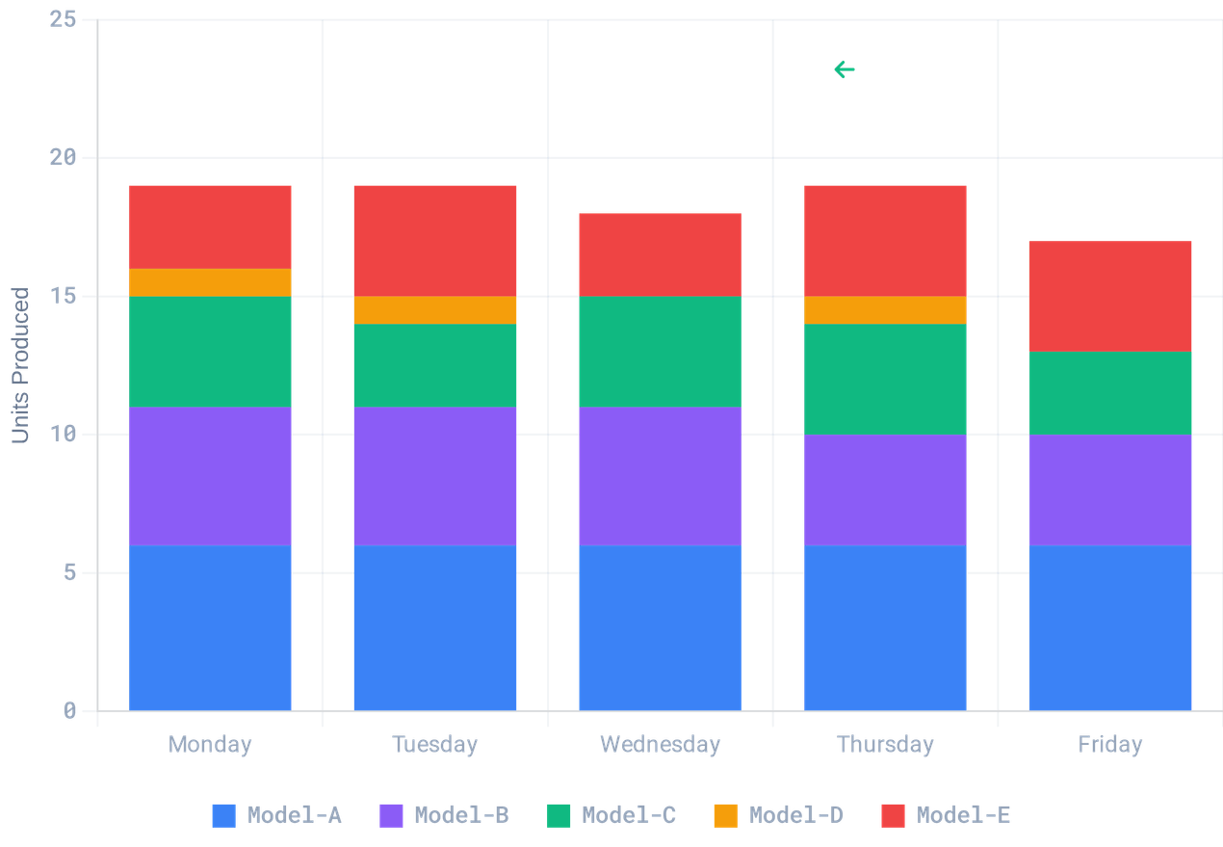


Daily Production Balance: The Core Output
Consistent Daily Output — No Monday Overload, No Friday Scramble
Max Variance: 2 Units
Near-Perfect Leveling
The optimizer has distributed 92 units across five days with a maximum daily variance of just 2 units — a level of balance difficult to achieve manually.
Model-Level Consistency
Each color band represents a product model. The consistent height of each band across days confirms that individual models are also being leveled.
Operational Predictability
A factory running at ~18 units per day, every day, allows for high-confidence planning of labor, logistics, and quality checks.
CONFIDENTIAL | INTERNAL DEMO | 2026

Slide 10
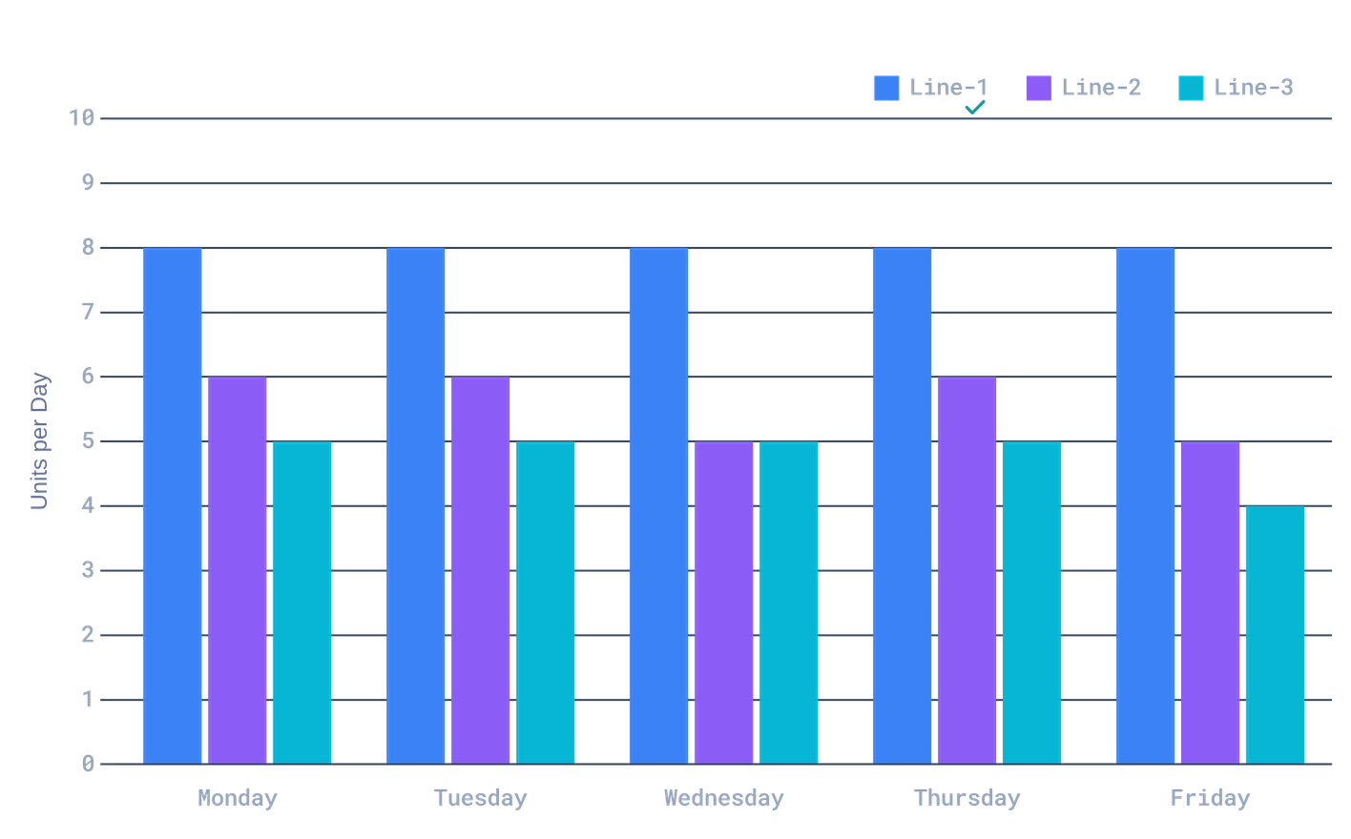



Every Line Carries a Predictable, Balanced Load
Predictable Labor Planning
Consistent Daily Load
Consistency means staffing levels can be set once at the start of the week and held steady — no daily re-planning required.
Structural Load Balance
Line-1 carries the highest load because it serves the most models. The optimizer respects this reality while leveling the daily volume.
Tunable Priorities
Increasing the Beta parameter makes these bars even flatter, trading some model-level balance for perfect line-level consistency.
CONFIDENTIAL | INTERNAL DEMO | 2026

Slide 11



The Schedule Heatmap: Proof of Balance
The Schedule at a Glance — Color Intensity Reveals the Plan
MODEL
MON
TUE
WED
THU
FRI
TOTAL
Model-A
6
6
6
6
6
30
Model-A: Perfect
6 units every single day. Zero variance.
Model-B
5
5
5
4
4
23
Model-C
4
3
4
4
3
18
Model-D: Optimal Spread
Model-D
1
1
—
1
—
3
3 units across 5 days — mathematically best possible distribution (1-1-0-1-0).
Model-E
3
4
3
4
4
18
Daily Consistency
Daily Total
19
19
18
19
17
92
17–19 units/day across the entire factory. Max variance of just 2 units.
CONFIDENTIAL | INTERNAL DEMO | 2026

Slide 12





Mid-Week Disruption? Re-Optimized in 4 Seconds.
SCENARIO: Urgent Order (+15 Units) + Stricter Line Balance Requested
INITIAL STATE
OPTIMIZED RESULT
Total Units
92
Total Units
107 (+15)
Line Balance (Beta)
1 (Standard)
Line Balance (Beta)
7 (Prioritized)
Line-2 Variance
±2 units
Line-2 Variance
±0 units (Flat)
Manual Reschedule
~2 Hours
Optimizer Time
4 Seconds
The optimizer doesn't just add the new units — it re-solves the entire week from scratch, honoring the updated business priority.
CONFIDENTIAL | INTERNAL DEMO | 2026

Slide 13



Fast. Consistent. Optimal.
Three Transformations That Change How We Plan
Hours of planning reduced to seconds
A weekly schedule that takes a planner 2–4 hours to build manually is generated in under 5 seconds. Re-planning after a disruption takes 4 seconds, not another morning.
Same inputs always produce the same quality output
The optimizer applies the same mathematical rules every time, regardless of who is running it. Planner experience and availability no longer determine schedule quality.
Mathematically proven best answer, every time
Not "pretty good" — certified optimal. The CP-SAT engine guarantees no better distribution exists. Reduced line imbalance directly translates to lower overtime costs.
This proof-of-concept runs on a standard laptop with no external dependencies. Path to full ERP integration: 4–8 weeks.
CONFIDENTIAL | INTERNAL DEMO | 2026

Slide 14
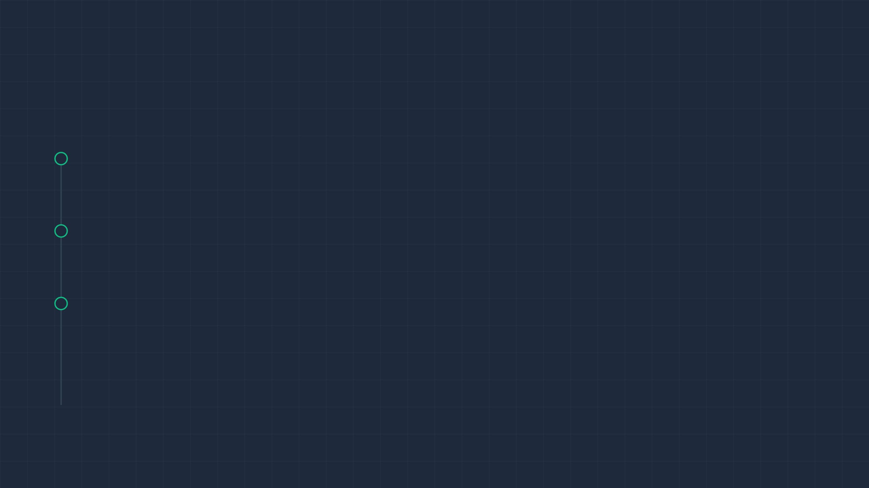



From Proof of Concept to Production
Proposed Pilot Roadmap
Discussion & Q&A
WEEKS 1-2
Data Integration
Integration with existing ERP?
Connect optimizer to ERP/MES data export. Automate the "Demand Input" step.
Handling machine downtime?
WEEKS 3-4
ROI and labor savings?
Parallel Testing (UAT)
Planners run the AI engine alongside their manual process to validate results and build trust.
Scaling to multiple factories?
WEEK 5
Go-Live
First AI-generated schedule released to the production floor.
CONFIDENTIAL | INTERNAL DEMO | 2026

Slide 15
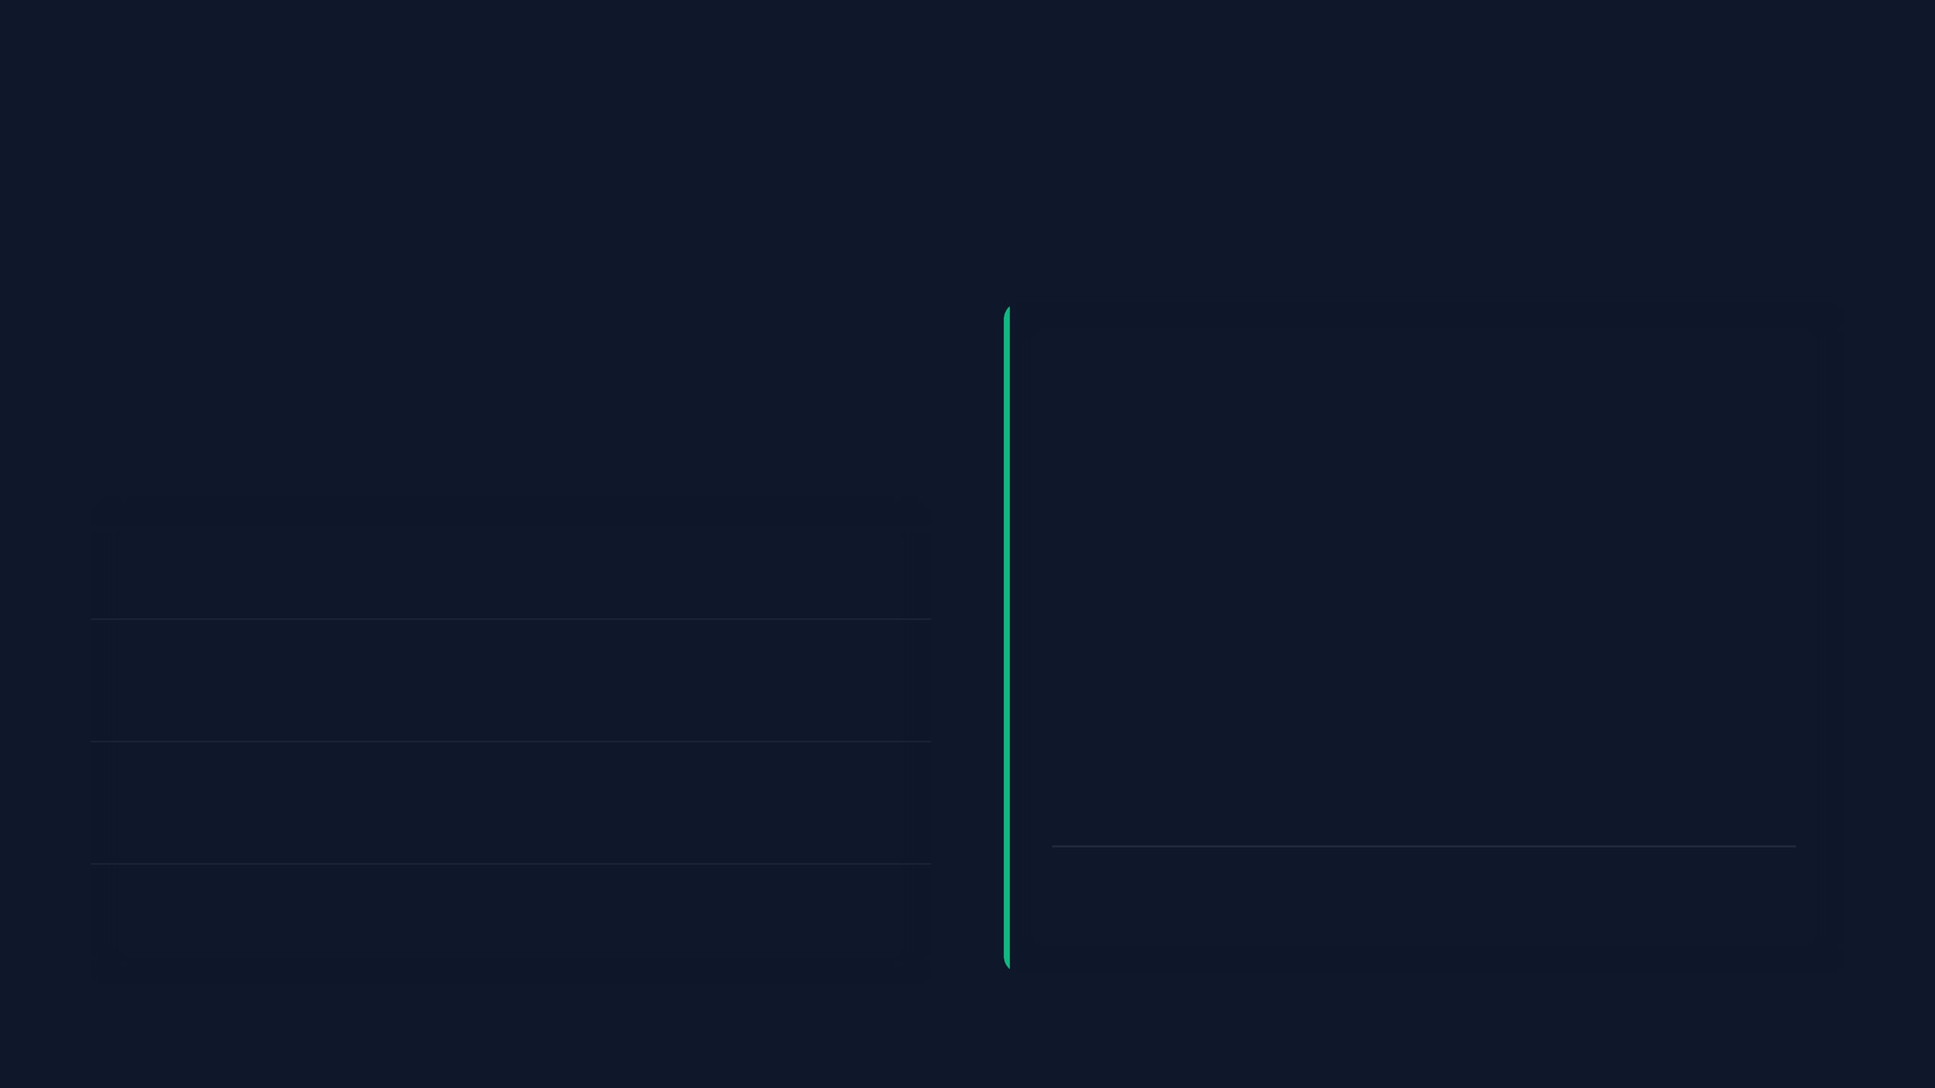





NEW CAPABILITIES
Advanced Constraints Engine
The solver now handles complex operational rules, balancing hard limits with soft preferences to optimize the schedule.
Compliance Report
Rear Loader 2512 Spacing
Scheduled: Wed, Thu, Fri
Rear Loader 2512
Max 1 per day · Evenly Spaced (e.g., Mon/Wed/Fri)
PKRRLSB Tuesday Preference
Rear Loader (PKRRLSB)
Scheduled: Tue
Preferred Days: Tuesday, Thursday
DC Refuse Friday Preference
Manual Side Loader (PKRML)
Scheduled: Fri
Preferred Days: Tuesday, Thursday
DC Refuse Stock
Constraint Penalty Score
0 (Perfect)
Preferred Day: Friday

Slide 16


SCALABLE ARCHITECTURE
Multi-Week Planning
The system now ingests full production datasets, allowing planners to switch contexts instantly and optimize independent weekly batches.
WEEK 14
WEEK 15
WEEK 16
Total Units
50
Total Units
50
Total Units
53
Model Mix
13 Types
Model Mix
13 Types
Model Mix
11 Types
KEY CONSTRAINTS
KEY CONSTRAINTS
KEY CONSTRAINTS
Standard Mix
Line Balance
DC Refuse Stock
Rear Loader 2512
High Volume
Complex Spacing
Unified Data Ingestion
Context-Aware Solving
Single CSV upload parses multiple weeks automatically, grouping orders by "Exit Factory Year & Week".
The solver detects which constraints are active for the selected week (e.g., Week 15's DC Refuse rule) and adapts logic instantly.

