Slide 1
Satisfying Customer Demand: Inventory Management
© 2013 Samuel H. Huang All Rights Reserved

Slide 2
Factors Influencing Inventory
Economies of scale: reduce average unit cost
Demand uncertainty: use safety inventory (extra inventory) to minimize the chance of running out of stock
Customer satisfaction: more inventory, higher chance of satisfying customer demand, higher customer satisfaction
Price fluctuation: speculative, should be handled by finance
© 2013 Samuel H. Huang All Rights Reserved

Slide 3
Inventory Cost
Product cost (c): unit cost of product
Ordering cost (O): fixed cost associated with setting up a production lot or placing a purchase order
Inventory holding cost (H)
  Capital cost (I): a percentage of c
  Storage cost (W): cost associated with product storage
© 2013 Samuel H. Huang All Rights Reserved

Slide 4
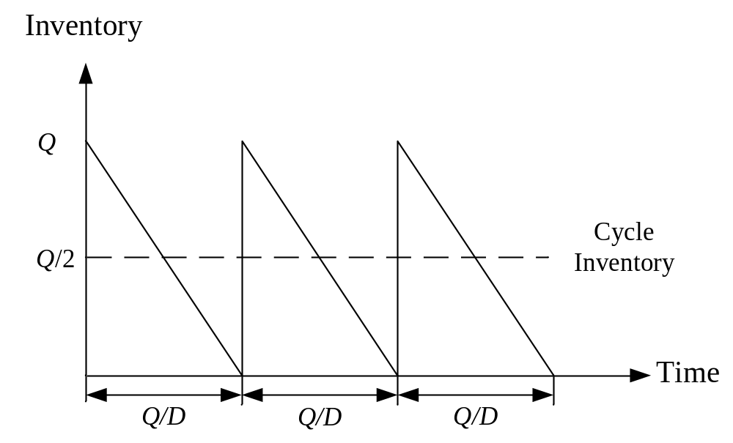
Cycle Inventory Profile
Demand (D): demand rate in units per year (deterministic and constant)
Lot size (Q): decision variable
© 2013 Samuel H. Huang All Rights Reserved

Slide 5
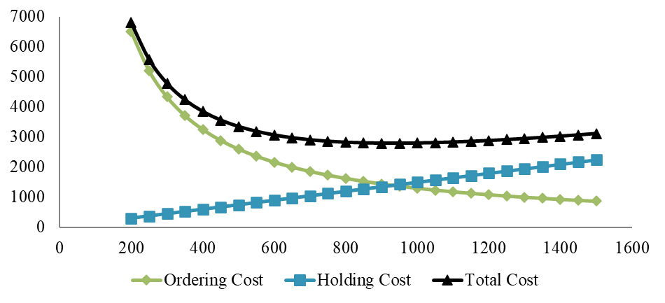
Cost Analysis
c = $12/unit, O = $500/order; H = $3/year; D = 2,600 units/year
Demand is always satisfied so yearly product cost remains constant regardless of Q
Yearly ordering cost and holding cost are a function of Q
© 2013 Samuel H. Huang All Rights Reserved

Slide 6
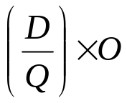
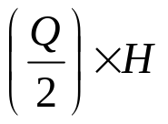
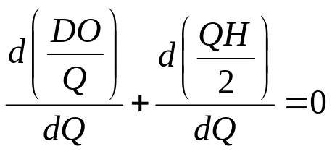
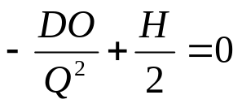
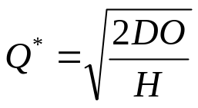
Economic Order Quantity (EOQ) Model
Yearly ordering cost
Yearly inventory holding cost
Cost minimization
© 2013 Samuel H. Huang All Rights Reserved

Slide 7
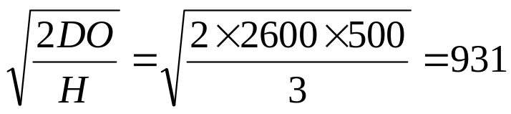
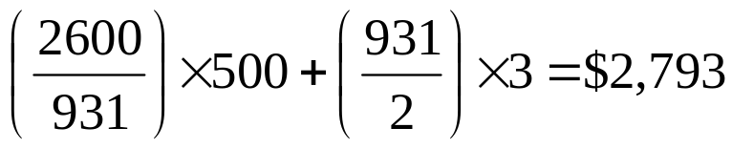
EOQ Example I
D = 2,600 units/year, c = $12/units
Shipping cost O = $500/shipment regardless of quantity
Interest rate = 5%, storage cost $0.2/unit/month
Yearly holding cost H = I + W = $12×5% + $0.2×12 = $3
EOQ =
Total cost =
© 2013 Samuel H. Huang All Rights Reserved

Slide 8
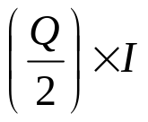
EOQ Example II
Option of renting a dedicated warehouse
  $18/ft²/year, require yearly contract
  10 units/ft² storage capacity
Average storage cost $1.8/unit/year, but warehouse will not always be fully utilized
Yearly ordering cost remains the same
Yearly capital cost
© 2013 Samuel H. Huang All Rights Reserved

Slide 9

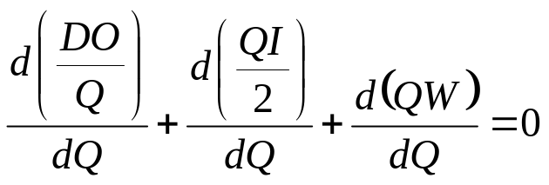
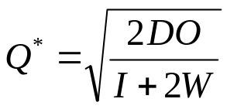
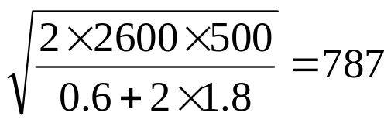
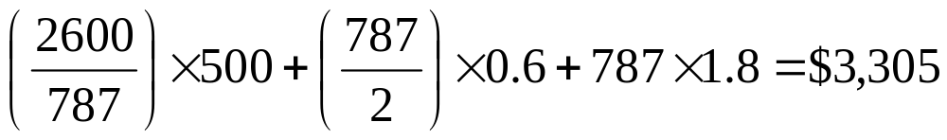
EOQ Example II (Cont.)
Yearly storage cost
Cost minimization
EOQ =
Total cost =
Higher cost, not a good option
© 2013 Samuel H. Huang All Rights Reserved

Slide 10
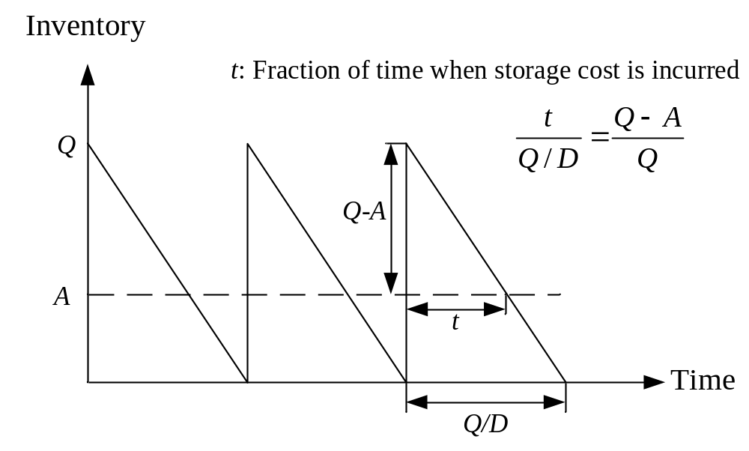
EOQ Example III
Company owns a storage area that can hold 600 units
Additional units are stored in a public warehouse
© 2013 Samuel H. Huang All Rights Reserved

Slide 11
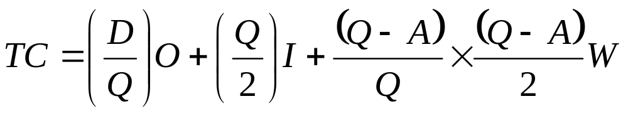
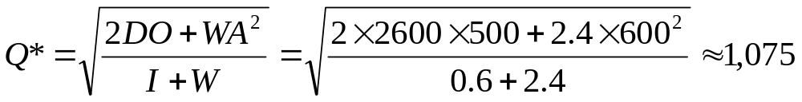
EOQ Example III (Cont.)
Total cost to be minimized
Optimal order quantity
© 2013 Samuel H. Huang All Rights Reserved

Slide 12
Multiple Products
n: number of products
i: index of product, i = 1, 2, …, n
D_{i}: annual demand for product i
O: ordering cost incurred each time an order is placed (independent of product variety)
O_{i}: additional ordering cost incurred if product i is included in the order
H_{i}: annual inventory holding cost for product i
© 2013 Samuel H. Huang All Rights Reserved

Slide 13
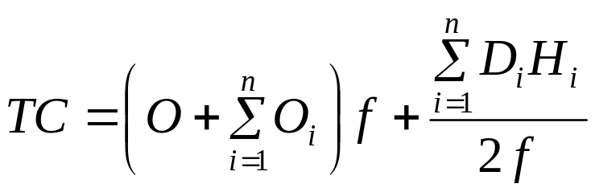
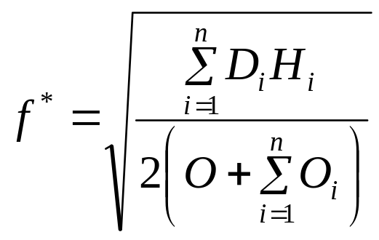
Ordering Strategies
No Aggregation: order products independently; likely to incur higher cost
Complete Aggregation: order products jointly; will provide cost saving but may not be suitable when additional order costs for low-demand products are high
© 2013 Samuel H. Huang All Rights Reserved

Slide 14
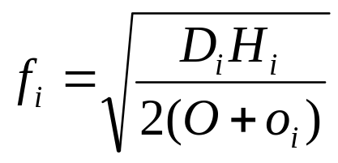

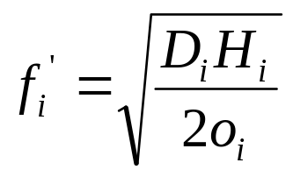
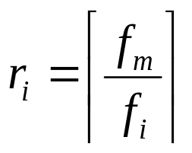
Ordering Strategies (Cont.)
Tailored Aggregation: order a subset of the products jointly
  Step 1. Find the most frequently ordered product assuming each product is ordered independently.
  Step 2. Identify frequency of other products as a relative multiple of the most frequently ordered product
© 2013 Samuel H. Huang All Rights Reserved

Slide 15
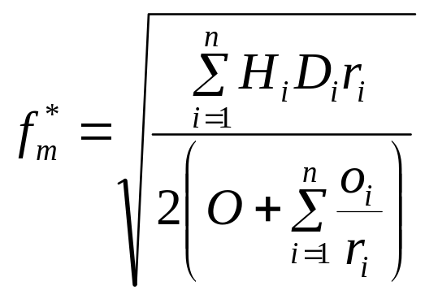
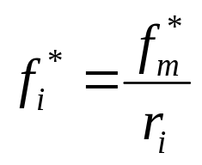
Ordering Strategies (Cont.)
  Step 3. Recompute the frequency of the most frequently ordered product, taking into account joint ordering
  Step 4. Recompute the ordering frequency of other products
© 2013 Samuel H. Huang All Rights Reserved

Slide 16
Multiple-product Example
Shipping from distribution center to retail store: $4,000 per trip
 | Laptop | Desktop | HDTV
Annual Demand | 52,000 | 26,000 | 5,200
Inventory Holding Cost | $48 | $40 | $48
Shipping to Distribution Center | $800 | $1,000 | $1,400
© 2013 Samuel H. Huang All Rights Reserved

Slide 17
No Aggregation
Total cost = $308,695
 | Laptop | Desktop | HDTV
Demand | 52,000 | 26,000 | 5,200
Holding Cost | $48 | $40 | $48
Ordering Cost | $4,000 + $800 | $4,000 + $1,000 | $4,000 + 1,400
EOQ | 3,225 | 2,550 | 1,082
Annual Cost | $154,795 | $101,980 | $51,920
© 2013 Samuel H. Huang All Rights Reserved

Slide 18
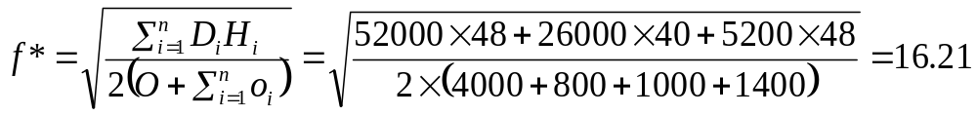
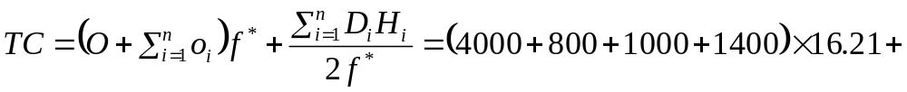
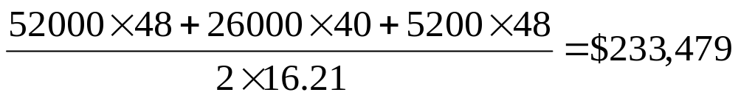
Complete Aggregation
Ordering frequency
Total cost
© 2013 Samuel H. Huang All Rights Reserved

Slide 19
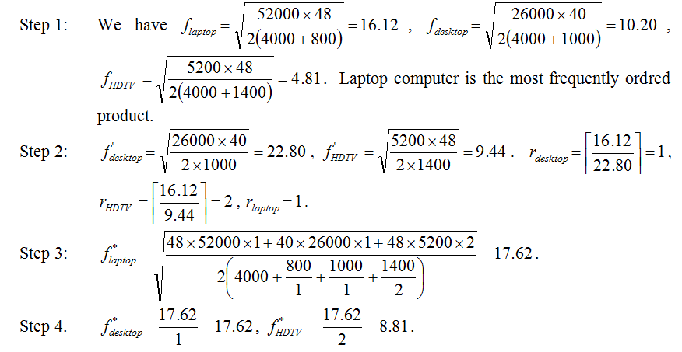
Tailored Aggregation
© 2013 Samuel H. Huang All Rights Reserved

Slide 20
Tailored Aggregation (Cont.)
Total cost = $229,037
 | Laptop | Desktop | HDTV
Order Frequency | 17.62 | 17.62 | 8.81
Order Quantity | 2,591 | 1,476 | 590
Ordering Cost | $84,576 | $17,620 | $12,334
Holding Cost | $70,829 | $29,512 | $14,166
Annual Cost | $155,405 | $47,132 | $26,500
© 2013 Samuel H. Huang All Rights Reserved

Slide 21
Quantity Discount
Offered to entice customers to place larger orders
A larger quantity means higher inventory holding cost
Need to analyze whether savings gained by purchasing a larger quantity can offset the additional inventory holding cost
© 2013 Samuel H. Huang All Rights Reserved

Slide 22
Notations
m: the number of price breaks
i: index of price break intervals, i = 1, 2, …, m
q_{i}: the upper limit of the ith price break interval
c_{i}: the unit cost in the ith price break interval [q_{i-1}, q_{i}]
q₀ = 0, q_{m} = ∞, and c_{i+1} < c_{i}
© 2013 Samuel H. Huang All Rights Reserved

Slide 23

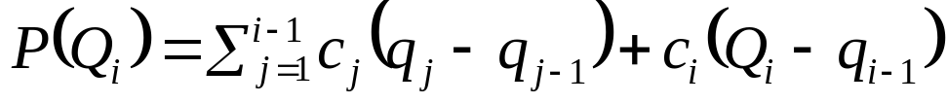
Type of Discount
All-unit discount: the total price for purchasing Q_{i} (where q_{i-1} ≤ Q_{i} ≤ q_{i}) units is
Incremental discount: the total price for purchasing Q_{i} (where q_{i-1} ≤ Q_{i} ≤ q_{i}) units is
© 2013 Samuel H. Huang All Rights Reserved

Slide 24
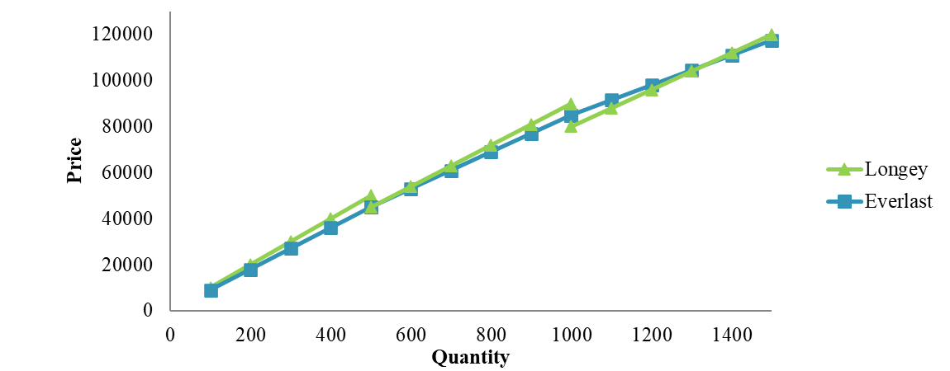
Example (Part I)
Quantity | Longey | Everlast
0 ≤ Q < 500 | 100Q | 90Q
500 ≤ Q < 1,000 | 90Q | 90×500 + 80×(Q – 500)
1,000 ≤ Q < ∞ | 80Q | 90×500 + 80×500 + 65×(Q – 1000)
© 2013 Samuel H. Huang All Rights Reserved

Slide 25
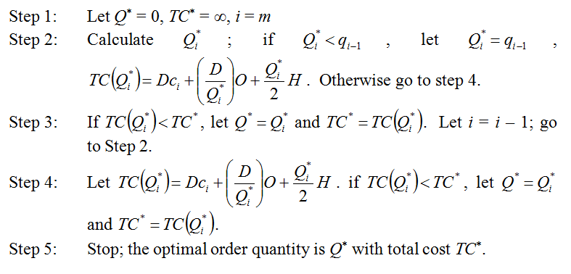
Optimal Order Quantity: All-unit Discount
© 2013 Samuel H. Huang All Rights Reserved

Slide 26
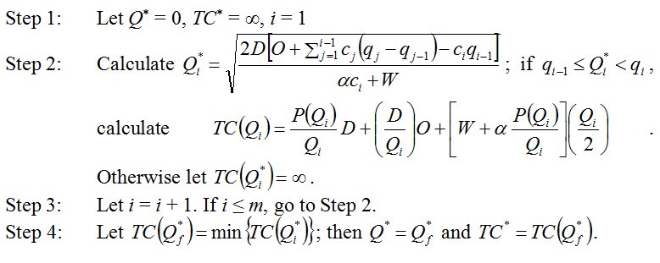
Optimal Order Quantity: Incremental Discount
© 2013 Samuel H. Huang All Rights Reserved

Slide 27
Example (Part II)
Annual demand = 9,600 units
Fixed ordering cost = $500
Annual capital cost = 10% of unit cost
Annual storage cost = $12/unit
Which supplier (Longey or Everlast) should be selected?
© 2013 Samuel H. Huang All Rights Reserved

Slide 28
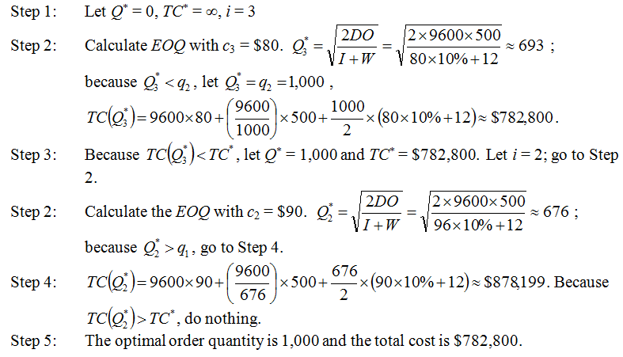
Longey: All-unit Discount
© 2013 Samuel H. Huang All Rights Reserved

Slide 29
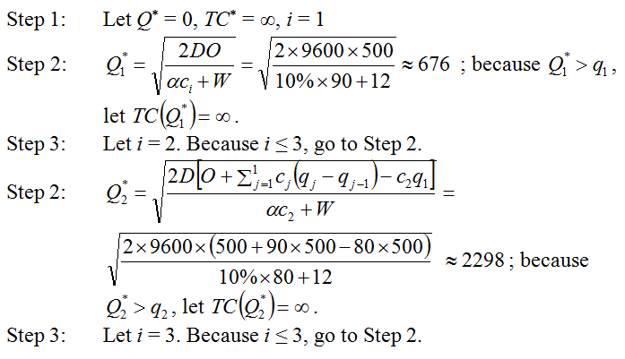
Everlast: Incremental Discount
© 2013 Samuel H. Huang All Rights Reserved

Slide 30
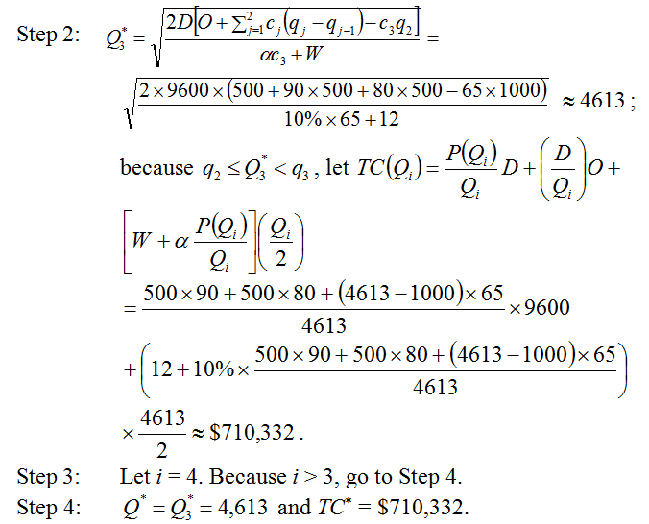
Everlast: Incremental Discount (Cont.)
© 2013 Samuel H. Huang All Rights Reserved

Slide 31
Safety Inventory
Extra inventory carried to satisfy uncertain customer demand
  Continuous review: an automatic inventory monitoring system provides continuous update, order quantity remains constant
  Periodic review: manual review of inventory at a fixed time interval (T), order quantity is the difference between a predetermined OUL (order-up-to level) and the current inventory
© 2013 Samuel H. Huang All Rights Reserved

Slide 32
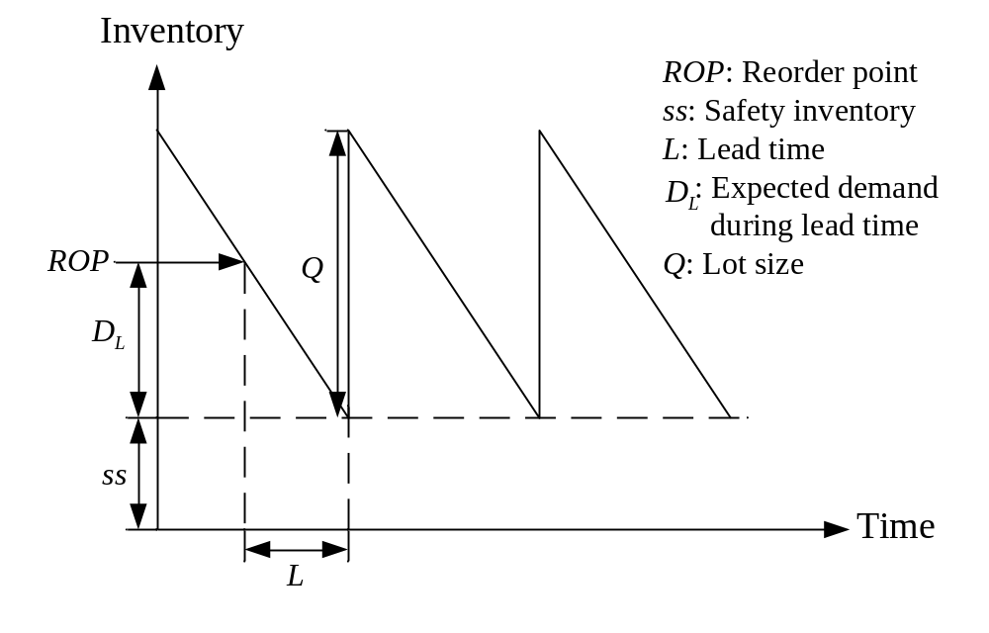
Safety Inventory Profile – Continuous Review
© 2013 Samuel H. Huang All Rights Reserved

Slide 33
ROP, CSL, and Safety Inventory
ROP: reorder point, a replenishment order is triggered when inventory falls to ROP
Demand during lead time (L) follows a normal distribution with mean D_{L} and standard deviation σ_{L}
If demand during lead time exceeds ROP then stockout occurs
CSL: cycle service level, the fraction of replenishment cycles that end with all the customer demands being met (event-oriented)
© 2013 Samuel H. Huang All Rights Reserved

Slide 34
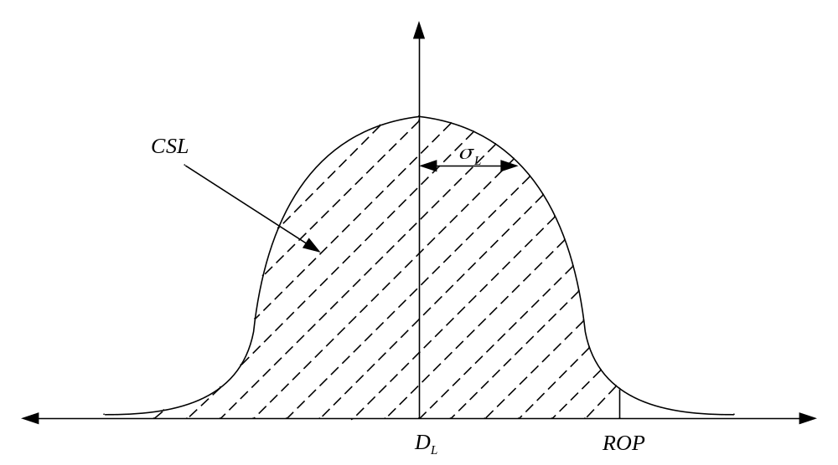
ROP, CSL, and Safety Inventory (Cont.)
Safety inventory ss = ROP – D_{L}
CSL = P(x ≤ ROP)
© 2013 Samuel H. Huang All Rights Reserved

Slide 35
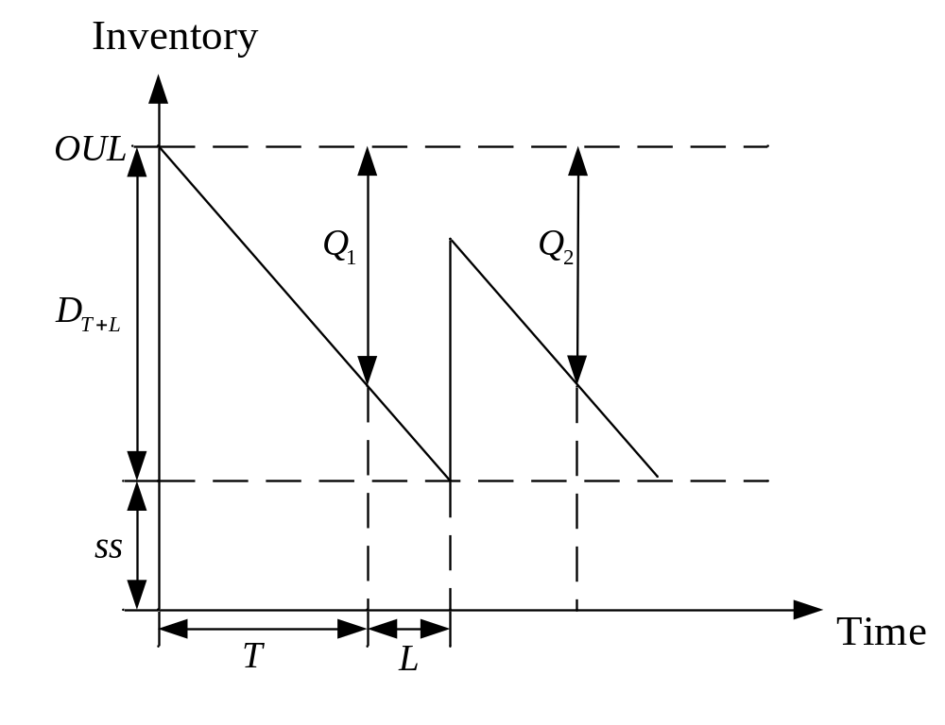
Safety Inventory Profile – Periodic Review
© 2013 Samuel H. Huang All Rights Reserved

Slide 36



OUL, CSL, and Safety Inventory
Safety inventory is the difference between OUL and the demand during the time interval T + L
© 2013 Samuel H. Huang All Rights Reserved

Slide 37
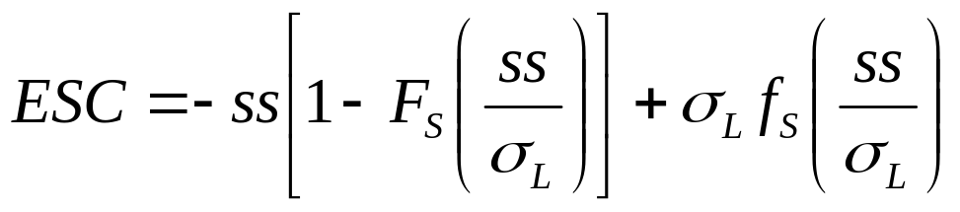
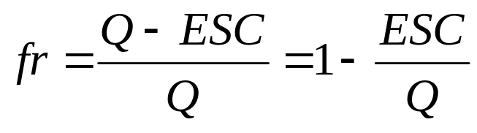
Fill Rate
Expected shortage per replenishment cycle
Fill rate (a quantity oriented performance measure)
© 2013 Samuel H. Huang All Rights Reserved

Slide 38
Example
Weekly demand is normally distributed with a mean of D_{w} = 1,000 and a standard deviation of σ_{w} = 50
Replenishment lead time = 2 weeks
Order lot size = 3,000
CSL = 95%
© 2013 Samuel H. Huang All Rights Reserved

Slide 39
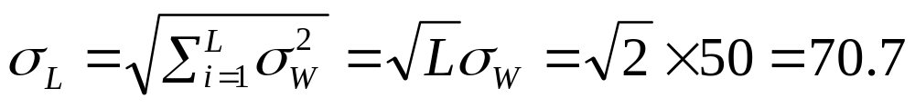
Continuous Review
Demand distribution during lead time
Place a replenishment order of 3,000 units when inventory is below 2,116
Fill rate = 99.95%
  D_{L} = D_{W}×2 = 1,000×2 = 2,000
© 2013 Samuel H. Huang All Rights Reserved

Slide 40
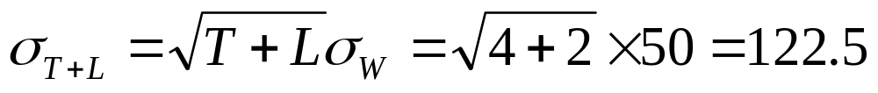
Periodic Review
Review period T = 4 weeks
Demand distribution during lead time (review interval + replenishment)
Place a replenishment order of 6201 – v (current inventory) units every 4 weeks
© 2013 Samuel H. Huang All Rights Reserved

Slide 41
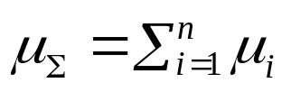
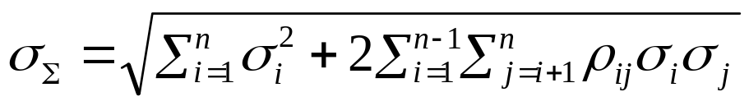
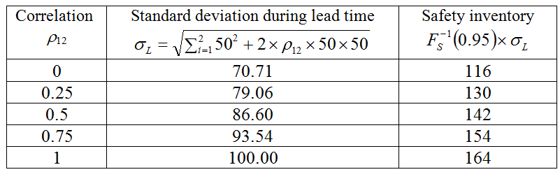
Impact of Demand Correlation
Sum of demand from n periods
Impact of demand correlation (continuous review example)
© 2013 Samuel H. Huang All Rights Reserved

Slide 42
Inventory Aggregation Example
Four store locations holding their own inventory
Monthly demand information
Store location | 1 | 2 | 3 | 4
Mean (μ) | 100 | 80 | 70 | 90
Standard Deviation (σ) | 30 | 15 | 20 | 25
Store location | 1 | 2 | 3 | 4
1 | - | ρ₁₂ = 0.5 | ρ₁₃ = 0.3 | ρ₁₂ = 0.1
2 | - | - | ρ₂₃ = 0.6 | ρ₂₄ = 0.2
3 | - | - | - | ρ₃₄ = 0.4
4 | - | - | - | -
© 2013 Samuel H. Huang All Rights Reserved

Slide 43
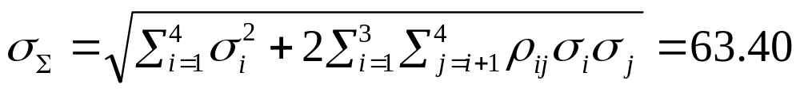

Inventory Aggregation Example (Cont.)
Review inventory twice a month (T = 0.5 month)
Replenishment lead time (L) is 0.5 month
Desired CSL = 97%
Total safety inventory = 56 + 28 + 38 + 47 = 169
Aggregate inventory to a single store
Safety inventory = 119
© 2013 Samuel H. Huang All Rights Reserved

Slide 44
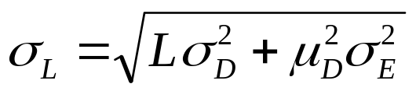
Impact of Lead Time Uncertainty
Lead time follows a normal distribution with a mean L and a standard deviation σ_{E} (measured using a certain unit of time)
Let μ_{D} and σ_{D} denote the mean and the standard deviation of demand (measured using the same unit of time), respectively
The standard deviation of demand during lead time
© 2013 Samuel H. Huang All Rights Reserved

Slide 45
Example
Lead time follows a normal distribution with a mean of 30 days and a standard deviation of 3 days
Monthly (30 days) demand follows a normal distribution with a mean of 340 and a standard deviation of 63.40
Daily demand is independent
CSL = 97%
© 2013 Samuel H. Huang All Rights Reserved

Slide 46
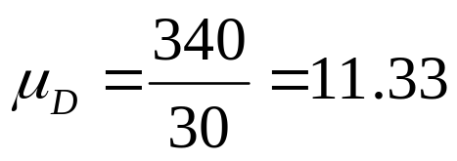
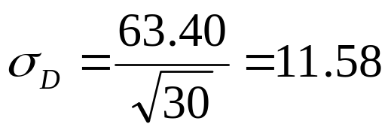
Example (Cont.)
Lead time is measured using the unit of day; need to convert monthly demand into daily demand
© 2013 Samuel H. Huang All Rights Reserved

Slide 47
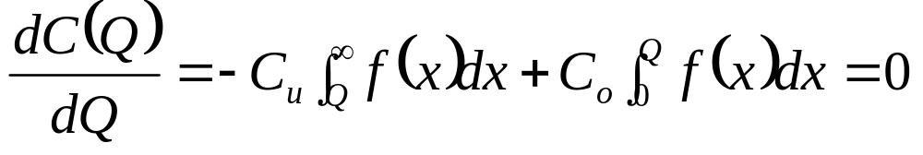



Optimal Product Availability
C_{o}: cost of overstocking by one unit,
C_{u}: cost of understocking by one unit
Expected cost by having Q units of inventory
© 2013 Samuel H. Huang All Rights Reserved

Slide 48


Continuous Stocked Products
Annual demand D, annual holding cost H, order quantity Q
C_{o} = QH/D
Demand during stockout is lost: C_{u} = lost profit
Demand during stockout is backlogged and offered a discount of C_{d} per unit: C_{u} = C_{d} – QH/D
© 2013 Samuel H. Huang All Rights Reserved

Slide 49

Seasonal Products
p: retail price per unit
c: cost per unit
s: salvage value per unit
C_{u} = p – c; C_{o} = c – s
© 2013 Samuel H. Huang All Rights Reserved

Slide 50



Optimal Order Quantity and Expected Profit
Optimal order quantity
Expected profit
© 2013 Samuel H. Huang All Rights Reserved

Slide 51


Expected Overstock and Expected Understock
Expected overstock
Expected understock
© 2013 Samuel H. Huang All Rights Reserved

Slide 52
Example
Opportunity to sell digital TV converters
Total demand follows a normal distribution with a mean of 5,000 and a standard deviation of 500
Sell price = $75; cost = $30 if quantity < 6,000; otherwise cost = $25
Unsold converters have no salvage value
How many converters should be ordered?
© 2013 Samuel H. Huang All Rights Reserved

Slide 53

Example (Cont.)
Quantity < 6,000; c = $30
Quantity >= 6,000; c = $25
Order 6,000 units
E(5127) = $210,512
E(6000) = $224,682
© 2013 Samuel H. Huang All Rights Reserved

Slide 54
Case Study 1: Shipping Options
Weekly demand of laptop computers in BVE store is independent and normally distributed with a mean of 1,000 and a standard deviation of 300
Inventory holding cost = $152 per laptop per year
When out of stock, the store offers $100 discount per laptop to keep the customer
© 2013 Samuel H. Huang All Rights Reserved

Slide 55
Case Study 1: Shipping Options (Cont.)
Regular shipping costs $6,000 per order and takes 2 weeks for delivery
Expedited shipping costs $7,000 per order and takes 1 week for delivery
Inventory is monitored continuously
Determine inventory management policy and shipping option
© 2013 Samuel H. Huang All Rights Reserved

Slide 56
Case Study 1: Key Points
Regular shipping has lower fixed ordering cost; it has a longer delivery lead time and thus requires more safety inventory, which leads to higher inventory holding cost
Need to determine optimal CSL to calculate required safety inventory
Product is continuously stocked, need to determine the order quantity in order to calculate CSL
© 2013 Samuel H. Huang All Rights Reserved

Slide 57

Case Study 1: Solution
© 2013 Samuel H. Huang All Rights Reserved

Slide 58
Case Study 2: Component Commonality
Company manufacture two laptop models with independent demand
  Ultra Pro: weekly demand is independent and normally distributed with a mean of 800 and a standard deviation of 400; uses LG8555 battery
  Ultra Home: weekly demand is independent and normally distributed with a mean of 100 and a standard deviation of 250; uses LG81111 battery
LG8555 and LG8111 are jointly ordered
© 2013 Samuel H. Huang All Rights Reserved

Slide 59
Case Study 2: Component Commonality (Cont.)
Replenishment lead time is 4 weeks
Unit Cost: $80 for LG8555; $78 for LG8111
Annual inventory holding cost is 20% of unit cost
Desired CSL = 99%
Will the company reduce cost if Ultra Home also uses LG8555 battery?
© 2013 Samuel H. Huang All Rights Reserved

Slide 60
Case Study 2: Key Points
Safety inventory is required for both LG8555 and LG8111
Use a common component (LG8555) can lower the required safety inventory (independent demand)
LG8555 has a slightly higher unit cost than LG8111
Need to analyze the trade off between lower safety inventory cost and higher purchasing cost
© 2013 Samuel H. Huang All Rights Reserved

Slide 61
Case Study 2: Solution
Safety inventory for LG8555
Safety inventory for LG8111
Total safety inventory holding cost = $47,919
Annual holding cost = 1861×80×20% = $29,776
Annual holding cost = 1163×78×20% = $18,143
© 2013 Samuel H. Huang All Rights Reserved

Slide 62


Case Study 2: Solution (Cont.)
When LG8555 is used for both models, the weekly demand follows a normal distribution with a mean of 900 (800 + 100) and a standard deviation of 471.7 ( )
Safety inventory
Safety inventory holding cost = 2195×80×20% = $35,120
Increase in purchasing cost = 100×52×(80 – 78) = $10,400
Total cost = $45,520 < $47,919
© 2013 Samuel H. Huang All Rights Reserved

