Slide 1
GDB Tool for ADSP Guide

Slide 2
Agenda
Environment Setting
User Guide
[Options] SYS_ADSP_DUMP Memory Layout
Trouble Shooting

Slide 3
Agenda
Environment Setting
User Guide
[Options] SYS_ADSP_DUMP Memory Layout
Trouble Shooting

Slide 4
Environment Setting
Requirement:
  You “MUST” install Python 3 on Linux server, otherwise the python script would be fail.
  You “MUST” get the XtensaTool which download from cadence.
  You “MUST” get the license key for using XtensaTool
  You “MUST” copy TOOL/GDB_DEBUG/hifi_debug_vXpX.tar.xz to your Linux Server from Aurisys package

Slide 5
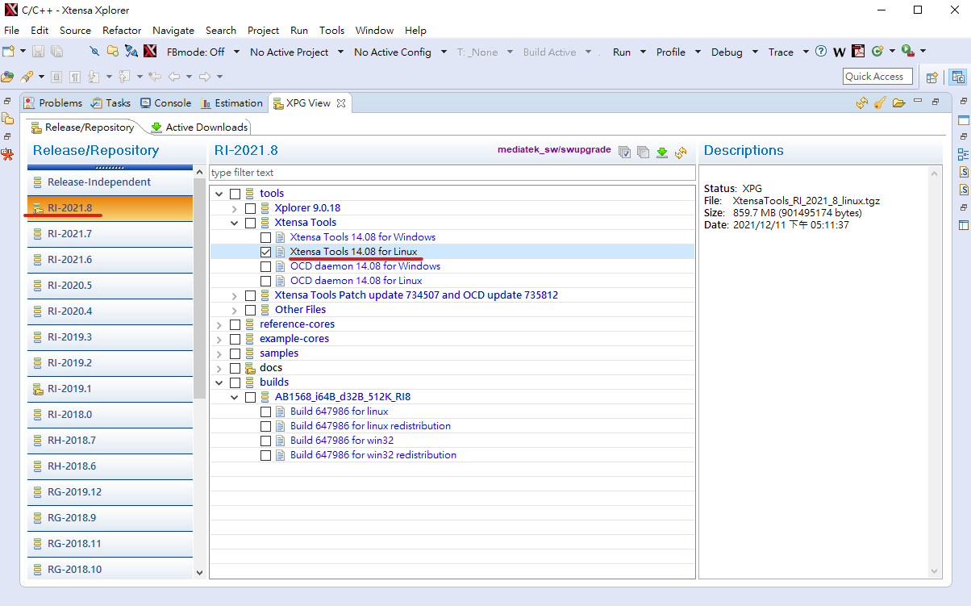
Download XtensaTools from IDE

Slide 6
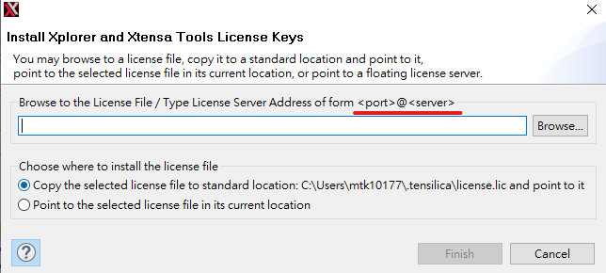
Set License Key
Please export the License Server Address before using the tool
  export XTENSAD_LICENSE_FILE=‘<port>@<server>'

Slide 7
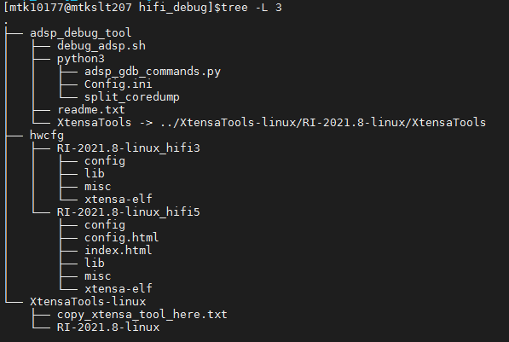
Tar hifi_debug_vXpX.tar.xz on server
Decompress the Tool to linux server
  tar Jxvf hifi_debug_tool_vXpX.tar.xz
!!! copy XtensaTool which download from cadence !!!

Slide 8
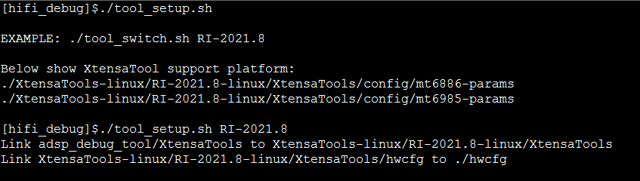
Auto setup by tool_setup.sh
./tool_setup.sh
  Show tools support information
./tool_setup.sh RI-2021.8
  Ex: mt6985 is RI-2021.8, tool setup to RI-2021.8
  Create soft link as previous folder structure
  Fast-switch different xtensatools version by the script

Slide 9
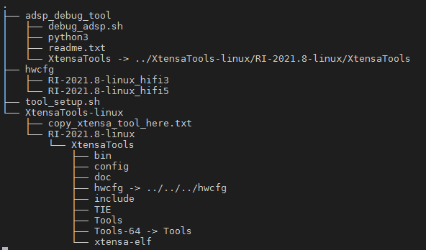
Folder Structure (after tool_setup.sh)
Hwcfg copy from aurisys package
Tool script for adsp debug
Soft link to XtensaTools path
Soft link to hwcfg path
XtensaTool from cadance

Slide 10
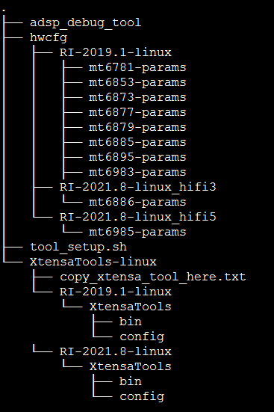
Copy params files to XtensaTools/config
“Auto copy after hifi_debug_v5p3”
Copy params files to related version of XtensaTools/config
Copy params files to related version of XtensaTools/config

Slide 11
Agenda
Environment Setting
User Guide
[Options] SYS_ADSP_DUMP Memory Layout
Trouble Shooting

Slide 12
Simple usage
cd hifi_debug/adsp_debug_tool
Put the correspond hifiX_X.elf and SYS_ADSP_DUMP
./debug_adsp.sh ${platform} ${elf_path}
Ex
  ./debug_adsp.sh mt6983 hifi3_a.elf ;# debug mt6983 hifi a
  ./debug_adsp.sh mt6983 hifi3_b.elf ;# debug mt6983 hifi b
  ./debug_adsp.sh mt6985 hifi5_a.elf ;# debug mt6985 hifi a
  ./debug_adsp.sh mt6985 hifi5_b.elf ;# debug mt6985 hifi b

Slide 13
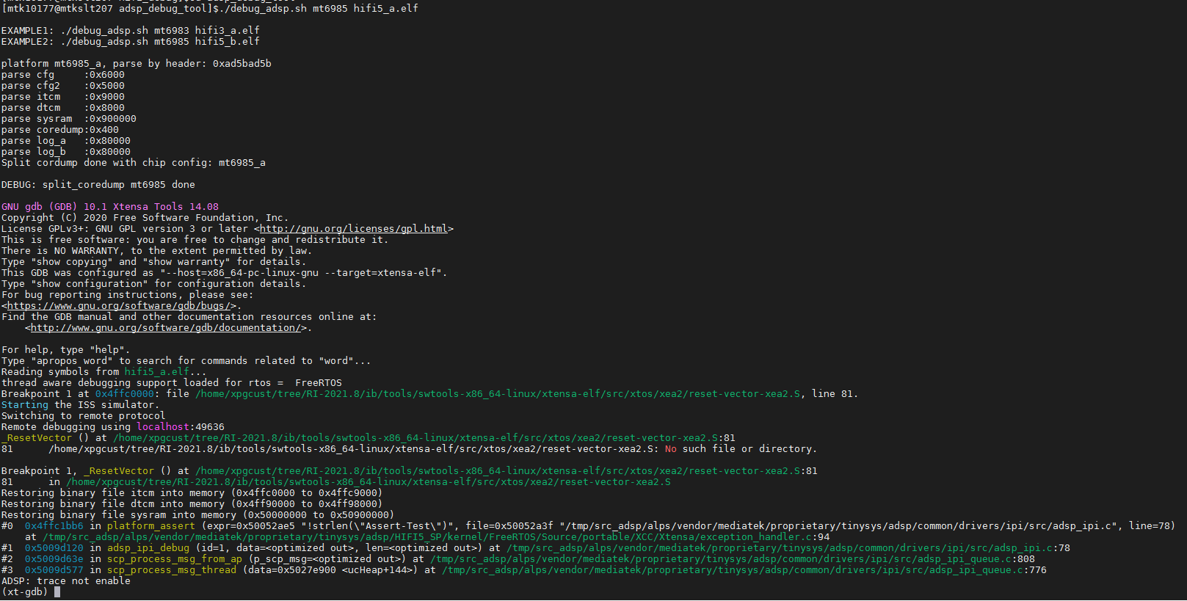
Simple usage

Slide 14
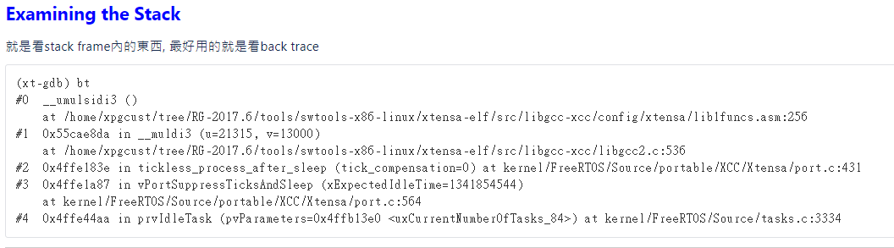
Examining the Stack

Slide 15
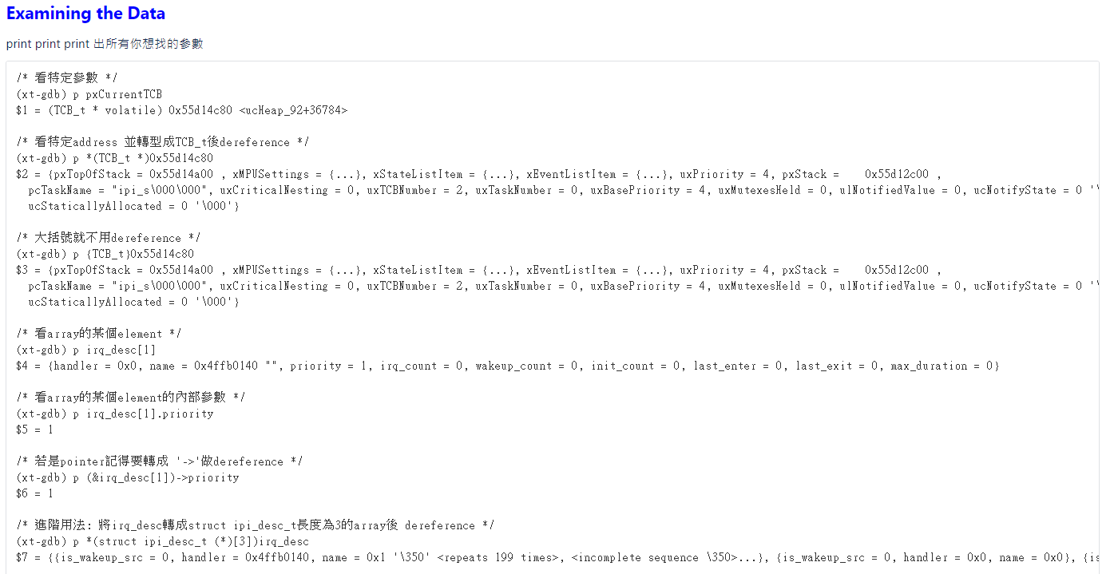
Examining the Data

Slide 16
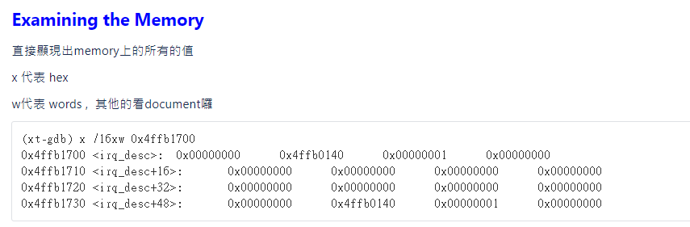
Examining the Memory

Slide 17
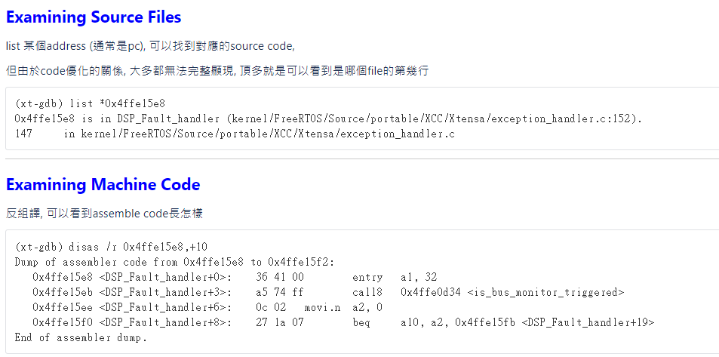
Examining Source Files or Assemble code

Slide 18
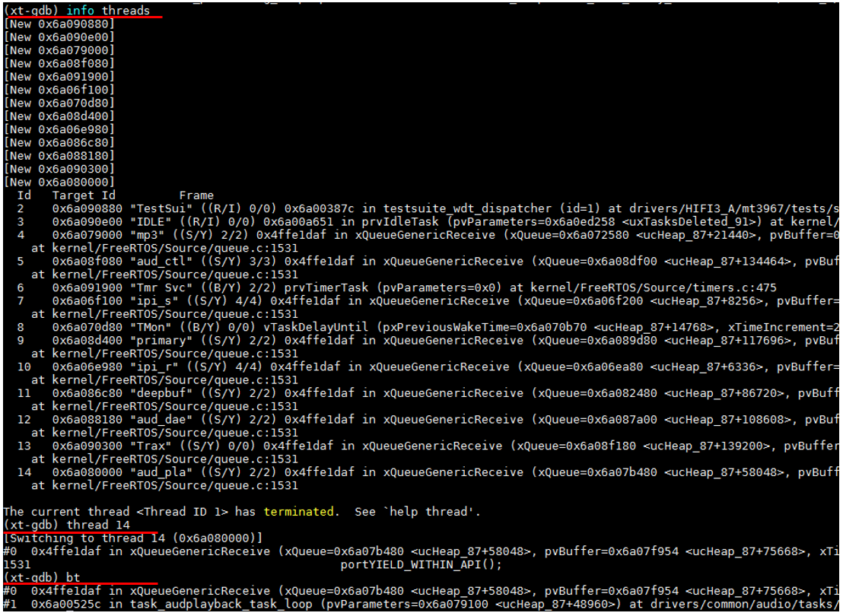
Switch to other task and show backtrace

Slide 19
Agenda
Environment Setting
User Guide
[Options] SYS_ADSP_DUMP Memory Layout
Trouble Shooting

Slide 20
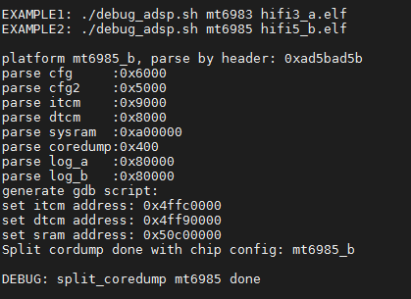
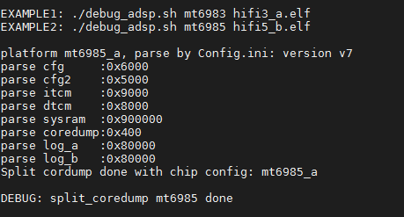
[Options] SYS_ADSP_DUMP layout
Mt6985, Mt6886 :
  Parse by dump header & elf
Others legacy platform
  Parse by Config.ini
Need to update “config.ini” if memory relayout

Slide 21
[Options 1] Parse by dump header
SYS_ADSP_DUMP Binary Layout
Magic: 0xAD5BAD5B | Size: 0x6000 | Name: cfg
Mem dump
Magic: 0xAD5BAD5B | Size: 0x5000 | Name: cfg2
Mem dump
Magic: 0xAD5BAD5B | Size: 0x9000 | Name: itcm
Mem dump
Magic: 0xAD5BAD5B | Size: 0x8000 | Name: dtcm
Mem dump
Magic: 0xAD5BAD5B | Size: 0x900000 | Name: sysram
Mem dump
……

Slide 22
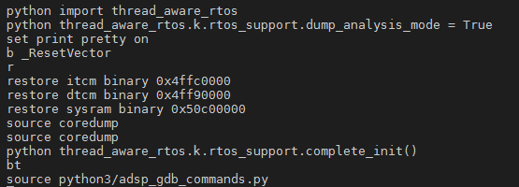
[Options 1] Parse by dump header (2)
Parse section address by reading specific symbol from elf file
gdb_cmd.txt

Slide 23
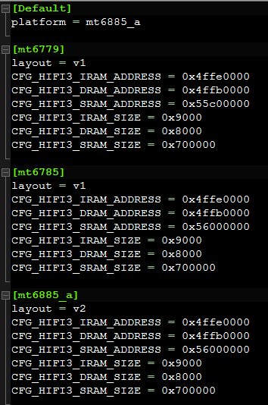
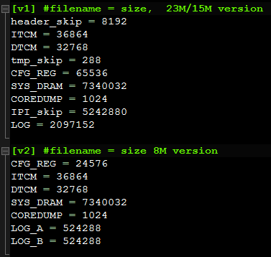
[Options 2] Parse by Config.ini
SYS_ADSP_DUMP Binary Layout
Mem dump
Mem dump
Mem dump
Mem dump
Mem dump
……
SYS_ADSP_DUMP
sequence
./debug_adsp.sh mt6885 hifi3_a.elf
File: ./python3/Config.ini
CFG_HIFI3_SRAM_SIZE = SYS_DRAM:
should be the same configuration at platform.mk
[Remind] Generally if Memory optimization or increase heap, you must change the debug layout

Slide 24
(cont.)[Options 2] SYS_ADSP_DUMP Layout
Version | V1 |  | V2 |  | V3 |  | V4
Platform [Android Version] | mt6779 mt6785 [Q] |  | mt6885 mt6873 mt6893 |  | mt6853 mt6877 |  | mt6785 [R] mt6781
File Size (Around) | 14 MB |  | 8 MB |  | 10 MB |  | 8 MB
Layout | Segment | Size | Segment | Size | Segment | Size | Segment | Size
 | ELF Header | 8 KB | CFG_REG | 24 KB | CFG_REG | 24 KB | CFG_REG | 64 KB
 | ITCM | 36 KB | ITCM | 36 KB | ITCM | 36 KB | ITCM | 36 KB
 | DTCM | 32 KB | DTCM | 32 KB | DTCM | 32 KB | DTCM | 32 KB
 | Temp | 288 B | SYS_DRAM | 7 MB | SYS_DRAM | 9 MB | SYS_DRAM | 7 MB
 | CFG_REG | 64 KB | CoreDump | 1 KB | CoreDump | 1 KB | CoreDump | 1 KB
 | SYS_DRAM | 7 MB | LOG_A | 512 KB | LOG_A | 512 KB | LOG_A | 512 KB
 | CoreDump | 1 KB | LOG_B | 512 KB | LOG_B | 512 KB | LOG_B | 512 KB
 | IPI_Buffer | 5 MB
 | LOG | 2 MB
 | Reserved Memory *mt6779 only | 9 MB
…….

Slide 25
Agenda
Environment Setting
User Guide
[Options] SYS_ADSP_DUMP Memory Layout
Trouble Shooting

Slide 26
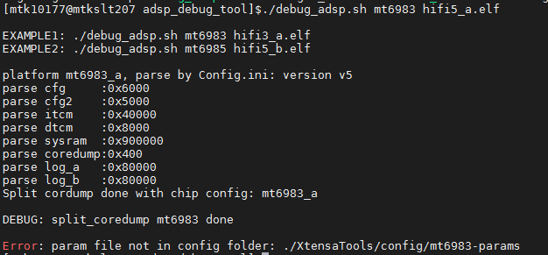
Error: param file not in config folder
Ans : Copy params files to XtensaTools/config

Slide 27
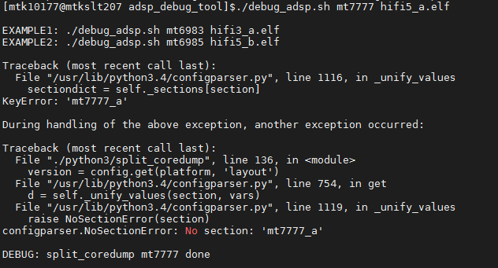
Error: Configparser.NoSectionError
Ans: [Options 2] Parse by Config.ini
Need add the platform layout of mtxxxx_x

Slide 28
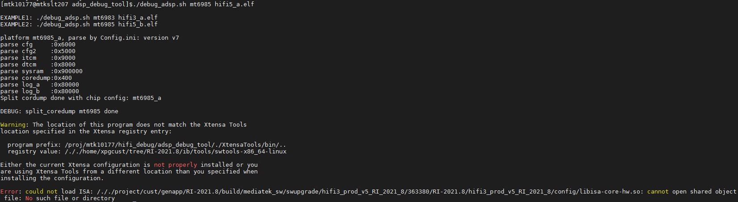
Error: could not load ISA
The mtxxxx-params path setting is wrong

Slide 29
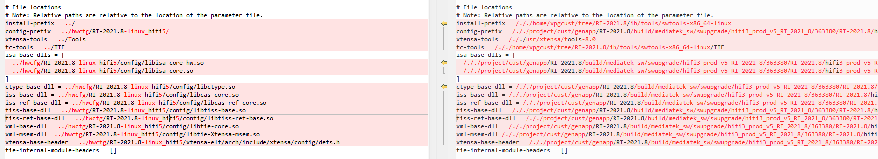
(cont.) Error: could not load ISA
Example: mtXXXX-params
  Fix hwcfg relative paths to the location of this file (XtensaTools/config/mtxxxx-params)
Correct
Wrong

Slide 30
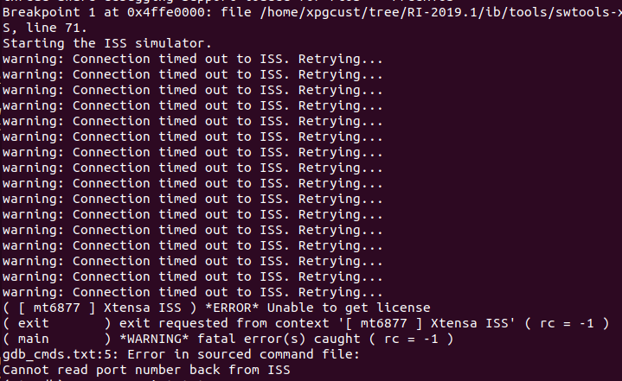
Error: could not load ISA – port error
Ping Specific Port using telnet:
$ telnet <ip_address> <port_number>
$ telnet <domain_name> <port_number>
If can’t ping the license server, please check the firewall setting or contact to IT for help
Ref: Set License Key

