Slide 1
Audio DSP SWIP
Build Library with Xtensa Xplorer IDE
Mediatek Audio Team

Slide 2
Outline
Create Project
Add Source Codes
Compiler Options
Build Library
Appendix
  How to find config version

Slide 3
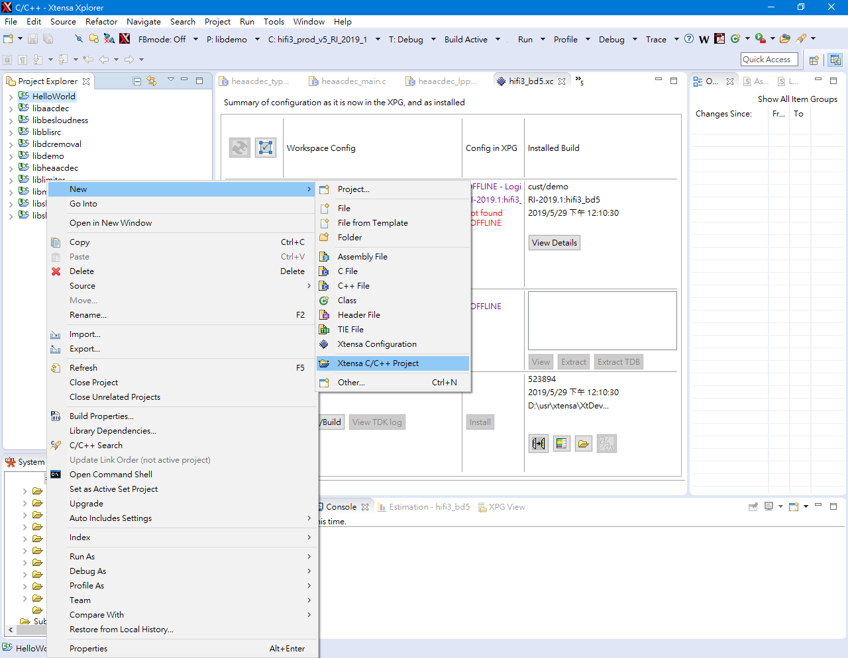
Create Project
Mouse right click in empty area of the project explorer.
Choose New → Xtensa C/C++ Project

Slide 4
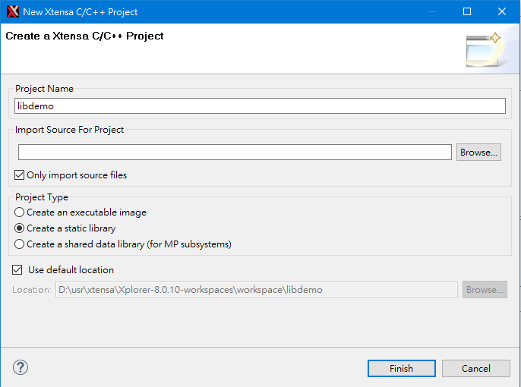
Create Project
Name your project as your library name.
Project Type: Create a static library

Slide 5
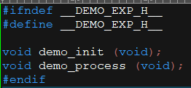
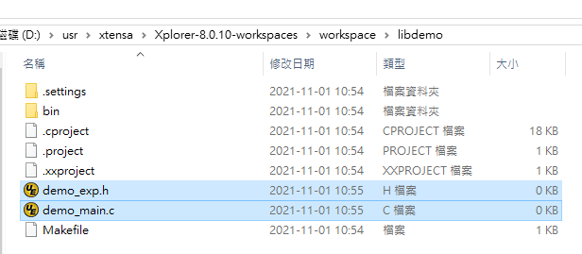
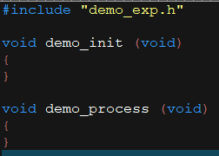
Add Source Codes
Put your source codes (all .h & .c files) in the project workspace directory.
  For example: demo_exp.h & demo_main.c

Slide 6
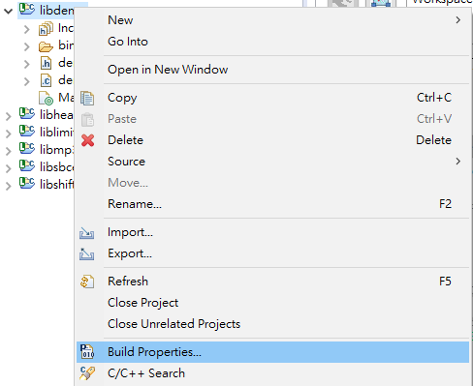
Build Properties
Choose the project and press F5 to refresh for new added source codes.
Mouse right click on the project to choose build properties.

Slide 7
Compiler Options
Target can choose “Debug”, “Release”, “ReleaseSize”, “CommonTarget” or add your own target for different compiler options.
Current audio HiFi3 compiler options in general: -O3 -Wall -mcoproc -Werror -mlongcalls -LNO:simd -ffunction-sections -fdata-sections -Wno-error=format
Press “Apply”

Slide 8
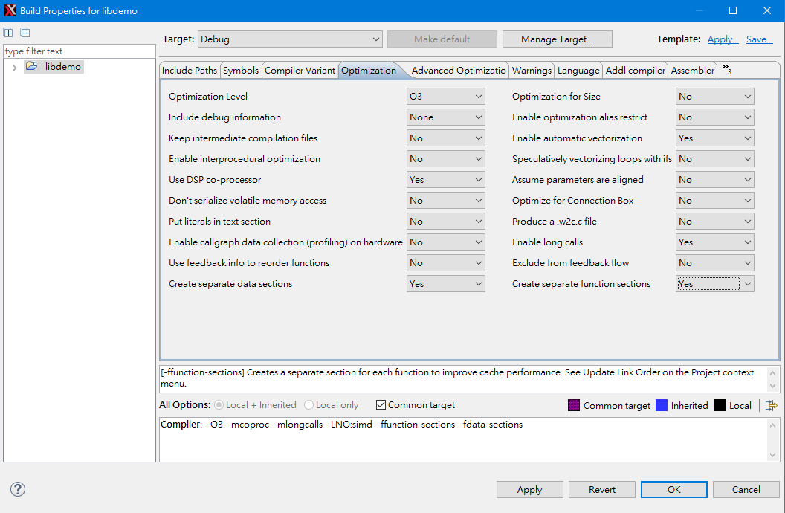
Compiler Options: Optimization Tab

Slide 9
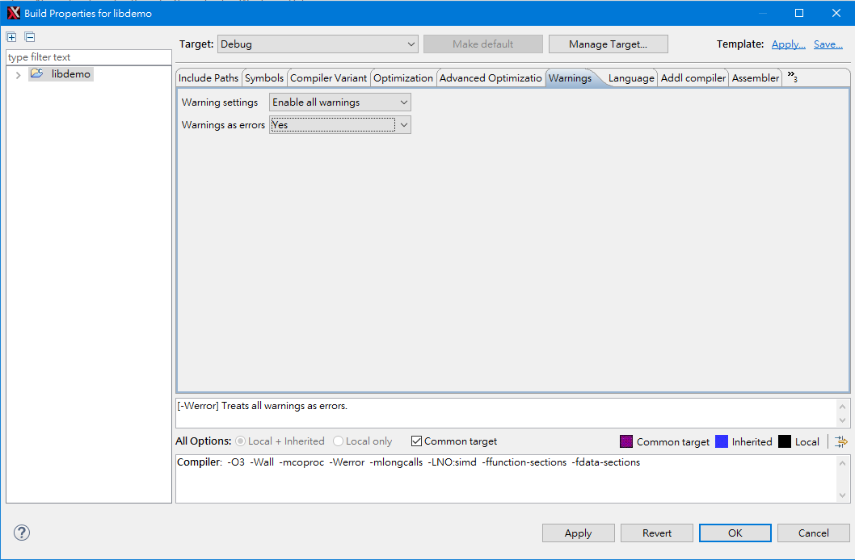
Compiler Options: Warnings Tab

Slide 10
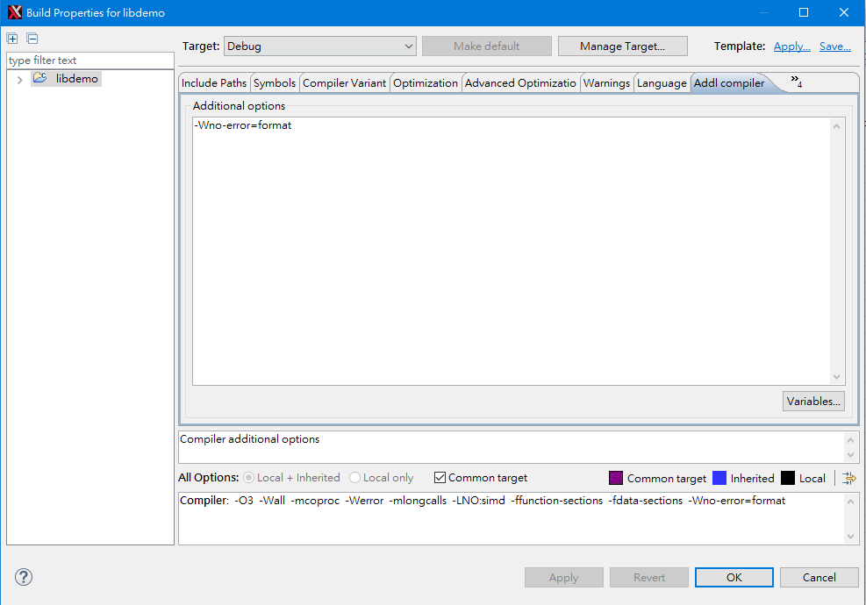
Compiler Options: Addl compiler Tab

Slide 11
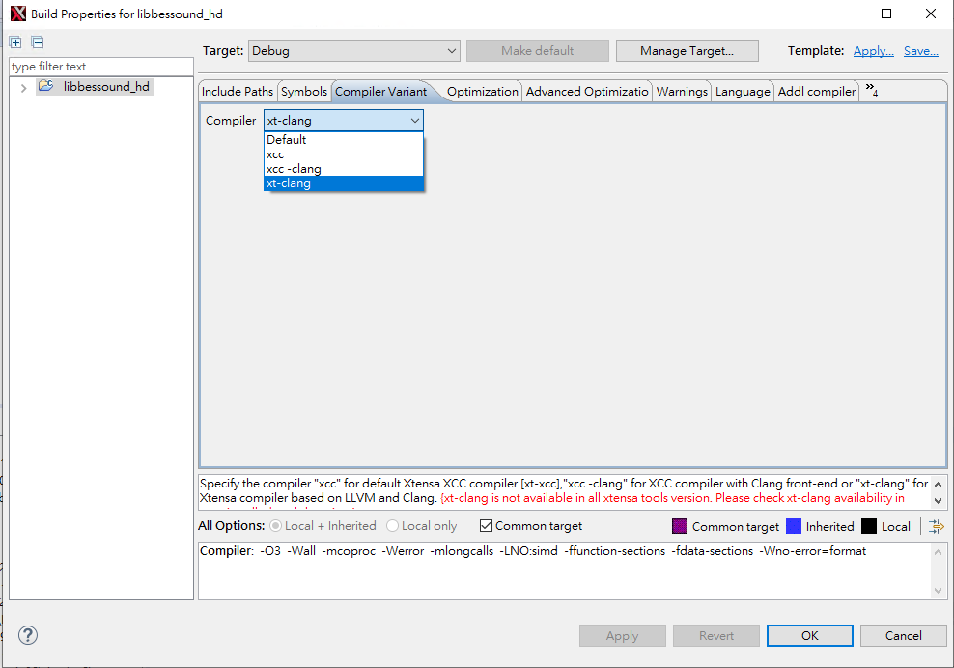
Compiler Options: Compiler Variant
Choose compiler type
  xt-clang is recommended for security concern

Slide 12
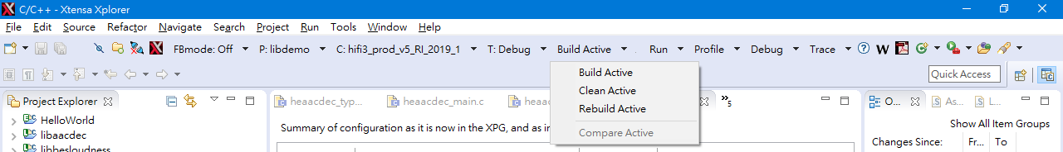
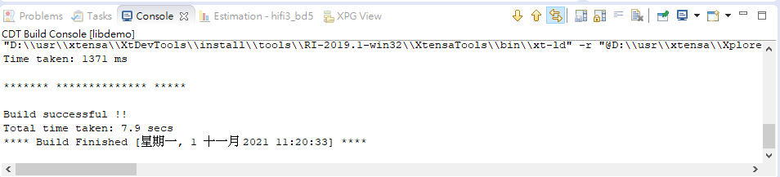
Start to Build Library
Choose P (Project), C (Configuration), T (Target), and then press “Build Active”
  For example, P:libdemo, C:hifi3_prod_v5_RI_2019_1, T:Debug
  If you want to rebuild the library, you can “Clean Active” and then “Build Active”, or just “Rebuild Active”.
  Console will show if this build is “successful” or not.

Slide 13
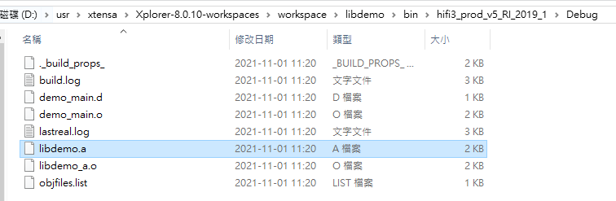
Get Your Library

Slide 14
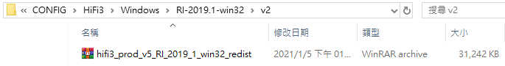
Appendix – How to find config version
Find Readme under Aurisys_exe_V1.21XX.01\CONFIG\HiFiX

