Slide 1
Hifi3 Debugging Tools
2019/1/7

Slide 2
Debug Items
Basic function
  UART (useful!)
  Logger (useful!)
  CFGREG Dump
  ADSP JTAG
System SW debug
  Monitor
    Task monitor (useful!)
    Heap Management Tool
    Timestamps
  Assert
    Exception Handler (useful!)
    Stack overflow / Malloc failed hook
  Dump
    TRAX
    XT-GDB Dump (useful!)
    Debug Dump type (useful!)
    Debug Command (useful!)
System img debug
  xt-objdump
Audio Related
  Audio PCM Dump (useful!)
  Audio Utilities
    HEAP : AUDIO_CHECK(ptr)
    LOCK : MTK_AUDIO_LOCK_ENABLE_TRACE
    AUDIO IPI : print_msg_info
    IPI DMA : DUMP_REGION
    RINGBUF SW: DUMP_RINGBUG
    RINGBUF HW dump function

Slide 3
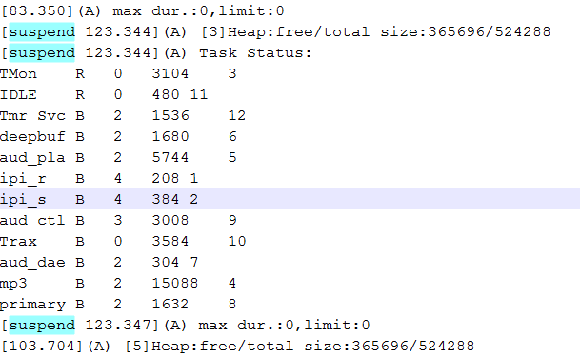
Basic function
Uart
  uart2 : 921600
  CFG_UART_SUPPORT = yes (default =no for performance)
  align kernel timestamp
    CFG_KERNEL_TIMESTAMP_SUPPORT =yes
  print AP suspend info
    use freeRTOS tick to continue timestamp, timestamp will retrograde after AP resume.

Slide 4
Uart
With printf function, AUD_LOG_V will not print log
Runtime disable/enable uart output (ADSP should be active to received command)
adb shell "echo 1 > /sys/class/misc/adsp/adsp_uart_switch"
adb shell "echo 0 > /sys/class/misc/adsp/adsp_uart_switch"
System print | Audio Feature print
PRINTF_D | AUD_LOG_D
PRINTF_I | AUD_LOG_I
PRINTF_W | AUD_LOG_W
PRINTF_E | AUD_LOG_E

Slide 5
ADSP Logger
  Linked in MTKlogger
  /sdcard/mtklog/mobilelog/adsp_log_xxx_
ADSP EE log
  Triggered by user cmd
    /sys/class/misc/adsp # cat adsp_A_db_test
  Triggered by system exception (EE & Kernel API)
    SYS_ADSP_DUMP in db file
ELF header | ITCM | DTCM | reserved | hifi3 cfgreg | dram(system) | hifi3 core reg | Dram (shared mem)
SYS_ADSP_DUMP composition

Slide 6
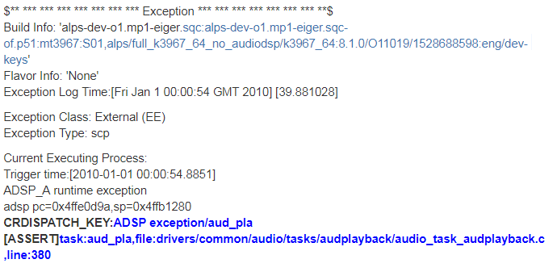
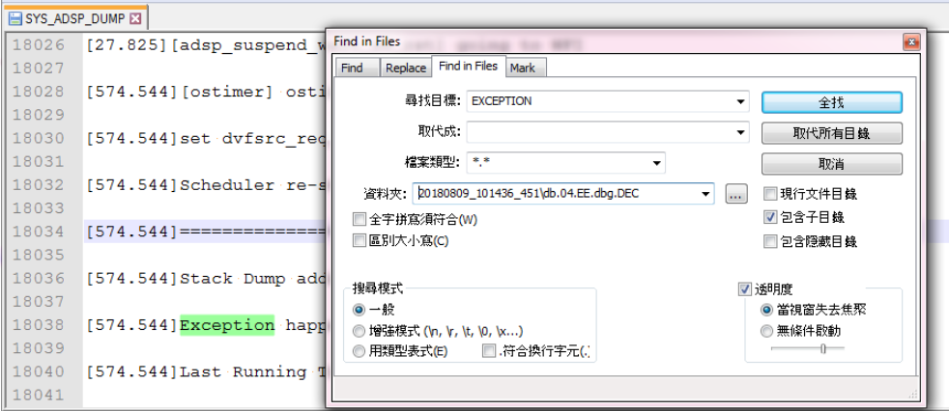
ADSP EE Format
  "aud_pla": the name of Hifi3 task in which exception is happened.
  If the exception is caused by ASSERT, the filename and line information will be shown in aee screen and __exp_main.txt in db.
  SYS_ADSP_DUMP can see the ADSP Last Log

Slide 7
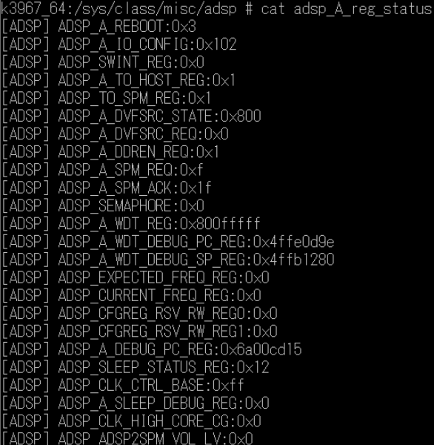
ADSP CFGREG dump
Runtime check Hifi3 config register
  adb shell cat /sys/class/misc/adsp/adsp_A_reg_status
All the Hifi3 config register will be dumped
to SYS_ADSP_DUMP in aee db file when
AEE exception is triggered by Hifi3 WDT.

Slide 8
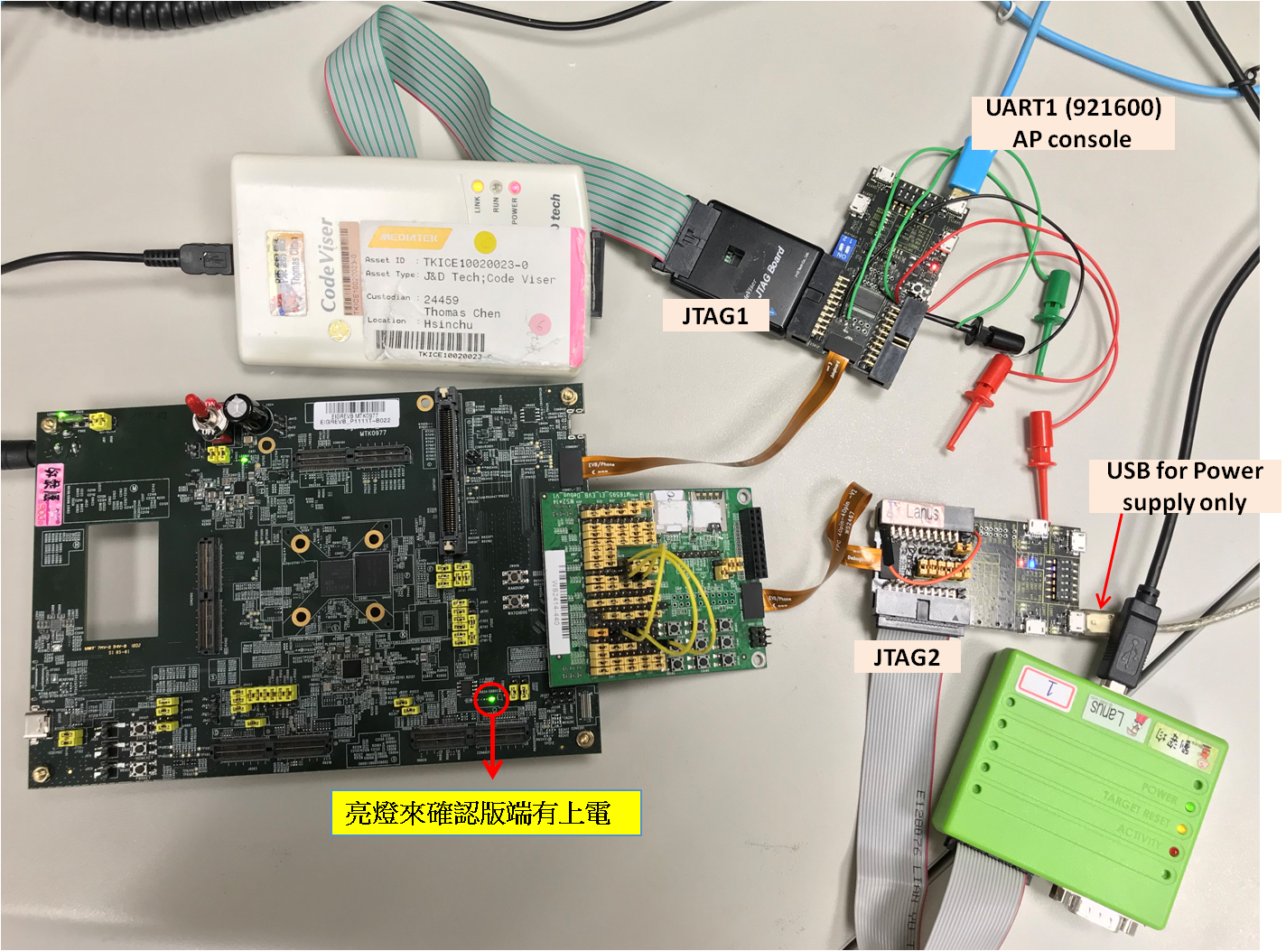
ADSP JTAG (Currently only available at EVB board )
JTAG HW setup (Use Flyswatter2 as ADSP JTAG)
  EVB need Rework, please find corresponding SA
  Set GPIO to ADSP_JTAG Mode for JTAG
Notes:
OCD manager 找不到controller : hifi3 CPU reset需要放掉

Slide 9
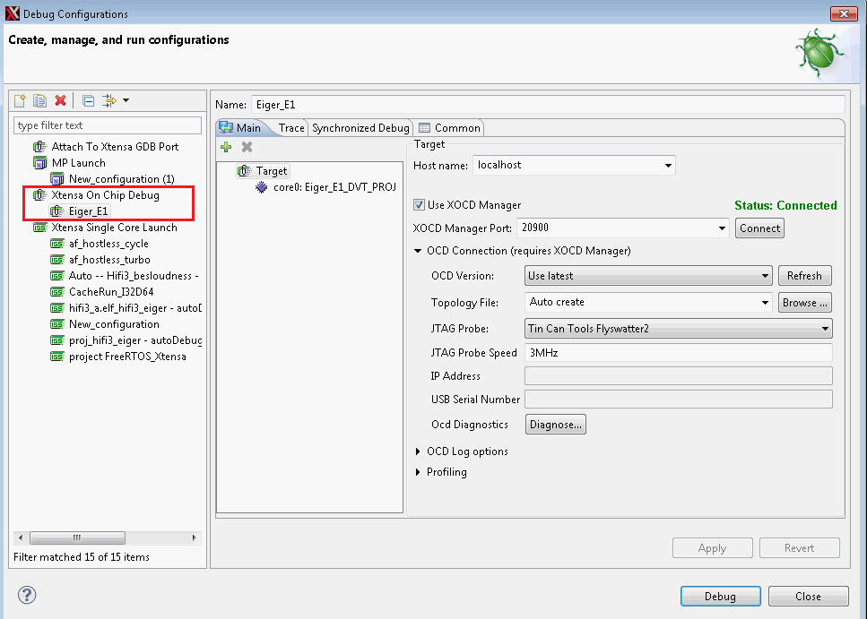
JTAG SW setup
  Xplorer Download and installed Xtensa OCD Daemon 12.0.6
  Set Debug Target Configuration

Slide 10
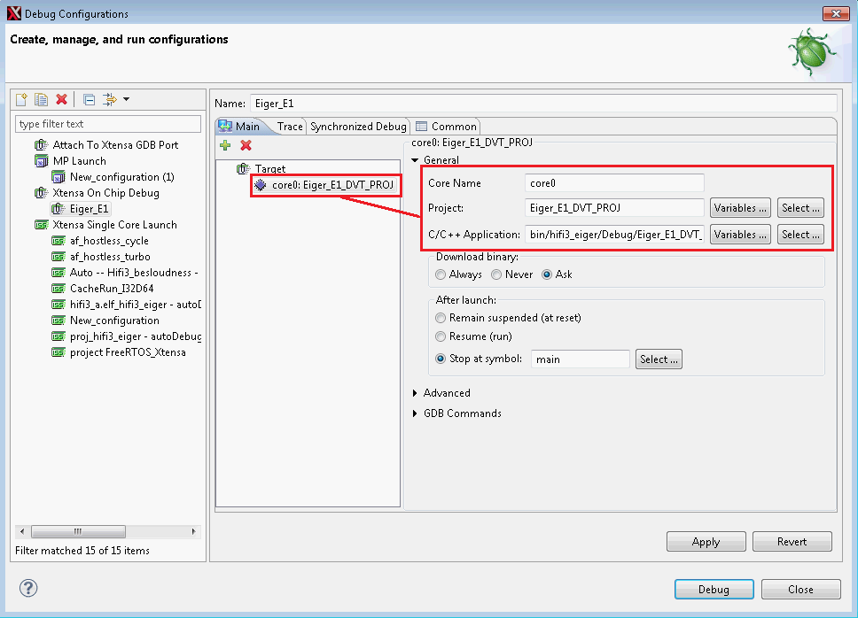
  Set Debug Configuration

Slide 11
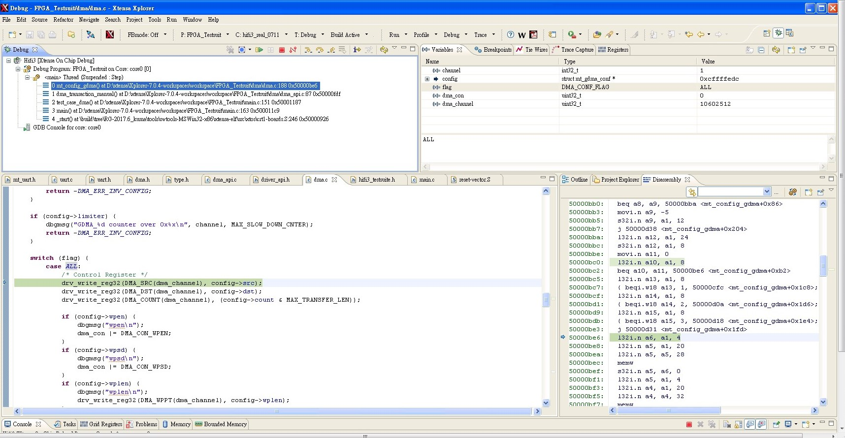
  Debug window

Slide 12
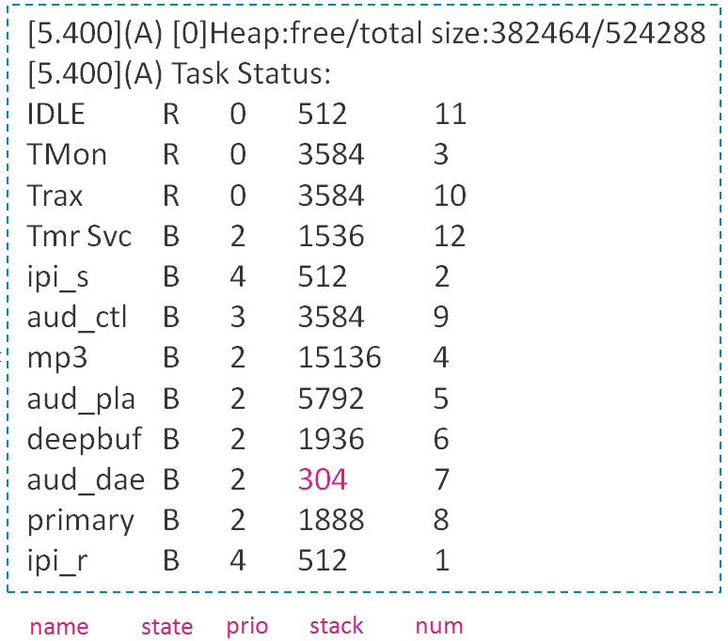
System SW debug
  TASK Monitor
    Total Heap status
    Task status
      State
    'B' - Blocked
    'R' - Ready
    'D' - Deleted (waiting clean up)
    'S' - Suspended, or Blocked without a timeout
          Stack
    The lower number the less free space.
Notes:
'B' - Blocked
'R' - Ready
'D' - Deleted (waiting clean up)
'S' - Suspended, or Blocked without a timeout

Slide 13
Heap Memory Management Tool
Extend from FreeRTOS (heap_4.c only)
Feature 1: Monitor heap memory usage
  Combine Task Monitor, Monitor each time slice memory usage.
Feature 2 : Detail information of allocate memory
  Command, dump detail information of each allocate block

Slide 14
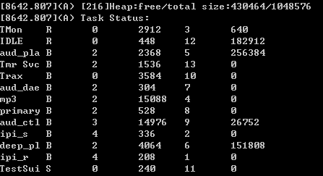
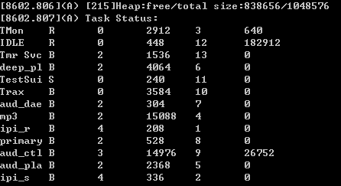
Feature 1: Monitor heap memory usage
#define configUSE_MALLOC_MEMORY_USAGE (FreeRTOSConfig.h)
Audio is playing
Audio stop (idle)
Heap usage by each task

Slide 15
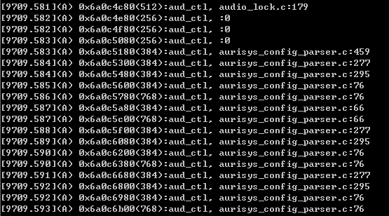
Feature 2: Detail information of allocate memory
Triggered in vApplicationMallocFailedHook
  Need combined with Feature 1 (both set in FreeRTOSConfig.h)
#define configUSE_MALLOC_DEBUG_MSG_LEN 32
Memory header point
size
task
File : line

Slide 16
  TimeStamps
    IPI
      CFG_IPI_STAMP_SUPPORT
      Record each ipi id send/recv success count
    IRQ
      set_irq_limit(1) → default 3 ms, if over threshold, print error msg
    Task function process
      Audio_task_utility
        init_time_interval(int id, unsigned long long thresholdns)
        record_time_interval(int id); → warning if the function process time over thresholdns.
        stop_time_interval(int id);

Slide 17
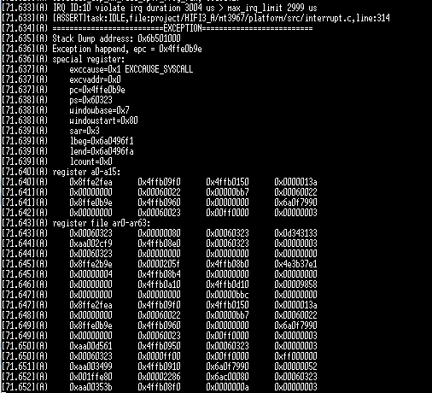
  Exception Handler
    Through ADSP Uart
    Dump stack register
      Feed in Xt-gdb to trace
    Exception cause and address
      epc
      exccause
      excvaddr
Notes:
The program counter (PC) holds the address of the next instruction to execute
PS : processor state

Slide 18
Malloc Failed
  vApplicationMallocFailedHook(void)
Stack overflow
  vApplicationStackOverflowHook(xTaskHandle pxTask, char *pcTaskName)
  Check when Task context switch
  Can reference on Task Monitor Stack status
Above Errors will trigger system Assert (WDT) to info AP

Slide 19
TRAX
  Xtensa provided, record function execution flow (no data info)
TRAX enable method :
  adb cmd
    AP sends IPI_TRAX_ENABLE to trigger DSP enable/disable TRAX.
  cd sys/class/misc/adsp
    echo 1 > adsp_A_trax. (start record)
    echo 0 > adsp_A_trax. (stop record)
    cat adsp_A_trax

Slide 20
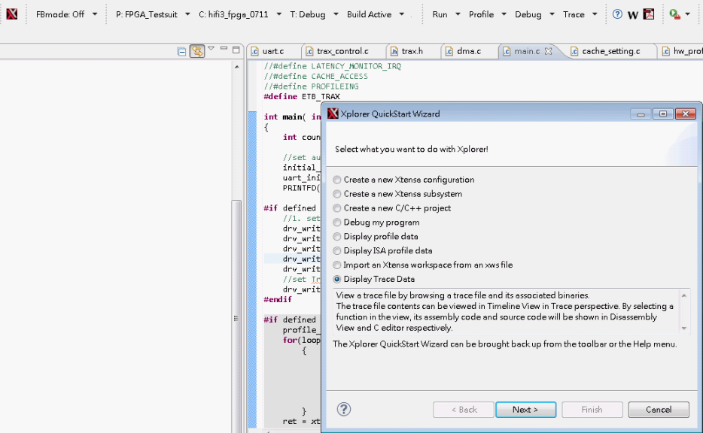
Analyze trace data by Xplorer (0)

Slide 21
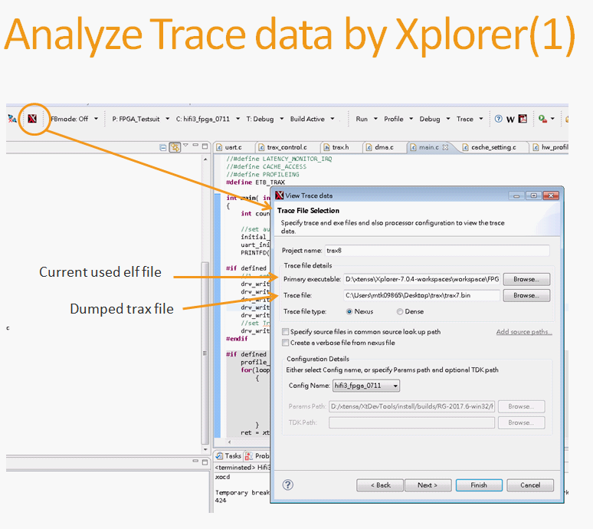

Slide 22
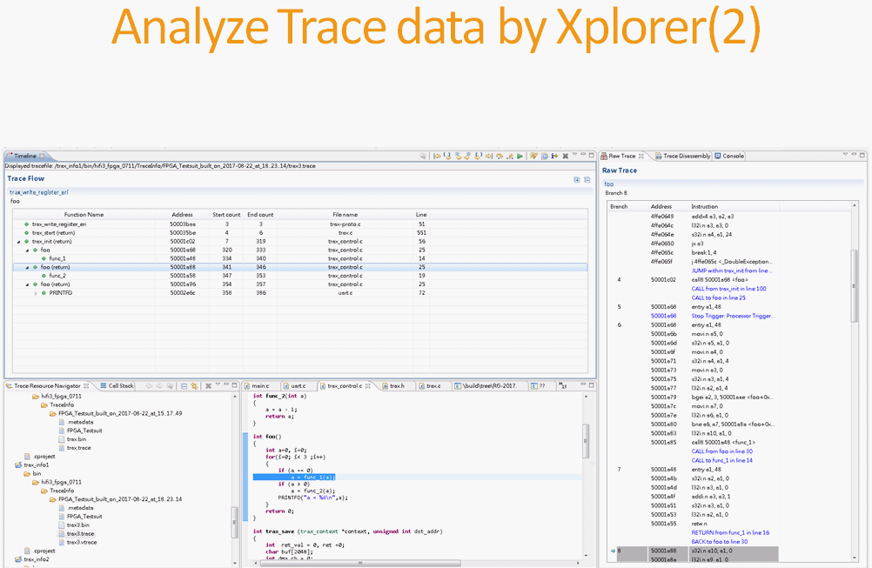

Slide 23
GDB DUMP (Useful to debug!)
  Use AEE db file to show more debug info
Get Tools: (version 3.0 , for mt6779 only)
  Aurisys_exe_Vxxxxxxx\TOOL\HiFi3
decompress the tools to the linux server
  tar -jxv -f hifi3_debug_tool_v3_181217.tar.bz2
add tools path to the bashrc
  vim .bashrc
  export PATH=$PATH:/proj/mtkxxxx/hifi3_debug_tool/XtensaTools/bin

Slide 24
Preparation : Put files into the hifi3_debug_tool folder
  SYS_ADSP_DUMP : decompress the db file, copy out the "SYS_ADSP_DUMP"
    ex: TagLog_2010_0101_001217_EE\db.01.EE\20180511_172021_386\db.01.EE.dbg.DEC\SYS_ADSP_DUMP
  hifi3_a.elf : which is in the out folder, copy it out too.
    partial_build :
    $(alps)\vendor\mediatek\proprietary\tinysys\freertos\source\tinysys-scp_out\freertos\source\HIFI3_A\hifi3_a.elf
    full_build :
    $(alps)\out\target\product\$(project)\obj\TINYSYS_OBJ\tinysys-adsp_intermediates\freertos\source\HIFI3_A\hifi3_a.elf
    Official load :
    \ALPS_symbols\{branch name}\ {branch tag}\{project}.out.symbols\alps\out\target\product\{project}\obj\TINYSYS_OBJ

Slide 25
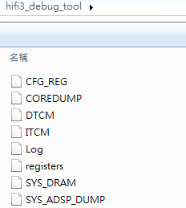
Basic CMD
  python XtensaTools/bin/split_coredump SYS_ADSP_DUMP
  xt-gdb
  (xt-gdb) source script.txt
(Optional) ADSP Boot up exception
  Check the stack address: (0x4ffb0d70 is just example here)
  Log or Uart :
    Key word : "[8.342](A) Stack Dump address: 0x4ffb0d70"
  Xt-gdb
    (xt-gdb) print pExceptionContext
    $1 = (ExceptionContext *) 0x4ffb0d70 <exceptionContext_109>
  Use split_coredump with parameter of address at register file
    split_coredump SYS_ADSP_DUMP 0x4ffb0d70
GDB Split contents
  DTCM : Internal data memory
  ITCM: Internal code memory
  CFG_REG : Config register dump
  Log : last log for debug
  Register : hifi3 core registers.
  SYS_Dram : for system memory

Slide 26
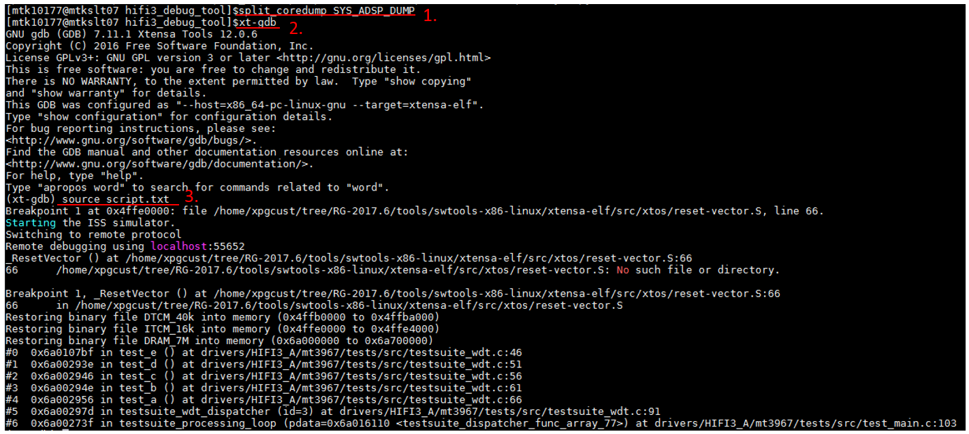
Basic GDB cmd for back trace, other gdb cmd please use help to check
$ python split_coredump SYS_ADSP_DUMP
$ xt-gdb
$ (xt-gdb) source script.txt
$ (xt-gdb) Info threads
$ (xt-gdb) thread n
$ (xt-gdb) bt
[Customer Notice]
Thread-info supported after RG-2018.9
If the version before RG-2018.9 , do the below flow.[N1]
Notes:
[N1] If the version before RG-2018.9 , do the below flow.
In the path “\RG-2018.9-win32\XtensaTools\share\gdb\python”, copy folder FreeRTOS to the folder
“\RG-2017.6-win32\XtensaTools\share\gdb\python”.
From the folder “C:\usr\xtensa\XtDevTools\install\tools\RG-2018.9-win32\XtensaTools\share\gdb\python\thread_aware_rtos”, copy the file __init__.py and replace the same file in folder “C:\usr\xtensa\XtDevTools\install\tools\RG-2017.6-win32\XtensaTools\share\gdb\python\thread_aware_rtos”.
Run the xt-gdb session again.

Slide 27
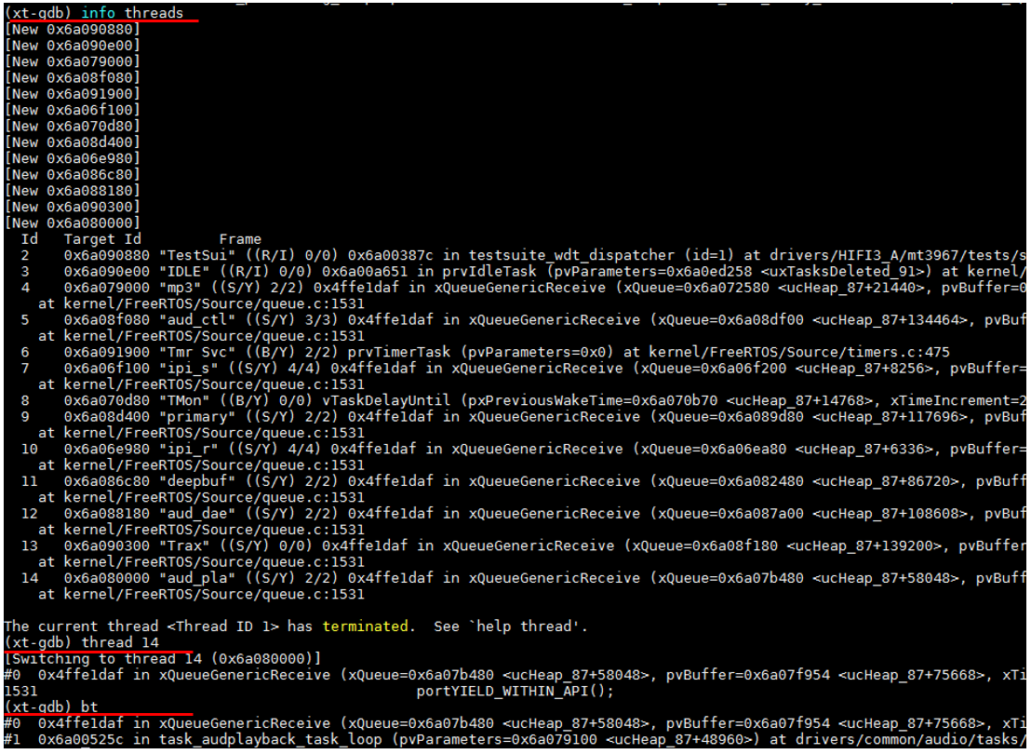
GDB Dump

Slide 28
Debug Dump type
Dump type | Hifi3 in Exception (EE) | Kernel API | KE reboot | HW reboot
CFG reg | Y | Y | Y | N
I/D TCM | Y | Y | Y | Y
Core Register | Y | ? | N | N
Dram | Y | Y | N | N
Debug Tool | Xt-gdb | Xt-gdb | Check CFG reg Check ITCM Check DTCM | Check ITCM Check DTCM
Version | Legacy | Legacy | From p0.mp3.p60 | From p0.mp3.p74
FileName | SYS_ADSP_DUMP | SYS_ADSP_DUMP | SYS_EXTRA_ADSP_RAW | SYS_ADSP_COREDUMP

Slide 29
Debug method
Xt-gdb: (with split_coredump)
  Backtrace(if no core register dump, useless), View all data , adsp log
Check CFG reg
  PC & SP & IRQ & Internal CLK CG & exception addr & cause & BUS monitor info.
Check ITCM
  Check the instruction memory whether occur memory corruption?
Check DTCM
  ADSP_A_OSTIMER_BUFFER (ADSP_A_DTCM_SHARE_BASE - 0x0040)
    Check current Ostimer time
  ADSP_A_IPC_BUFFER (ADSP_A_DTCM_SHARE_BASE - 0x0280)
    Check ipi last send/recv to share buffer
  ADSP_A_SYS_STATUS (ADSP_A_DTCM_SHARE_BASE - 0x0688)
    Check hifi status (reset, sleep, suspend, active) USEFUL!
  ADSP_BUS_MON_BACKUP_BASE (ADSP_A_DTCM_SHARE_BASE - 0x0744)
    Check whether occur bus hang & latched R/W addr
  ADSP_INFRA_BUS_DUMP_BASE (ADSP_A_DTCM_SHARE_BASE - 0x07E4)
    Check whether occur infra bus hang

Slide 30
Debug Command
These command can help you to dump some adsp system message or do some profiling
Before use debug command, you need to check the "CFG_DEBUG_COMMAND_SUPPORT = yes" in adsp platform.mk
Write the command to adsp
  adb shell "echo %command% %variable% > sys/kernel/debug/audiodsp“
  Ex:
  adb shell "echo cmds > sys/kernel/debug/audiodsp“
Read the result in the memory and show it on user space
  adb shell "cat sys/kernel/debug/audiodsp”

Slide 31
Class | %command% | %variable% | Help | Result in memory
help | cmds | N | show the support commands (some of command isn't support with compile option) | Y
dvfs | dvfs_dump | N | show the system feature/swip mcps information show the dvfs (vore, ddr_rate, cpu freq) information | Y
Task monitor | task_monitor_start | [option] time_ms | start or re-start task monitor with time_ms, it can change the task monitor period (>=50ms) | N
 | task_monitor_stop | N | stop task monitor | N
 | task_monitor_dump | N | show the task monitor result in user space | Y
Trace | trace_start | N | start trace the event when task context switch | N
 | trace_stop | N | stop trace function and show the result | Y

Slide 32
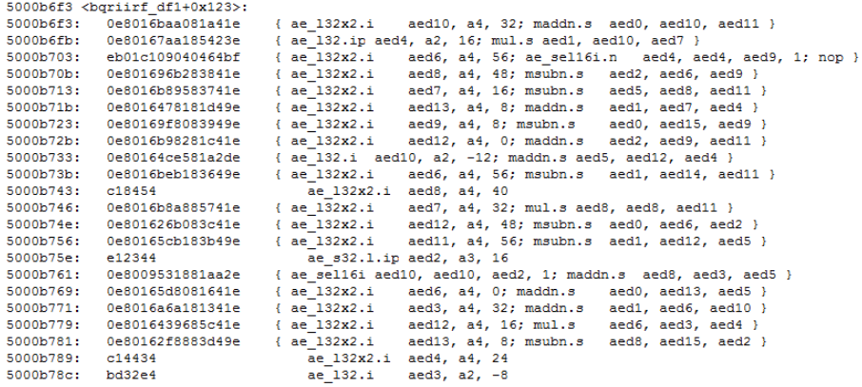
System img debug
Get HiFi3 Assembly Code From Object File
  Use the "xt-objdump.exe" tool.
  Tool path: D:\usr\xtensa\XtDevTools\install\tools\RG-2017.6-win32\XtensaTools\bin
Command : (you can try other flag to gain more info from obj file, xt-objdump --help )
  xt-objdump.exe --xtensa-core=hifi3_xxx -d "object file name" > "assembly code file name"
  example: xt-objdump.exe --xtensa-core=hifi3 -d bqriirf_df1_hifi3.o > bqriirf_df1_hifi3_asm.txt
Notes:
Buf Address need 128byte aligned

Slide 33
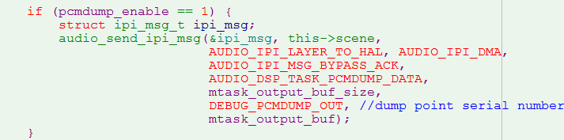
Audio Related Debug
Audio PCM DUMP
  Enable/Disable method
    adb shell setprop vendor.streamout.dsp.dump 1
    adb shell setprop vendor.streamout.dsp.dump 0
  Use IPI + dma to transfer data back
Dump file position
  / data/vendor/audiohal/audio_dump/
driver implement code
Notes:
Buf Address need 128byte aligned

Slide 34
pxNextFreeBlock
HEAP :
  AUDIO_MALLOC(sz)
  AUDIO_CHECK(ptr)
  AUDIO_FREE(ptr)
LOCK :
  MTK_AUDIO_LOCK_ENABLE_TRACE (Local config)
size
0x55
p_head
Check head & tail value
0x66
p_tail
[132.141](A) [E][ALOCK] 0x6a088700: lock((mAurisysLibManagerLock), 1000), audio_task_audplayback.c, CreateAurisysLibManager(), 691L FAIL!! retval: 4294966221, try to lock when [131.141]
[132.143](A) [E][ALOCK] 0x6a088700:
========================= dump(+) =========================
[132.144](A) [E][ALOCK] 0x6a088700: time [131.141], lock((mAurisysLibManagerLock)), audio_task_audplayback.c, CreateAurisysLibManager(), 688L
[132.145](A) [E][ALOCK] 0x6a088700:
========================= dump(-) =========================
[132.146](A) AUD_WARNING(lock timeout!!): "drivers/common/audio/tasks/audplayback/audio_task_audplayback.c", 691L
[132.147](A) [ASSERT]task:aud_pla,file:drivers/common/audio/tasks/audplayback/audio_task_audplayback.c,line:691
First place to acquire lock
Notes:
enum { /* audio_ipi_msg_data_t */
AUDIO_IPI_MSG_ONLY,
AUDIO_IPI_PAYLOAD,
AUDIO_IPI_DMA,
};
enum { /* audio_ipi_msg_ack_t */
/* bypass ack, but still send to audio queue */
AUDIO_IPI_MSG_BYPASS_ACK = 0,
/* need ack, and block in audio queue until ack back */
AUDIO_IPI_MSG_NEED_ACK = 1,
AUDIO_IPI_MSG_ACK_BACK = 2,
/* bypass audio queue, but still send to ipc queue */
AUDIO_IPI_MSG_DIRECT_SEND = 3,
AUDIO_IPI_MSG_CANCELED = 8
};

Slide 35
AUDIO IPI :
  void print_msg_info(const char *func_name, const char *description, const struct ipi_msg_t *p_ipi_msg);
  audio_send_ipi_msg_to_kernel()
    Print ipi msg when send fail
Notes:
enum { /* audio_ipi_msg_data_t */
AUDIO_IPI_MSG_ONLY,
AUDIO_IPI_PAYLOAD,
AUDIO_IPI_DMA,
};
enum { /* audio_ipi_msg_ack_t */
/* bypass ack, but still send to audio queue */
AUDIO_IPI_MSG_BYPASS_ACK = 0,
/* need ack, and block in audio queue until ack back */
AUDIO_IPI_MSG_NEED_ACK = 1,
AUDIO_IPI_MSG_ACK_BACK = 2,
/* bypass audio queue, but still send to ipc queue */
AUDIO_IPI_MSG_DIRECT_SEND = 3,
AUDIO_IPI_MSG_CANCELED = 8
};

Slide 36

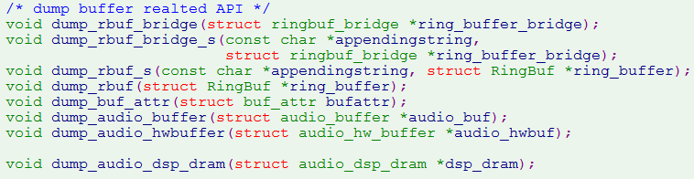
RINGBUF SW:
  DUMP_RINGBUG(LOG_F, description, rb, count)
  DUMP_RINGBUG(AUD_LOG_W, "underflow", rb, count);
RINGBUF HW
  Check funcion
  dump function
Notes:
DUMP_RINGBUG
__FUNCTION__, \
description, \
(rb)->base, \
(rb)->read, \
(rb)->write, \
(rb)->size, \
audio_ringbuf_count(rb), \
audio_ringbuf_free_space(rb), \
count
-------------------------
Datacount :
R==W
R > W
W>R
Assert:
R<Base R>End
W< Base W >End

Slide 37
IPI DMA :
  AUD_DMA_READ(scp_buf, dram_addr, size)
  AUD_DMA_WRITE(dram_addr, scp_buf, size)
    Check if in ISR
    Check scp_buf address should be 128byte aligned
  DUMP_REGION(LOG_F, description, p_region, count)
  DUMP_REGION(pr_notice, "read_idx fail", region, count);
    Dump region info as ringbuf
Notes:
[I][DMA] init_audio_ipi_dma(), dma 0x6a700000, phy 0x6a700000/0x6a700000, sz 0x500000, checksum 10880/10880, offset 11008
LOG_F("%s, offset: 0x%x, size: 0x%x" \
", read_idx: 0x%x, write_idx: 0x%x" \
", region_data_count: 0x%x, count: %u", \
description, \
(p_region)->offset, \
(p_region)->size, \
(p_region)->read_idx, \
(p_region)->write_idx, \
audio_region_data_count(p_region), \
count); \

