Slide 1
Aurisys Introduction
Notes:
This is JH, MTK audio software enginer,
I'll give you a brief of auriys introduction
If you have any questions, feel free to interrupt.

Slide 2
Agenda
Introduction
Aurisys Framework and Interface
System Level Aurisys Structure
Tuning Architecture
Debug
Lib verifier
Notes:
This is agenda,
I’ve divied my presentation into six part.
First is introduction
Second is introduce the aurisys software interface
3rd is system level auryss structure
Following are the tuning architecture、Debug、lib verifier

Slide 3
Introduction
Aurisys is a framework to facilitate the sound processing solution development on MTK platforms.
  includes standardized and platform independent interfaces for
    sound processing
    Tuning
    Software debug
  The software can be re-used and create a more consistent experience for the developers.
Not processor instruction dependent
Library A for AP
Library A for AP
AP
Aurisys library
Sources
Library B for MCU
Library B for MCU
MCU
Library C for DSP
Deploy
Library C for DSP
Compile
DSP
Notes:
Aurisys is a framework … (照念)
For example:
If your processing library source is not platform instruction dependent,
It can be compiled to differnet library for AP/MCU/DSP.
These library can be executed in different processor without modification.
It’s our goal of aurisys framework’

Slide 4
Aurisys Framework & ARSI
Aurisys framework
  Adapt variant running environment. (e.g. AP/DSP/MCU)
    Aurisys library has same control flow/data flow/tuning flow
  Adapt variant library processing capability (ex: working sample rate/bit format…)
    Aurisys framework can convert input/output data format automatically
ARSI(Aurisys Software Interface) include two type APIs
  ARSI-PROC: Sound processing interface
  ARSI-PAR: Parameter parsing interface
Aurisys Framework
Aurisys_config.xml
ARSI-PROC call
ARSI-PAR call
ARSI
Running on AP/DSP/MCU side to do the sound processing
3rd Party Aurisys
Sound processing library
3rd Party Aurisys
Parameter Parsing Library
Running on AP side to do the paramter file parsing
Notes:
This page is used to show the aurisys architecture.
The aurisys framework can
… for example: , library don’t need to know it’s runing on which environment
… library may only support 48000 thoudsands Hz sample rate and sixteen bit format, aurisy framework can handle the pcm data format transformation
… Auris
The ARSI is the abbreviation of “aurisys software interface”, it include two type API.
The first type of API is ARSI-PROC: it’s aurisys software interface for sound processing
The secon type of API is ARSI-PAR: it’s aurisys software itnerface for parameter parsing.
Aurisys framework can read the aurisys_config.xml to know the aurisys library’s capabality. (ex: bit foramt/sample rate suprot and so on)
And aurisys framework can control the aurisys library through ARSI-PROC call & ARSI-PAR call

Slide 5
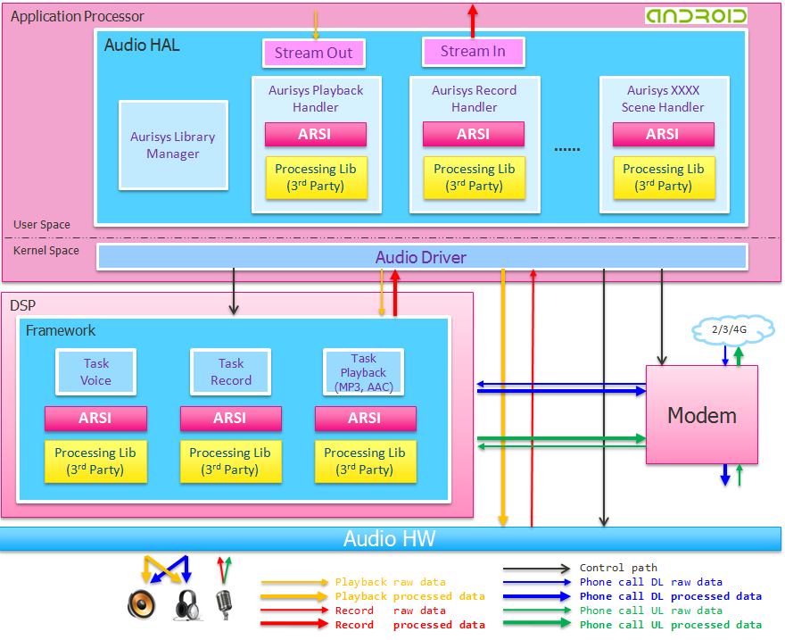
System Level Aurisys Structure
Support aurisys framework
Vendor’s aurisys library
Support aurisys framework
Vendor’s aurisys library
Aurisys library can be easy to porting to AP/DSP/MCU of MTK platform
Notes:
It’s system level aurisys structure.
MTK will provide the AP side & DSP side aurisys framework,
Therefore, vendor’s aurisys library can runing on AP & DSP & Modem without much modification.

Slide 6
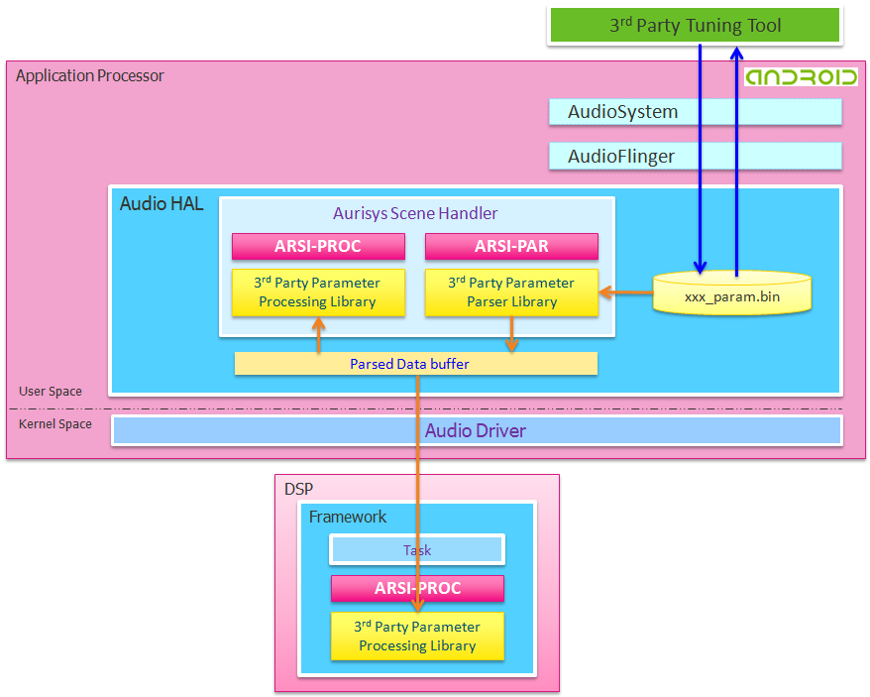
Tuning Architecture
adb interface
(android debug bridge)
Aurisys framework
ARSI-PROC: aurisys sound processing interface
ARSI-PAR: aurisys parameter parsing interface
Notes:
For the tuning architecture,
MTK provide the adb interface which can communicate with vendor’s aurisys library.
If vendor want to do the parameter tuning.
1. Vendor can push vendor’s parameter file to device to update the parameter
2. And using adb command to triger aurisys library to do the parameter reload.
3. Vendor also can set/get parameter value through ADB command.
If vendor’s library is runing on DSP which cannot to do the File I/O,
Aurisys framework will parsing the parameter file on AP side and transfer the parameter buffer to the DSP side aurisys lib

Slide 7
Debugging Interface
ARSI also provide debugging interface
  Log:
    Dynamic enable/disable library log through ADB command
  Debugging dump:
    Aurisys library can write proprietary data to a file for issue debugging
    Dynamic enable/disable debugging dump through ADB command
Notes:
This page is talking about the aurisys debugging interface.
Aurisys framework provide the debugging infterface for Logging & debugging dump
Vendor can dynamic enable/disable library log throug adb command

Slide 8
Lib Verifier
Lib verifier provide a simple test program to verify your Aurisys lib’s implementation which is pass API level test or not
Easy to compile & run in variant environment and simulator
  It only contain 1 main source file and 3 header files
You also can check the source to know the aurisys library’s
  Control sequence
  Simple implementation
Lib Verifier
ARSI testing
ARSI
“3rd Party Aurisys lib” or “reference implementation”
Notes:
Lib verifier will call the aurisys software interface to do the API level checking.
Checking the API return value or if there any segmentation faul and so on…

Slide 9
Q&A
Notes:
This is the end of presentation, thank you so much.

Slide 10
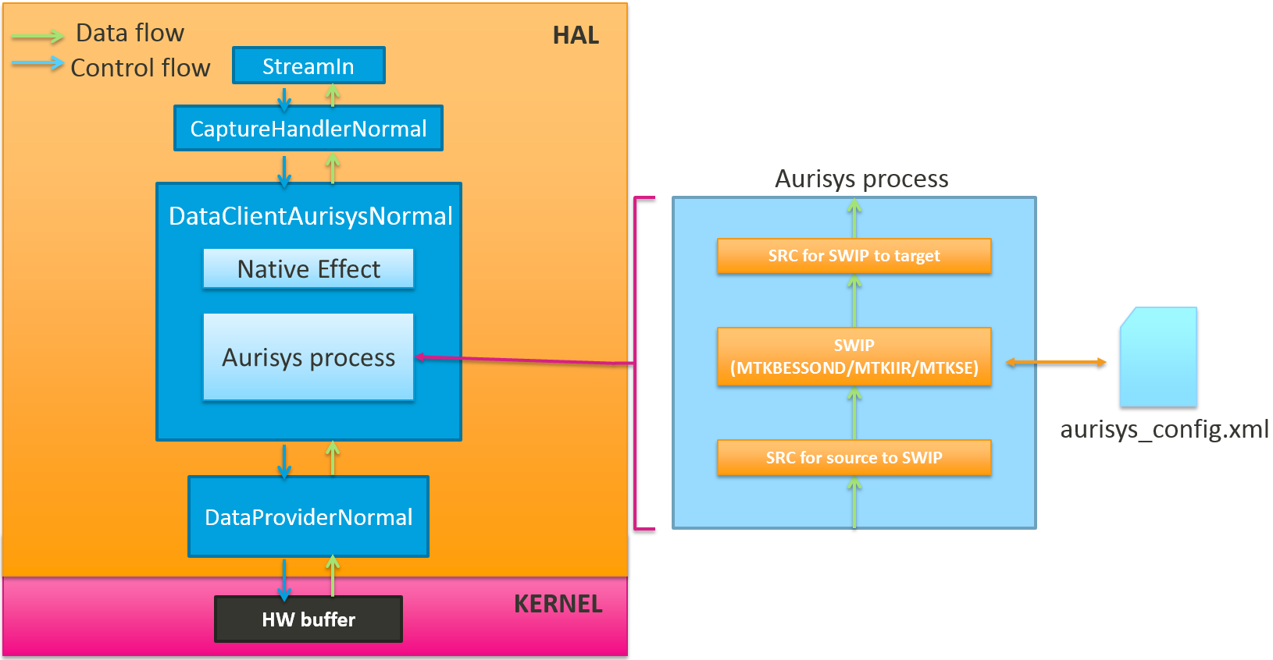
Android HAL Block Diagram (Record)

Slide 11
aurisys_config.xml
 | Record | VoIP UL | VoIP DL | Playback
library | mtk_speech_enh | mtk_speech_enh | mtk_speech_enh | mtk_bessound
aurisys_scenario | RECORD_WITHOUT_AEC | VOIP | VOIP_WITHOUT_AEC | PLAYBACK_NORMAL
sample_rate | 48000/16000 | 16000 | 16000 | 8000/11025/12000/16000/22050/24000/32000/44100/48000/64000/88200/96000/128000/176400/192000
audio_format | 16bit | 16bit | 16bit | 32bit
frame_size_ms | 20 | 20 | 20 | 0 (not specified)
UL buf channels | In:1/2/3 Out:1/2 | In:1/2/3 Out:1/2 Ref: 1 | In:1/2/3 Out:1/2 | X
DL buf channels | X | In:1 Out:1 | In:1 Out:1 | In:2 Out:2

Slide 12
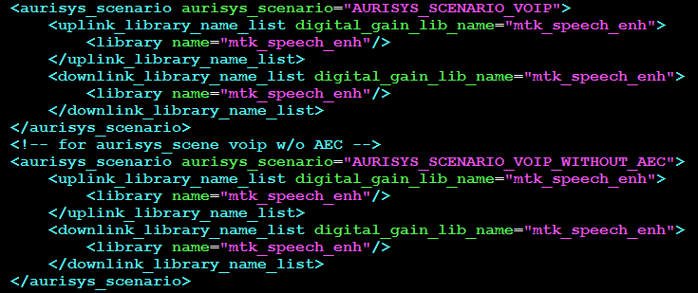
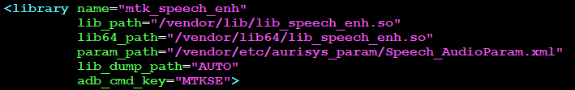
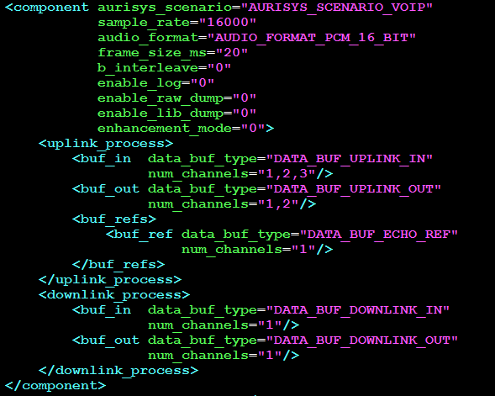
aurisys_config.xml
Consist of aurisys_scenarios and hal_librarys
  aurisys_scenarios describe what 3rd party library would be used for certain scenario (e.g., VoIP, Record, Playback …)
  hal_librarys describe the SWIP capability (e.g., sample rate, format, channel number, frame size …) for certain scenario
aurisys_scenario
hal_library
Can add more than 1 lib to the Aurisys structure

Slide 13
Debug ADB CMDs
Enable Aurisys log:
  adb shell "AudioSetParam AURISYS_SET_PARAM,HAL,ALL,MTKSE,ENABLE_LOG,1=SET“
Enable Aurisys Raw and EPL dump:
  adb shell "AudioSetParam AURISYS_SET_PARAM,HAL,ALL,MTKSE,ENABLE_RAW_DUMP,1=SET“
    /sdcard/mtklog/audio_dump/mtk_speech_enh.X.XXX.XXXX.ul_in.pcm
    /sdcard/mtklog/audio_dump/mtk_speech_enh.X.XXX.XXXX.ul_out.pcm
    /sdcard/mtklog/audio_dump/mtk_speech_enh.X.XXX.XXXX.aec.pcm
  adb shell “AudioSetParam AURISYS_SET_PARAM,HAL,ALL,MTKSE,ENABLE_LIB_DUMP,1=SET“
    /sdcard/mtklog/audio_dump/mtk_speech_enh.X.XXXX.XXXX.lib_dump.bin
For now, we don’t support DSP side raw dump.
Therefore, we strongly recommend implement lib dump for debug

Slide 14
Get ADB result from console
Out put adb command result to a file:
  adb shell "AudioSetParam AURISYS_SET_PARAM,DSP,ALL,AURISYS_DEMO,KEY_VALUE,HAHA,on=SET ">List.ini
Some of the commands may output as stderr, use below command instead:
  adb shell "AudioSetParam AURISYS_SET_PARAM,DSP,ALL,AURISYS_DEMO,KEY_VALUE,HAHA,on=SET 2>&1">List.ini

Slide 15
Aurisys Control Flow
Aurisys Control Flow on AP
Aurisys Cotnrol Flow on DSP

Slide 16
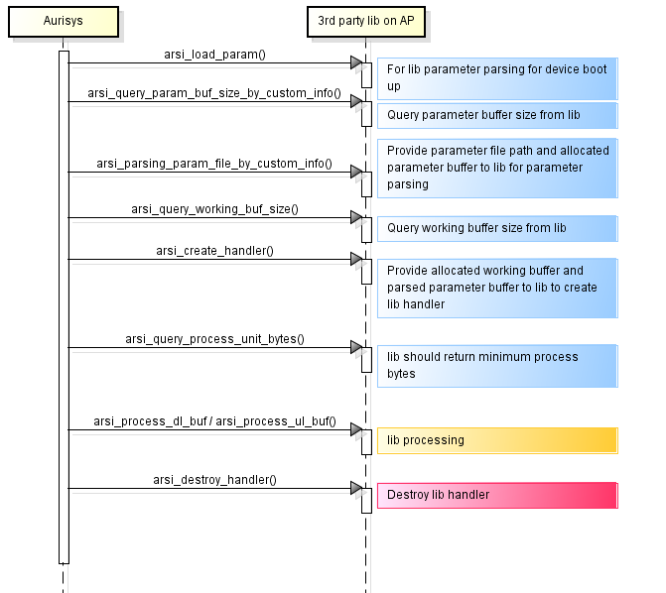
Aurisys Control Flow on AP
arsi_load_param would only called ones when device boot up. This function is optional, but implement this function may reduce lots of time form file IO.
Processing loop

Slide 17
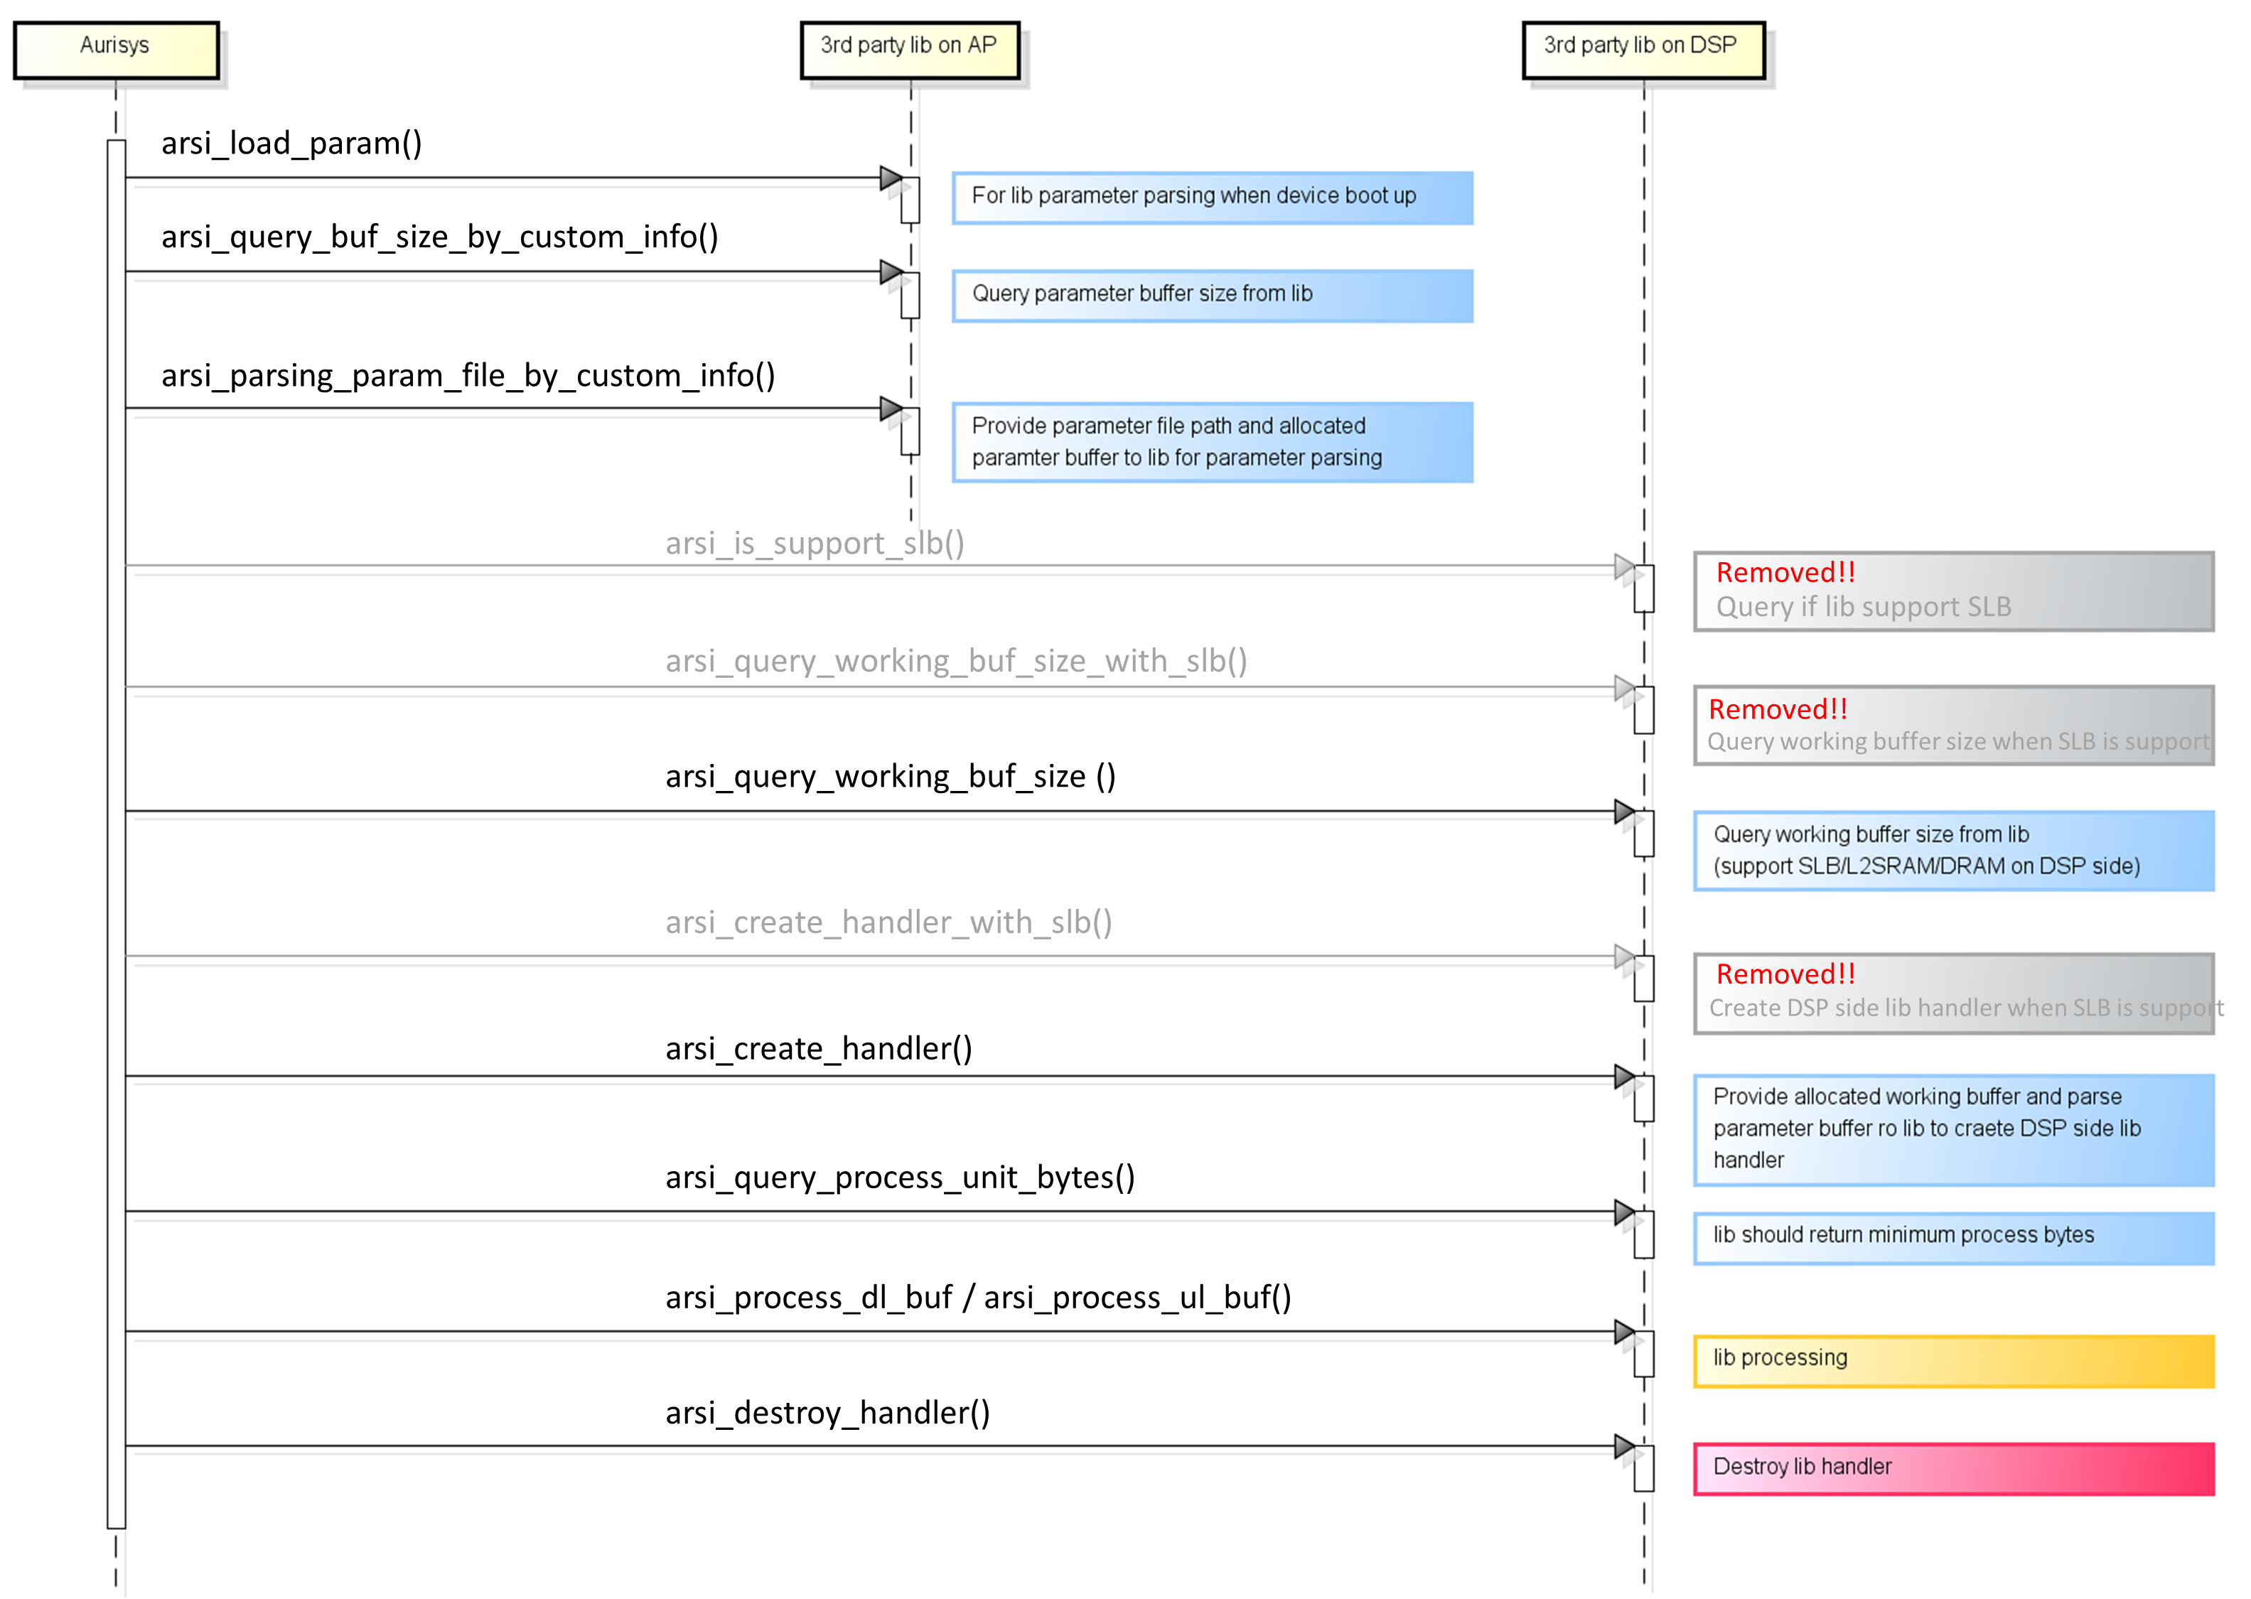
Aurisys Control Flow on DSP
Since lib on DSP cannot access parameter file on AP, 3rd party lib should provide AP side lib for parameter parsing
Aurisys will provide parsed parameter buffer from AP to DSP for DSP side lib to create lib handler
Processing loop

Slide 18
requirements for Aurisys initialization.
Because the Aurisys create will be performed on the first read/write operation, due to some latency considerations, during initialization(red box), the total execution time of these APIs should not exceed one frame size as much as possible (for example, processing data for 20ms at once, the execution time of these APIs should ideally be within 20ms)
During simulation, the corresponding API's response time should be checked.

Slide 19
VoIP VS Phone Call Control Flow
VoIP DL/UL task use different lib handler for processing, phone call use same lib handler.
For VoIP task, UL/DL lib handler is independent, UL task cannot access to DL task voice data, vice versa.
VoIP task
Phone call task
VoIP DL task
VoIP UL task
Phone call task
arsi_create_handler
arsi_create_handler
arsi_create_handler
Processing Loop
Processing Loop
Processing Loop
arsi_process_dl_buf
arsi_process_ul_buf
arsi_process_dl_buf
arsi_process_ul_buf
arsi_destroy_handler
arsi_destroy_handler
arsi_destroy_handler

Slide 20
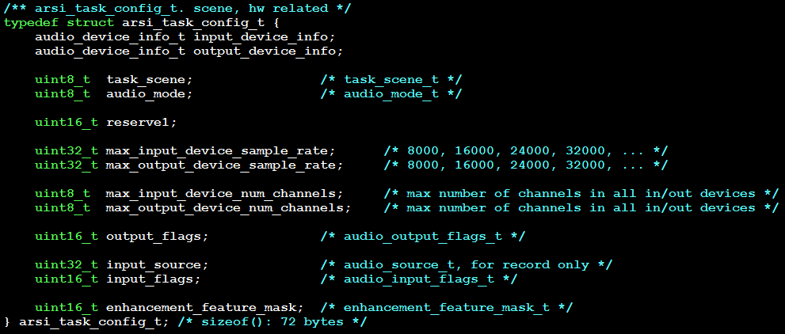
Voice Recognition + AEC Support
MTK has implement voice recognition + AEC scene with MTK proprietary input_source 81 (only need it when customer required)
3rd party Lib could use input_source 81 to determine is voice recognition + AEC scene or not
task_config will be provided in arsi_query_param_buf_size_by_custom_info and arsi_parsing_param_file_by_custom_info API

Slide 21
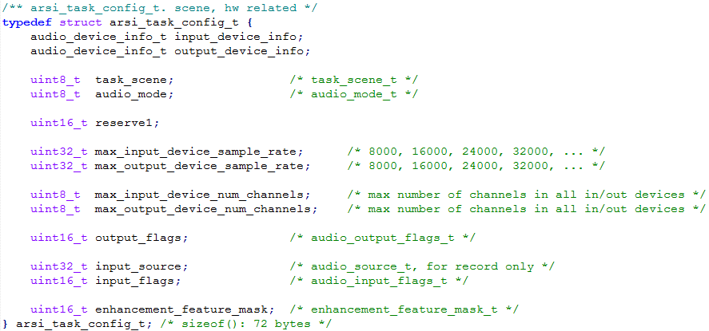
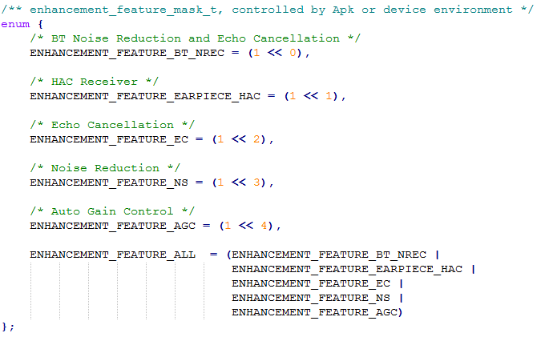
enhancement_feature_mask
3rd party should use enhancement_feature_mask to on/off corresponded enhancement feature in task_config.
For example, AEC function can be turned on/off by controlling the ENHANCEMENT_FEATURE_EC flag.
Only ENHANCEMENT_FEATURE_EC is mandatory, other are optional.

Slide 22
Aurisys API list
ARSI-PROC APIs
ARSI-PAR APIs

Slide 23
ARSI-PROC APIs
Functions | Description
arsi_query_working_buf_size | Query the size of the working buffer
arsi_query_process_unit_bytes | Query the basic data consumption for uplink/downlink processing
arsi_create_handler | Create handler and initialize it
arsi_process_ul_buf | Processing microphone/uplink data
arsi_process_dl_buf | Processing playback/downlink data
arsi_destroy_handler | Deinitialize handler and destroy it (no need to free the working buffer)
arsi_update_device | Update task device info
arsi_update_param | Update enhancement parameters
arsi_set_ul_digital_gain | Set uplink digital gain
arsi_set_dl_digital_gain | Set downlink digital gain
arsi_set_ul_mute | Mute/unmute uplink
arsi_set_dl_mute | Mute/unmute downlink
arsi_set_ul_enhance | Enable/disable uplink enhancement function
arsi_set_dl_enhance | Enable/disable downlink enhancement function
arsi_set_debug_log_fp | Set debug log print callback function
arsi_query_max_debug_dump_buf_size | Query the size of dump buf file for each downlink/uplink processing
arsi_set_addr_value | Set value at a specified address
arsi_get_addr_value | Get value from the specified address
arsi_set_key_value_pair | set key_value string to library
arsi_get_key_value_pair | get key_value string from library

Slide 24
ARSI-PAR APIs
Functions | Description
arsi_load_param | This function will only called once when device boot up. Load the parameter file content into memory Library can retrieve the parameter buffer from memory without any file I/O afterward Implemented in AP side only, but not in DSP.
arsi_query_param_buf_size_by_custom_info | Query the buffer size to keep speech enhancement parameters Implemented in AP side only
arsi_parsing_param_file_by_custom_info | Parsing param file to get parameters into p_param_buf Implemented in AP side only

