Slide 1
Aurisys Tuning Guide
Mediatek

Slide 2
Outline
Aurisys Tuning Overview
Interfaces
Aurisys Static and Dynamic Tuning

Slide 3
Outline
Aurisys Tuning Overview
Interfaces
Aurisys Static and Dynamic Tuning

Slide 4
Overview
Aurisys define a series of adb commands which include transmitting the whole parameter file to the device, receiving whole parameter file from the device, transmitting specific data to the 3rd party sound processing library , and receiving specific data from the 3rd party library.
This document will introduce Aurisys tuning adb commands and show the tuning steps under Audrisys structure.
3rd Party Tuning Tool
Db/xml/bin…
adb cmd
AudioSystem
3rd party library
AudioFlinger
Library param:
Addr/Key
Audio HAL
arsi
(aurisys SW interface)
Aurisys

Slide 5
Outline
Aurisys Tuning Overview
Tuning Interfaces
  Set parameter
  Get parameter
Aurisys Static and Dynamic Tuning

Slide 6
Tuning Interface - Set Parameter
adb shell "AudioSetParam AURISYS_SET_PARAM,$target,$scene,$lib,$cmd=SET“
Argument | Example | Comments
$target | HAL, DSP | The processing API in AP (HAL) or in DSP
$scene | PLAYBACK_NORMAL, RECORD_WITHOUT_AEC, VOIP… | Specific scene for library tuning, “ALL” is for all scenes that library supported. Please refer to scene table page (p.8)
$lib | library name | Library name which need tuning, defined as adb_cmd_key in aurisys_config_hifi3.xml
$cmd | PARAM_FILE,your_param_path APPLY_PARAM,enhancement_mode ADDR_VALUE,0XAA,0XBB KEY_VALUE,your_key,your_value | Please refer to send CMD summary page (p.9)

Slide 7
Tuning Interface - Get Parameter
adb shell "AudioSetParam AURISYS_GET_PARAM,$target,$scene,$lib,$cmd"
Argument | Example | Comments
$target | HAL, DSP | The processing API in AP (HAL) or in DSP
$scene | PLAYBACK_NORMAL, RECORD_WITHOUT_AEC, VOIP… | Specific scene for library tuning, “ALL” is for all scenes that library supported. Please refer to scene table page (p.8)
$lib | library name | Library name which need tuning, defined as adb_cmd_key in aurisys_config_hifi3.xml
$cmd | PARAM_FILE APPLY_PARAM ADDR_VALUE,0XAA KEY_VALUE,your_key | Please refer to get CMD summary page (p.10)

Slide 8
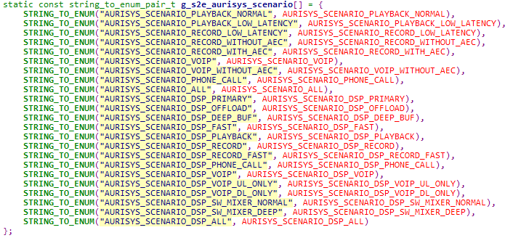
Scene Table
Aurisys defines series of scenes for HAL and DSP
HAL
DSP

Slide 9
Tuning Interface - Set Parameter CMD Summary
Aurisys contains two types of tuning CMD:
  Static : CMD should be sent before library open
  Dynamic : only works when library running
CMDs | ARSI Function Calls | Usage | CMD type
PARAM_FILE,param_path |  | set parameter file path | Static
APPLY_PARAM,mode | arsi_query_param_buf_size_by_custom_info arsi_parsing_param_file_by_custom_info arsi_update_param | apply new customize information to library, and change its enhancement parameter. IP provider can provide different custom_info for user to select. The custom_info should be an string. | Dynamic
ADDR_VALUE,addr,value | arsi_set_addr_value | set “value” at the “addr” in library, “addr” should be defined by the library itself | Dynamic
KEY_VALUE,key,value | arsi_set_key_value_pair | set "value" of the "key" in library, “key” should be defined by the library itself | Dynamic

Slide 10
Tuning Interface - Get Parameter CMD Summary
Aurisys contains two types of tuning CMD:
  Static : CMD should be sent before library open
  Dynamic : only works when library running
CMDs | ARSI Function Calls | Usage | CMD type
PARAM_FILE |  | get parameter file path | Static
APPLY_PARAM |  | get customize information form library | Dynamic
ADDR_VALUE,addr | arsi_get_addr_value | get value at the “addr” in library, “addr” should be defined by the library itself | Dynamic
KEY_VALUE,key | arsi_get_key_value_pair | get value of the "key" in library, “key” should be defined by the library itself | Dynamic

Slide 11
API For Set/Get Parameter
Alternatively, can use below JAVA API for set/get tuning parameter
  AudioManager.setParameters("AURISYS_SET_PARAM,$target,$scene,$lib,$cmd=SET");
  AudioManager.setParameters("AURISYS_GET_PARAM,$target,$scene,$lib,$cmd");

Slide 12
Outline
Aurisys Tuning Overview
Interfaces
Tuning example
  Static tuning
  Dynamic tuning

Slide 13
Static Tuning - PARAM_FILE
For applying another parameter file, can be done by below tuning steps.
Tuning steps:
  adb shell "AudioSetParam AURISYS_SET_PARAM,DSP,ALL,AURISYS_DEMO,PARAM_FILE,/data/d.dat=SET“
  Run playback process with AURISYS_DEMO lib. (CMD should be sent before library open)
Before AURISYS_DEMO open, set this command will replace AURISYS_DEMO parameter file to the /data/d.dat. This CMD will take effect till sending another PARAM_FILE CMD or killing audioserver (by killing audioserver, the parameter file will reset to param_path as defined in aurisys_config.xml).

Slide 14
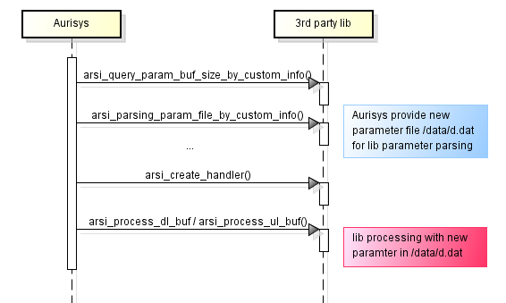
Static Tuning - PARAM_FILE
CMD1: adb shell "AudioSetParam AURISYS_SET_PARAM,DSP,ALL,AURISYS_DEMO,PARAM_FILE,/data/d.dat=SET"
CMD1

Slide 15
Dynamic Tuning - ADDR_VALUE/KEY_VALUE
For dynamically applying another address value or key value, can be done by below tuning steps.
Tuning steps:
  Run playback process with AURISYS_DEMO lib. (below CMD only works when library running)
  adb shell "AudioSetParam AURISYS_SET_PARAM,DSP,ALL,AURISYS_DEMO,ADDR_VALUE,0x1234,0x5566=SET"
  adb shell "AudioSetParam AURISYS_SET_PARAM,DSP,ALL,AURISYS_DEMO,KEY_VALUE,HAHA,on=SET"
First run playback process with AURISYS_DEMO lib, then set these commands will replace AURISYS_DEMO address 0x1234 value to 0x5566, and replace key_value HAHA to on. These commands will take effect till playback end, and will not effect next playback round.
AURISYS_DEMO is defined as adb_cmd_key in aurisys_config.xml/aurisys_config_hifi3.xml, key value (e.g. HAHA,on) and address value (e.g. 0x1234,0x5566) should be defined by the library itself.

Slide 16
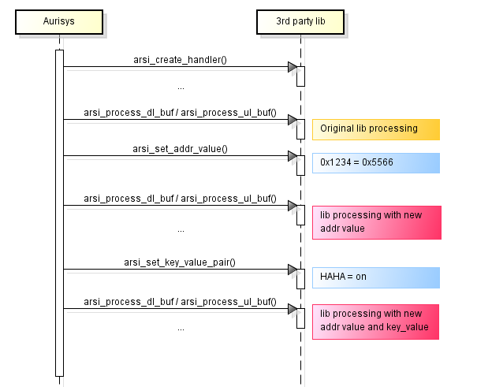
Dynamic Tuning - ADDR_VALUE/KEY_VALUE
CMD1: adb shell "AudioSetParam AURISYS_SET_PARAM,DSP,ALL,AURISYS_DEMO,ADDR_VALUE,0x1234,0x5566=SET"
CMD2: adb shell "AudioSetParam AURISYS_SET_PARAM,DSP,ALL,AURISYS_DEMO,KEY_VALUE,HAHA,on=SET"
CMD1
CMD2

Slide 17
Dynamic Tuning - APPLY_PARAM
APPLY_PARAM can work both statically and dynamically.
Dynamic tuning steps :
  Run playback process with AURISYS_DEMO lib.
  (adb shell "AudioSetParam AURISYS_SET_PARAM,DSP,ALL,AURISYS_DEMO,PARAM_FILE,/data/d.dat=SET“)
  adb shell "AudioSetParam AURISYS_SET_PARAM,DSP,ALL,AURISYS_DEMO,APPLY_PARAM,SetAudioCustomScene,app1=SET"
First run playback process to open AURISYS_DEMO lib, then set APPLY_PARAM command will set AURISYS_DEMO custom info to SetAudioCustomScene=app1. If set PARAM_FILE command before APPLY_PARAM, will dynamically replace AURISYS_DEMO parameter file to the /data/d.dat and update parameter. PARAM_FILE command will take effect till sending another PARAM_FILE command or killing audioserver (by killing audioserver, the parameter file will reset to param_path as defined in aurisys_config.xml/aurisys_config_hifi3.xml).

Slide 18
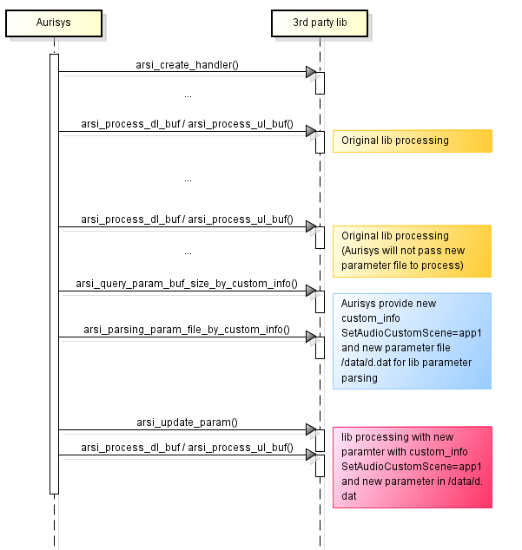
Dynamic Tuning - APPLY_PARAM
CMD1: adb shell "AudioSetParam AURISYS_SET_PARAM,DSP,ALL,AURISYS_DEMO,PARAM_FILE,/data/d.dat=SET"
CMD2: adb shell "AudioSetParam AURISYS_SET_PARAM,DSP,ALL,AURISYS_DEMO,APPLY_PARAM,SetAudioCustomScene,app1=SET"
CMD1
CMD2
Set by CMD2
Set by CMD1

Slide 19
How to check set result?
Check set CMD result :
  After setting CMD, console will show “SET_PASS”, if CMD successfully transfer to library. Otherwise it will show “SET_FAIL”.
Check CMD take effect in library:
  adb shell "AudioSetParam AURISYS_GET_PARAM,DSP,PRIMARY,AURISYS_DEMO,PARAM_FILE“
  Below CMDs can only send after open AURISYS_DEMO lib, or will get “GET_FAIL” in console.
  adb shell "AudioSetParam AURISYS_GET_PARAM,DSP,PRIMARY,AURISYS_DEMO,ADDR_VALUE,0x1234"
  adb shell "AudioSetParam AURISYS_GET_PARAM,DSP,PRIMARY,AURISYS_DEMO,KEY_VALUE,HAHA“
  adb shell "AudioSetParam AURISYS_GET_PARAM,DSP,PRIMARY,AURISYS_DEMO,APPLY_PARAM“

Slide 20
appendix

Slide 21
Aurisys ARSI functions
Functions | Description
arsi_query_param_buf_size_by_custom_info | Query the buffer size to keep library parameters
arsi_parsing_param_file_by_custom_info | Parsing param file to get parameters into p_param_buf
arsi_update_param | Update param and enhancement mode
arsi_set_addr_value | Set value at a specified address
arsi_get_addr_value | Get value from the specified address
arsi_set_key_value_pair | set key_value string to library
arsi_get_key_value_pair | get key_value string from library

Slide 22
Get ADB result from console
Out put adb command result to a file:
  adb shell "AudioSetParam AURISYS_SET_PARAM,DSP,ALL,AURISYS_DEMO,KEY_VALUE,HAHA,on=SET">List.ini
Some of the commands may output as stderr, use below command instead:
  adb shell "AudioSetParam AURISYS_SET_PARAM,DSP,ALL,AURISYS_DEMO,KEY_VALUE,HAHA,on=SET 2>&1">List.ini

Slide 23

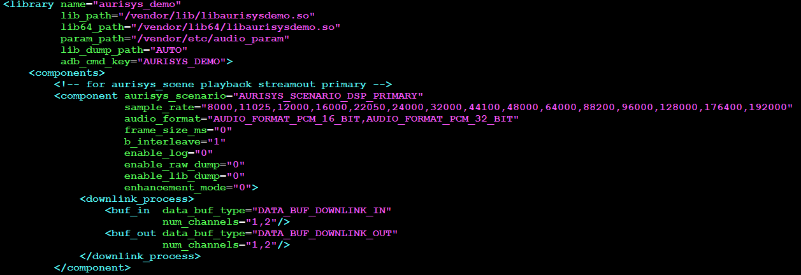
aurisys_config_hifi3.xml
adb shell "AudioSetParam AURISYS_SET_PARAM,$target,$scene,$lib,$cmd=SET "

