Slide 1
Aurisys Lib Verifier User Guide

Slide 2
Outline
Lib verifier introduction
Aurisys interface version
File/Folder structure description
Build/run the demo lib & lib verifier
  For x86 Linux environment
  For Android
  For Xplorer simulator
  For MRV PDK
3rd party lib verification
  Verification flow
  Test Config Structure
  Update makefile/Android.mk
  Check test result
  Lib dump parser
3rd party release package to mtk
Notes:
Configuration
Lib test case?
Extend device_config.h
Make
Run test
Check result
Feedback result/bugs to MTK

Slide 3
Aurisys Lib Verifier Introduction
Aurisys lib verifier package include
  A reference implementation of aurisys library
  Simple test environment to
    Development & test 3rd party aurisys wrapper on simulator of DSP
    Help 3rd party to do unit test before release to MTK
Demo
Aurisys Library
3rd party
Aurisys Library
3rd party
Aurisys Library
Lib verifier on simulator
3rd party implement
Aurisys library
Lib verifier on simulator
Release to MTK
Aurisys framework on device
MTK provide demo library & lib verifier
3rd party MUST do the library verification before release
MTK integrate the 3rd party on device
Aurisys Library Development Flow
Notes:
What’s aurisys lib verifier
Aurisys library developemnt flow

Slide 4
Lib Verifier Version
The following table describes which Aurisys API version is used in each Android version.
Aurisys API Version | Support Anrdroid Version
1.3.0 | P
1.4.0 | Q
1.5.0 | R
1.6.0 | S
1.7.0 | T
1.8.0 | U, V
1.9.0 | W

Slide 5
File/Folder Structure Description
Folder/File name | Allow 3rd party modfiy it | Description
Interface/ | No | aurisys lib interface header files [Except] Only allow 3rd party to add library entry point to arsi_library_entry_points.h
libaurisysdemo/ | Yes | 3rd party aurisys lib reference implementation
lib_dump_parser/ | Yes | 3rd party lib dump parser reference implementation
lib_verifier/pcm/ | Yes | Input/output pcm folder
lib_verifier/vendor/ | Yes | 3rd party parameter files
lib_verifier/*.c & .h | No | Lib verifier implementation
lib_verifier/device_config.h | 3rd party can extend it | Define the device’s configuration
lib_verifier/test_case_config.h | Yes | Define the test case which is depends on aurisys lib’s capability
lib_verifier/Android.mk | Yes | Makefile for Android build system
lib_verifier/makefile | Yes | GNU makefile for linux
.settings Bin .cproject .project Xxproject Makefile | Yes | Xplorer simulator project files
src/ test/ | Yes | MRV PDK project files

Slide 6
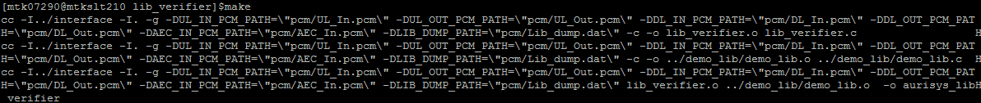
x86 linux environment
-Build/Run Demo Lib & Lib Verifier
Build demo lib & lib verifier
  cd API/V1.x.x/lib_verifier
  make
Run lib verifier & output test result to test_result.txt
  ./aurisys_lib_verifier > test_result.txt
You can check the test_result.txt to know the failure case & related debug message

Slide 7
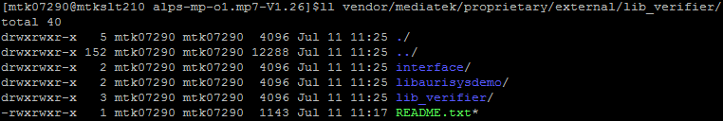
Android environment
– Build/Run Demo Lib & Lib Verifier
Build demo lib & lib verifier on Android BSP
  Copy API/V1.x.x to $ANDROID_ROOT/vendor/mediatek/proprietary/external/lib_verifier
  cd $ANDROID_ROOT
  Build demo library
    make libaurisysdemo
  Build lib verifier
    make aurisys_lib_verifier
Push demo lib & lib verifier to device
  adb root & adb remount
  adb push out/target/product/$PROJECT/vendor/lib/libaurisysdemo.so /vendor/lib/
  adb push out/target/product/$PROJECT/vendor/bin/aurisys_lib_verifier /vendor/bin/
  adb shell chmod 777 /vendor/bin/aurisys_lib_verifier
Run lib verifier & output log to lib_verifier_test_result.txt
  adb shell "aurisys_lib_verifier > /sdcard/lib_verifier_test_result.txt"
You can check the lib_verifier_test_result.txt to know the failure case & related debug message

Slide 8
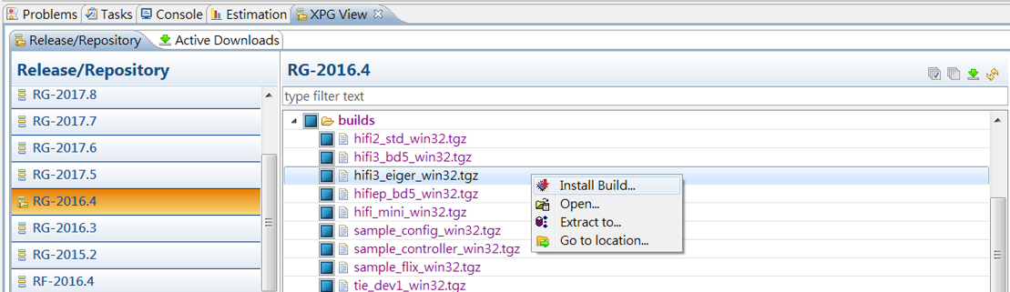
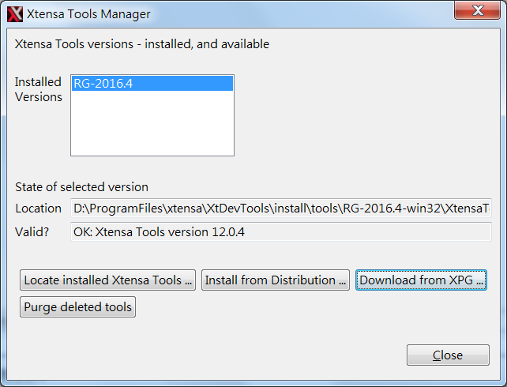
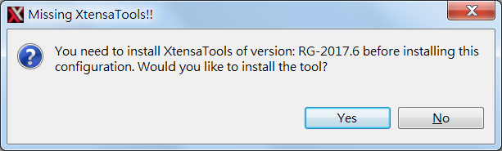
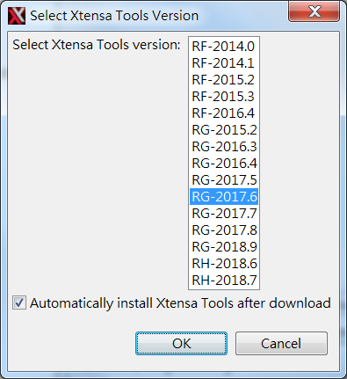
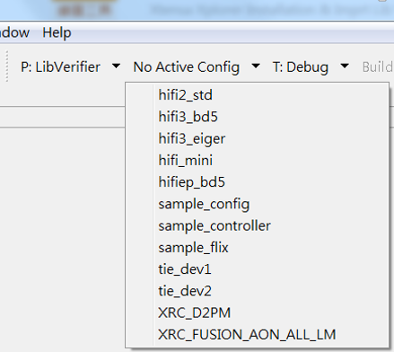
Xplorer Simulator – Build/Run Demo Lib & Lib Verifier
– Install MTK HW Configuration
Put CONFIG\HiFi3\hifi3_eiger_win32.tgz under {install root}\XtDevTools\downloads\RG-2016.4\builds
IDE open XPG View and install hifi3_eiger_win32.tgz & RG-2017-6 package
After installation done, you can find the hifi3_eiger HW configure
The config file is hw dependent, please contact the MTK adsp window
1
2
3
5
4
6
7

Slide 9
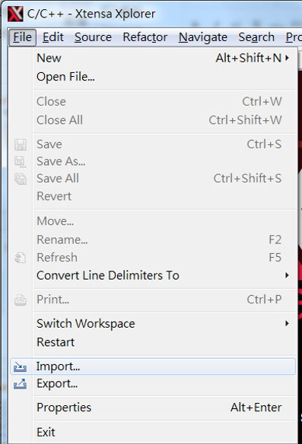
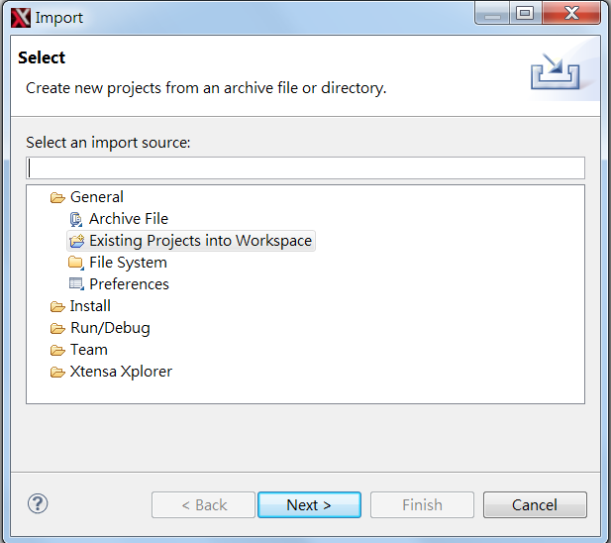
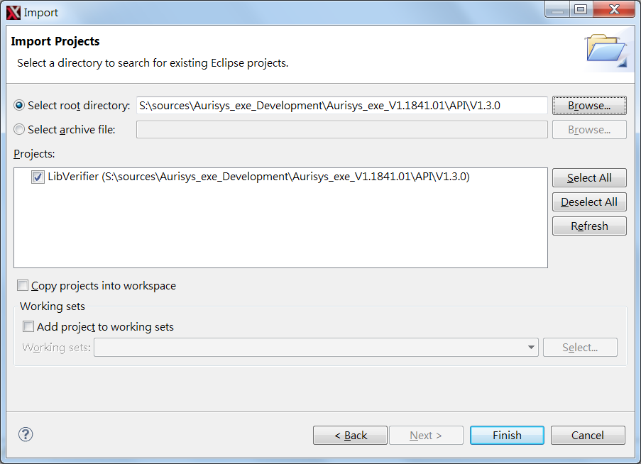
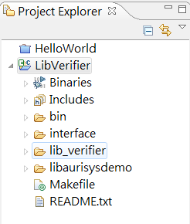
Xplorer Simulator
- Import Lib Verifier Workspace
2
1
3
Select the lib verifier workspace folder
Workspace imported
4

Slide 10
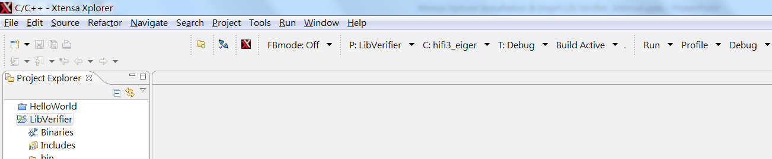
Xplorer Simulator
- Build & Run Lib Verifier
Select the target project with LibVerifier
Configure HW configuration with hifi3_eiger
build project
Run or debug
1
2
3
4
4

Slide 11
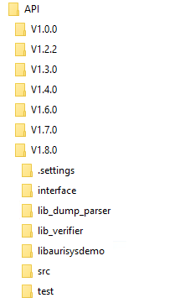
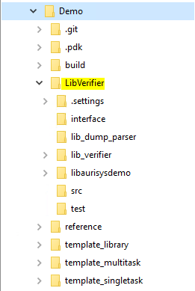
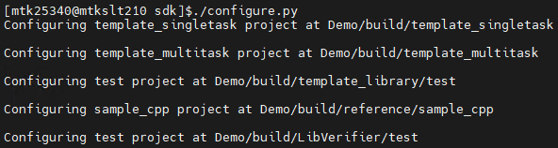
MRV PDK
- Import PDK Lib Verifier Projects
Please install RV PDK first
Add LibVerifier to MRV PDK workspace
  Create “LibVerifier” folder in {PDK_ROOT}/sdk/Demo folder
  Copy lib verifier sources to the “LibVerifier” folder
Generate makefiles
  Run configure.py in {PDK_ROOT}/sdk/
Open MRV PDK IDE
  Run runIDE.sh in {PDK_ROOT}/sdk/Demo
1
Create LibVerifier folder
Choose what Lib Verifier version you want
Ex: For U OS: 1.8.0
2
Copy files
Aurisys dev packages
RV PDK Demo project folder
Notes:
Lib_verifier
-IDE
-RV
-…
-…
-lib_verifier

Slide 12
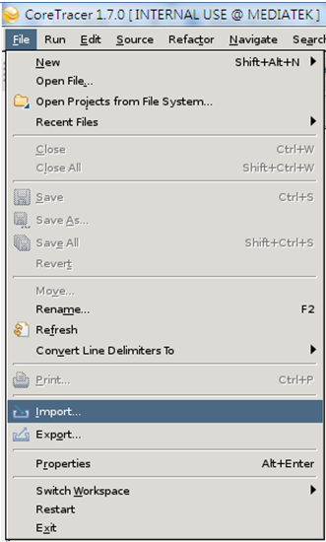
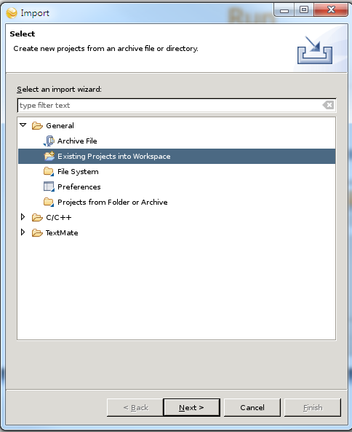
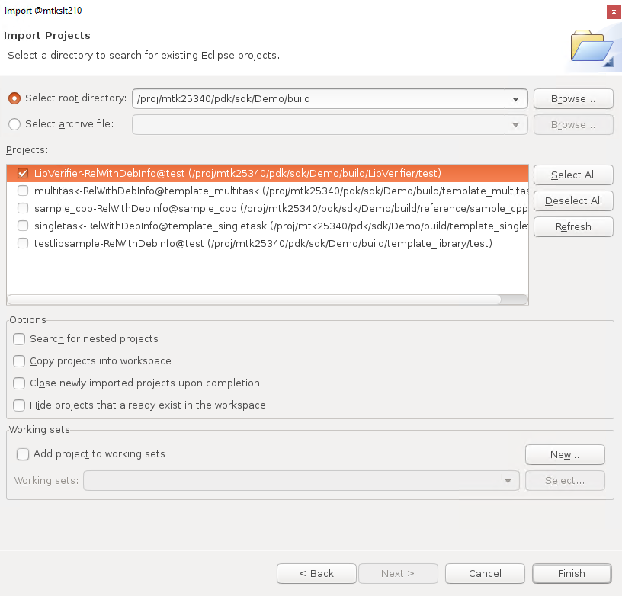
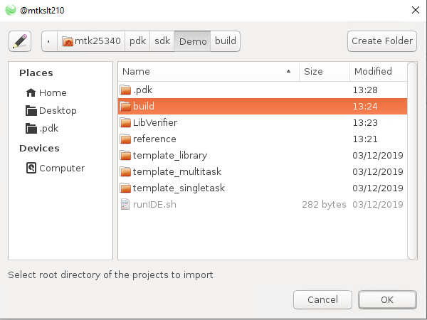
MRV PDK
- Import PDK Lib Verifier Projects
Import the generated project - LibVerifier
  File -> Import
  Existing Projects into Workspace -> Next
  Click the Browse button of Select root directory
  Select the “build” folder of RV PDK and click OK button
  Select the Projects of “LibVerifier”
  Click “Finish” button
2
1
2
3
4
5
4
6
Notes:
Lib_verifier
-IDE
-RV
-…
-…
-lib_verifier

Slide 13
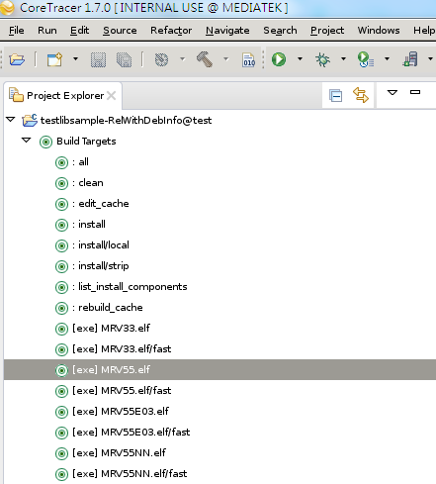
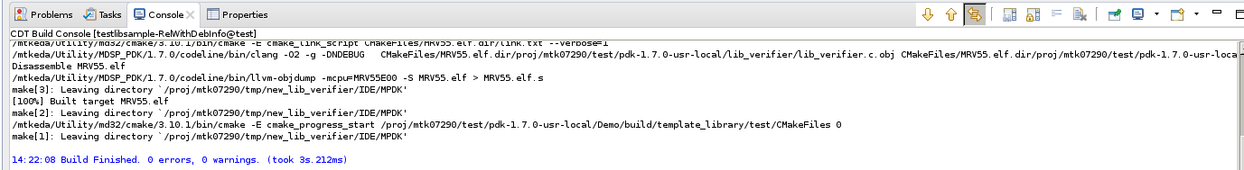
MRV PDK
- Build
Double click the “Build Targets” you want (ex: [exe]RV55.elf)
Check build pass log

Slide 14
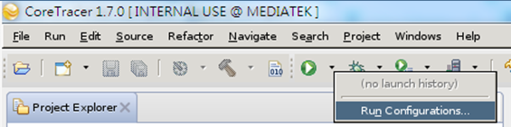
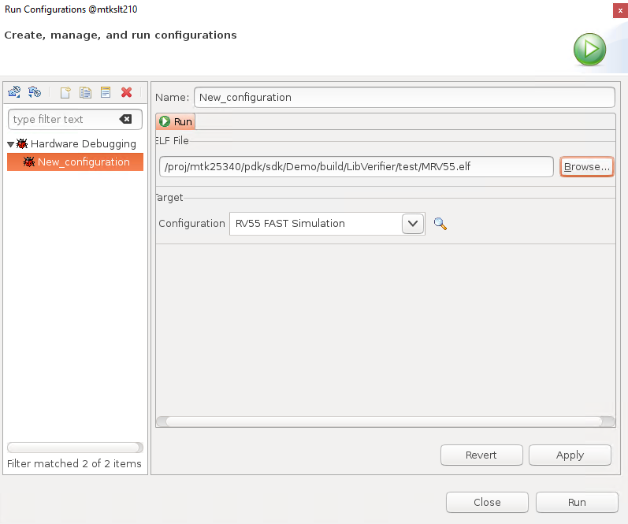
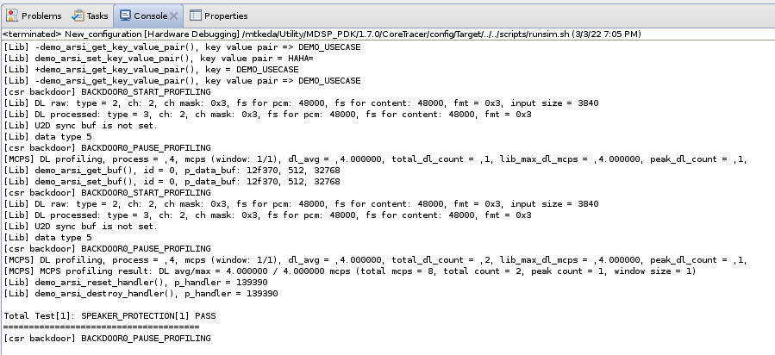
MRV PDK
- Run
1
2
Run projects
  Click the run button
  Click the “Run Configuration” item
  Double click the “Hardware Debugging” item to new configuration
  Select the elf file of LibVerifier project to run
    Ex: XXX/Demo/build/LibVerifier/test/MRV55.elf
  Select the Configuration you want
    “RV55 Moderate Simulation” : For profiling the cycle count of RV55
  Click the “Run” button
3
4
5
6
The log of running result

Slide 15
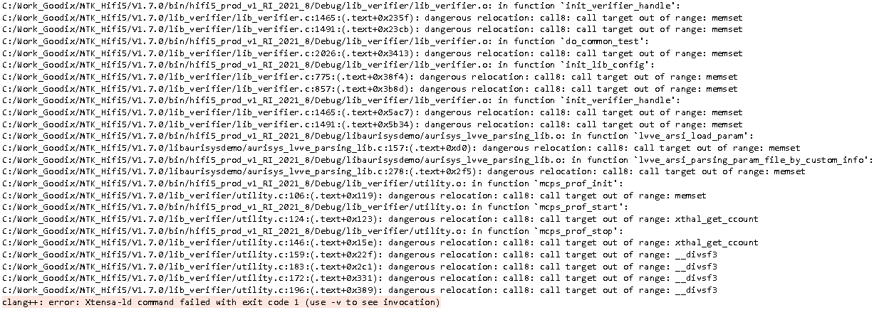
Trouble Shooting
If you got build error message like below
CFLAG follow the recommended setting
  -Wall -mcoproc -Werror -mlongcalls -LNO:simd -ffunction-sections -Wno-error=format -fdata-sections

Slide 16
3rd party lib verification

Slide 17
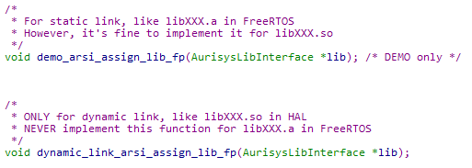
Verification Flow
3rd party library source code integration
  Replace the demo lib implementation in libaurisysdemo/ with yours
Add 3rd party library entry function declaration to interface/arsi_library_entry_points.h
Configure the test case in lib_verifier/test_case_config.h
  Playback: mtk_playback_test_case_list
  Record: mtk_record_test_case_list
  VoIP: mtk_voip_test_case_list
  Phone call: mtk_phone_call_test_case_list
Update makefile
  Update makefile or Android.mk if you add new source files
Compile & Run
Check the test result
Add 3rd party library’s declaration here

Slide 18
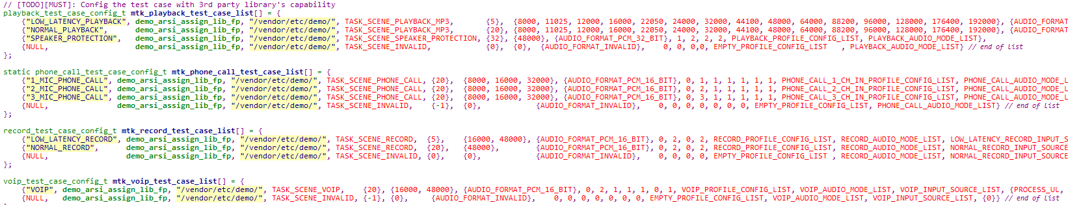
Test_case_config.h
Config the test case with 3rd party library's capability
Note:
1. Add l2sram size test list since V1.8.0, and 3rd party can extend it.

Slide 19
Playback Test Config Structure
struct playback_test_case_config_t
Member | Description
const char *test_case_name | This string is used to show in test result NULL string imply it’s end of test case list
void (*arsi_assign_lib_fp)(AurisysLibInterface *lib) | Configure the entry function of test case
string_buf_t param_file_path | The library’s parameter file path
task_scene_t task_scene | Define the working scene of test case
uint32_t frame_size | Define the frame size of test case You can define many frame size which library supported Ex: {5,20}
uint32_t working_sample_rate | Define the sample rate of test case You can define many sample rate which library supported Ex: {8000, 16000}
uint32_t audio_format | Define the audio format of test case You can define many audio format which library supported Ex: {AUDIO_FORMAT_PCM_16_BIT,AUDIO_FORMAT_PCM_32_BIT}
uint8_t interleave | Define the pcm is interleave or not Lib verifier only support non-interleave format now Will support interleave format soon
uint8_t dl_in_ch | Define the number of downlink input channel of test case
uint8_t dl_out_ch | Define the number of downlink output channel of test case
profile_config_t profile_config | Define the profiles of test case
int8_t audio_mode | Define the audio_mode of test case
audio_source_t input_source | Define the input source of test case
int32_t mem_l2sram_size (since V1.8.0) | Define the available l2sram memory size of the test case

Slide 20
Record Test Config Structure
struct record_call_test_case_config_t
Member | Description
const char *test_case_name | This string is used to show in test result NULL string imply it’s end of test case list
void (*arsi_assign_lib_fp)(AurisysLibInterface *lib) | Configure the entry function of test case
string_buf_t param_file_path | The library’s parameter file path
task_scene_t task_scene | Define the working scene of test case
uint32_t frame_size | Define the frame size of test case You can define many frame size which library supported Ex: {5,20}
uint32_t working_sample_rate | Define the sample rate of test case You can define many sample rate which library supported Ex: {8000, 16000}
uint32_t audio_format | Define the audio format of test case You can define many audio format which library supported Ex: {AUDIO_FORMAT_PCM_16_BIT,AUDIO_FORMAT_PCM_32_BIT}
uint8_t interleave | Define the pcm is interleave or not Lib verifier only support non-interleave format now Will support interleave format soon
uint8_t ul_in_ch | Define the number of uplink input channel of test case
uint8_t ul_ref_in_ch | Define the number of uplink reference input channel of test case
uint8_t ul_out_ch | Define the number of uplink output channel of test case
profile_config_t profile_config | Define the profiles of test case
int8_t audio_mode | Define the audio_mode of test case
audio_source_t input_source | Define the input source of test case
int32_t mem_slb_size | Define the available slb memory size of the test case
int32_t mem_l2sram_size (since V1.8.0) | Define the available l2sram memory size of the test case

Slide 21
Phone Call/VoIP Test Config Structure
struct phone_call_test_case_config_t / struct voip_test_case_config_t
Member | Description
const char *test_case_name | This string is used to show in test result NULL string imply it’s end of test case list
void (*arsi_assign_lib_fp)(AurisysLibInterface *lib) | Configure the entry function of test case
string_buf_t param_file_path | The library’s parameter file path
task_scene_t task_scene | Define the working scene of test case
uint32_t frame_size | Define the frame size of test case You can define many frame size which library supported, Ex: {5,20}
uint32_t working_sample_rate | Define the sample rate of test case You can define many sample rate which library supported, Ex: {8000, 16000}
uint32_t audio_format | Define the audio format of test case You can define many audio format which library supported Ex: {AUDIO_FORMAT_PCM_16_BIT,AUDIO_FORMAT_PCM_32_BIT}
uint8_t interleave | Define the pcm is interleave or not Lib verifier only support non-interleave format now Will support interleave format soon
uint8_t ul_in_ch | Define the number of uplink input channel of test case
uint8_t ul_ref_in_ch | Define the number of uplink reference input channel of test case
uint8_t ul_out_ch | Define the number of uplink output channel of test case
uint8_t dl_in_ch | Define the number of downlink input channel of test case
uint8_t dl_ref_in_ch | Define the number of downlink reference input channel of test case
uint8_t dl_out_ch | Define the number of downlink output channel of test case
profile_config_t profile_config | Define the profiles of test case
int8_t audio_mode | Define the audio_mode of test case
audio_source_t input_source | Define the input source of test case
int32_t mem_slb_size | Define the available slb memory size of the test case
Int32_t mem_l2sram_size (since V1.8.0) | Define the available l2sram memory size of the test case

Slide 22
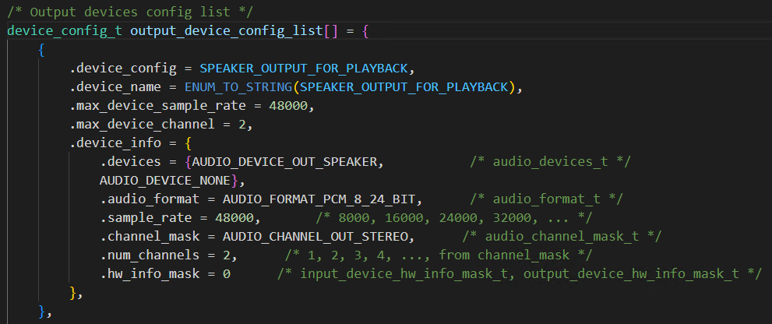
device_config.h
Config the test case with 3rd party library's capability.
If the library supports multiple input/output devices, 3rd party should extend the config list.
Mind that since V1.8.0, audio_device_t changed to an array type, and each array item represents only one device.

Slide 23
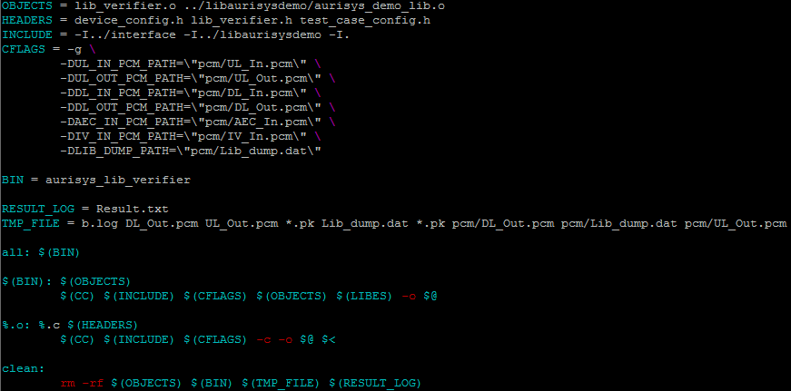
Update Makefile
API/V1.x.x/lib_verifier/makefile
If you add new source files, please update OBJECTS variable
If you add new header files, please update HEADERS variable
If the target environment support file I/O,
You can specify the pcm input/output path

Slide 24
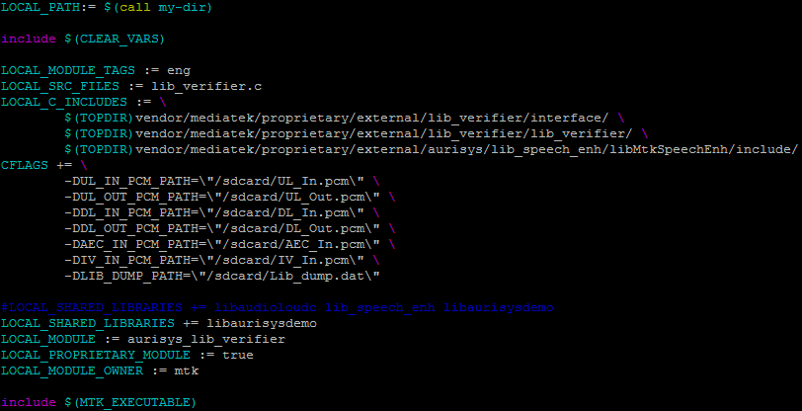
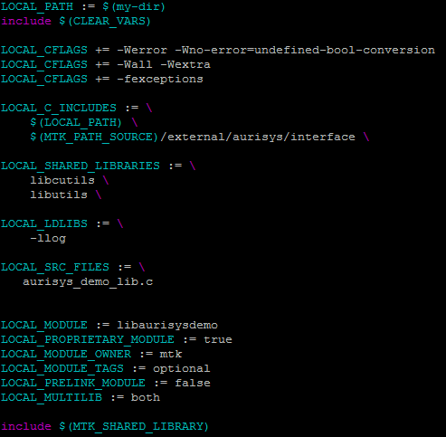
Update Android.mk
API/V1.X.X/lib_verifier/Android.mk
If you add new source file, please update LOCAL_SRC_FILES variable
If the target environment support file I/O,
You can specify the pcm input/output path
API/V1.X.X/libaurisysdemo/Android.mk
If you add new source file, please update LOCAL_SRC_FILES variable

Slide 25
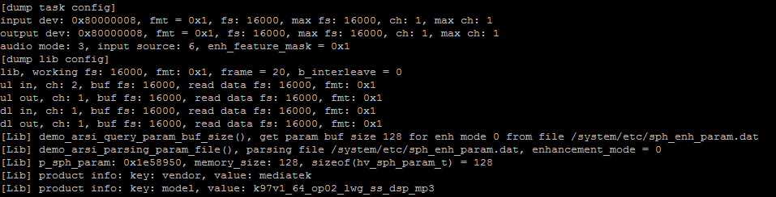
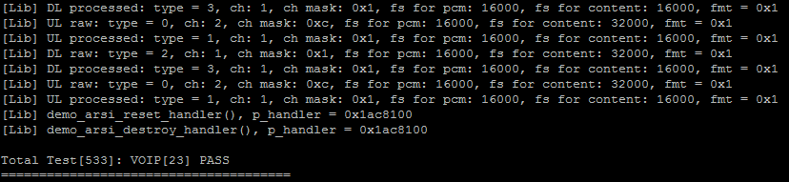
Check Test Result – Pass Case
Below are the test result example
Test case information
3rd party lib log
Test result: PASS
It’s 533th total test case
It’s 23th VOIP test case

Slide 26
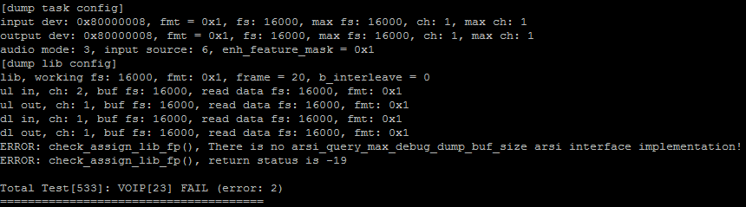
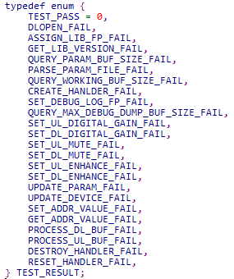
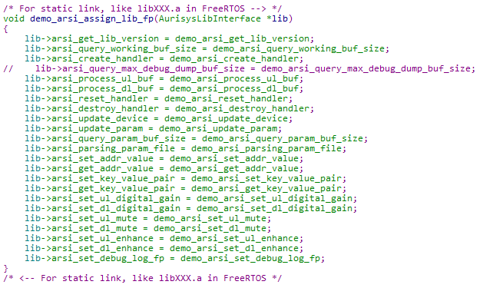
Check Test Result – Failure Case
Error message
Test result: Fail
Lib_verifier.h
demo_lib.c
Root cause

Slide 27
Lib dump parser

Slide 28
Compile & Run Lib Dump Parser
Lib dump is designed for 3rd party dumping their debug information while signal processing
  Customer can provide the lib dump file to 3rd party for trouble shooting
  Strongly recommend 3rd party implement it
Lib dump parser is a reference implementation for parsing the lib dump file on Linux
  Compile
    cd API/Vx.x.x/lib_dump_parser
    make
  Run
    ./demo_decode_dump ../lib_verifier/pcm/Lib_dump.dat

Slide 29
3rd party release to mtk

Slide 30
Release Packages
3rd party release aurisys lib to MTK MUST contain below files
  The 3rd party library & aurisys wrapper
  The parameter file that library needed
  aurisys_config.xml
    Please refer to the “XML Descriptor for Aurisys” section in Aurisys_Development_Tutorial.doc
    This xml configuration must match the test case configuration of lib verifier
  The lib verifier package which 3rd party used
    MTK have to review if there is any invalid modification
  The output log of lib verifier
    Confirm that 3rd party lib can pass all verifier test

Slide 31
appendix

Slide 32
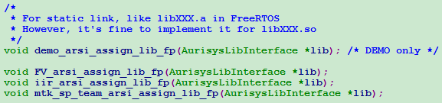
NEVER Change API Files!!
DO NOT edit files in interface/
  arsi_api.h
  arsi_api_version.h
  arsi_call_type.h
  arsi_type.h
  audio_task.h
  wrapped_audio.h
  wrapped_errors.h
except
  arsi_library_entry_points.h
    Please notify MediaTek SWRD if you want to change this file

Slide 33
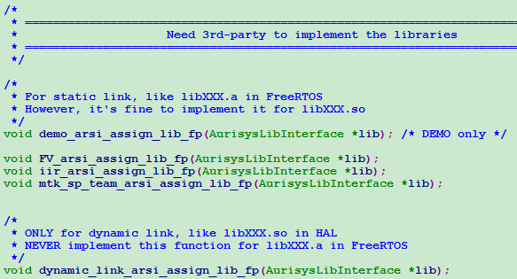
Entry points – Dynamic Link (HAL)
user
dlopen()
  dynamic_link_arsi_assign_lib_fp
API
3rd party libraries
  lib_demo.so
  libfvaudio.so
  lib_iir.so

Slide 34
Entry points - Static Link(FreeRTOS)
user
  arsi_library_entry_points.h
  demo_arsi_assign_lib_fp
  FV_arsi_assign_lib_fp
  iir_arsi_assign_lib_fp
API
3rd party libraries
  lib_demo.a
  libfvaudio.a
  lib_iir.a

Slide 35
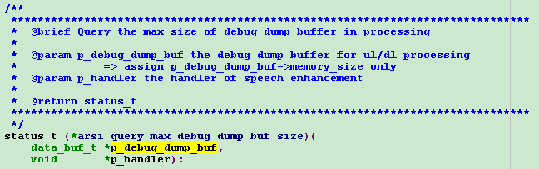
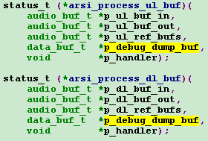
Dump for processing
(VM/EPL/…)
Get max dump buf size of one frame
Audio
Driver
arsi_query_max_debug_dump_buf_size
Lib
arsi_process_ul_buf
dump bufs
sdcard
dump bufs
Lib decode program
PCM / time info / gain / …

Slide 36
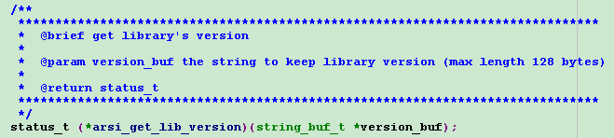
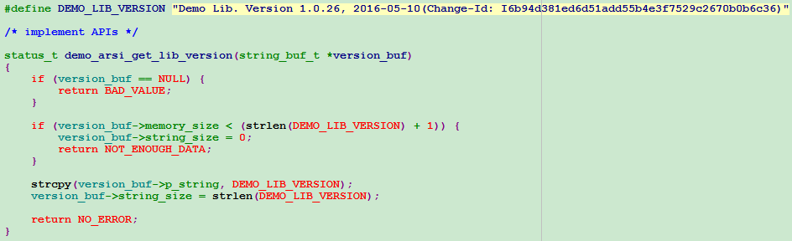
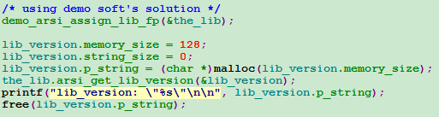
Lib Version
Any string you want

Slide 37
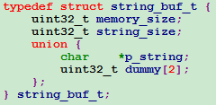
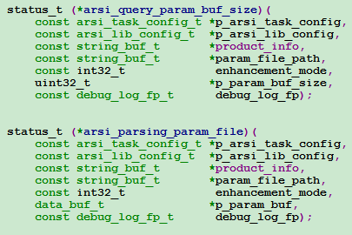
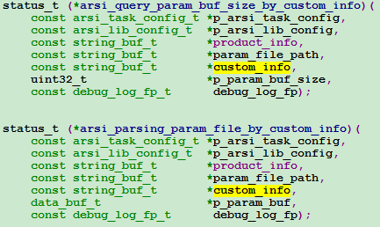

New Parsing API
Before V1.3.0
// phase out after V1.3.0
After V1.3.0
Ex:" SetAudioCustomScene=app1,aa=bb,cc=dd”
demo_arsi_assign_lib_fp
// phase out after V1.3.0
new

Slide 38
Thank you
Questions and Discussions

