Slide 1
MTK NNE framework introduction
MTK audio team

Slide 2
Agenda
Introduction
MTK NNE framework and Interface
Model deployment
Test with MTK NNE framework
Troubleshooting

Slide 3
Introduction
The MTK NNE framework is used to simplify the steps of testing and developing an NNE application on MTK platforms.
Up to 4 models can be deployed on MTK NNE framework.
The MTK NNE framework is developed with Xtensa NNE SDK V1.4p2.

Slide 4
NNE related folder structure
Place the
tflite model
ADSP_PATH
HIFI5_SP
middleware
nne_model
model
V1.4p2
sample
Place the model
test code
common
drivers
nne
api
NNE APIs supported
by MTK

Slide 5
HiFi5 Structure with NNE
L2TCM
768 KB
UBUF
128 KB
Int bus
Int bus
I-TCM
32 KB
HiFi5 DSP CoreA
HiFi5 DSP CoreB
I-TCM
32 KB
NNE
interrupt
D-TCM
36 KB
D-TCM
64 KB
NN:
32 8x8
NN:
32 8x8
D-Cache
128 KB
I-Cache
64 KB
D-Cache
128 KB
I-Cache
64 KB
Bus Interconnect

Slide 6
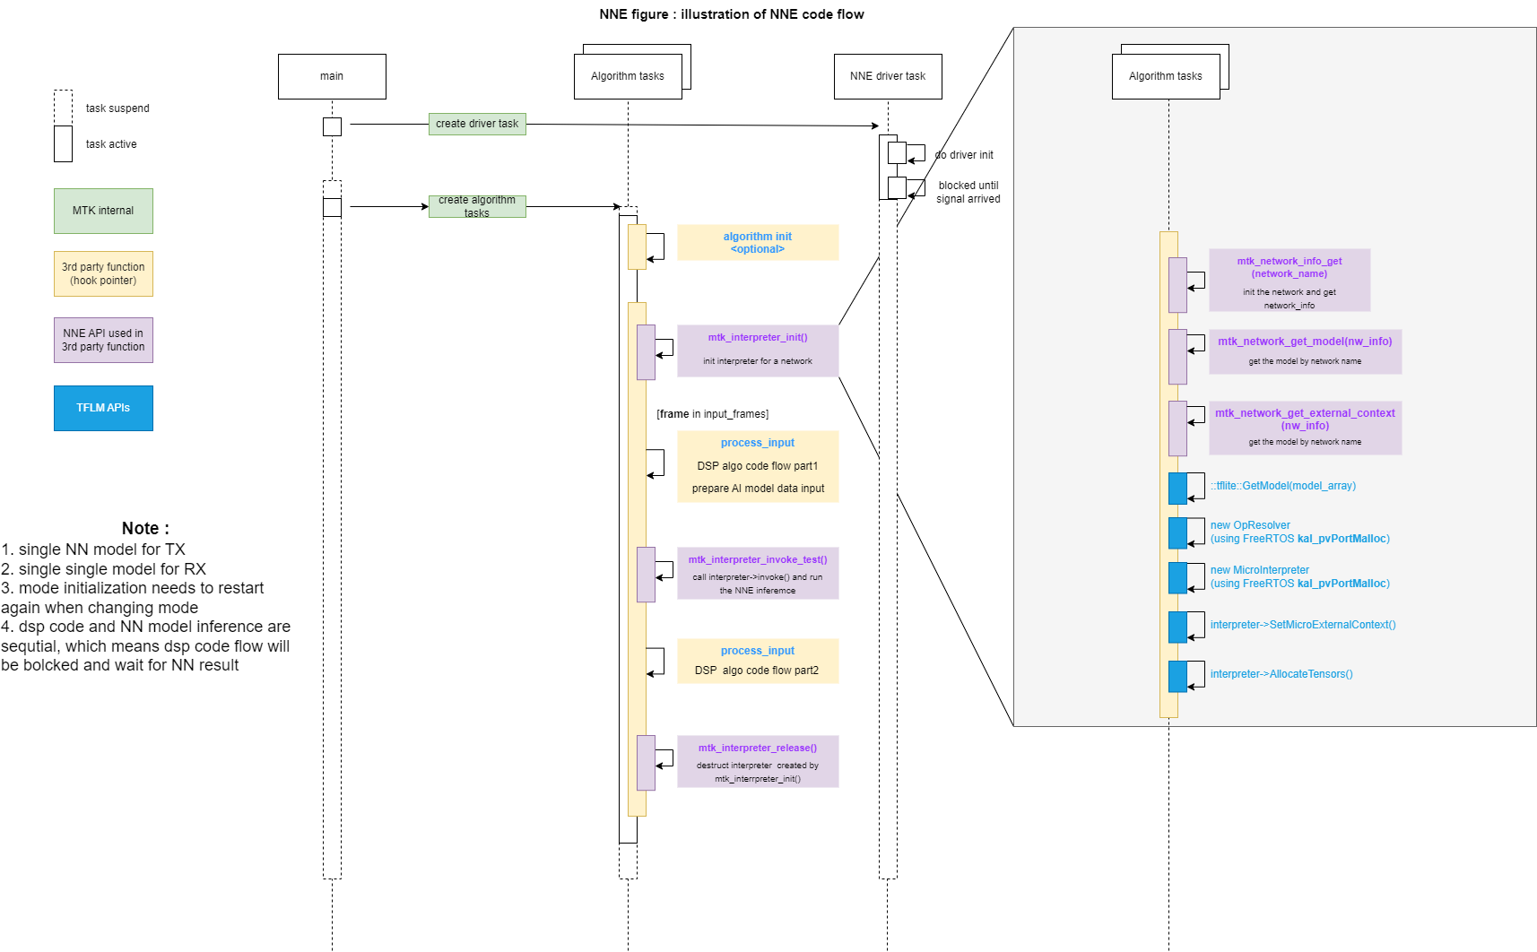
NNE inference flow

Slide 7
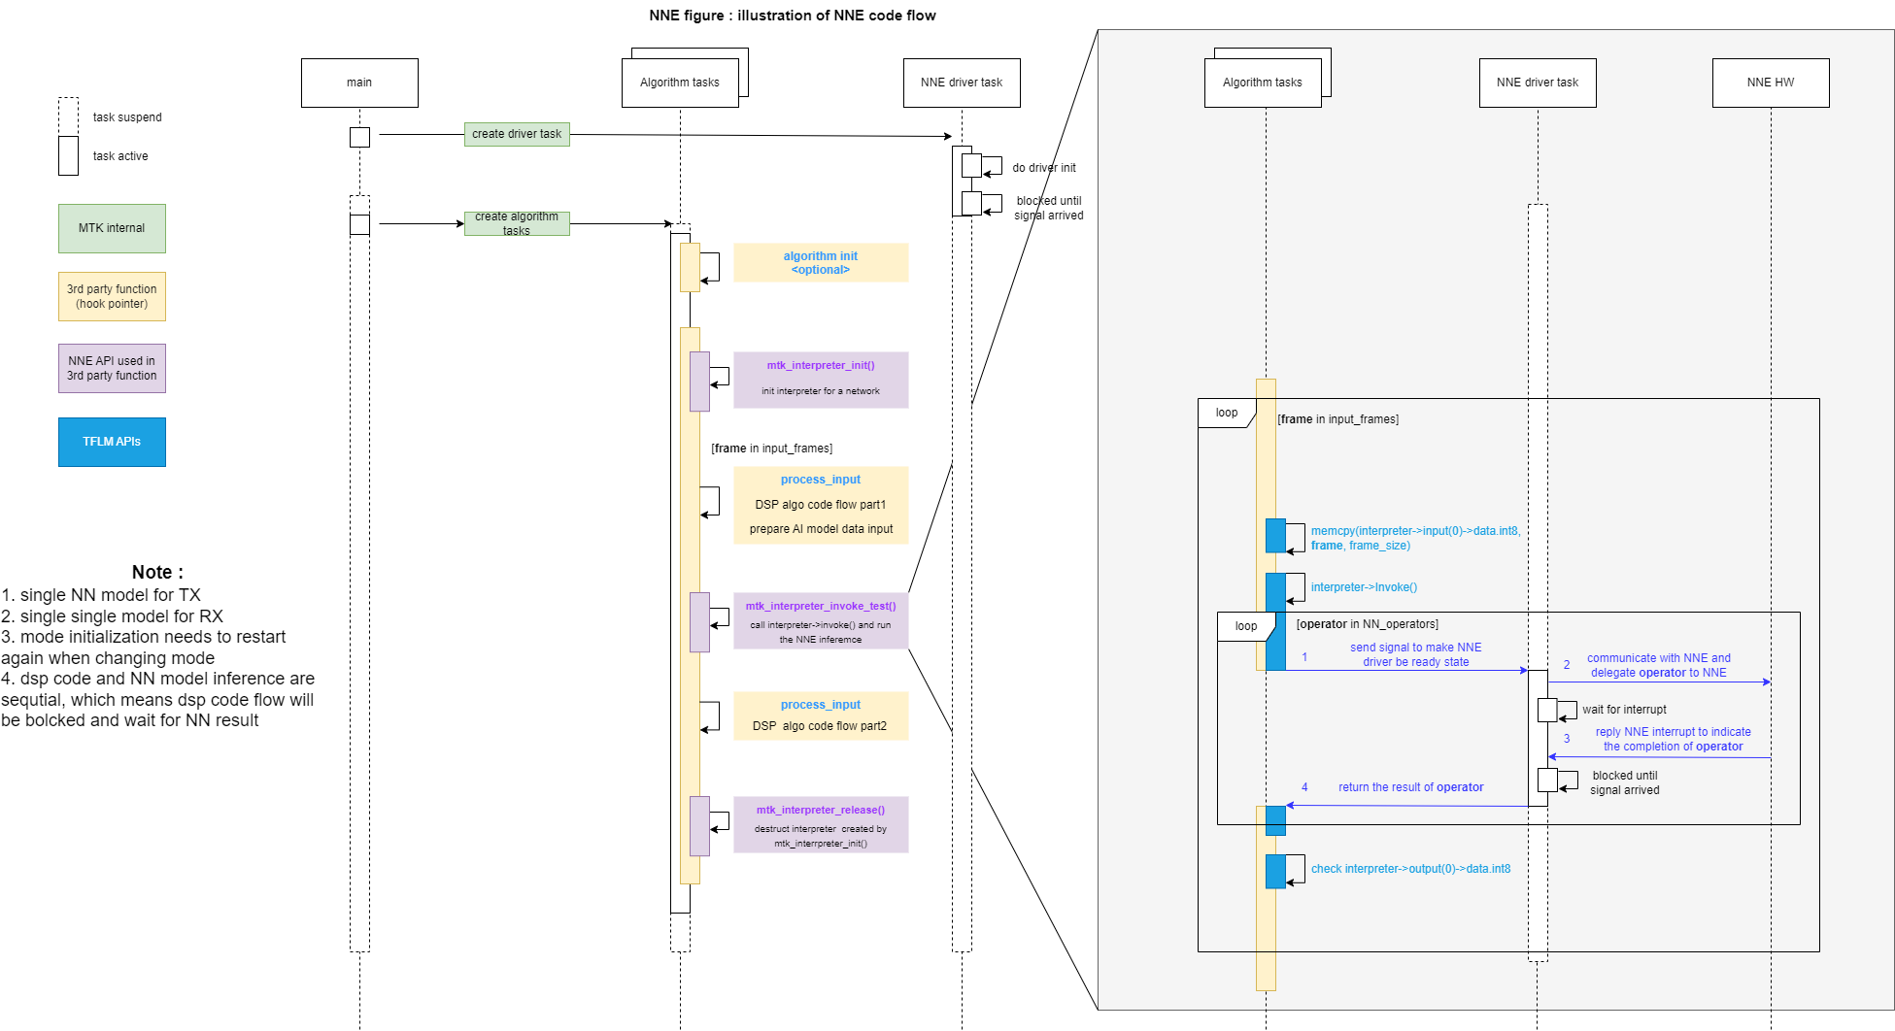
NNE inference flow (2)

Slide 8
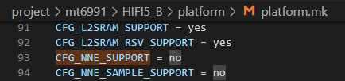

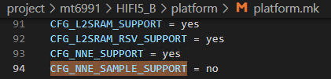
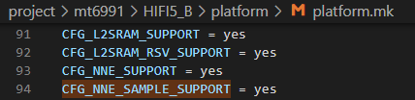
Enable MTK NNE framework in HiFi5 DSP
Please enable the option “CFG_NNE_SUPPORT” by modifying the default value from no to yes and rebuild the ADSP image.
  Path: ${ADSP_PATH}/HIFI5_SP/project/${PLATFORM}/HIFI5_B/platform/platform.mk
To test models, please enable the option “CFG_NNE_SAMPLE_SUPPORT” as well
  The CFG_NNE_SAMPLE_SUPPORT only takes effect when CFG_NNE_SUPPORT is enabled.
There is a sample project demonstrating the way to enable MTK NNE framework. Please refer to the project ${PLATFORM}-sample-project-nne.
  Path: Path: ${ADSP_PATH}/HIFI5_SP/project/${PLATFORM}/HIFI5_B/${PLATFORM}-sample-project-nne/project.mk
 | Not enabled | enabled
Enable MTK NNE framework
Test models (MTK NNE framework must be enabled)

Slide 9
Developer note – C flags
To develop an algorithm/application for NNE, the following c flags are necessary. Please add these C flags in the library’s build script.
Makefile example:
  ${ADSP_PATH}/middleware/nne_model/sample/makefile_nne_sample.mk
CFLAGS += \
-DTF_LITE_STATIC_MEMORY \
-DTF_LITE_DISABLE_X86_NEON \
-DXTENSA \
-DTF_LITE_MCU_DEBUG_LOG \
-DTF_LITE_USE_CTIME \
-DMAX_RFFT_PWR=9 \
-DMIN_RFFT_PWR=MAX_RFFT_PWR \
-DHIFI5 \
-DNNLIB_HIFI5 \
-DDMA=1

Slide 10
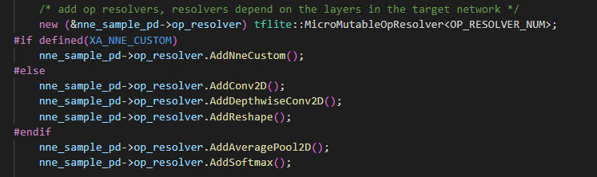
Developer note – NNE op resolver
If developers want to use NNE to accelerate Neural Network computations. The op_resolver (MicroMutableOpResolver) should call AddNneCustom() to enable the NNE op resolver.

Slide 11
Developer note – NNE sample code
Please refer to the sample code in the following paths to develop NNE applications
  ${ADSP_PATH}/HIFI5_SP/middleware/nne_model/sample/src/nne_sample_person_detect.cc
  ${ADSP_PATH}/HIFI5_SP/middleware/nne_model/sample/src/nne_sample_micro_speech_lstm.cc

Slide 12
NNE test helper APIs
These APIs are helper functions to run an NNE inference simply. They can be used not only in test functions but also applications.
These APIs are defined in the nne_test_helper.h
APIs | Description
mtk_interpreter_init | The function is a helper function to create a tflite::MicroInterpreter
mtk_interpreter_release | The function is a helper function to destruct a tflite::MicroInterpreter
mtk_interpreter_invoke_test | The function is a helper function to call the tflite::MicroInterpreter->Invoke()

Slide 13
NNE test helper APIs (1)
API | arguments | return
mtk_interpreter_init | char *network_name void *interpreter void *tensor_arena size_t tensor_arena_size void *p_op_resolver int kNumResourceVariables | Return type: void * Return: the address of interpreter (the same as the input argument interpreter ) NULL if initialization for the interpreter failed.
 | Description
 | Defined in nne_test_helper.h The function is a helper function to create a tflite::MicroInterpreter. The function does not allocate memory. The arguments interpreter, tensor_arena, and p_op_resolver should be allocated through Aurisys (arsi_query_wroking_buf_size()) before calling this function. Moreover, the argument p_op_resolver should be added required op_resolvers before calling this function (please see this page). If developer needs an interpreter other than a tflite::MicroInterpreter, this function is not applicable to the usage. Please follows the constructor of the desired Interpreter to create an instance.
API | arguments | return
mtk_interpreter_release | void *interpreter | Return type: void Return: no return
 | Description
 | Defined in nne_test_helper.h The function is a helper function to destruct a tflite::MicroInterpreter. The function does not free the memory. It only call the destructor of tflite::MicroInterpreter, so developers should free the memory space of interpreter after calling this function.

Slide 14
NNE test helper APIs (2)
API | arguments | return
mtk_interpreter_invoke_test | char *network_name void *p_interpreter void *input_buf size_t input_buf_size void *output_buf size_t output_buf_size | Return type: int Return: the result of interpreter invoke test. This function will return the following values. 0: finish interpreter invoke -1: argument is NULL -2: arguments input_buf_size or output_buf_size are 0 -3: input buf size is smaller than the model input size output buf size is smaller than the model output size -4: error encountered when processing interpreter->Invoke();
 | Description
 | Defined in nne_test_helper.h The function is a helper function to call the tflite::MicroInterpreter->Invoke(). The function does not allocate memory, so the arguments interpreter, input_buf, and output_buf should be allocated a memory space first. Moreover, the argument interpreter should be initialized first before calling this function. Developers can use mtk_interpreter_init() to create a tflite::MicroInterpreter for the test.

Slide 15
NNE test helper APIs (3)
If developers want to further improve the performance of NNE inference, please used the MTK NNE framework APIs described in the next page to implement the interpreter initialization and invocation.

Slide 16
MTK NNE framework APIs
The MTK NNE framework APIs are used to obtain necessary materials for the NNE infrastructure, such as model data and network context.
If the model is built in the ADSP image, there is a network name corresponding to the model. Developers can get the network info through the network name.
After obtaining the network info, developers can use it to create an TFLM interpreter, and call interpreter->invoke() to run NNE inference.
These APIs are defined in the xa_network_api.h
APIs | Description
mtk_network_info_get | The function is used to get the network_info prebuilt in adsp image.
mtk_network_get_model | The function is used to get the buffer of the model stored in the network_info.
mtk_network_get_external_context | This function is used to get the address of TNNE external context.
is_nne_enabled | The function is used to check if NNE is initialized in the ADSP system.

Slide 17
MTK NNE framework APIs (1)
API | arguments | return
mtk_network_info_get | char *network_name | Return type: network_info_t * Return: address of the instance of network_info_t or NULL if no network is found for the given name.
 | Description
 | Defined in xa_network_api.h The function is used to get the network_info prebuilt in adsp image. The argument network_name is the ‘name’ entry defined in the model config. About the model config, please see the page.
API | arguments | Return
mtk_network_info_get | network_info_t *nw_info | Return type: unsigned char * Return: the address of the model or NULL if no network is found for the given name.
 | Description
 | Defined in xa_network_api.h The function is used to get the buffer of the model stored in the network_info.

Slide 18
MTK NNE framework APIs (2)
API | arguments | return
mtk_network_get_external_context | network_info_t *nw_info | Return type: Struct XaTnneNetworkContext * Return: the address of the struct XaTnneNetworkContext
 | Description
 | Defined in xa_network_api.h This function is used to get the address of TNNE external context.
API | arguments | Return
is_nne_enabled | void (no argument) | Return type: bool Return: true if NNE is enabled and initialized. Otherwise, return false.
 | Description
 | Defined in xa_network_api.h The function is used to check if NNE is initialized in the ADSP system.

Slide 19
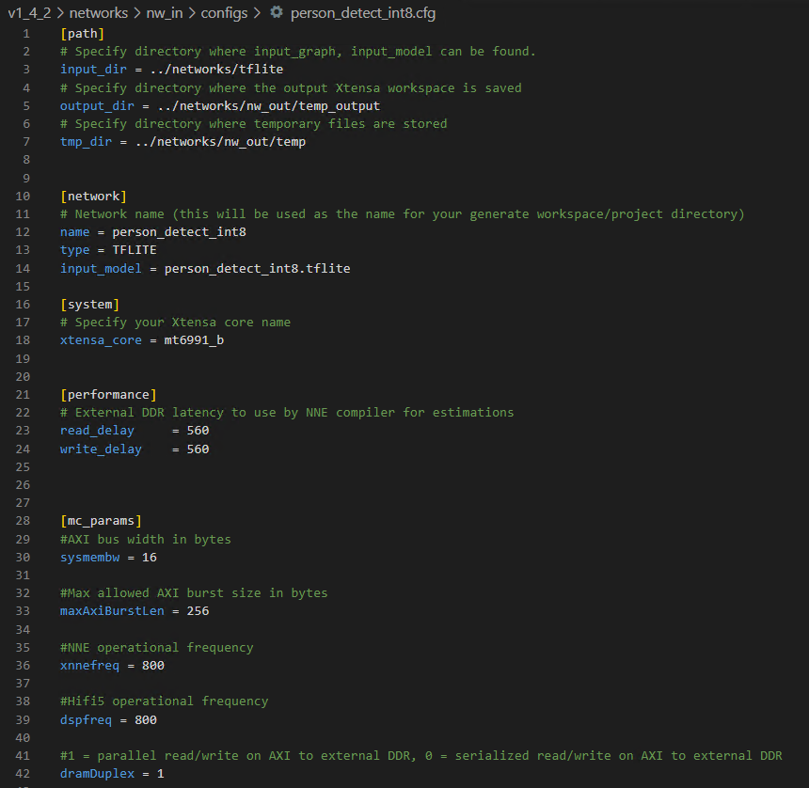
Model deployment - Model config
The model configuration needs to be set according to the hardware specifications
  xtensa_core = ${PLATFORM}_b
    If using DX-4, please set as mt6991_b
  Read/write_delay = 560 cycles
    Dram access worst latency: 700 ns
    700 ns = 560 cycles in 800M
  maxAxiBurstLen = 256
  xnnefreq = 800
  dspfreq = 800

Slide 20
Ways to deploy models to ADSP
There are 2 ways to deploy models to ADSP. Use one of the following to add models:
  Copy all models from the NNE SDK
    Please note that the way replaces all the previous models. If developers want to add models without replacing old ones, please use the next way.
  Add models manually

Slide 21
#1 Copy all models from the NNE SDK
Steps
  Place models into the NNE SDK
  Run NNE SDK build
  Copy the produced models from the NNE SDK

Slide 22
#1 Copy all models from the NNE SDK
Step1. Place models into the NNE SDK
Place the model (.tflite file) in the following path
  ${NNE_SDK_PATH}/networks/tflite/
Add the model to the nw_list:
  File: ${NNE_SDK_PATH}/networks/nw_in/nw_list.txt
  Add model example
    networkName = person_detect_int8, priority = 0, instances = 1
The file name of the model excluding .tflite file extension
Instances is optional.
The priority of the model.
0 has the highest priority, multiple model can have same priority

Slide 23
#1 Copy all models from the NNE SDK
Step2. Run NNE SDK build
Command
  $ cd ${NNE_SDK_PATH}/build
  $ ./nne110.sh --test_app tflm --clean --core hifi5
The above commands would trigger NNE SDK build flow, and the corresponding NNE custom tflite files are placed in the following path
  ${NNE_SDK_PATH}/networks/nw_out/${MODEL_NAME}_files/${MODEL_NAME}_nne_custom.tflite
After finishing NNE SDK build flow, the NNE custom tflite files will be converted to C headers. Please check the following path.
  ${NNE_SDK_PATH}/test/tflm/include/${MODEL_NAME}_model_data.h

Slide 24
#1 Copy all models from the NNE SDK
Step3. Copy the produced models from the NNE SDK
Copy all the model headers (Note 1) to the following path. The model headers are inside the path $(NNE_SDK)/test/tflm/inc
  ${ADSP_PATH}/HIFI5_SP/middleware/nne_model/model/v1.4p2/inc
Copy the $(NNE_SDK)/test/tflm/inc/xa_network_model_data.h to the following path
  ${ADSP_PATH}/HIFI5_SP/middleware/nne_model/model/v1.4p2/inc
Copy $(NNE_SDK)/test/tflm/src/xa_network_model_data.cc to the following path and rename to xa_network_model_data.c (Note 2)
  ${ADSP_PATH}/HIFI5_SP/middleware/nne_model/model/v1.4p2/src
Rebuild ADSP image
Note
  If there are multiple models defined in the nw_list.txt, the NNE SDK would generate a model header for each model. The model header name is suffixed with _model_data.h.
  Please note that the xa_network_model_data.cc must be renamed to C file because the ADSP build script does not support CC file currently.

Slide 25
#2 Add models manually
Steps
  Place models into the NNE SDK (same as the 1st way)
  Run NNE SDK build (same as the 1st way)
  Modify the xa_network_model_data.c/.h manually
The step 1 and 2 are the same for both the 1st and 2nd methods.

Slide 26
#2 Add models manually
Step3. Modify the xa_network_model_data.c/.h manually
Copy all the model headers to the following path. The model headers are inside the path $(NNE_SDK)/test/tflm/inc
  ${ADSP_PATH}/HIFI5_SP/middleware/nne_model/model/v1.4p2/inc
modify
  ${ADSP_PATH}/HIFI5_SP/middleware/nne_model/model/v1.4p2/inc/xa_network_model_data.h
    “#define NETWORKS_COUNT 2”, Please modify the number following NETWORKS_COUNT to the desired number of models to be run on the ADSP.
  ${ADSP_PATH}/HIFI5_SP/middleware/nne_model/model/v1.4p2/src/xa_network_model_data.c
    Include “${MODEL_NAME}_model_data.h”
    xa_nw_models adds ${MODEL_NAME}_nne_custom_tflite
    xa_nw_priorities adds priorities for models (0 has the largest priority)
    xa_nw_name adds model names

Slide 27
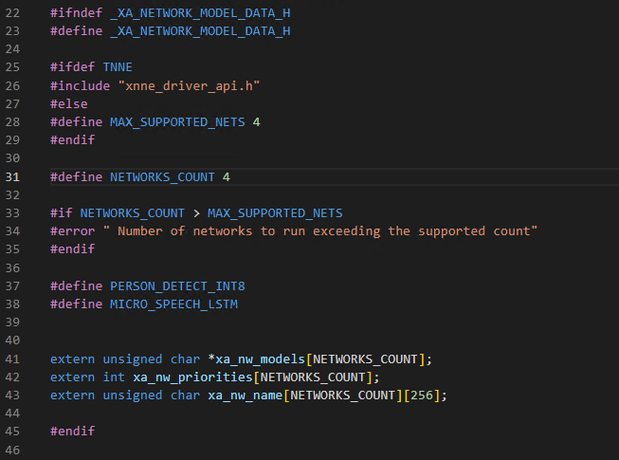
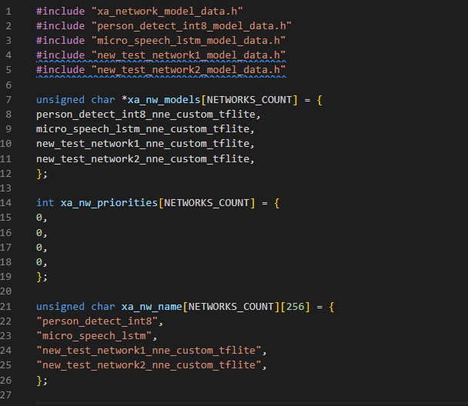
#2 Add models manually
Step3. Modify the xa_network_model_data.c/.h manually example
Here is a sample adding 2 models new_test_network1 and new_test_network2.
xa_network_model_data.h
xa_network_model_data.c
Add the model headers
created by NNE SDK
The model number you want to
run on adsp. In this sample, the
Number is 4
Add the binary data of models
to xa_nw_models
Define the priority of models
to xa_nw_priorities.
0 has the largest priority.
Add the name of models
to xa_nw_name.
The name of model is the
same as the name attribute
written in the model’s cfg file

Slide 28
NNE sample
NNE sample is a small framework to test models with NNE. To use NNE sample, developers should create and register a nne_sample_handler for their model. Here is the steps to test the models.
  Create a nne_sample_handler, the members are shown in the following table. Implement the init, start, and deinit callbacks of the NNE sample code
    Developers can leverage the NNE test helper APIs to implement the start callback, please see the next page for example.
  Register the nne_sample_handler
    Modify the file: ${ADSP_PATH}/middleware/nne_model/sample/src/nne_sample_registration.c
    use register_sample_handler(struct nne_sample_handler *) to register the nne sample handler
      For example: register_sample_handler(&sample_handler_pd);
  Build libmtnne_sample.a
  Rebuilt ADSP image
Member | Type | Descrption
nw_name | char * | Model name
init | void (*)(void) | a callback to initialize the NNE sample code
start | void (*)(void) | a callback to start the NNE sample code, this is the major part to run the NNE inference
deinit | void (*)(void) | a callback to deinitialize the NNE sample code

Slide 29
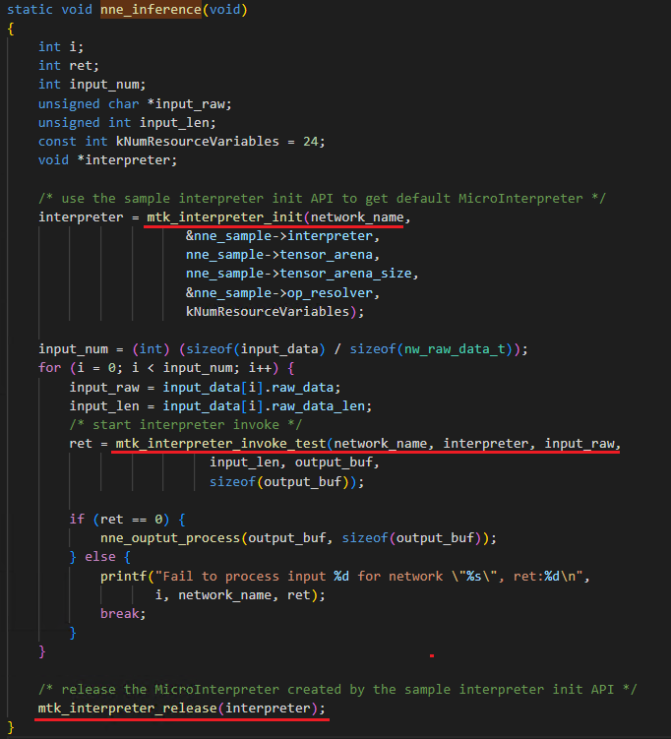
NNE sample (1) - Create a nne_sample_handler
Please see the sample code in the following path
  ${ADSP_PATH}/middleware/nne_model/sample/src/nne_sample_person_detect.cc
The start callback can be simply implemented by the NNE test helper functions (please see the page for detail)

Slide 30
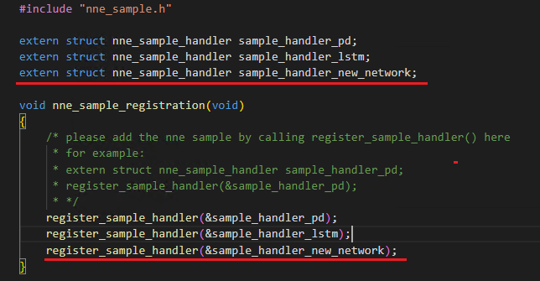
NNE sample (2) - Register the nne_sample_handler
Modify the following file to register the nne sample handler
  ${ADSP_PATH}/middleware/nne_model/sample/src/nne_sample_registration.c

Slide 31
NNE sample (3) - Build libmtnne_sample.a
Build
  command:
    make -f makefile_nne_sample.mk all
    ADSP_PROJECT=mtXXXX
    XTENSA_TOOLS_VERSION=RI-2023.11-linux
    TFLM_BASE=${LOCAL_TFLM_PATH}
    Example (DX-4): make -f makefile_nne_sample.mk all ADSP_PROJECT=mt6991 XTENSA_TOOLS_VERSION=RI-2023.11-linux TFLM_BASE=../v1_4_2/dsp/tflm/tflite-micro
  Path: ${ADSP_PATH}/middleware/nne_model/sample
Output lib: ${ADSP_PATH}/middleware/nne_model/sample/libmtnne_sample.a

Slide 32
NNE sample – Test
After registering the nne sample handler, developers can test models with the following APIs
API | arguments | return
run_all_nne_sample | void (no argument) | Return type: void Return: no return
 | Description
 | Defined in nne_sample.h This API runs all the registered nne_sample_handlers.
API | arguments | Return
run_nne_sample | char *nw_name | Return type: void Return: no return
 | Description
 | Defined in nne_sample.h This API runs specific nne_sample_handlers that have the same nw_name as the argument nw_name (the nw_name is the same as the name defined in the model config).

Slide 33
Memory usage
Take Person Detect INT8 model as example:
item | description |  | Memory (Byte) | Memory (MB)
1 | NNE Driver | Fix size | 410624 | 0.3916 MB
2 | Model (person_detect_int8_nne_custom.tflite) | Size depends on the model | 357344 (person_detect_int8.tflite size: 300568) | 0.3407 MB
3 | Tensor arena (TensorFlow Lite Micro的working buffer) | Size depends on the model | 406528 | 0.3876 MB
 | Total |  | 1174496 | 1.12 MB

Slide 34
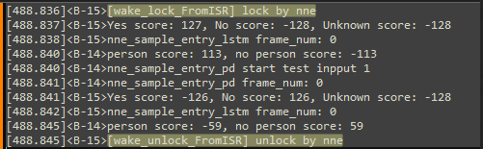
Q&A (1)
How long does the initialization take?
  The model initialization will be completed during ADSP boot time, and retrieving the initialized models using the MTK APIs will not take much time.
Does the model need to allocate another memory block to store?
  TFLite model is built in the ADSP image, so developers do not need to allocate memory for models
How to check if the NNE is active？
  If the following 2 lines are shown in the ADSP log, that means the NNE is active.
  [wake_lock_FromISR] lock by nne / [wake_unlock_FromISR] unlock by nne

Slide 35
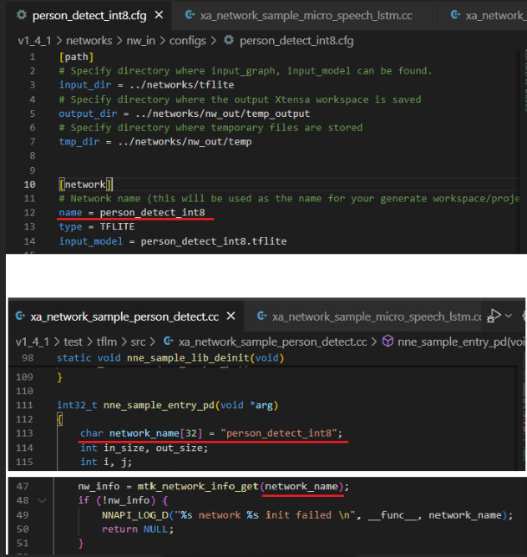
Q&A (2)
In the sample code, the initialization is done by obtaining the model through its name. How is this name configured?
  The model name needs to match the 'name' field in the model's cfg file. For example, for the model 'person_detect_int8', its model name can be found in the 'name' field within the file networks/nw_in/configs/person_detect_int8.cfg.

Slide 36
NNE simulation runs slowly
The NNE simulation experiment has a slow inference speed, taking 14 minutes for a single sample.
  The cache setting in HWCFG HiFi5_NNE_2023_11 bypasses the address range from 0x4000_0000 to 0x6000_0000, so the NNE simulation is run without caching and gets a worse performance.
  The solution is to add the following settings to FDFLAGS in ${NNE_SDK}/test/tflm/makefile_network_test, which will set 0x4000_0000 to 0x6000_0000 as cacheable.
    -Wl,--defsym=_memmap_cacheattr_reset=0x41111140

Slide 37
ADSP exception when copy data to tensor
ADSP encounters exception when copies data to input tensor.
  This may be caused by missing C flags. Please check if the C flags in this page are defined in the library build script.
  Alternatively, developers can print the size of tensor using the following code
    printf("%s sizeof(TfLiteTensor):%d\n", __func__, sizeof(TfLiteTensor));
    The correct size of TfLiteTensor is 40 bytes, If the size shown is 60 bytes, it means the C flags are not correctly added in the build script.

Slide 38
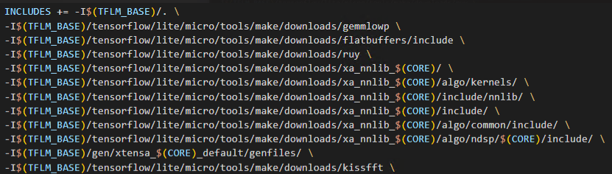
Build Error: header not found
The TFLM headers can not be found.
  Please refer to ${NNE_SDK_PATH}/test/tflm/makefile_network_test to include the TensorFlow headers in the build script. Add the following snippet and include $(INCLUDES) in the build command.
    Note: TFLM_BASE is the local TFLM path, which, in the case of the NNE SDK, will point to the path ${NNE_SDK_PATH}/dsp/tflm/tflite-micro.

Slide 39
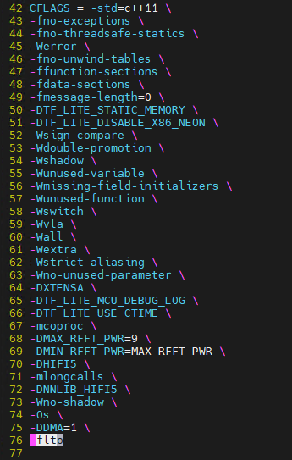
Link error with –flto flag
Encountered linker error while building HIFI5_SP
  Error message: error adding symbols: file in wrong format.
  If look at the generated .o files, you will find that they are not normal binaries but LLVM IR bitcode.
Root cause: The reason is that the build script includes "-flto" in CFLAGS, which is a flag for linker to perform image optimization. Therefore, the compiled .o files will be in LLVM IR (Intermediate Representation).
Solution: remove the "-flto" flag in the library build script.

Slide 40
Thank you

