Slide 1
X20 DSP FAQ
Cortex-M4 Processor as open DSP v1.1

Slide 2
System Information

Slide 3
Getting Start
Platform and Development Environment
  Internal Memory
    512 KB SRAM, access with zero wait state
    No separate for PMEM/DMEM
  Tool Chain
    gcc-arm-none-eabi-4_8-2014q3
  Operating System
    FreeRTOS
  Clock Rate
    Maximum clock rate reaches 354 MHz
  Compile Option / MTK Built-in Features
    We have sensor hub/sound trigger/MP3 decoder in DSP which can be disabled in compile time by compile options to release more memory for vendor’s usage
  Other Features
    We don’t provide cache or dynamic switch binaries for DSP, there is only 512 KB for all features
    We have Floating Point Units (FPU)

Slide 4
Clock Rate
DVFS
  Clock Rate Selection
    We have three DSP clock rate, if your application can be run at 110MHz, there is large power savings for the whole system
    We don’t have automatic DVFS to detect current DSP loading and adjust the voltage automatically
    What we do is to register a frequency requirement of the specified application. When the application starts, a provided API should be called to notify the system. Besides, it also needs to call another API to notify the system when it is stopped. The system will adjust the voltage according current applications.
Low Power Mode
Normal Mode
Turbo Mode
0.8V
0.9 V
1.0 V
110 MHz
224 MHz
354 MHz
Ultra Low Power
Always-on features
Normal applications
High Sampling Rate applications
High Complexity algorithm

Slide 5
Compromise with limited resources
MTK Built-in Features Resource Requirement
  Internal Memory
    Sensor Hub – around 324KB (RO 172KB, RW 112KB)
    Sound Trigger – 142KB (RO 30KB, RW 112KB)
    MP3 + SRC – 130KB (RO 65KB, RW 65KB)
    Operating System – 30KB
Principle
  Tradeoff
    OEM should select what they really want in CortexM4 since the memory size is not enough
    The sensor feature and MP3 have an application processor version. Thus, if the OEM wants to add a vendor’s algorithm for voice call, they can select the application processor version of sensor/MP3 to release memory of the DSP.
    The DSP codebase is source release. The OEM/vendor can compile by themselves
  Future Plan
    We plan to development dynamic swap in the future. For example, when a voice call comes, we don’t need sound trigger in this scenario, we can swap out the sound trigger and swap in algorithms of voice call.
    Sensor features should be divided into small pieces so that the OEM can pick what they really want

Slide 6
Development Debug Facilities
Debug Facilities
  ICE
    Debug tools such as Trace32 or Codeviser debugger is allowed
  Trace
    DSP system trace
      The DSP traces can be logged through UART
      The DSP traces can also be collected as a file stored in the device storage
    Vendor IP
      We provide an API for the developer to check the correctness of their program by logging. The API is consistent and can be used in different systems. The provided API would call the function pointer passed in the initialization. The called function is responsible for logging the required statements by calling the system-specific logging API. It can also be disabled easily by bypassing the requirements. It’s helpful for the developer which doesn’t need to remove and insert logging code anymore.

Slide 7
Feature Packages w/o dynamic loading for DSP
Possible Packages of MTK Built-in Features in Open DSP
 | MP3 + SRC | Voice Call Enhancement (3rd Party Solution) | Voice Call Enhancement (MTK Built-In) | Sound Trigger | Sensor Feature
Feature Package A | Open DSP | Not Support | Modem Side | Not Support | AP
Feature Package B | AP | Open DSP | Not Support | Not Support | AP
Feature Package C | AP | Not Support | Modem Side | Open DSP | AP
Feature Package D | AP | Not Support | Modem Side | Not Support | Open DSP
Feature Package E | Open DSP | Open DSP | Not Support | Not Support | AP
Feature Package F | Open DSP | Not Support | Modem Side | Open DSP | AP
Feature Package G | AP | Open DSP | Not Support | Open DSP | AP
Feature Package H | AP | Not Support | Modem Side | Open DSP | Open DSP
AP VS DSP → Power consumptions
Open DSP VS MTK Inside Modem → quality

Slide 8
Audio Development

Slide 9
Development Audio Routing / Inter-processor-communications
Communications
  Application Processor
    The communication between AP and DSP is by an interrupt. There is a shared memory can be passed along with the interrupt. The size can be used is 48 bytes.
    If we need to transmit a quantity of data, we can just transmit the data address through the interrupt and start to move the data by a DMA HW.
  Modem
    The DSP can access voice data to/from modem side. The vendors don’t need to take care with the communications between modem.
Audio Routing
  HW path setting
    The HW path and audio routing settings are done by application processor
    Current input/output device, gain setting, and other required information will be transferred to the vendor IP (vendor IP should follow our API)

Slide 10
Development Voice Call
Spec
  Sample Rage
    In X20, we only have NB or WB.
    No matter it’s NB or WB, we’ll send WB data to the vendor IP
  Frame period
    20ms per frame
  Round Trip Delay
    MTK already has 140ms delay
  Process time
    RX task needs to be processed less than 3ms per frame
    TX task needs to be processed less than 12ms per frame
    Otherwise, we’ll need to delay one more frame, the delay will become 160ms (not include IP group delay)
Standard Interface
  Interface for sound enhancement
    We’ve defined generic interfaces for processing sounds which is portable to MTK platforms

Slide 11
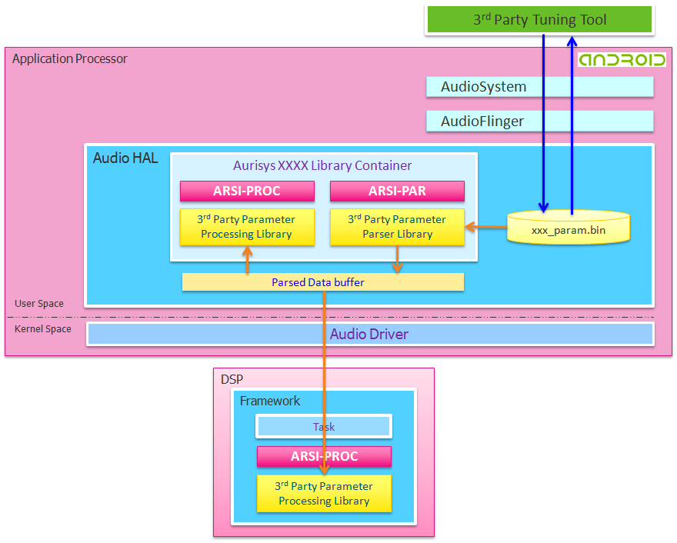
Parameter Management Function Block

Slide 12
Parameter Management Description
ARSI-PAR
  Overview
    ARSI-PAR defines API for parsing parameters. It provides programming interface to parse and transmit parameters between PC tool, APMCU, and DSP. Tuning and applying parameters by scenarios can also be achieved.
  Usage
    For a software IP, the parameters may be differ in different scenarios or situations. To ease of reference, The parameters are gathered into a file. To get the maximum flexibility of use, the format of the parameter file is defined by the 3rd Parties themselves. The ARSI-PAR is designed for parsing parameters for specified scenarios. It provides the interface to transfer parameter file to the 3rd party library.
    During parameters tuning, the PC tool updates the parameter file to the mobile device and then the parameter files are parsed by the 3rd party parameter parsing library to get required parameters. The parameters will then be transferred to the 3rd party processing library for processing sounds. Besides, when the mode changes (for example, the output device changes from headphone to speaker), we need to extract the parameters of the specified mode and the parsing library will be called.

Slide 13
Parameter Management Tool Development
Tool Development
  Overview
    The connection between the PC tool and the mobile device is through USB and the communication is based on adb commands. We define a series of adb commands which include transmitting the whole parameter file to the device, receiving whole parameter file from the device, transmitting specific data to the device, and receiving specific data from the device. The software IP providers can design their own PC tools which can communicate with the mobile devices without making changes to the legacy code of the MTK platforms
  ADB Command Block
  Argument Table
Command | Comments
adb shell "AudioSetParam AURISYS_SET_PARAM,$target,$scene,$lib,$cmd $mode=SET” | Used to update parameter file and apply parameters to the library
adb shell “AudioSetParam AURISYS_GET_PARAM,$target,$scene,$lib,$cmd” | Used to query current parameter setting. Query the value of a specified address and query the whole parameter file are allowed.
Argument | Example | Comments
$target | DSP, HAL | The processing API maybe either in AP or in DSP
$scene | PHONE_CALL, PLAYBACK, RECORD | Specify a scenario, the information will be used as an argument of the parser function
$lib | library name | The library should be specified since there maybe several libraries added to the Aurisys
$mode | Enhancement mode | Enhancement mode. IP provider can provide different enhancement for user to select what they want. The mode should be an integer. Only used in APPLY_PARAM command
$cmd (for URISYS_SET_PARAM) | PARAM_FILE,param_path | set parameter file path
 | APPLY_PARAM | apply new param during playback/phone call/...
 | ADDR_VALUE,addr,value | set “value” at the “addr” in library
 | KEY_VALUE,key,value | set "value" of the "key" in library, “key” can be defined by the library itself
$cmd (for URISYS_GET_PARAM) | PARAM_FILE | return param_path
 | ADDR_VALUE,addr | return the value at the address “addr” in library
 | KEY_VALUE,key | return the value at the “key” in library

Slide 14
Parameter Management Tool Development cont’d
Example
  adb shell "AudioSetParam AURISYS_SET_PARAM,DSP,RECORD,MyLib,PARAM_FILE,/data/d.dat=SET“
    set parameter file path: /data/d.dat and establish the connection between MyLib and the parameter file
  adb shell "AudioSetParam AURISYS_SET_PARAM,DSP,PHONE_CALL,MyLib,APPLY_PARAM,2=SET“
    apply new parameters for record scenario, the enhancement mode is 2
  adb shell "AudioSetParam AURISYS_SET_PARAM,DSP,RECORD,MyLib,ADDR_VALUE,0x1234,0x5678=SET"
    set value 0x5678 at the address 0x1234 in MyLib
  adb shell "AudioSetParam AURISYS_SET_PARAM,DSP,RECORD,MyLib,KEY_VALUE,MyKey,MyVauel=SET“
    set value "MyValue" to the key "MyKey" in MyLib
  adb shell "AudioSetParam AURISYS_GET_PARAM,DSP,PHONE_CALL,MyLib,PARAM_FILE“
    return param_path of MyLib
  adb shell "AudioSetParam AURISYS_GET_PARAM,DSP,PHONE_CALL,MyLi,ADDR_VALUE,0x1234“
    return the value at the address 0x1234 in Mylib
  adb shell "AudioSetParam AURISYS_GET_PARAM,DSP,PHONE_CALL,MyLib,KEY_VALUE,MyKey“
    return the value of the key "MyKey" in Mylib

Slide 15
END

