Slide 1
GNU ARM Eclipse Guide
HY Chang

Slide 2
Outline
GNU ARM Eclipse IDE
Target board
IDE Install Step
New Project
  Import project
Environment Settings
Project Settings
Debug Settings
Run Project at Target
Appendix
  Makefile setting
  Semihosting
  Board Purchase Info

Slide 3
GNU ARM Eclipse
GNU ARM Eclipse plug-ins allow to create, build, debug and in general to manage ARM and AArch64 projects (executables and static/shared libraries, in both 32 and 64-bit versions) with the Eclipse framework.
  Latest to Eclipse 4.4 Luna.
  The plug-ins run on Windows, GNU/Linux and Mac OS X

Slide 4
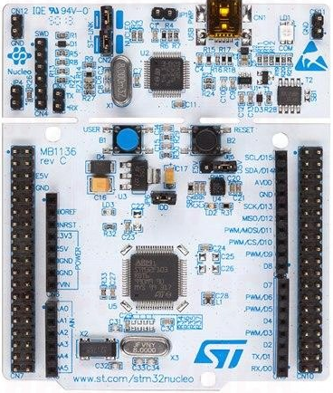
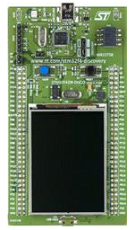
Target board
Target board:
  STM32F401RE
    512K Flash
    96K RAM
    84Mhz
Target board:
  STM32F429I-DISCO
    2M Flash
    256K RAM
    180Mhz
    8M external SDRAM

Slide 5
Target board
ST-Link USB Driver :
  STSW-LINK008 for Win vista & Win 7 & Win 8
    http://www.st.com/web/en/catalog/tools/PF260218
  STSW-LINK009 for Win XP
    http://www.st.com/web/catalog/tools/FM147/SC1887/PF260219

Slide 6
IDE Install Step
Download Eclipse CDT
  Need to Download Eclipse CDT First : Here
  Current Latest Version: Luna Service Release 2 (4.4.2)
Install Eclipse plug-ins
one or more cross build toolchain(s)
  Toolchain version: here
the optional build tools (make & rm) for Windows
  Build Tool: here
the debugging tools
  OpenOCD : here

Slide 7
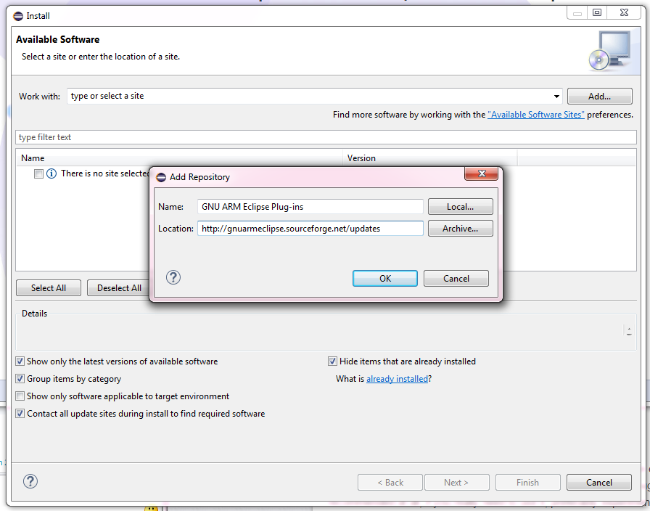
Install plug-in – Step1
(IDE navigation bar) Help→ Install New Software

Slide 8
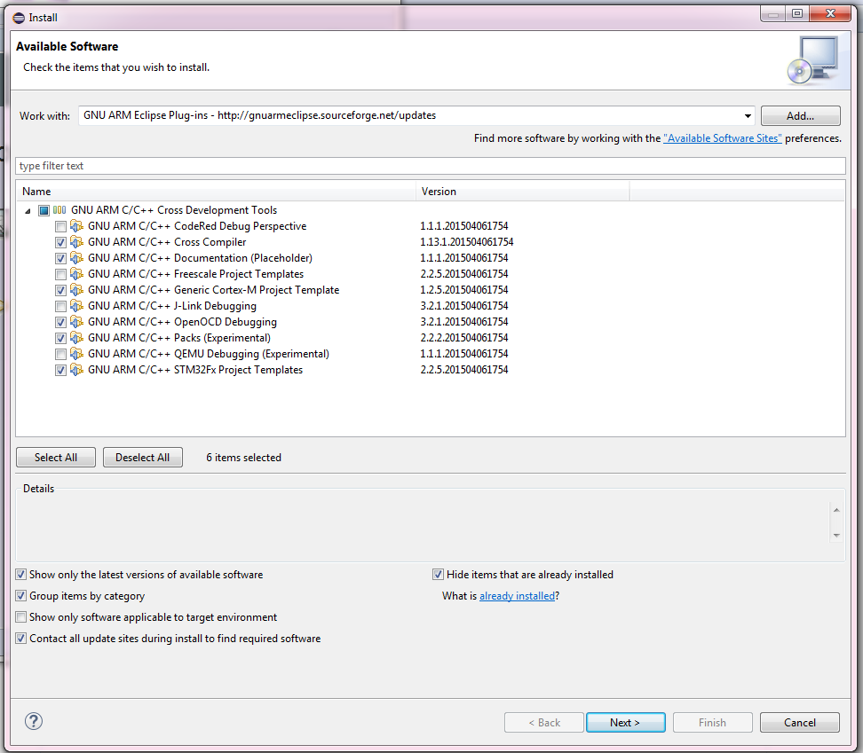
Install plug-in – Step2
Select necessary components

Slide 9
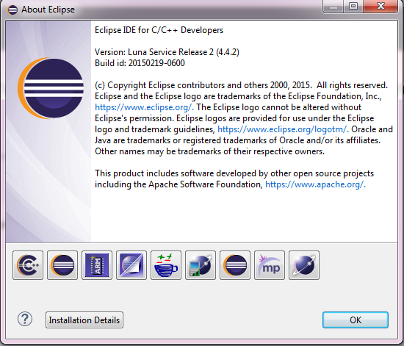
Install plug-in – Step3
After installing plug-in, you will see ARM plug-in icon
Help → About Eclipse

Slide 10
New Project
Project for stm32F401RE
  Use FreeRTOS_F401_122815 as the template project.
Project for stm32F429Discovery
  Use FreeRTOS_F429_122815 as the template project.
  Unachieved the file and import into your workspace

Slide 11
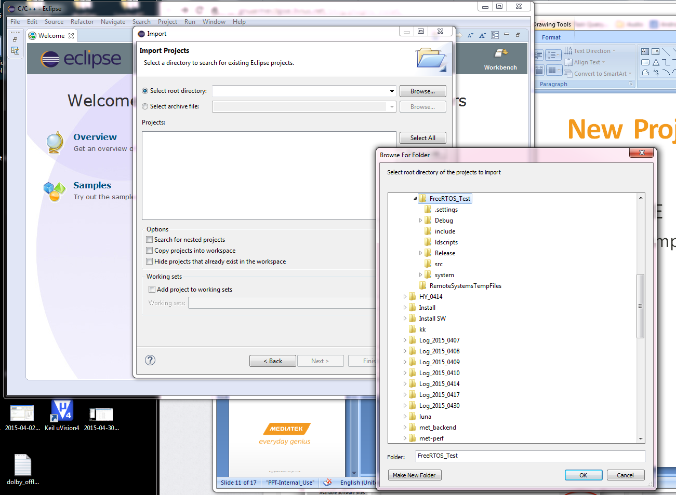
Import Project
File → Import →Select root directory→ select template

Slide 12
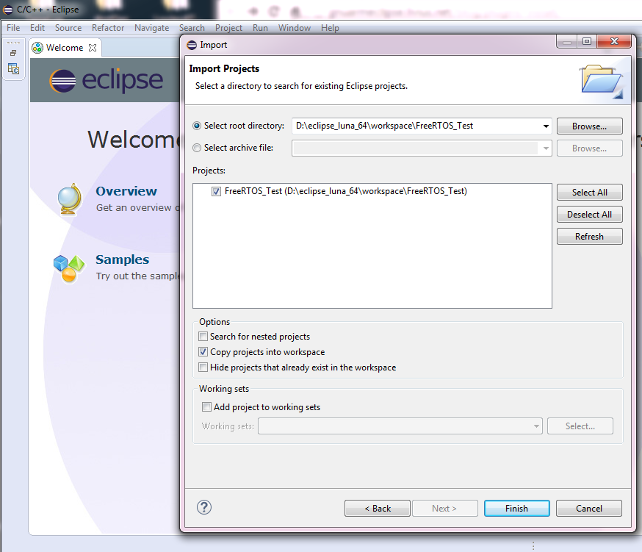
Import Project
Select Projects and copy into workspace

Slide 13
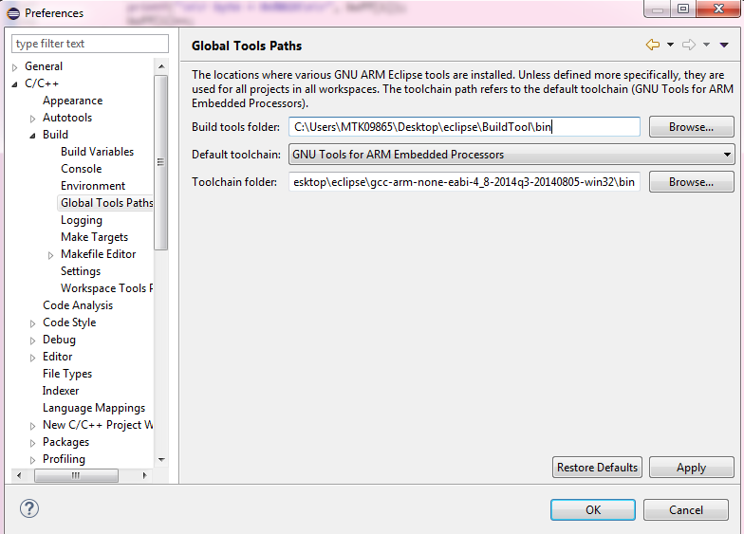
Environment Settings
Set Tool Chain & Build Tool Path
  Window → Preferences →C/C++ → Build → Global Tools Paths

Slide 14
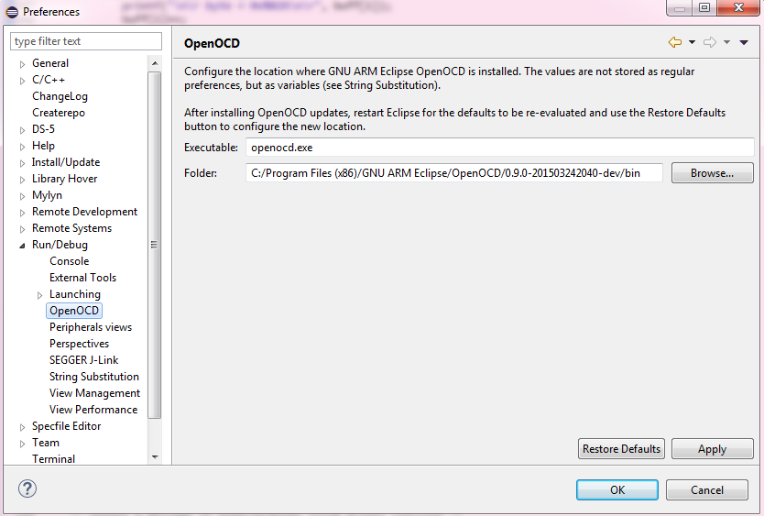
Environment Settings
Set OpenOCD Path
  Window → Preferences →Run/Debug→ OpenOCD

Slide 15
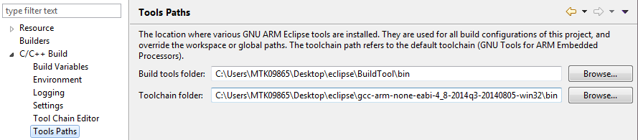
Project Settings – ToolCahin
Project → Properties→ C/C++ Build → Tools Path
  You can set in Window Preference global path or here by project

Slide 16
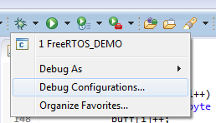
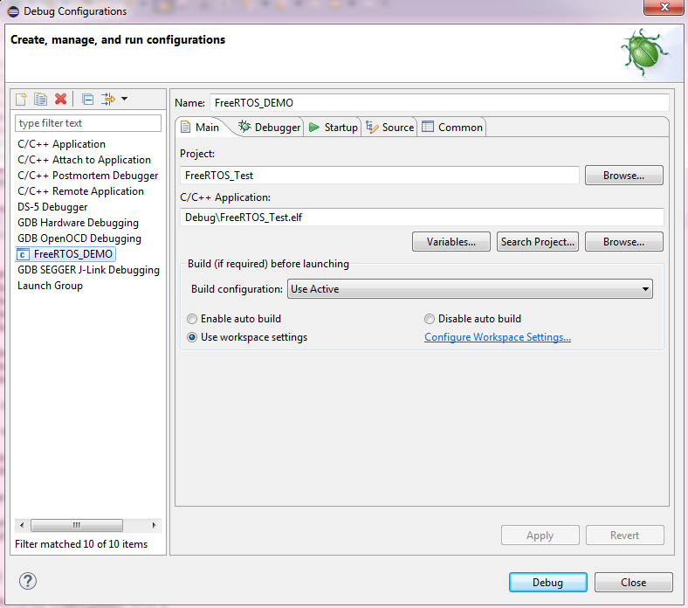
Debug Setting
Run→ Debug Configurations→ OpenOCD Debugging
Select your workspace project

Slide 17
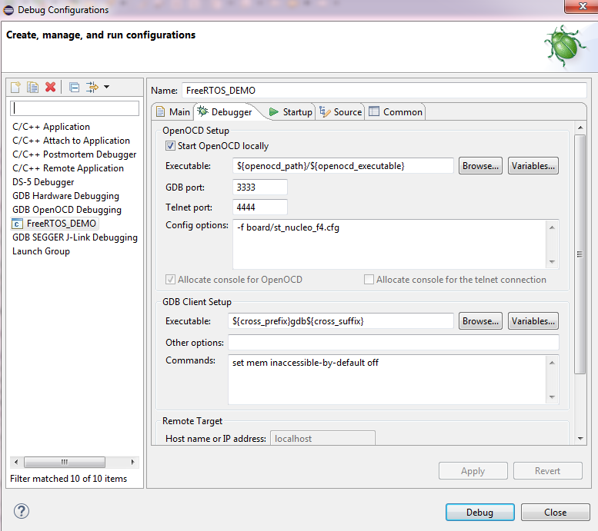
Debug Setting
Debugger Config options: set current openocd config board script
Project for stm32F401RE
  -f board/st_nucleo_f4.cfg
Project for stm32F429Disco
  -f board/stm32f429discovery.cfg

Slide 18

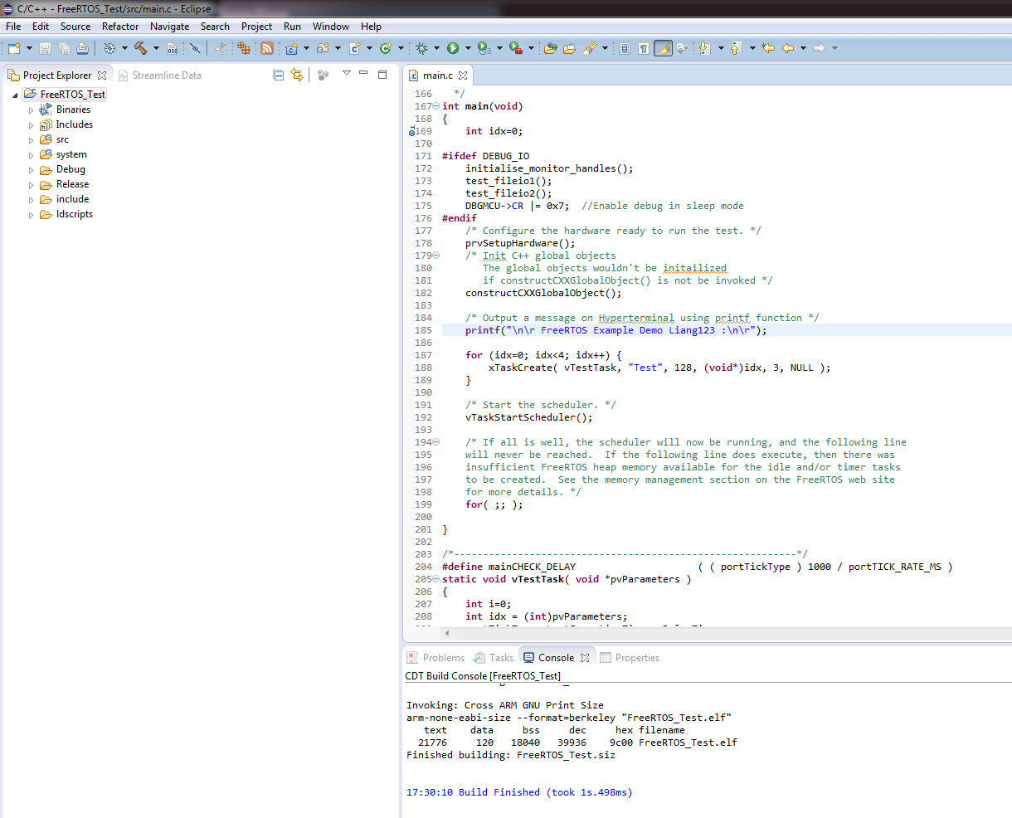
Build Project

Slide 19
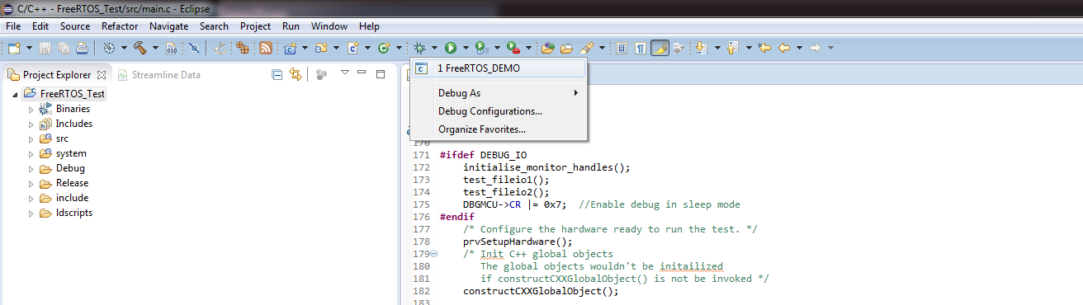
Run Project
Debug→ FreeRTOS_DEMO

Slide 20

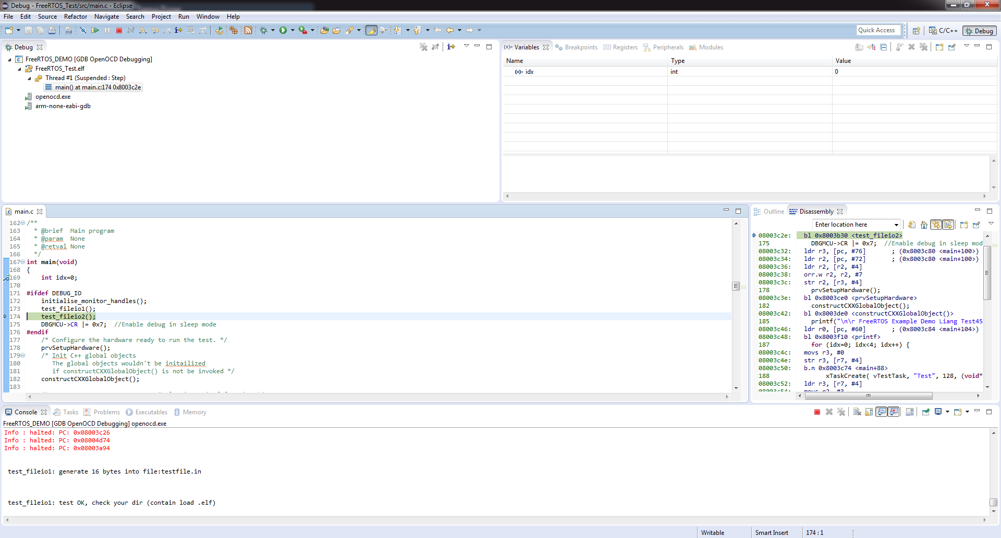
Run Project – Debug mode
1.Debug Actions
5.Switch View
2.Source code View
3.Disassembly View
4. Semihost printf message

Slide 21
Appendix

Slide 22
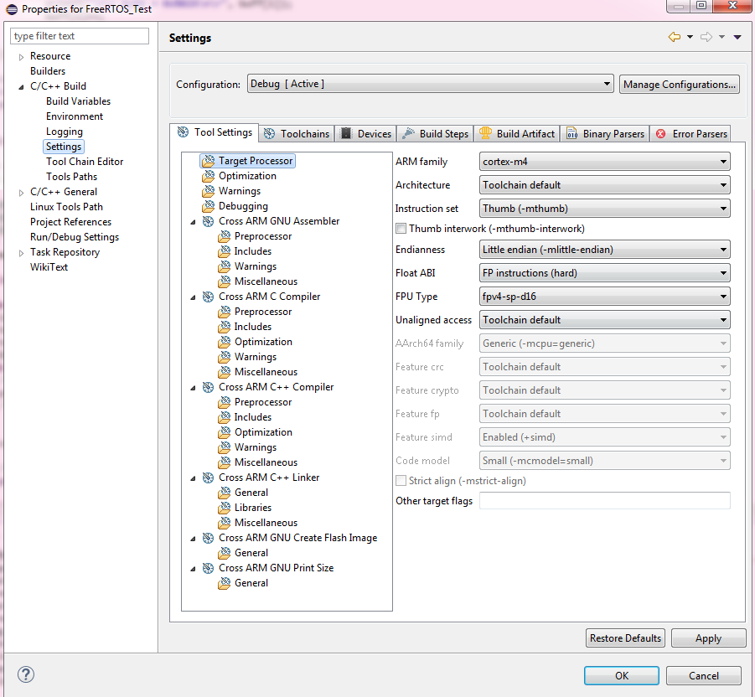
Project Settings - Makefile
Project → Properties → Settings
  Set Compiler flag
  Set Linker flag

Slide 23
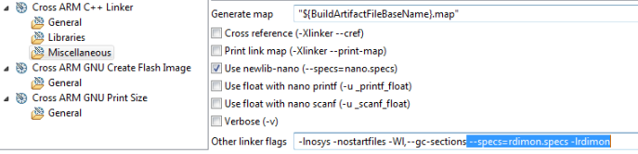
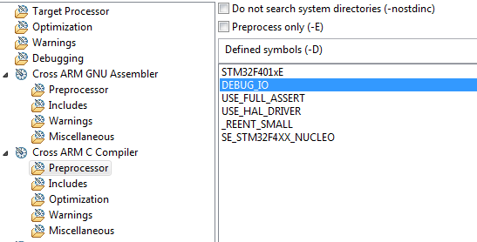
Project Settings – enable Semihosting
Print message in IDE console not in serial Uart port
ADD in Linker
  --specs=rdimon.specs –lrdimon
ADD in Compiler define
  DEBUG_IO

Slide 24
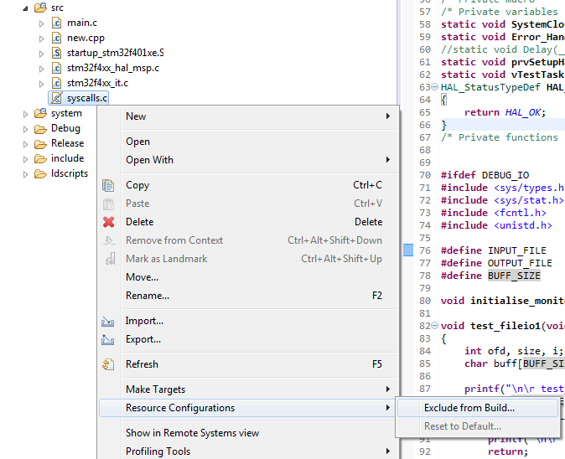
Project Settings – enable Semihosting print
Exclude syscalls.c from building, make printf avaliable in workspace.

Slide 25
Board Purchase Info
STMicroelectronics STM32F429I-DISCO
STMicroelectronics NUCLEO-F401RE

