Slide 1
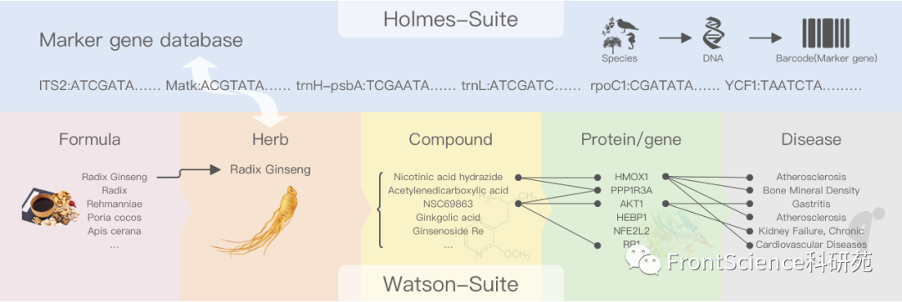
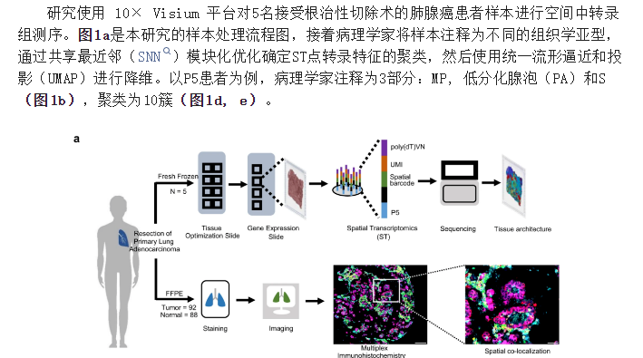
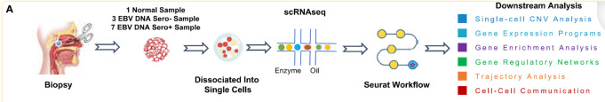
实验设计思路与示意图
https://bioicons.com/
Epstein-Barr virus DNA seropositivity links distinct tumoral heterogeneity and immune landscape in nasopharyngeal carcinoma

Slide 2
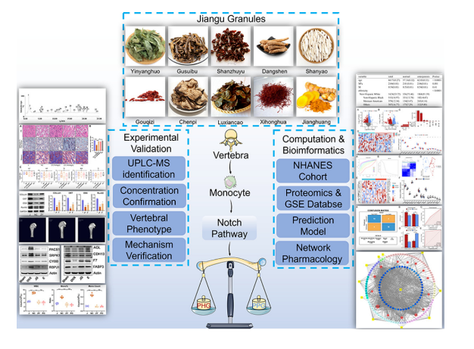
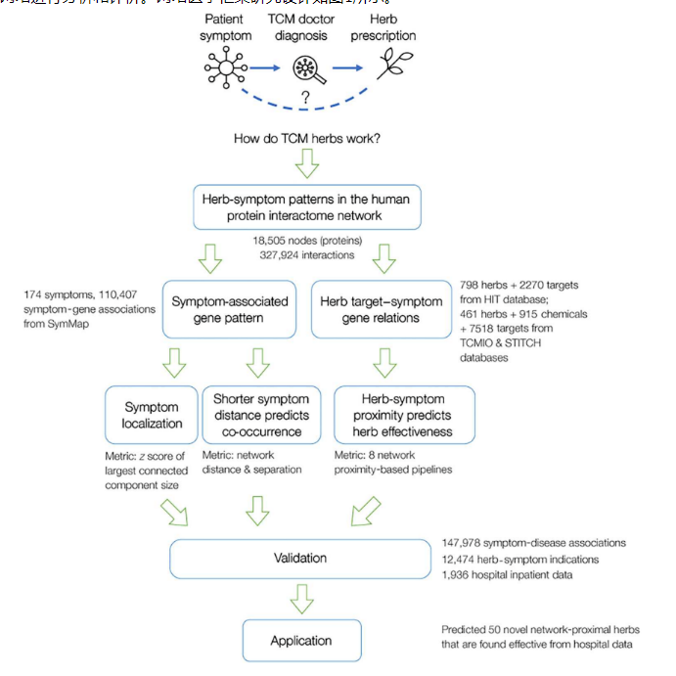
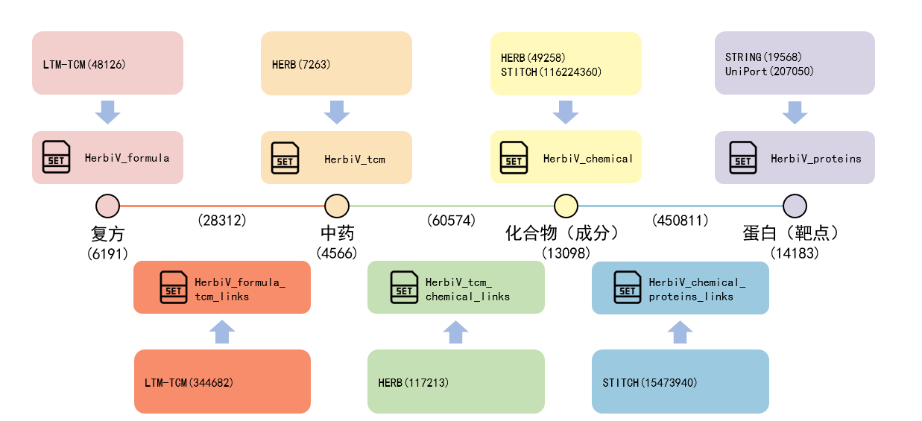

Slide 3
黄芪
中药
甘草
衰老
肿瘤预后

