Slide 1
Machine Learning Ⅱ
Deep Learning of Land Cover Classification with Pytorch
Qianwen Liu
Mark Bana
Thanh Nguyen

Slide 2
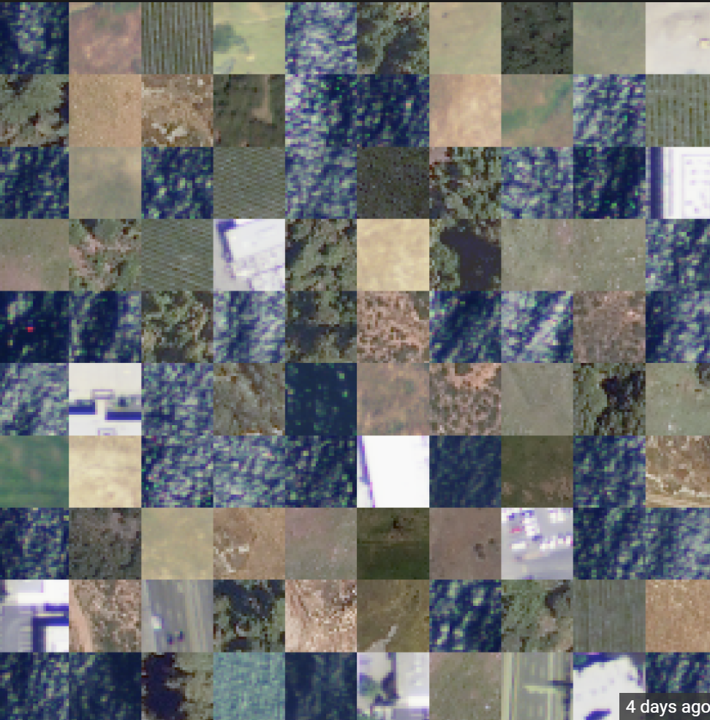
The Airborne Dataset
Our Dataset
Covering different landscapes like forests, water, mountains, etc;
Why Land Cover Classification?
For years scientists across the world have been mapping changes in the landscape to prevent future disasters, monitor natural resources, and collect information on the environment. When land covers change, our health, economy, and environment can all be affected.

Slide 3
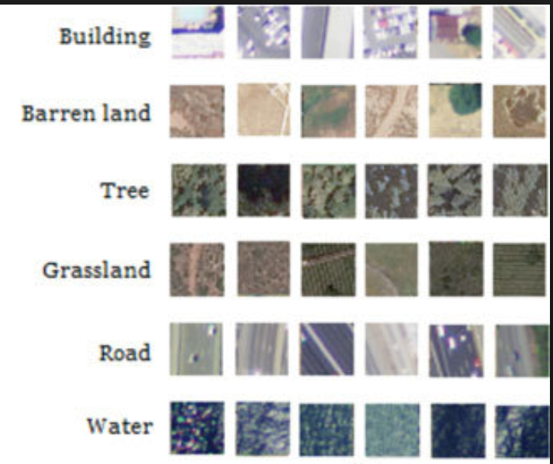
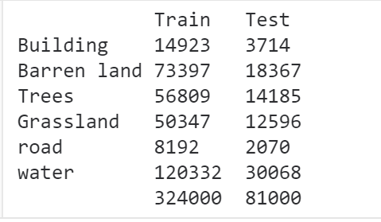
The Airborne Dataset
Size: 2.42 G
405,000 images
Training Set: 324,000
Testing Set: 81,000
Image size: 28 X 28 X 4
6 Classes

Slide 4

Project Overview
- Data Validation - Implemente Network - Vary Parameters - Performance Metrics

Slide 5

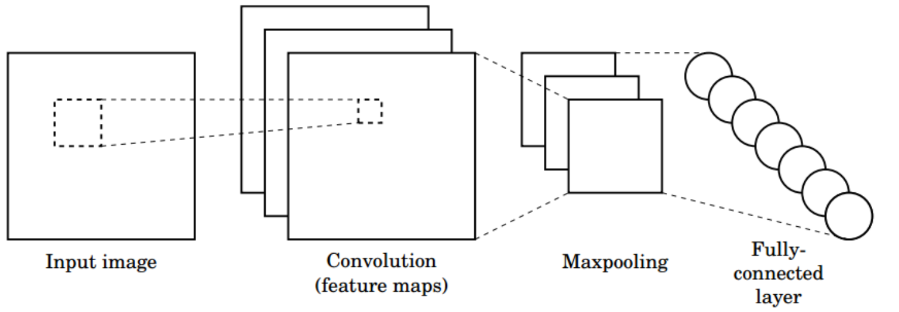
Project Overview -
Implementation of Convolution NN with Pytorch

Slide 6
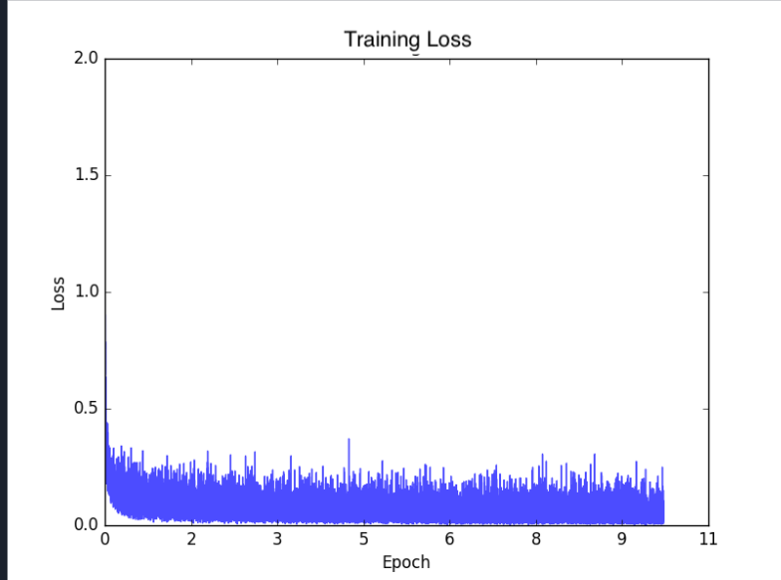
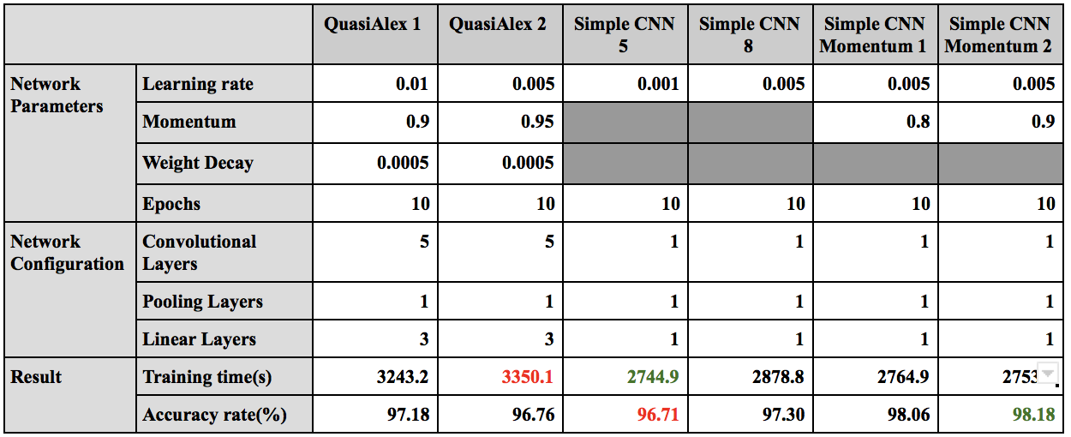
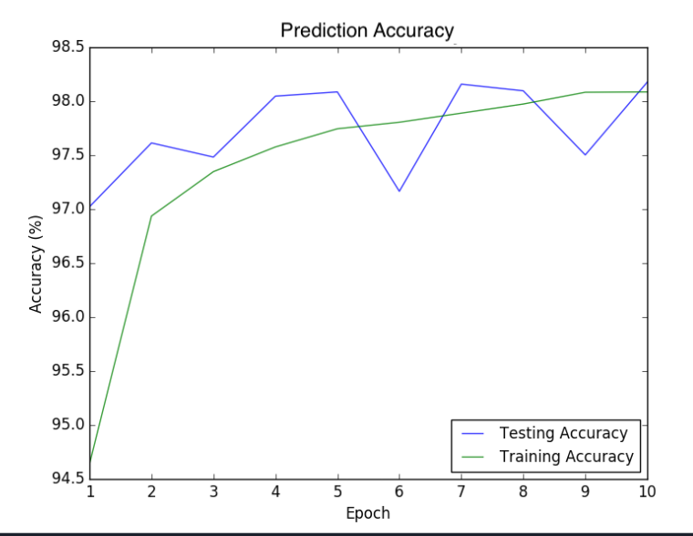
Project Overview -
Network Configurations and Parameters

Slide 7
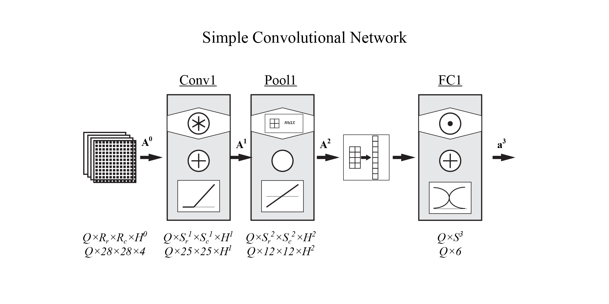
Network Architecture
Simple Configuration

Slide 8
Network Architecture
Simple Configuration
Convolution kernel size: 4 x 4
H¹ = 4, 8, 16, 32
Pooling layer kernel size: 3 x 3, stride 2

Slide 9
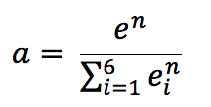
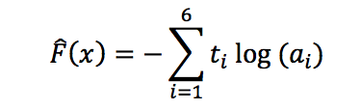
Training Algorithm
Output layer, softmax transfer function:
Loss function, cross-entropy:
Optimization method: Gradient Descent with mini-batches
Batch sizes 10, 100, 1000
Included momentum on some trials

Slide 10
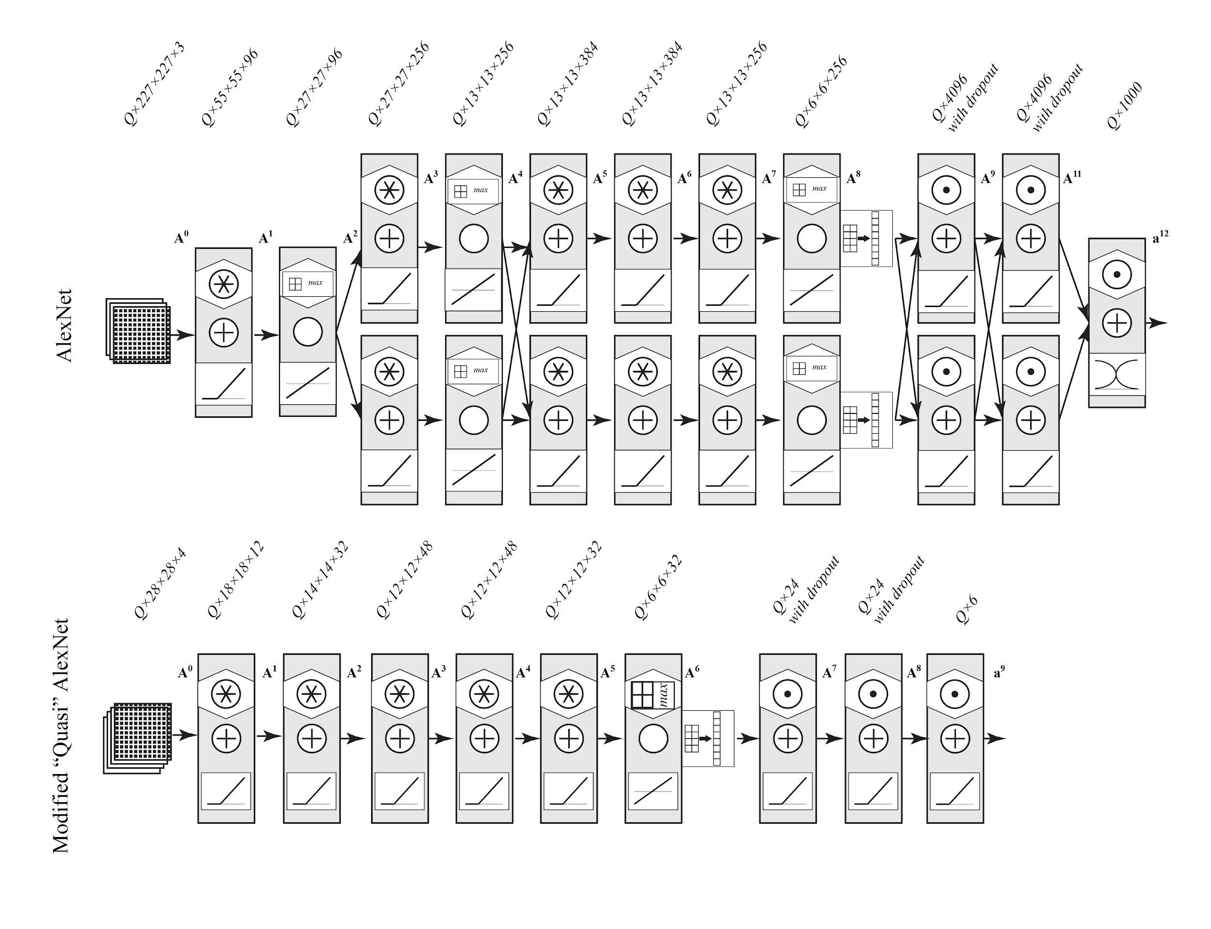
Network Architecture
Complex Configuration

Slide 11
Experiment Setup
Data Collection
Kaggle API
Data Integrity
Number of entries
No null values
0-255 for X and 0/1 for Y
Shuffle data to avoid single label for a mini batch
Network Implementation
Extensive documentation and flexibility
Pytorch Module and cuda
Mini-batches optimization
Parameter Update
Subset testing
Performance Evaluation
Over fitting
Accuracy rates vs Training time

Slide 12
Result

Slide 13
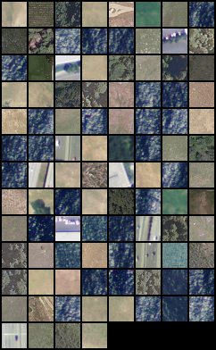
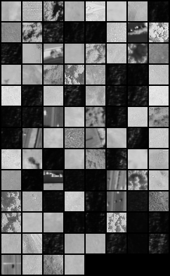
Result

Slide 14
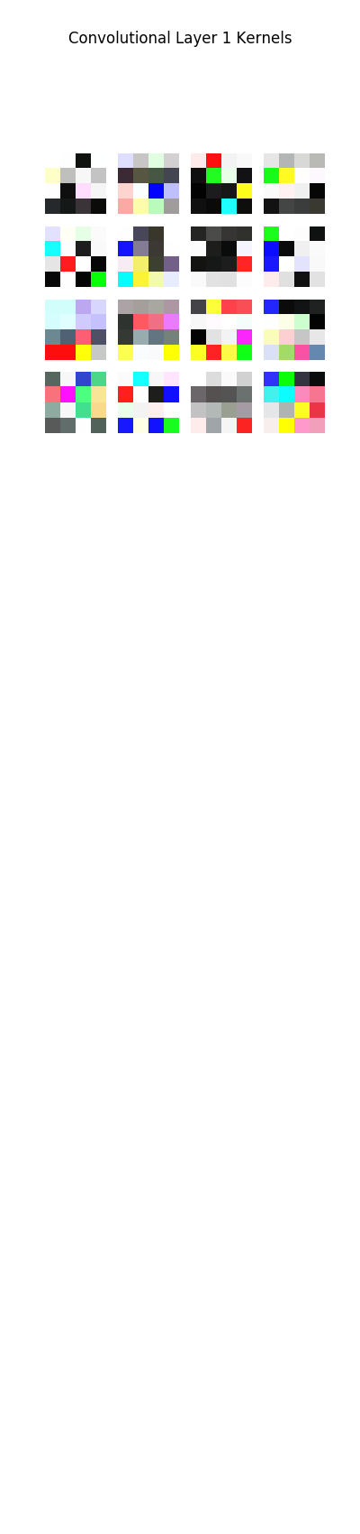
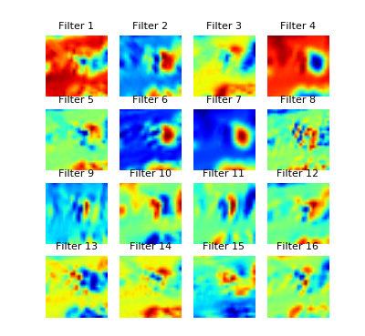
Result

Slide 15
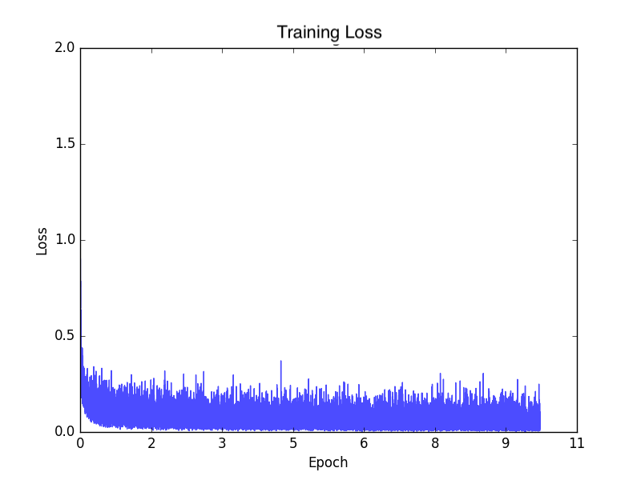
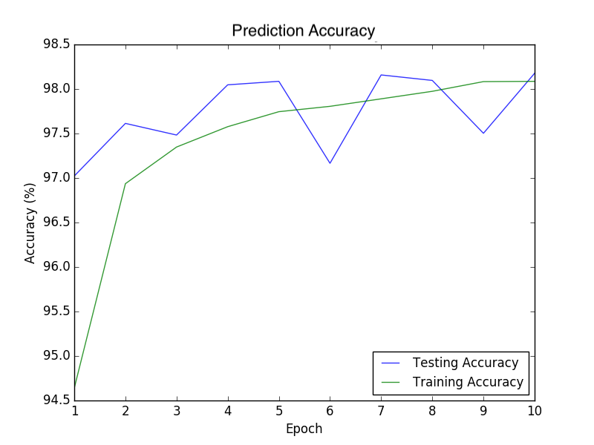
Result
Average loss: 0.06
Accuracy rate: 98.18%

Slide 16
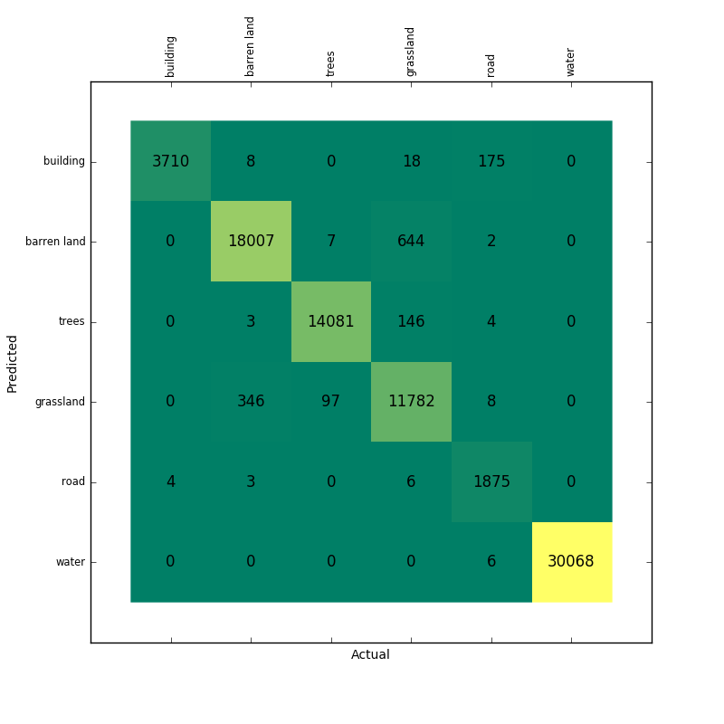
Result
Water: 100%
Building: 99.89%
Trees: 99.27%
Barren land: 98.03%
Grassland: 93.53%
Road: 90.58%

Slide 17
Recommendations
1. Dirty data? Overlapping, sub-class?
2. Large images?
3. To reduce the bias in the confusion matrix, we can try tuning the decision boundaries in a proper way in certain classes.
4. Train RGB and INR separately?

Slide 18
Q & A

