Slide 1
The Relational Model
Chapter 3
Notes:
1
The slides for this text are organized into chapters. This lecture covers Chapter 3.
Chapter 1: Introduction to Database Systems
Chapter 2: The Entity-Relationship Model
Chapter 3: The Relational Model
Chapter 4 (Part A): Relational Algebra
Chapter 4 (Part B): Relational Calculus
Chapter 5: SQL: Queries, Programming, Triggers
Chapter 6: Query-by-Example (QBE)
Chapter 7: Storing Data: Disks and Files
Chapter 8: File Organizations and Indexing
Chapter 9: Tree-Structured Indexing
Chapter 10: Hash-Based Indexing
Chapter 11: External Sorting
Chapter 12 (Part A): Evaluation of Relational Operators
Chapter 12 (Part B): Evaluation of Relational Operators: Other Techniques
Chapter 13: Introduction to Query Optimization
Chapter 14: A Typical Relational Optimizer
Chapter 15: Schema Refinement and Normal Forms
Chapter 16 (Part A): Physical Database Design
Chapter 16 (Part B): Database Tuning
Chapter 17: Security
Chapter 18: Transaction Management Overview
Chapter 19: Concurrency Control
Chapter 20: Crash Recovery
Chapter 21: Parallel and Distributed Databases
Chapter 22: Internet Databases
Chapter 23: Decision Support
Chapter 24: Data Mining
Chapter 25: Object-Database Systems
Chapter 26: Spatial Data Management
Chapter 27: Deductive Databases
Chapter 28: Additional Topics

Slide 2
The Relational Model

Slide 3
Relational Database: Definitions
Relational database: a set of relations
Relation = Instance + Schema
  Instance : a table, with rows and columns.
  #Rows = cardinality, #fields = degree or arity.
  Schema : specifies name of relation, plus name and type of each column.
    e.g., Students(sid: string, name: string, login: string, age: integer, gpa: real).
Can think of a relation as a set of rows or tuples (all rows are distinct).
Notes:
3

Slide 4
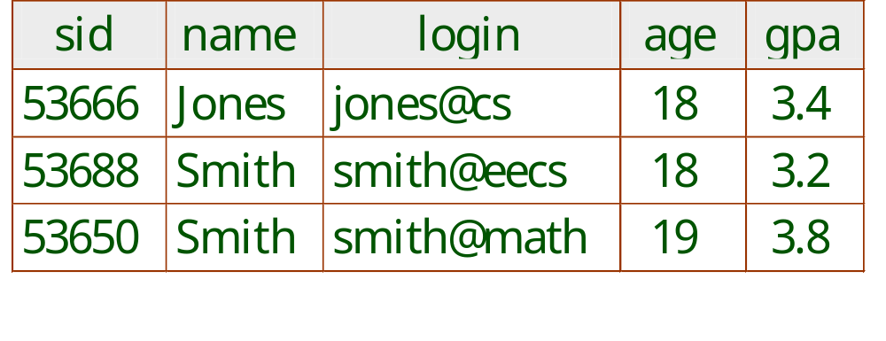
Example Instance of Students Relation
Cardinality = 3, degree = 5, all rows distinct
Do all columns in a relation instance have to
be distinct?
Notes:
4
Columns viewed as list of values. No, can be the same.
See mondial-abh.pdf

Slide 5
Quick Question
How many distinct tuples are in a relation instance with cardinality 22?

Slide 6
Relational Query Languages
The relational model supports simple, powerful querying of data.
Queries can be written intuitively, and the DBMS is responsible for efficient evaluation.
  The key: precise semantics for relational queries.
  Allows the optimizer to extensively re-order operations.
Notes:
9
And still ensure that the answer does not change

Slide 7
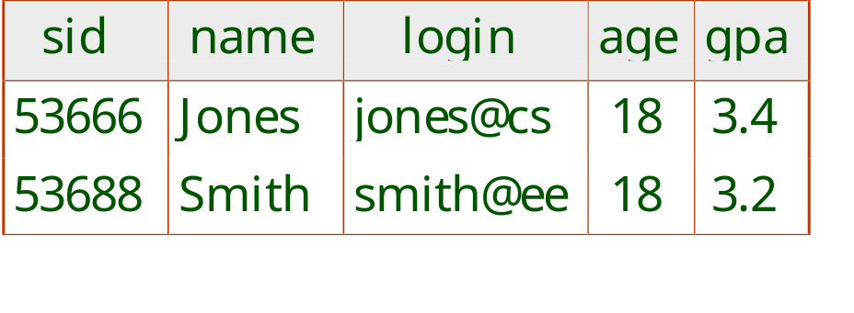
The SQL Query Language: Preview
To find all 18 year old students, we can write:
SELECT *
FROM Students S
WHERE S.age=18
To find just names and logins, replace the first line:
SELECT S.name, S.login
Notes:
Set up in access

Slide 8
Exercise
Modify this query so that only the login column is included in the answer.
If the clause WHERE S.gpa >= 3.3 is added to the original query, what is the set of tuples in the answer?
What if the clause WHERE S.gpa > Jones is added?
SELECT *
FROM Students S
WHERE S.age=18
Answer 1: Select S.login.
Answer 2: you can write WHERE c AND c’
Answer 3: comparison fails, so get empty set
Set up in access
Notes:
Answer 1: Select S.login.
Answer 2: you can write WHERE c AND c’
Answer 3: comparison fails, so get empty set
Set up in access

Slide 9
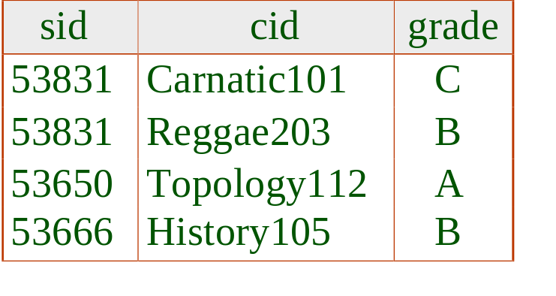
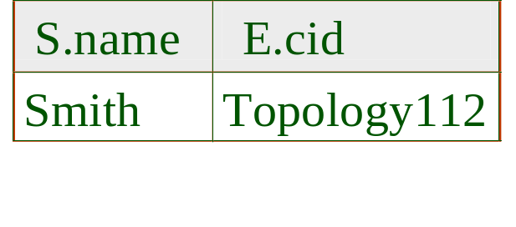
Querying Multiple Relations
What does the following query compute?
SELECT S.name, E.cid
FROM Students S, Enrolled E
WHERE S.sid=E.sid AND E.grade=“A”
Given the following instance of Enrolled:
we get:
Notes:
Skip in Harbour Centre.
Conceptually, this is selecting from the cross-product of the two relations. Set up in SQL Server.

Slide 10
Data Description:
Creating Tables in SQL

Slide 11
Creating Relations in SQL
Creates the Students relation.
  The type (domain) of each field is specified.
  Enforced by the DBMS.
CREATE TABLE Students
(sid CHAR(20),
name CHAR(20),
login CHAR(10),
age INTEGER,
gpa REAL)
CREATE TABLE Enrolled
(sid CHAR(20),
cid CHAR(20),
grade CHAR(2))
The Enrolled table holds information about courses that students take.
Notes:
15
Both entities and relations are represented by tables! Set up in mysql 354demo. Illustrate enforcement of integrity constraints.

Slide 12
Destroying and Altering Relations
DROP TABLE Students
Destroys the relation Students. The schema information and the tuples are deleted.
ALTER TABLE Students ADD COLUMN firstYear integer
The schema of Students is altered by adding a new field.
Notes:
16
Show in SQL Server.
create table Students2 like Students
every tuple in the current instance is extended with a null value in the new field.

Slide 13
Adding and Deleting Tuples
Can insert a single tuple using:
INSERT INTO Students (sid, name, login, age, gpa)
VALUES (53688, ‘Smith’, ‘smith@ee’, 18, 3.2)
Can delete all tuples satisfying some condition (e.g., name = Smith):
DELETE
FROM Students S
WHERE S.name = ‘Smith’
Notes:
10
It’s good style but not necessary to include column names in Insert command. Show in SQL Server.

Slide 14
Data Description
Specifying Constraints in SQL

Slide 15
Integrity Constraints (ICs)
IC: condition that must be true for any instance of the database; e.g., domain constraints.
  ICs are specified when schema is defined.
  ICs are checked when relations are modified.
A legal instance of a relation is one that satisfies all specified ICs.
  DBMS should not allow illegal instances.
ICs make stored data more faithful to real-world meaning.
Avoids data entry errors.
Notes:
5

Slide 16
Candidate Keys
A set of fields is a superkey for a relation if : No two distinct tuples can have same values in all key fields.
Candidate key = minimal superkey =
no subset of fields is a superkey.
Examples.
  sid is a candidate key for Students. (What about name?)
  The set {sid, gpa} is a superkey but not a candidate key.
Notes:
6
The need for a primary key is why everbody gets a student ID, SIN, etc.
Key is Ambiguous between “superkey”, “candidate key”, chosen primary key, search key.
Set of fields is important for indexing too.

Slide 17
Primary Keys in SQL
Possibly many candidate keys (specified using UNIQUE), one of which is chosen as the primary key.
“For a given student and course, there is a single grade.” vs. “Students can take only one course, and receive a single grade for that course; further, no two students in a course receive the same grade.”
What does the Unique constraint do? Is this a good idea?
CREATE TABLE Enrolled
(sid CHAR(20),
cid CHAR(20),
grade CHAR(2),
PRIMARY KEY (sid,cid) )
CREATE TABLE Enrolled
(sid CHAR(20)
cid CHAR(20),
grade CHAR(2),
PRIMARY KEY (sid),
UNIQUE (cid, grade) )
Notes:
6
Default value is some “existing” student (e.g., “Burnaby Mountain” for SFU campus)
Can’t set sid in Enrolled to “null” if sid is part of primary key of Enrolled.
Illustrate in SQL Server.
INSERT INTO
354demo.Enrolled (sid, cid, grade)
VALUES (2000, null, D) vs.
vs. correct
INSERT INTO
354demo.Enrolled (sid, cid, grade)
VALUES (2000, 355, D)
vs.
INSERT INTO
354demo.Enrolled (sid, cid, grade)
VALUES (2000, 355, null)
% change to 360 for primary key

Slide 18
Exercise
Give an example of an attribute (or set of attributes) that you can deduce is not a candidate key, if this instance is legal.
Is there any example of an attribute (or set of attributes) that you can deduce is a candidate key?
Does every relational schema have some candidate key?

Slide 19
Foreign Keys

Slide 20
Multiple Choice Question on Foreign Keys
Suppose we try to delete a record that has a foreign key constraint defined on it. (There is another record pointing to it.) The effect of the foreign key constraint is to
reject the deletion.
propagate/cascade the deletion to linked records.
use a NULL value
take action as specified by the database designer.
Notes:
answer: a)

Slide 21
Foreign Keys and Referential Integrity
Foreign key : Set of fields in one relation that is used to refer to a tuple in another relation.
Must correspond to primary key of the second relation.
Like a pointer.
E.g. sid is a foreign key referring to Students:
  Enrolled(sid: string, cid: string, grade: string)
  If all foreign key constraints are enforced, referential integrity is achieved, i.e., no dangling references.
Notes:
7
Can you name a data model w/o referential integrity?
Links in HTML!

Slide 22
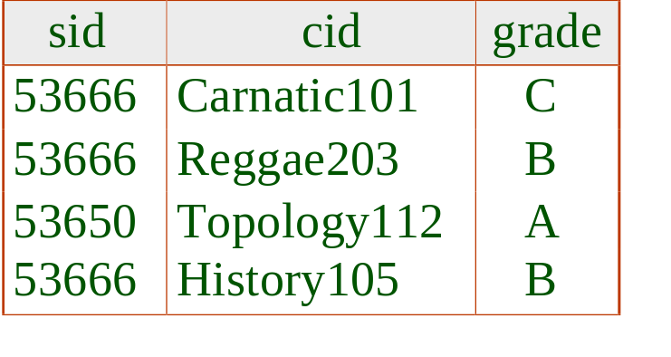
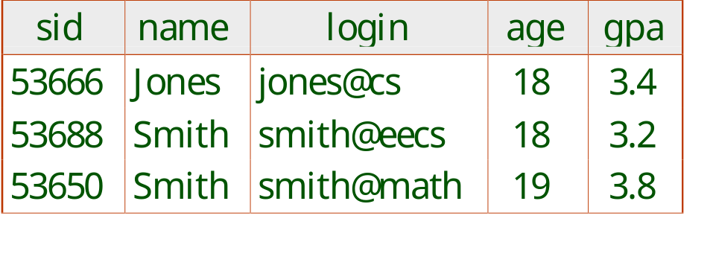
Foreign Keys in SQL
Only students listed in the Students relation should be allowed to enroll for courses.
CREATE TABLE Enrolled
(sid CHAR(20), cid CHAR(20), grade CHAR(2),
PRIMARY KEY (sid,cid),
FOREIGN KEY (sid) REFERENCES Students )
Enrolled
Students
Notes:
7
Illustrate in SQL Server

Slide 23
Enforcing Referential Integrity
sid in Enrolled is a foreign key that references Students.
What should be done if an Enrolled tuple with a non-existent student id is inserted?
What should be done if a Students tuple is deleted, e.g. sid = 53666?
  Delete all Enrolled tuples that refer to 53666.
  Disallow deletion 53666.
  Set sid in Enrolled tuples that refer to 53666 to a default sid.
  Set sid in Enrolled tuples that refer to it to a special value null, denoting `unknown’ or `inapplicable’.
Notes:
13
Reject it. The DBMS will do this.
Can I right-click in SQL server to get a foreign key constraint?
Similar if primary key of Students tuple is updated.

Slide 24
Referential Integrity in SQL
SQL/92 and SQL:1999 support all 4 options on deletes and updates.
  Default is NO ACTION (delete/update is rejected)
  CASCADE (also delete all tuples that refer to deleted tuple)
  SET NULL / SET DEFAULT (sets foreign key value of referencing tuple)
CREATE TABLE Enrolled
(sid CHAR(20),
cid CHAR(20),
grade CHAR(2),
PRIMARY KEY (sid,cid),
FOREIGN KEY (sid)
REFERENCES Students
ON DELETE CASCADE
ON UPDATE SET DEFAULT )
Notes:
14
Illustrate in SQL Server (perhaps only the “on delete” part)
no action is usually deferred
restrict is usually immediate

Slide 25
Primary and Foreign Keys
A foreign key must point to a primary key.
In logic, we can introduce names to denote entities.
In object-oriented models, we can have object IDs.
In the relational model, primary keys play the role of names of entities.
Base tables define names for entities.
  E.g. student ids in Students.
Foreign keys point to names defined by other tables.

Slide 26
Where do ICs Come From?
ICs are based upon the semantics of the real-world enterprise that is being described in the database relations.
We can check a database instance to see if an IC is violated, but we can NEVER infer that an IC is true by looking at an instance.
  An IC is a statement about all possible instances!
  For example, we know name is not a key, but the assertion that sid is a key is given to us.
Key and foreign key ICs are the most common; more general ICs supported too.

Slide 27
Translate ER Diagrams to SQL

Slide 28
Problem Solving Steps
Understand the business rules/requirements
Draw the ER diagram
Write the SQL and create the database

Slide 29
Basic Translation Method
Introduce one table for each entity set.
  key attribute -> primary key.
Introduce one table for each relationship.
  if no key constraints: key attributes of related entity sets -> primary key (multi-column).
  if key constraints: key attribute of entity set with key constraint -> primary key (single-column).

Slide 30
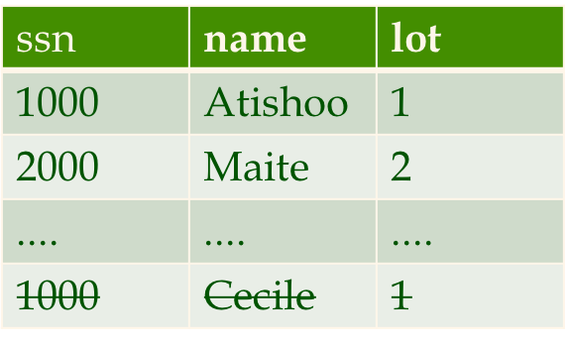
Logical DB Design: ER to Relational
Entity sets to tables:
CREATE TABLE Employees
(ssn CHAR(11),
name CHAR(20),
lot INTEGER,
PRIMARY KEY (ssn))
name
ssn
lot
Employees
Notes:
3

Slide 31
Review: The Works_In Relation
since
since
name
name
dname
dname
ssn
did
did
budget
lot
budget
Employees
Manages
Departments
Works_In
since
Exercise:
Write a create statement for the Departments entity set.
Write a create statement for the Works_In relation.
Don’t worry too much about the exact syntax. It’s enough for now just to have an approach. E.g, how many columns do you need? What kind of columns?
Notes:
8
maybe show premier league example

Slide 32
Relationship Sets to Tables
In translating a relationship set to a relation, attributes of the relation must include:
  Keys for each participating entity set (as foreign keys).
    This set of attributes forms a superkey for the relation.
  All descriptive attributes.
CREATE TABLE Works_In(
ssn CHAR(11),
did INTEGER,
since DATE,
PRIMARY KEY (ssn, did),
FOREIGN KEY (ssn)
REFERENCES Employees,
FOREIGN KEY (did)
REFERENCES Departments)
Notes:
5
You can have a relationship without attributes, e.g. no since column.

Slide 33
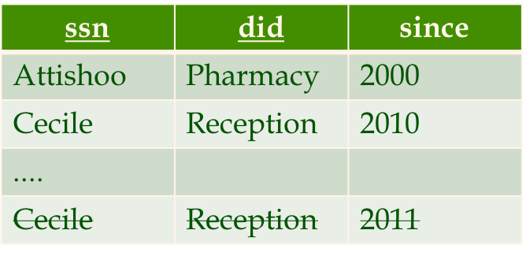
Example Instance
CREATE TABLE Works_In(
ssn CHAR(11),
did INTEGER,
since DATE,
PRIMARY KEY (ssn, did),
FOREIGN KEY (ssn)
REFERENCES Employees,
FOREIGN KEY (did)
REFERENCES Departments)

Slide 34
Key Constraints
Translating ER Diagram Constraints

Slide 35
Key Constraints
since
Each dept has at most one manager, according to the key constraint on Manages.
name
dname
ssn
lot
did
budget
Employees
Manages
Departments
Translation to
relational model?
1-to-1
1-to Many
Many-to-1
Many-to-Many
Notes:
6
make examples. Why do foreign keys not work?

Slide 36
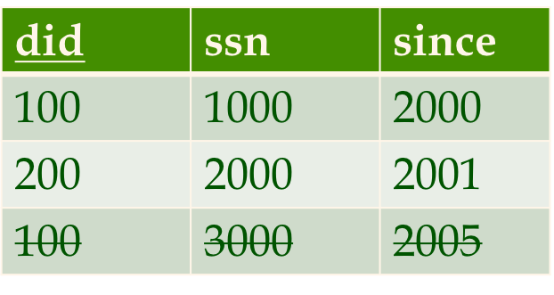
Translating ER Diagrams: Option 1
CREATE TABLE Manages(
ssn CHAR(11),
did INTEGER,
since DATE,
PRIMARY KEY (did), /*not (did,ssn)
FOREIGN KEY (ssn) REFERENCES Employees,
FOREIGN KEY (did) REFERENCES Departments)
Map relationship to a table with just one primary key field.
Manages
Departments
did | dname | budget
100 | CS | 1M
200 | Biology | 10M
300 | Engineering | 100M
Notes:
7
Department manager contains information in both departments and manages
Pro: eliminates relation (the Departments table)
Con: wastes space if not all departments have managers
Set up and illustrate in SQL Server.

Slide 37
Translating ER Diagram: Option 2
Sometimes a good idea to combine Manages and Departments.
CREATE TABLE Dept_Mgr(
did INTEGER,
dname CHAR(20),
budget REAL,
ssn CHAR(11),
since DATE,
PRIMARY KEY (did),
FOREIGN KEY (ssn) REFERENCES Employees)
Dept_Mgr
did | dname | budget | ssn | since
100 | CS | 1M | 1000 | 2000
200 | Biology | 10M | 2000 | 2001
300 | Engineering | 100M | 1000 | 2006
400 | Philosophy | 10M | null | 1999
Notes:
7
Department manager contains information in both departments and manages
Pro: eliminates relation (the Departments table)
Con: wastes space if not all departments have managers
Set up and illustrate in SQL Server.

Slide 38
Participation Constraints
Translating ER Diagram Constraints

Slide 39
Participation Constraints
CREATE TABLE Works_In(
ssn CHAR(11),
did INTEGER,
since DATE,
PRIMARY KEY (ssn, did),
FOREIGN KEY (ssn)
REFERENCES Employees,
FOREIGN KEY (did)
REFERENCES Departments)
Every department must have some employee.
Each employee must work in some department.
Can we capture these constraints?
name
name
dname
dname
ssn
since
did
did
budget
lot
budget
Employees
Departments
Works_In
Notes:
5
Answer: no.
Another example: every premier league player must play for some team.

Slide 40
Relationship Sets to Tables
In translating a relationship set to a relation, attributes of the relation must include:
  Keys for each participating entity set (as foreign keys).
    This set of attributes forms a superkey for the relation.
  All descriptive attributes.
CREATE TABLE Works_In(
ssn CHAR(11),
did INTEGER,
since DATE,
PRIMARY KEY (ssn, did),
FOREIGN KEY (ssn)
REFERENCES Employees,
FOREIGN KEY (did)
REFERENCES Departments)
Notes:
5
You can have a relationship without attributes, e.g. no since column.

Slide 41
Participation Constraint + Key Constraint
Translating ER Diagram Constraints

Slide 42
Key Constraints
since
name
dname
ssn
lot
did
budget
Employees
Manages
Departments
Notes:
6
make examples. Why do foreign keys not work?

Slide 43
Participation Constraint + Key Constraint
CREATE TABLE Dept_Mgr(
did INTEGER,
dname CHAR(20),
budget REAL,
ssn CHAR(11),
since DATE,
PRIMARY KEY (did),
FOREIGN KEY (ssn) REFERENCES Employees)
since
since
name
name
dname
dname
ssn
did
did
budget
lot
budget
Employees
Manages
Departments
We can capture participation + key constraints involving one entity set in a binary relationship.
But little else (with what we have so far).
CREATE TABLE Dept_Mgr(
did INTEGER,
dname CHAR(20),
budget REAL,
ssn CHAR(11) NOT NULL,
since DATE,
PRIMARY KEY (did),
FOREIGN KEY (ssn) REFERENCES Employees
ON DELETE NO ACTION) <- 这个可有可无，默认就是这个
Notes:
8

Slide 44
Translating ER Diagram: Option 2
Sometimes a good idea to combine Manages and Departments.
CREATE TABLE Dept_Mgr(
did INTEGER,
dname CHAR(20),
budget REAL,
ssn CHAR(11),
since DATE,
PRIMARY KEY (did),
FOREIGN KEY (ssn) REFERENCES Employees)
Dept_Mgr
did | dname | budget | ssn | since
100 | CS | 1M | 1000 | 2000
200 | Biology | 10M | 2000 | 2001
300 | Engineering | 100M | 1000 | 2006
400 | Philosophy | 10M | null | 1999
Notes:
7
Department manager contains information in both departments and manages
Pro: eliminates relation (the Departments table)
Con: wastes space if not all departments have managers
Set up and illustrate in SQL Server.

Slide 45
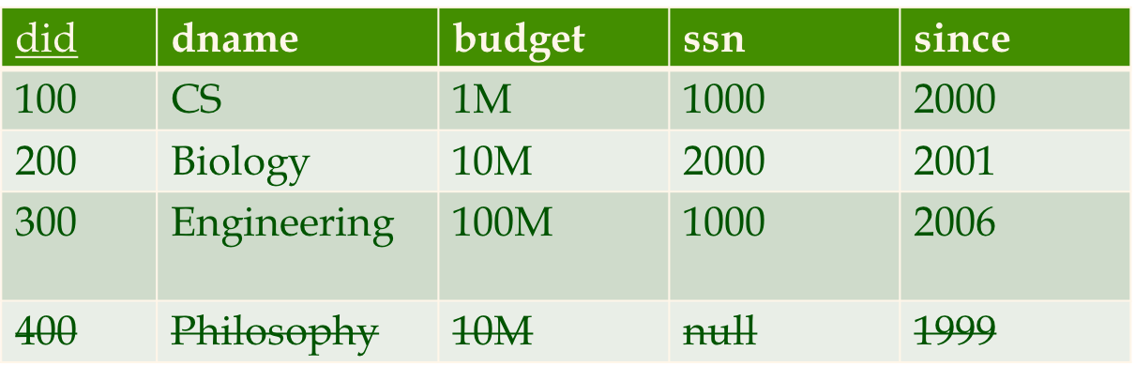
Example Instance
CREATE TABLE Dept_Mgr(
did INTEGER,
dname CHAR(20),
budget REAL,
ssn CHAR(11) NOT NULL,
since DATE,
PRIMARY KEY (did),
FOREIGN KEY (ssn) REFERENCES Employees
ON DELETE NO ACTION)<-默认
Dept_Mgr
Notes:
8

Slide 46
Weak Entities
Translating ER Diagram Constraints

Slide 47
Review: Weak Entities
A weak entity can be identified uniquely only by considering the primary key of another (owner) entity.
  Owner entity set and weak entity set must participate in a relationship with key + participation constraint ( = 1)
  Weak entity set must have total participation in this identifying relationship set.
grade
sid
login
filename
submit
time
Students
Submits
Assignment
Notes:
10
maybe make consistent with assignment example

Slide 48
Translating Weak Entity Sets
Weak entity set and identifying relationship set are translated into a single table.
  When the owner entity is deleted, all owned weak entities must also be deleted.
  What guarantees existence of owner?
CREATE TABLE Assignments (
filename CHAR(20),
sid CHAR(20),
submittime time,
grade CHAR(2),
PRIMARY KEY (filename, sid), <= 两个不能相同
FOREIGN KEY (sid) REFERENCES Students(sid)
ON DELETE CASCADE)
Notes:
11
Not null -> owner entity must participate in identifying relationship.
Guaranteed by non-null constraint on primary key field

Slide 49

Example Instance

Slide 50
Review: Binary vs. Ternary Relationships
name
pname
age
ssn
lot
Dependents
Employees
Purchaser
Beneficiary
Better design
Policies
policyid
cost
Notes:
7
For each dependent, exactly one policy of which the dependent is the beneficiary.
For each policy, there is exactly one employee who purchases it.

Slide 51
Binary vs. Ternary Relationships SQL
CREATE TABLE Policies (
policyid INTEGER,
cost REAL,
ssn CHAR(11) NOT NULL,
PRIMARY KEY (policyid).
FOREIGN KEY (ssn) REFERENCES Employees,
ON DELETE CASCADE)
The key constraints allow us to combine Purchaser with Policies and Beneficiary with Dependents.
Participation constraints lead to NOT NULL constraints.
CREATE TABLE Dependents (
pname CHAR(20),
age INTEGER,
policyid INTEGER,
PRIMARY KEY (pname, policyid).
FOREIGN KEY (policyid) REFERENCES Policies,
ON DELETE CASCADE)
Notes:
8
Set up and illustrate in SQL Server
maybe do assignments as well

Slide 52
Review: ISA Hierarchies
name
ssn
lot
Employees
hourly_wages
hours_worked
As in C++, or Java, attributes are inherited.
If we declare A ISA B, every A entity is also considered to be a B entity.
ISA
contractid
Hourly_Emps
Contract_Emps
Overlap constraints: Can Joe be an Hourly_Emps as well as a Contract_Emps entity? (Allowed/disallowed)
Covering constraints: Does every Employees entity also have to be an Hourly_Emps or a Contract_Emps entity? (Yes/no)
Notes:
12
Think about a possible design.

Slide 53
Translating ISA Hierarchies to Relations
3 relations: Employees, Hourly_Emps and Contract_Emps.
  Every employee is recorded in Employees. For hourly emps, extra info recorded in Hourly_Emps (hourly_wages, hours_worked, ssn)
2 relations: Just Hourly_Emps and Contract_Emps.
  Hourly_Emps: ssn, name, lot, hourly_wages, hours_worked.
  Each employee must be in one of these two subclasses.
1 relation: Employees.
  Emps: ssn, name, lot, hourly_wages, hours_worked, contractid.
  Requires null values.
必须是coverage
Notes:
13
Discuss Pros and Cons.
Easier to do in OLAP, object-relational model, XML.
3 relations: ; must delete Hourly_Emps tuple if referenced Employees tuple is deleted).
Queries involving all employees easy, those involving just Hourly_Emps require a join with Employees to get some attributes.

Slide 54
Example Instances: 3 relations
Employees
ssn | name | lot
1000 | Atishoo | 1
2000 | Maite | 2
.... | .... | ....
Contract Employees
ssn | ContractID
2000 | 2215A
.... | ....
Hourly Employees
ssn | hourly_wages | hours_worked
1000 | $20 | 100
2000 | $50 | 20
.... | .... | ....

Slide 55
Example Instances: 2 relations
assumes covering
Contract Employees
ssn | ContractID | name | lot
2000 | 2215A | Maite | 2
.... | ....
Hourly Employees
ssn | name | lot | hourly_wages | hours_worked
1000 | Atishoo | 1 | $20 | 100
2000 | Maite | 2 | $50 | 20
.... |  |  | .... | ....

Slide 56
Example Instances: 1 relations
Employees
ssn | name | lot | hourly_wages | hours_ worked | contractID
1000 | Atishoo | 1 | $20 | 100 | null
2000 | Maite | 2 | $50 | 20 | 2215A
.... |  |  | .... | ....

Slide 57
Summary: From ER to SQL
Basic construction: each entity set becomes a table.
Each relationship becomes a table with primary keys that are also foreign keys referencing the entities involved.
Key constraints in ER give option of merging entity table with relationship table (e.g. Dept_Mgr).
  Use non-null to enforce participation.

Slide 58
Views

Slide 59
Views
A view is just a relation, but we store a definition, rather than a set of tuples.
CREATE VIEW YoungActiveStudents (name, grade)
AS SELECT S.name, E.grade
FROM Students S, Enrolled E
WHERE S.sid = E.sid and S.age<21
Views can be dropped using the DROP VIEW command.
Notes:
18
Set up and Illustrate in SQL Server. Do views later?
How to handle DROP TABLE if there’s a view on the table?
DROP TABLE command has options to let the user specify this.

Slide 60
Views and Security
Views can be used to present necessary information (or a summary), while hiding details in underlying relation(s).
  Given YoungStudents, but not Students or Enrolled, we can find students s who have are enrolled, but not the cid’s of the courses they are enrolled in.
Notes:
22

Slide 61
View Exercise
Consider the following schema.
Emp(eid: integer, ename: string, age: integer, salary: real)
Works(eid: integer, did: integer, pct_time: integer)
Dept(did: integer, budget: real, managerid: integer)
And the view
CREATE VIEW SeniorEmp(sname, sage, salary)
AS SELECT E.ename, E.age, E.salary
FROM Emp E
WHERE E.age >50
Notes:
Set up sample database in SQL Server. Is it in book already?
Exercise 3.19

Slide 62
Exercise ctd.
How will the system process the query:
SELECT S.sname
FROM SeniorEmp S
WHERE S.salary > 100,000
Notes:
Set up in SQL Server.

Slide 63
Relational Model: Summary
A tabular representation of data.
Simple and intuitive, currently the most widely used.
Integrity constraints can be specified by the DBA, based on application semantics. DBMS checks for violations.
  Two important ICs: primary and foreign keys
  In addition, we always have domain constraints.
Rules to translate ER to relational model
Powerful and natural query languages exist.
Notes:
15
very general, we know this from logic and linguistics.

