Slide 1
Infer Video Resolution from
Encrypted Youtube Traffic
Qianyou and Yuntong

Slide 2
Introduction: Network Inference?
Notes:
Network inference is basically, Mapping network traffic characteristics to network events, and therefore learn traffic patterns and guess about what is going on on the network. Video Streaming evaluation and inference is one subcategory in this field.

Slide 3
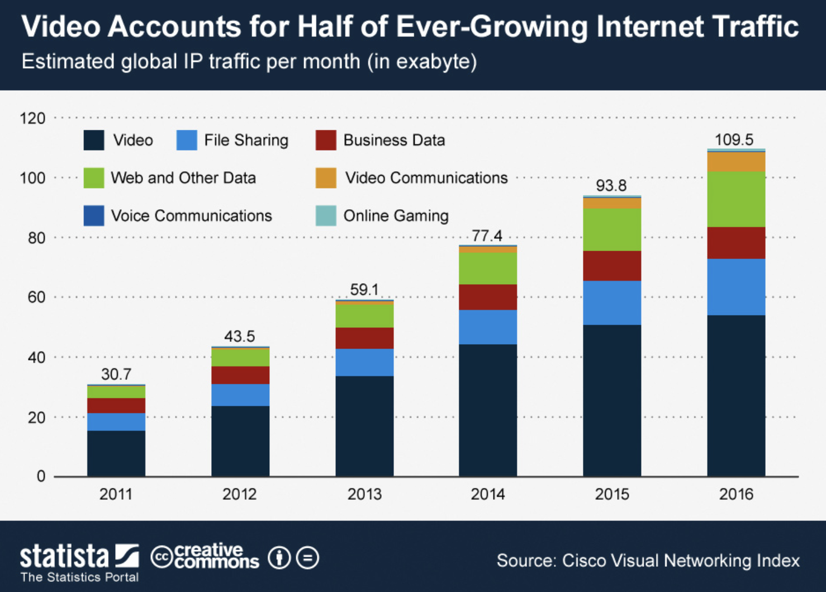

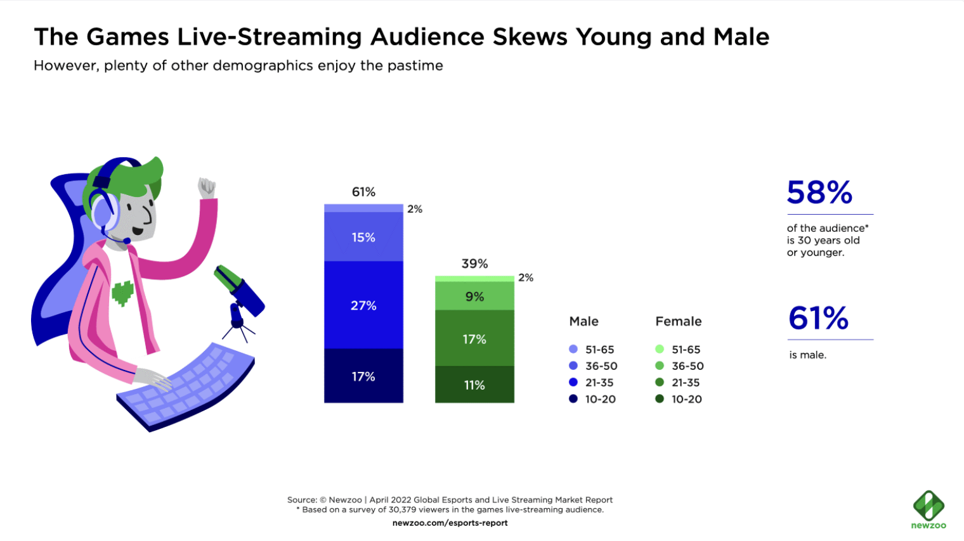


Why bother evaluating video streaming?
Video accounts for most amount of traffic in the internet
Who cares about video streaming performance?
Home users
ISPs
Regulators
I CARE

Slide 4
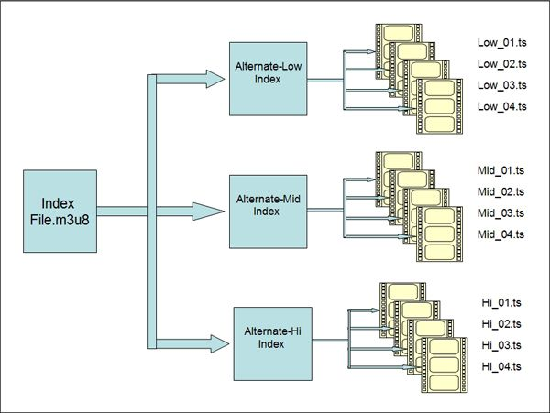
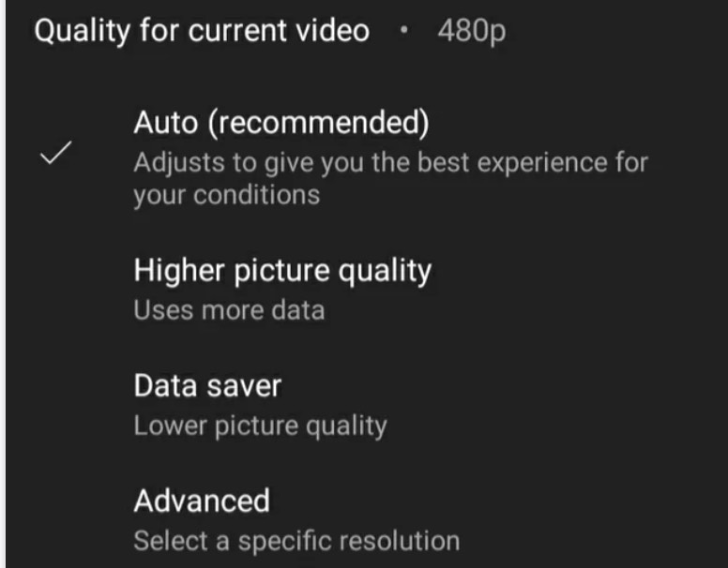
Example: DASH video streaming
Dynamic Adaptive Streaming over HTTP
Encoder
Split each quality level into segments
2-4s
Notes:
When introducing about video streaming, someone cannot overlook DASH. Briefly introduce DASH here. Dynamic Adaptive Streaming over HTTP (DASH) is a streaming technique widely used in delivering high-quality video content over the internet. It allows a video to be streamed in various quality levels, adapting in real-time to changes in network conditions.
Adapt video quality based on changing conditions
Use a complex architecture of servers and caches
Sequentially fetch video segments from a location of choice
Use encrypted protocols (HTTPS)
All communications between the client and the servers are secured using HTTPS

Slide 5
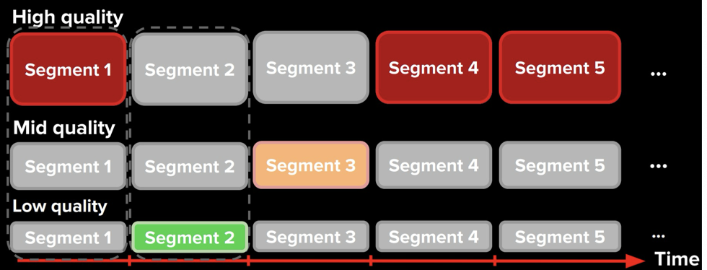
Adapt to changing condition
Notes:
Adapting Video Quality Based on Changing Conditions
DASH works by dividing a video into small segments, each of which can be streamed at different quality levels. The client-side player monitors the network conditions—such as available bandwidth and connection speed—and requests the appropriate quality level for the next segment. If the bandwidth decreases, the player requests lower-quality video segments to avoid buffering; conversely, if the bandwidth increases, it requests higher-quality segments to maximize viewing experience.

Slide 6
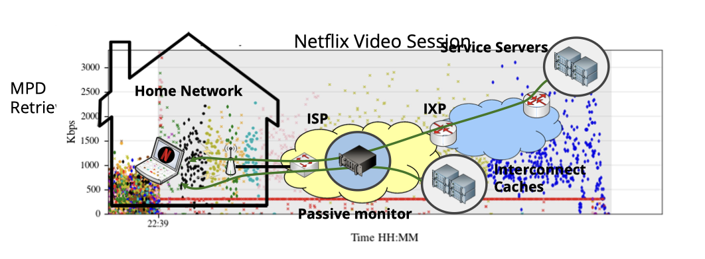
Good, but when come to encryption…
Notes:
We want to extracting features from traffic.
And this figure shows the whole process, find out where feature extractions can be performed.
It also depict what ISPs can observe with an encrypted traffic, kind of a mess!

Slide 7
Infer video resolution from encrypted packets
Why
Easy for network management & troubleshooting
Necessary for user privacy
Crucial for cybersecurity
Notes:
Service providers and network administrators need to ensure a high Quality of Experience (QoE) for users. Knowing the video quality being streamed helps in dynamically managing network resources, like bandwidth allocation and prioritization of traffic, without needing to decrypt the content. Identifying fluctuations in video quality can help diagnose underlying network issues or performance bottlenecks. This is crucial for providers to quickly address and resolve issues that could degrade user experience.
As more data becomes encrypted by default due to increased privacy concerns and regulatory requirements (like GDPR and CCPA), the ability to infer video quality without decrypting packets ensures that user privacy is maintained while still allowing providers to optimize and monitor their networks.
Analyzing traffic patterns and inferred video quality can help network administrators identify anomalies that may indicate cybersecurity issues such as denial of service attacks (DDoS), unauthorized network access, or other malicious activities that could affect service quality. service providers can ensure that they are maintaining service standards without exposing the content to potential security vulnerabilities. This kind of monitoring needs to be done in a way that does not compromise the encrypted nature of the data.

Slide 8
Build resolution inference models for ENCRYPTED video traffic

Slide 9
Application layer features are Encrypted
How to extract necessary information to infer Quality/Resolution?
Notes:
So again underscore the importance of a method to inference from features

Slide 10
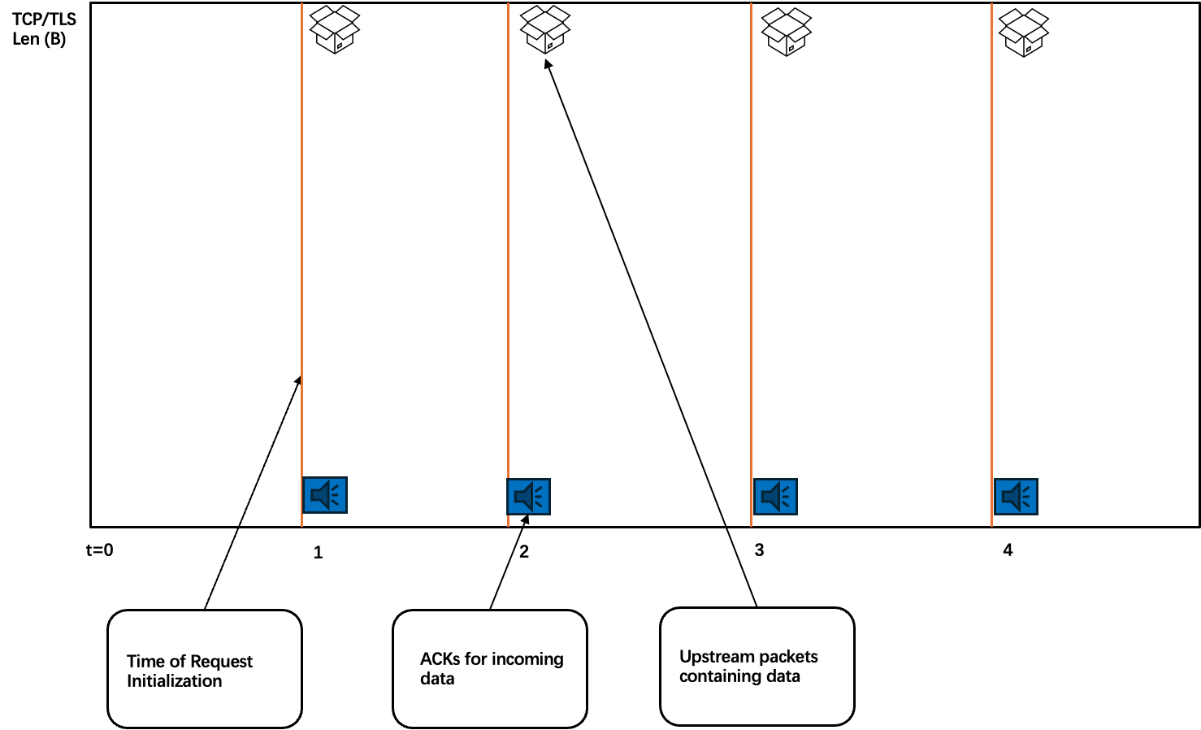
Inspiration: Segment Estimation instead of Actual Content
Upstream traffic reveals request boundaries
HTTP/S traffic for video is sequential
Able to Infer from packets
Notes:
So we are able to make inference from this idea, segment estimation!
We can infer from syn ack packets in the quic protocol to the streaming status of these packets instead of the actual video data.
Due to the nature of TCP/TLS （Transport Layer Security）that it transmitting a large number of SYN, SYN-ACK, ACK packets, we could infer the streaming status from these packets instead of the actual video data.

Slide 11
Goal & Features
Predict Resolution of video given a/multiple pcap file(s) with encrypted packets
Features in mind:
Total_bytes
Avg, max, min, std, bytes_per_chunk
Avg, max, min, std, chunk_transfer_time
Avg, max, min, std, time_between_chunks
Retransmitted_chunk_numbers, calculatede_bitrate
…
Notes:
Youtube because we find a dataset w/ Youtube sessions

Slide 12

Dataset
RequetDataSet
Craig Gutterman, Katherine Guo, Sarthak Arora, Xiaoyang Wang, Les Wu, Ethan Katz-Bassett, Gil Zussman, “Requet: Real-Time QoE Detection for Encrypted YouTube Traffic,” in Proc. ACM MMSys’19 (to appear), 2019.
Jan - June 2018
Youtube “Auto”
HTTP/TLS/TCP DASH
Resolutions: 144p, 240p, 360p, 480p, 720p, 1080p
Lengths: 8-12 mins
Total 360 pcaps
3 GB of data
Notes:
Experiment performed by columbia university and Nokia Bell Labs back in 2018
We collect traces over 6 months from Jan. through June 2018, with video resolution selection set to “auto”. This means the YouTube client is automatically selecting video resolution based on changes in network condition. For each session, we set an initial resolution to ensure that all resolution levels have enough data points.
In each session we play a clip and collect a 10-min trace from the moment the client sends the initial request. We choose this range of length in order for the client to experience buffer increase, decay and steady state. Shorter clips with a length close to buffer capacity (e.g., 2 min) can sometimes never enter steady state, even when given abundant network bandwidth.
Each group includes a diverse set of clips in terms of activity level. It ranges from low activity types such as lectures to high activity types such as action sequences. This fact can be seen in the wide range of video bitrates for any given resolution. Fig. 8 shows the average playback bitrate for each video resolution for each clip in our dataset.
It would take 5-6 hours to process the data and get our features if just using python, and not to mention it always crashes. Thanks to spark and M3Pro Chip, we are going to shorten the time into just 20-40 minutes.
这里我可以插嘴讲讲python为什么sb
//**可讲可不讲：We choose to not use the darpa dataset because it was hard to find all the pcaps that have tcp packets

Slide 13
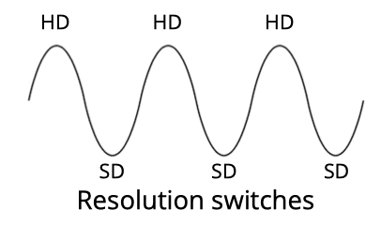
ML Pipeline Overview
Task: Develop a resolution inference model from encrypted traffic
Procedure:
Data Cleaning
Basic Inference Model
Feature Importance Analysis (Select features by layer)
( Repeat 2 and 3 to replicate the study using various feature groups)
Get the best model and evaluate with ROC and P/R curve
Notes:
Predict the ongoing resolution of real video sessions (TODO)

Slide 14
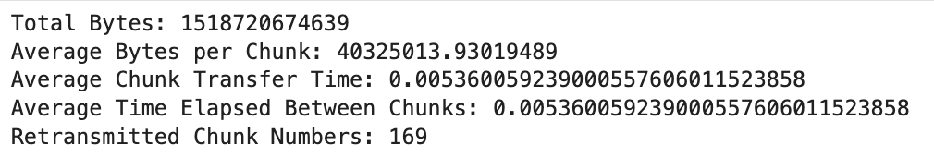
Data Processing: Initial Traffic Analysis for verification
Psuedo Code showcasing the process:
## PACKET-based Parsing
# 1. Load the pcap file
# 2. Filter TCP packets related to video streaming
# 3. Analyzing packets
# Track retransmissions
# Track chunk sizes and transfer times
# last ACK
# etc ...
# 4. Calculate desired metrics
# 5. Further handling to calculate GET request response time
# This requires identifying HTTP GET requests and their corresponding responses, which would involve deeper packet inspection and protocol-specific parsing.
# 6. Calculate the bitrate in bits per second (scapy kicks in)
# Calculate total duration in seconds
# sum the payload sizes of TCP packets
Notes:
Some examples here

Slide 15
Network + Transport Features Selection
Basic features:
seg. sizes (all, last-10, cumulative)
seg. request inter-arrivals
seg. completions inter-arrivals
# pending requests
# downloaded segments
# requested segments
…
Additional Features from the Network and Transport Layers:
throughput up/down
throughput down diff
pkt count up/down
byte count up/down
pkt inter-arrivals up/down
#parallel flows
#flags up/down
rcv window size up/down
idle time up/down
bytes per pkt up/down
round trip time (RTT)
bytes in flight up/down
#retransmissions up/down
#out of order pks up/down
…
Notes:
Feature we collected including:
seg. sizes (all, last-10, cumulative) - Refers to the segment sizes of video, including all segments, the sizes of the last 10 segments, and the cumulative size of segments.
seg. request interarrivals - The interarrival times between segment requests.
seg. completions interarrivals - The interarrival times between the completions of segment transmissions.
#pending requests - The number of video segment requests that are pending.
#downloaded seg. - The number of video segments that have been downloaded.
#requested seg. - The number of video segments that have been requested.
throughput up/down - The upload and download throughput, typically measured in bits per second (bps).
throughput down diff - The difference in download throughput, which may refer to changes in download speed over a period of time.
pkt count up/down - The count of packets uploaded and downloaded.
byte count up/down - The count of bytes uploaded and downloaded.
pkt interarrivals up/down - The interarrival time of packets uploaded and downloaded.
#parallel flows - The number of parallel flows, indicating the number of concurrent connections.
#flags up/down - The count of flags set during upload and download, which might relate to TCP flags such as SYN, ACK, etc.
rcv window size up/down - The receive window size for uploads and downloads, a part of TCP flow control that dictates how much data can be sent before needing an acknowledgment.
idle time up/down - The idle time for uploads and downloads, referring to the periods of inactivity between active transmissions.
goodput up/down - The actual useful data transmission rate, different from throughput, which excludes all protocol overhead and retransmitted data.
bytes per pkt up/down - The number of bytes per packet, for both uploads and downloads.
round trip time - The time it takes for a packet to travel to the destination and back, commonly used to measure network latency.
bytes in flight up/down - The amount of unacknowledged data in the network during a round-trip time.
#retransmissions up/down - The number of times packets have been retransmitted during uploads and downloads.
#out of order pks up/down - The count of out-of-order packets received, for both uploads and downloads.
Combined Network w/ Application features perform best

Slide 16
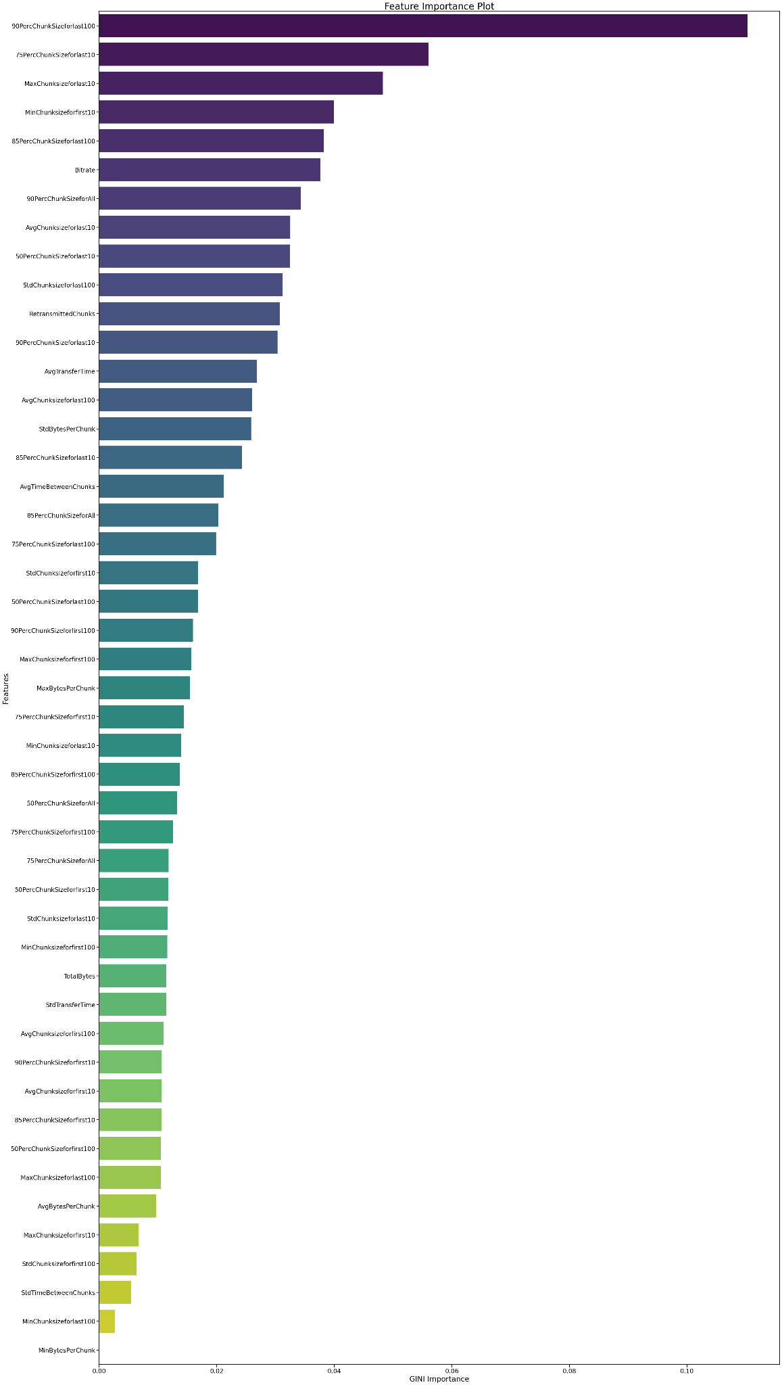
Appendix
Top 5 Feature importance
90Perc ChunkSize for last 100
75Perc ChunkSize for last 10
Max Chunksize for last 10
Min Chunksize for first 10
Bitrate
Overall, combining Application Layer & Network features give better result
Notes:
Overall Combined Network w/ Application features perform best

Slide 17
Questions for training a model
Validation
Time granularity for inference?
Features to use?
One model per service or a singleton for all services?
Which model?
Infer Quality metrics at periodic intervals
10 seconds / inference
Different sets of input (Net, App, Net+Tran..)
Different set of services
Targeted: train one service - test one
Combined: train on all services
Which model?
Selected random forest by 5-fold CV
Notes:
Question encountered in design process

Slide 18
Model Training
Feature Analysis
OneVsRestClassifier
Strategy for multi-class classification that involves training a separate binary classifier for each class.
Benefits: Effective at distinguishing between multiple categories, handling imbalances between classes.
RandomForestClassifier
An ensemble learning method based on decision trees that outputs the mode of the classes predicted by individual trees.
Benefits: handle high-dimensional features, feature importance scores to assess impact on the outcome.
Group Network Features:
Arrange features into groups and evaluate which collection of features achieves the highest accuracy.
E.g. Group1 for Top 5 network layer features like IP addresses, Group2 for Top 10 transport layer features like TCP ports), and etc.
Feature Importance Analysis & Application:
Models trained with different sets of layer-specific features help identify which features are most predictive of video resolution, aiding in feature selection and model optimization.
Notes:
Regarding Model
employed a combined model approach using OneVsRestClassifier and RandomForestClassifier to predict video resolutions
OneVsRestClassifier is a multi-class classification strategy where an independent binary classifier is trained for each class. Specifically, for each class, the model trains a classifier treating samples of this class as positive samples and all other classes as negative.well-suited for dealing with multi-class classification issues.
RandomForestClassifier is an ensemble learning method based on decision trees. It builds multiple decision trees and outputs the class that is the mode of the classes output by individual trees. Random Forest can automatically handle feature selection and reduce overfitting
OneVsRestClassifier was used to encapsulate RandomForestClassifier, enabling it to handle classification tasks across multiple resolution categories.
Regarding Features
Layer-specific features provide crucial insights at various stages of network communication, from connection setup to data transmission.
features from the same layer might be using the same information to be computed.
important to understand which features had the highest impact on prediction accuracy.

Slide 19
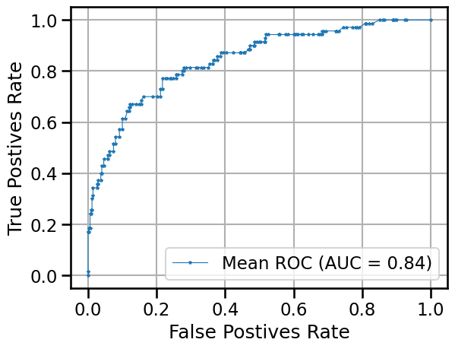
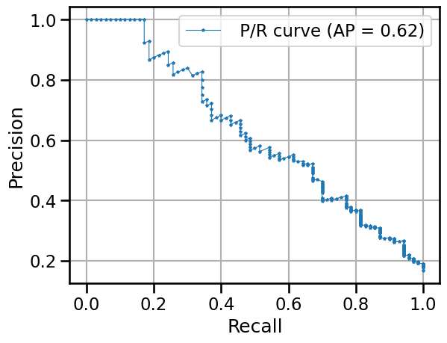
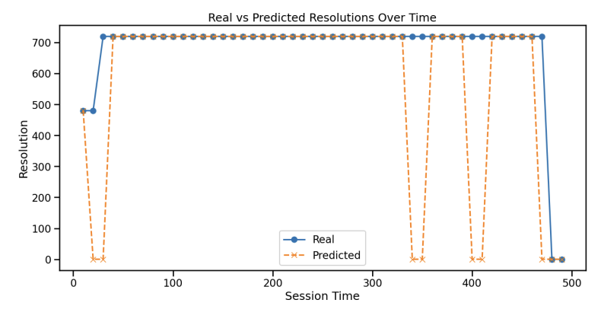
Model Training & Evaluation
(Target: Resolution)
Notes:
The image shows two curves used to evaluate the performance of a classifier: the ROC curve and the Precision-Recall (P/R) curve.
The Area Under the Curve (AUC) measures the overall performance of the classifier; the closer it is to 1, the better the performance. In this graph, the AUC is 0.84, indicating good classification performance.
The right graph is the Precision-Recall curve, which shows the relationship between Precision and Recall at different thresholds.
he Average Precision (AP) is the area under the P/R curve, with a value of 0.62 here, suggesting the model balances precision and recall at a moderate level.
So, good separability between the classes. But, Current Model might rank positive examples higher than negative examples effectively, it struggles with achieving high precision at higher recall levels.

Slide 20
TODO List and Future Work
More Statistic Evaluationand Model Improvements with more features
More Visualization
Build a model for inference Startup Delay as another Regressive Module
Emulating network conditions?
Automated collection from real-time video traffic? (Golang or similar)

Slide 21
Thank you!

Slide 22
DSCI 599: Infer Video Resolution from Encryption
Team: Qianyou, Yuntong
Approach
Preprocessing:
- Iterative Packet Analysis: The code iterates through packets in a pcap file, possibly to filter out specific types of packets (e.g., TCP packets) or to extract certain information (like IP addresses, port numbers, etc.).
- Feature Extraction: Although the details are not fully revealed in the snippet, typically, feature extraction might involve deriving statistics or features from the packet data, such as sizes, inter-arrival times, or other TCP?IP header information.
Prediction:
- Feature Selection: The model seems to use various calculated features such as TotalBytes, AvgBytesPerChunk, StdBytesPerChunk, etc., which are likely derived during the preprocessing phase. These features are probably key indicators of video resolution or quality inferred from network traffic.
- Random Forest Model: This is an ensemble machine learning method used for classification and regression. It builds multiple decision trees and merges them to get a more accurate and stable prediction. The choice of Random Forest could be due to its effectiveness in handling large datasets with high dimensionality and its ability to provide importance scores for features, which can be crucial for understanding which aspects of the network data most strongly predict video resolution.
Concept
The core idea revolves around network inference, specifically mapping network traffic characteristics to network events to learn traffic patterns and infer video resolutions without decrypting the traffic.
This is particularly crucial as video accounts for a significant portion of internet traffic, and understanding video streaming performance is essential for home users, ISPs, and regulators.
It is highly relevant in today's environment where much of the internet's bandwidth is consumed by streaming services, and privacy and security are paramount. The methodology proposed could significantly impact how video streaming services are monitored and optimized by ISPs and other stakeholders.
Milestones & Deliverables:
Feb 28: Data Preprocessing and Feature Engineering
Deliverable 1: A detailed document or report outlining the data cleaning process, including the methods used for removing outliers and handling missing data.
Deliverable 2: A functional script (code) for feature extraction, along with a README file detailing how to run the script, the input data format, and the expected output.
Mar 8: Model Choice
Deliverable 1: A comparative analysis report of different machine learning models, explaining the rationale behind the chosen model(s).
Deliverable 2: Blog or LinkedIn post discussing the model selection process, highlighting key considerations and potential impacts on the project.
Mar 22: Model Training and Pruning
Deliverable 1: Code for the training and pruning of models, including documentation on how to use the code, adjust parameters, and interpret results.
Deliverable 2: A summary of the model training process, presenting initial results, accuracy scores, and insights gained during the pruning phase.
Mar 29: Preliminary Testing and Assessment
Deliverable 1: A test report summarizing the findings from the preliminary testing phase, including performance metrics and initial evaluation results.
Deliverable 2: A poster or visual representation of the test results, showcasing key data points, metrics, and preliminary conclusions.
Apr 10: Final Testing and Tuning
Deliverable 1: Final version of the program code with comprehensive instructions on installation and usage.
Deliverable 2: An in-depth analysis report of the final testing phase, highlighting improvements made during tuning, with detailed performance metrics.
Apr 24: Project Summary and Report Writing
Deliverable 1: A comprehensive final presentation capturing the entire research project effort, including methodologies, findings, analysis, and conclusions.
Deliverable 2: A github repo summarizing the project
Results
Notes:
Concept: A graphic and explanation on what you are trying to do
Approach: Method to acquire and clean data, ML tools used, Challenges and solutions
Results: Plots and Tables to discuss the results
Milestones:
Deliverables:

