Slide 1
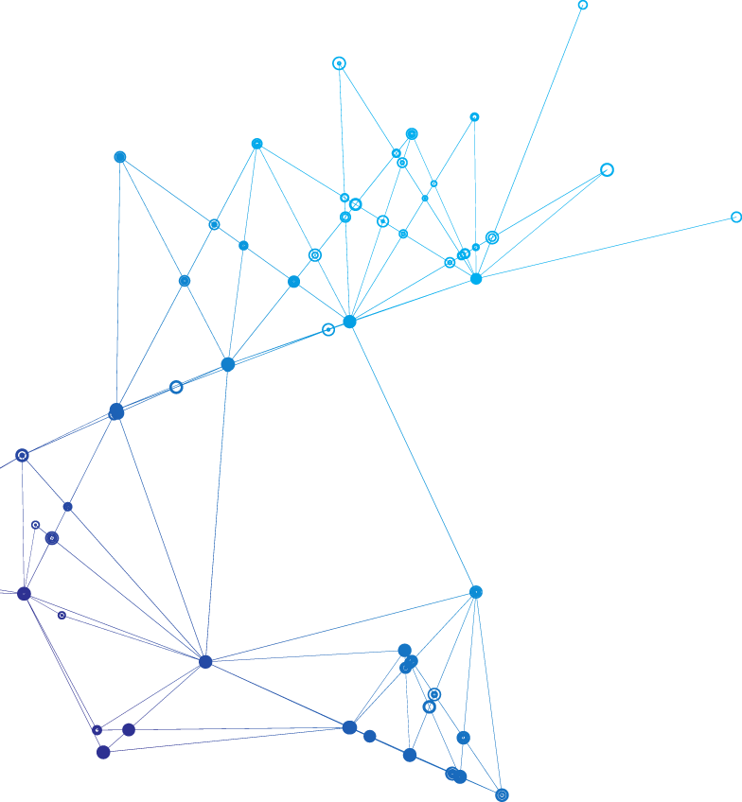

Jump Cat Finance
decentralized prediction project
focus on real-time prediction
in the field of sports and e-sports competition

Slide 2
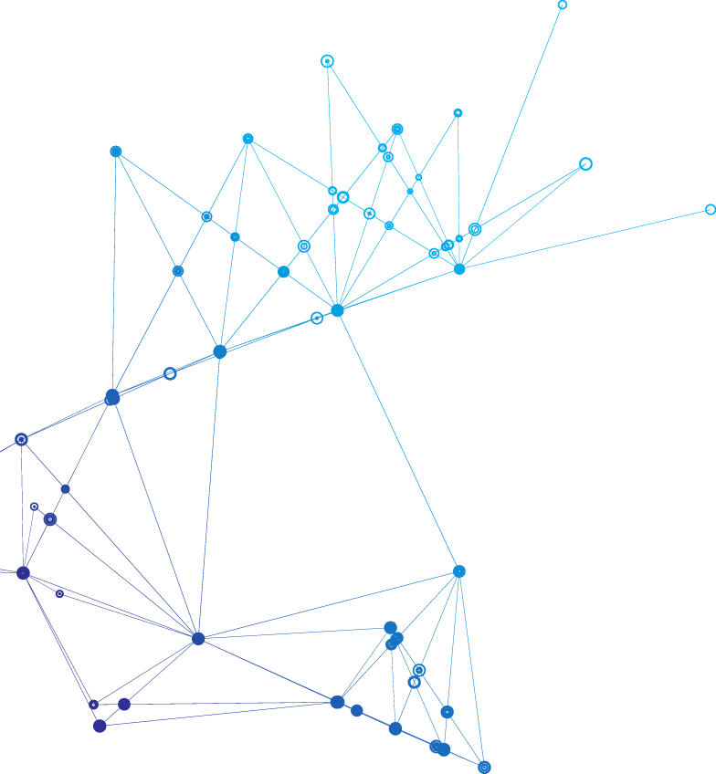
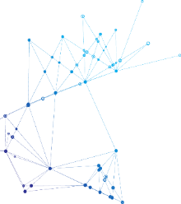
CONTENT
01
Introduction
02
Technology
03
Dao
04
Future

Slide 3
1
Introduction

Slide 4
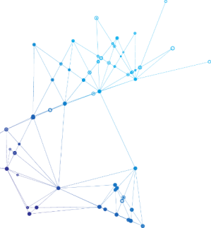
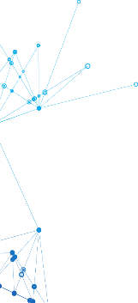
Introduction
Jump Cat Finance is a decentralized solution for prediction finance
Unlike other projects, it focuses more on real time odds calculation
Oracle result is determined by the creation node, and at the same time, the board node and Dao governance are used for hierarchical verification
Based on these new designs, users can trade real time for the prediction results, and maximize profits through real time judgments on the competition situation
At the same time, this kind of real time prediction judgment, will also optimize the viewing experience and bring a different feeling

Slide 5
2
Technology
行业PPT模板http://www.1ppt.com/hangye/

Slide 6

Technology
Why Solana ?
High TPS and Speed
Security
Low Transaction Cost
Community Culture

Slide 7
Technology
Algorithm can automatically settle the real time odds
Users can update their judgment of the situation in real time such as AMM swap
Buy at a low price, sell at a high price, and get an extra profit compared to the
traditional prediction market

Slide 8

Technology
Tradition Odds
Realtime Odds
Before Match
Based on pre-competition information
Dynamic switching is not allowed in match
Compatible with the traditional odds
Based on real-time situation of the game
Dynamic switching like jumping cat

Slide 9
3
Dao

Slide 10
Dao
Role
Dao
Important Verification
Developer Foundation
Develop, Verification Early stage
Board node
Verification, Share Profit
License node
Determined, Share Profit

Slide 11
Token
Election Board
License Auction
Stake
Profit Burn

Slide 12
4
Future

Slide 13




Future
Follow Order
Leverage
Lottery
Online games

Slide 14
Thank you
Development team is in building
If you are interested, please contact me : )
gaodaowang@163.com
https://github.com/qiaoboat/jumpcat_solana
https://jumpcat.finance

