Slide 1
Short Review of Information Retrieval
Qiao, 21 June, 2020

Slide 2
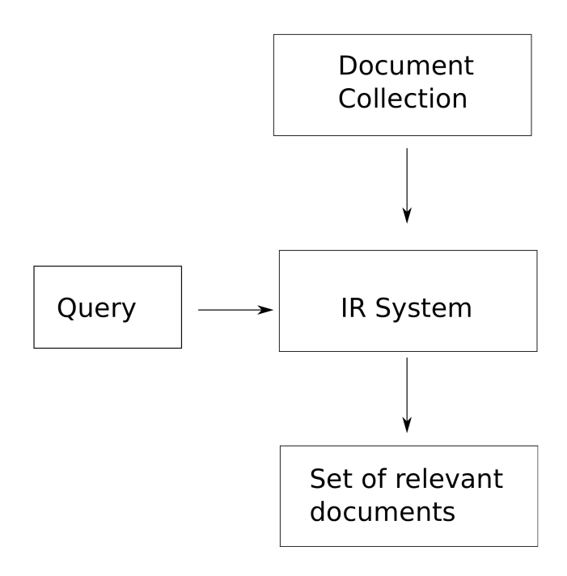
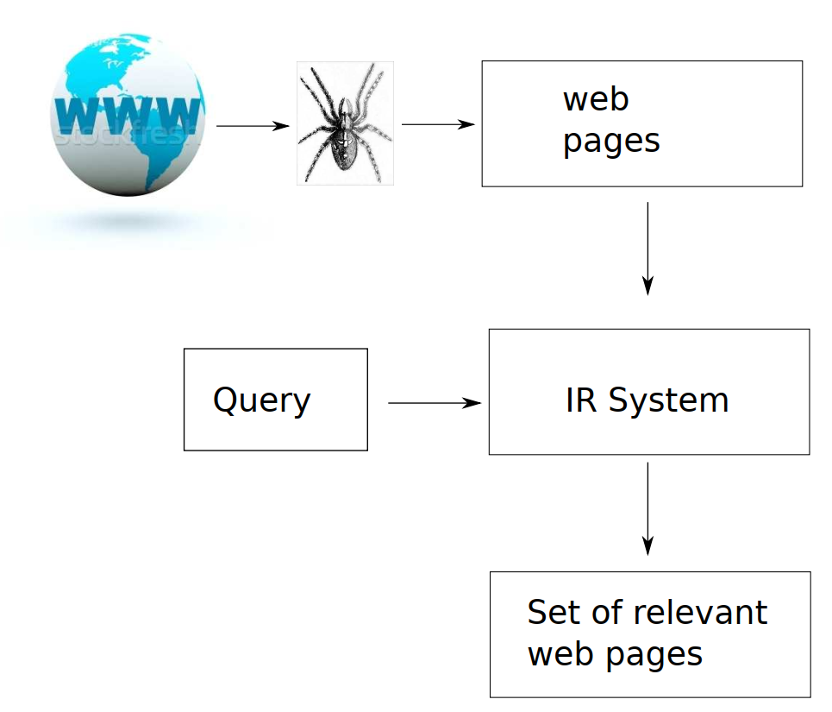
Information Retrieval
Information retrieval (IR) is finding material (usually documents) of an unstructured nature (usually text) that satisfies an information need from within large collections (usually stored on computers). (Manning, 2009)

Slide 3
Outline
Inverted Index and Boolean Retrieval
Rank Retrieval
PageRank

Slide 4
Inverted Index and Boolean retrieval model
Notes:
倒排

Slide 5
Example Query
Which plays of Shakespeare contain the words Brutus AND Caesar but NOT Calpurnia?
Naïve method: grepping through text, a linear search over all the documents,
drawbacks:
slow,
lacking flexible matching operations

Slide 6
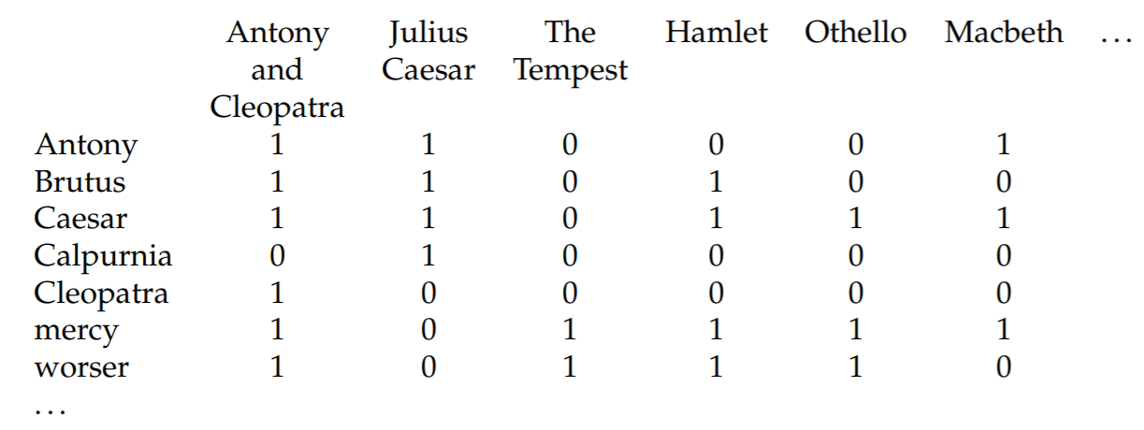
Avoid linearly scanning: index the documents in advance

Slide 7
Better representation
- Characteristics of the term-document incidence matrices:
Sparse
Too large
- Can we do better?
Only store 1s

Slide 8
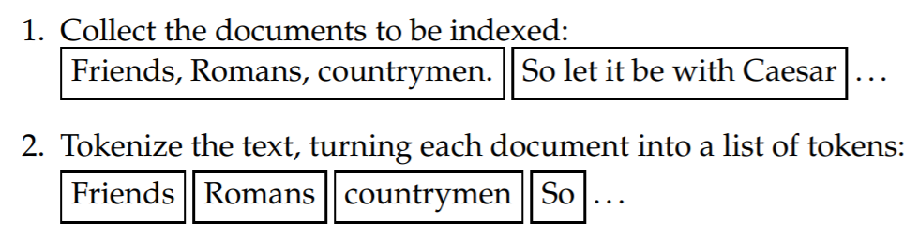
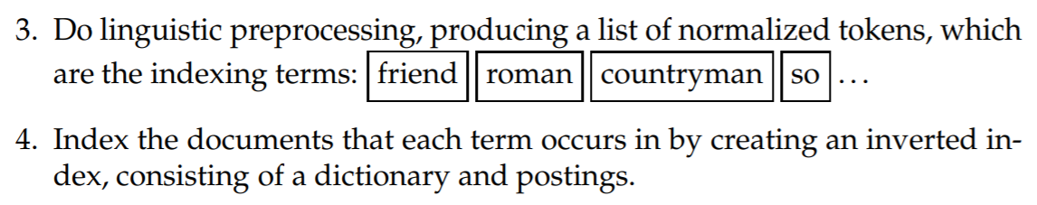
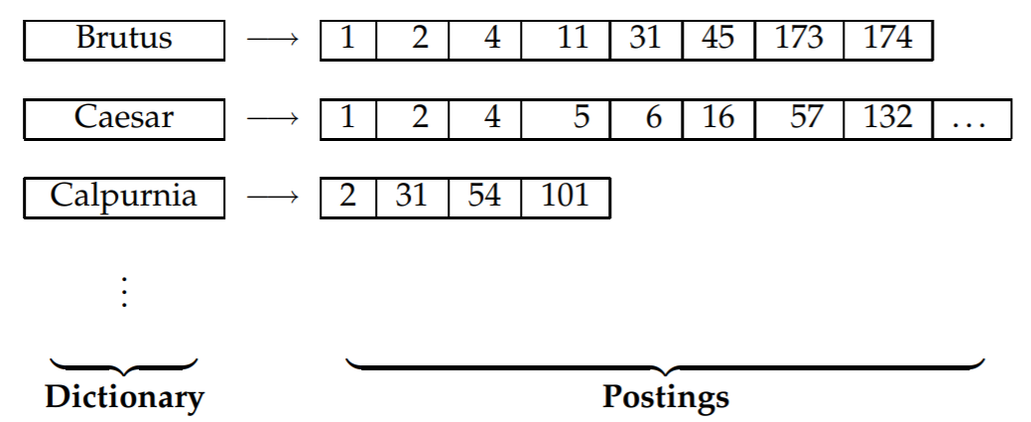
Construct Inverted Index

Slide 9
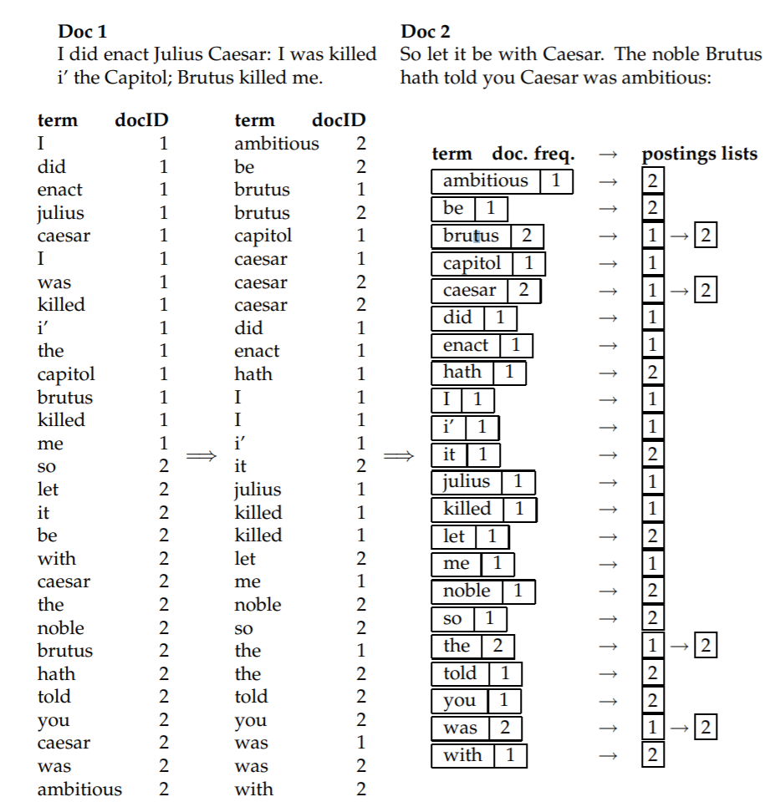
A toy example

Slide 10
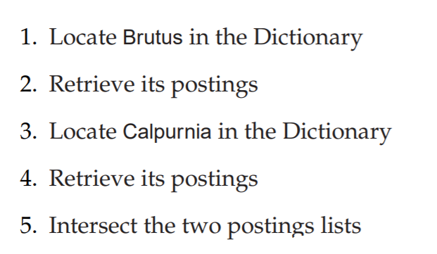
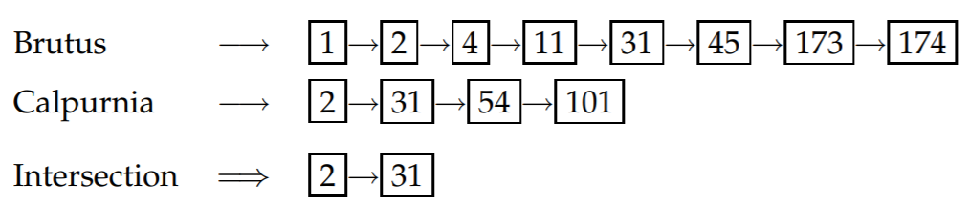
Process a query: Brutus AND Calpurnia
Brutus AND NOT Calpurnia ;
Brutus OR NOT Calpurnia
Notes:
O(x + y)
O(N)

Slide 11
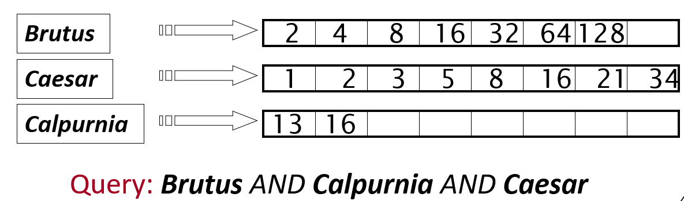
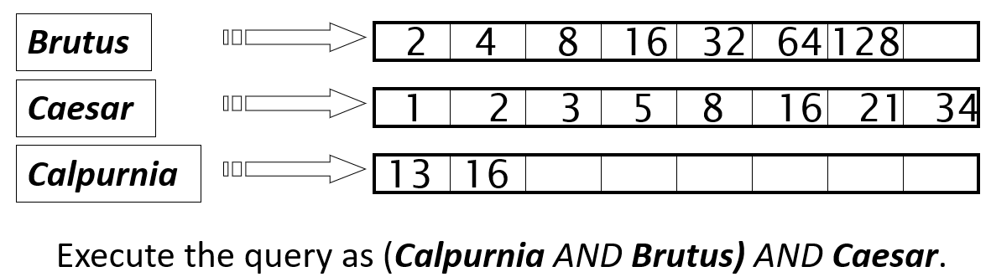
More efficient computation
Notes:
From small document frequency to large document frequency

Slide 12
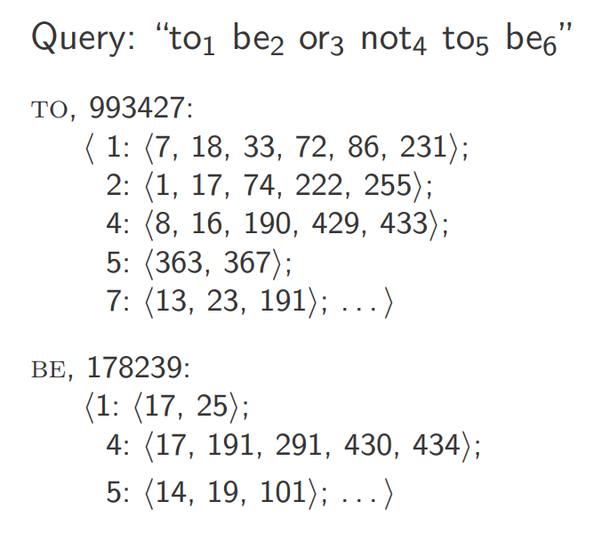
Multi-word query with positional index
<term, number of docs containing term;
doc1: position1, position2 … ;
doc2: position1, position2 … ;
etc.>
Notes:
Document 4 is more likely to have “to be or not to be”

Slide 13
Rank Retrieval
Vector Space Model, Scoring Document, etc.

Slide 14
Characteristics of Boolean Retrieval
Documents either match or don’t.
Good for professional users
Not good for ordinary users
Most users incapable of writing Boolean queries
No natural text queries
Either 0 result (no match), or many result (e.g., 1000)
Rank them with scoring functions!

Slide 15
Scoring with Vector Space Model
Based on Bag of Words model: no ordering
Vectorized representations for both query and document

Slide 16
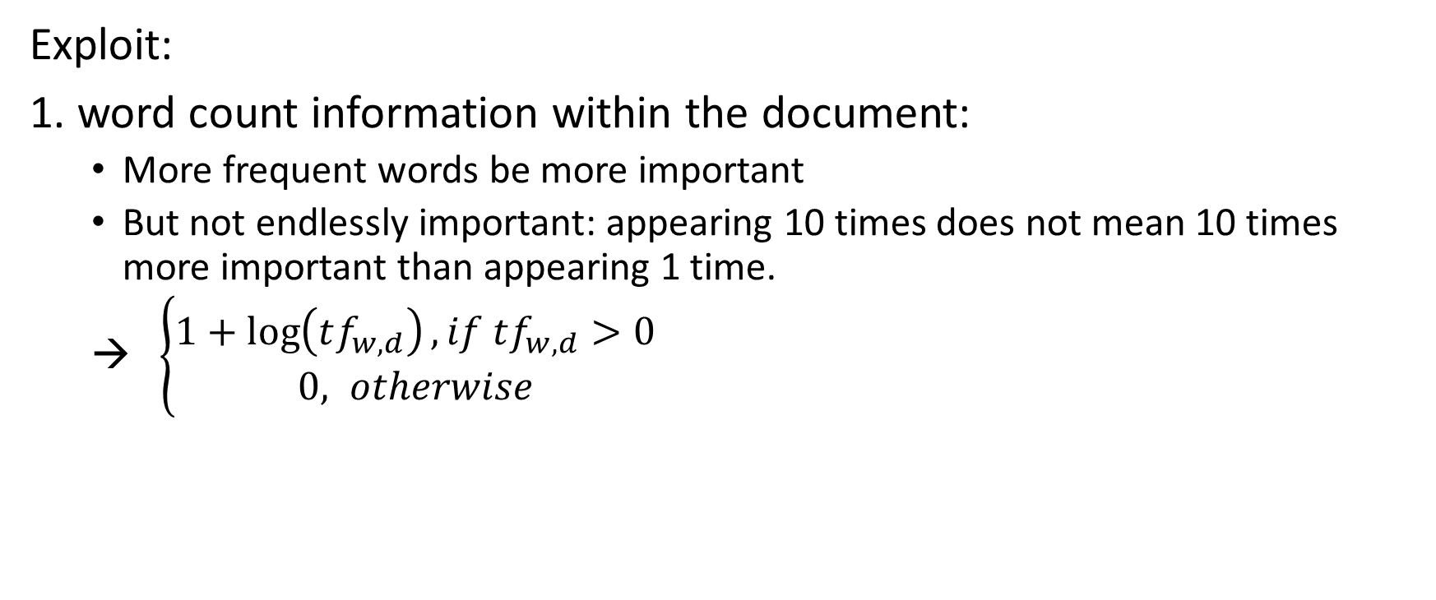
Vectorization with Tf-Idf weighting
Exploit:
1. word count information within the document:
More frequent words be more important
But not endlessly important: appearing 10 times does not mean 10 times more important than appearing 1 time.
→ $\left\{\begin{aligned}1+\log\left(tf_{w,d}\right), if tf_{w,d}>0 \\ 0, otherwise\end{aligned}\right.$

Slide 17
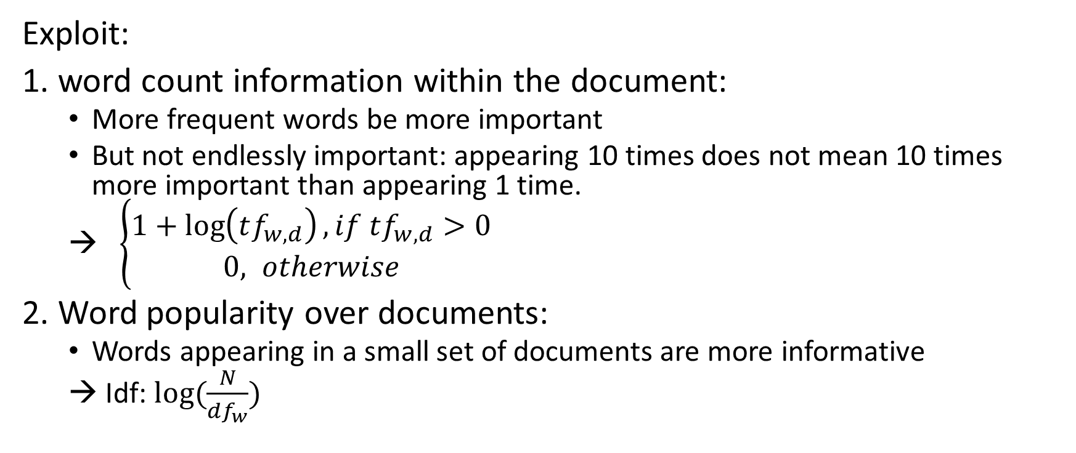
Vectorization with Tf-Idf weighting
Exploit:
1. word count information within the document:
More frequent words be more important
But not endlessly important: appearing 10 times does not mean 10 times more important than appearing 1 time.
→ $\left\{\begin{aligned}1+\log\left(tf_{w,d}\right), if tf_{w,d}>0 \\ 0, otherwise\end{aligned}\right.$
2. Word popularity over documents:
Words appearing in a small set of documents are more informative
→ Idf: $log⁡(\frac{N}{df_{w}})$

Slide 18
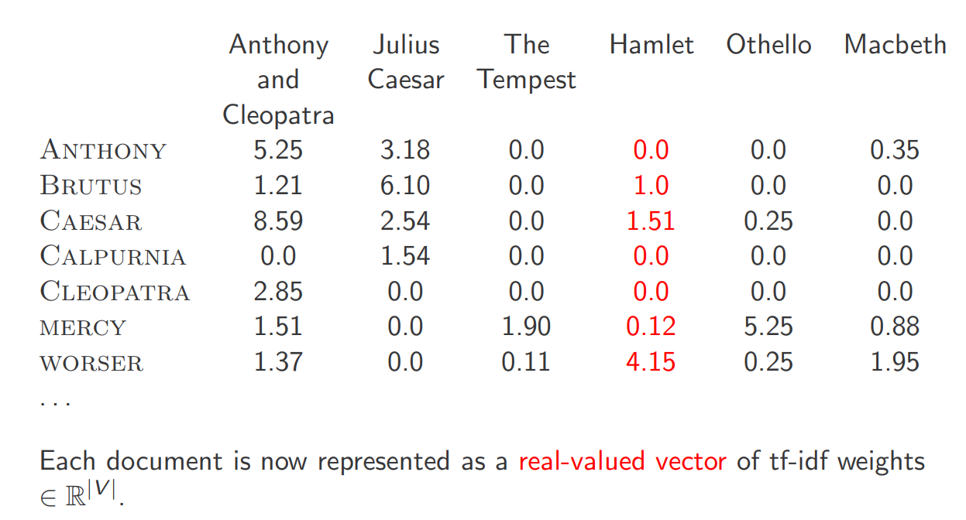

VSM with Tf-Idf weighting
Put them all together:
Tf-Idf$\left(w\right)=(1+\log\left(tf_{w,d}\right))⋅log⁡(\frac{N}{df_{w}})$
Each document (column) can
be represented as a vector
Notes:
Very high-dimensional: tens of millions of dimensions when you apply this to web search engines Each vector is very sparse - most entries are zero LSA/LSI
Could be many variants for TF and DF computation

Slide 19
Scoring based on VSM
Represent query as a vector
Represent document as a vector
Computer vector distances/proximity: Cosine distance
Rank documents
Notes:
Euclidean distance is large for vectors of different lengths.

Slide 20
Better scoring functions: BM25
Used in Lucene – Elasticsearch, Solr, has probabilistic interpretation (approximation to 2-Poisson model)
Okapi BM25, one of the most popular yet effective variation
Notes:
B is a normalization term for document length

Slide 21
Motivation
Poisson distribution:
Models the probability of an event occurring K times in a fixed interval of time/space, such as
Number of cars arriving at a toll booth per minute
Number of typos on a page
In our context:
Model the probability of a word occurring K times (i.e., p(tf = k)) in a document
Notes:
Core reference paper:
A probabilistic approach to automatic keyword indexing. Part I. On the Distribution of Specialty Words in a Technical Literature
https://asistdl.onlinelibrary.wiley.com/doi/abs/10.1002/asi.4630260402
Probabilistic Models for Automatic Indexing (Section: A Model for Index Term Distribution)
https://people.csail.mit.edu/jrennie/papers/other/bookstein-indexing-74.pdf
A Unified Relevance Retrieval Model by Eliteness Hypothesis
http://www0.cs.ucl.ac.uk/staff/J.Gorla/uni-initial-model.pdf
Book:
The Probabilistic Relevance Framework: BM25 and Beyond

Slide 22
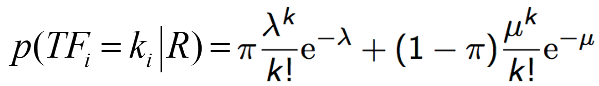
Motivation cont. Eliteness/specialty/aboutness
Given a word, it may or may not indicate the topic of a document
In the eye of a word, there could be two types of documents: where it is none-specialty (class 1) or it is a specialty word (class2)
Single Poisson falls short → using mixture of 2 Poisson model:
2-Poisson distribution:
Notes:
Different terms are used to refer to the similar notion, Eliteness/specialty/aboutness

Slide 23
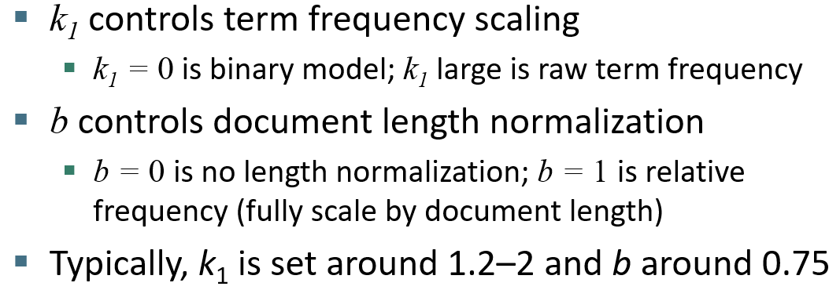
Route to Okapi BM25 ranking function

Slide 24
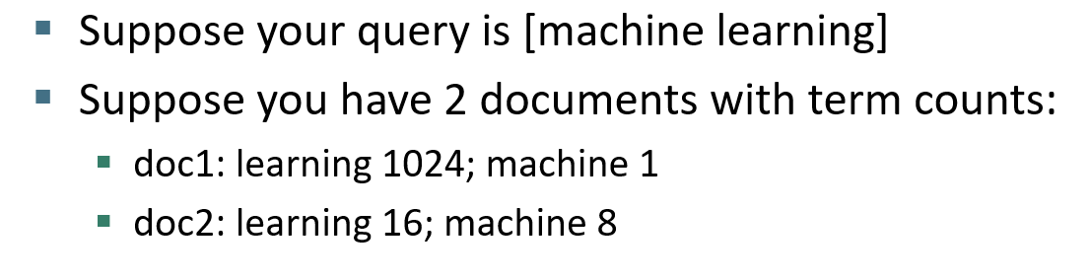
BM25 vs. Tf-Idf
Scores (Assume idf=1, log2):
Tf-Idf:
doc1: 11.00
doc2: 7.26
BM25:
doc1: 4.99
doc2: 5.73
Notes:
Values were computed using the the tf-idf and BM25 functions defined earlier, note like BM25, we added up tf-idf scores of the query terms to from the documents’ tf-idf scores

Slide 25
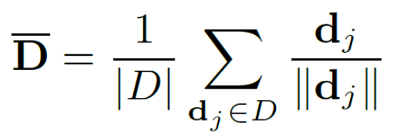
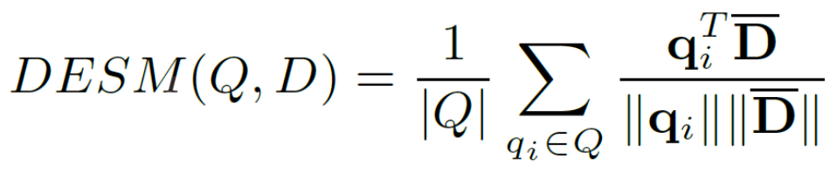
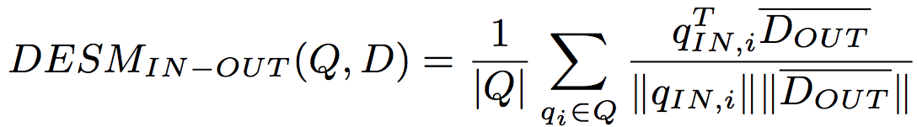
Why not Word2vec embeddings?
Two versions of embeddings: pivotal vs. context word embeddings;
During w2v training, pivotal word is used to predict context word (SkipGram);
Query: pivotal word embeddings; Document: context word embeddings.
Nalisnick, Mitra, Craswell & Caruana. 2016. Improving Document Ranking with Dual Word Embeddings. WWW 2016 Companion. http://research.microsoft.com/pubs/260867/pp1291-Nalisnick.pdf
Mitra, Nalisnick, Craswell & Caruana. 2016. A Dual Embedding Space Model for Document Ranking. arXiv:1602.01137 [cs.IR]
Notes:
In: pivotal word embeddings
Out: context word embeddings

Slide 26
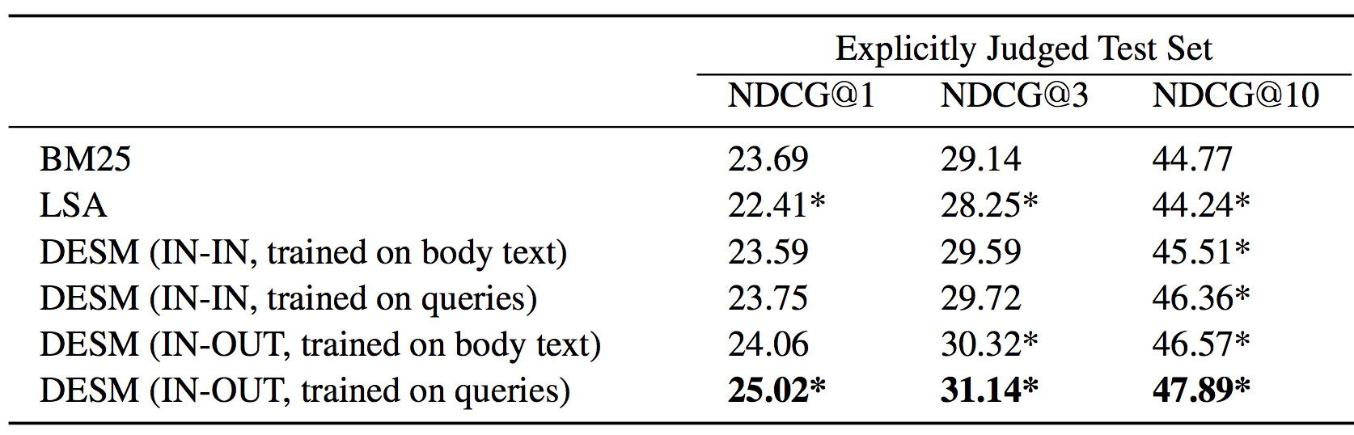
Performance

Slide 27
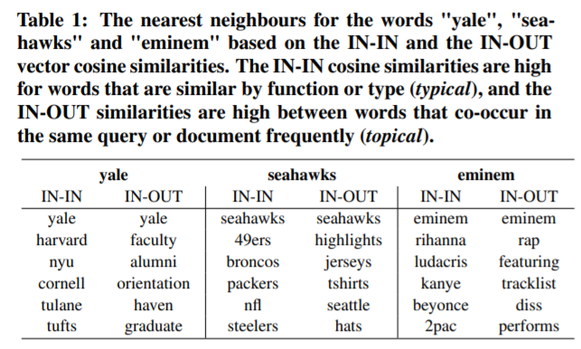
Possible interpretation for good performance
Observations:
In-In: Pivotal-to-pivotal prediction, high scores for words similar by function/type;
In-Out: Pivotal-to-context prediction, high scores for frequently co-occurring terms;
Therefore, if one document contains more co-occurring terms with a query term, it could be scored higher using.
Notes:
Added to answer an in-class question

Slide 28
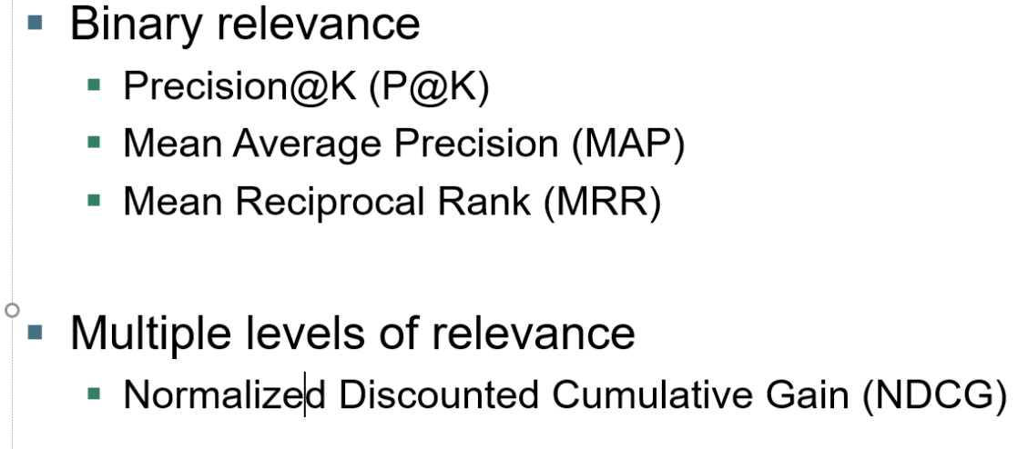
Evaluation methods

Slide 29
Others
Using pretrained language models:
Bert, XLNet, etc.
Learning to rank
Rank Net, LambdaRank, LambdaMART, etc.

Slide 30
PageRank
Ranking documents using linking information

Slide 31
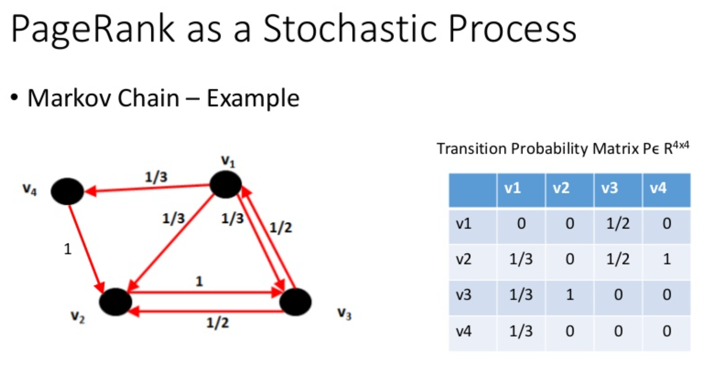
Random walk over the network
Start from one node v (webpage)
Walk to another node following out-link with equal probability
After one step of walk, what is the probability of the walker standing at each of the nodes?
Notes:
1-order markov chain

Slide 32
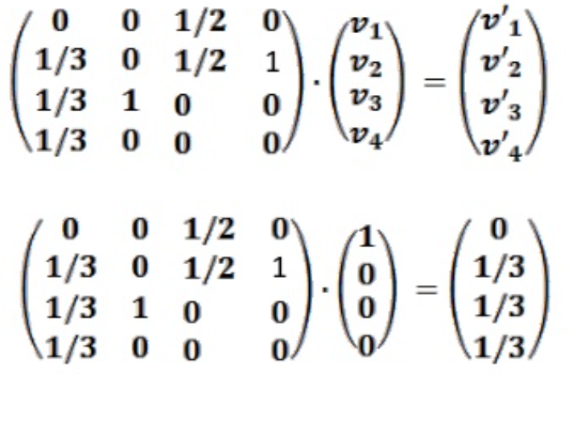
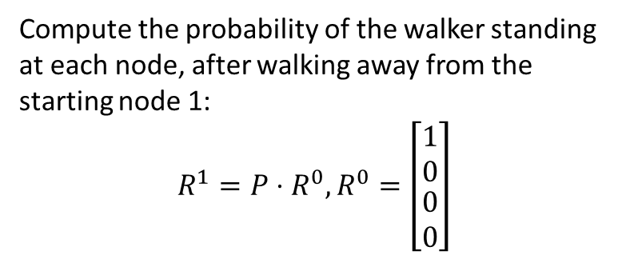
Random walk over the network
Compute the probability of the walker standing at each node, after walking away from the starting node 1:
$$R^{1}=P⋅R^{0}, R^{0}=\left[\begin{matrix}1 \\ 0 \\ \begin{aligned}0 \\ 0\end{aligned}\end{matrix}\right]$$
Notes:
1-order markov chain

Slide 33
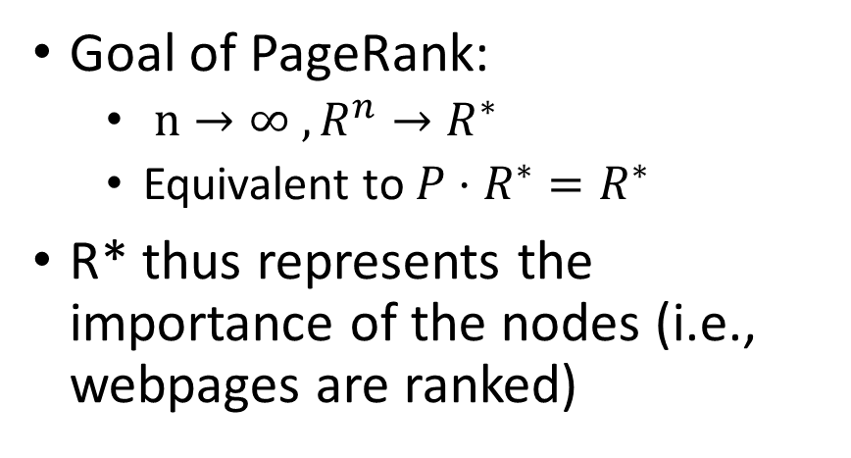
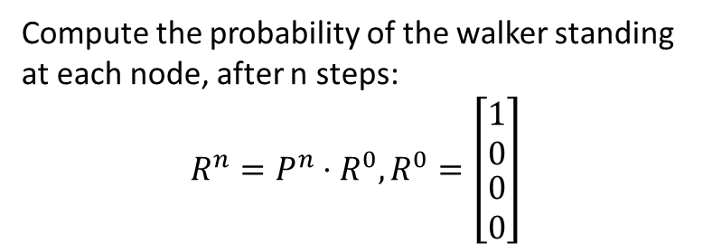
Random walk over the network
Compute the probability of the walker standing at each node, after n steps:
$$R^{n}=P^{n}⋅R^{0}, R^{0}=\left[\begin{matrix}1 \\ 0 \\ \begin{aligned}0 \\ 0\end{aligned}\end{matrix}\right]$$
Goal of PageRank:
$n→∞ , R^{n}→R^{∗}$
Equivalent to ${P⋅R}^{∗}=R^{∗}$
R* thus represents the importance of the nodes (i.e., webpages are ranked)
Notes:
1-order markov chain

Slide 34
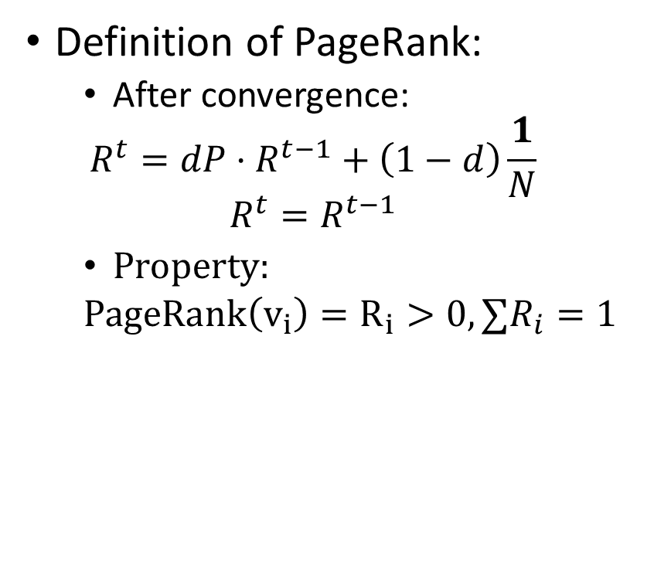
Teleportation as a trick to ensure convergence
Teleportation:
With 1/N probability jumps to any node in the graph (including itself)
It makes the graph
Fully-connected
Aperiodic graph
Hence ensures convergence to R*
Definition of PageRank:
After convergence:
$$R^{t}=dP⋅R^{t−1}+\left(1−d\right)\frac{1}{N}$$
$$R^{t}=R^{t−1}$$
Property:
$PageRank\left(v_{i}\right)=R_{i}>0,∑R_{i}=1$

Slide 35
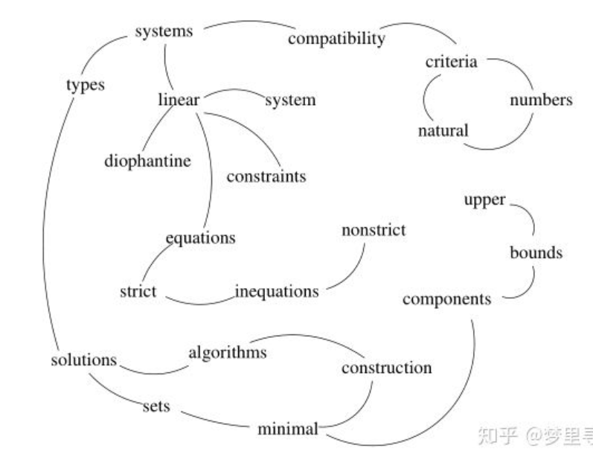
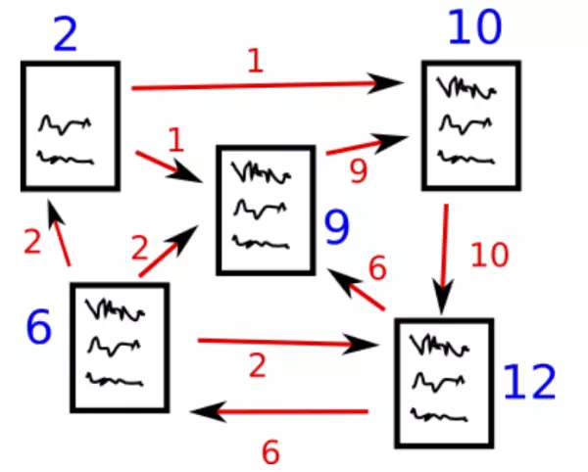
Ranking Sentence/Words with PageRank: TextRank
How to construct the transition matrix?

Slide 36
Core references
https://web.stanford.edu/class/cs276/
https://nlp.stanford.edu/IR-book/
https://www.cl.cam.ac.uk/teaching/1314/InfoRtrv/materials.html

