Slide 1




Automated AMS IP Generator for CMOS Technologies (collaboration with UMN)
University of Southern California
May. 2019

Slide 2
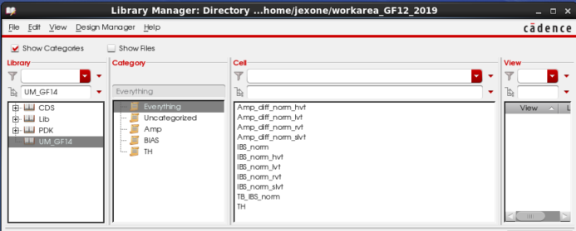
USC delivered File structure
folder
sub-folder
Netlist name
Sub-circuit list
UM.tar
netlist
netlist_BS_AMP
UM
IBS_norm_hvt
IBS_norm_rvt
IBS_norm_lvt
IBS_norm_slvt
Amp_diff_norm_hvt
Amp_diff_norm_ rvt
Amp_diff_norm_ lvt
Amp_diff_norm_ slvt
untar
netlist_TH
cdslib
UM_GF14

Slide 3
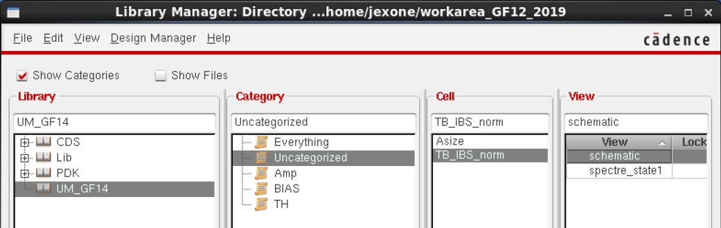
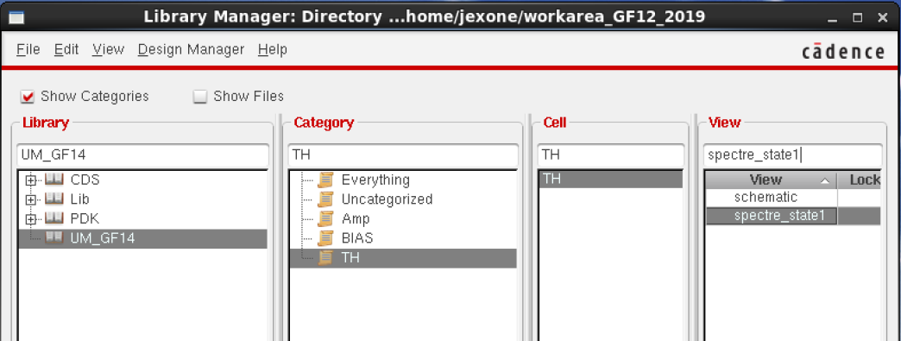
GF14 Design Testbench
Amplifier’s AC response Testbench
T/H’s FFT evaluation Testbench

Slide 4
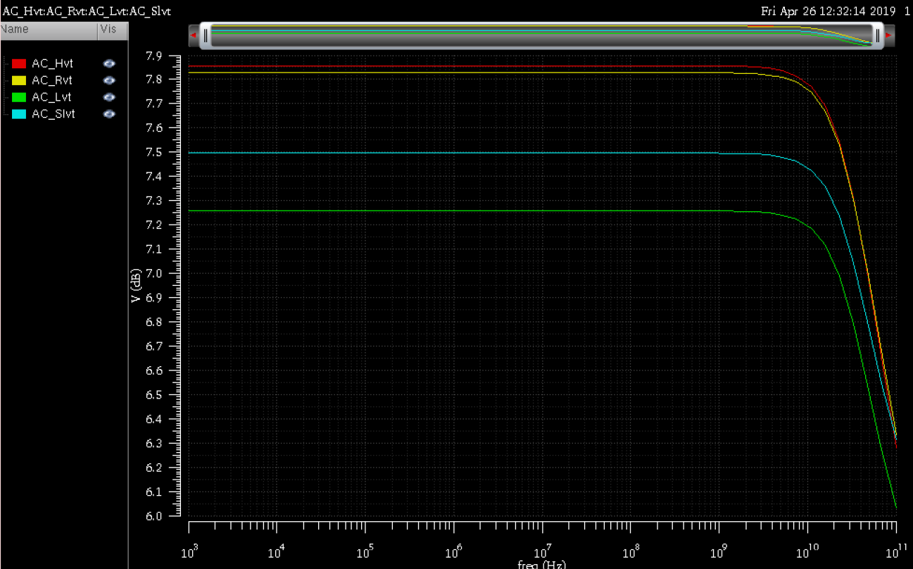
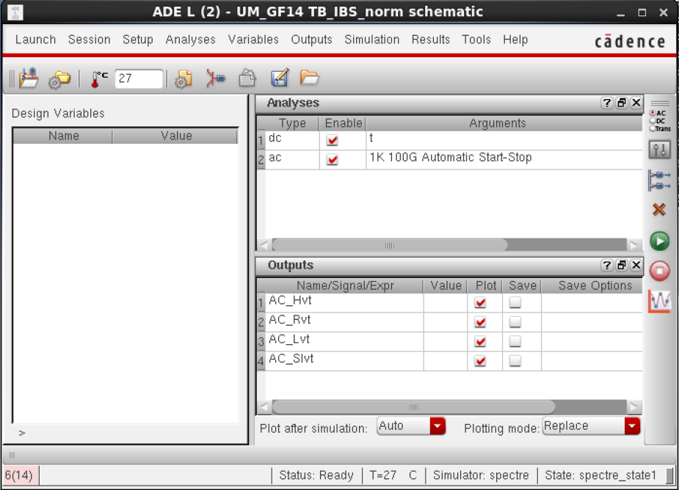
GF14 Design Test-Bench (Bias & Amp circuits)

Slide 5
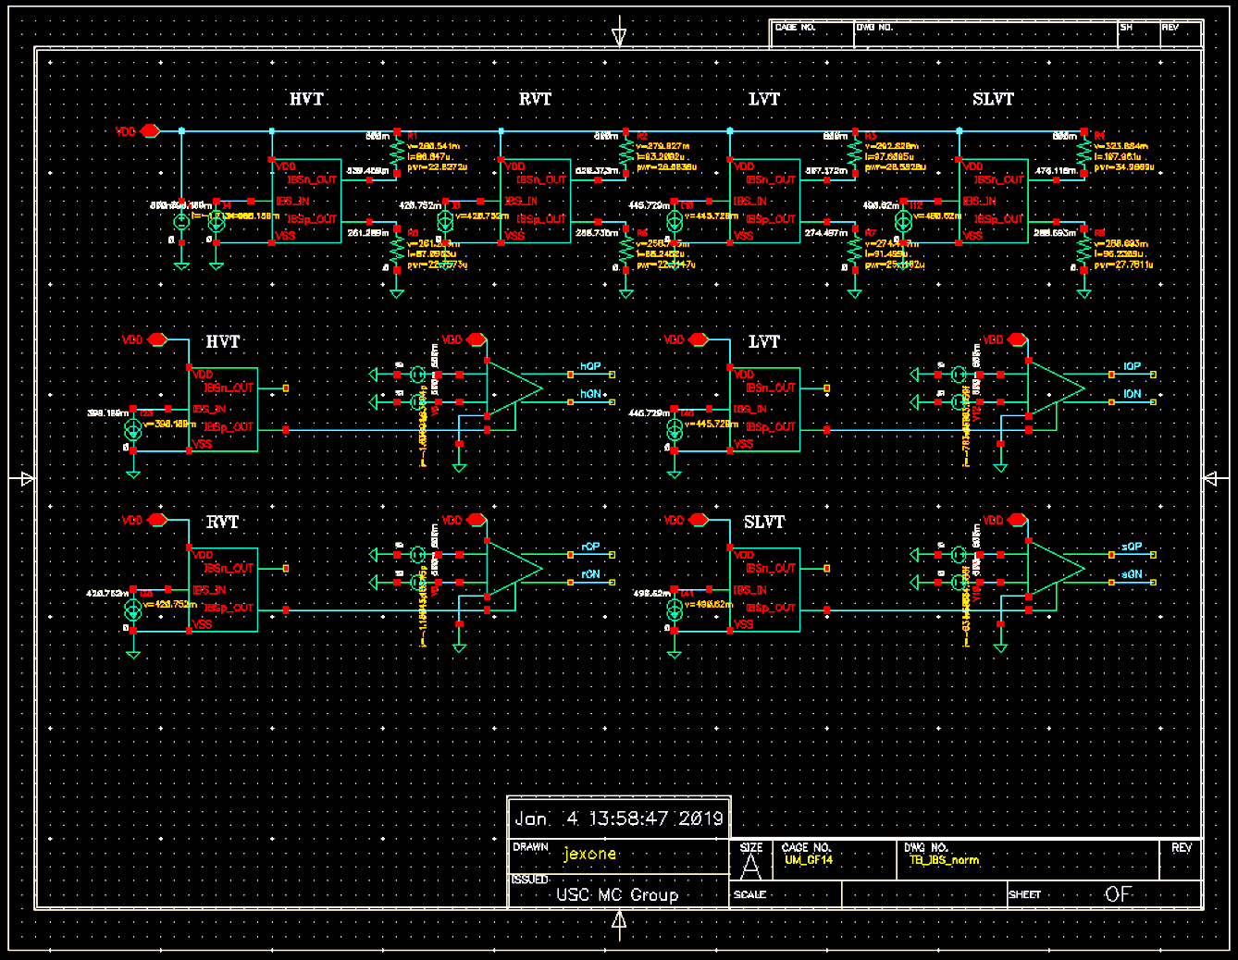
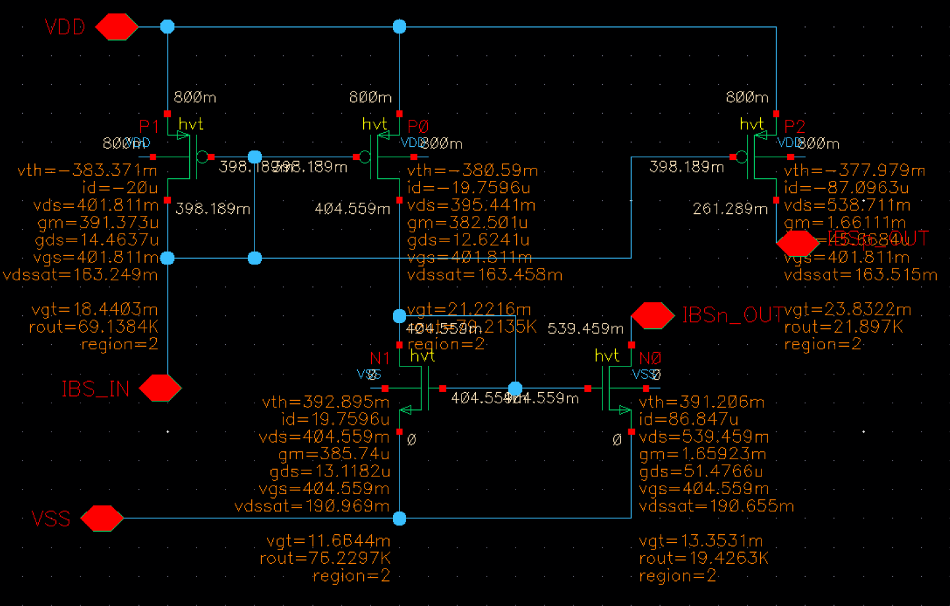
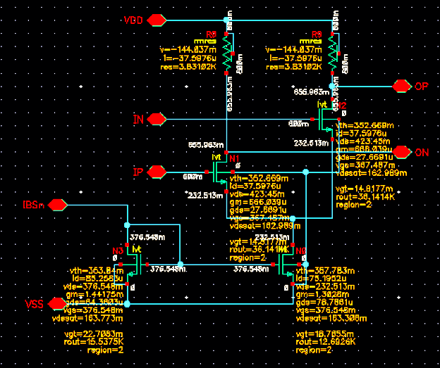
GF14 Design Example (Bias & Amp circuits)
Simple
Current mirror
NMOS/PMOS
Simple
Diff. Amp wit
Resistive Load
NMOS Input
600mV V_{CM}
800mV VDD
High V_{TH} CMOS
Normal V_{TH} CMOS
Low V_{TH} CMOS
Super-low V_{TH} CMOS
4 different type transistor
Circuits are prepared.

Slide 6
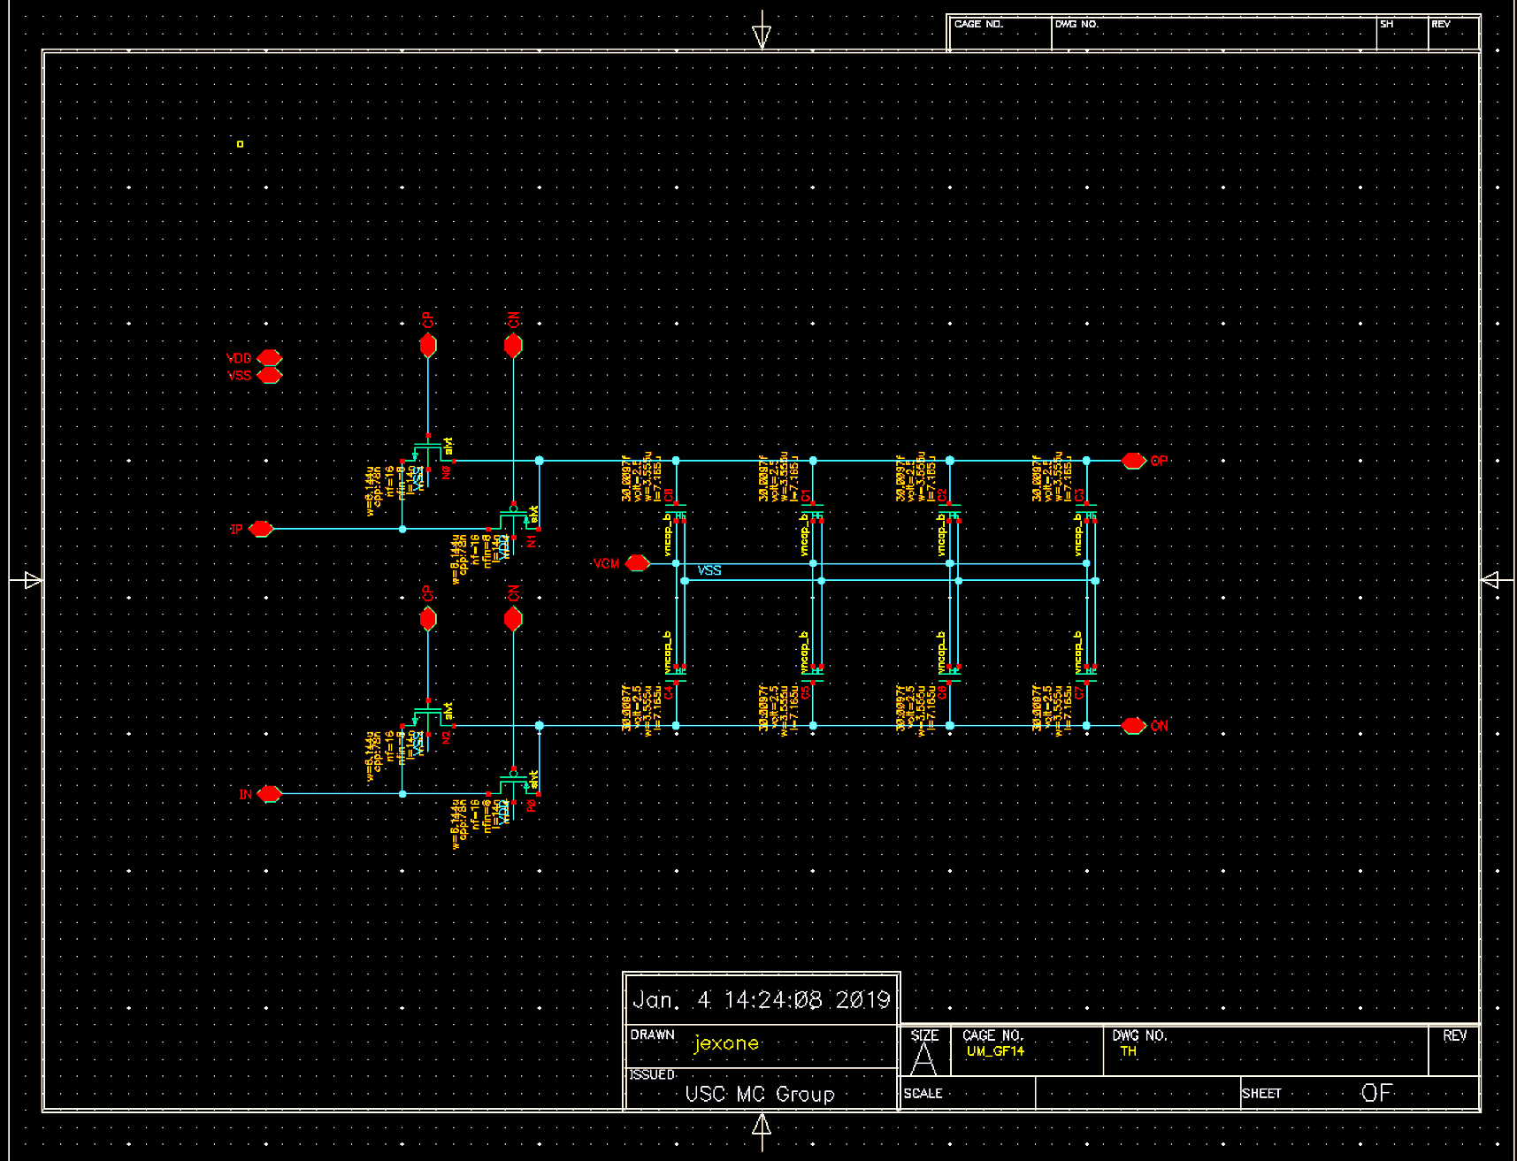
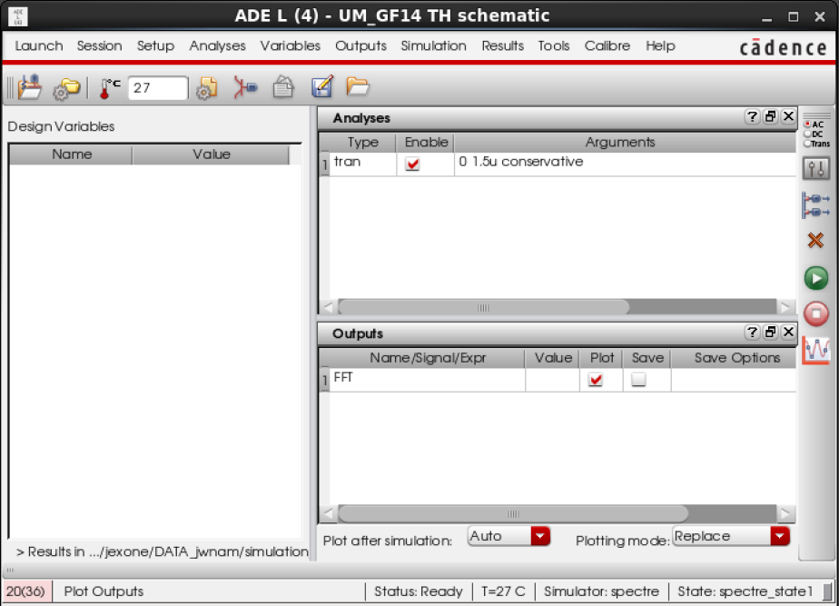
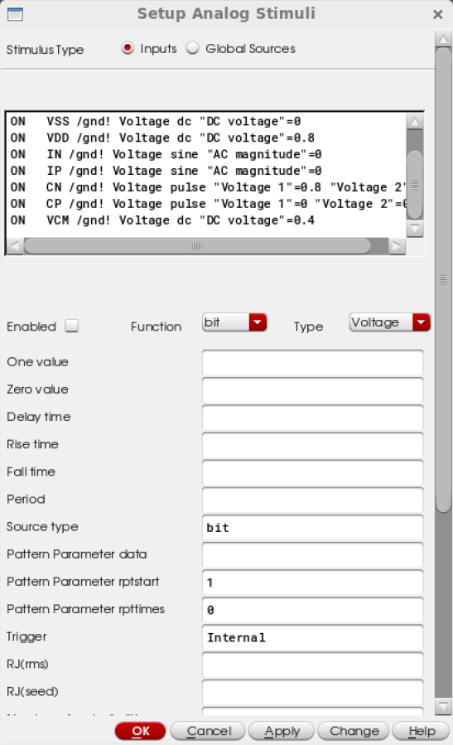
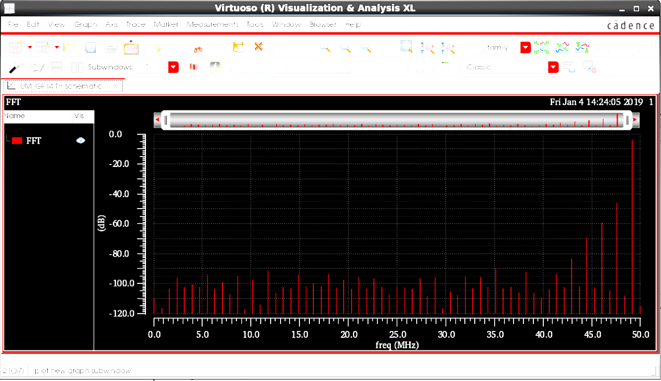
GF14 Design Example (Switched Cap T/H)
CMOS Transmission gate Switch
ADE
Stimuli
FFT plot
Sampling capacitor (Array)
Differential Top-plate T/H circuit

