Slide 1
Uninformed Search and informed search solving 24-puzzle Problem
09015113 Qiaofeng Liu

Slide 2
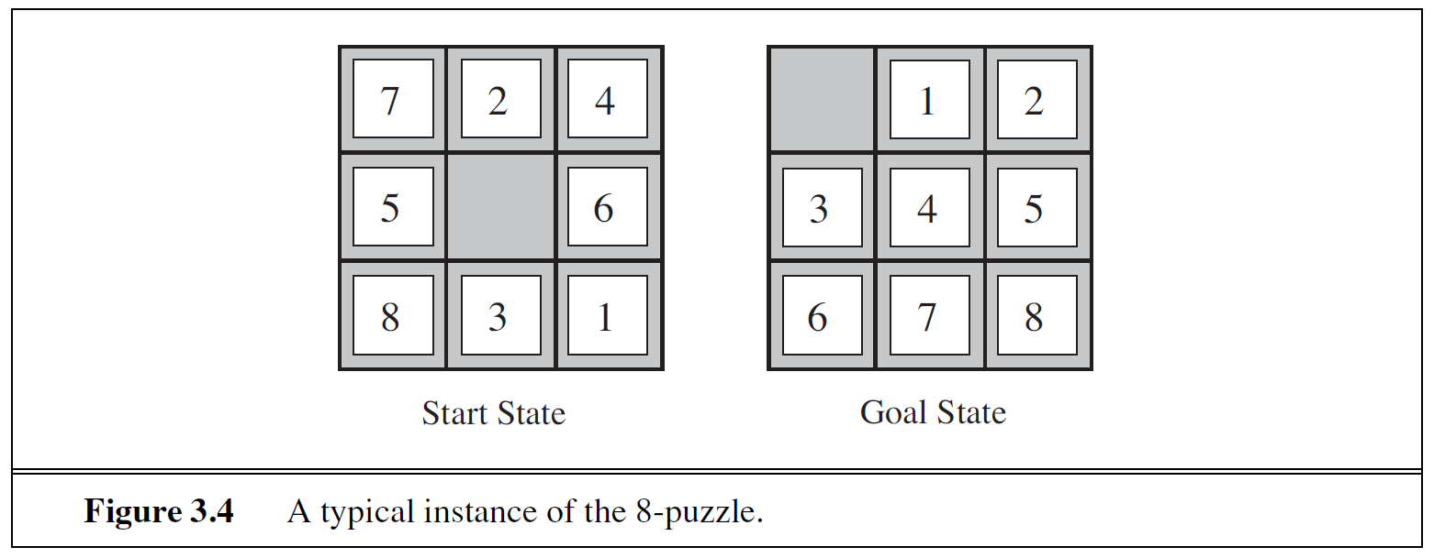
Problem description
Figure 3.4 shows us an instance of the 8-puzzle problem, and we can easily extend this to 24-puzzle problem.

Slide 3
Standard formulation
States: A state description specifies the location of each of the 24 tiles and the blank in one of the 25 squares.
Initial State: Any state can be designated as the initial state. Note that any given goal can be reached from exactly half of the possible initial states.
Actions: Movements of the blank space Left, Right, Up or Down.
Transition Model: Given a state and action, this returns the resulting state.
Goal Test: This checks whether the state matches the goal configuration.
Path Cost: Each step costs 1, so the path cost is the number of steps in the path.

Slide 4
Basis for searching
The possible sequence starting at the initial state forms a search tree with the initial state at the root; the branches are actions and the nodes correspond to state in the state space of the problem.
We need to consider taking actions by expanding the current state; that is, applying each legal action to the current state, thereby generating a new set of states.
The set of all leaf nodes available for expansion at any given point is called the frontier (or, open list, according to some authors).
The process of expanding nodes on the frontier continues until either a solution is found or there are no more states to expand.

Slide 5
Basis for searching
Four components of a node n:
n.State: the state in the state space to which the node corresponds
n.Parent: the node in the search tree that generated this node
n.Action: the action that was applied to the parent to generate the node
n.Path-Cost: the cost of the path from the initial state to the node

Slide 6
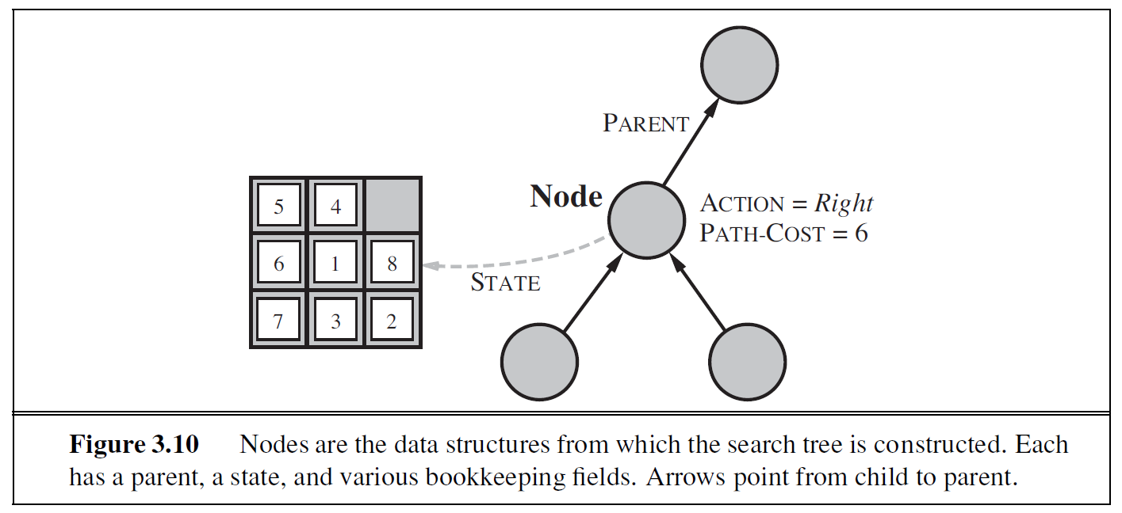
Basis for searching
Figure 3.10 displays an example of the node structure.

Slide 7
Measuring problem-solving performance
Completeness: Is the algorithm guaranteed to find a solution where there is one?
Optimality: Does the strategy find the optimal solution (the solution with the lowest path cost)?
Time complexity: How long does it take to find a solution?
Space complexity: How much memory is needed to perform the search?

Slide 8
search strategy
Uninformed Search: The strategies have no additional information about states beyond that provided in the problem definition. All search strategies are distinguished by the order in which nodes are expanded.
Informed Search: The strategies know whether one non-goal state is “more promising” than another.

Slide 9
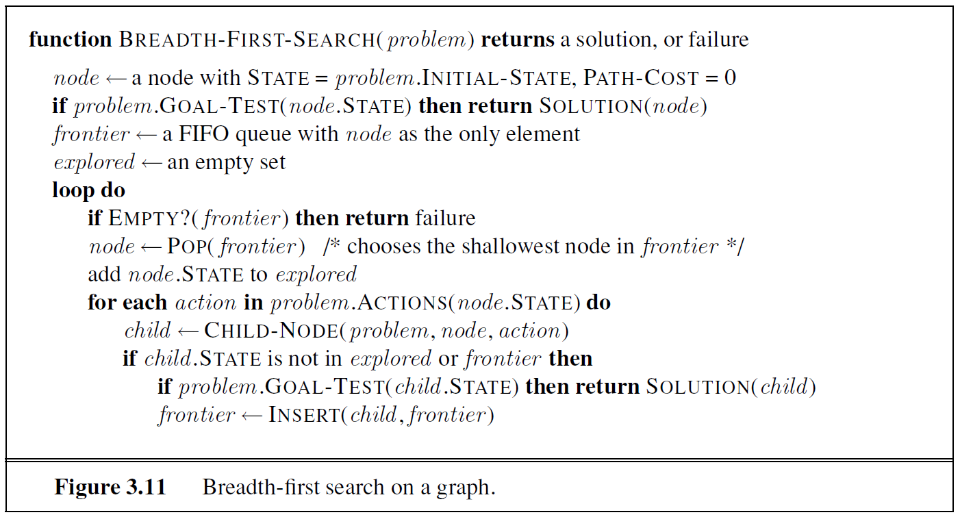
Breadth-first search

Slide 10
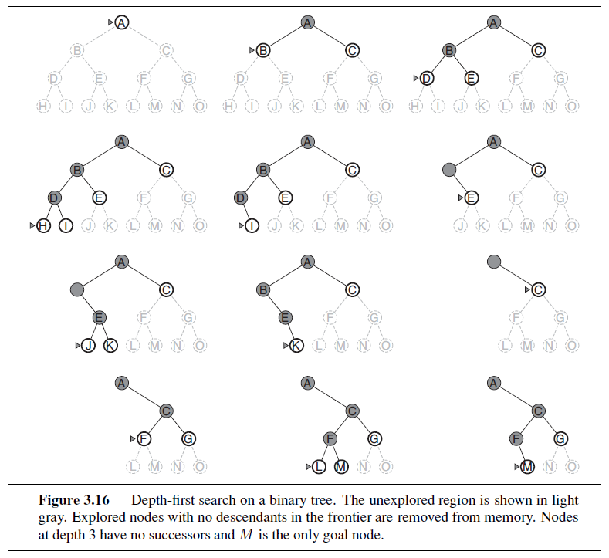
Depth-first search
Figure 3.16 displays the process of doing DFS.
We could simply implement this by applying backtracking.

Slide 11
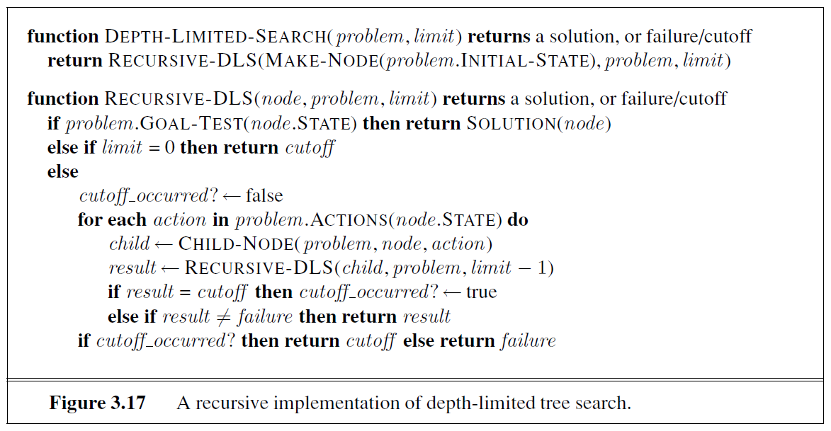
Depth-limited search

Slide 12
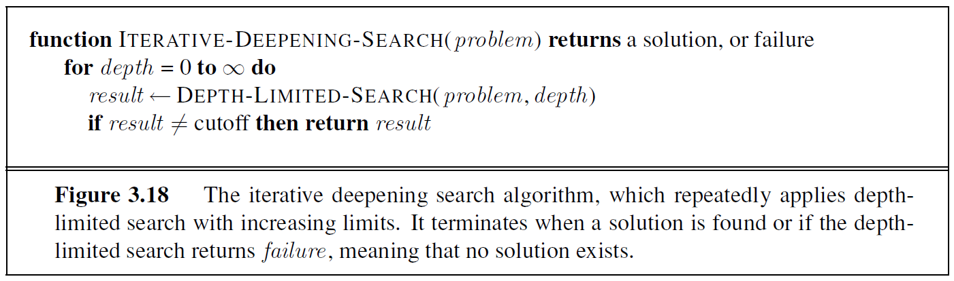
Iterative deepening DFS

Slide 13
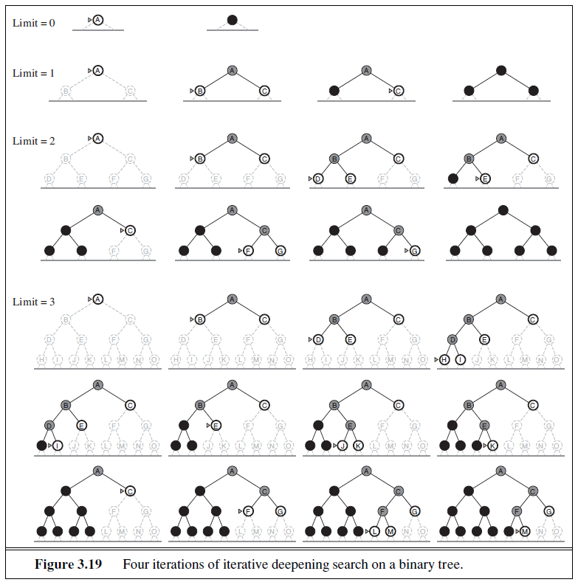
Iterative deepening DFS
Figure 3.19 displays the process of doing Iterative Deepening DFS.
Iteratively deepening the search until it finds a solution.

Slide 14
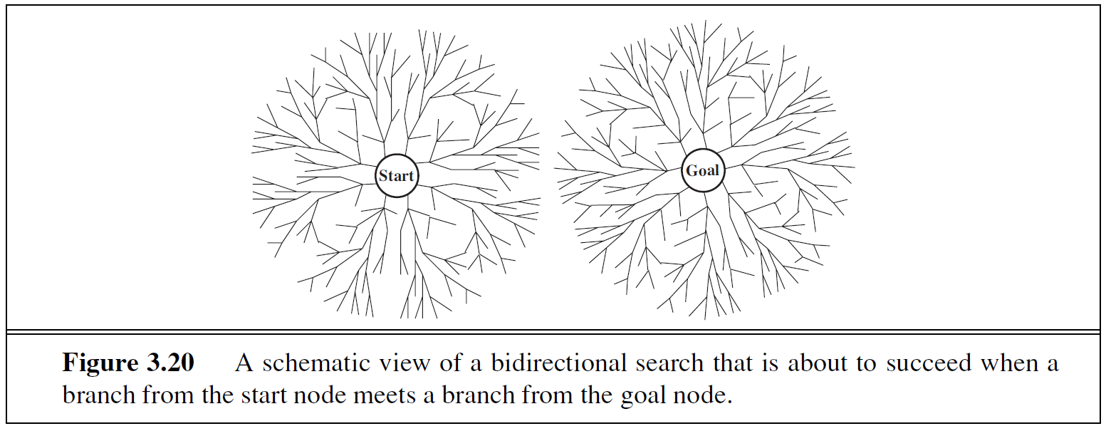
bidirectional search

Slide 15
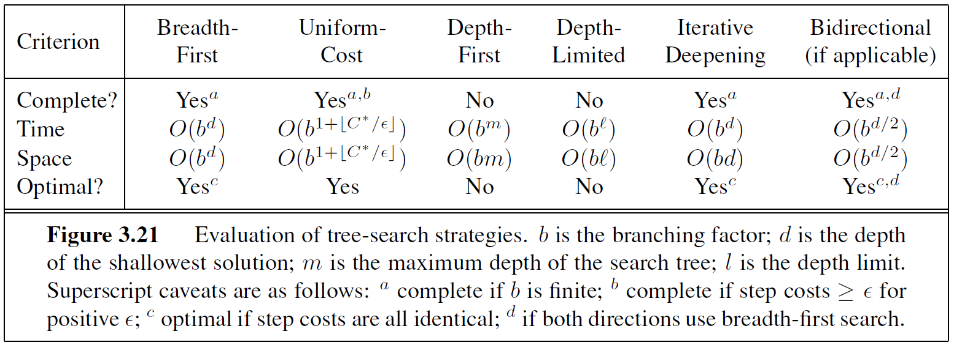
COMPARING uninformed search strategies

Slide 16
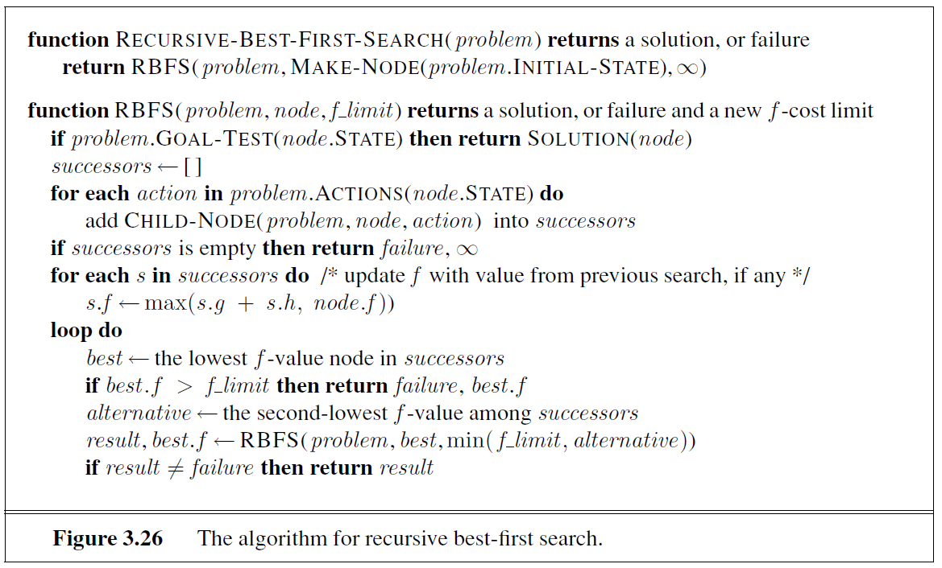
Recursive-best first search

Slide 17
Alternative Heuristic function
Heuristic Function 1: Number of misplaced tile.
Heuristic Function 2: the Manhattan Distance from the goal state (Because tiles cannot move along diagonals, the distance we will count is the sum of the horizontal and vertical distances.)
They are both Admissible Heuristic Functions, because they never overestimate the cost to reach the goal state.

Slide 18
MY implementation
Uninformed Search:
Simple Breadth-first Search (SimBFS.hpp)
Simple Bidirectional Breadth-first Search (SimBiDirectBFS.hpp)
Informed Search:
Best-first Search based on Priority Queue (HBFS.hpp)
Bidirectional Best-first Search (HBiDirectBFS.hpp)

Slide 19
Best-first Search based on Priority Queue
Improved the Breadth-first Search by replacing the FIFO queue with a priority queue. The node with the smallest f-value is chosen to expand first. (The f-value of a node is equal to the Path-Cost to reach the current state, plus the value evaluated by the heuristic function used.)
Heuristic Function 2 (calculating the Manhattan Distance from the goal state) is used.

Slide 20
Bidirectional Best-first Search
Very similar to the search algorithm in the previous slide.
Additionally, applying backward search simultaneously like the simple bidirectional Breadth-first Search.

Slide 21
Experiment
Testcase 1:
Files: Board100.txt ~ Board1029.txt, 30 files in total
24-puzzle, countermarching 10 steps from the goal state
Testcase 2:
Files: Board0.txt ~ Board29.txt, 30 files in total
24-puzzle, countermarching 30 steps from the goal state

Slide 22
Experiment

Slide 23
Summary
Informed Search Strategies are not worse than Uninformed Search Strategies in most of the time, because some Heuristic Functions are applied to help improve the decision making.
The selection of Heuristic Function depends on the problem setting, and it varies. But, it would be better if the program could learn a good Heuristic. (Reinforcement Learning)
Also, there are still many good algorithms for solving 24-puzzle problem, like Pattern Database.

Slide 24
Reference
Stuart Russell, Peter Norvig, B. Artificial Intelligence: A Modern Approach, 3rd ed.; Pearson Education Inc.: New Jersey, U.S., 2010
https://en.wiktionary.org/wiki/Manhattan_distance
https://en.wikipedia.org/wiki/Iterative_deepening_A*
https://blog.csdn.net/ju136/article/details/6876647

