Slide 1

Graphite—监控利器
宋传胜
chuansheng.song@langtaojin.com

Slide 2
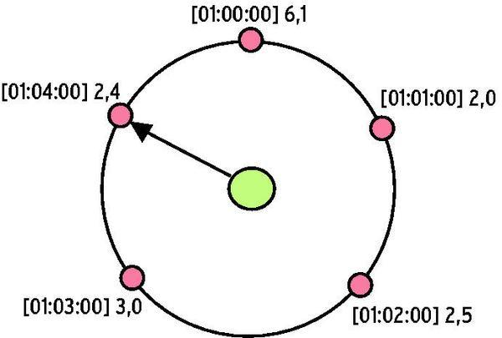
RRDTool – Round Robin Database
Ganglia/Cacti/Mrtg的底层

Slide 3
为啥不用Ganglia/Cacti了
底层采用了类似RRD的数据库whisper，纯python，性能稍差一些
Whisper采用定长，每data point 12字节，可以不按时序更新，rrdtool做不到，定长磁盘读取性能也较好
增加新图表不需要配置！
方便管理

Slide 4
Graphite
Whisper （存储）
Carbon （采集服务器、聚集）
Graphite web （Django前端，dashboard）

Slide 5
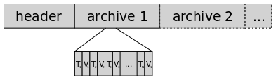
Whisper
使用磁盘文件管理
固定尺寸，即使没有数据也占好尺寸
storage-schema.conf配置存储时间间隔
whisper-info.py/whisper-fetch.py/whisper-resize.py
Notes:
whisper-info.py /opt/graphite/storage/whisper/guang/webstatus/http_1xx.wsp
whisper-fetch.py /opt/graphite/storage/whisper/guang/webstatus/http_2xx.wsp | tail
vim /opt/graphite/conf/storage-schemas.conf
----- 会议笔记(12-12-20 12:35) -----
F5

Slide 6
storage-schemas.conf
[mysql_stats]
pattern = ^mysql\.
retentions = 10s:2d,60s:14d,30m:2y
[default_1min_for_1day]
pattern = .*
retentions = 60s:14d,30m:2y

Slide 7
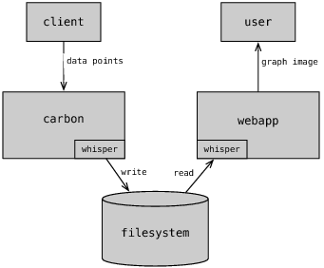
Carbon
端口 TCP 2003
carbon-cache.py/carbon-aggregator.py / carbon-relay.py
Notes:
/usr/bin/python /opt/graphite/bin/carbon-cache.py start

Slide 8
Graphite Web
/usr/bin/python /opt/graphite/webapp/graphite/manage.py runfcgi method=prefork host=0.0.0.0 port=3033 pidfile=/var/run/graphite.pid daemonize=True
http://graphite.jcndev.com
http://graphite.jcndev.com/dashboard
图片url增加format=json就可以输出json数据
http://graphite.jcndev.com/admin/

Slide 9
强大的Graphite Functions
*.mysql-guangdb*.mysql_commands-update.value
removeBelowValue(stats.timers.guang.web.products.htm.upper,0)
integral(stats_counts.guang.crawl.itemimg.succ)
derivative(collectd192_168_10_121collectd.memcached-mem1.memcached_items-current.value)
log(integral(stats_counts.taobao.crawl.itemhtml.succ), 1.05)
highestCurrent( stats.timers.guang.web.*.*.count, 8)
removeBelowValue(mostDeviant(8, stats.timers.guang.web.*.*.mean),0)
Notes:
首页 GraphData操作

Slide 10
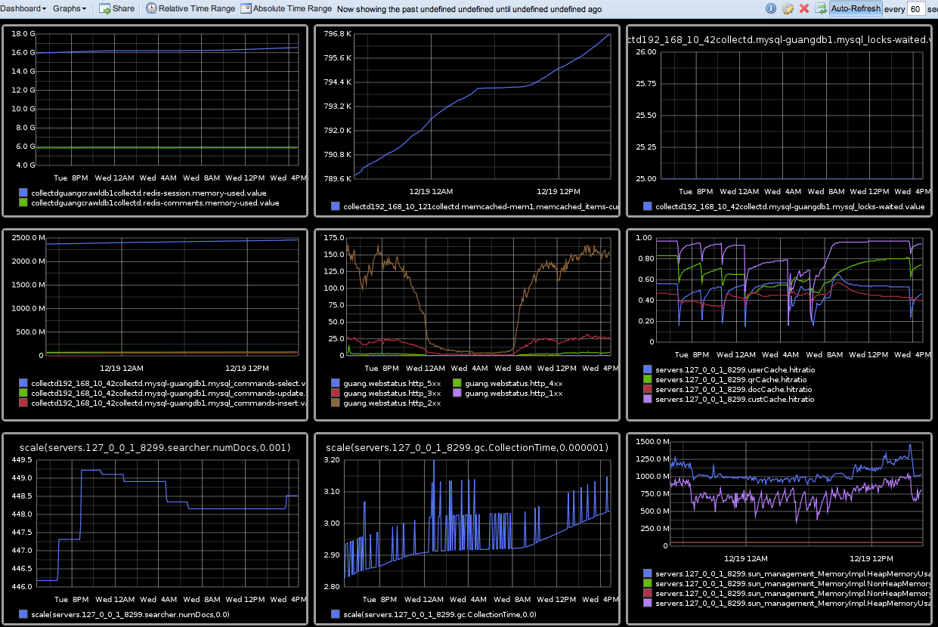
案例
从cache ratio变化发现solr索引不正常

Slide 11
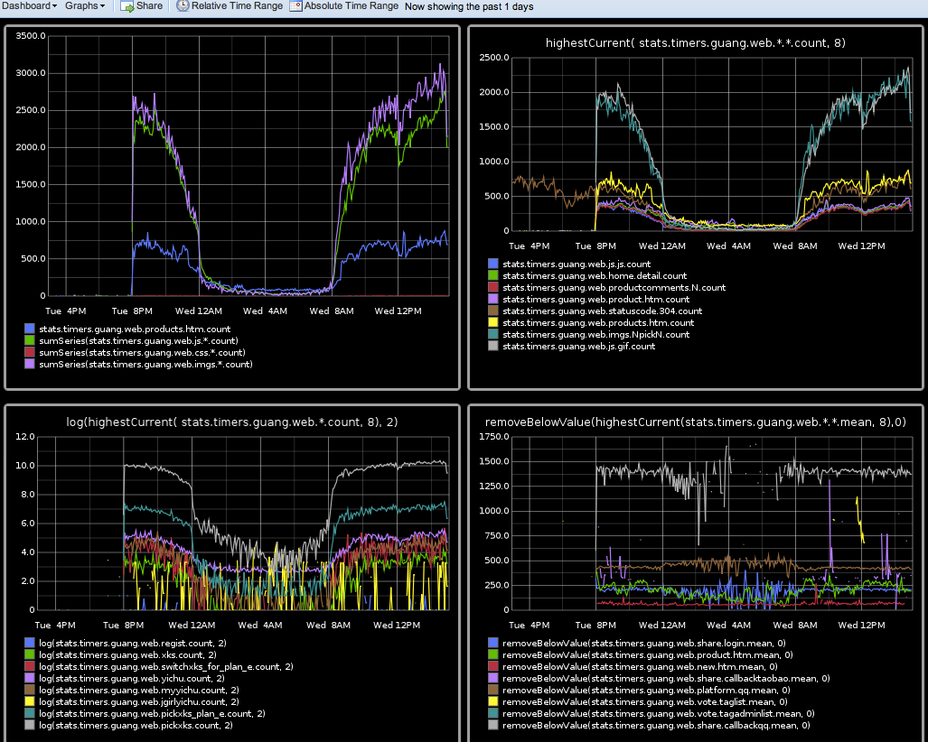
案例
从topn请求发现tomcat在serve静态文件

Slide 12
Statsd
StatsD -- node.js server
UDP，允许丢包
定期aggrate数据发送到graphite backend
Counting -- gorets:1|c
Sampling -- gorets:1|c|@0.1
Timing -- glork:320|ms
Gauges -- gaugor:333|g
Sets -- uniques:765|s

Slide 13
Statsd Client
Java client
  http://review.jcndev.com/#change,19080
Python client
  pygaga.helpers.statsd
  http://review.jcndev.com/#change,19338
Notes:
crawl_item_impl.py

Slide 14
Collectd
collectd – The system statistics collection daemon
支持mysql、redis、snmp、memcached、IPMI等数据采集
支持发送到graphite/ganglia/cacti
Notes:
Guangcrawldb1 -- /opt/collectd/sbin/collectd -C /etc/collectd/collectd.conf -P /var/run/collectdmon.pid
----- 会议笔记(12-12-20 12:35) -----
F5

Slide 15
Logster
Logster - generate metrics from logfiles -- python
Logstash – java
logster --output=graphite --graphite-host=localhost:2003 SampleLogster /space/logger/jcn/access.guang.j.cn.log -p guang.webstatus
Notes:
0 0 * * * (/bin/rm -f /space/logger/jcn/access.guang.j.cn.log)
*/1 * * * * (/usr/bin/rsync --append --inplace --partial -aq 192.168.10.227::logs/access.guang.j.cn.log /space/logger/jcn/access.guang.j.cn.log; /usr/local/bin/logster --output=graphite --graphite-host=localhost:2003 SampleLogster /space/logger/jcn/access.guang.j.cn.log -p guang.webstatus)
vim /space/chris/logster/logster/parsers/SampleLogster.py
Server下
----- 会议笔记(12-12-20 12:35) -----
F5

Slide 16
JMXTrans
Write jmx to graphite/ganglia
Notes:
Solr1
/space/chris/jmxtrans/jmxtrans.sh start /space/chris/jmxtrans/graphite.json
vim /space/chris/jmxtrans/graphite.json
----- 会议笔记(12-12-20 12:35) -----
F2

Slide 17
Alert
https://github.com/scobal/seyren
http://graphite.jcndev.com/seyren/
http://review.jcndev.com/#change,19418
Usage: graphite_alert.py --stderr --color --verbose debug --target servers.127_0_0_1_8299.qrCache.hitratio --warnv 0.8 --errorv 0.72 –lastn 3 --nogt --since -1hours --use_paperboy
TODO: implement admin dashboard 4 alert

Slide 18
性能瓶颈
主要性能瓶颈出现在每秒写文件个数和字节数
优化
  集群
  缓存，批量更新
  降低更新频率
  减少图表数量

Slide 19
Dashboard Replacement
http://graphite.jcndev.com/tasseo/guangweb
http://gdash.jcndev.com/dashboards/guangweb/
http://graphite.jcndev.com/graphene/dashboard-guangwebcount.html
graphiti …

Slide 20
其他替代品
Opentsdb – hadoop 大数据
大规模可视化
  http://square.github.com/cubism/

Slide 21
Read List
The Architecture of Open Source Applications: Graphite – 性能问题
Understanding StatsD and Graphite
Measure Anything, Measure Everything
Graphite Documentation -- Functions
Related bookmark
Monitoring Wonderland Survey - Visualization

