Slide 1
High Level Synthesis

Slide 2
High Level Synthesis
In one word:
The High-Level Synthesis (HLS) tool transforms a C specification into an RTL implementation that you can synthesize into a Xilinx FPGA.
Benefits:
-- Working at a higher level of abstraction while creating high-performance hardware.
-- Accelerating the computationally intensive parts of their algorithms on FPGA.
Using a high-level synthesis design methodology allows you to:
-- Develop algorithms at the C-level.
-- Verify at the C-level. -- Control the C synthesis process through optimization directives. -- Create multiple implementations from the C source code using optimization directives.

Slide 3
High Level Synthesis
High-level synthesis synthesizes the C code as follows: -- Top-level function arguments synthesize into RTL I/O ports.
-- C functions synthesize into blocks in the RTL hierarchy. -- Loops in the C functions are kept rolled by default.
-- Arrays in the C code synthesize into block RAM in the final FPGA design.
You can use optimization directives to modify and control the default behavior of the internal
logic and I/O ports. This allows you to generate variations of the hardware implementation
from the same C code.

Slide 4
Vivado HLS Design Flow

Slide 5
HLS : Reports
-- Area: Amount of hardware resources required to implement the design based on the resources available in the FPGA, including look-up tables (LUT), registers, block RAMs, and DSP48s. -- Latency: Number of clock cycles required for the function to compute all output values.
-- Initiation interval (II): Number of clock cycles before the function can accept new input data. -- Loop iteration latency: Number of clock cycles it takes to complete one iteration of the loop. -- Loop initiation interval: Number of clock cycles before the next iteration of the loop starts to process data. -- Loop latency: Number of cycles to execute all iterations of the loop.

Slide 6
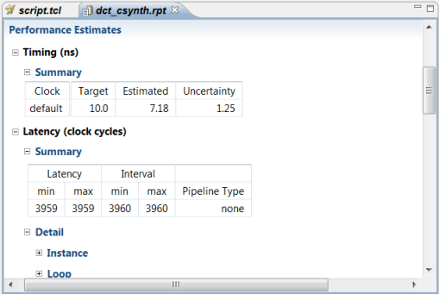
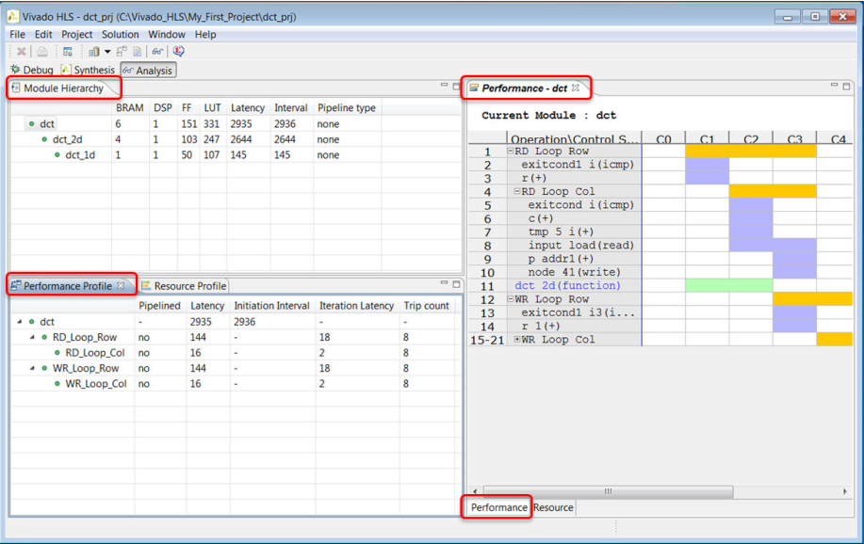
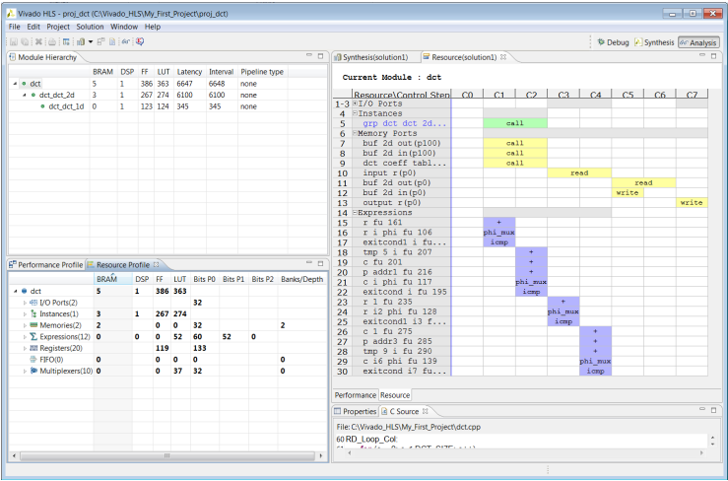
HLS : Reports
Synthesis Report
-- General Information
-- Performance Estimate
-- Utilization Estimate
-- Interface
Analysis Perspective
Notes:
Schedule View

Slide 7
HLS : Optimize
-- Instruct a task to execute in a pipeline, allowing the next execution of the task to begin
before the current execution is complete.
-- Specify a latency for the completion of functions, loops, and regions. -- Specify a limit on the number of resources used. -- Override the inherent or implied dependencies in the code and permit specified operations. For example, if it is acceptable to discard or ignore the initial data values, such as in a video stream, allow a memory read before write if it results in better performance. -- Select the I/O protocol to ensure the final design can be connected to other hardware blocks with the same I/O protocol.

Slide 8
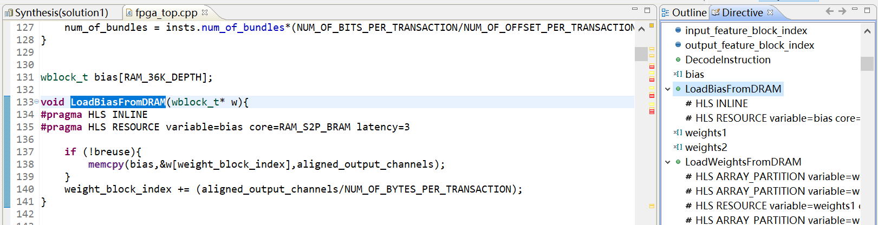
Applying Optimization Directives
You can add optimization directives via directives.tcl/ GUI/ source code.
With the source code active in the Information pane, select the Directives tab on the right to display and modify directives for the file. The Directives tab contains all the objects and scopes in the currently opened source code to which you can apply directives.

Slide 9
Applying Optimization Directives
You can apply optimization directives to the following objects and scopes:
-- Interfaces: When you apply directives to an interface, Vivado HLS applies the directive to the top-level function, because the top-level function is the scope that contains the interface.
-- Functions: When you apply directives to functions, Vivado HLS applies the directive to all objects within the scope of the function. The effect of any directive stops at the next level of function hierarchy.
-- Loops: When you apply directives to loops, Vivado HLS applies the directive to all objects within the scope of the loop.
-- Arrays: When you apply directives to arrays, Vivado HLS applies the directive to the scope that contains the array. -- Regions: When you apply directives to regions, Vivado HLS applies the directive to the entire scope of the region. A region is any area enclosed within two braces.

Slide 10
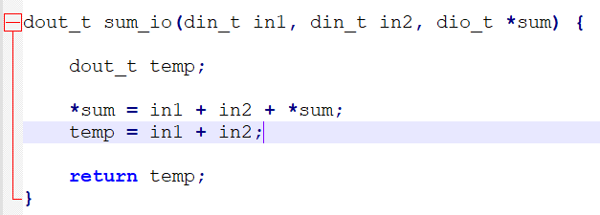
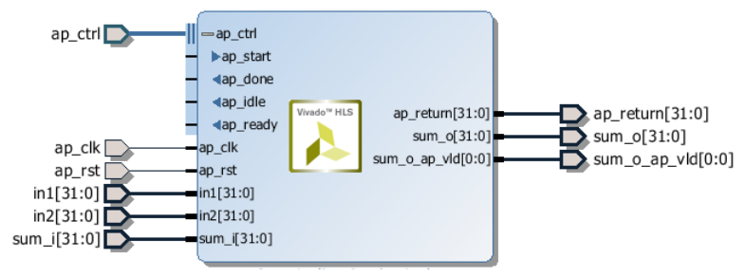
Interface Synthesis
When the top-level function is synthesized, the arguments (or parameters) to the function are synthesized into RTL ports. This process is called interface synthesis.
-- Two inputs in1 and in2.
-- A pointer sum that is both read from and written to.
-- Return value temp.
-- Clock and Reset ports.
-- Block level interface protocol.
-- Port level interface protocol.

Slide 11
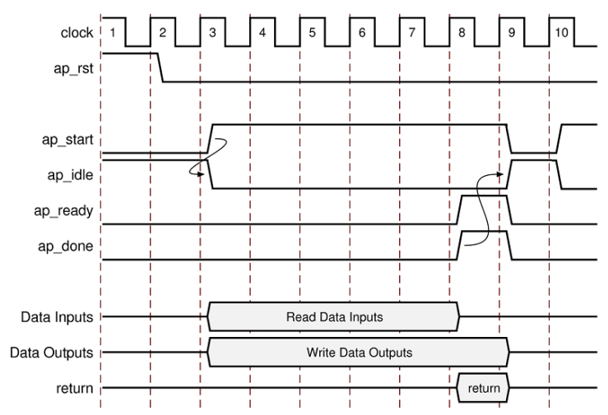
Interface Synthesis
When the top-level function is synthesized, the arguments (or parameters) to the function are synthesized into RTL ports. This process is called interface synthesis.
-- Clock and Reset ports.
-- Block level interface protocol.
-- Port level interface protocol.

Slide 12
Interface Synthesis
The interface MODE option has types below:
-- ap_fifo: Implements the port with a standard FIFO interface using data input and output ports with associated active-Low FIFO empty and full ports. -- ap_bus: Implements pointer and pass-by-reference ports as a bus interface. -- ap_memory: Implements array arguments as a standard RAM interface. -- bram: Implements array arguments as a standard RAM interface. If you use the RTL design in Vivado IP integrator, the memory interface appears as a single port. -- axis: Implements all ports as an AXI4-Stream interface. -- s_axilite: Implements all ports as an AXI4-Lite interface. -- m_axi: Implements all ports as an AXI4 interface.

Slide 13
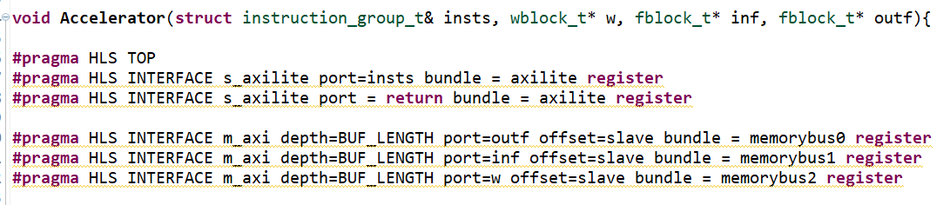

Slide 14
Optimize -- Clocks, resets and RTL Outputs
Reset:
-- None, no reset is added to the design.
-- Control, the default, all control registers are reset.
-- State, this adds a reset to control registers plus any registers or memories derived from static and global variables in the C code.
-- All, to add a reset to all registers and memories in the design.
RTL Outputs:
-- Specify the type of FSM encoding used in the RTL state machines.
-- Add an arbitrary comment string, such as a copyright notice to all RTL files.
-- Specify a unique name to all RTL output file names.
-- Force the RTL ports to use lower names.
Clocks:
-- For C and C++ designs only a single clock is supported. The same clock is applied to all functions in the design.
For SystemC designs, each SC_MODULE may be specified with a different clock.

Slide 15
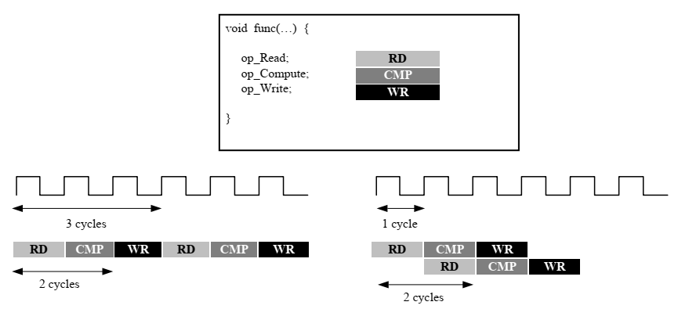
Optimizing for Throughput
Function and Loop Pipelining:
Pipelining allows operations to happen concurrently: each execution step does not have to complete all operations before it begins the next operation.
Pipelining is applied to functions and loops.
(a) Without Function Pipelining (b)With Function Pipelining
-- Without Function Pipelining, the function has an initiation interval (II)
of 3 and a latency of 3.
-- With Function Pipelining, a new input is read every cycle (II=1) with
no change to the output latency.

Slide 16
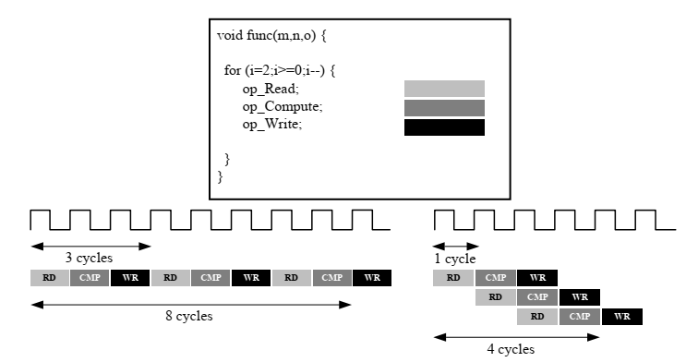
Optimizing for Throughput
Function and Loop Pipelining:
Pipelining allows operations to happen concurrently: each execution step does not have to complete all operations before it begins the next operation.
Pipelining is applied to functions and loops.
(a) Without Loop Pipelining (b)With Loop Pipelining
-- In (a), there are 3 clock cycles between each input read (II=3), and it
requires 8 clock cycles before the last output write is performed.
-- In (b), a new input sample is read every cycle (II=1) and the final
output is written after only 4 clock cycles.

Slide 17
Optimize – Partitioning Arrays
Warning：Unable to schedule ‘xxx' operation on array 'mem' due to limited memory ports.
-- Arrays are implemented as block RAM which only has a maximum of two data ports.
-- The issue above can be solved by splitting the array (a single block RAM resource) into multiple smaller arrays (multiple block RAMs), effectively increasing the number of ports.
The original array is split into equally sized blocks of consecutive elements of the original array.
The original array is split into equally sized blocks interleaving the elements of the original array.
The default operation is to split the array into its individual elements. This corresponds to resolving a memory into registers.

Slide 18
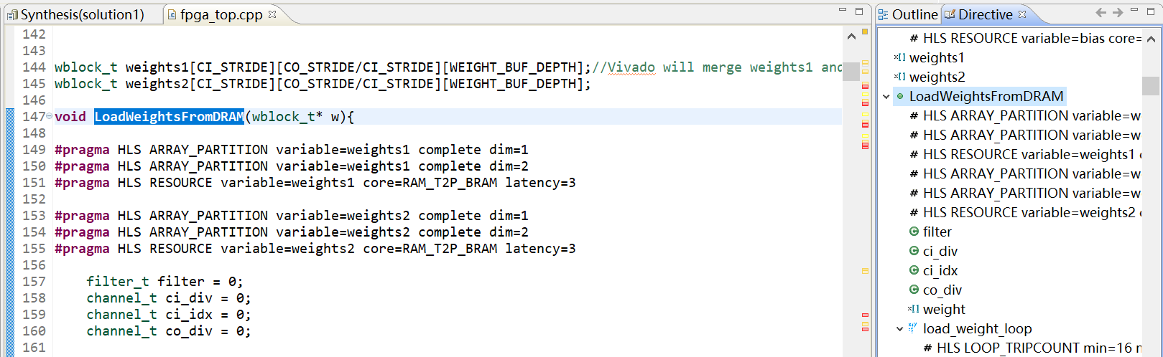

Slide 19
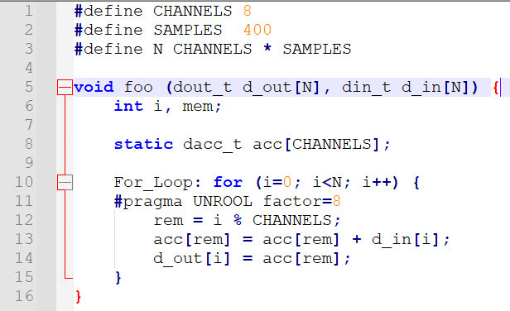
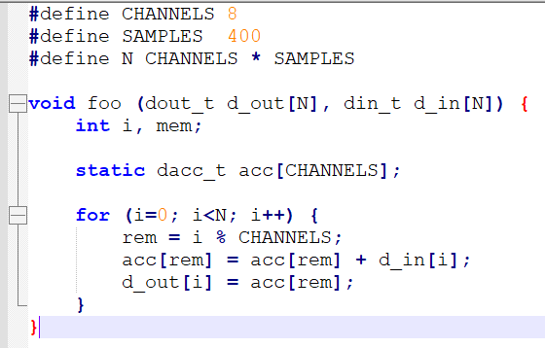
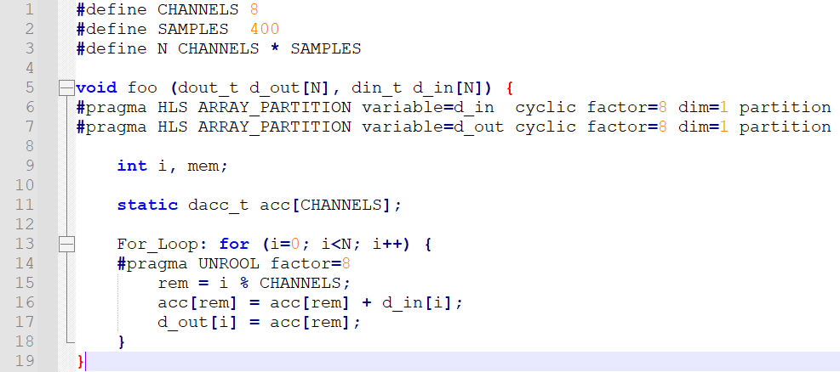
Optimize – Loop Unrolling
By default, loops are kept rolled in Vivado HLS. We can use UNROLL directive to unroll the loop.

Slide 20
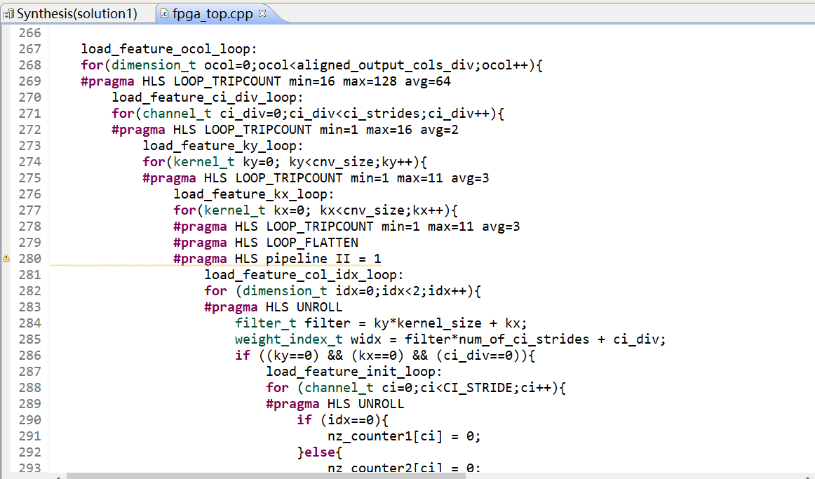

Slide 21
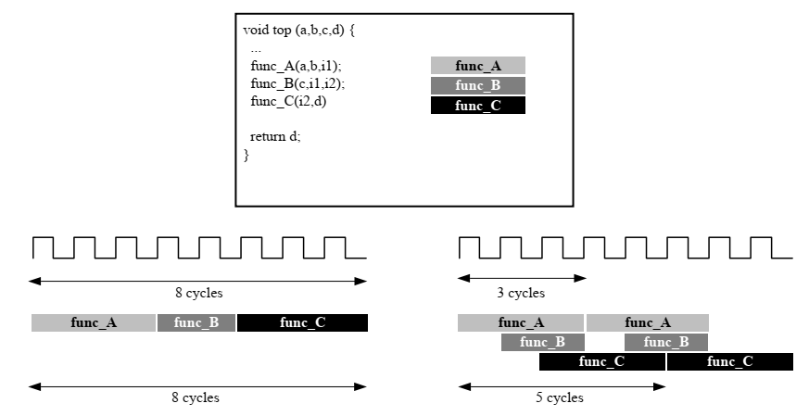
Optimize – Dataflow
The dataflow optimization is useful on a set of sequential tasks to create an architecture of concurrent processes.
(a) Without dataflow (b) With dataflow

Slide 22
Dataflow Optimization Limitations
The following behaviors can prevent or limit the overlapping that Vivado HLS can perform with DATAFLOW optimization:
-- Single-producer-consumer violations -- Bypassing tasks -- Feedback between tasks -- Conditional execution of tasks -- Loops with multiple exit conditions

Slide 23
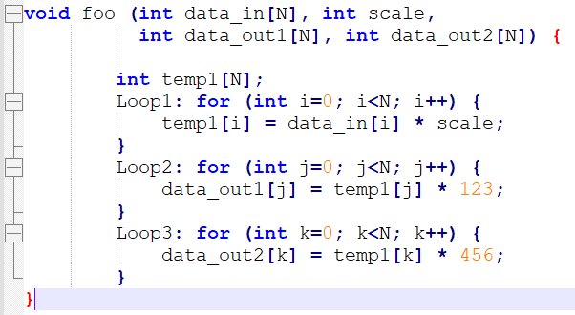
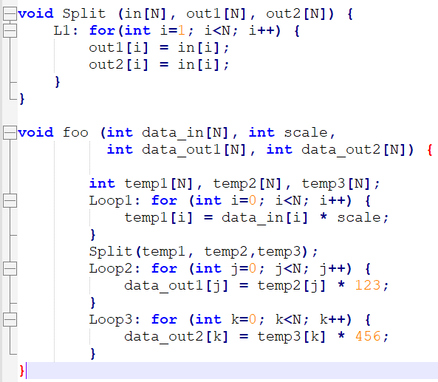
Dataflow Optimization Limitations
Single-producer-consumer Violations :
For Vivado HLS to perform the DATAFLOW optimization, all elements passed between tasks must follow a single-producer-consumer model. Each variable must be driven from a single task and only be consumed by a single task.

Slide 24
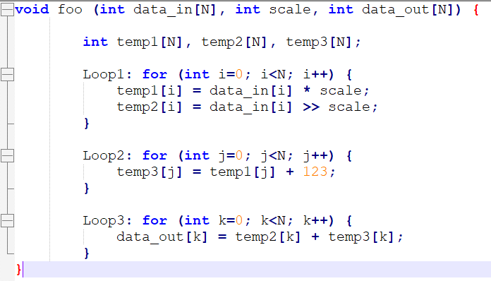
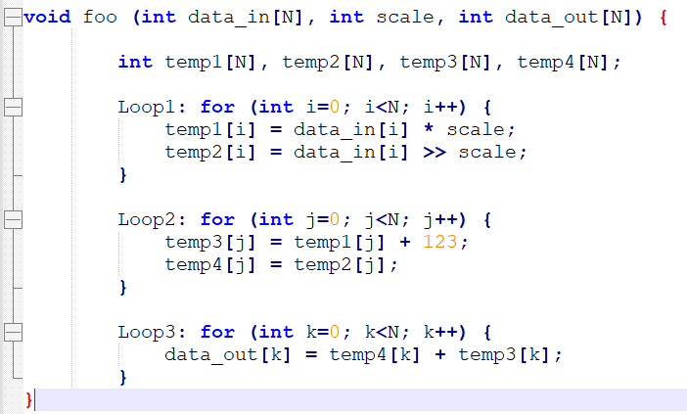
Dataflow Optimization Limitations
Bypassing Tasks:
Data should generally flow from one task to another. If you bypass tasks, this can reduce the performance of the DATAFLOW optimization.

Slide 25
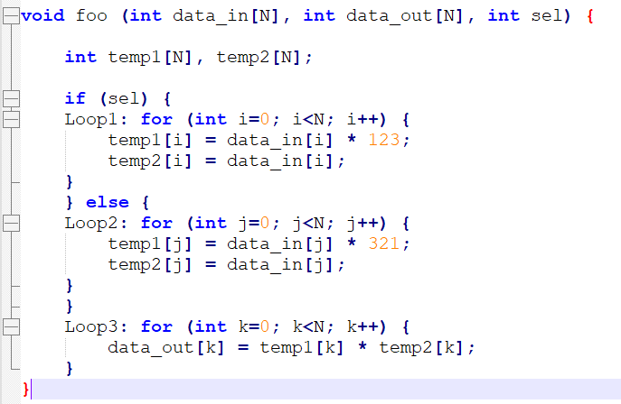
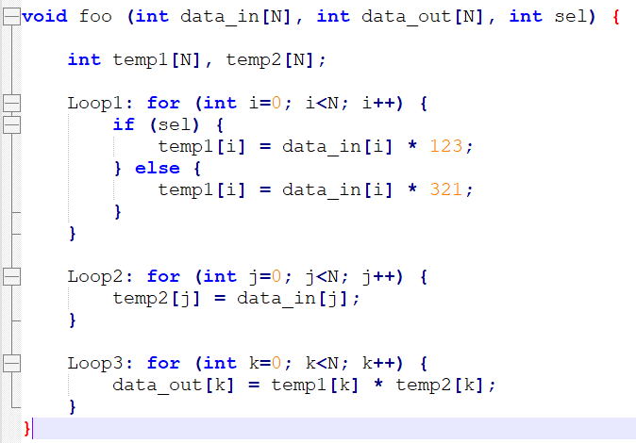
Dataflow Optimization Limitations
Conditional Execution of Tasks:
The DATAFLOW optimization does not optimize tasks that are conditionally executed.
To ensure each loop is executed in all cases, you must make sure the loops are always executed, and data always flows from one loop to the next.

Slide 26
Dataflow Optimization Limitations
Feedback between Tasks:
Feedback occurs when the output from a task is consumed by a previous task in the DATAFLOW region. Feedback between tasks is not permitted in a DATAFLOW region.
Loops with Multiple Exit Conditions:
Loops with multiple exit points cannot be used in a DATAFLOW region.
Finally, the DATAFLOW optimization has no hierarchical implementation. If a sub-function or loop contains additional tasks that might benefit from the DATAFLOW optimization, you must apply the DATAFLOW optimization to the loop, the sub-function, or inline the sub-function.

Slide 27
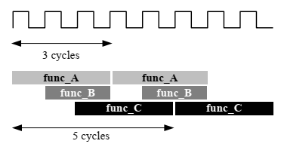
Configuring DATAFLOW Memory Channels
-- For scalar, pointer, and reference parameters, Vivado HLS implements the channel as a FIFO.
-- If the parameter is an array, Vivado HLS implements the channel as a ping-pong buffer or a FIFO as follows:
If Vivado HLS determines the data is accessed in sequential order, Vivado HLS implements the memory channel as a FIFO channel of depth 2.
If Vivado HLS is unable to determine that the data is accessed in sequential order or in an arbitrary manner, Vivado HLS implements the memory channel as a ping-pong buffer.

Slide 28
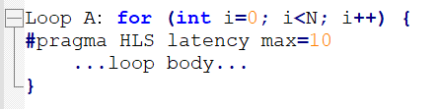
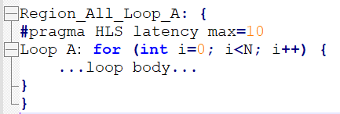
Optimizing for Latency
Vivado HLS supports the use of a latency constraint on any scope. Latency constraints are specified using the LATENCY directive.
When a maximum and/or minimum LATENCY constraint is placed on a scope, Vivado HLS tries to ensure all operations in the function complete within the range of clock cycles specified. The latency directive applied to a loop specifies the required latency for a single iteration of the loop.

Slide 29
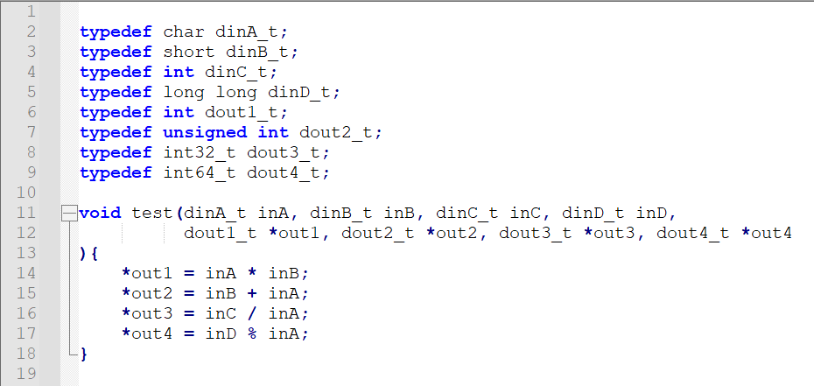
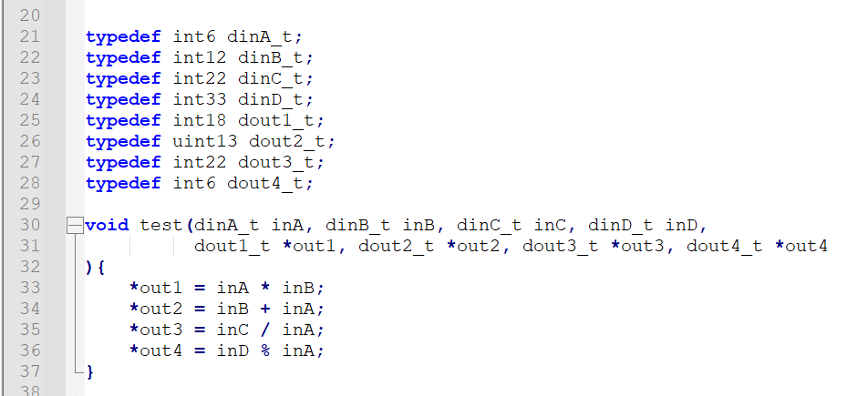
Optimizing for Area
Use the appropriate precision for the data types.
Confirm the size of any arrays that are to be implemented as RAMs or registers. The area impact of any over-sized elements is wasteful in hardware resources.
Pay special attention to multiplications, divisions, modulus or other complex arithmetic operations. If these variables are larger than they need to be, they negatively impact both area and performance.

Slide 30
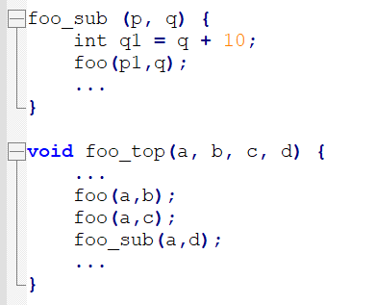
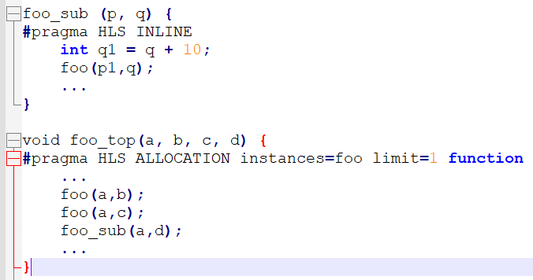
Optimizing for Area – Function Inlining
Function inlining removes the function hierarchy. A function is inlined using the INLINE directive. Inlining a function may improve area by allowing the components within the function to be better shared or optimized with the logic in the calling function.

Slide 31
Optimizing for Area – Mapping Arrays into One
When there are many small arrays in the C Code, mapping them into a single larger array typically reduces the number of block RAM required.
The ARRAY_MAP directive supports two ways of mapping small arrays into a larger one: • Horizontal mapping: this corresponds to creating a new array by concatenating the original arrays. Physically, this gets implemented as a single array with more elements. • Vertical mapping: this corresponds to creating a new array by concatenating the original words in the array. Physically, this gets implemented by a single array with a larger bit-width.

Slide 32
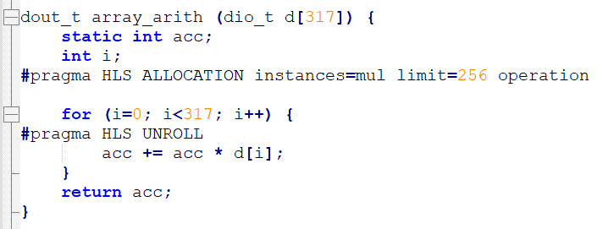
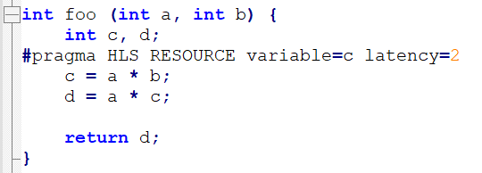
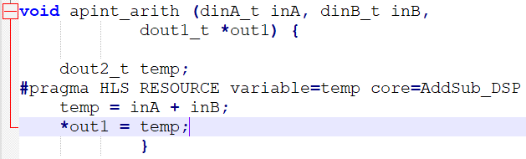
Optimizing for Area – Controlling hardware Resources
If a design called foo has 317 multiplications but the FPGA only has 256 multiplier resources (DSP48s). The ALLOCATION directive shown left directs Vivado HLS to create a design with maximum of 256 multiplication operators.
The following command informs Vivado HLS to use a 2-stage pipelined multiplier for variable c. It is left to Vivado HLS which core to use for variable d.
In the left example, the RESOURCE directives specify that the operation for variable temp is implemented using the AddSub_DSP core. This ensures that the operation is implemented using a DSP48 rather than LUTs which by default.

Slide 33
HLS vs Opencl
OPTIMIZE | XILINX OPENCL | VIVADO HLS
array_partition | __attribute__((xcl_array_partition(<type>, <factor>, <dimension>))) | #pragma HLS array_partition variable=<name> \ <type> factor=<int> dim=<int>
array_reshape | __attribute__((xcl_array_reshape(<type>, <factor>, <dimension>))) | #pragma HLS ARRAY_RESHAPE <variable> <type> <factor> <dim>
dataflow | __attribute__((xcl_dataflow)) | #pragma HLS DATAFLOW
pipeline | __attribute__((xcl_pipeline_loop(II=1))) | #pragma HLS PIPELINE
unroll | __attribute__((opencl_unroll_hint(<factor>))) | #pragma HLS unroll <factor>
inline | __attribute__((always_inline)) | #pragma HLS inline

Slide 34
HLS vs OpenCL
 | HLS | OpenCL
Time of Exitance | 30-40 years | from 2008
Scope | module，Module-level algorithm implementation | system，for heterogeneous， A complete programming model
Target Product | IP which will be integrated into system | A complete design
The user | FPGA developer，develop algorithm quickly | System developer, little impact on the circuit

Slide 35
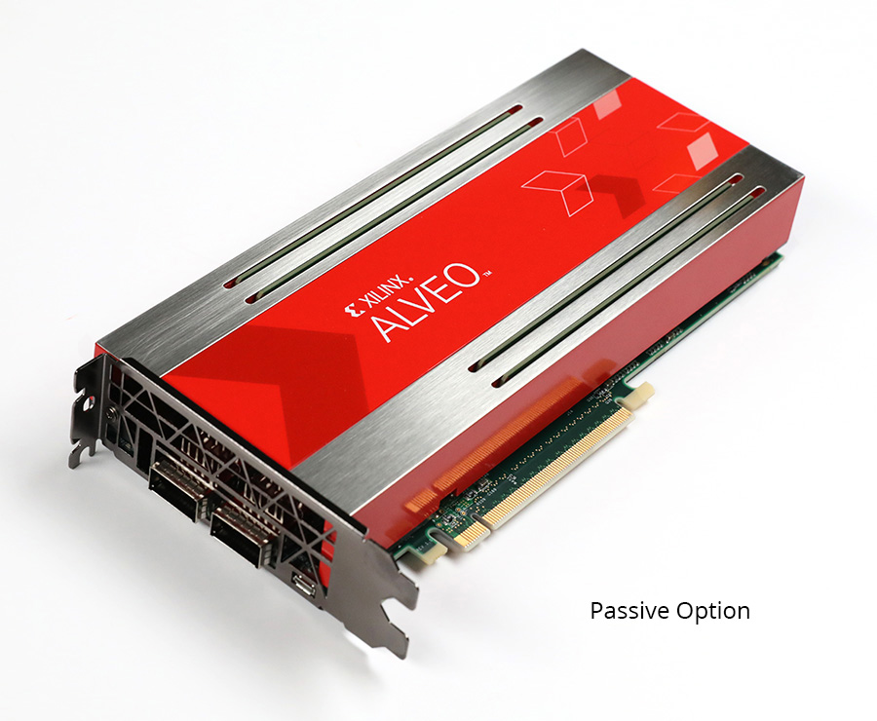
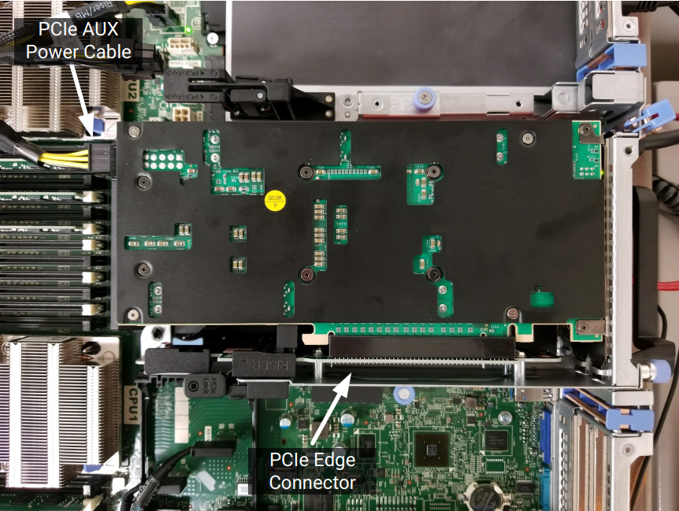
OpenCL Support
-- A software programming model for software engineers and a software methodology for system architects.
-- First industry standard for heterogeneous computing.
-- Provides increased performance with hardware acceleration.

Slide 36
OpenCL Support
Xilinx suggests using HLS to develop FPGA kernel and using OpenCL supported software to generate host code.
Steps for application execution on a heterogeneous system are shown as below:
-- Powering up
-- Initializing runtime components
-- Configuring the device
-- Allocating buffers
-- Writing the buffers to FPGA memory
-- Running the accelerators
-- Reading the buffers from FPGA memory

Slide 37
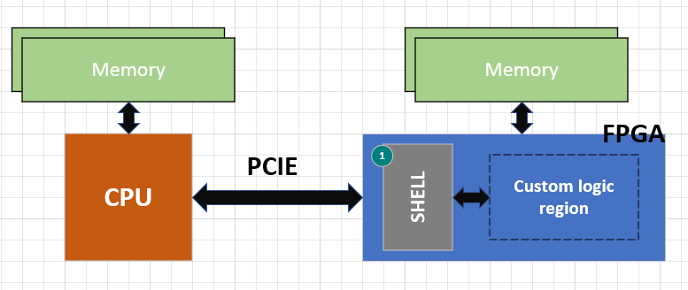
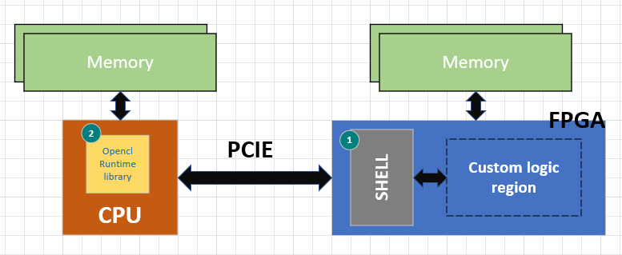
OpenCL Support
1. On power up, only the shell is initialized in the FPGA. The shell will manage communication with the host.
2. Devices = get_devices(“Xilinx/Altera”);
cl::Device device = devices[0];
cl::Context context(…);
cl::CommandQueue q(context, device, …);

Slide 38
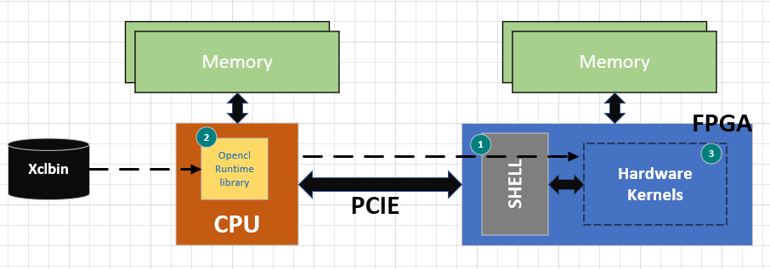
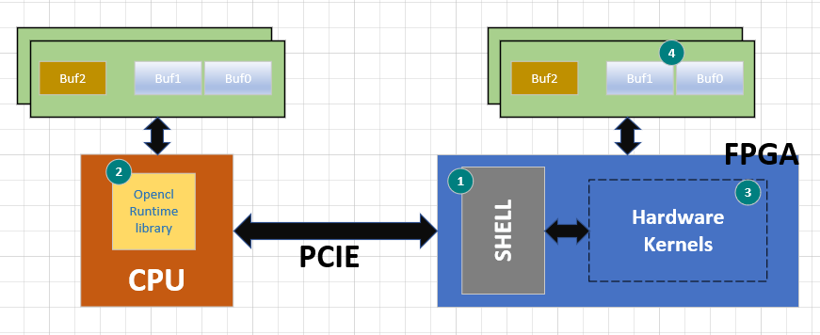
OpenCL Support
3. cl::Program::Binaries bins{{fileBuf,
FileBufSize}};
cl::Program program(context, devices
bins, …);
4. buf0 = cl::clCreateBuffer(context, CL_MEM_READ_ONLY,…);
buf1 = cl::clCreateBuffer(context, CL_MEM_READ_ONLY, …);
buf2 = cl::clCreateBuffer(context, CL_MEM_WRITE_ONLY,… );

Slide 39
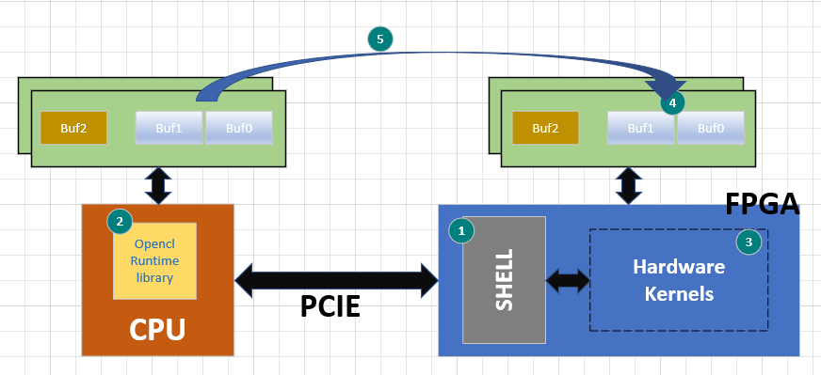
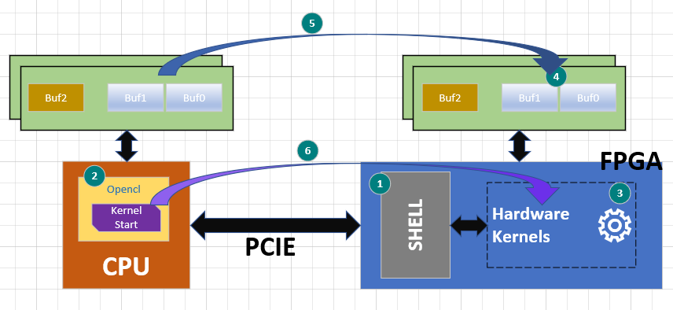
OpenCL Support
5. clEnqueueMigrateMemObjects (Command_Queue, 1, &GlobMem_BUF_DataIn_1, …);
6. Kernel = cl::clCreatekernel(program, “mykernel”, …);
cl::clSetKernelArg(kernel, 0, sizeof(cl_mem), &buf0);
cl::clSetKernelArg(kernel, 1, sizeof(cl_mem), &buf1);
cl::clEnqueueTask(Command_Queue, Kernel, 0, NULL, NULL);

Slide 40
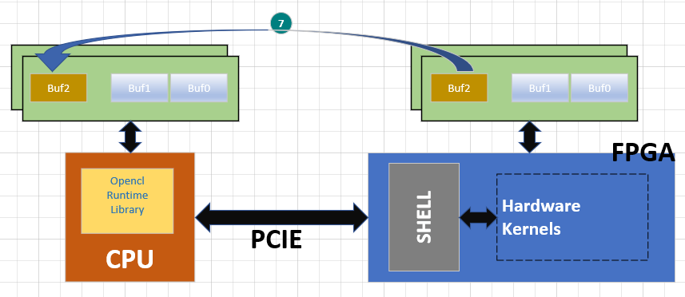
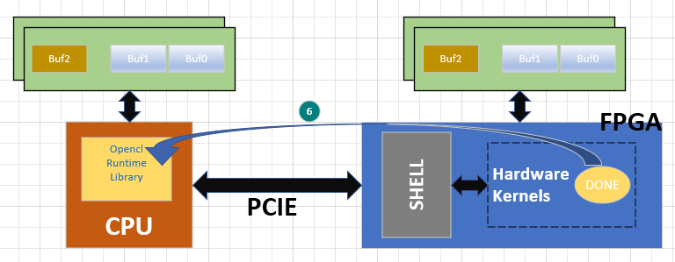
OpenCL Support
6(cont’d).
cl::clFinish(Command_Queue);
7. cl::clEnqueueMigrateMemObjects(Command_Queue, 1, &GlobMem_BUF_RES,
CL_MIGRATE_MEM_OBJECT_HOST,…);

Slide 41
The End

