Slide 1
PPM Django and other web servers
CPE team

Slide 2
Agenda
1. Django
A simple Django demo
Model CRUD
DRF
2. Other web servers
Flask
Node.js (Raw, Sequelize)
Go(Gin and Gorm)
Spring Boot (JPA, Mybatis)

Slide 3
Django
1

Slide 4



Slide 5
Simple Django Demo - Three steps to create a web project
Install Django
pip install django==2.1
Create a Project
django-admin startproject hello_world
Start Project
python manage.py runserver 127.0.0.1:8040
Try it
http://localhost:8040/
How to prove I’m a good man?
Notes:
from django.http import HttpResponse
def test(req):
return HttpResponse("Joey is a good man")
urlpatterns = [
path('test', test),
path('admin/', admin.site.urls),
]

Slide 6
Default Files
manage.py
command-line utility
For more information please type python manage.py -h
settings.py
Django settings for project.
url.py
Project URL Configuration
wsgi.py
WSGI config for hello_world project.

Slide 7
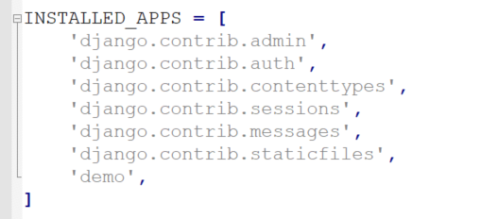
Create Module
Create a App
python manage.py startapp demo
Add app name to settings.py

Slide 8
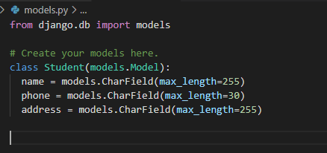
Model
Define a model in models.py
Make migration
python manage.py makemigrations
python manage.py migrate
Notes:
# Create your models here.
class Student(models.Model):
name = models.CharField(max_length=255)
phone = models.CharField(max_length=30)
address = models.CharField(max_length=255)

Slide 9
CRUD
python manage.py shell
Add
from demo.models import Student
stu = Student()
stu.name = "Joey“
stu.address="SH“
stu.save()
Query
Student.objects.all()
Student.objects.get(pk=1)

Slide 10
CRUD
Edit
stu = Student.objects.get(pk=1)
stu.address = "AH“
stu.save()
Delete
stu = Student.objects.get(pk=1)
stu.delete()

Slide 11
DRF – Django Rest Framework
Django REST framework is a powerful and flexible toolkit for building Web APIs.
Some reasons you might want to use REST framework:
The Web browsable API is a huge usability win for your developers.
Authentication policies including packages for OAuth1a and OAuth2.
Serialization that supports both ORM and non-ORM data sources.
Customizable all the way down - just use regular function-based views if you don't need the more powerful features.
Extensive documentation, and great community support.
Used and trusted by internationally recognised companies including Mozilla, Red Hat, Heroku, and Eventbrite.

Slide 12

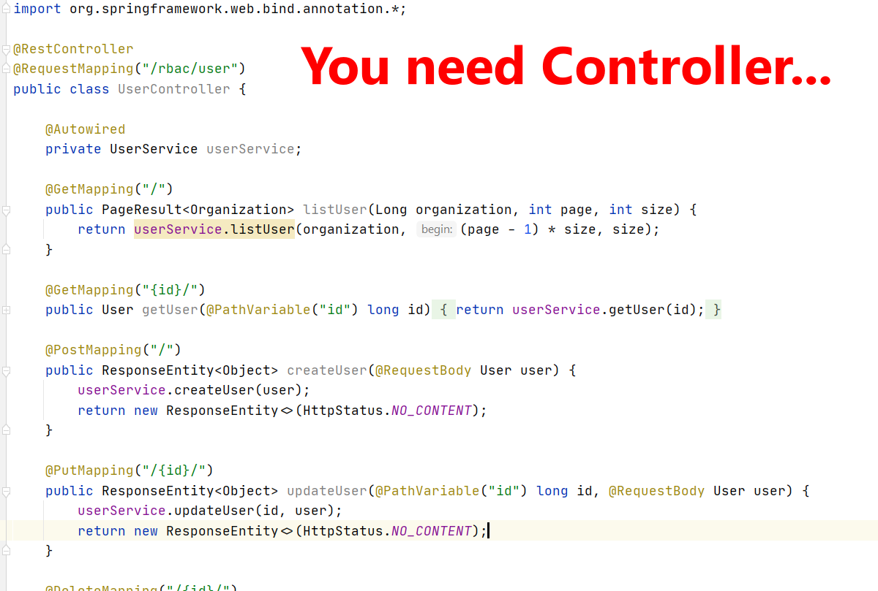
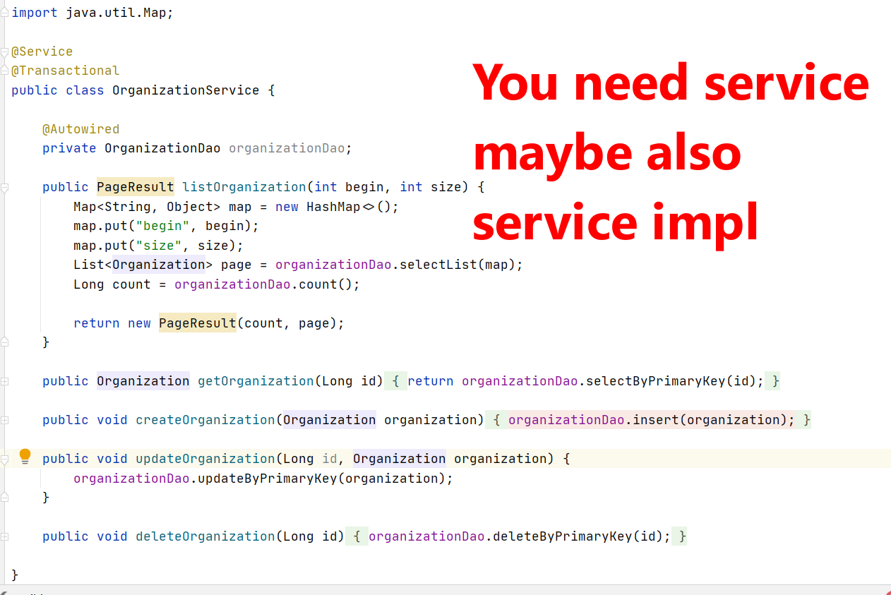
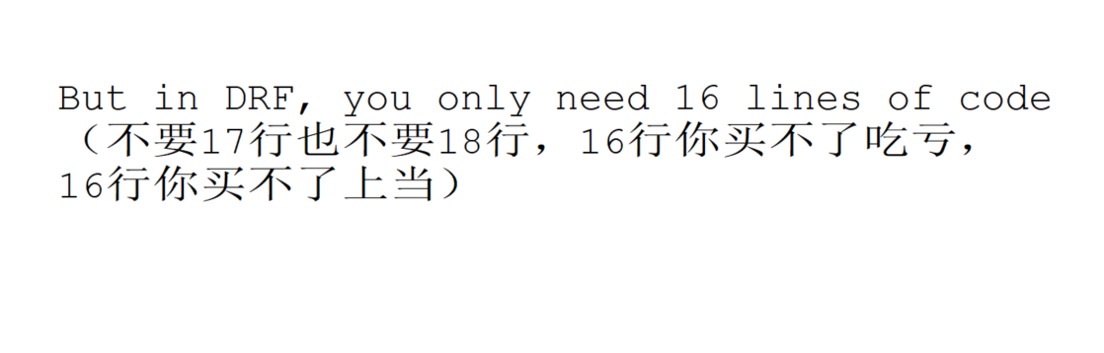
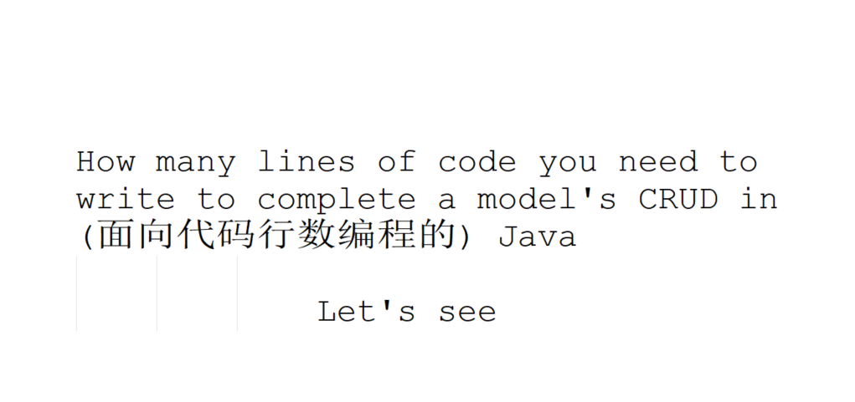
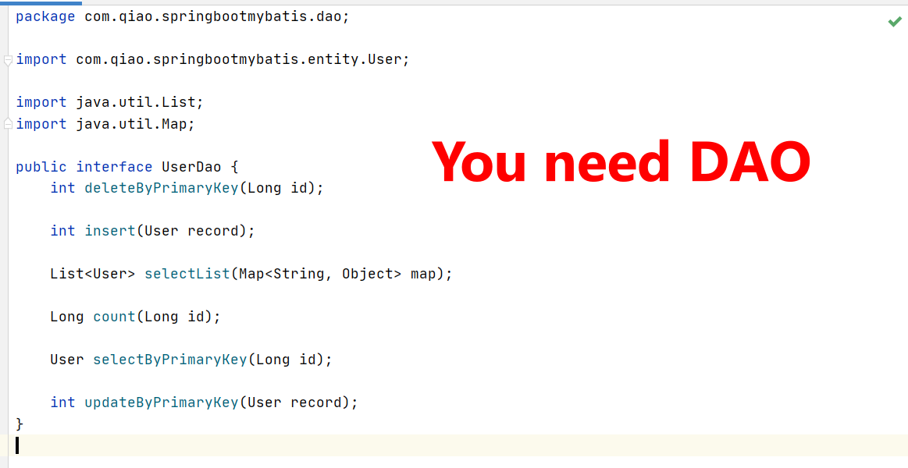
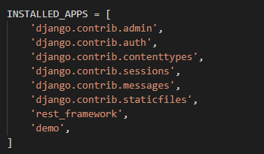
DRF Demo
pip3 install djangorestframework==3.9.1
Config settings.py

Slide 13
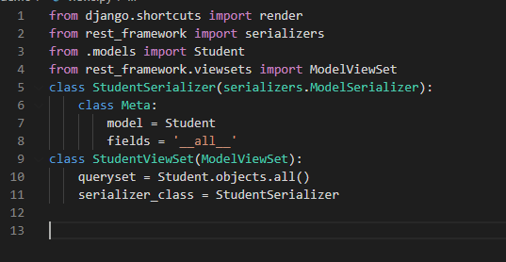
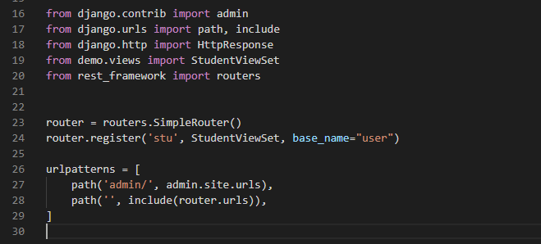
Notes:
from django.shortcuts import render
from rest_framework import serializers
from .models import Student
from rest_framework.viewsets import ModelViewSet
# Create your views here.
class StudentSerializer(serializers.ModelSerializer):
class Meta:
model = Student
fields = '__all__'
class StudentViewSet(ModelViewSet):
queryset = Student.objects.all()
serializer_class = StudentSerializer
----------------
from django.contrib import admin
from django.urls import path, include
from django.http import HttpResponse
from demo.views import StudentViewSet
from rest_framework import routers
router = routers.SimpleRouter()
router.register('stu', StudentViewSet, base_name="user")
urlpatterns = [
path('admin/', admin.site.urls),
path('', include(router.urls)),
]

Slide 14
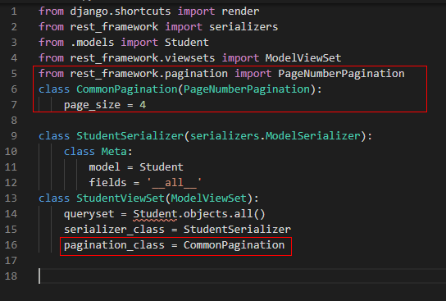
How about pagination
Four lines
Notes:
from django.shortcuts import render
from rest_framework import serializers
from .models import Student
from rest_framework.viewsets import ModelViewSet
from rest_framework.pagination import PageNumberPagination
class CommonPagination(PageNumberPagination):
page_size = 4
class StudentSerializer(serializers.ModelSerializer):
class Meta:
model = Student
fields = '__all__'
class StudentViewSet(ModelViewSet):
queryset = Student.objects.all()
serializer_class = StudentSerializer
pagination_class = CommonPagination

Slide 15
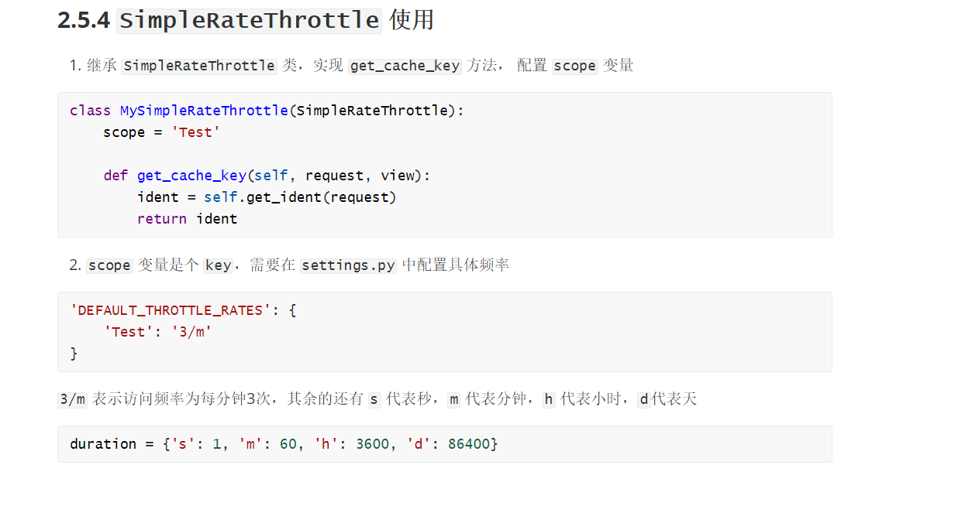
Throttle

Slide 16
Other web frameworks
2

Slide 17
Demo
两张表
Organization
User
关系
Organization 对 User 是 one to many
Organization 本身也是 one to many
要求
Organization 的增删改
User 的增删改
Organization 页面要展示 父 Organization 的name
User 页面展示的 User 只属于某一个 Organization
User 页面展示所属 Organization 的名字

Slide 18
Flask
Web framework: Flask
ORM: Flask-SQLAlchemy
Effort: 3-4 days
Compare to Django
优点
Flask 可以选择很多插件，比如 ORM 框架就有很多种选择
适合很复杂的架构
缺点
很明显代码更多
个人认为学习成本比较高

Slide 19
Nodejs - Raw
Web framework: Express
ORM: None
Effort: 1-2 days
Compare to Django
优点
用 JS 编程，学习效率高
缺点
社区貌似不是很活跃
性能肯定不高
代码量很多

Slide 20
Nodejs - Sequelize
Web framework: Express
ORM: Sequelize
Effort: 1-2 days
Compare to Django
优点
用 JS 编程，学习效率高
缺点
社区貌似不是很活跃
性能肯定不高
代码量很多
对于我来说，学习 ORM 框架又花去好些时间

Slide 21
Gin
Web framework: Gin
ORM: Gorm
Effort: 2-3 days
Compare to Django
优点
Go 语言现在非常火，可以学习下
Go 语言的运行效率高
缺点
学习成本高，会 C 可能会简单些
代码量很多

Slide 22
Spring Boot JPA
Web framework: Spring MVC
ORM: JAP
Effort: 1 days
Compare to Django
优点
会 Java 学习成本低
JPA 封装的比较好，简单的 CRUD 很容易
缺点
面向代码行数编程？

Slide 23
Spring Boot Mybatis
Web framework: Spring MVC
ORM: Mybatis
Effort: 1 days
Compare to Django
优点
会 Java 学习成本低
自己写 SQL，性能好
缺点
要自己写 SQL，效率低
面向代码行数编程？

Slide 24
Conclusion
Django 的代码量最少，但是有学习成本
没事别瞎折腾，Java 挺好的
完

Slide 25
Q&A

Slide 26
Thank You.

