Slide 1
Tap Me Plus One
林橋毅 蔡文綺

Slide 2
Outline

Slide 3
遊戲規則

Slide 4
遊戲架構與流程圖
遊戲主體
計分板

Slide 5
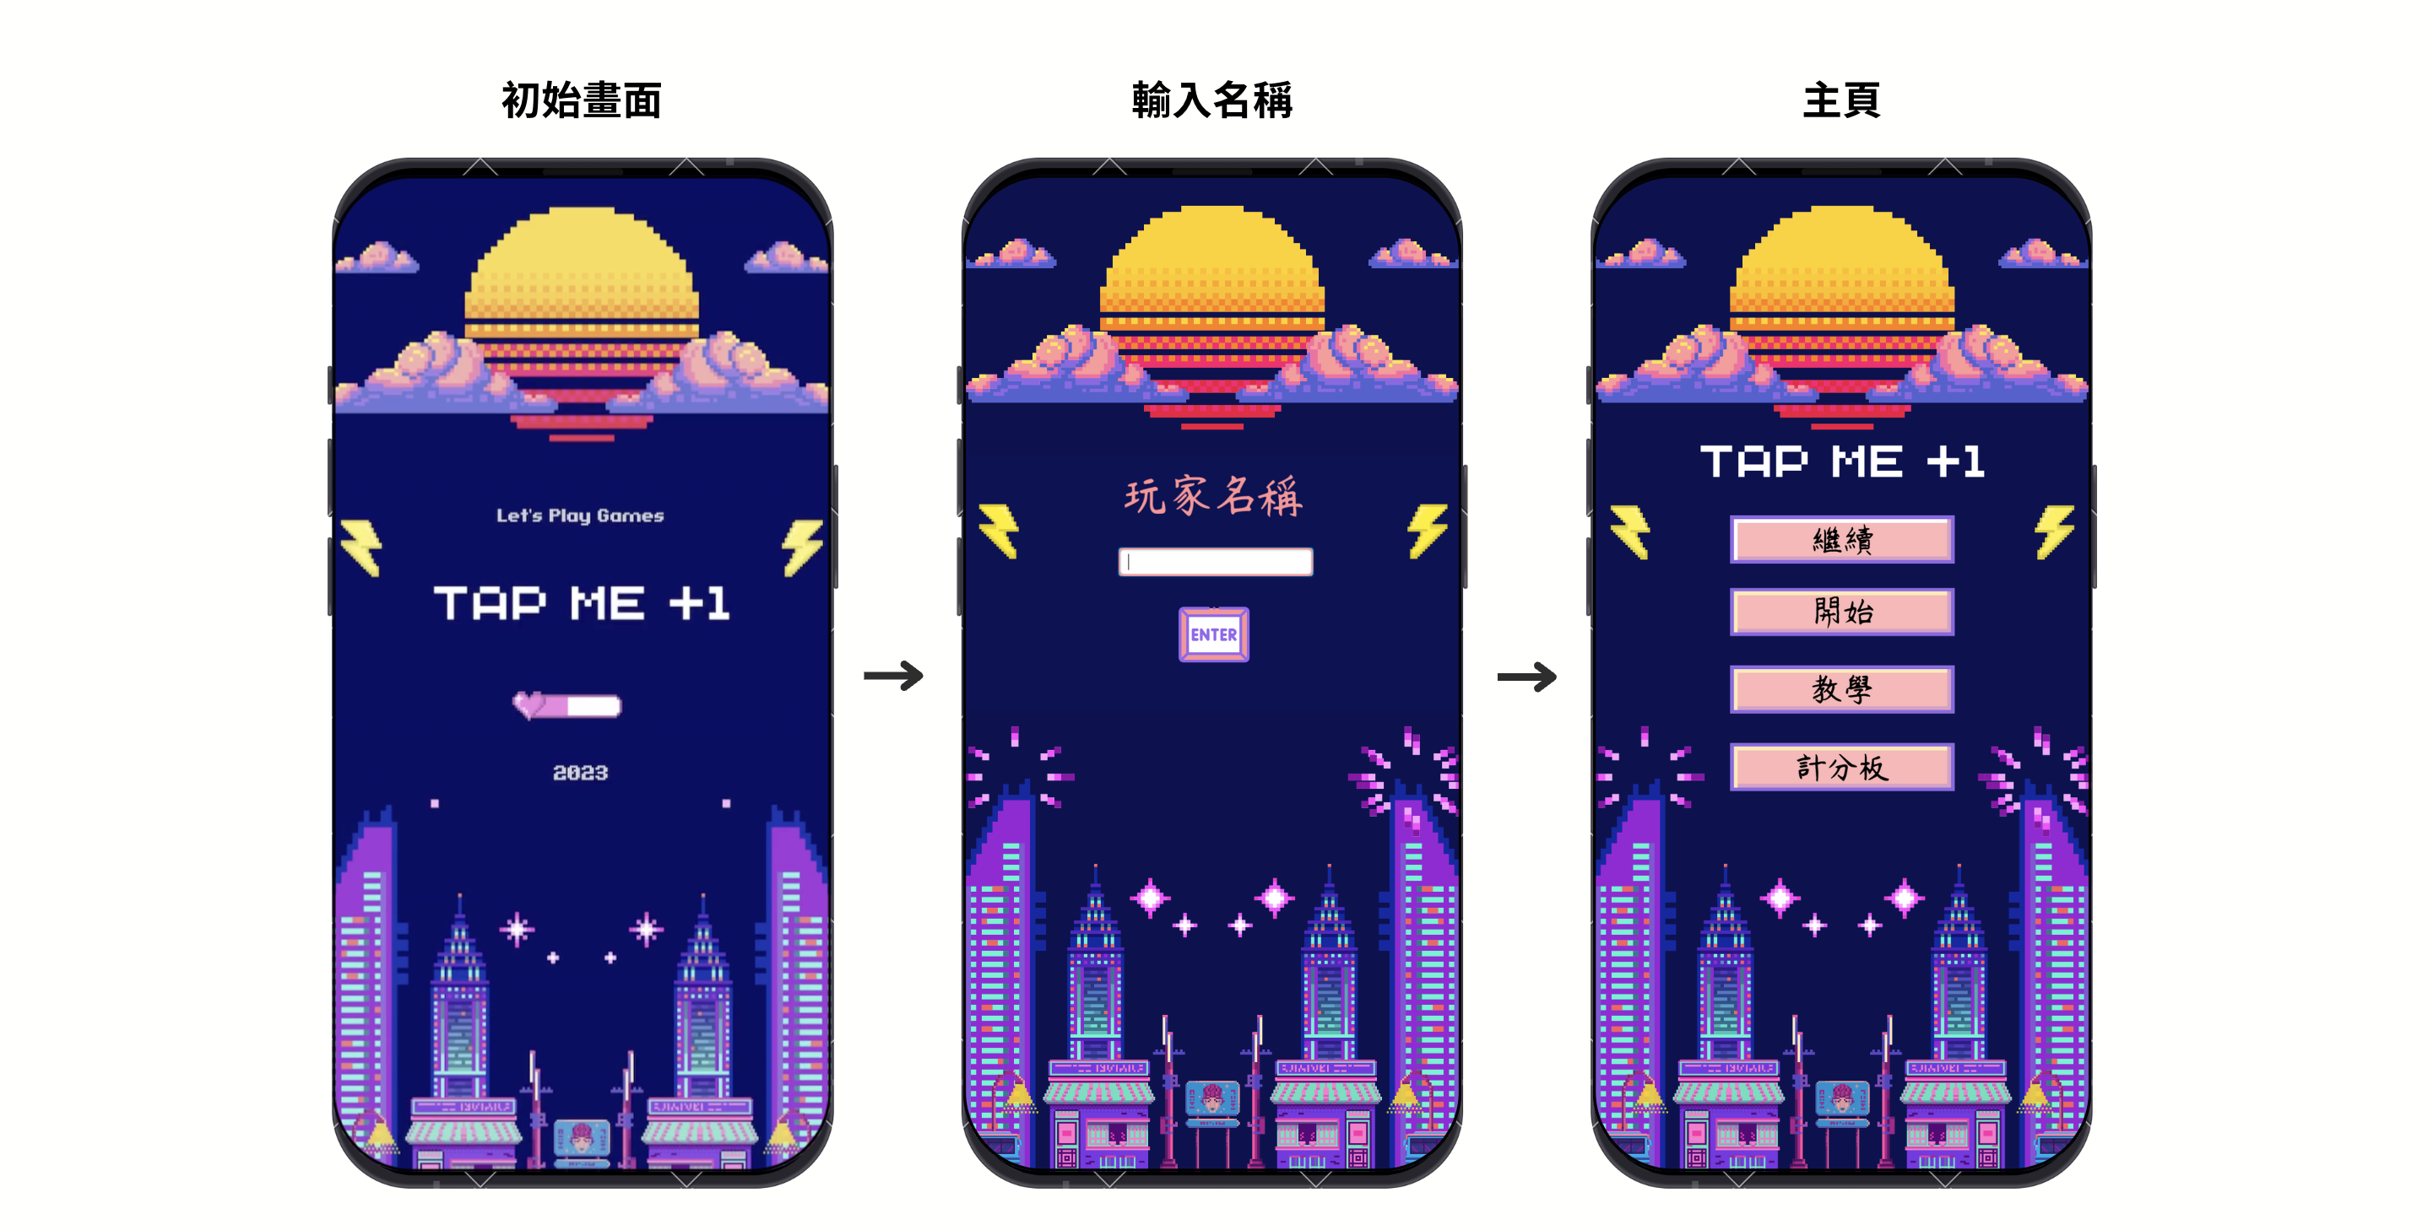

Slide 6
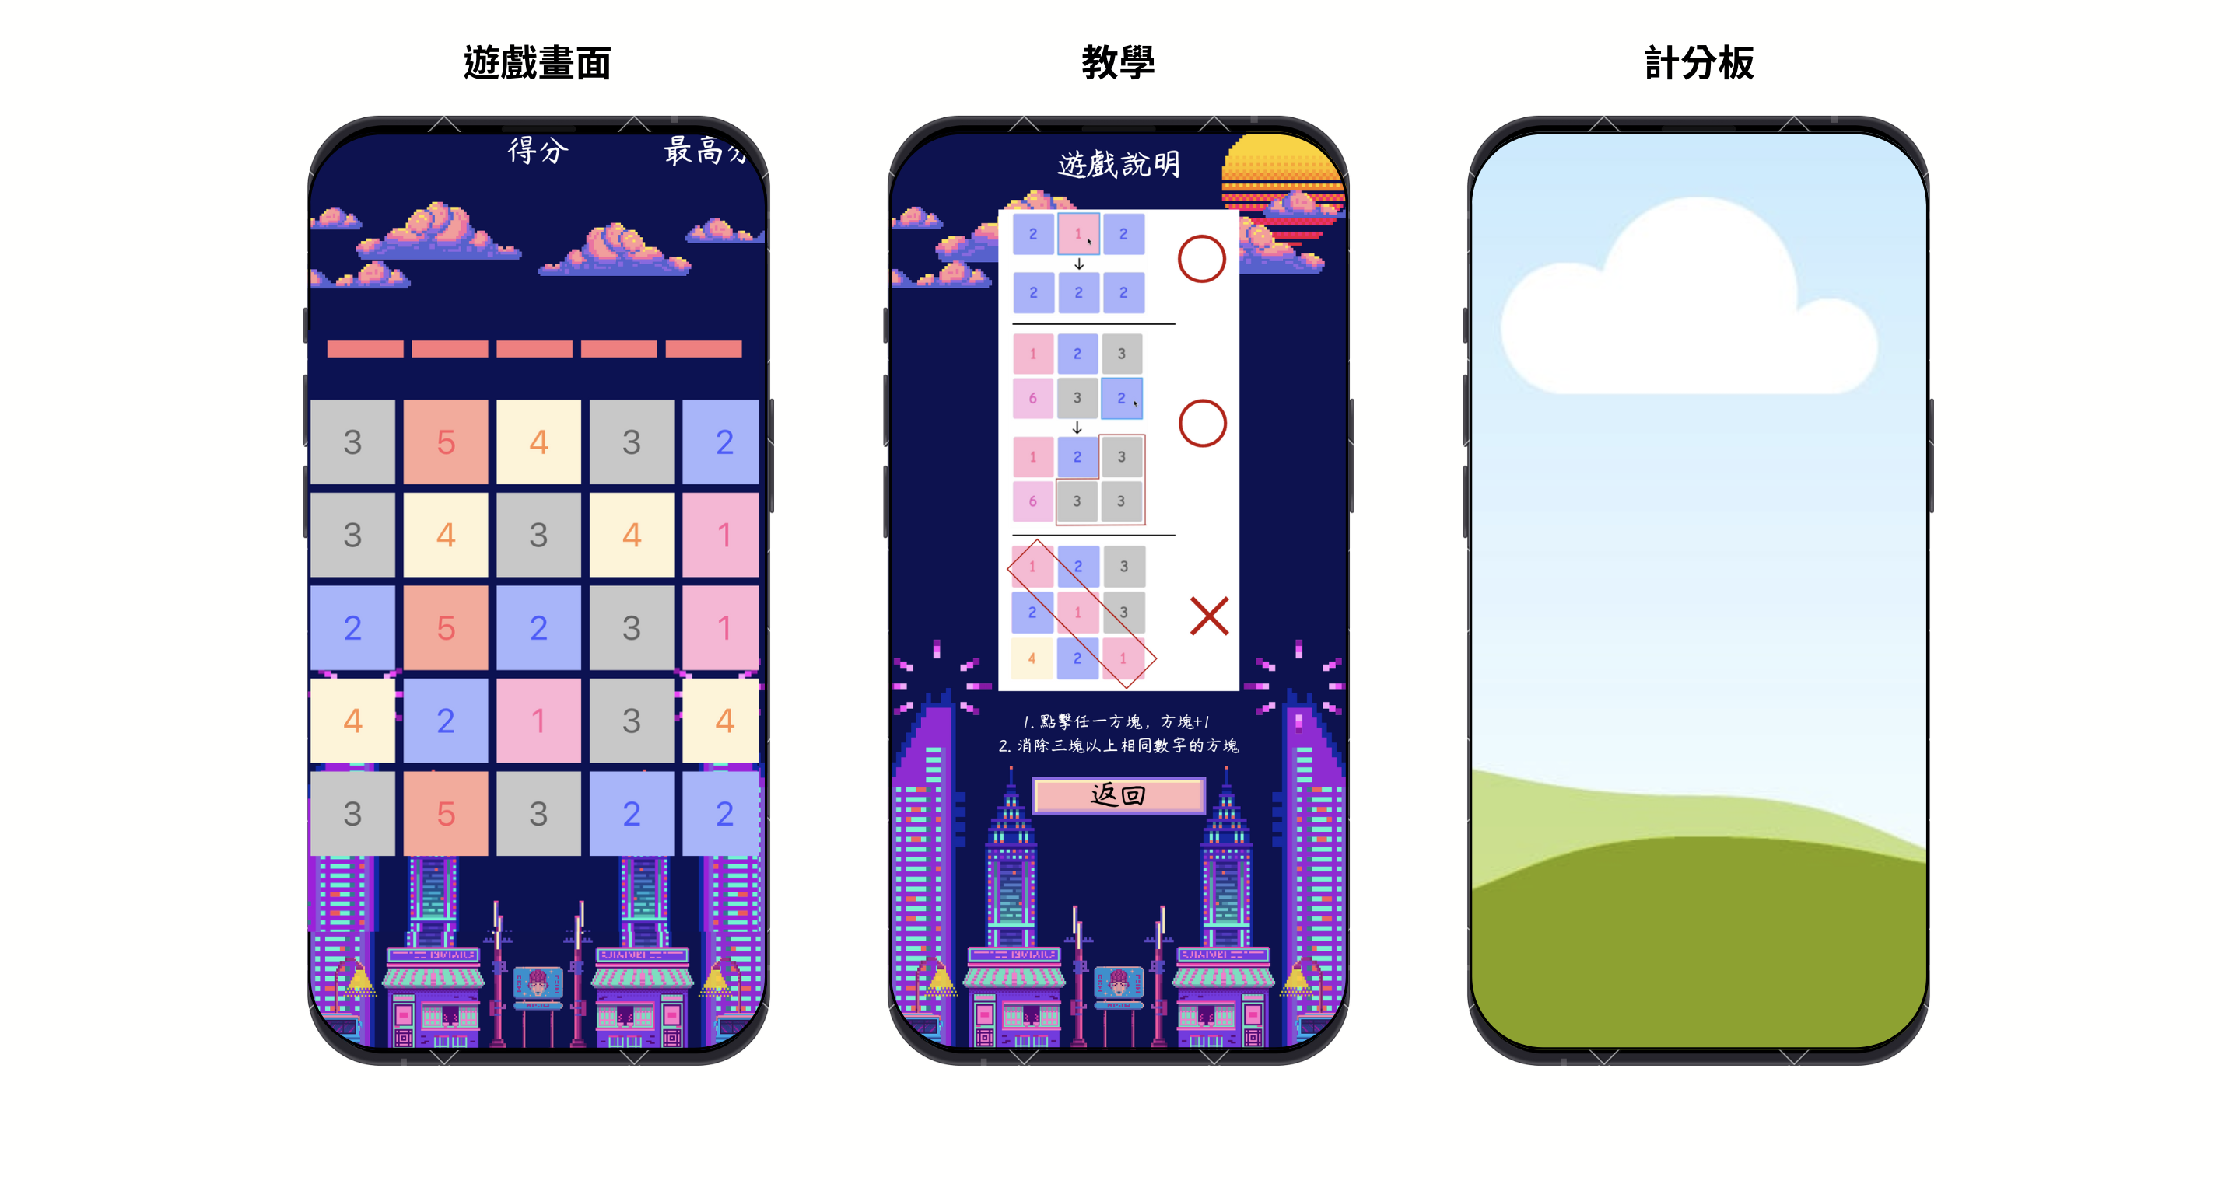

Slide 7
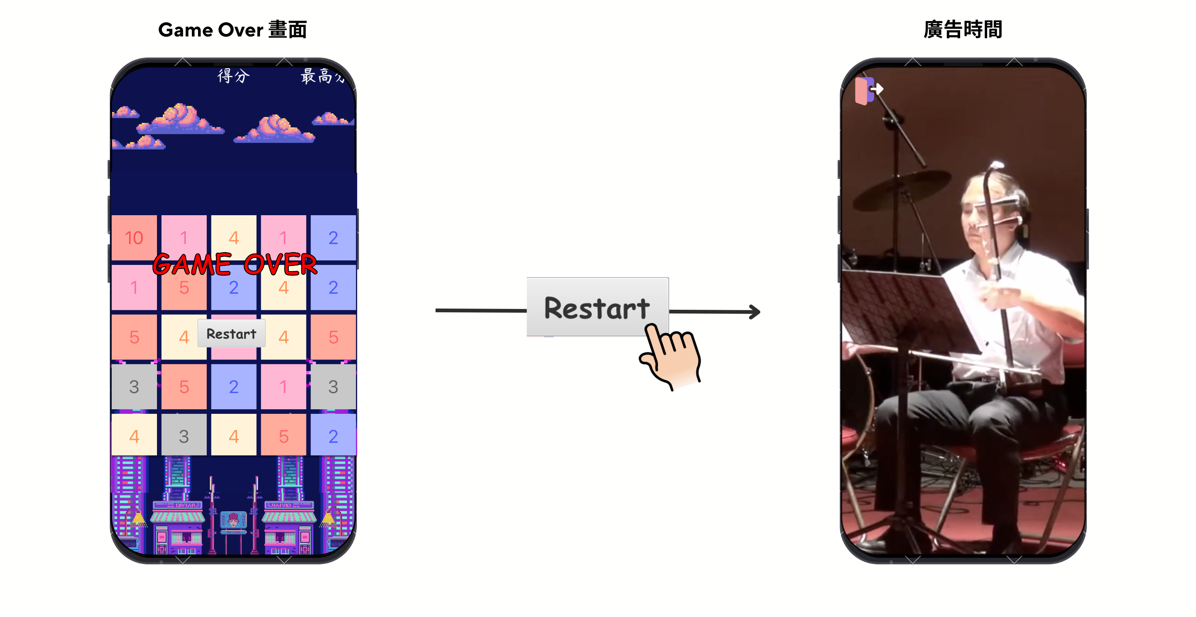

Slide 8
Flow Chart
等待點擊
BFS
回收方塊
新增方塊
掃描版面
有可合併的區塊

Slide 9
BFS Algorithm with Route
1 | 2 | 5 | 3 | 4
4 | 3 | 5 | 2 | 1
4 | 3 | 2 | 5 | 4
1 | 2 | 1 | 3 | 3
4 | 4 | 5 | 2 | 5
1 | 2 | 5 | 3 | 4
4 | 4 | 5 | 2 | 1
4 | 3 | 2 | 5 | 4
1 | 2 | 1 | 3 | 3
4 | 4 | 5 | 2 | 5
Queue: [1,1]

Slide 10
BFS Algorithm with Route
1 | 2 | 5 | 3 | 4
4 | 4 | 5 | 2 | 1
4 | 3 | 2 | 5 | 4
1 | 2 | 1 | 3 | 3
4 | 4 | 5 | 2 | 5
 | X
Queue: [1,0]

Slide 11
BFS Algorithm with Route
1 | 2 | 5 | 3 | 4
4 | 4 | 5 | 2 | 1
4 | 3 | 2 | 5 | 4
1 | 2 | 1 | 3 | 3
4 | 4 | 5 | 2 | 5
R | X
Queue: [2,0]

Slide 12
BFS Algorithm with Route
1 | 2 | 5 | 3 | 4
4 | 4 | 5 | 2 | 1
4 | 3 | 2 | 5 | 4
1 | 2 | 1 | 3 | 3
4 | 4 | 5 | 2 | 5
R | X
U
Queue:

Slide 13
BFS Algorithm with Route
1 | 2 | 5 | 3 | 4
4 | 4 | 5 | 2 | 1
4 | 3 | 2 | 5 | 4
1 | 2 | 1 | 3 | 3
4 | 4 | 5 | 2 | 5
R | X
U
Queue:

Slide 14
Backtracking and animation
1 | 2 | 5 | 3 | 4
4 | 4 | 5 | 2 | 1
4 | 3 | 2 | 5 | 4
1 | 2 | 1 | 3 | 3
4 | 4 | 5 | 2 | 5
R | X
U

Slide 15
Backtracking and animation
1 | 2 | 5 | 3 | 4
4 | 4 | 5 | 2 | 1
4 | 3 | 2 | 5 | 4
1 | 2 | 1 | 3 | 3
4 | 4 | 5 | 2 | 5
R | X
U

Slide 16
Backtracking and animation
1 | 2 | 5 | 3 | 4
4 | 4 | 5 | 2 | 1
4 | 3 | 2 | 5 | 4
1 | 2 | 1 | 3 | 3
4 | 4 | 5 | 2 | 5
R | X
U

Slide 17
BFS Algorithm with Route
1 | 2 | 5 | 3 | 4
 | 5 | 5 | 2 | 1
 | 3 | 2 | 5 | 4
1 | 2 | 1 | 3 | 3
4 | 4 | 5 | 2 | 5

Slide 18
Padding
1 | 2 | 5 | 3 | 4
 | 5 | 5 | 2 | 1
 | 3 | 2 | 5 | 4
1 | 2 | 1 | 3 | 3
4 | 4 | 5 | 2 | 5
 | 2 | 5 | 3 | 4
 | 5 | 5 | 2 | 1
1 | 3 | 2 | 5 | 4
1 | 2 | 1 | 3 | 3
4 | 4 | 5 | 2 | 5

Slide 19
Add new Block
1 | 2 | 5 | 3 | 4
3 | 5 | 5 | 2 | 1
1 | 3 | 2 | 5 | 4
1 | 2 | 1 | 3 | 3
4 | 4 | 5 | 2 | 5

Slide 20
Scan and BFS… until no block can combine
1 | 2 | 5 | 3 | 4
3 | 5 | 5 | 2 | 1
1 | 3 | 2 | 5 | 4
1 | 2 | 1 | 3 | 3
4 | 4 | 5 | 2 | 5
1 | 2 | 5 | 3 | 4
3 | 5 | 5 | 2 | 1
1 | 3 | 2 | 5 | 4
1 | 2 | 1 | 3 | 3
4 | 4 | 5 | 2 | 5

Slide 21
Scan and BFS… until no block can combine
1 | 2 |  | 3 | 4
3 |  | 6 | 2 | 1
1 | 3 | 2 | 5 | 4
1 | 2 | 1 | 3 | 3
4 | 4 | 5 | 2 | 5
1 | 1 | 5 | 3 | 4
3 | 2 | 6 | 2 | 1
1 | 3 | 2 | 5 | 4
1 | 2 | 1 | 3 | 3
4 | 4 | 5 | 2 | 5
No C.C that size >= 3

Slide 22
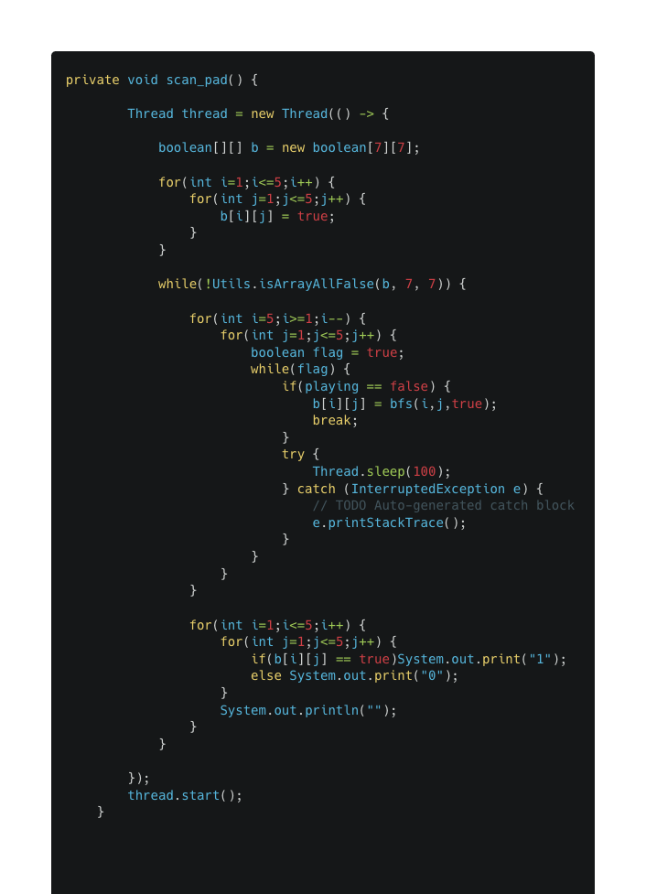
Detect animation playing
需要等待動畫播放完才能讓玩家點擊下一個方塊
使用 Thread 監控動畫狀態，進入動畫則將 flag = 1, vice versa
使用 Thread.sleep() 避免 CPU 使用率過高

Slide 23
Ads

Slide 24
GitHub Page
https://github.com/qiaoyi213/TapMePlusOne

Slide 25
Reference
Json-simple: https://github.com/fangyidong/json-simple
Microsoft Designer
ChatGPT

