Slide 1
Automated 3D Integration
Research progress

Slide 2


Slide 3
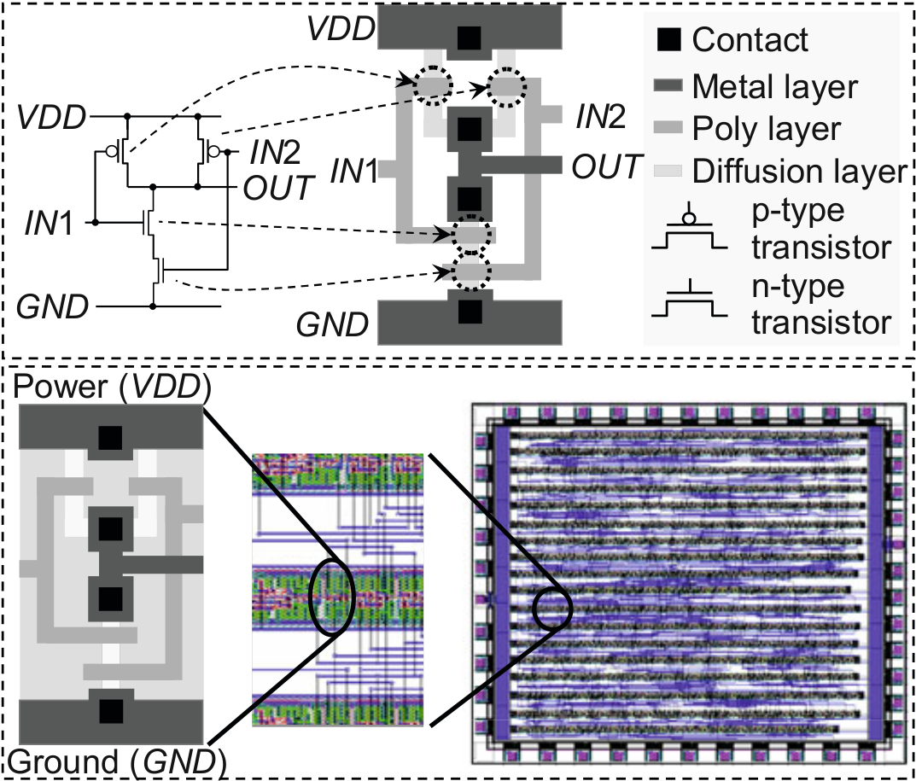
What is in an IC?

Slide 4
2D is struggling and reforming
CMOS scaling
5nm in 2020, but at what cost?
ITRS restructed themselves to find alternatives

Slide 5
2D Future is manyfold
Keep scaling CMOS beyond its limits
3D integration
Quantum computing

Slide 6
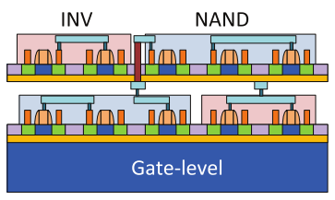
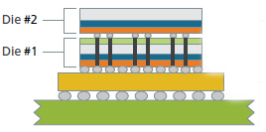
3D wafer processing
Sequential: Monolithic
Parallel: Stacking

Slide 7
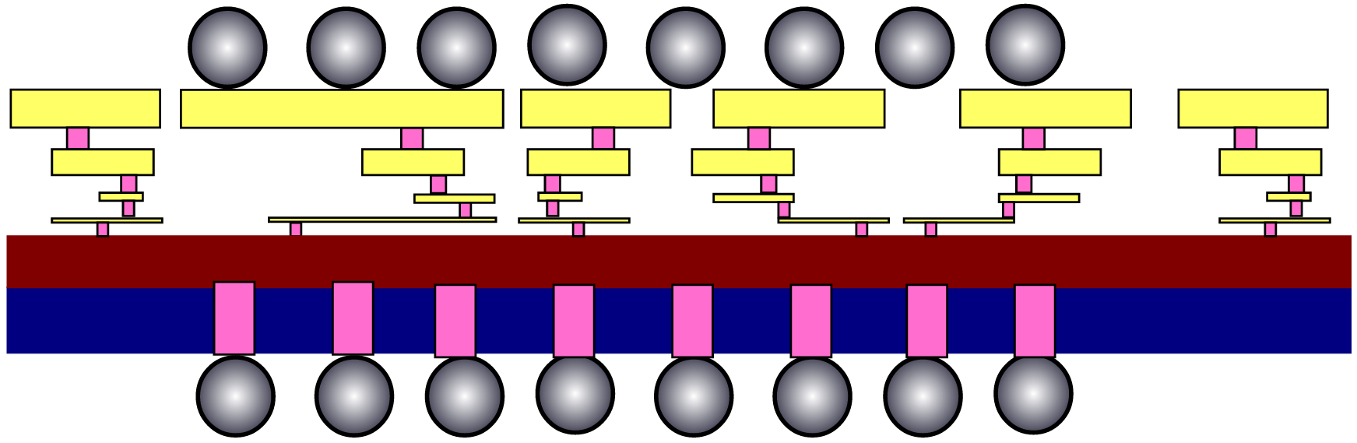
3D Stacking techniques
TSV, µ-bumps

Slide 8
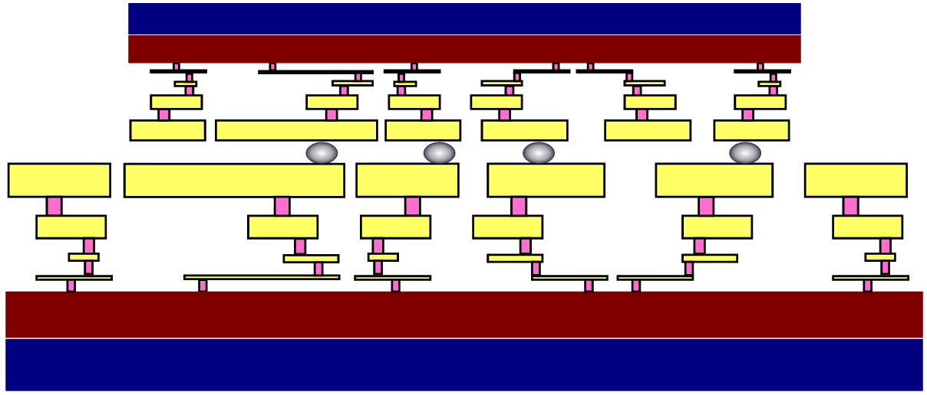
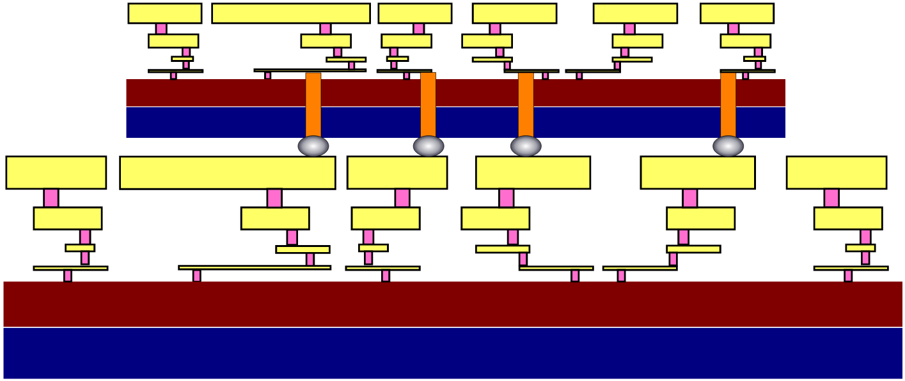
3D Stacking techniques
TSV, µ-bumps
F2F, F2B

Slide 9
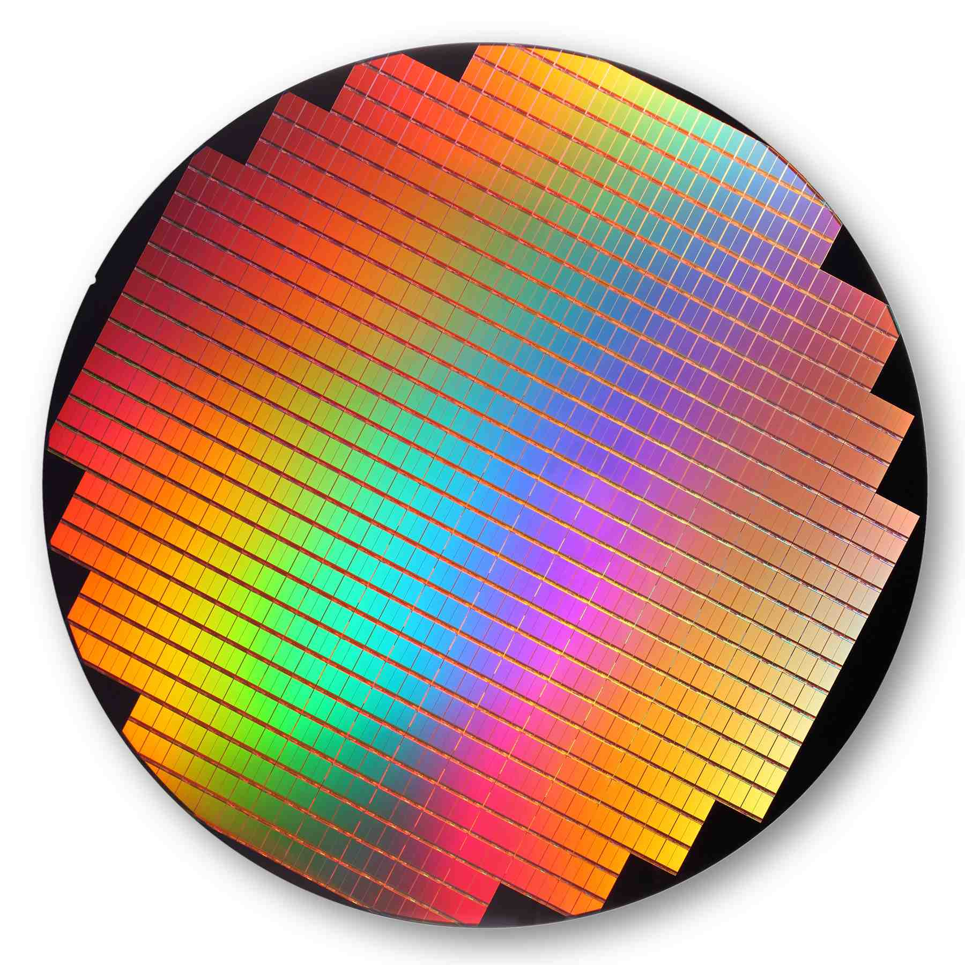
3D Stacking techniques
TSV, µ-bumps
F2F, F2B
W2W, D2W, D2D

Slide 10
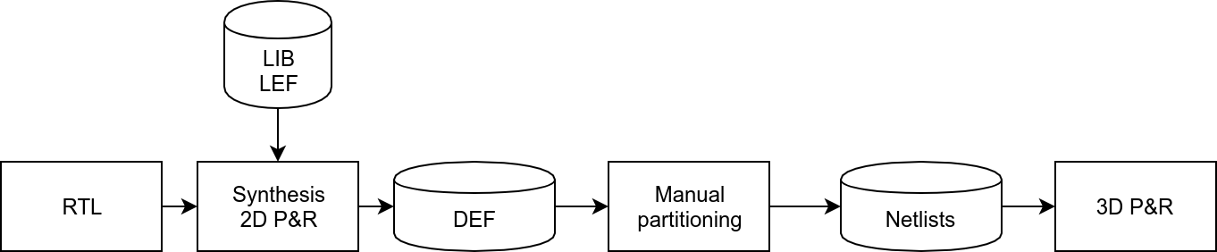
3D Flow

Slide 11
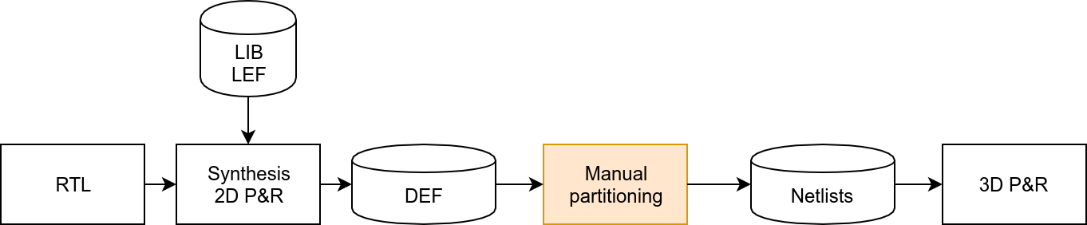
3D Flow

Slide 12
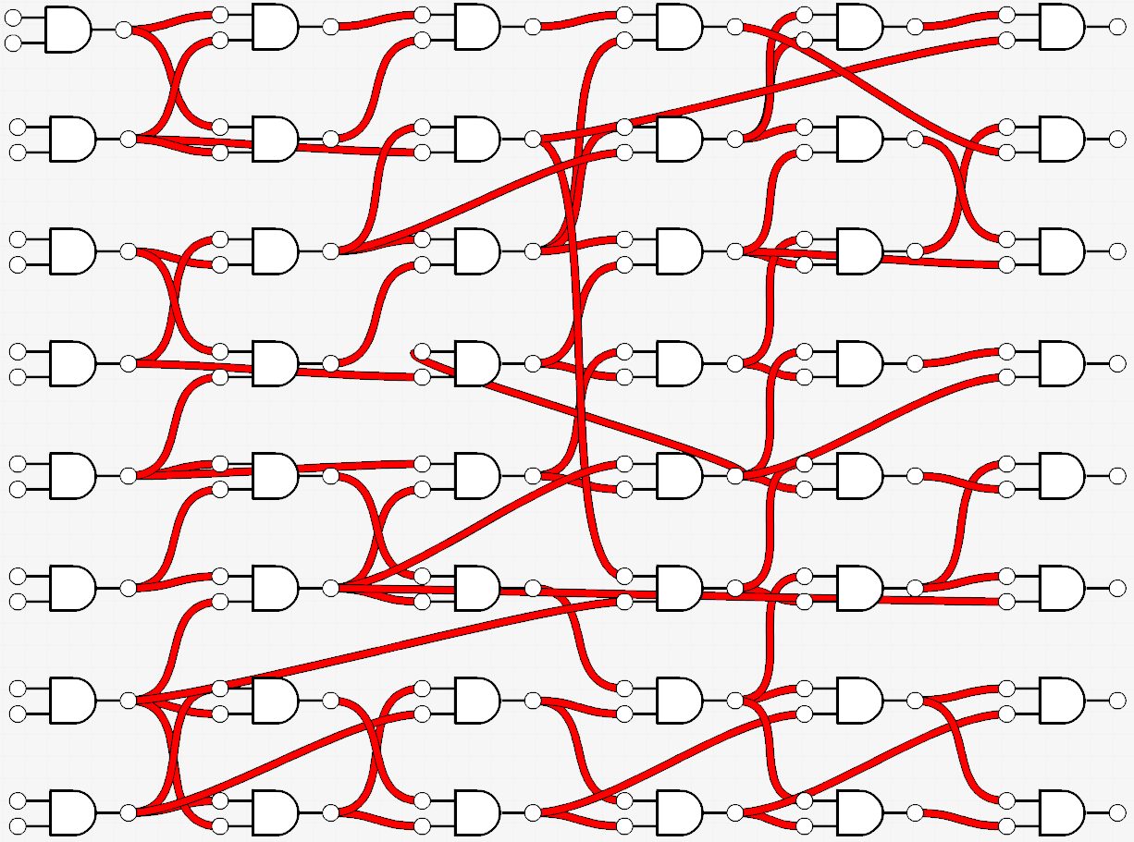
The problem

Slide 13
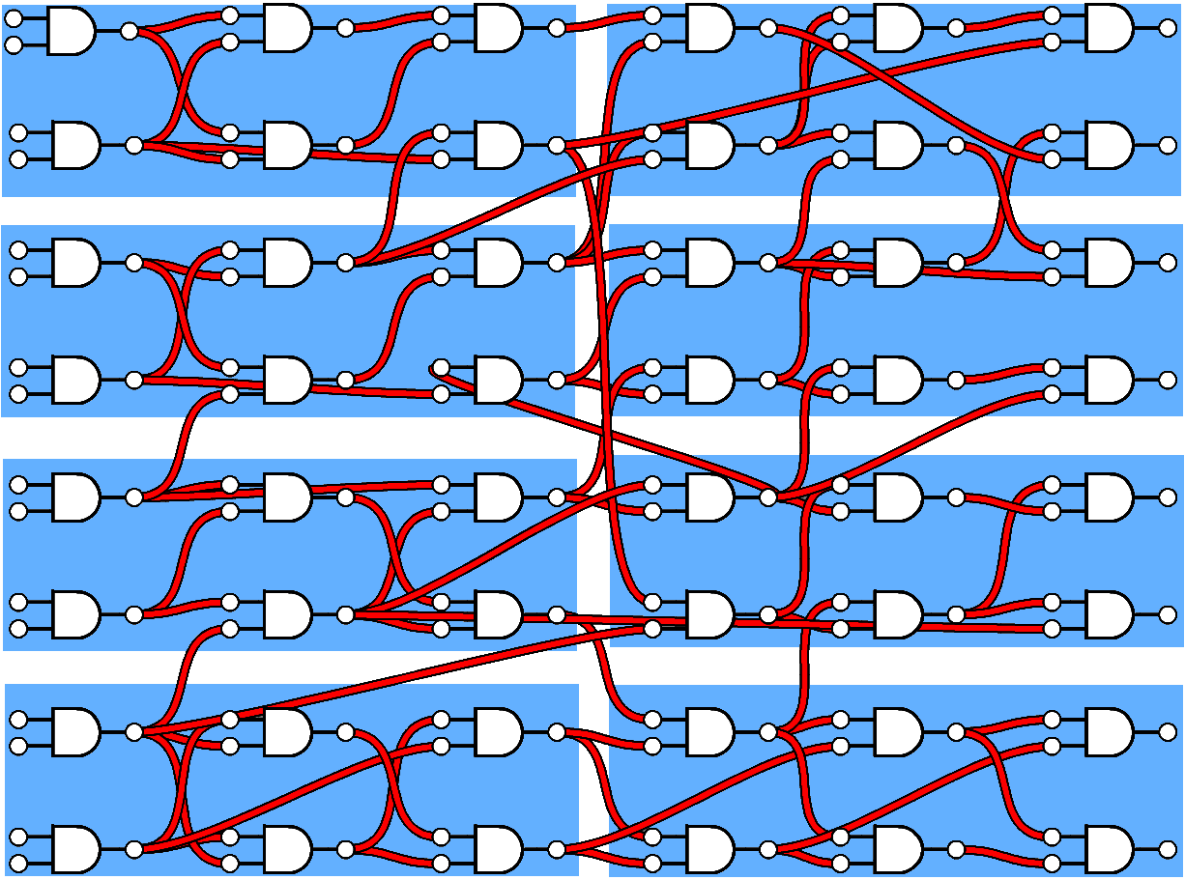
The problem
How do we cluster?

Slide 14
The problem
How do we cluster?
How do we partition?

Slide 15
The problem
module top();
module die1();
module die2();
How do we cluster?
How do we partition?
How do we generate the netlists?

Slide 16
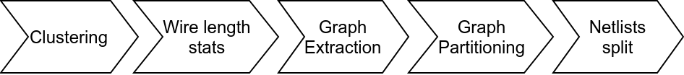
Automate the partitioning

Slide 17
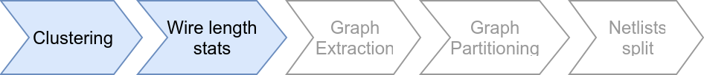
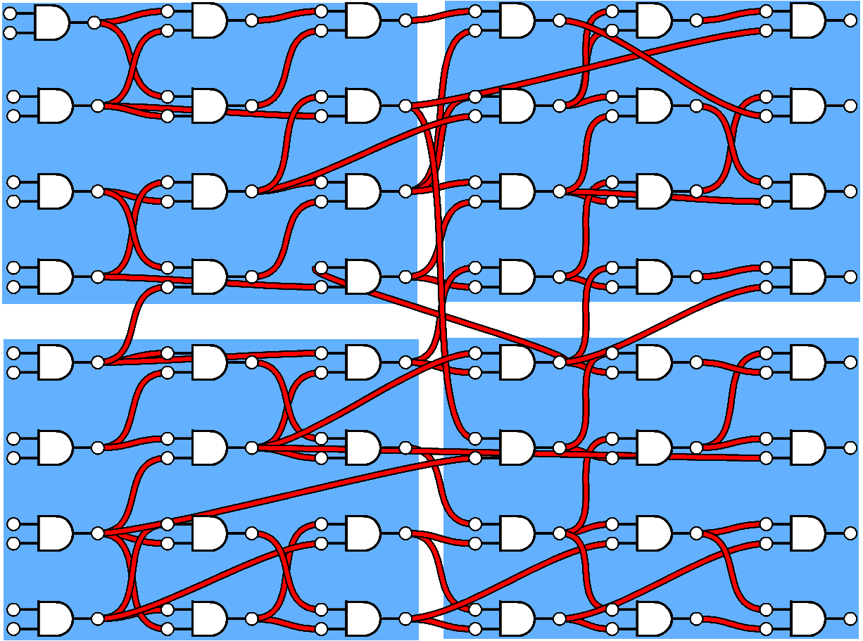
Choose the right clustering
Inter-cluster connectivity: 13 nets
Intra-cluster connectivity: 27 nets

Slide 18

Clustering
Inter-cluster connectivity: 18 nets
Intra-cluster connectivity: 22 nets

Slide 19
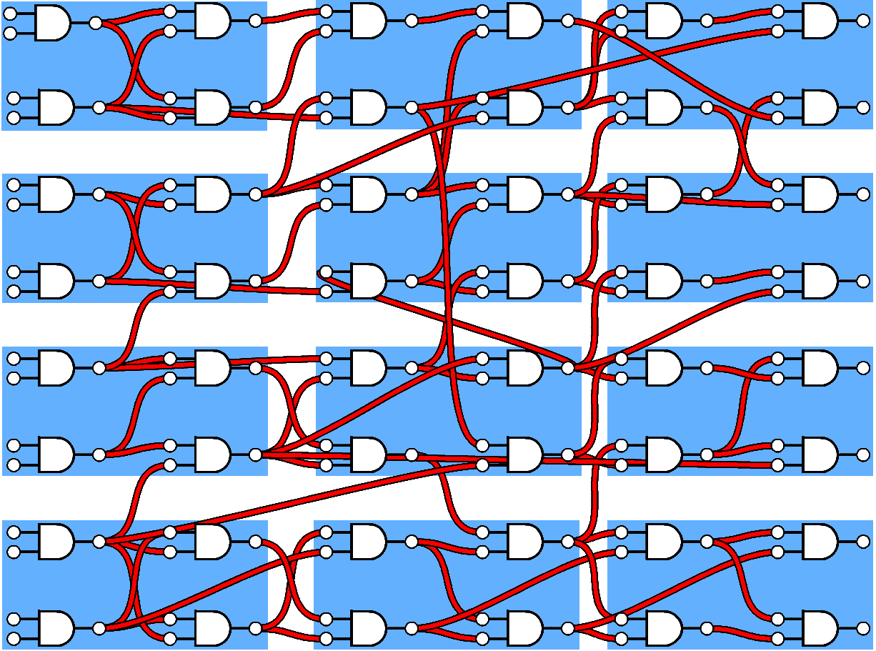
Clustering
Inter-cluster connectivity: 27 nets
Intra-cluster connectivity: 13 nets

Slide 20
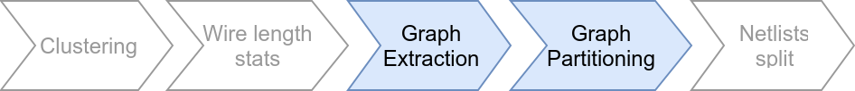
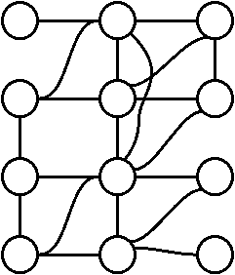
Graph extraction

Slide 21
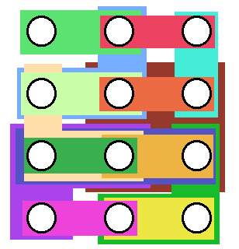
Hypergraph extraction

Slide 22
Partitioning

Slide 23
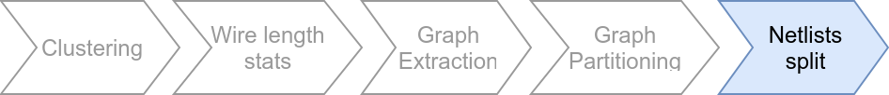
Split the netlist
Die 1
?
module top();
module die1();
module die2();
Die 2

Slide 24
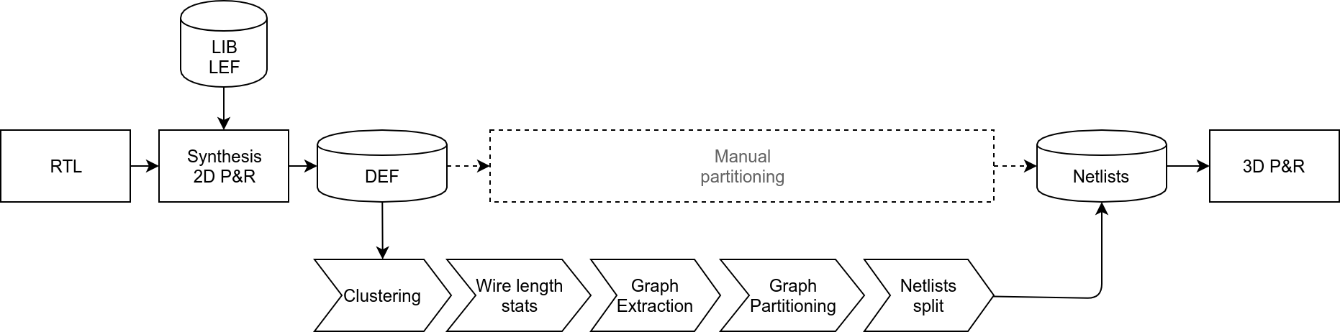
New 3D flow

Slide 25
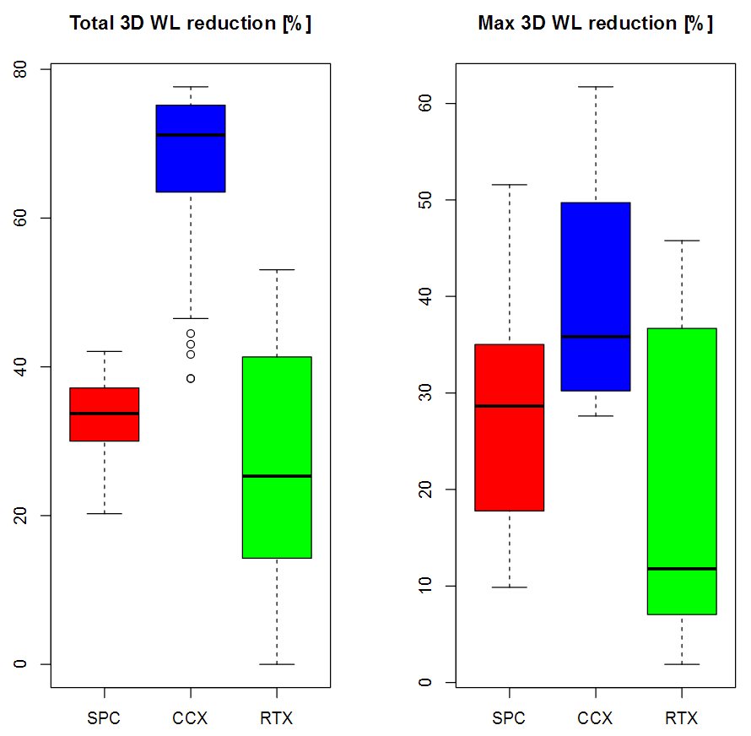
Up to 77% save in 3D wire length

Slide 26
Up to 61% in critical path reduction

Slide 27
Asymmetric partitioning How to trick the partitioner
Dummy node with no area impact, but high power

Slide 28
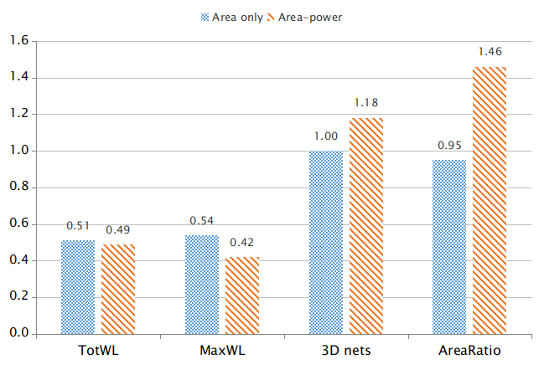
Unwanted area disbalance

Slide 29
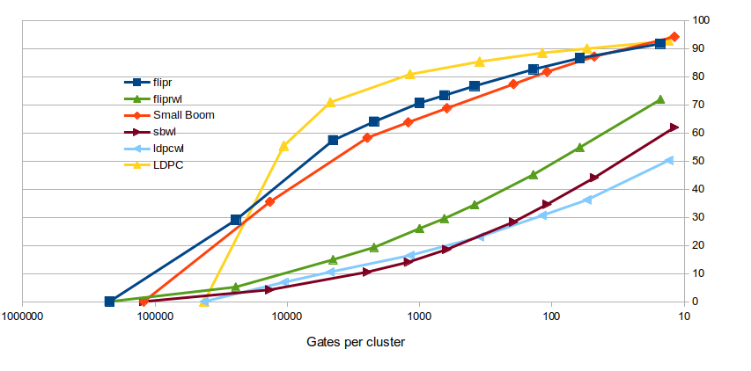
Clustering grain: Target 1000 gates
Inter-cluster WL ratio
Inter-cluster nets ratio
Smaller clusters

Slide 30
Next steps
Test other clustering methods
Netlist split
Various software improvements

Slide 31
Publication plan
December 2017
June 2018
Optimal cluster size
for 3D integration
Clustering methods review: what is the best, should it be taken lightly?

Slide 32
Long term
Clustering and partitioning methods collection
Cadence integration is risky, → alternative?
Netlist partitioning, how to publish?
3D integration comparison: monolithic vs stacking

Slide 33
Probabilité
Impact
 | Faible | Moyenne | Elevée
Intolérable |  | Perte de licence
Préoccupant | Perte du partenariat avec IMEC | Sujet obsolète | Outils libres inadéquats
Négligeable |  | Article refusé

