Slide 1

3D-Stacked Integrated Circuits: How Fine Should System Partitioning be?
ISCAS2019 – Quentin DELHAYE
How to split an SoC functionnality for implementation in 3D stacked IC?
Do we need to go as deep as gate-level?
If not, what functionnality size should not be broken? (to maximize the benefits of 3D integration)
Notes:
j’ai enlevé la figure ce n’est pas moi qui l’as faite

Slide 2
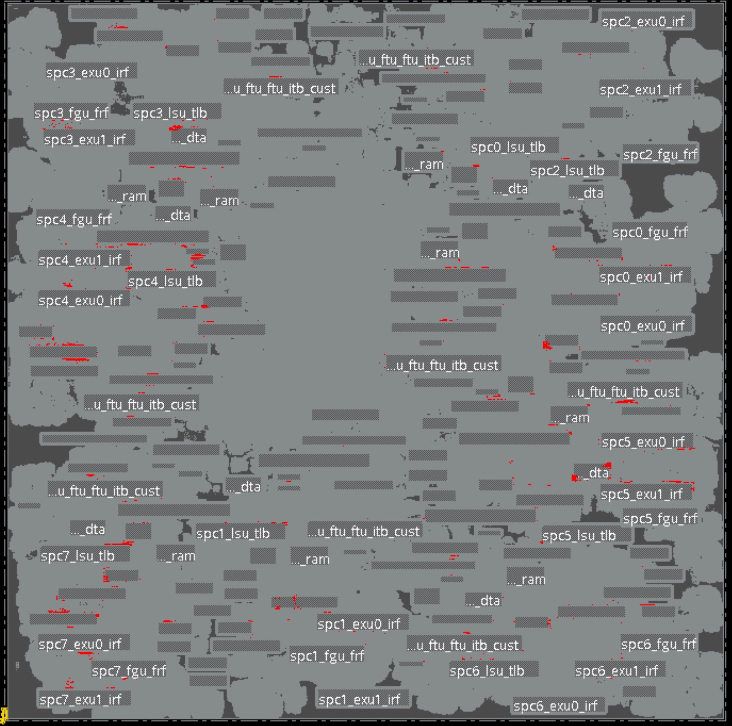
Clusters and graphs toward 3D
2D P&R design

Slide 3
Clusters and graphs toward 3D
2D P&R design
Hierarchical clustering

Slide 4
Clusters and graphs toward 3D
2D P&R design
Hierarchical clustering
Intra-cluster: protected from 3D
Inter-cluster: potential 3D gains

Slide 5
Clusters and graphs toward 3D
2D P&R design
Graph:
Clusters → edges (area)
Nets → vertices (number)
Hierarchical clustering
Intra-cluster: protected from 3D
Inter-cluster: potential 3D gains

Slide 6



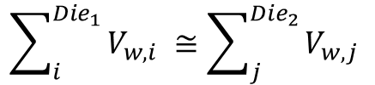





Clusters and graphs toward 3D
$$Die_{1}$$
MIN
$$E_{w}$$
$$Die_{2}$$
$$V_{w}$$
$$Die_{1}$$
MAX
$$Die_{2}$$
$$E_{wc}$$
2D P&R design
Graph: Clusters → edges &
Nets → vertices
Hierarchical clustering
Intra-cluster: protected from 3D
Inter-cluster: potential 3D gains
$$\sum_{i}^{Die_{1}}{V_{w,i} ≅\sum_{j}^{Die_{2}}{V_{w,j} }}$$
$$min\left(\sum_{i}{E_{wc,i}}\right) \text{vs} max\left(\sum_{i}{E_{wc,i}}\right)$$

Slide 7
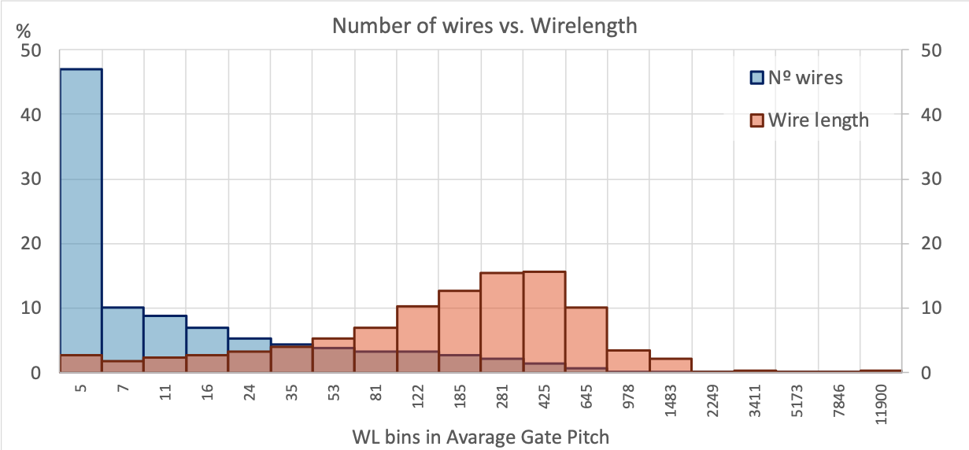
2D: What wire-length to cut?
Analysis of implemented 2D design after P&R
Relative histograms of Number of Wires & Wire Length (WL)
X-axis → Average Gate Pitch to express WL
Not absolute WL, so technology independent
Notes:
Analysis of implemented 2D design (after P&R)
Relative histograms of Number of Wires & Wire Length (WL)
X-axis uses Average Gate Pitch (AGP) to express WL (not absolute WL)

Slide 8
2D: What wire-length to cut?
A
B
A - Over 45% of wires are 5AGP or lower
B - 70% for 0.1k to 2k AGP: this is where we should cut
Notes:
Analysis of implemented 2D design (after P&R)
Relative histograms of Number of Wires & Wire Length (WL)
X-axis uses Average Gate Pitch (AGP) to express WL (not absolute WL)

Slide 9
3D integration tech. flavors
 | 3D-SIC | 3D-SOC |  | 3D-IC
Wire level | Global | Intermediate | Local | Local
Function partition | Die | Clusters | Std cells | Transistors
3D Tech | Die stacking | W2W bonding | Active layer bonding or deposition
Source: E. Beyne, 3D Heterogeneous Integration Technologies enabling
System Technology Co-Optimisation, 3D & Systems summit , 2019
Notes:
3D-SIC is OK. But what if we want to go to the next level, what are the challenges?
We need to define the blocks of cells with which we want to work: clustering.
We need to decide which block goes on which die: partitioning

Slide 10
3D integration tech. flavors
 | 3D-SIC | 3D-SOC |  | 3D-IC
Wire level | Global | Intermediate | Local | Local
Function partition | Die | Clusters | Std cells | Transistors
3D Tech | Die stacking | W2W bonding | Active layer bonding or deposition
Next level challenges: clustering and partitioning
Notes:
3D-SIC is OK. But what if we want to go to the next level, what are the challenges?
We need to define the blocks of cells with which we want to work: clustering.
We need to decide which block goes on which die: partitioning

Slide 11
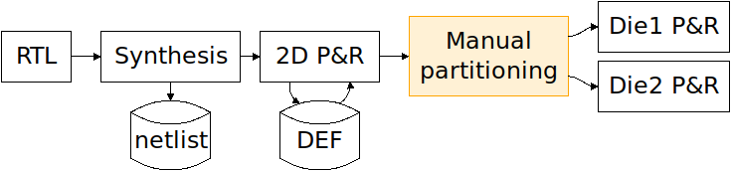
Method: Global flow
SoA partitioning is manual or gate-level automated
Notes:
Reuse the FOSDEM slide.
Basically, we work on a fully P&R’d 2D design.
We neglect the 3D overhead.
There is no native 3D P&R yet, wich would make our work way easier. Right now, we are stuck at prospecting 3D gains based on a 2D analysis.

Slide 12
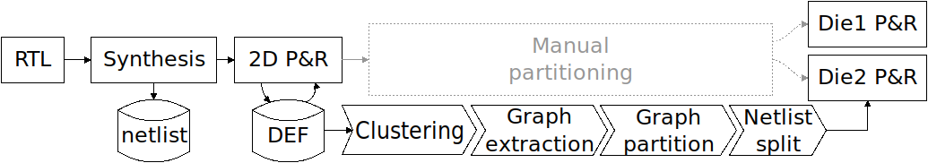
Method: Global flow
Our solution expands the possibilities with adaptative clustering grain
Notes:
Reuse the FOSDEM slide.
Basically, we work on a fully P&R’d 2D design.
We neglect the 3D overhead.
There is no native 3D P&R yet, wich would make our work way easier. Right now, we are stuck at prospecting 3D gains based on a 2D analysis.

Slide 13
Method: Global flow
Flow up to graph partitioning is fully automated
Notes:
So far, we have a fully working toolchain up to the graph partitioning, point at which we have some manual handling.

Slide 14
Method: Global flow
Highlight the decisions in the clustering step
Notes:
And in the work we are talking about today, we actually focus on the clustering.

Slide 15

Designs
Design | Gates | Nets | Wire-length (norm to design HPL)
D1 | 42k | 50k | 2 101
D2 | 121k | 137k | 2 050
D3 | 185k | 200k | 2 860
D4 | 220k | 234k | 4 318
D5 | 290k | 306k | 5 312
D6 | 694k | 774k | 12 606
D7 | 808k | 883k | 16 722
Selection of designs with various topologies and connection densities
Notes:
Table showing the designs used in this experiment.
Since we used several PDKs, the technology dependent parameters have been normalized on the design half-perimeter length.

Slide 16
Aim of the experiment
Study the partitioning grain to find an optimum
Observe the impact of the grain on the percentage of total system wire-length cut
Observe the number of 3D connexions and their impact on 3D pitch

Slide 17
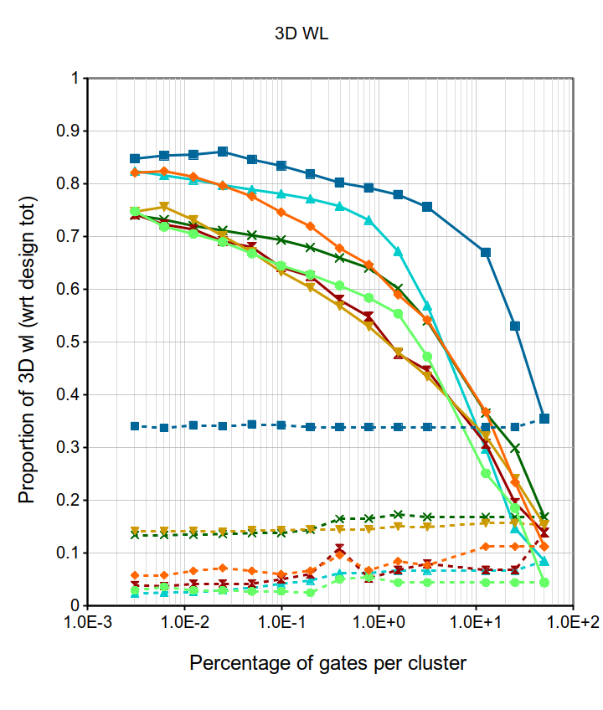
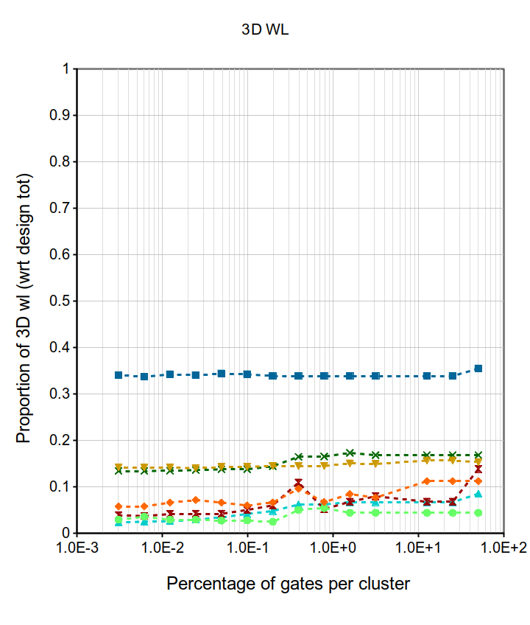
Potential wire-length gain in 3D
Measure the total wire-length cut by the partitioning
MIN-CUT: No change
MAX-CUT: Progress with cluster size
2048 clusters
Up to 85% of total WL cut
Reach a threshold for small clusters
Around 2k clusters (ie 100s of gates per cluster): 70% to 85% of total WL could gain by going 3D
MIN-CUT
MAX-CUT

Slide 18
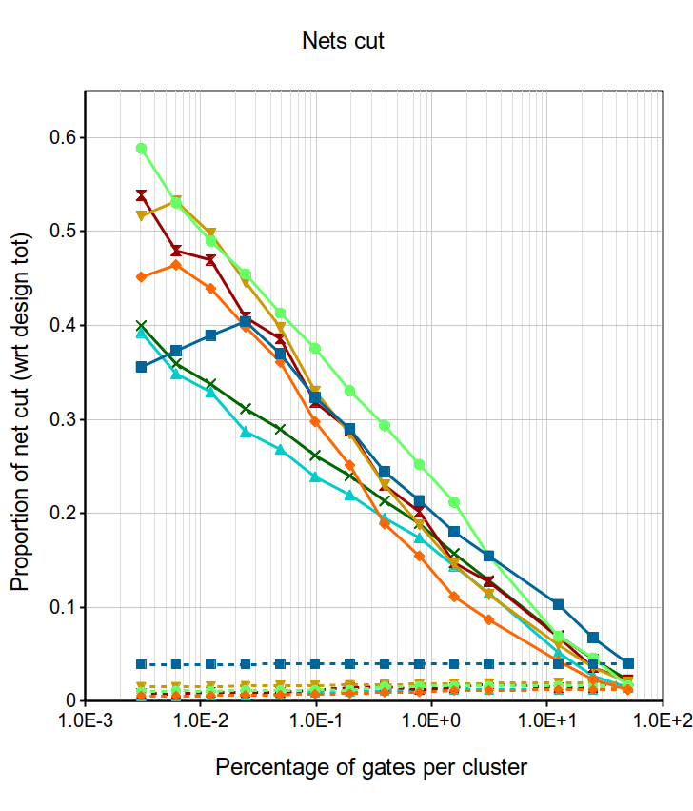
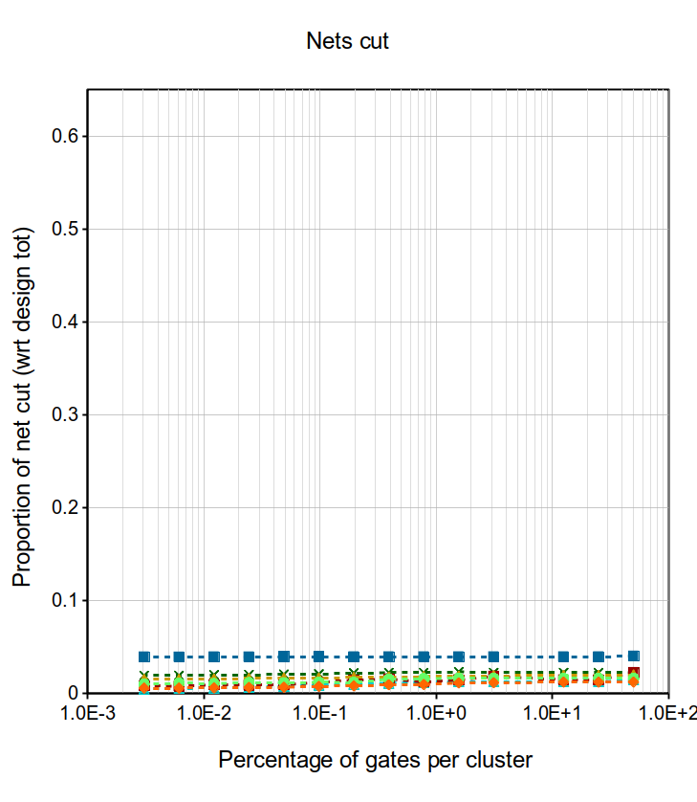
Number of 3D wires
MIN-CUT: No influence of the clustering grain
MAX-CUT produces up to 57% more 3D nets
Exponential rise of the number of 3D connexions
2048 clusters
For 2k clusters (100s of gates), we generate on average 35% of 3D wires (18k to 255k wires)
MIN-CUT
MAX-CUT
Notes:
3D pitch: sqrt(11250.10 (sum of gate area for D4) / 93238 (no wires for 2k clusters for D7)) = 0.347 um,
Against sqrt(11250.10 / 124736) = 0.300 um for 32k clusters (15% worse than for 2k clusters) At that level, we have 6 gates per cluster, close enough to a gate-level partitioning.
D4 was synthesised in 7nm. For a 45 nm design like SPC: sqrt(830983.65 / 118107) = 2.65 um

Slide 19

3D wires and 3D pitch
3D pitch can be approximated by $\sqrt{\frac{\sum{gates area}}{\sum{3D wires}}}$
Designs synthesised using a 45nm PDK, results can be extrapolated to the 7nm SoA
8 clusters (28k gates) | 2k clusters (100 gates) | 32k clusters (6 gates)
895 nm | 350 nm | 300 nm
15% better

Slide 20
Conclusions & future work
What would be an ideal partitioning grain to maximize the 3D gains?
Graph theory can be used for partitioning decision at gate-cluster level:
100s of gates per cluster (2k clusters)
Cut 35% of wires and up to 73% of total WL
3D pitch around 350 nm, 15% better than gate-level
New clustering methods: heuristics wire-length
Fully automated toolchain
Notes:
3D-IC technology enables savings on total and maximum system wirelength thus reducing Si area, power and improving performance

