Slide 1

3D-Stacked Integrated Circuits: How Fine Should System Partitioning be?
Notes:
j’ai enlevé la figure ce n’est pas moi qui l’as faite

Slide 2
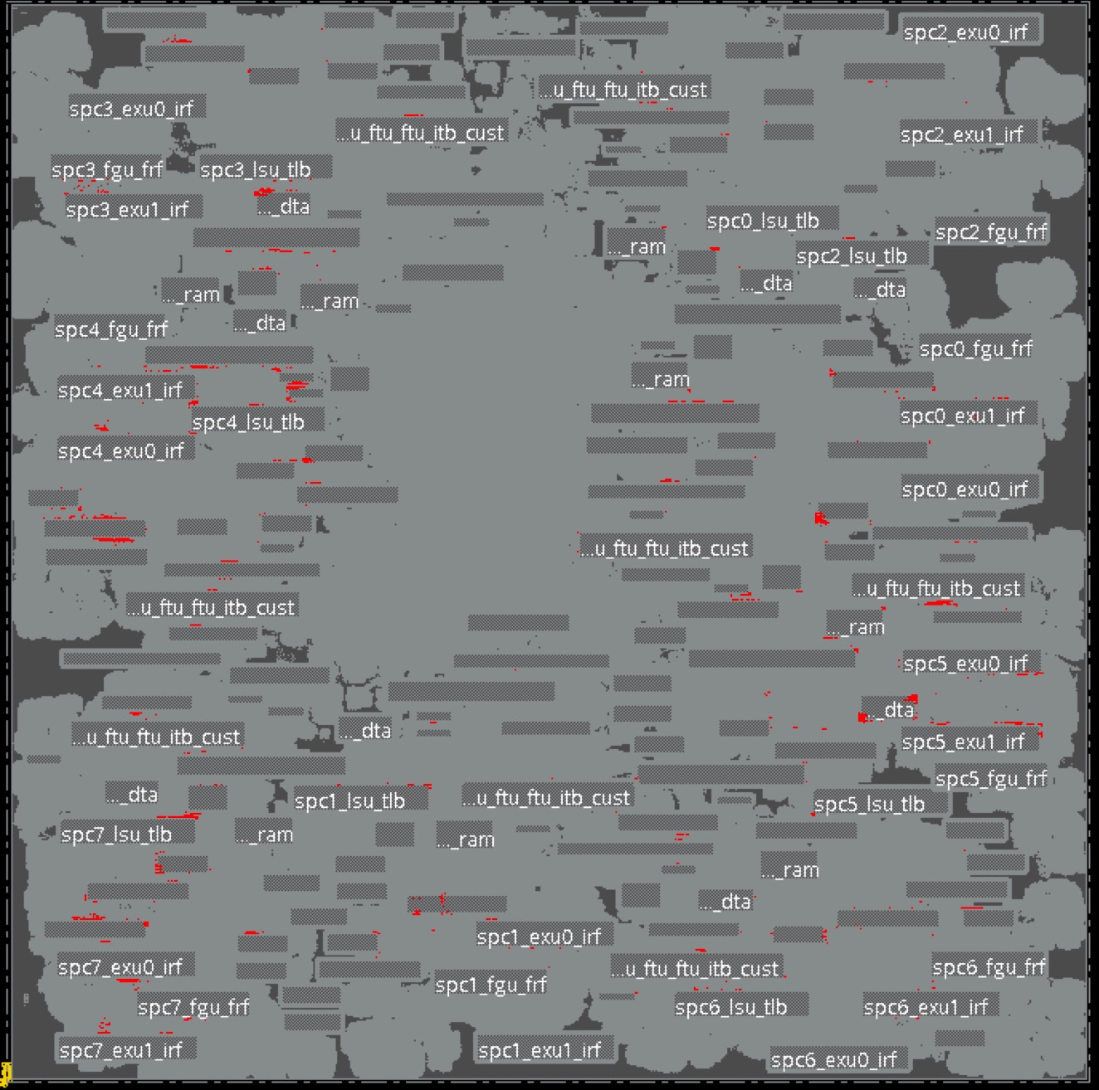
Clusters and graphs toward 3D
2D P&R design
You can use thie fig on the right to replace the plain square on the left

Slide 3
Clusters and graphs toward 3D
2D P&R design
Hierarchical clustering

Slide 4
Clusters and graphs toward 3D
2D P&R design
Hierarchical clustering
Intra-cluster: protected from 3D
Inter-cluster: potential 3D gains

Slide 5
Clusters and graphs toward 3D
2D P&R design
Graph:
Clusters → edges (area)
Nets → vertices (number)
Hierarchical clustering
Intra-cluster: protected from 3D
Inter-cluster: potential 3D gains

Slide 6
Clusters and graphs toward 3D
MIN
MAX
2D P&R design
Graph:
Clusters → edges (area)
Nets → vertices (number)
MIN-CUT or MAX-CUT
Hierarchical clustering
Intra-cluster: protected from 3D
Inter-cluster: potential 3D gains

Slide 7
2D: What wire-length to cut?
Analysis of implemented 2D design (after P&R)
Relative histograms of Number of Wires & Wire Length (WL)
X-axis uses Average Gate Pitch (AGP) to express WL (not absolute WL)
Notes:
Analysis of implemented 2D design (after P&R)
Relative histograms of Number of Wires & Wire Length (WL)
X-axis uses Average Gate Pitch (AGP) to express WL (not absolute WL)

Slide 8
2D: What wire-length to cut?
70% of total wl
Over 45% of wires are 5AGP or lower
70% in the range 0.1k to 2k AGP: this is where we should cut
Notes:
Analysis of implemented 2D design (after P&R)
Relative histograms of Number of Wires & Wire Length (WL)
X-axis uses Average Gate Pitch (AGP) to express WL (not absolute WL)

Slide 9
In the next 15 minutes
Correlation between MAX-cut and 3D nets
Study of an optimal partitioning grain
Notes:
In the next 15 minutes, you will hear about the correlation between a max-cut partitioning and 3D nets.
And from this correlation, what is actualy the optimal partitioning or clustering grain.

Slide 10
In the next 15 minutes
Correlation between MAX-cut and 3D nets
Study of an optimal partitioning grain
Notes:
But before all that, we need to talk about 3D, MAX-cut and clustering.

Slide 11
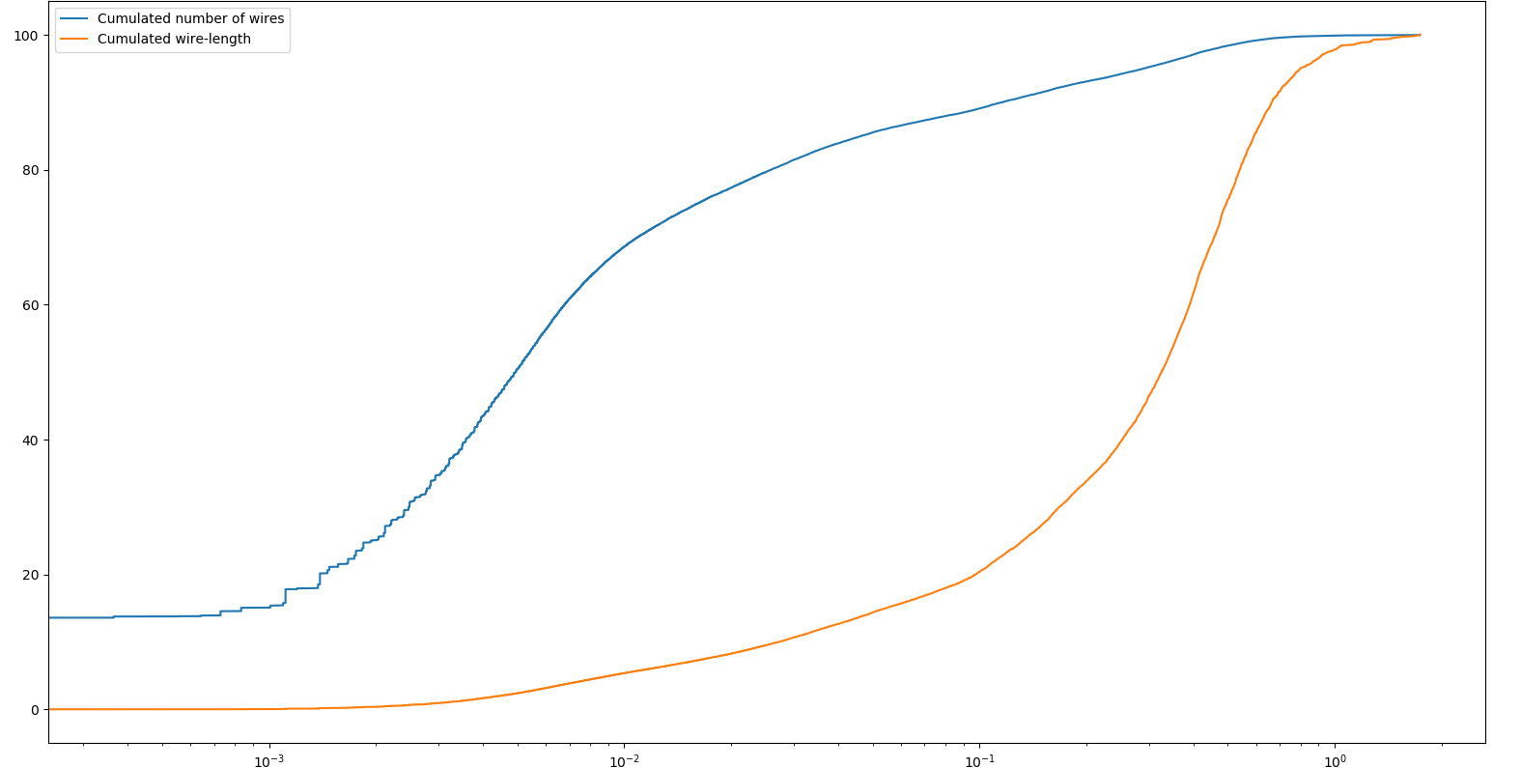
What is inside a 2D IC?
Number of wires
Wire-length
Net length, norm on hpl

Slide 12
What is inside a 2D IC?
Net length, norm on hpl
Local
Intermediate wires
Global

Slide 13
3D integration tech. flavours
 | 3D-SIC | 3D-SOC |  | 3D-IC
Wire level | Global | Intermediate | Local | Local
Function partition | Die | Clusters | Std cells | Transistors
3D Tech | Die stacking | W2W bonding | Active layer bonding or deposition
Source: E. Beyne, 3D Heterogeneous Integration Technologies enabling
System Technology Co-Optimisation, 3D & Systems summit , 2019
Notes:
3D-SIC is OK. But what if we want to go to the next level, what are the challenges?
We need to define the blocks of cells with which we want to work: clustering.
We need to decide which block goes on which die: partitioning

Slide 14
3D flavours
 | 3D-SIC | 3D-SOC |  | 3D-IC
Wiring | Global | Intermediate | Local | Local
Partition | Die | Clusters | Std cells | Transistors
3D Tech | Die stacking | W2W bonding | Active layer bonding or deposition
Next level challenges: clustering and partitioning
Notes:
3D-SIC is OK. But what if we want to go to the next level, what are the challenges?
We need to define the blocks of cells with which we want to work: clustering.
We need to decide which block goes on which die: partitioning

Slide 15
Focus on the clustering
What would be a good clustering method?
What would be an ideal clustering grain?
Notes:
Clustering grain that we also call « partitioning grain ».

Slide 16
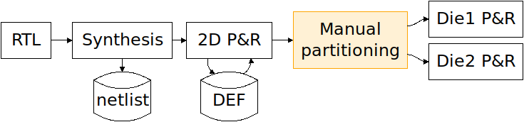
Method: Global flow
SoA partitioning is manual or gate-level automated
Notes:
Reuse the FOSDEM slide.
Basically, we work on a fully P&R’d 2D design.
We neglect the 3D overhead.
There is no native 3D P&R yet, wich would make our work way easier. Right now, we are stuck at prospecting 3D gains based on a 2D analysis.

Slide 17
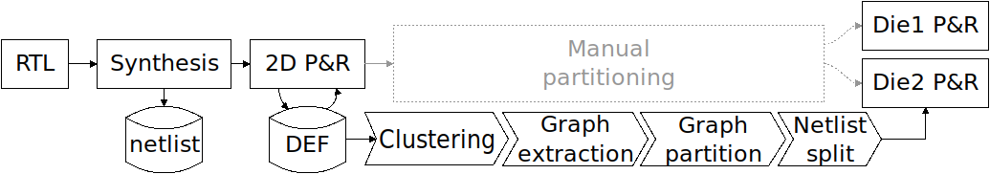
Method: Global flow
Our solution expands the possibilities with adaptative clustering grain
Notes:
Reuse the FOSDEM slide.
Basically, we work on a fully P&R’d 2D design.
We neglect the 3D overhead.
There is no native 3D P&R yet, wich would make our work way easier. Right now, we are stuck at prospecting 3D gains based on a 2D analysis.

Slide 18
Method: Global flow
Flow up to graph partitioning is fully automated
Notes:
So far, we have a fully working toolchain up to the graph partitioning, point at which we have some manual handling.

Slide 19
Method: Global flow
Highlight the decisions in the clustering step
Notes:
And in the work we are talking about today, we actually focus on the clustering.

Slide 20
Method: Clustering
Notes:
We all agree that the clustering method is important, but the grain should gather as much attention.
Justify why we need to cluster a design. What is the struggle?
It’s not a question of computing power, we can easily work with tens of thousand clusters.
The clustering is actually working toward the true aim of the partitioning: avoid cutting short nets.
We thus want to know if there exists an ideal clustering grain at which we maximize the total wire-length cut (the longer we cut, the shorter the total 3D WL), while we minimize the number of nets contributing to this total WL (the less net cut, the less net need to be routed in 3D, limiting the amount of 3D TSV needed).
Moreover, we want to know if this grain is consistent across different design (different in term of number of gates, but also in terms of interconnection density).

Slide 21
Method: Clustering
Notes:
We all agree that the clustering method is important, but the grain should gather as much attention.
Justify why we need to cluster a design. What is the struggle?
It’s not a question of computing power, we can easily work with tens of thousand clusters.
The clustering is actually working toward the true aim of the partitioning: avoid cutting short nets.
We thus want to know if there exists an ideal clustering grain at which we maximize the total wire-length cut (the longer we cut, the shorter the total 3D WL), while we minimize the number of nets contributing to this total WL (the less net cut, the less net need to be routed in 3D, limiting the amount of 3D TSV needed).
Moreover, we want to know if this grain is consistent across different design (different in term of number of gates, but also in terms of interconnection density).

Slide 22
Method: Clustering
Notes:
Etc. Untill we reach a lot of clusters.

Slide 23
Method: Partitioning
Bipartition the graph: Min/max-cut
Min or max cutsize:
Number of nets
Total wire-length
Average wire-length
Notes:
You basically have two choices: Min- or MAX-cut. Each will either minimize or maximize what is called the “cutsize”. This cutsize depends on the metric used to caracterize the edges of the graph.
It can be the amount of nets in one edge, the total or average wire-length in an edge, or whatever.
The former would make sense in the way that it aims at minimizing the amount of interconnection between the partitions, which are actually 3D connections in our case. However, we found out that since MIN-cut algorithms are already used in during the 2D P&R, the partitioning simply falls back on the very same partitions, yielded few new results.
The later though, aims at maximizing those 3D connections, which can highlight some intersting correlation between the amount of 3D wires and the total 3D wirelength, as we will see together later.
All those algorithms produce balanced bipartitioning, meaning we end up with two dies of the same size.

Slide 24
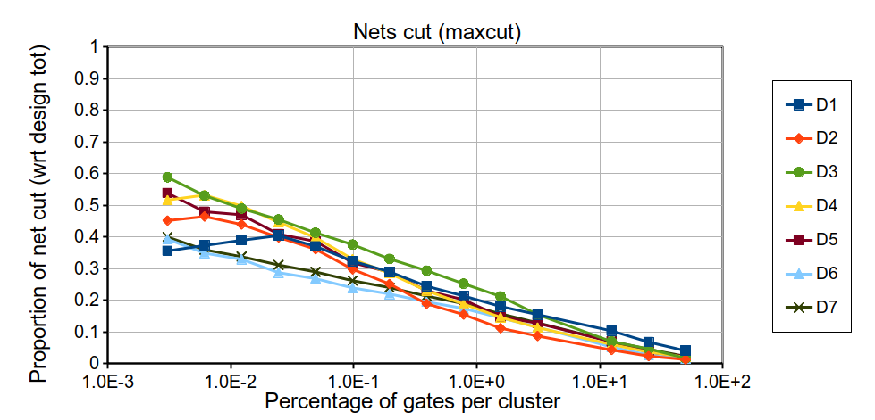
Designs
Design | Gates | Nets | Wire-length (norm to design HPL)
D1 | 42k | 50k | 2,101
D2 | 121k | 137k | 2,050
D3 | 185k | 200k | 2,860
D4 | 220k | 234k | 4,318
D5 | 290k | 306k | 5,312
D6 | 694k | 774k | 12,606
D7 | 808k | 883k | 16,722
Selection of designs with various topologies and connection densities
Notes:
Table showing the designs used in this experiment.
Since we used several PDKs, the technology dependent parameters have been normalized on the design half-perimeter length.

Slide 25
Aim of the experiment
Study the partitioning grain to find an optimum
Observe the impact of the grain on the percentage of total system wire-length cut
Observe the number of 3D connexions and their impact on 3D pitch

Slide 26
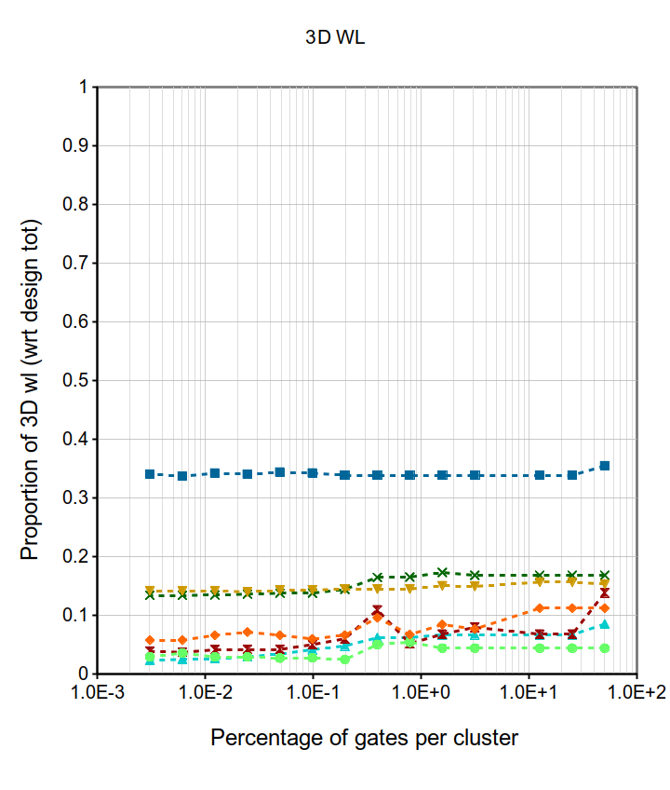
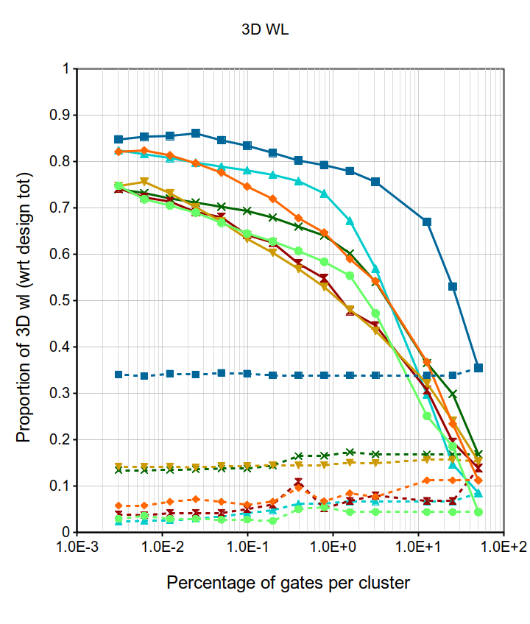
Potential wire-length gain in 3D
Measure the total wire-length cut by the partitioning
MIN-CUT: No change
MAX-CUT: Progress with cluster size
2048 clusters
Up to 85% of total WL cut
Reach a threshold for small clusters
Around 2k clusters (ie 100s of gates per cluster): 70% to 85% of total WL could gain by going 3D

Slide 27
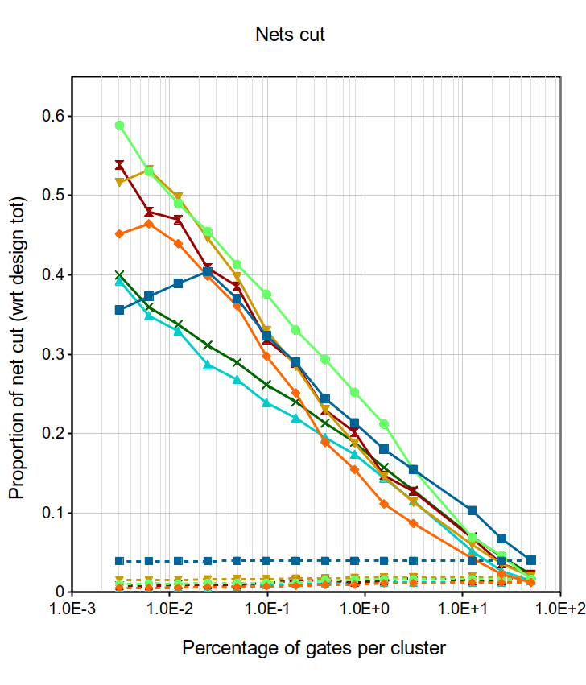
Number of wires and 3D pitch
MIN-CUT: No influence of the clustering grain
MAX-CUT produces up to 57% more 3D nets
Exponential rise of the number of 3D connexions
2048 clusters
For 2k clusters (100s of gates), we generate on average 35% of 3D wires (18k to 255k wires)

Slide 28
Results: clustering grain
Cut as little as possible, stay low on the Y-axis

Slide 29
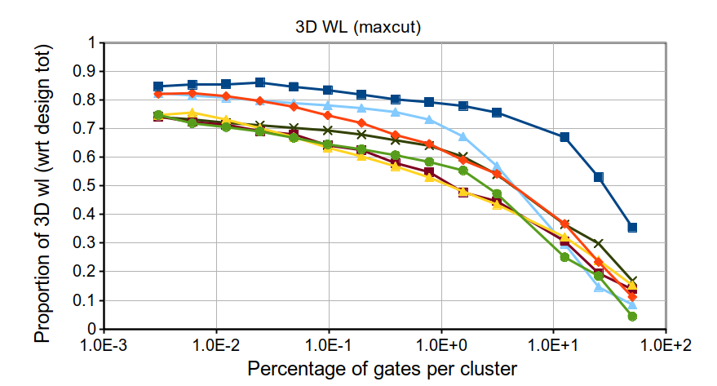
Results: clustering grain
Cut as long as possible, get high on the Y-axis

Slide 30
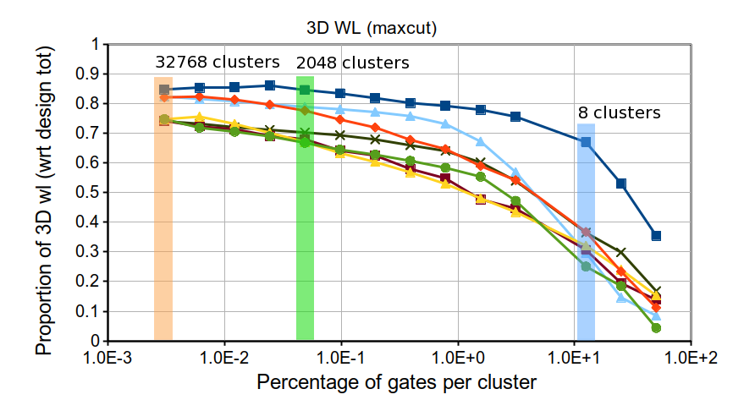
Results: clustering grain

Slide 31
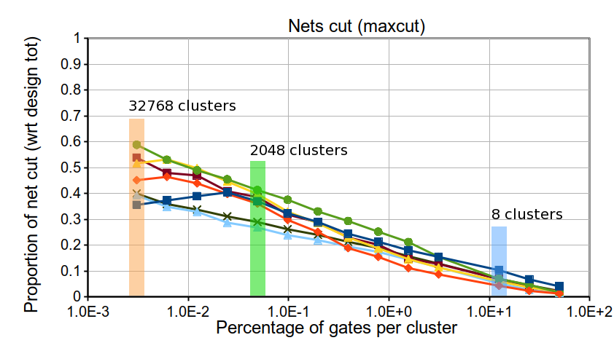
Results: clustering grain
Notes:
2048 clusters in terms of gates:
D1: 21, D2: 59, D3: 91, D4: 108, D5: 142, D6: 339, D7: 395

Slide 32
Results: clustering grain
 | Percentage of nets cut |  |  | Percentage of 3D WL
Clusters | 8 | 2048 | 32768 | 8 | 2048 | 32768
Average | 7% | 35% | 49% | 37% | 73% | 78%
Std dev | 2% | 5% | 7% | 13% | 6% | 4%

Slide 33
Inter-function wirelength significant for smaller functionalities
Up to 80% of total WL taken by inter-function WL
potentially cut by 3D
For 0.1 to1Kgates clusters inter-function WL is 55-75% of total WL
b)
c)
a)
Soit on ralonge le graph pour faire un rectangle plus large que haut et texte est alors en haut

Slide 34
Inter-function wirelength significant for smaller functionalities
Up to 80% of total WL taken by inter-function WL
potentially cut by 3D
For 0.1 to1Kgates clusters inter-function WL is 55-75% of total WL
b)
c)
a)
Soit on fait l’invers: plus long que large

Slide 35
Conclusions & future work
3D-IC technology enables savings on total and maximum system wirelength thus reducing Si area, power and improving performance
Graph theory and algorithms can be used to make a partitioning decision at gate-cluster level
New clustering methods: heuristics on progressive wire-length
Fully automated toolchain

