Slide 1
Log目的、作用
Log分类
Log格式
Log实例
Log支持的功能
glossary
Log实现
Log管理
Log调试
Log三步走

Slide 2
Log目的、作用
Log不是功能模块，而是对已发生事件的显示、记录，同时可以对其分析以得出某些有规律的结论。
以汽车为例：
Flow，policy，nat以及其他service相当于发动机，车身，轮胎等；
Log相当于仪表或行车记录仪，没有log汽车的功能不会有影响，但是会缺少直观，准确，细节。
类似的还有snmp，各种统计信息等。

Slide 3
Log分类
Event log vs traffic log
Event log 控制平面产生，一般需要进行快速响应，反映的是系统的运行状态，如设备温度过高，interface down，HA failover/failure，IPSec failure等。
Traffic log 数据平面产生，大部分由报文触发，大多数以提供信息或分析数据为目的，一般不需要进行快速响应。通过对log分析，可以得出如报文pattern，系统资源使用等信息。
这里我们讲的是traffic log

Slide 4
Log格式
RFC3164 (traditional) syslog
RFC5424 structure data log (SD-log)
还可自定义其他log格式，优点灵活+节省空间，缺点是需要额外解析
other related RFCs:
5425， 5426， 5676， 5848， 6012， 6587

Slide 5
Log实例 (1)
traditonal log
<14>Aug 31 15:21:06 flow-vsrx10 RT_FLOW: RT_FLOW_SESSION_CLOSE: session closed Some-reason: 124.193.37.100/30007->124.193.37.200/32768 0x0 Medium 124.193.37.100/30007->124.193.37.200/32768 0x0 Fake-src-nat-type Fake-src-nat-rule Fake-dst-nat-type Fake-dst-nat-rule 17 session_policy4 source_zone4 Fake-dst-zone 1 4294967295(1073741824) 4294967294(1073741824) 4294967291 junos:SSL junos:SSL user4(Fake-UAC-roles) source_interface4 Fake-encrypt Infrastructure Encryption 4 application-character4 client-proxy 3735928575 124.193.37.100/30007->124.193.37.200/32768 Fake-host Fake-src-vrf-group Fake-dst-vrf-group Fake-tunnel-inspection root

Slide 6
Log实例 (2)
sd-log:
<14>1 2020-08-31T15:30:16.840Z flow-vsrx10 RT_FLOW - RT_FLOW_SESSION_CLOSE [junos@2636.1.1.1.2.129 reason="Some reason" source-address="124.193.37.100" source-port="31006" destination-address="124.193.37.200" destination-port="32768" connection-tag="0" service-name="Medium" nat-source-address="124.193.37.100" nat-source-port="31006" nat-destination-address="124.193.37.200" nat-destination-port="32768" nat-connection-tag="0" src-nat-rule-type="Fake src nat type" src-nat-rule-name="Fake src nat rule" dst-nat-rule-type="Fake dst nat type" dst-nat-rule-name="Fake dst nat rule" protocol-id="17" policy-name="session_policy4" source-zone-name="source_zone4" destination-zone-name="Fake dst zone" session-id-32="1" packets-from-client="4294967295" bytes-from-client="1073741824" packets-from-server="4294967294" bytes-from-server="1073741824" elapsed-time="4294967291" application="junos:SSL" nested-application="junos:SSL" username="user4" roles="Fake UAC roles" packet-incoming-interface="source_interface4" encrypted="Fake encrypt" application-category="Infrastructure" application-sub-category="Encryption" application-risk="4" application-characteristics="application-character4" secure-web-proxy-session-type="client-proxy" peer-session-id="3735928575" peer-source-address="124.193.37.100" peer-source-port="31006" peer-destination-address="124.193.37.200" peer-destination-port="32768" hostname="Fake host" src-vrf-grp="Fake src vrf group" dst-vrf-grp="Fake dst vrf group" tunnel-inspection="Fake tunnel inspection" tunnel-inspection-policy-set="root"]

Slide 7
Log支持的功能(1)
log {
(source-address source-address | source-interface source-interface);
escape;
time-format (year | millisecond);
event-rate logs per second; (for stream mode)
file {
files files;
name name;
path path;
size size;
}
format (binary | sd-syslog | syslog | protobuf);
max-database-record max-database-record;
mode (event | stream | stream-event);
rate-cap logs per second; (for event mode)
report {
logs-per-table {
idp idp;
ipsec-vpn ipsec-vpn;
screen screen;
session-all session-all;
sky sky;
utm utm;
}
table-lifetime table-lifetime;
table-mode {
dense;
}
}

Slide 8
Log支持的功能(2)
root-streaming;
stream stream-name {
category (all | content-security | fw-auth | screen | alg | nat | flow | sctp | gtp | ipsec | idp | rtlog |pst-ds-lite | appqos |secintel |aamw);
filter {
threat-attack;
}
format (binary | sd-syslog | syslog | welf);
host {
ip-address;
port port-number;
routing-instance instance-name;
}
rate-limit {
log-rate;
}
severity (alert | critical | debug | emergency | error | info | notice | warning);
source-address {
ip-address;
}
time-format (year | millisecond);
transport {
protocol (tcp | tls | udp);
tcp-connections tcp-connections;
tls-profile tls-profile;
}
}
utc-timestamp;
}

Slide 9
Glossary：
Flow 防火墙处理报文基本流程
Service 防火墙提供的上层服务，以flow为基础，如IDS，UTM，IDP，TCP proxy等
Control/data plane 控制/数据平面
Ukernel 数据平面通过ukernel与控制平面通信
DPQ data plane queue，数据平面处理报文、消息队列，flow获取队列中的报文或消息进行处理
Reinject flow处理过程中将报文或消息重新加入队列
Rtlogd run/real time log daemon，控制平面处理log进程
Llmd local logging management daemon，控制平面处理本地log进程

Slide 10
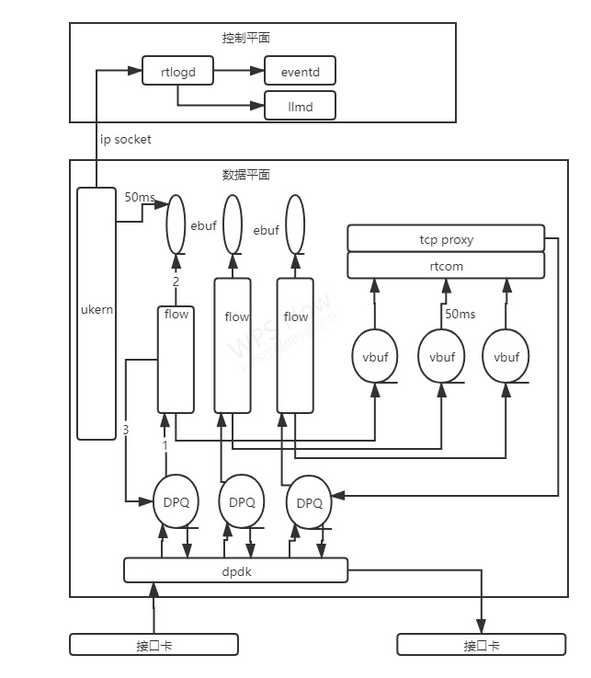
Log实现(1)

Slide 11
Log实现(2)
Log的生成在flow/service处理报文过程中
同一个报文可能生成多个Log
Event mode Log流程: Log API -> enqueue ebuf -> 继续其他处理
Ukernel 50ms timer -> 遍历ebuf -> 通过socket发送给控制平面rtlogd, rtlogd根据配置可能写文件或发送至eventd
Stream mode udp based log 流程: Log API -> reinject to DPQ -> 继续其他处理
flow poll DPQ -> 发送udp log
Stream mode tcp based log 流程: Log API-> enqueue vbuf -> 继续其他处理
flow 50ms timer -> 遍历vbuf -> call rtcom API -> call tcp-proxy -> reinject to DPQ -> create TCP connection and rtcom connection
flow 50ms timer -> 遍历vbuf -> call rtcom API -> 发送tcp log

Slide 12
Log实现(3) – onbox reporting

Slide 13
Log实现(4) – onbox reporting
Flow向share memory写入解析binary log
Llmd polling thread 读入log
Polling thread分发log给不同queue
Writing thread将log写入DB
用户show命令通过ip socket传递给llmd
UI thread根据show命令查询DB
定时器任务将DB rotate (清除老数据)
Rtlogd 与 llmd sync 配置、状态信息

Slide 14
Log管理
1. 统一，命名、格式、内容、字段顺序
2. 按需，客户需求，自身需求
一般而言，涉及丢包，资源分配，或对报文有特定检查都需要发送log
3. 简单易扩展

Slide 15
Log调试
1. Log是非功能模块，需要其他模块触发，添加命令触发机制
2. Log问题大多是性能，配置或网络相关
3. Log内容错误不易发现，需要自动化测试

Slide 16
Log三步走(1)
短期：Log定义框架
Log生成API, better to make a common lib for both event and stream mode
traditional log (RFC3164), sd-log (RFC5424)
event mode (save to file)
Log file rotate
udp based stream mode
multiple stream support
rate limit
自生成log (debug)
配置处理

Slide 17
Log三步走(2)
中期：binary/protobuf log (to save disk space and bandwidth)
Log filter (by facility/category/severity/regex)
tcp/tls based stream mode
performance and log acceleration
event mode (save to DB)

Slide 18
Log三步走(3)
长期：Log限速优先队列，超长log
on-box reporting (low/mid-end), save log to db, and generate reports, like top count 10, top volume 10, top risk 10, show statistics in specific interval, etc..
根据Log分析，动态调节系统
客户定制log，可以根据需要使用命令配置希望得到的log形式，比如改变某些字段顺序，去除某些字段
自动生成log帮助文档

