Slide 1
从现代C++元编程到ORM
祁 宇
qicosmos@163.com
purecpp.org

Slide 2
新特性（C++11/14/17）
元编程
元编程的一些用途
元编程实现ORM
Modern C++ Creative Ideas

Slide 3


Slide 4

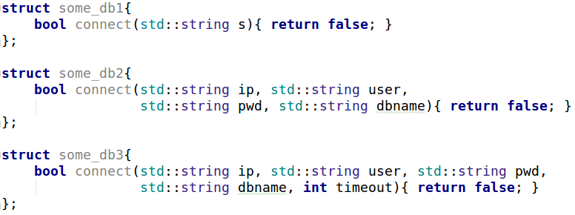
Variadic Template
适配不同的接口

Slide 5
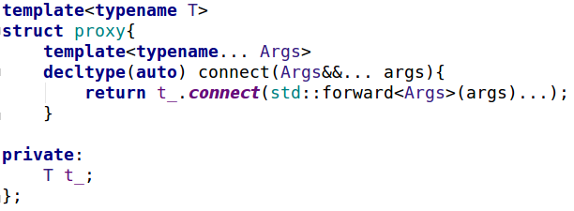
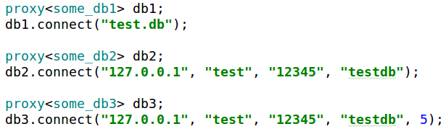
Variadic Template

Slide 6
Structured Binding
std::map<int, int> mp = { {1, 2}, {3, 4} };
for(auto&& [k, v] : mp)
std::cout<<k<<" "<<v<<'\n';
std::tuple<int, double> tp(1, 2.5);
auto [a, b] = tp;

Slide 7
Variadic Template + Structured Binding
分割一个定长的variadic template
template<typename... Args>
auto split_3args(Args&&... args){
auto tp = std::make_tuple(std::forward<Args>(args)...);
return std::make_tuple(std::get<0>(tp), std::get<1>(tp), std::get<2>(tp));
}
auto t = split_3args(1, 2.5, "test", '1'); //tuple(1, 2.5, "test")

Slide 8
Variadic Template + Structured Binding
template<typename... Args>
auto split_3args(Args&&... args){
auto tp = std::make_tuple(std::forward<Args>(args)...);
auto [a, b, c, d] = tp;
return std::make_tuple(a, b, c);
}
auto split_3args(auto a, auto b, auto c, auto d){
return std::make_tuple(a, b, c);
}

Slide 9
Constexpr If
template<typename T> std::enable_if_t<std::is_integral<T>::value, std::string> to_str(T t) { return std::to_string(t); } template<typename T> std::enable_if_t<!std::is_integral<T>::value, std::string> to_str(T t) { return t; }

Slide 10
Constexpr If
消除enable_if
让编译期选择变得简单
更紧密、清晰的上下文
template<typename T> auto to_str17(T t) { if constexpr(std::is_integral<T>::value) return std::to_string(t); else return t; }

Slide 11
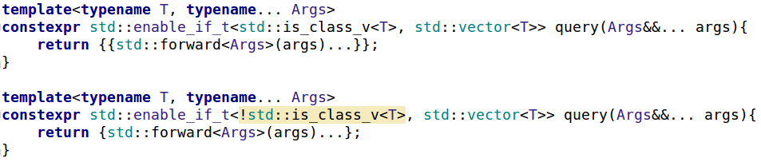
Enable_if
用constexpr if消除enable_if
提供参数相同，返回类型不同的同名接口

Slide 12
Constexpr If + Variadic Template
扩展接口：
接口不变
根据参数类型的不同展现不同的行为
extend(); //no extention
extend(0); //do int branch
extend(2.5); //do double branch

Slide 13
Constexpr If + Variadic Template
template<typename... Args>
auto extend(Args&&... args){
if constexpr(sizeof...(Args)==0){
std::cout<<"no extention"<<std::endl;
}
else if constexpr(sizeof...(Args)==1){
if constexpr(std::is_same_v<int, Args...>){
std::cout<<"do int branch"<<std::endl;
}
else if constexpr(std::is_same_v<double, Args...>){
std::cout<<"do double branch"<<std::endl;
}
}
}

Slide 14
Fold Expression
简化variadic template的使用
template<typename T>
auto add(T t){
return t;
}
template<typename Arg, typename... Args>
auto add(Arg arg, Args... args){
return arg+add(args...);
}
add(1,2,3); //6
template<typename... Args> auto add(Args... args) { return (args + ...); }
template<typename... Args> auto sub (Args... args) { return (args - ... - 1); }

Slide 15
Fold Expression
//c++11
template<typename... Args>
void print(Args... Args){
std::initializer_list<int>{(std::cout << args<<std::endl, 0)...};
}
//c++17 unary fold
template<typename... Args>
void print(Args... args) {
((std::cout<<args<<std::endl), ...);
}
//c++17 binary fold
template<typename ...Args> void print(Args&&... args) {
(std::cout << ... << args) << '\n'; }

Slide 16
连接任意个字符串
template<typename... Args>
inline void append(std::string& s, Args&&... args) {
((s+=std::forward<Args>(args), s += ", "),...);
}
std::string s="";
append(s, "a", "b", "c"); //a, b, c

Slide 17
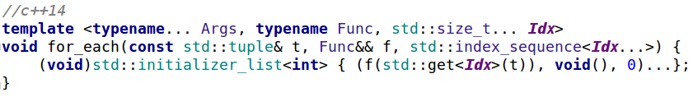
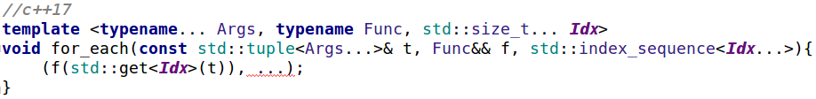
Fold Expression
遍历tuple/variadic template

Slide 18
Static_assert
编译期检查，在编译期就抓住错误
fun_for_1024<0,1,2,4>(); //ok
fun_for_1024<4,2,1,0>(); //ok
fun_for_1024<0,1,1,4>(); //static assertion failed: hi guy, just for 1024
fun_for_1024<1,0,2,5>(); //static assertion failed: hi guy, just for 1024
fun_for_1024<1,0,2>(); //static assertion failed: hi guy, just 4 numbers

Slide 19
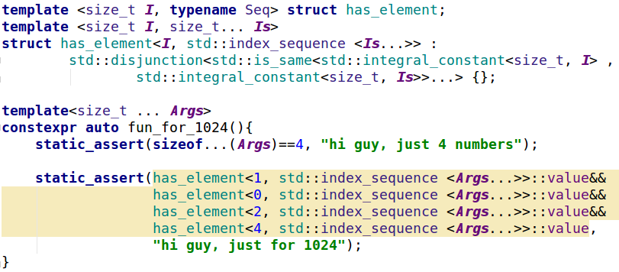
Static_assert

Slide 20

Future C++
Type-and resource-safe
Significantly simpler and clearer code
As fast or faster than anything else
Good at using “modern hardware”
Significantly faster compilation catching many more errors

Slide 21
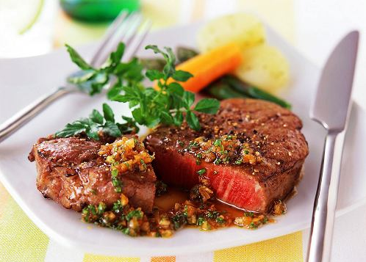

Slide 22
ORM
统一好用的接口
可扩展的接口
自动生成sql脚本
自动化地实体映射

Slide 23
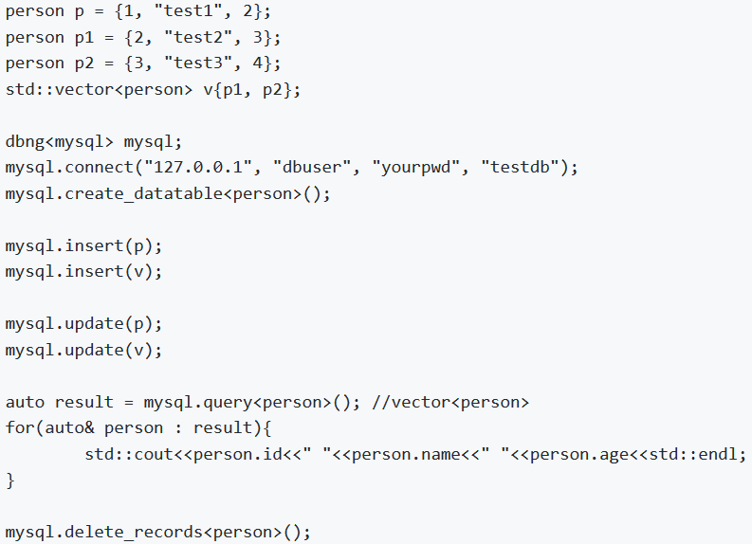
ORM
https://github.com/qicosmos/ormpp

Slide 24
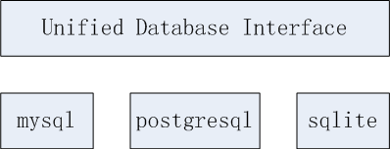


ORM
屏蔽不同数据库的差异

Slide 25
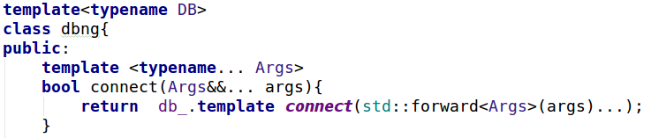
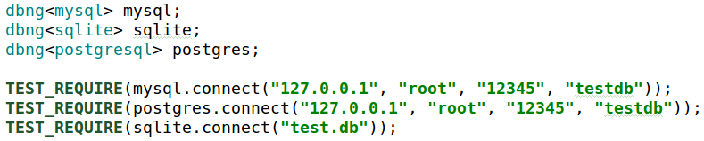
统一接口
通过可变模板参数统一接口
通过policy-base设计和variadic template来屏蔽数据库接口差异

Slide 26
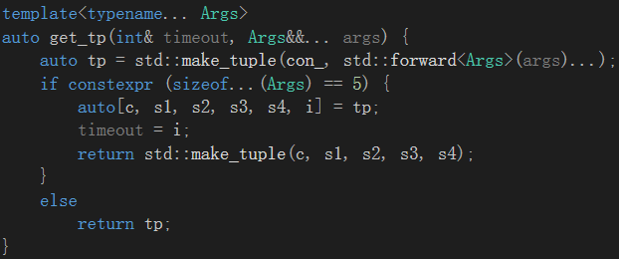
统一接口
通过constexpr if 和variadic template实现静态多态

Slide 27
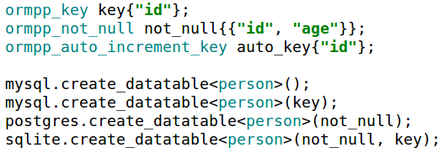

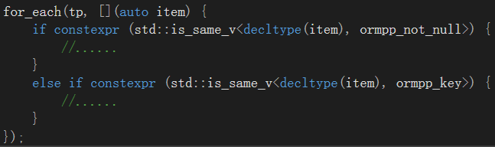
扩展接口
通过constexpr if和variadic template来扩展接口

Slide 28
编译期反射
编译期获得对象的元数据（field name, field type, field sequence）
struct person {
std::string name;
int age;
};
REFLECTION(person, name, age)
std::cout << get_name<person, 0>()<< get_name<person, 1>() << std::endl;
std::cout << get<0>(p) << get<1>(p) << std::endl;
person p = { "admin", 20 };
for_each(p, [](const auto& item, auto idx) {
std::cout << item << " " << decltype(i)::value << std::endl;
});
<<Compile-time Reflection, Serialization and ORM Examples>>
https://github.com/CppCon/CppCon2017
https://www.youtube.com/watch?v=WlhoWjrR41A

Slide 29
自动生成sql语句
通过编译期反射获取对象和字段的名称
通过类型映射获取数据库类型名称
" CREATE TABLE person ( id INT, name TEXT, age INT) "
struct person {
int id;
std::string name;
int age;
};
REFLECTION(person, id, name, age)

Slide 30
自动生成sql脚本
编译期反射获取对象名称
编译期反射获取字段名数组
编译期获取类型名称数组？
constexpr auto name = iguana::get_name<T>(); → "person"
constexpr auto arr = iguana::get_array<T>(); → {"id" , "name" , "age" }
→{“INTEGER" , “TEXT" , “INTEGER" }

Slide 31
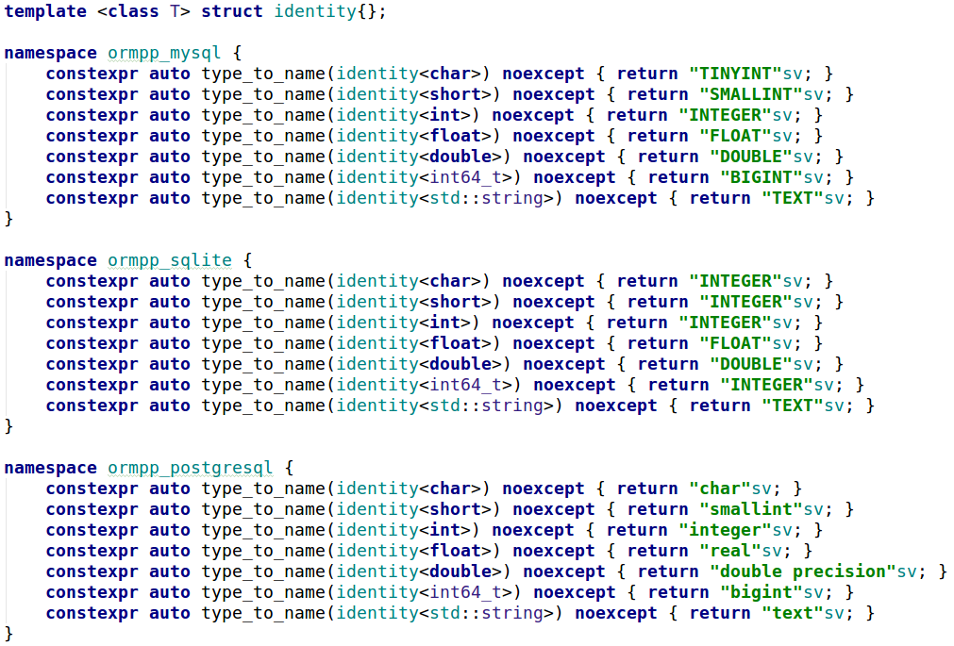
类型映射
C++类型映射到数据库字段类型

Slide 32
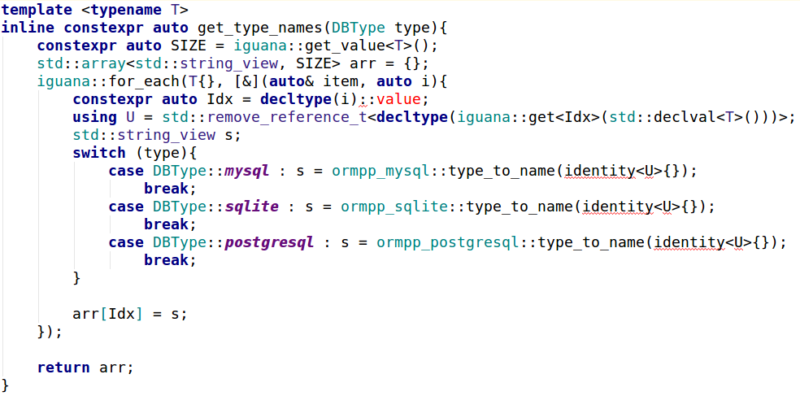
获取类型名称
编译期获取类型名称数组

Slide 33

自动生成脚本
对象名 + 字段名 + 类型名 ➔ 自动生成sql语句
struct person {
int id;
std::string name;
int age;
};
REFLECTION(person, id, name, age)
" CREATE TABLE person ( id INT, name TEXT, age INT) "
只需要一个对象类型就可以自动生成创建语句, insert,update,delete 类似
This is the magic of modern C++ !

Slide 34
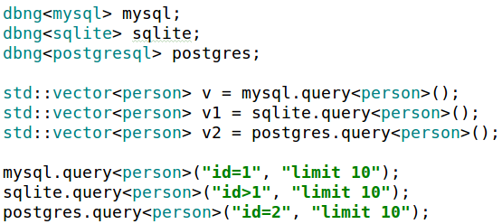

实体映射

Slide 35
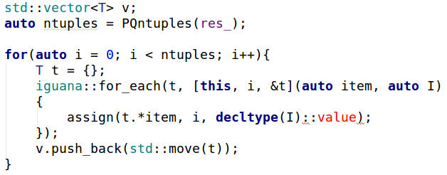
实体映射
Postgresql to Entity

Slide 36
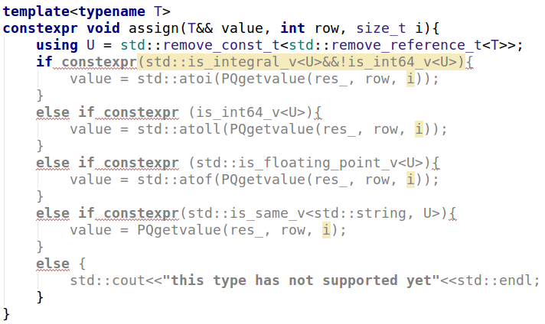
实体映射
Postgresql to Entity

Slide 37
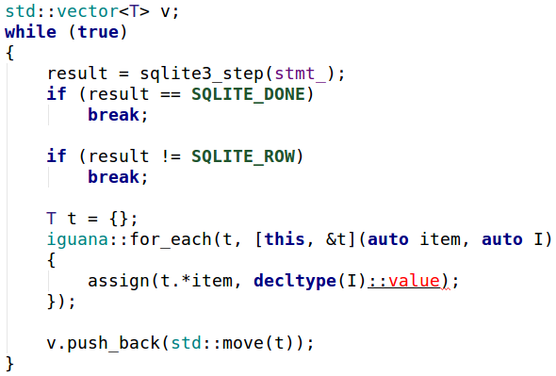
实体映射
Sqlite to Entity

Slide 38
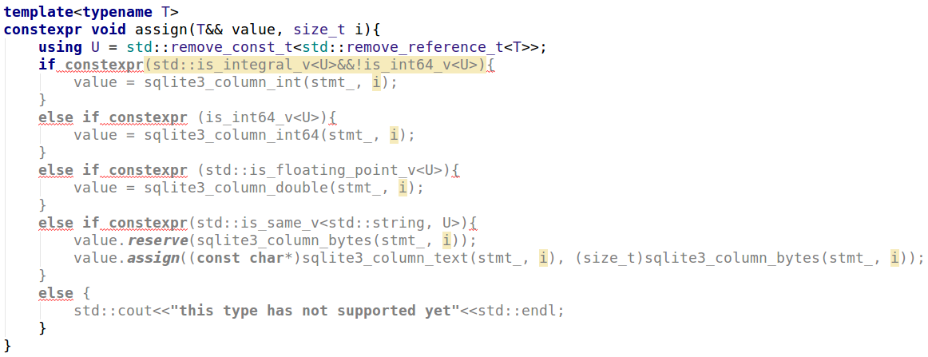
实体映射
Sqlite to Entity

Slide 39
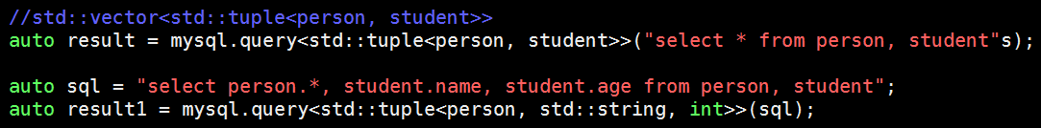
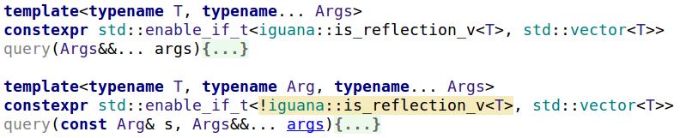
实体映射
多表查询

Slide 40
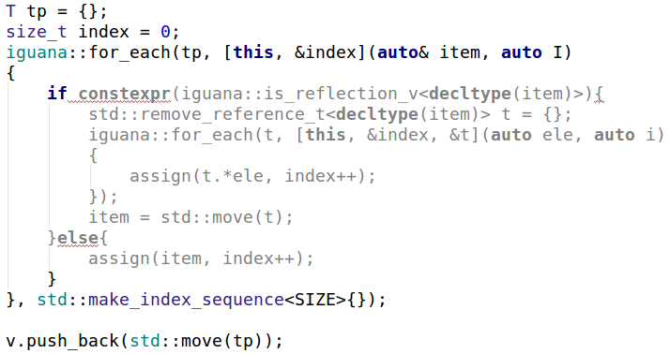
实体映射
返回tuple结果时要注意元素是否为对象

Slide 41
ormpp
ormpp ---- 让数据库操作变得简单
header only
cross platform
unified interface
easy to use
easy to change database
https://github.com/qicosmos/ormpp

Slide 42


Slide 43
Logging
Validation
Thread Strategy
Caching
Exception Handling
… and a lot more

Slide 44


Slide 45
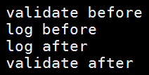
dbng<mysql> mysql;
mysql.connect("127.0.0.1", "root", "12345", "testdb");
mysql.warper_connect<log>("127.0.0.1", "root", "12345", "testdb");
mysql.warper_connect<validate, log>("127.0.0.1", "root", "12345", "testdb");
mysql.warper_connect<validate, log, thead_proxy>("127.0.0.1", "root", "12345", "testdb");

Slide 46
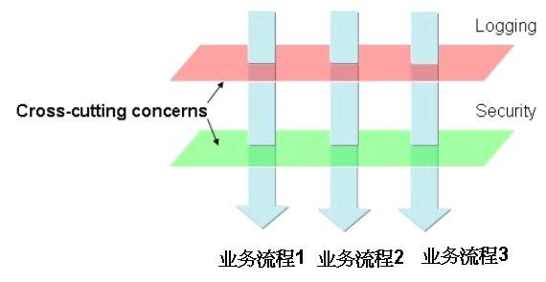
AOP

Slide 47
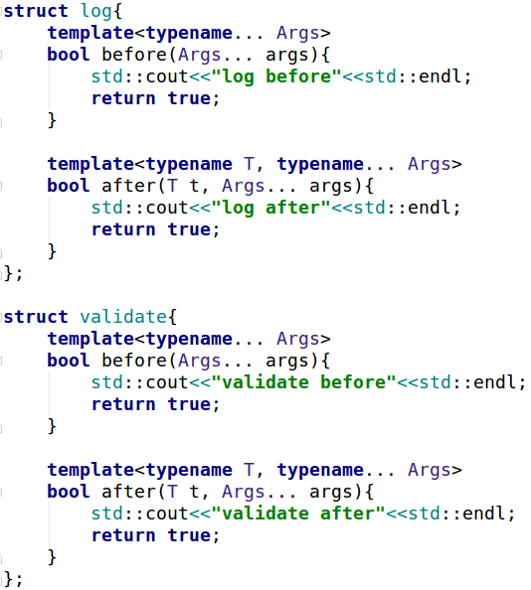
AOP
before和after你可以定义一个也可以定义两个

Slide 48
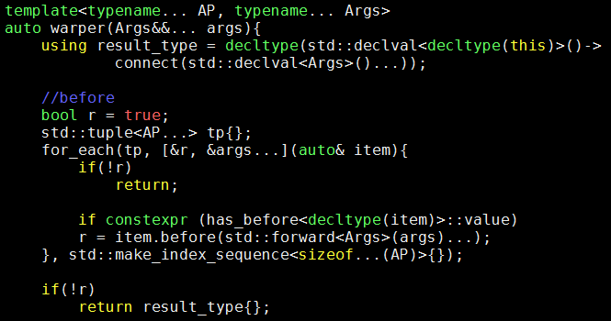
AOP
核心逻辑之前的切面

Slide 49
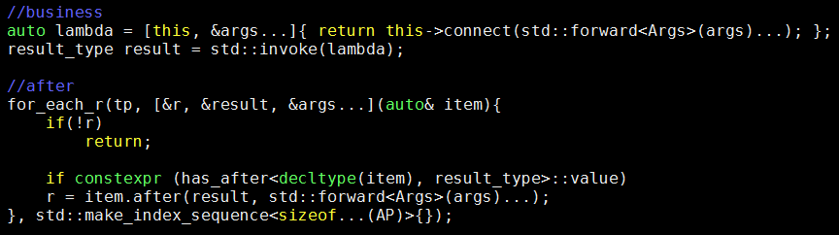
AOP
核心逻辑之后的切面

Slide 50
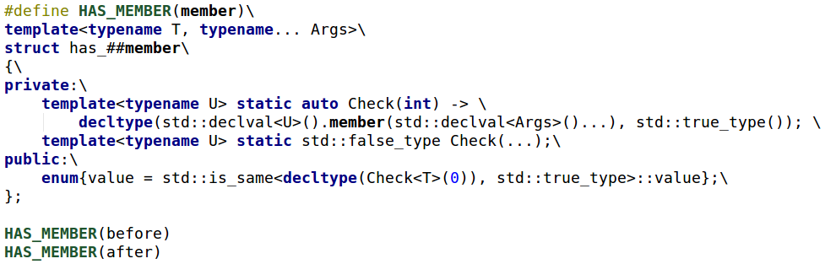

Slide 51
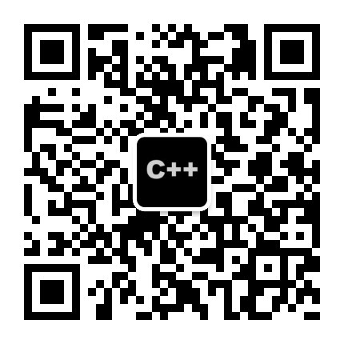

Purecpp----Modern C++ Open Source Community
purecpp open source
Rpc framework—rest_rpc
Serialization engine—iguana
ORM--ormpp
http framework--cinatra
http://purecpp.org (modern c++ open source community)
https://github.com/qicosmos
https://www.youtube.com/watch?v=WlhoWjrR41A
https://www.youtube.com/watch?v=vh1BhlqF-fs
https://isocpp.org/

Slide 52
Newer is Better!

