Slide 1
Compile-time reflection, Serialization and ORM Examples

Slide 2
Outline
concepts of reflection
implementation of compile-time reflection
application of compile-time reflection
prospect

Slide 3
concepts of reflection
the essence of reflection
benefits of reflection
what can it be used for?

Slide 4
the essence of reflection
reflection
a mechanism that gets internal information of a class by meta data.
get the type of an object, get the fields and methods by meta dada.
metadata
data that provides information about other data.
meatadata describes other data.
self description

Slide 5
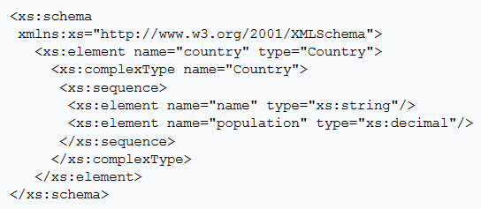
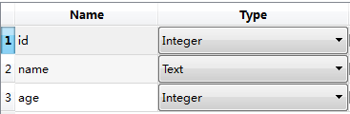
the essence of reflection
classic metadata
name, type, sequence
Notes:
https://zh.wikipedia.org/wiki/XML_Schema

Slide 6
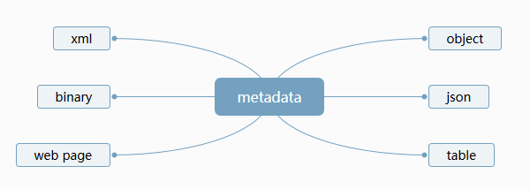
the essence of reflection
reflection
reflection
automatically mapping metadata to any other data format
metadata is the key point

Slide 7
benefits of reflection
simplification
cut the complexity
flexibility
change the behavior without any modification of an exist object
decoupling
decouple visit from the metadata of an object

Slide 8
benefits of reflection
if no reflection
void Serialize(Archive &ar)
{
ar.Serialize("vec", vec);
ar.Serialize("ls", ls);
ar.Serialize("st", st);
ar.Serialize("deq", deq);
ar.Serialize("mp", mp);
ar.Serialize("set", set);
ar.Serialize("un_mp", un_mp);
ar.Serialize("un_set", un_set);
}
duplicate
trivial
error prone
should be automatic!

Slide 9
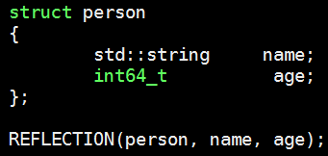


benefits of reflection

Slide 10
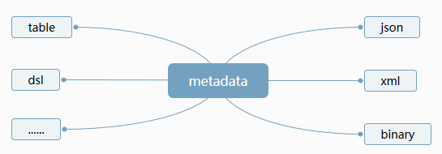
what can it be used for?
reflection
automatically mapping metadata to any other format

Slide 11
what can it be used for?
Serialization
ORM(Object Relational Mapping)
DSL(domain-specific language)

Slide 12
Outline
concepts of reflection
implementation of compile-time reflection
application of compile-time reflection
prospect

Slide 13
implementation of compile time reflection
technology foundation
technical thought
concrete implementation
limitations
proposals of reflection

Slide 14
technology foundation
C++11/14/17 features
variadic templates
std::tuple
auto lambda
std::apply
constexpr if
std::string_view
……
macros

Slide 15
technology foundation(macros)
count variadic arguments number
#define GET_ARG_COUNT(...) GET_ARG_COUNT_INNER(__VA_ARGS__, RSEQ_N())
#define GET_ARG_COUNT_INNER(...) ARG_N(__VA_ARGS__)
#define ARG_N(_1, _2, _3, _4, N, ...) N
#define RSEQ_N() 4, 3, 2, 1, 0
static_assert(GET_ARG_COUNT(a) == 1);
static_assert(GET_ARG_COUNT(a, b) == 2);
static_assert(GET_ARG_COUNT(a, b, c) == 3);
GET_ARG_COUNT(a)
➔GET_ARG_COUNT_INNER(a, 4, 3, 2, 1, 0)
➔ARG_N(a, 4, 3, 2, 1, 0)
➔1

Slide 16
technology foundation(macros)
#define RSEQ_N() 4,3,2,1,0
#define ARG_N(_1, _2, _3, _4, N, ...) N
#define GET_ARG_COUNT_INNER(...) MARCO_EXPAND(ARG_N(__VA_ARGS__))
#define GET_ARG_COUNT(...) GET_ARG_COUNT_INNER(__VA_ARGS__, RSEQ_N())
#define MARCO_EXPAND(x) x
MARCO_EXPAND for visual studio

Slide 17
Outline
concepts of reflection
implementation of compile-time reflection
application of compile-time reflection
prospect

Slide 18
application of compile-time reflection
Serialization
ORM(Object Relational Mapping)
DSL(domain-specific language)

Slide 19
Outline
concepts of reflection
implementation of compile-time reflection
application of compile-time reflection
prospect

Slide 20
prospect
data binding
protocal adaptor

