Slide 1
从现代C++元编程到ORM
祁 宇
qicosmos@163.com
purecpp.org

Slide 2
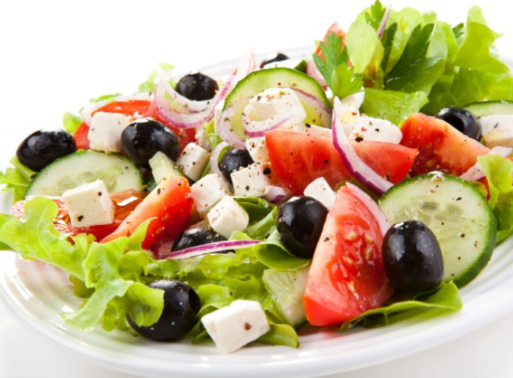

Slide 3
Variadic Template

Slide 4
Constexpr If

Slide 5
Enable_if

Slide 6
Structured Binding

Slide 7
Fold Expression

Slide 8
Static_assert

Slide 9
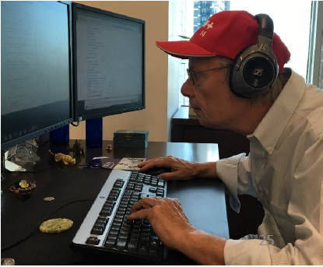
Future C++
Type-and resource-safe
Significantly simpler and clearer code
As fast or faster than anything else
Good at using “modern hardware”
Significantly faster compilation catching many more errors

