Slide 1
从现代C++元编程到ORM
祁 宇
qicosmos@163.com
purecpp.org

Slide 2


Slide 3

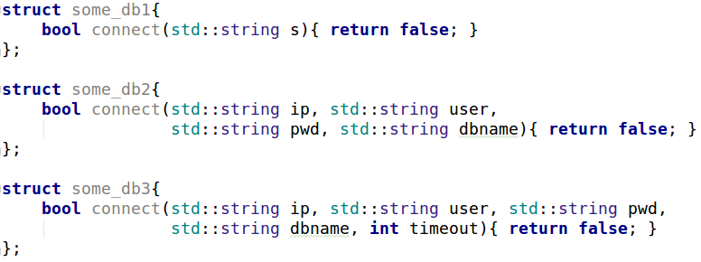
Variadic Template
适配不同的接口

Slide 4
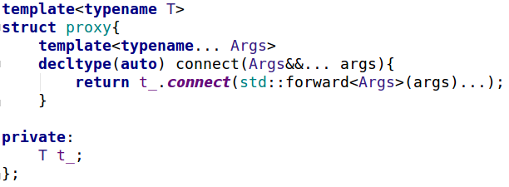
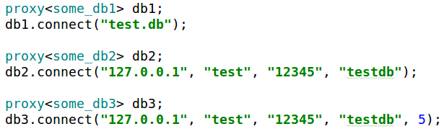
Variadic Template

Slide 5
Structured Binding
std::map<int, int> mp = { {1, 2}, {3, 4} };
for(auto&& [k, v] : mp)
std::cout<<k<<" "<<v<<'\n';
std::tuple<int, double> tp(1, 2.5);
auto [a, b] = tp;

Slide 6
Variadic Template + Structured Binding
分割一个定长的variadic template
template<typename... Args>
auto split_3args(Args&&... args){
auto tp = std::make_tuple(std::forward<Args>(args)...);
return std::make_tuple(std::get<0>(tp), std::get<1>(tp), std::get<2>(tp));
}
auto t = split_3args(1, 2.5, "test", '1');
//tuple(1, 2.5, "test")
template<typename... Args>
auto split_3args(Args&&... args){
auto tp = std::make_tuple(std::forward<Args>(args)...);
auto [a, b, c, d] = tp;
return std::make_tuple(a, b, c);
}

Slide 7
Constexpr If
template<typename T> std::enable_if_t<std::is_integral<T>::value, std::string> to_str(T t) { return std::to_string(t); } template<typename T> std::enable_if_t<!std::is_integral<T>::value, std::string> to_str(T t) { return t; }

Slide 8
Constexpr If
消除enable_if
让编译期选择变得简单
更紧密、清晰的上下文
template<typename T> auto to_str17(T t) { if constexpr(std::is_integral<T>::value) return std::to_string(t); else return t; }

Slide 9
Constexpr If + Variadic Template
扩展接口

Slide 10
Enable_if

Slide 11
Fold Expression

Slide 12
Static_assert

Slide 13

Future C++
Type-and resource-safe
Significantly simpler and clearer code
As fast or faster than anything else
Good at using “modern hardware”
Significantly faster compilation catching many more errors

Slide 14
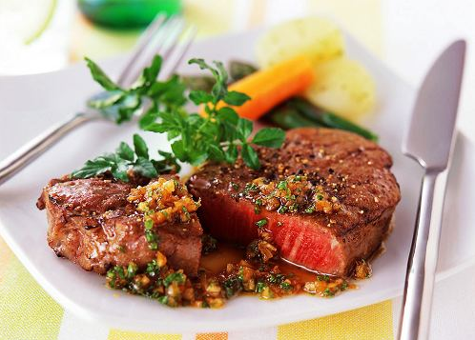

Slide 15
统一语义的接口
可扩展的接口
灵活易用的接口
类型映射
编译期反射
自动生成sql脚本
自动化地实体映射

Slide 16


Slide 17
AOP
Logging
Validation
Thread Strategy
Caching
Exception Handling
… and a lot more

