Slide 1
Compilte-time reflection, Serialization and ORM Examples

Slide 2
Outline
concepts of reflection
implementation
application of compile-time reflection
prospect

Slide 3
concepts of reflection
the essence of reflection
benefits of reflection
what can it be used for?

Slide 4
reflection
a mechanism that gets internal information of a class by meta data.
get the type of an object, get the fields and methods by meta dada.
metadata
data that provides information about other data.
meatadata describes other data.
self description

Slide 5
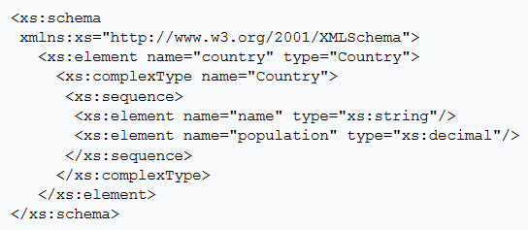
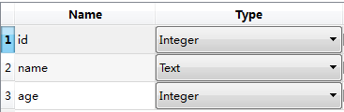
classic metadata
name, type, sequence
Notes:
https://zh.wikipedia.org/wiki/XML_Schema

Slide 6
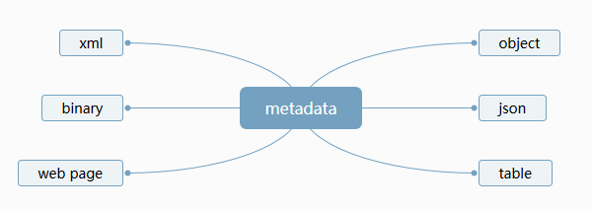
reflection
reflection
automatically mapping metadata to any other data format

Slide 7
implementation
technology foundation(macro)
technical thought
concrete implementation
limitations
proposals of reflection

Slide 8
application of compile-time reflection
serialization
ORM
DSL

Slide 9
prospect
data binding
protocal adaptor

